Slide 1


Mapping toxic metals in private wells and the association with birth defects
Alison P. Sanders, PhD
Postdoctoral Fellow
Department of Preventive Medicine
Icahn School of Medicine at Mount Sinai
November 12, 2013

Slide 2
Mapping toxic metals in private wells and the association with birth defects
Alison P. Sanders, PhD
Postdoctoral Fellow
Department of Preventive Medicine
Icahn School of Medicine at Mount Sinai
November 12, 2013

Slide 3
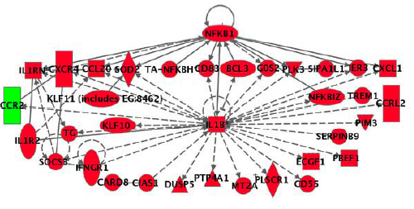
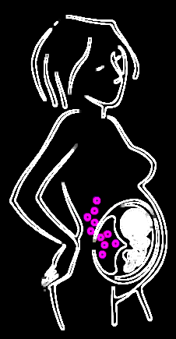
Trans-disciplinary research:
Environmental metals and birth defects
Exposure
Health Effects
Mechanism

Slide 4
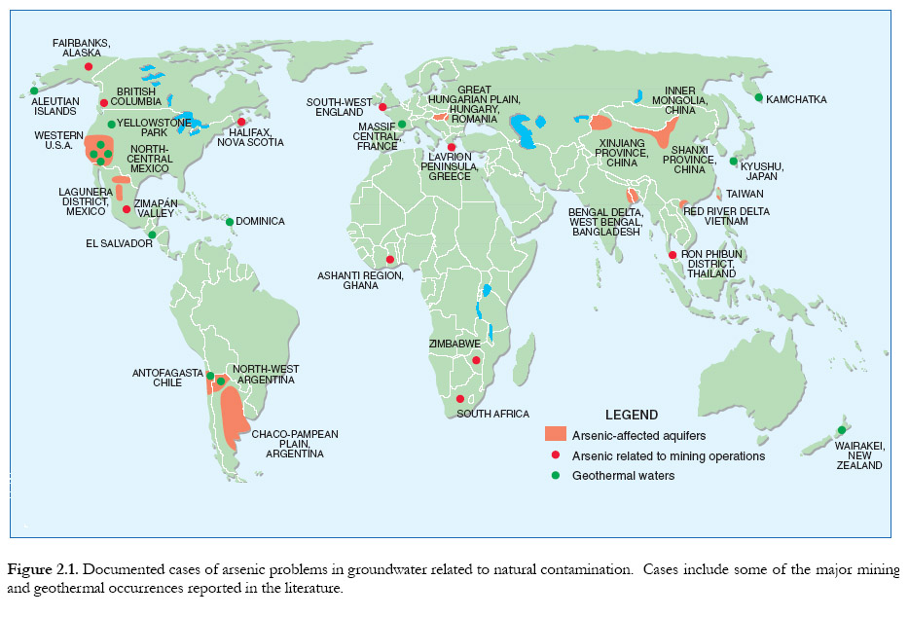
Arsenic occurs in drinking water worldwide
77 million

Slide 5
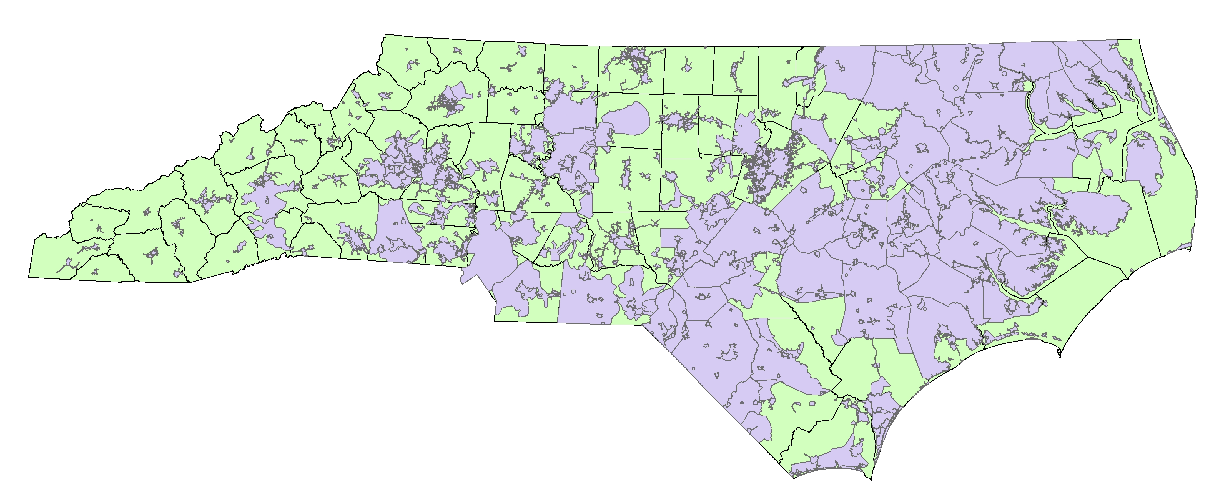
Arsenic in North Carolina private wells
    2.3 million (26%) NC residents use private domestic wells (Kenny et al., 2009)
      42 million (14%) in US
      Private wells are unregulated
    Domestic well users have an excess lifetime risk of bladder and lung cancer that is five-times higher than public well users (Kumar et al., 2010)
26 % in NC
Public
Private

Slide 6
Arsenic in North Carolina private wells
    2.3 million (26%) NC residents use private domestic wells (Kenny et al., 2009)
      42 million (14%) in US
      Private wells are unregulated
    Domestic well users have an excess lifetime risk of bladder and lung cancer that is five-times higher than public well users (Kumar et al., 2010)
26 % in NC
Study goal: To comprehensively determine spatial and temporal trends of arsenic in NC private wells
Public
Private

Slide 7

Local monitoring of private wells
The NCDHHS provides well water testing on an individual homeowner basis:
  Electronic records from 1998 – 2010
  Unfiltered well water samples analyzed via Inductively Coupled Plasma – Mass Spectrometry (ICP-MS)
  >25 organic, inorganic, and microbial contaminants
  Provided over 68,000 well water arsenic analyses

Slide 8
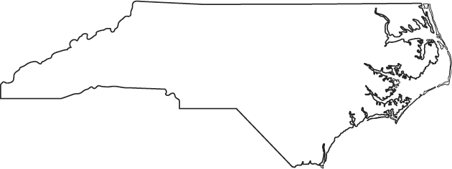
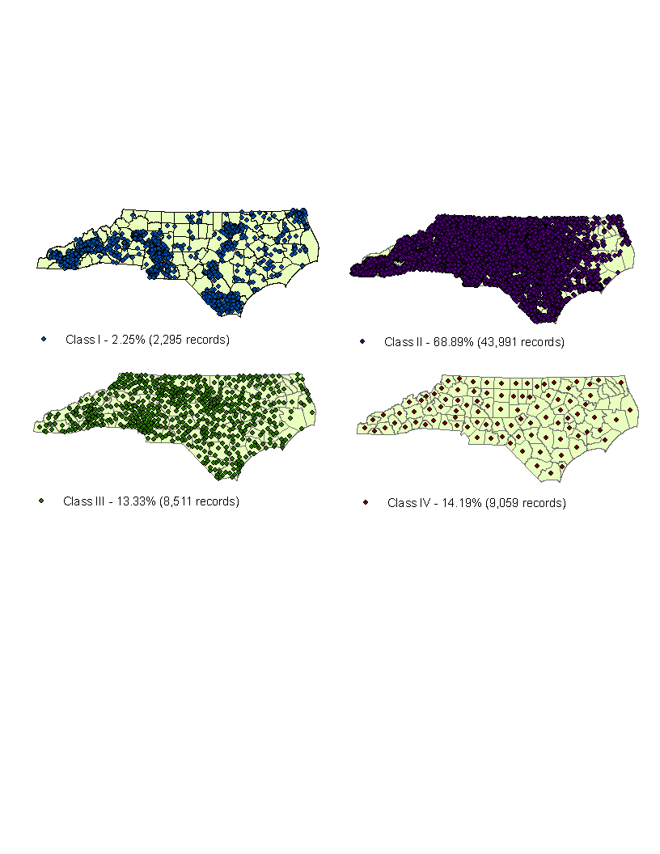
Few wells had GPS data
63,000 records
2,295 records (<4%)
Global positioning system (GPS) - hand-held devices used to record well coordinates.

Slide 9
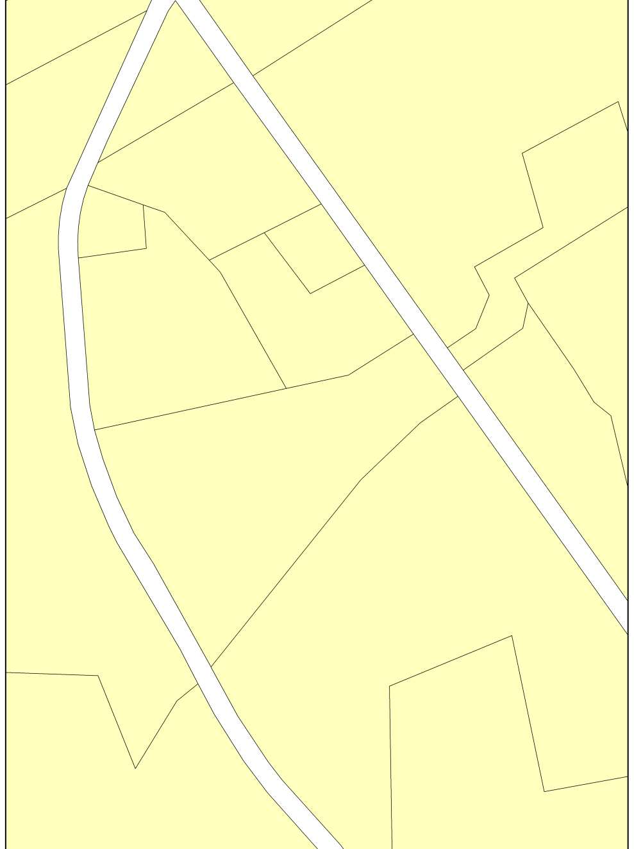
Geocoding: Assigning coordinates to a private well by matching the owner address to an address with a known longitude and latitude.
Typed Owner Address | Reference File Address
100 Anonymous Rd. | 100 Anonymous Rd.
(-73.1002, 35.6778)
Matched Address
Private well
Geocoded location
Home

Slide 10
Geocoding scheme increased map-able data 20-fold
A
B
GPS- 3.60% (2,295 records)
Geocoded address- 68.89% (43,991 records)
2,295 43,991 records

Slide 11
Geocoding scheme increased map-able data 20-fold
A
B
GPS- 3.60% (2,295 records)
Geocoded address- 68.89% (43,991 records)
C
D
Zip Code Centroid– 13.33% (8,511 records)
County Centroid -14.19% (9,059 records)
2,295 63,000 records

Slide 12
Arsenic levels elevated in NC wells
Sanders et al., 2012
>7,700 had detectable arsenic (12%)
Over 1,500 wells exceeded 10 μg/L (the EPA MCL)
>200 exceeded 50 μg/L

Slide 13
Arsenic levels elevated in NC wells
    Geographic trends across the state
    Levels as high as 806 μg/L
Sanders et al., 2012
>7,700 had detectable arsenic (12%)
Over 1,500 wells exceeded 10 μg/L (the EPA MCL)
>200 exceeded 50 μg/L

Slide 14
Arsenic occurs naturally in NC groundwater
n
Number of wells sampled
Sanders et al., 2012
Notes:
Counties with elevated arsenic tend to stay high for over a decade
Geological formation: North Carolina Slate Belt (“Carolina Terraine”)
Highest county averages were in Stanly, Union, and Montgomery.
The Carolina Terraine geology extends through South Carolina and into parts of Georgia (did not analyze SC samples)

Slide 15
Estimated arsenic levels at unmonitored locations
Sanders et al., 2012

Slide 16
Some at-risk areas have large populations served by private wells
Rankª | County | No of wells that exceed EPA standard (%) | No of wells above detect (%) | Population using domestic wells, in thousands (%) ^{b} | Population at risk rank^{c}
1 | Stanly | 176 (20.8) | 485 (57.1) | 25.947 (44.0) | 1
2 | Union | 634 (19.5) | 1454 (44.7) | 49.197 (30.2) | 2
3 | Anson | 10 (10.20) | 34 (34.7) | 2.704 (10.6) | 11
4 | Montgomery | 34 (9.1) | 120 (32.3) | 8.213 (30.1) | 3
5 | Dare | 36 (6.3) | 137 (24.0) | 8.091 (23.9) | 7
…
Total | -- | 1436 (2.3) | 7713 (12.1) | 2295.33 (26.4) | --
a Rank based on tendency of wells to exceed the EPA standard throughout an 11-year period.
b Data from (Kenny et al., 2009).
c Rank based on composite of percentage of wells that exceed the EPA standard through the 11-year period and percentage of county residents using private domestic well water.

Slide 17
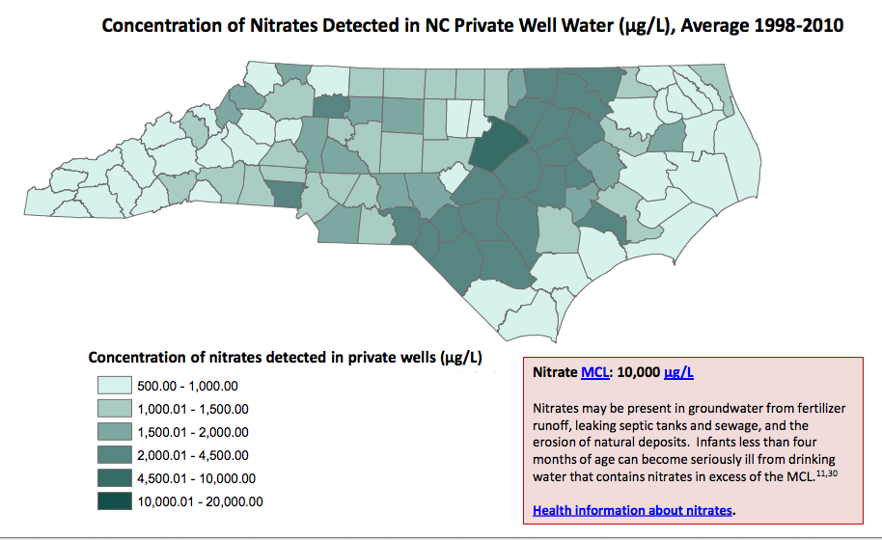
SRP RTC website developed:
http://www2.sph.unc.edu/ncwellwater

Slide 18
Public health relevance
Raise awareness of areas of concern
Individuals relying on private wells for drinking water should have their well water tested.

Slide 19
Exposure
Health Effects
Mechanism

Slide 20
Birth defects are the leading cause of infant mortality
Approximately 3% of all live births (Petrini et al., 2002).
$2.6 billion associated hospital costs in the US (Russo and Elixhauser, 2006)
$73.4 million in NC (NCBDMP, 2006)
Roughly 60-70% of birth defects have no known cause (Brent and Beckman, 1990).
Environmental
Genetic
Unknown
(Brent, 2004)

Slide 21
Congenital Heart Defects (CHDs)
33% of all defects are CHDs (CDC, 2013)
CHDs are the leading cause of defect-related deaths
CHDs are more than half ($1.4 billion) of the total estimated annual hospital costs due to birth defects (Russo and Elixhauser, 2006)
CHD classification is complex, strategies include phenotypic subgroups (Botto et al., 2007)
Prioritized CHD categories:
  Conotruncal (~8%)
  Atrioventricular septal defect (5%)
  Left ventricular outflow tract obstruction (2.4%)

Slide 22
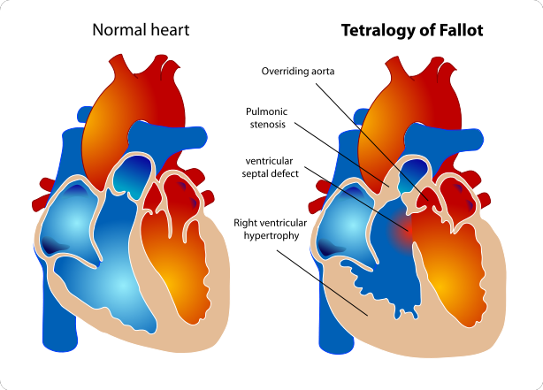
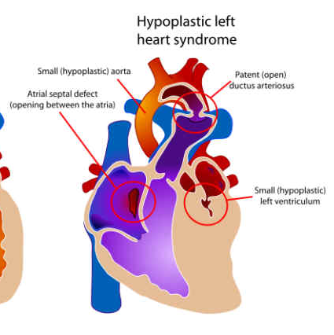
Congenital Heart Defects (CHDs)
33% of all defects are CHDs (CDC, 2013)
CHDs are the leading cause of defect-related deaths
CHDs are more than half ($1.4 billion) of the total estimated annual hospital costs due to birth defects (Russo and Elixhauser, 2006)
CHD classification is complex, strategies include phenotypic subgroups (Botto et al., 2007)
Prioritized CHD categories:
  Conotruncal (~8%)
  Atrioventricular septal defect (5%)
  Left ventricular outflow tract obstruction (2.4%)

Slide 23
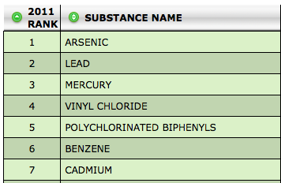
Metals are understudied environmental teratogens in human populations
Environmental
Metals rank among the top 10 in the priority list of hazardous substances
Genetic
Unknown
ATSDR, 2013

Slide 24
Metals are understudied environmental teratogens in human populations
Environmental
Evidence of metal exposure in NC pregnant women
Metal | % detected | n
Arsenic | 65.7 | 210
Cadmium | 57.3 | 211
Mercury | 63.8 | 210
Lead | 100 | 211
Genetic
Unknown
Sanders et al., 2012

Slide 25
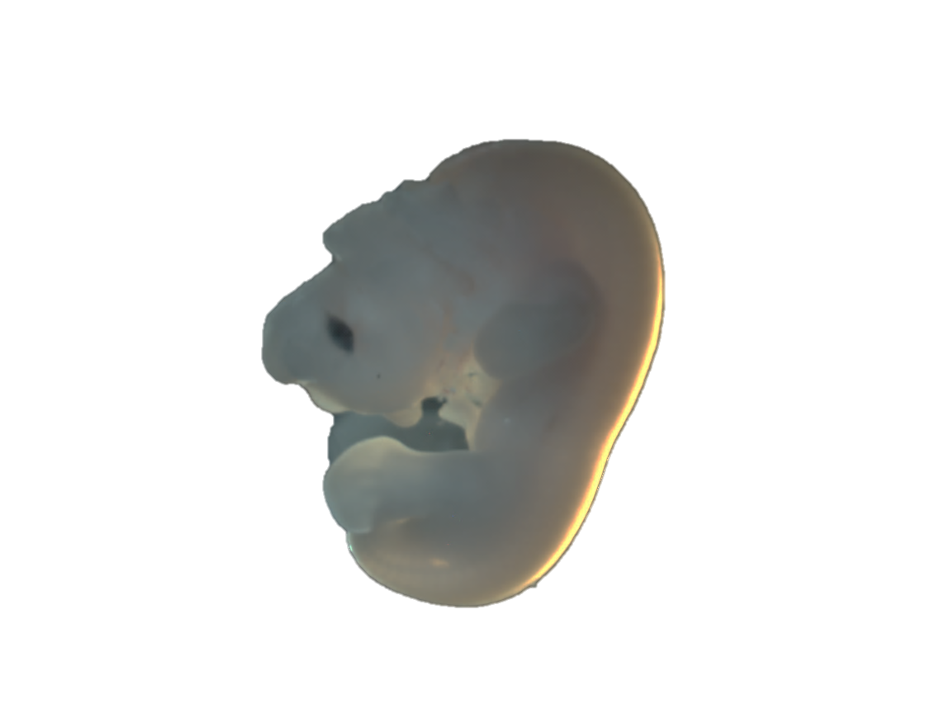
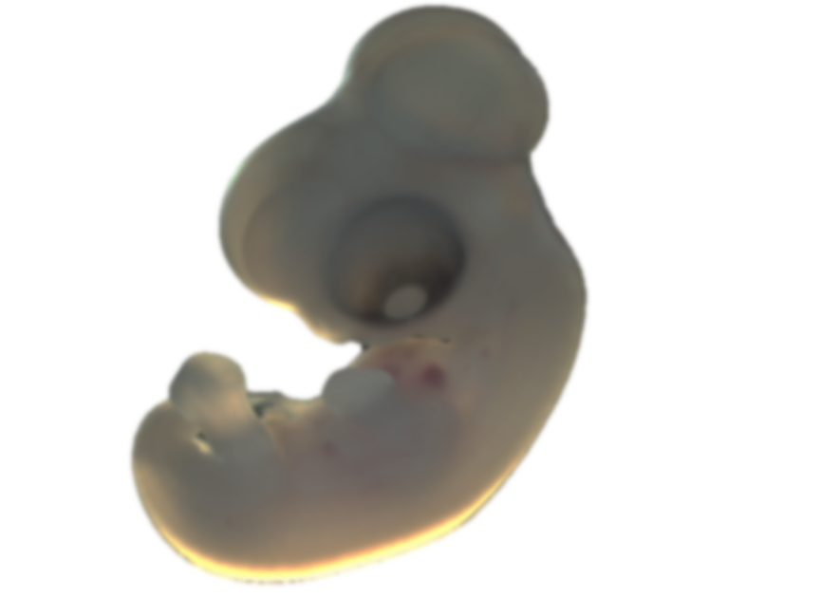
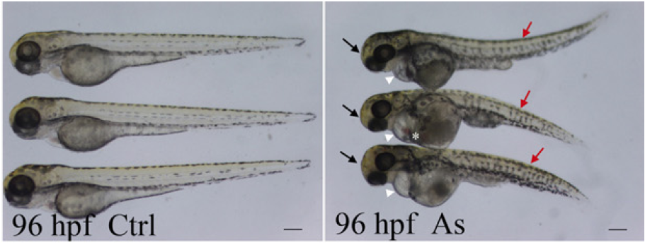
Evidence of metal-associated birth defects
Metals cause gross morphological defects in animals (Domingo, 1994; Golub, 1998)
Hundreds of animal studies demonstrate arsenic-induced neural tube defects (NTDs) (Holson, 2000)
Arsenic- and cadmium-induced heart defects (Li et al., 2012; Li et al., 2009; Cheng et al., 2001)
Limited epidemiologic evidence
Control
Arsenic-treated
Ahir et al., 2013
Li et al., 2009

Slide 26
Study goal: To assess the relationship between private well metal levels and the prevalence of birth defects in NC
Exposure
Health Effects
Mechanism

Slide 27
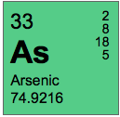
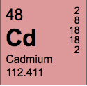
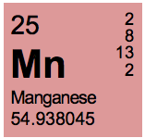
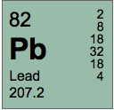
Environmental metals measured in North Carolina wells
Included wells with GPS or a geocoded street address
~46,000 well measures for each metal.
Metals of potential harm to pregnant women and the developing fetus

Slide 28

Birth defects in North Carolina
North Carolina Birth Defects Monitoring Program (BDMP) is an active population-based surveillance system established in 1987.

Slide 29
Birth defects in North Carolina
North Carolina Birth Defects Monitoring Program (BDMP) is an active population-based surveillance system established in 1987.
Hypothesis: Environmental metal levels are associated with the prevalence of specific birth defects in North Carolina

Slide 30
Study design and population
Semi-ecologic cohort study:
  20,151 cases with selected birth defects identified by the NC BDMP between 2003-2008
  668,371 non-malformed controls sampled from birth certificates during the same birth years.
Eligibility: liveborn, singleton infants with a geocoded residence at delivery, and cases with no known chromosomal abnormalities.
Subjects excluded if missing data on any covariates including maternal race, age, or education (n=2,092).
Final cohort included 686,435 births
  20,094 cases and 666,341 controls

Slide 31
Selected birth defect phenotypes
  Spina bifida without anencephaly (n=255)
  Anotia/microtia (n=124)
  Tetralogy of Fallot (TOF), transposition of the great arteries (TGA), and common truncus (n=545)
  Atrioventricular septal defect (AVSD) (n=378)
  Hypoplastic left heart syndrome (HLHS) (n=183)
  Cleft palate without cleft lip (CP) (n=433)
  Cleft lip with or without cleft palate (CL/P) (n=631)
  Tracheo-esophageal fistula (TEF) (n=196)
  Pyloric stenosis (n=1332)
  Reduction defect of upper or lower limb (n=311)
  Gastroschisis (n=258)
  Hypospadias (n=2290)
CHDs

Slide 32
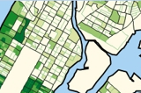
Exposure assigned at using an ecologic unit
Individual-level data on maternal drinking water source or consumption not available
Applied a census tract ecologic unit of analysis
Calculated averages in census tracts
Excluded tracts with < than 10 wells
Census Block Groups
Census Tracts
www.caliper.com

Slide 33
Spatial patterns of metals in NC

Slide 34
Metal levels exceed EPA guidelines in NC wells
10 ppb
5 ppb
    2.2%
    0.1%
50 ppb - SMCL
15 ppb
    21%
    3.9%

Slide 35
Ecologic exposure assignment
Residence at delivery was used to assign census tracts to cases and controls
Calculated 50th and 90th average tract level percentiles
“Lower exposure” ≤ 50th ptile
“Higher exposure” ≥ 90th ptile

Slide 36
Prevalence ratios (PRs) used to estimate the association
A dichotomous variable used to compared the “higher exposure” census tracts to “lower exposure”
a priori covariates: maternal age, race, and education status.
Log-linear regression used to estimate the association between the prevalence of each birth defect and census tract metal levels in drinking water.

Slide 37
Prevalence Ratios* with 95% CIs
PR (95%CI)
CHDs
1. 2. 3. 4. 5. 6. 7. 8. 9. 10. 11. 12. 13.
*PRs adjusted for maternal age, race, and education status

Slide 38
Prevalence Ratios* with 95% CIs
Potential ecologic associations between the prevalence of CHDs and census tract levels of Mn
PR (95%CI)
CHDs
1. 2. 3. 4. 5. 6. 7. 8. 9. 10. 11. 12. 13.
*PRs adjusted for maternal age, race, and education status

Slide 39
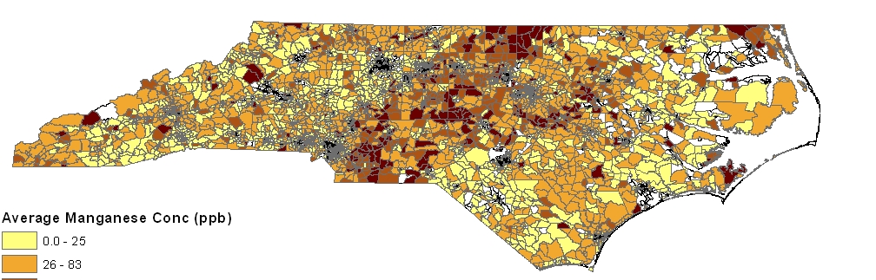
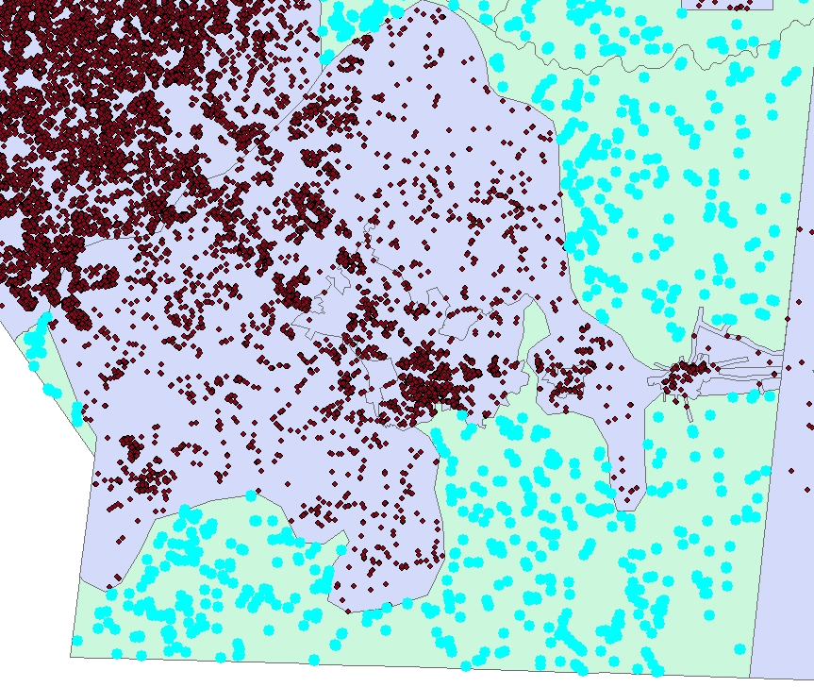
Sensitivity analyses to address exposure misclassification
i. Apply the census block group as the ecologic unit
ii. Exclude individuals in areas served by public water supplies
Manganese
Public
Private*

Slide 40
Potential exposure misclassification
B.
Model 1 – crude
Model 2 – adjusted for maternal age, race, and education
Model 3 – adjusted for maternal age, race, and education and restricted to private well users

Slide 41
Private well levels exceed EPA guideline levels for As, Cd, Mn, Pb
Potential ecologic associations between census tract levels of Mn and CHDs

Slide 42
Moving forward
“Ecologic fallacy” - observed associations are limited to the ecologic unit of analysis.
Issues of exposure misclassification and temporality.
Included NC live birth cohort over 6 year period
Adjusted for individual-level confounding factors
Examined specific phenotypes, and excluded chromosomal defects
Assessed private well metal levels

Slide 43
Public health relevance and conclusions
Private well levels exceed EPA guideline levels for toxic metals
Potential epidemiologic relationships between private well water metal levels and birth defects
Identify potential epigenetic mechanisms by which metals may alter development
Exposure
Health Effects
Mechanism

Slide 44
Public health relevance and conclusions
Metals are a widespread toxicants
Potentially preventable environmentally-mediated disease

Slide 45

Acknowledgements
Fry Laboratory
  Rebecca Fry
  Lab members
Research Translation
  Kathleen Gray
  Kyle Messier
  Fred Pfaender
  Marc Serre
  Tracey Slaughter
BDMP/NBDPS
Tania Desrosiers
  Amy Herring
  Bob Meyer
  Tom Luben
  Andrew Olshan
  Josh Warren
  Alison Woomert
DHHS
  Sue Chiang
  Dianne Enright
  Kay Flood
  Ann Grush
  Ken Rudo
  Mina Shehee
  Leslie Wolf

Slide 46
Thank you!

Slide 47
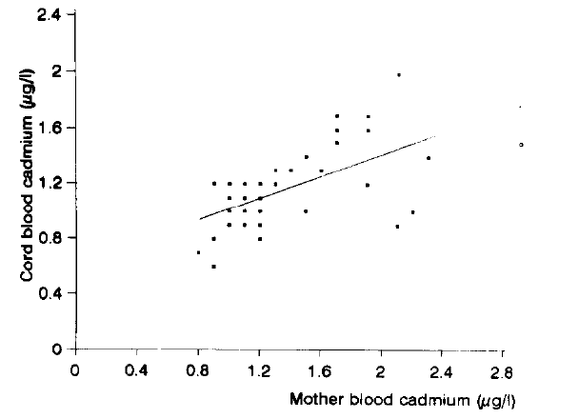
Newborn health effects related to maternal metal exposure
Arsenic: Increased risk of spontaneous abortion, stillbirth, preterm birth, low birth weight, and infant mortality (reviewed by Vahter, 2008)
Cadmium: Reduced birth weight, height and head circumference. Impaired cognitive, physiological, and neurobehavioral development in children
Mercury: Cognitive deficits, central nervous system, as well as lung and kidney damage
Lead: Cognitive and neurodevelopmental deficits (decreased IQ), and cardiovascular effects
(Galicia-Garcia, 1997)

Slide 48
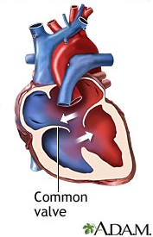
Congenital Heart Defects (CHDs)
Tetralogy of Fallot (TOF) - prevalence of 3.97 per 10,000 live births
Atrioventricular septal defects (AVSD) - prevalence of 4.71 per 10,000 live births
Hypoplastic Left Heart Syndrome (HLHS) - prevalence of 2.30 per 10,000 live births
(Parker et al. 2010)
AVSD

