Slide 1
Evaluating and Controlling Mercury in Aquatic Ecosystems
Stephen Dent, PhD
Environmental Engineer
EPA Region 9 Hg Workshop
Moving Beyond Source Control
September 25th, 2013

Slide 2
Presentation Objectives
Introduce Mercury Issues
  Relation to Eutrophication/Anoxia
Lake Management – Controlling Anoxia
  Oxygenation Systems
  Twin Lakes Study
  Other Applications
Concluding Thoughts/Management Considerations
Questions
CH₃Hg⁺
Overview

Slide 3
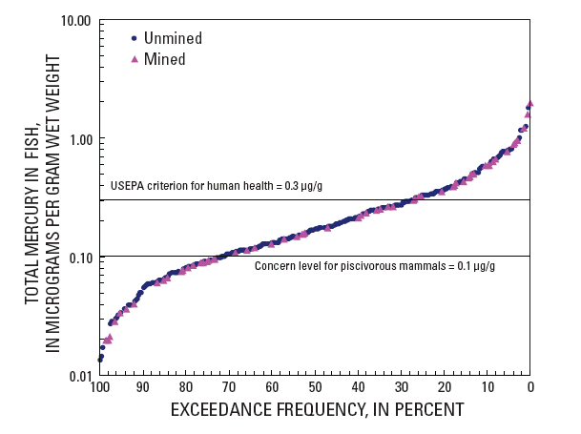
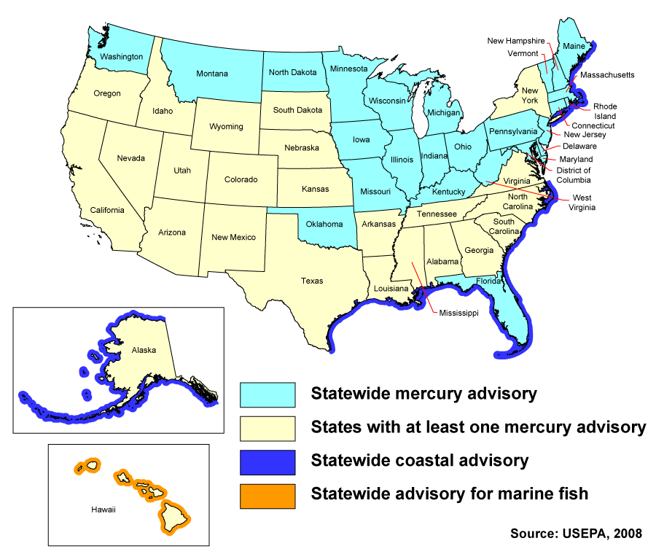
Scope of Mercury Issues in US
367 Stream Sites Sampled Across United States
Sites with Fish Greater than 0.3 ug/g
  25%
Sites with Fish Greater than 0.6 ug/g
  10%
Importance

Slide 4
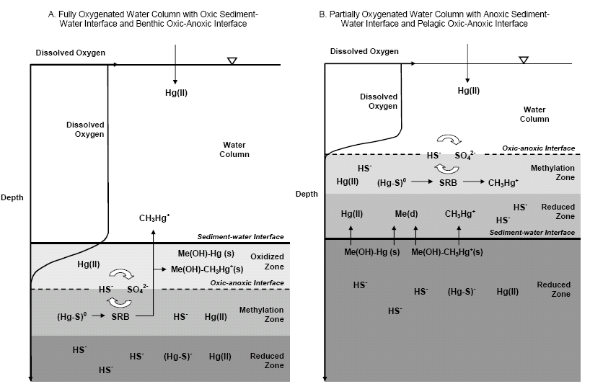
Conceptual Hg Model
Hg Dynamics

Slide 5
Oxygenation Systems
DIFFUSER PIPE
Beutel, M.W. and A.J. Horne. 1999. A review of the effects of hypolimnetic oxygenation on lake and reservoir water quality. Lake and Reservoir Management. 15(4):285-297.
Lakes

Slide 6
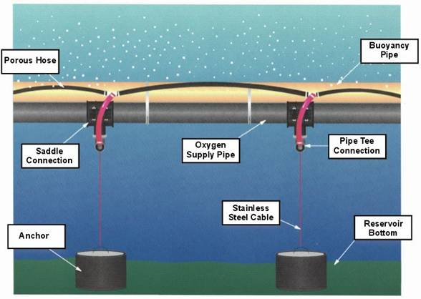
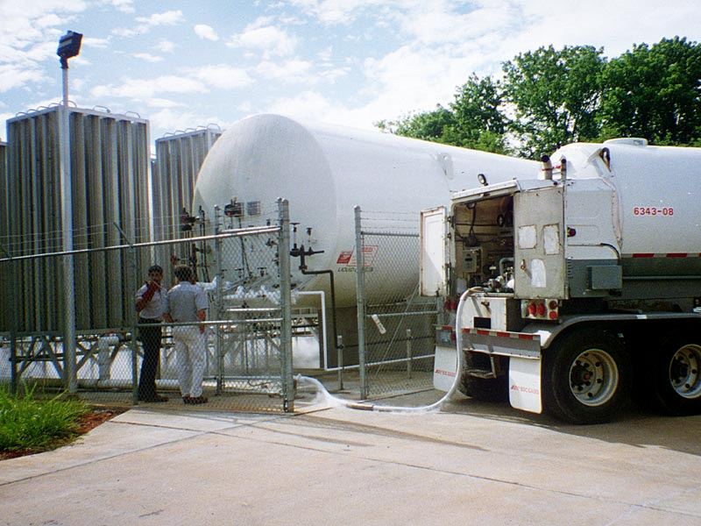
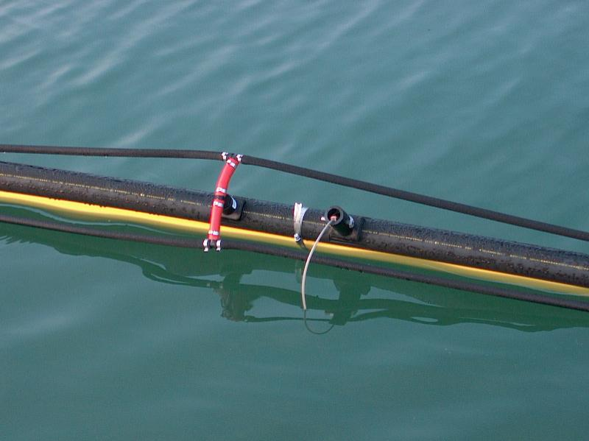
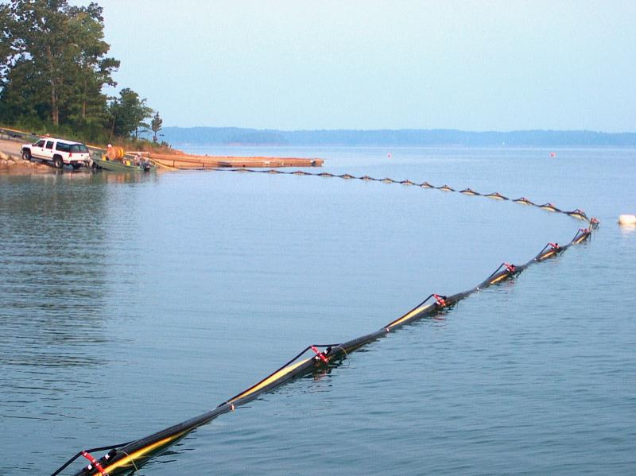
Linear Diffuser System
Lakes

Slide 7
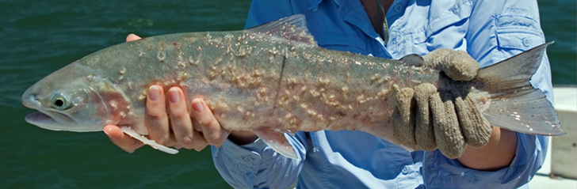
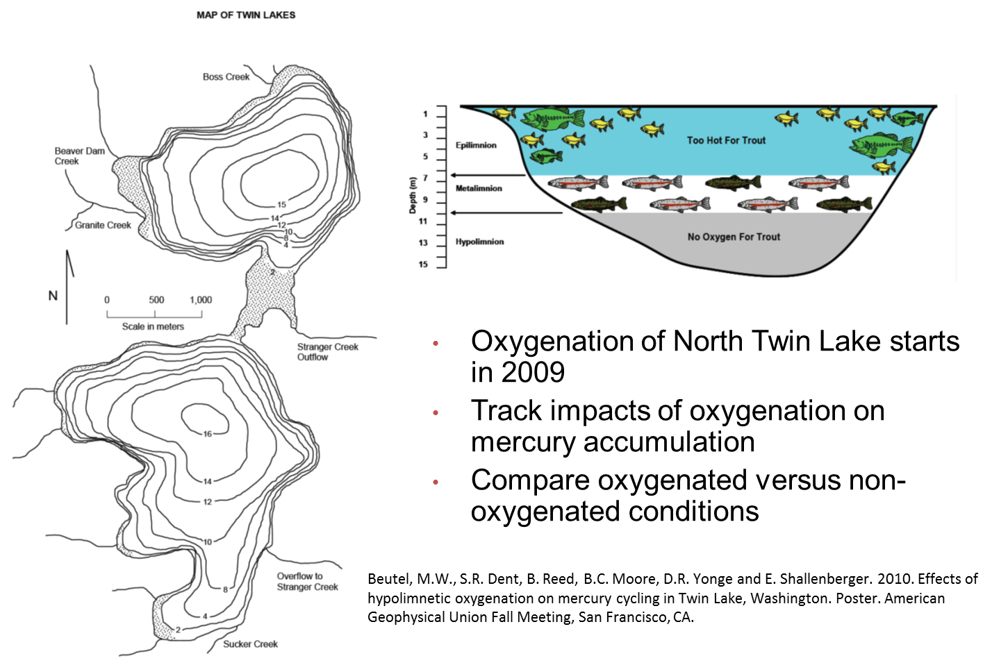
Twin Lakes, WA
Lakes

Slide 8
Hypothesis
The working hypothesis for this component is that the maintenance of an oxygenated sediment/water interface and hypolimnion will reduce the Fe, Mn, and MeHg concentrations within the water column and in biota.
Lakes

Slide 9
Results – South Twin
mg/L
µg/L
µg/L
ng/L
Lakes

Slide 10
Results – North Twin
mg/L
µg/L
µg/L
ng/L
Lakes

Slide 11
Results - Profiles
NT
Lower Hypolimnion: 50 to 75% Reduction.
Upper Hypolimnion: 50 to 90% Increase.
ST

Slide 12
2009 and 2010 Mercury in Zooplankton

Slide 13
Sediment Sensitivity
Small Variations in Oxygen in Bulk Water Column.
Large Oxygen Deficit at Sediment Water Interface
Bryant, L, Gantzer, P., Little, J. 2011. Increased sediment oxygen uptake caused by oxygenation-induced hypolimnetic mixing. Water Research. 45, 3692-3703.

Slide 14
Measurement Limitations- DO vs Fe and Mn in NT
Lakes

Slide 15
Surrogate Redox Parameters – MeHg Covariance with Fe and Mn in NT
Lakes

Slide 16
Summary
Oxic Sediment Water Interface Not Maintained at NT
  Horizontal Oxygen Delivery Location
Negative Feedback: Metals Release W/ Mixing
  Release of Fe, Mn, and Hg,
Sampling Plan Design Critical For Tracking Performance
  Parameters
    The Hg Cycle is Tightly Linked to Fe and Mn Cycles
    Redox
  Spatial/Temporal Sampling Regime
Lakes

Slide 17
Concluding Thoughts
Hypolimnetic Oxygenation Can be Used to Control Mercury Accumulation in Lakes and Reservoirs,
  Very sensitive to how the system is designed and managed.
Data Gaps with Existing In Situ Eutrophication Strategies in Relation to Hg.
  Hypolimnetic Oxygenation,
  Nitrogen Addition,
  In Situ Treatments.

Slide 18
Special Thanks To:
Washington State University
  Dr. Marc Beutel
  Dr. Dave Yonge
  Dr. Rick Watts
  Dr. Barry Moore
  Dr. Doug Call
  The Countless Graduate Students from CEE and NATRS
  Colville Confederated Tribe
    Dr. Ed Shallenberger
Battelle Marine Science Laboratory
  Dr. Gary Gill
  Brenda Lasorsa
Agouron Institute
National Science Foundation’s GK-12 Program
WSU’s Culturally Relevant Engineering Applications in Mathematics (CREAM)

Slide 19
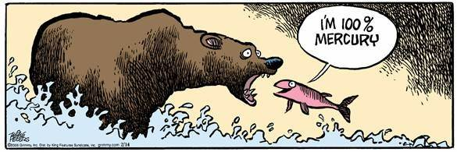
Questions?

Slide 20
Results-Oxygen Addition
2009: 30 SCFM
  Lease hypolimnetic metals input.
2010: 40 SCFM
  Most hypolimnetic metals input.
2011: 35 SCFM
  In between.

Slide 21
Factors Correlating with Fish Tissue (LMB) in Streams
Land Use Influences
  Hg in Tissue Correlates with % of Undeveloped Watershed
Land Cover influences
  Bioaccumulation Correlated with Basin % of Forest and Woody Wetland
Chemical Influences (A More Precarious Link)
  Unfiltered MeHg
  Sediment MeHg Normalized to OM (Related Back to Land Cover)
  Low pH
  Dissolved Sulfate
Rivers and Streams

Slide 22
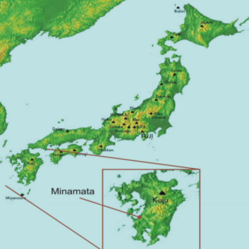
Anthropogenic Point Source Impacts
Minamata Bay
Acetaldehyde Production 1932 -1968
27 Tons Methylmercury Dumped Into the Bay
First Case: 1956
900 Killed
2 Million w/ Severe Health Effects
Importance

Slide 23
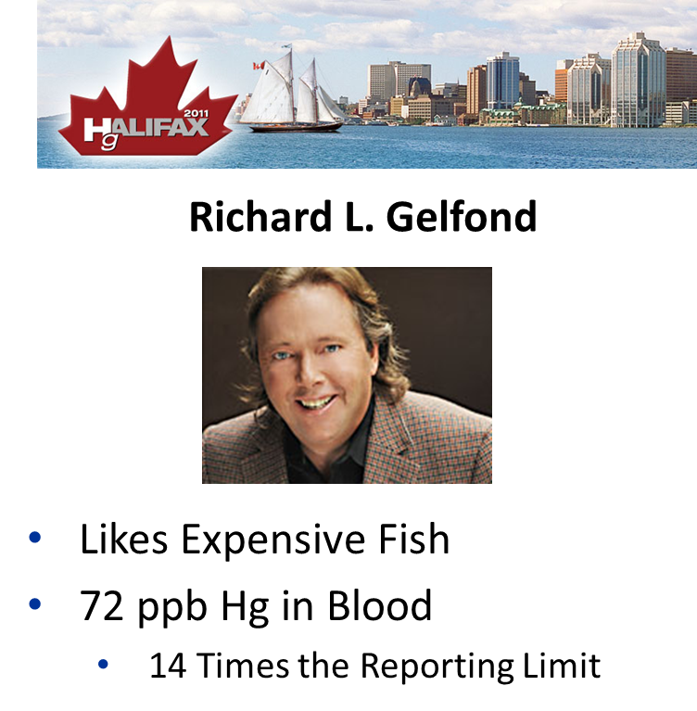
Non-Point Source Impacts
Importance

Slide 24
Total Mercury in Mined vs. Unmined Streams
Rivers and Streams

Slide 25
Methylmercury in Mined vs. Unmined Streams
Rivers and Streams

Slide 26
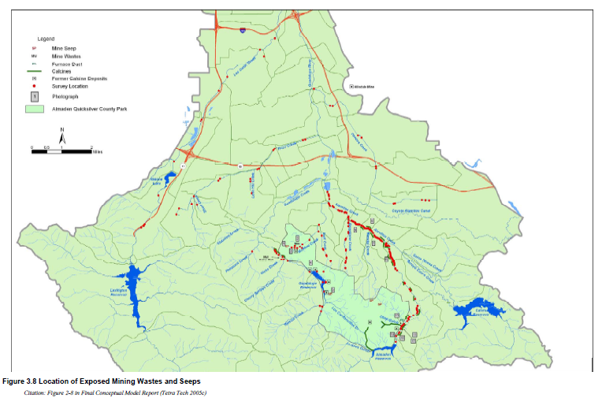
Guadalupe River Watershed Mercury TMDL
1.5 ng/L in Water
0.05 mg MeHg/kg (Small Fish)
0.1 mg MeHg/kg (Big Fish)
Lakes

Slide 27
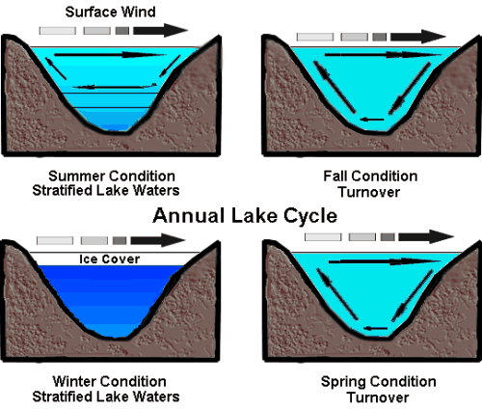
Stratification of Lakes and Reservoirs
Loss of cold-water habitat
Ammonia
Phosphate
Manganese
Mercury
Sulfide
Iron

Slide 28
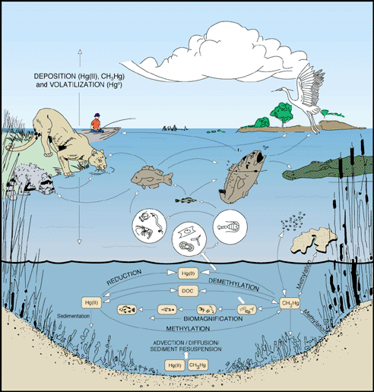
Mercury in Aquatic Ecosystems
Enters System as Hg(II)
Converted to MeHg in Anaerobic Zones
Biomagnifies Up Food Web
Typically Associated with Eutrophic Systems
USGS

Slide 29
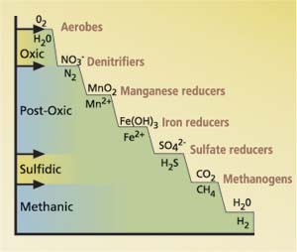
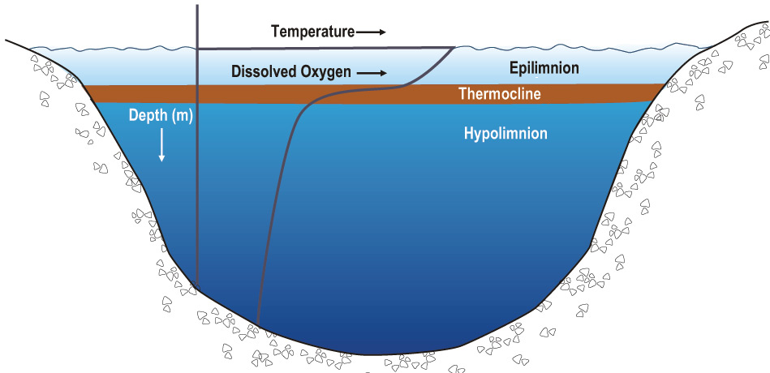
How Lake Hg Enrichment Works
Oxycline
Mn(II)
Fe(II)
S(II)
Lakes

Slide 30
Redox Chemistry of Oxygen Depletion
Water Column
+100 mV
+300 mV
Anaerobic
Anoxic
Oxic
S²⁻ +
Hg²⁺
CH₃Hg⁺
Fe²⁺
Mn²⁺
Hg²⁺
Fe³⁺
Mn³⁺
SRB
Hg²⁺, PO₄, NH₄⁺
SO₄²⁻
Fe³⁺ ← Mn³⁺
NO³⁻ ← O₂
Sediment
Adapted from Austin 2011
Dominant Oxic Species
Hg Dynamics

Slide 31
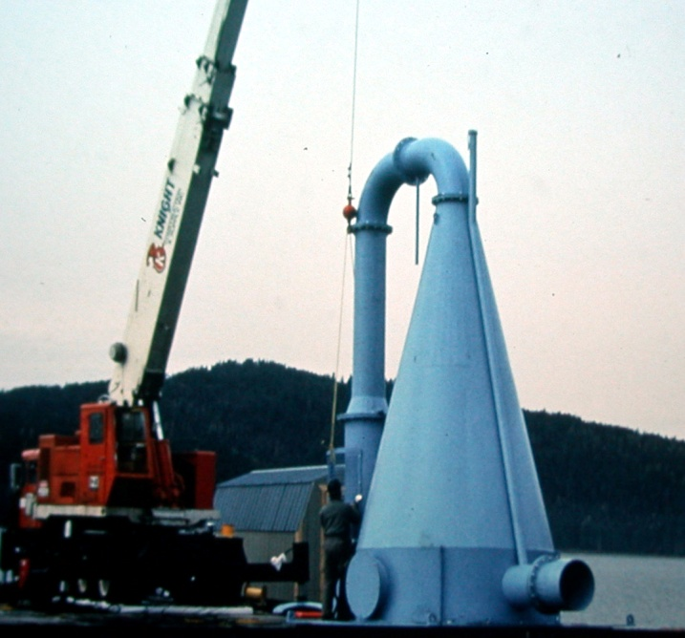
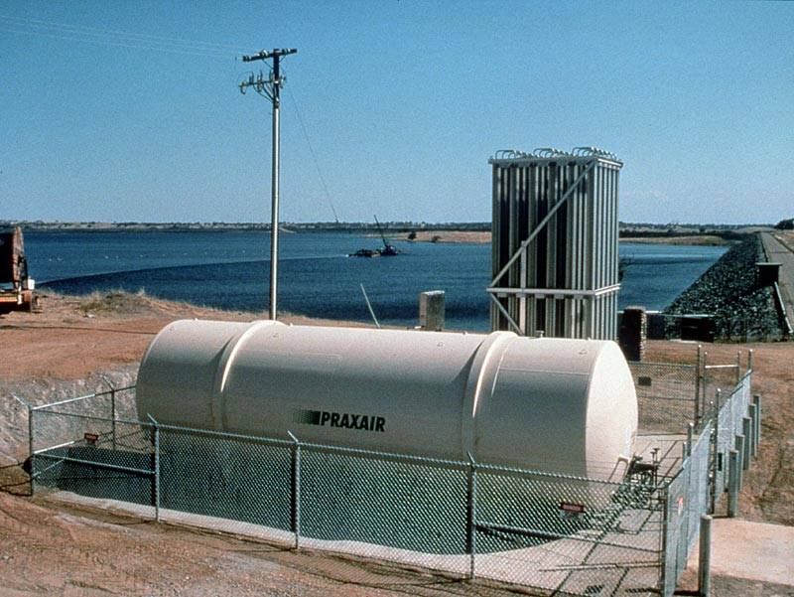
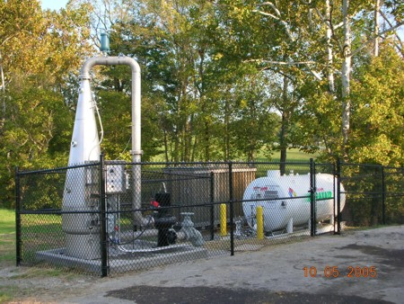
Submerged Contact Chamber
Lakes

Slide 32
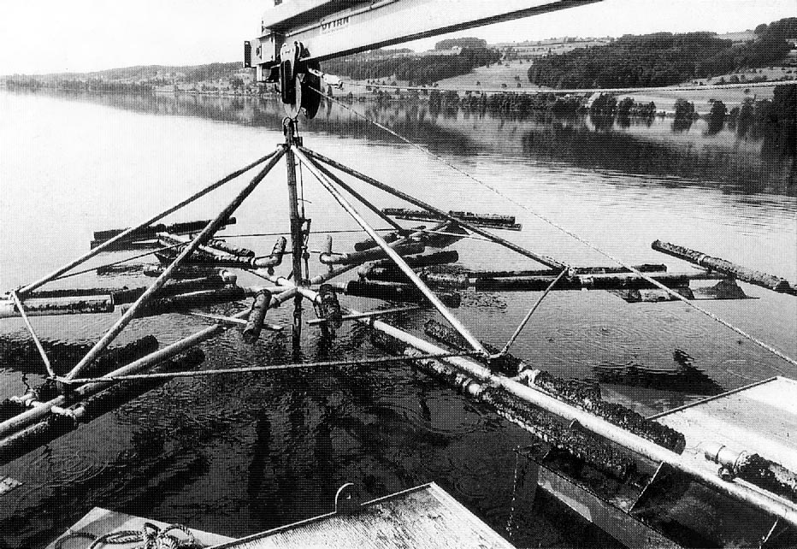
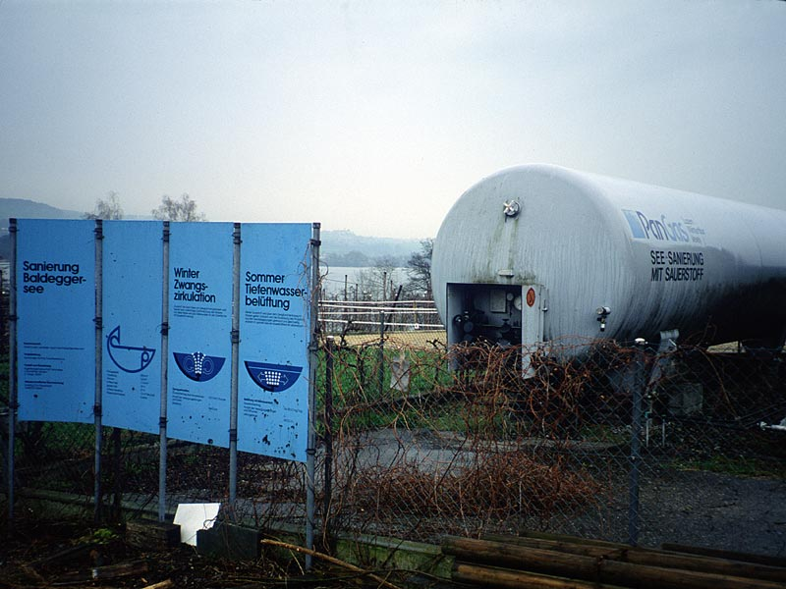
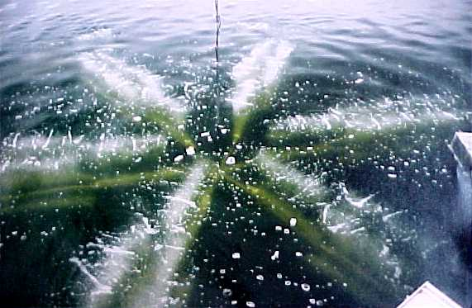
Bubble Plume Oxygenation
Lakes

Slide 33

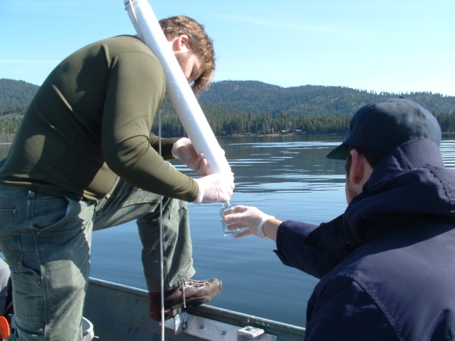



Effects of Hypolimnetic Oxygen on Water Column Iron, Manganese, and Methylmercury
Lakes

Slide 34
Bubble Plume Dynamics
Net Advective Flow Placement:
  Function of Flow per Lenth of Diffuser Line.
Mobley Engineering

Slide 35
Targeting Oxygenation Zones in Upper Hypolimnion
Mobley Engineering

Slide 36
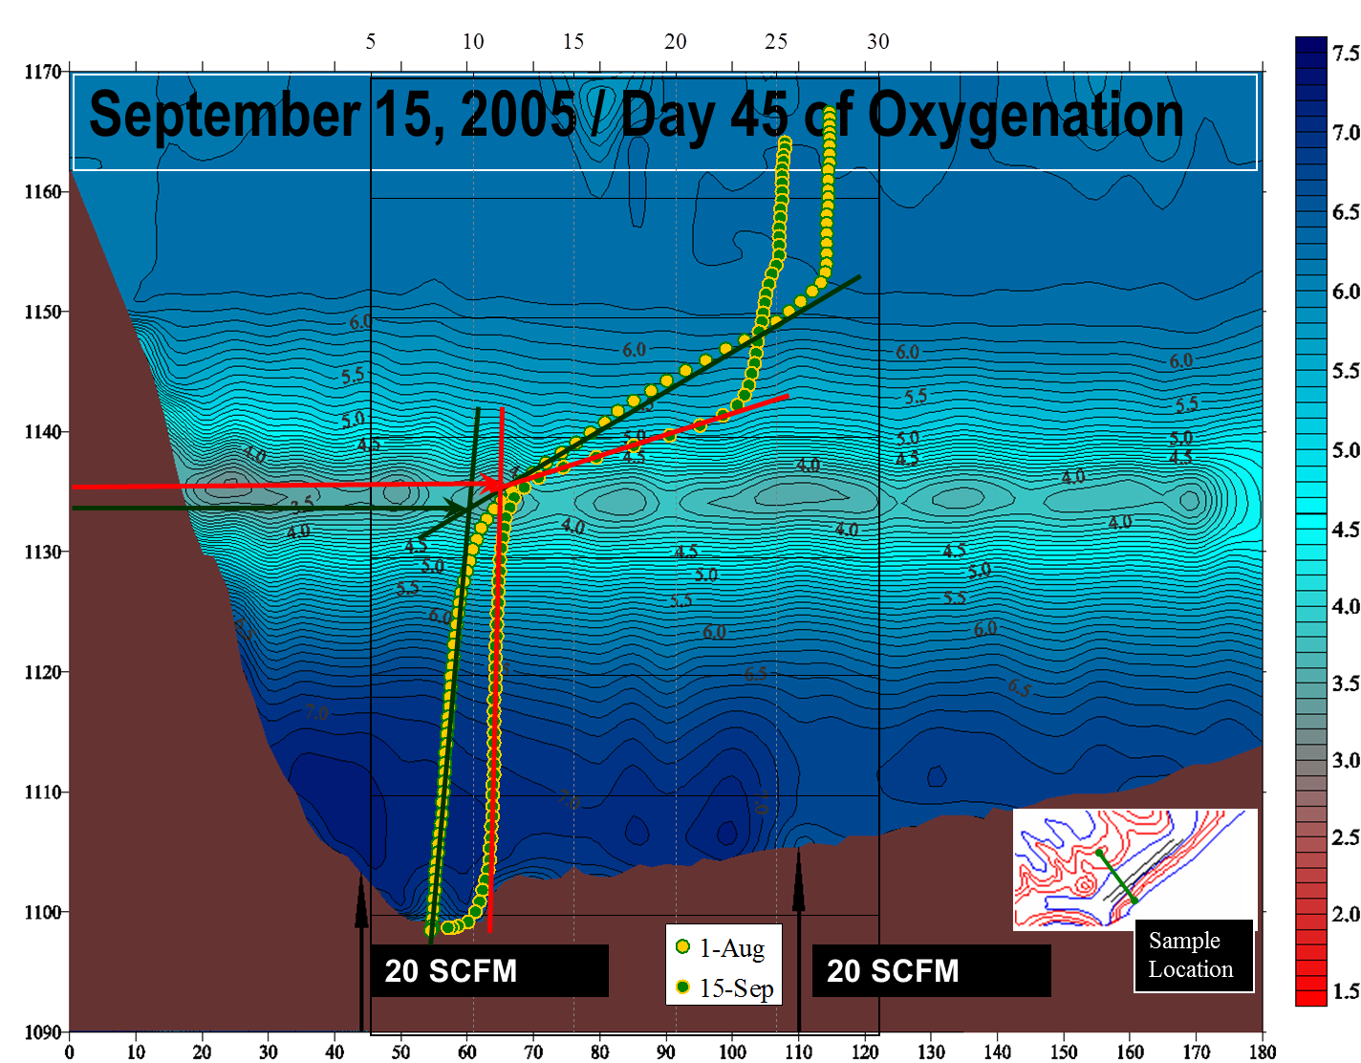
Targeting Oxygenation Zones in Lower Hypolimnion
Mobley Engineering

