Slide 1
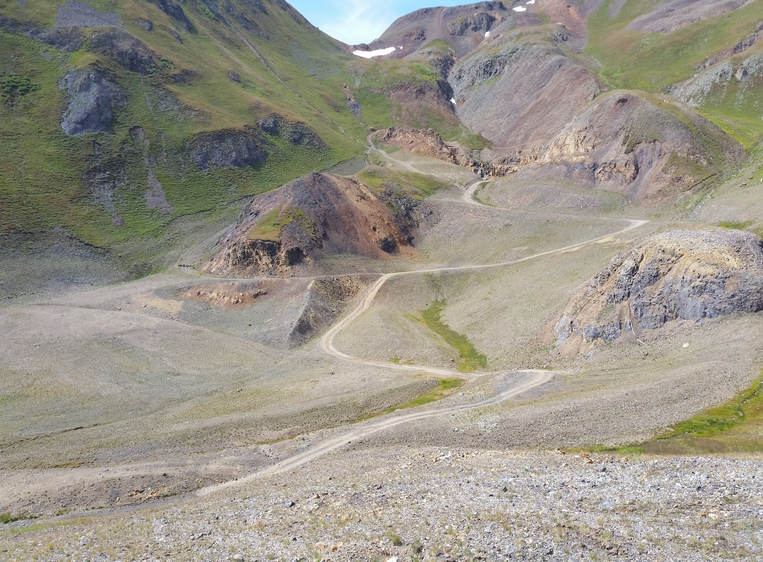
Overview, Lessons Learned and Best Practices Derived from Independent Optimization Reviews of Superfund Mining Sites
CLU-IN Internet Seminar May 24, 2017
U.S. Environmental Protection Agency

Slide 2
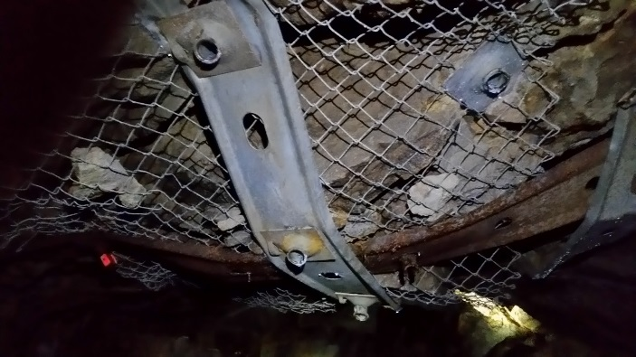
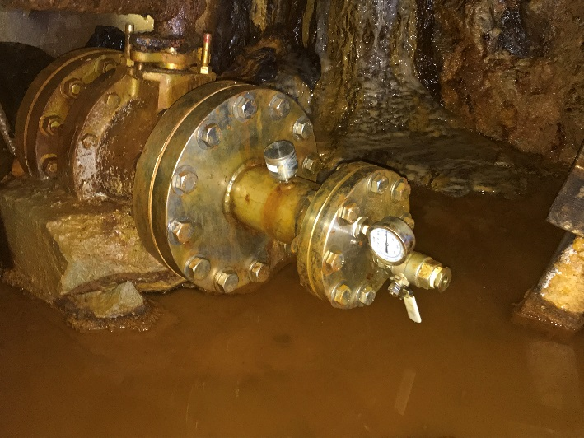
Introduction
Welcome
Webinar Logistics
Presenters
  Kirby Biggs; EPA OSRTI TIFSD
  Jody Edwards, P.G.; Tetra Tech
>15 nations attending!
Notes:
Jean / Kirby / Jody
Slide Time – 3
Running Total - 3

Slide 3
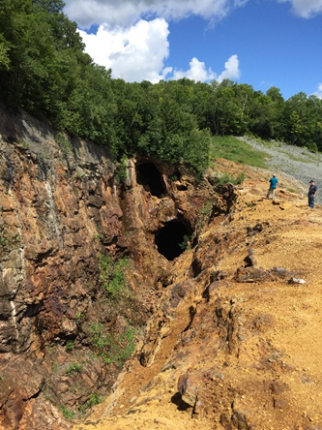
Webinar Outline
Status of Mine Sites in USA
What is Optimization?
EPA National Optimization Strategy
  Optimization Mine Sites Initiative
  Lessons Learned
Mine Site Characterization Best Practices
Optimization Review Case Studies
Summary
Questions
Elizabeth Mine, VT
Notes:
Kirby
Prior time – 3
Slide Time – 1
Running Total – 4

Slide 4
Mine Sites Status in USA

Slide 5
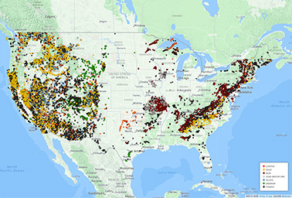
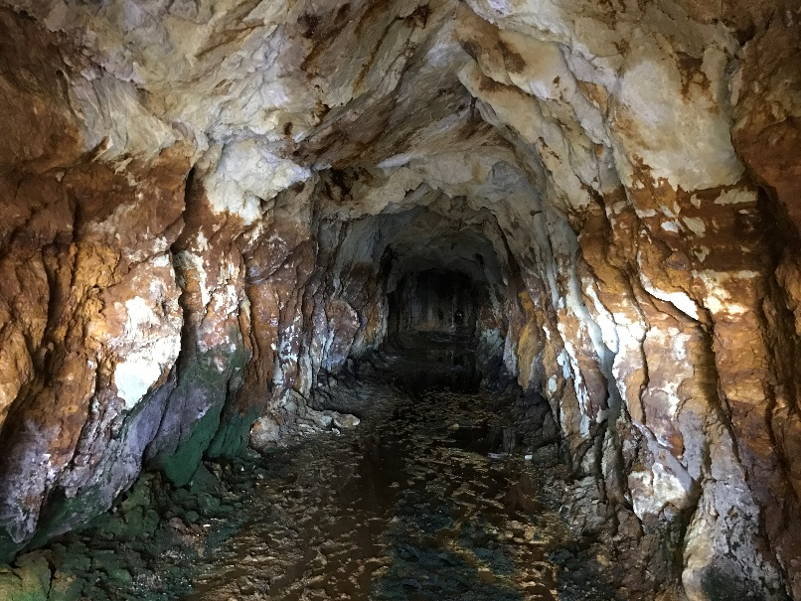
Abandoned Hardrock Mine Sites
Estimated 100,000 – 500,000 abandoned mine land (AML) sites
  Less than 500 AML sites documented
  139 AMLs on NPL or being addressed by Superfund Alternative Approach
Internal and external collaboration to address sites efficiently and effectively
  EPA National Mining Team
  Federal Mining Dialogue
  Abandoned Uranium Mines Workgroup
Increasing collaboration with state, tribal and private partners
Specialty focus of EPA optimization review program
Notes:
Kirby
Prior time – 4
Slide Time – 1
Running Total – 5

Slide 6
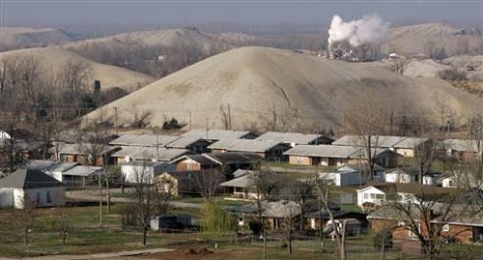
EPA National Mining Team
Key Functions
Support mine related policy and regulatory issues
Provide technical information and site-specific assistance on Superfund sites
Improve EPA management of mining issues
Support Federal Mining Dialogue and other federal coordination activities
Support Optimization Studies at Mine sites
Notes:
Kirby
Prior time – 5
Slide Time – 1
Running Total – 6

Slide 7








Federal Mining Dialogue (FMD)
Principals
  Department of the Interior
  Department of Agriculture
  EPA
Additional Participants
  Department of Energy
  Department of Justice
  US Army Corps of Engineers
  Office of Management and Budget
  ASTSWMO
Open exchange of information on common challenges
Coordinating on development and publication of Best Practices
Notes:
Kirby
Prior time – 6
Slide Time – 1
Running Total – 7

Slide 8
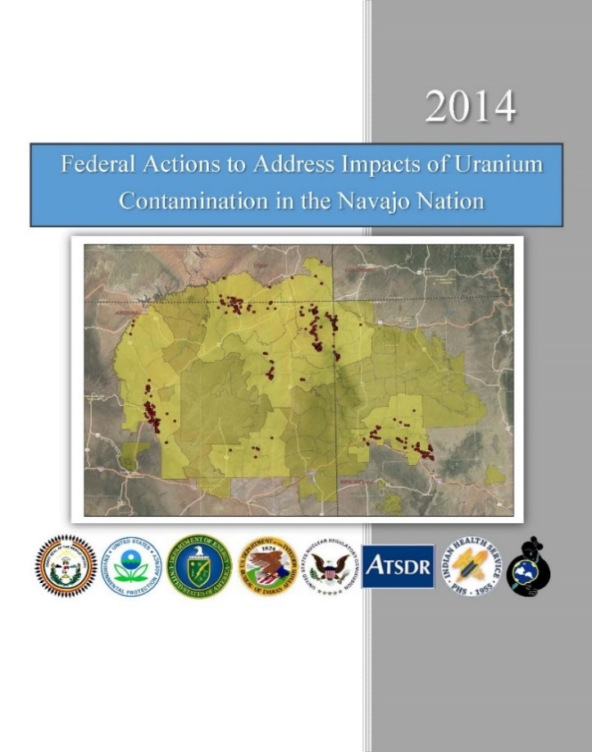
Abandoned Uranium Mine (AUM) Sites
4,200⁺ sites identified, many more not inventoried
Many reside on tribal and federal lands
Mine site sizes vary but most are large, remote, and difficult to access
37 large mines located in six states
Places to dispose waste is a challenge
Collaborative efforts to address sites
Notes:
Kirby
Prior time – 7
Slide Time – 1
Running Total – 8

Slide 9
What is Optimization?

Slide 10
EPA’s Definition of Optimization
Systematic site review by a team
of independent technical experts,
performed at any phase of a cleanup process, to identify opportunities to improve remedy protectiveness, effectiveness and cost efficiency, and to facilitate progress toward site completion.
Notes:
Kirby
Prior time – 8
Slide Time – 1
Running Total – 9

Slide 11
Applies to Any Site, Program or Remedy
Types of Sites / Programs | Example Types of Remedies Evaluated
DNAPL sites Dry cleaners Gas stations Industrial facilities Landfills MGP sites Mines / Mining districts Petroleum sites Sediment sites Wood treating sites --------------------------- CERCLA/Superfund RCRA State VCUP Brownfields Federal Facilities Tribal | Groundwater extraction & treatment Air sparging / Soil vapor extraction Non-aqueous phase liquid recovery Biosparging In situ thermal remediation In situ chemical oxidation In situ bioremediation Sediment capping Permeable reactive barriers (PRB) Constructed wetlands Landfill gas collection Surface water diversion/collection/treatment Monitored natural attenuation (MNA)
Investigation > Feasibility Study > Design > Remedial Action > LTMO > O&M
Notes:
Kirby
Prior time – 9
Slide Time – 1
Running Total – 10

Slide 12
Examples of Technical Support
Programmatic support
Strategic planning support
Systematic project planning (SPP) facilitation
CSM development
  Project Life Cycle CSM
    https://clu-in.org/download/remed/csm-life-cycle-fact-sheet-final.pdf
  High-resolution site characterization (HRSC)
  3-dimensional data visualization and analysis (3DVA)
Dynamic work strategy (DWS) development
Third-party technical review of site work plans and reports
Specialty characterization technology and sampling methods expertise
Notes:
Kirby / Jody?
Prior time – 10
Slide Time – 2
Running Total – 12

Slide 13
Typical Optimization Review Process
Engagement
Scoping
Project kick-off
Document / data acquisition and review
Site visit and interviews
Data analysis
Preliminary findings
Reporting
Lessons learned compilation
Typical Site Visit Agenda
Introductions
CSM
Remedy effectiveness/protectiveness
Extraction/injection systems
Treatment components
Costs
Environmental footprint reduction
Site closure
Debrief
Requires expert level, multidiscipline review team members
Notes:
Kirby
Prior time – 12
Slide Time – 2
Running Total – 14

Slide 14
Sites That May Benefit From Optimization
Sites with:
  Protectiveness concerns
  Technological challenges
  CSM data gaps; high site uncertainties
  High costs for remedial activities
  Interim remedies
Sites not meeting Remedial Action Objectives (RAO)
Sites scheduled for five-year reviews (FYR)
Sites in long-term remedial action (LTRA) and/or nearing operations and maintenance (O&M) transfer to States
Notes:
Kirby
Prior time – 14
Slide Time – 2
Running Total – 16

Slide 15

Focus of Optimization Reviews
Remedial goals
Maximize value of existing site documents and data
Conceptual site model (CSM)
Remedy performance
Protectiveness
Cost-effectiveness
Site completion / closure strategy
Environmental footprint
Notes:
Kirby
Prior time – 16
Slide Time – 1
Running Total – 17

Slide 16
Other Benefits of Optimization
  Site team and management provided with valuable 3rd-party perspective
    Provides path forward strategy
    Leverages adaptive management methods for flexibility
    Helps build consensus among site stakeholders
    Helps address community concerns
    Balances technical input from site contractors
  Accelerates schedule for site closure
  Facilitates transfer of LTRA sites to States
  Cross-pollinates expertise among sites and site teams
Notes:
16
Kirby
Prior time – 17
Slide Time – 1
Running Total – 18

Slide 17
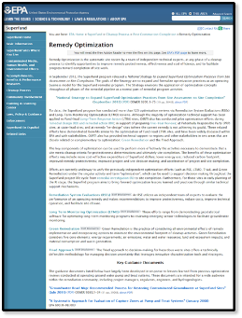
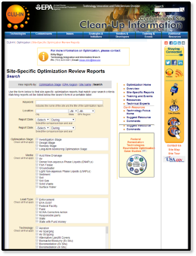
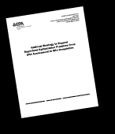
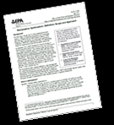
EPA Optimization Resources
Two locations for online resources
  www.cluin.org/optimization
  www.epa.gov/superfund/cleanup-optimization-superfund-sites
Remediation Optimization: Definition, Scope and Approach
  www.cluin.org/optimization/pdfs/OptimizationPrimer_final_June2013.pdf
Site-specific optimization review reports
  www.clu-in.org/optimization/reports.cfm
Notes:
Kirby
Prior time – 18
Slide Time – 2
Running Total – 20

Slide 18
EPA National Optimization Strategy

Slide 19
History of EPA Optimization Review Program
Year | Key Milestones
1997 | Site optimization reviews initiated by EPA
1999 | EPA-USACE-USAF collaboration on review practices
2000 | Pilot project – applied USACE RSE optimization process at 4 P&T sites in LTRA phase
2001 | Pilot project expansion – reviews at 16 additional P&T sites in LTRA phase
2002 | Development of guidance documents; internet seminars to address lessons learned
2003 | Diversification of site type (other than P&T); reviews performed earlier project phases
2004 | ‘Optimization Action Plan’ formalized optimization for Superfund Fund-lead LTRA sites
2004–2005 | Pilot project in Region 3 for streamlined approach to optimization reviews
2010 | After 150 sites reviewed, EPA directs development of National Optimization Strategy
2010–2012 | Strategy developed by national EPA workgroup (HQ / Regions / Office of R&D)
2012 | Formal release of “National Strategy to Expand Superfund Optimization Practices from Site Assessment to Site Completion”; Sept 12, 2012
2012–2013 | Development of standard operating procedures (SOP) and other technical resources
2017 | 224 optimization reviews performed to date USA-wide
2017+ | Expansion and training of optimization review resources; inclusion in new EPA contracts
Notes:
Kirby
Prior time – 20
Slide Time – 1
Running Total – 21

Slide 20
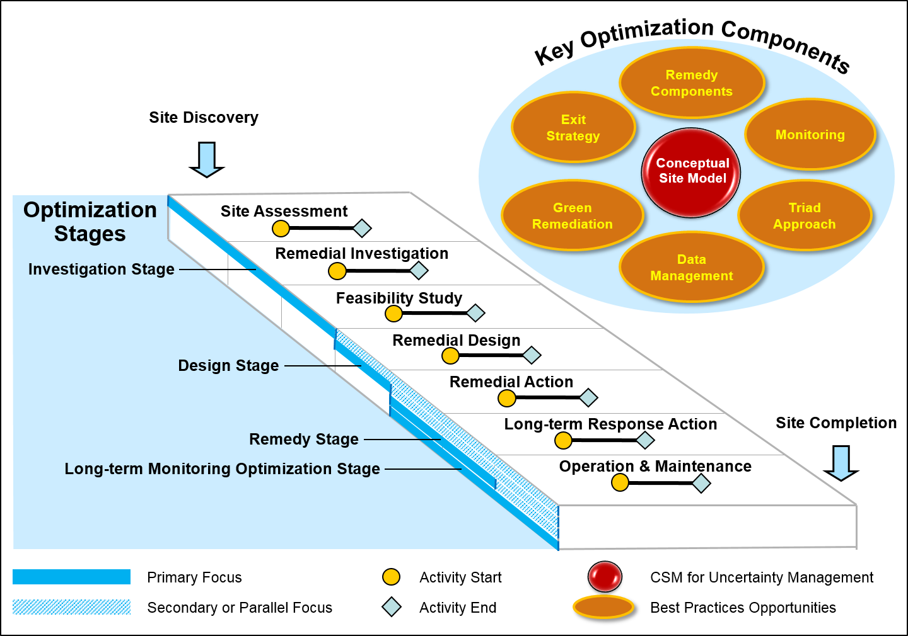
EPA National Optimization Strategy
Issued September 28, 2012
EPA’s National Strategy to Expand Superfund Optimization Practices from Site Assessment to Site Completion (2012)
  Systematic site review by a team of independent technical experts…
  Performed at any phase of a cleanup process…
  Identify opportunities to improve remedy protectiveness, effectiveness and cost efficiency…
  Facilitate progress toward site completion.
Notes:
20
Kirby
Prior time – 21
Slide Time – 2
Running Total – 23

Slide 21
Completed Optimization and Technical Support Events
EPA Region | Number of Events 1997-2010 | Number of Events 2011-2016 | Total Events 1997 to Date | % per Region
1 | 10 | 13 | 23 | 10 %
2 | 12 | 14 | 26 | 12 %
3 | 18 | 8 | 26 | 12 %
4 | 11 | 4 | 15 | 7 %
5 | 12 | 4 | 16 | 7 %
6 | 5 | 16 | 21 | 9 %
7 | 7 | 15 | 21 | 9 %
8 | 4 | 19 | 23 | 10 %
9 | 6 | 21 | 27 | 12 %
10 | 10 | 16 | 26 | 12 %
TOTAL | 95 | 130 | 224 | 100 %
Notes:
Kirby
Prior time – 23
Slide Time – 1
Running Total – 24

Slide 22
National Optimization Progress Report
DRAFT Optimization Review Results
Overall optimization program expanded
  ~ 50 ongoing optimization events per year
  ~ 20 optimization events completed per year
Reviews during all Superfund pipeline phases
  Pre-remedial action = ~ 35%
  Remedial action = ~ 51%
  Operations and maintenance = ~ 14%
Evaluation of recommendations implemented
  61 sites reviewed between 2010 and 2015 were evaluated
  64% implemented, in progress, or planned
  15% under consideration
  16% declined
Key results for all sites
  68% > improvements to the CSM
  60% > streamlined or improved monitoring
  39% > improved system engineering
  36% > change in remedial approach
Technical support completed for 25 events
  HRSC, 3DVA , Project Life Cycle CSMs, Environmental footprint analysis
Notes:
Kirby
Prior time – 24
Slide Time – 3
Running Total – 27

Slide 23
Optimization Mine Sites Initiative

Slide 24
History of Mining Site Optimization
Year | Key Milestones
Mid-2000’s | Mine site optimization reviews initiated at request of EPA Regions
2012 | National Optimization Strategy released
2015 | OSRTI evaluates results of 16 mining site pilot
2015 | Mine Sites Initiative begins under National Optimization Strategy
2016 | Focused reviews to support work at sites with fluid hazards
2017+ | Mine site reviews ongoing focus of optimization program
Notes:
Kirby
Prior time – 27
Slide Time – 1
Running Total – 28

Slide 25
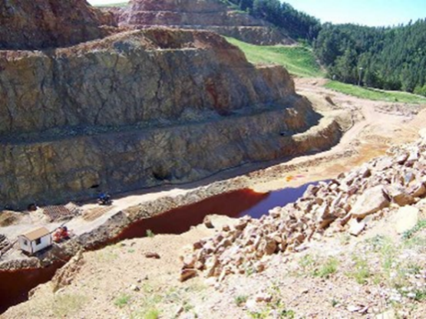
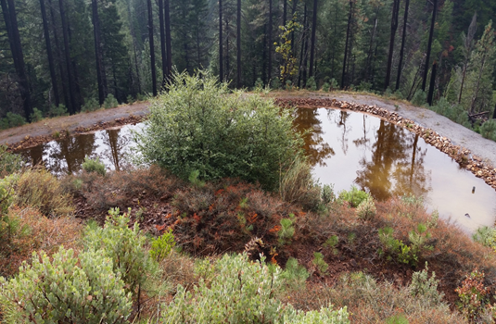
Overview of Mine Sites Optimization Efforts
Mine Site Optimization Reviews to Date
Optimization Metric | Total to Date
Locations
Events | 51
Sites and Mining Districts | 34
Individual Mine Workings and OUs | 99
Type of Support
Optimization Reviews | 24
Technical Support | 13
Focused Technical Reviews | 14
Activity Status
Completed | 30
In Progress | 17
Pending | 4
Notes:
Kirby
Prior time – 29
Slide Time – 1.5
Running Total – 30.5

Slide 26
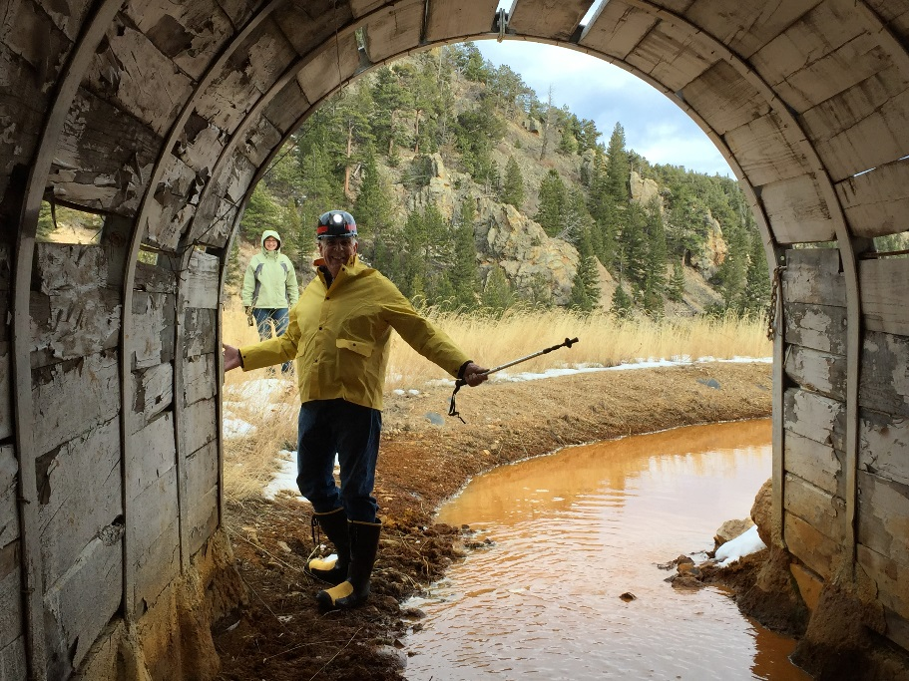
Mining Sites Reviewed
Mining Sites Initiative Optimization Reviews
  Barker Hughesville, MT
  Black Butte, OR
  Bunker Hill, CA
  Carpenter Snow Creek, MT
  Carson River Mercury, NV
  Central City/Clear Creek, CO
  French Gulch/Wellington-Oro, CO
  Gilt Edge, SD
  Homestake Mining Co., NM
  Iron King, AZ
  Lava Cap Mine, CA
  Silver Bow Creek/Butte, MT
  Standard Mine, CO
  Sulphur Bank, CA
  Summitville Mine, CO
  Tar Creek, OK
Focused Technical Reviews
  Capt. Jack Mill, CO
  Elizabeth Mine, VT
  Gold King Mine, CO
  Klau Buena Vista, CA
  Rico Argentine/St. Louis Tunnel, CA
  Standard Mine, CO
Notes:
Kirby
Prior time – 28
Slide Time – 1
Running Total – 29

Slide 27
Lessons Learned
Mining Sites Pilot
Sites with older remedies present more opportunities to optimize
Sites with high remediation costs often most complex, but present greater opportunities for cost savings
Monitoring data collection and analysis can be a significant cost
CSMs beneficial for reducing uncertainty in large, complex sites
Important data gaps can arise in any project stage
Primary remedies at pilot sites include active MIW treatment
Treating MIW costly and often does not address source cleanup
Alternative water quality criteria may be potential option for specific sites
Institutional controls (IC) may be applicable when mine waste can not be effectively removed or contained
Technical capabilities of project personnel important to project success
(Continued)
Notes:
Kirby
Prior time – 30.5
Slide Time – 2
Running Total – 32.5

Slide 28
Lessons Learned
Mining Sites Pilot
Use existing site attributes for remedial benefits
  Evaluate these opportunities during RI to support FS or RD stages
  Example: Monitor constituent levels before/after flow through existing wetlands
Reduce labor costs through automation of MIW treatment systems
  Examples: Installation of auto-samplers; automating water treatment controls
Improve MIW capture via drains and flow control within mine workings
  Example: Consider MIW from bedrock fractures, mineral veins and seeps
Improve WTP efficiency and lower costs through reduction of inflows
  Example: Modify surface water drainage to bypass openings in workings
Low discharge requirements can require costly treatment methods
  Particularly for sites with long-term MIW treatment needs
Passive treatment systems require low MIW discharge and space
  Adequate area and/or suitable topography may not exist
Notes:
Kirby
Prior time – 32.5
Slide Time – 2
Running Total – 34.5

Slide 29
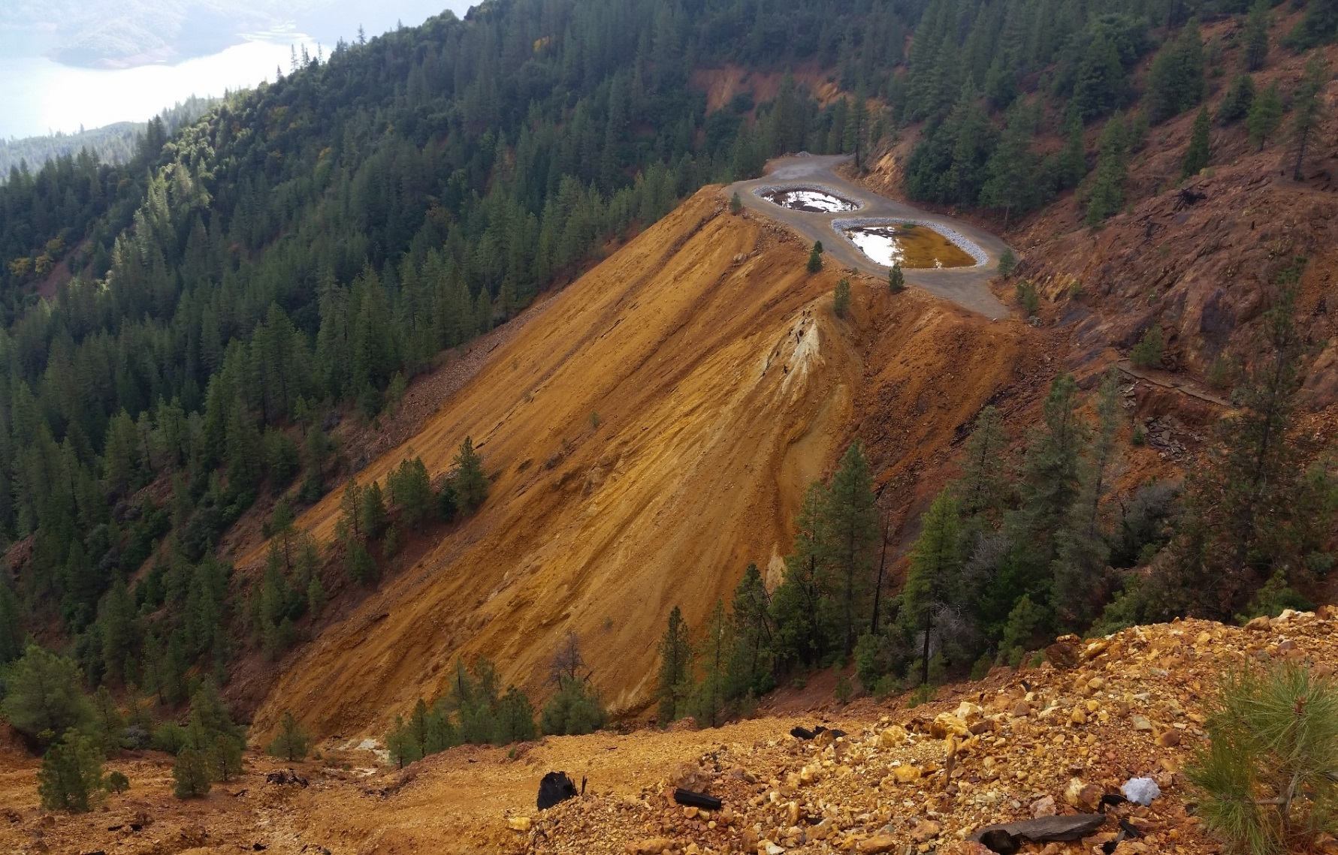
Lessons Learned
Mining Sites Pilot
Small Footprint Passive Treatment System
Balaklala Mine, CA
Notes:
Kirby
Prior time – 34.5
Slide Time – 0.5 seconds
Running Total – 36

Slide 30
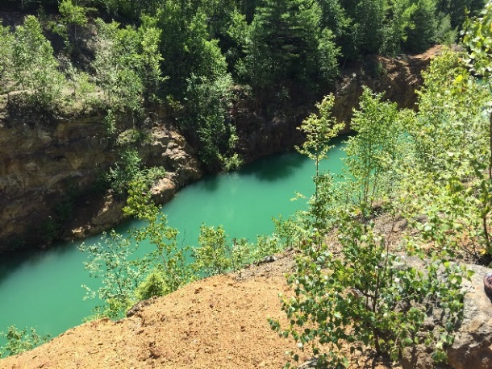
Lessons Learned
MIW-Focused Technical Reviews
Confirm MIW conditions and potential volume at risk of release prior to conducting invasive work
Confirm existing capacity to capture and treat potential MIW releases
Conduct Failure Mode & Effects Analyses (FMEA) on planned work activities to assess potential risks and consequences
Mitigate risk or provide contingency to contain and treat potential MIW releases
Develop contingency, notifications and emergency action plans (CNEAP)
Elizabeth Mine, VT
Notes:
Kirby
Prior time – 36
Slide Time – 1.5
Running Total – 37.5

Slide 31
Site Characterization Best Practices

Slide 32
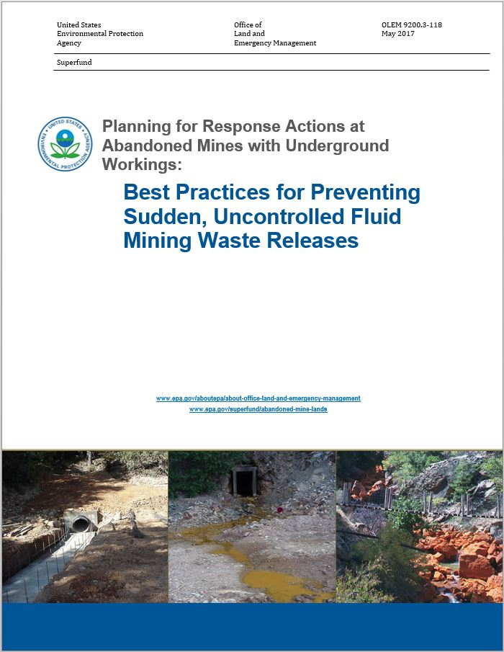
Best Practices: Underground Workings
  Preventing sudden, uncontrolled fluid mining waste releases
    MIW, saturated sediments/sludge
  Applies to investigation, rehabilitation and remedial activities
  Extensive technical review by federal agencies and states
  Formal independent peer review
  USGS
  PADEP, WVDEC
  NOVAGOLD Resources
  Colorado School of Mines, U.Nevada-Reno
Notes:
Kirby
Prior time – 37.5
Slide Time – 1.5
Running Total – 39

Slide 33









Best Practices Development Partners Contributing U.S. Federal Agencies
Department of the Interior (DOI)
  Office of Surface Mining, Reclamation and Enforcement (OSMRE)
  U.S. Geological Survey (USGS)
  Bureau of Reclamation (BOR)
Environmental Protection Agency (EPA)
Department of Labor
  Mine Safety and Health Administration (MSHA)
Department of Transportation (DOT)
  Federal Highways Administration (FHWA)
  Interstate Technical Group on Abandoned Underground Mines
Department of Homeland Security (DHS)
  Federal Emergency Management Agency (FEMA)
Department of Agriculture
  U.S. Forest Service (USFS)
Notes:
Kirby
Prior time – 39
Slide Time – 1
Running Total – 40

Slide 34
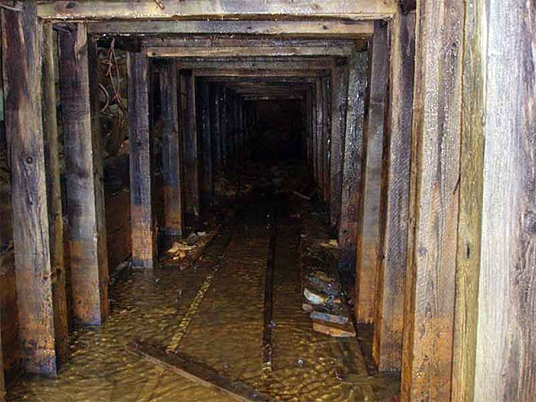
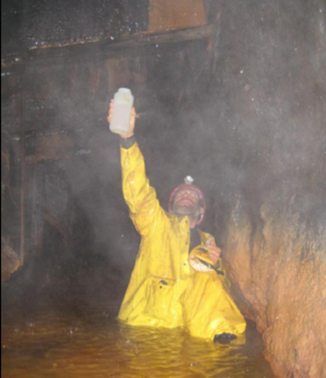
Key Best Practices for MIW
Initial Assessment Activities
Conduct initial site screening
  Document and data review
  Identify data gaps
  Conduct site Visit
Develop MIW CSM
  Visualization of mine workings and MIW conditions
Evaluate MIW pooling attributes
  Hydrogeologic
  Hydrologic
  Geochemical
  Geotechnical
Develop qualitative water balance
  Inflows - outflows
Notes:
Jody
Prior time – 41
Slide Time – 1
Running Total – 42

Slide 35
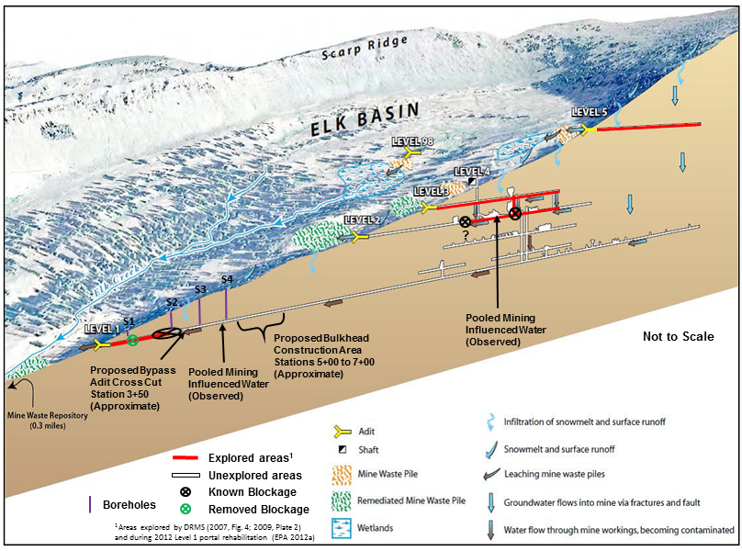
Example Simplified MIW CSM
Standard Mine, CO
Notes:
Jody
Prior time – 42
Slide Time – 2
Running Total – 44

Slide 36
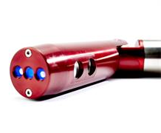
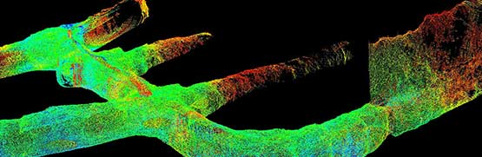
Key Best Practices for MIW
Field Investigation Activities
Plan and conduct minimally invasive measurement activities
  Geophysical studies, tracer studies
  Groundwater/MIW pooling water levels
  Surface water flows and water quality
Example downhole measurements
  Water elevations using pressure transducers
  MIW flow metering
  Visual inspection using video
  3-D laser mapping of workings
Develop detailed water balance
  Calculate / estimate hydrostatic conditions
Notes:
Jody
Prior time – 44
Slide Time – 1
Running Total – 45

Slide 37
Key Best Practices for MIW
Field Investigation Activities
Plan and conduct invasive measurement activities
  Drilling using blow-out preventers
  Downhole measurement through boreholes
  Monitoring well installation and sampling
Examples of drilling-related failure modes
  MIW releases through drilled boreholes
  Collapses or cave-ins within workings
  Ground failure from weight of drilling equipment
  Ground liquefaction from drilling vibration
Notes:
Jody
Prior time – 45
Slide Time – 1
Running Total – 46

Slide 38
Key Best Practices for MIW
FMEA
Conduct Failure Mode and Effects Analysis (FMEA)
  Qualitative or quantitative depending on available data
  Multi-discipline team with diverse expertise and knowledge
    One or more with prior FMEA experience
Identify potential failure modes and related elements
  Triggering event(s)
  Likelihood of occurrence
  Consequences and severity
  Receptors
Determine actions to eliminate or reduce failures
Notes:
Jody
Prior time – 46
Slide Time – 1.5
Running Total – 57.5

Slide 39
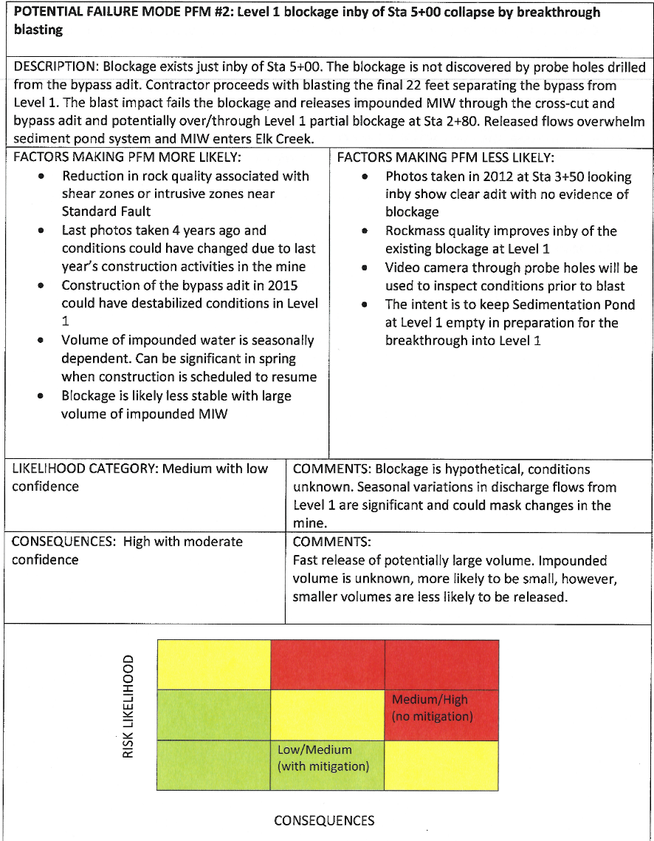
Example FMEA Worksheet
Qualitative
Failure Mode
Failure Mode Description
Factors Making Failure Mode More / Less Likely
Likelihood of Occurrence
Consequences
Risk Matrix
Notes:
Jody
Prior time – 57.5
Slide Time – 1.5
Running Total – 59

Slide 40
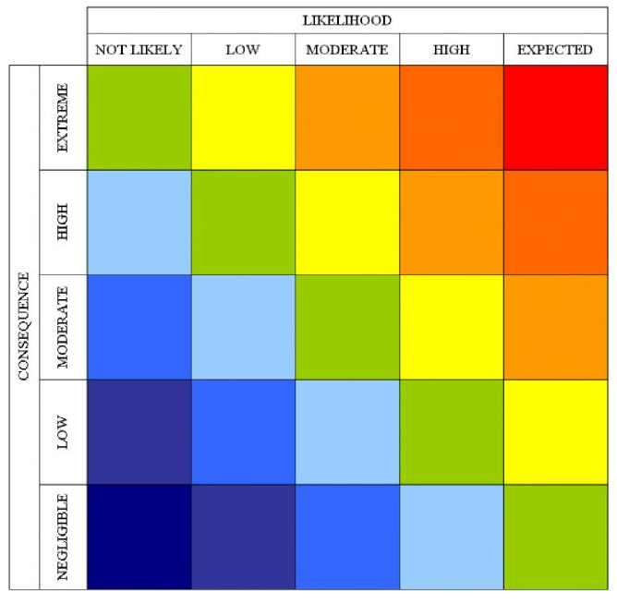
Practices for MIW
FMEA Risk Matrix
Matrix Axes
  Consequence & Likelihood
Color-coded risk levels
  Red – Extreme Risk
  Orange / orange-red – High Risk
  Yellow – Moderate Risk
  Green – Tolerable Risk
  Blue – Low to negligible Risk
Risk levels provide basis for risk mitigation activities
Notes:
Jody
Prior time – 59
Slide Time – 1
Running Total – 60

Slide 41
Key Best Practices for MIW
CNEAP
Develop CNEAP
  Contingency > Existing site infrastructure that would auto-manage MIW release (e.g., existing retention basin)
  Notifications > For emergency response agencies and downstream receptors; dependent on severity of event
  Emergency Action > Other actions taken if a release were to occur (e.g., site worker mustering locations)
CNEAP content directly supported by FMEA results
Designate CNEAP as governing document for managing, monitoring and response to potential MIW releases
  Work plans, HASPs, plans and specifications, etc.
Notes:
Jody
Prior time – 60
Slide Time – 2
Running Total – 62

Slide 42
Key Best Practices for MIW
Data Evaluation and Reporting
Collect and evaluate data
  Correlate MIW pooling water levels and discharge location(s)
  Update detailed water balance
Update MIW CSM
Identify needed mitigations
  Example – pre-draining MIW prior to work activities
Report findings to required parties
Plan and implement mitigation efforts
  Perform FMEA
  Update CNEAP
Notes:
Jody
Prior time – 62
Slide Time – 1
Running Total – 63

Slide 43

Reference Guide to Treatment Technologies for Mining-Influenced Water
Addresses 7 passive / 9 active technologies
  Summary of 7 additional technologies
  On-line searchable library of technologies
Technology discussions include:
  Technology description
  Constituents treated
  Operations
  Long-term maintenance
  System limitations
  Costs
  Effectiveness
Living resource; update in process
  Handbook for Treatment Technologies for Mining Wastes and Mining-Influenced Water
  Updates the MIW guide and expands the state of knowledge to include mining waste
www.cluin.org/mining
Notes:
Kirby
Prior time – 63
Slide Time – 1
Running Total – 64
Online, searchable library lists technologies provided in Appendix A of the Reference Guide to Treatment Technologies for Mining-Influenced Water, which includes summary information for the technologies discussed in the body of the report, as well as additional technologies or products designed as passive or low cost treatment options.

Slide 44
Optimization Review Case Studies

Slide 45
Bonita Peak Mining District
Site Information
Optimization review and technical support for RI planning
Newly listed Superfund site in Silverton, CO area
48 mines located in three adjacent, high-altitude drainage basins
  Animas River / Cement Creek / Mineral Creek
  Downstream confluence into Animas River
“One government” project team
  US EPA
  US Bureau of Land Management (BLM)
  US Forest Service (USFS)
  Colorado Department of Public Health and Environment (CDPHE)
  Colorado Division of Reclamation Mining and Safety (DRMS)
Approximately 40 project team members
  Program and project management
  Technical, legal and communications
Notes:
Kirby
Prior time – 64
Slide Time – 2
Running Total – 66

Slide 46
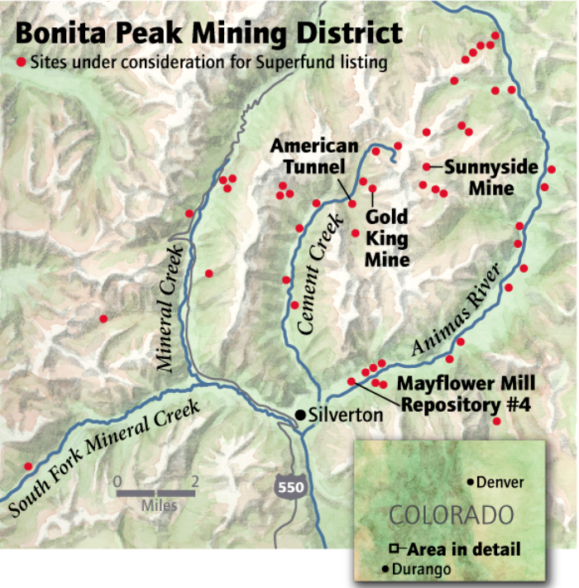
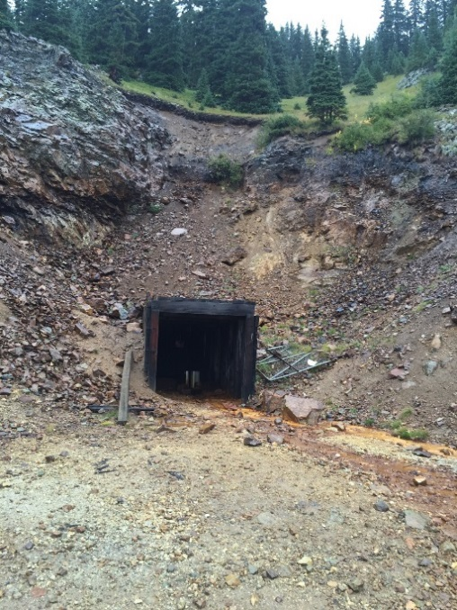
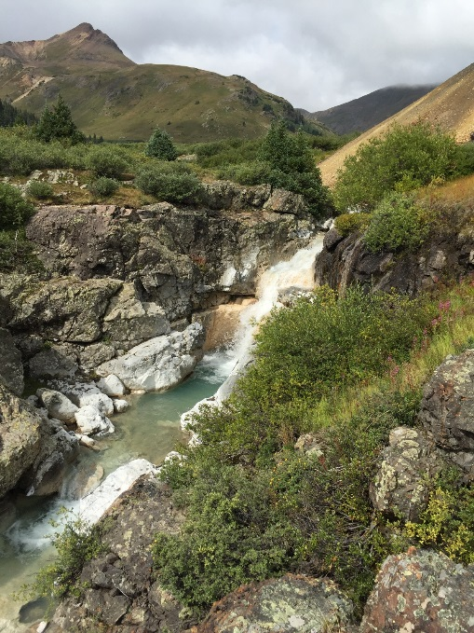
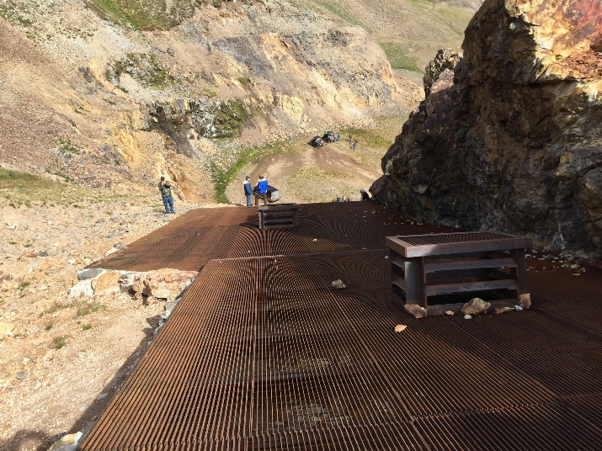
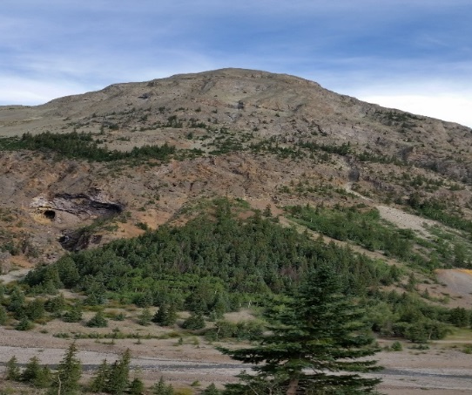
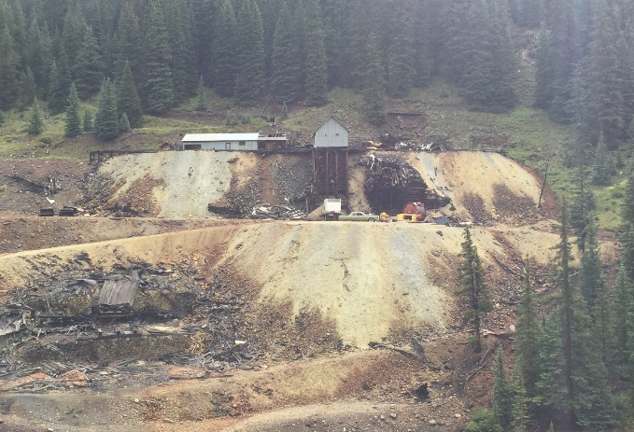
Bonita Peak Mining District
Site Information
Notes:
Kirby
Prior time – 66
Slide Time – .5 minutes
Running Total – 66.5

Slide 47
Bonita Peak Mining District
Challenges
High diversity in mine site characteristics
  Portals located along river/creeks and steep terrain up to 12,000 feet MSL
  Active MIW pooling and discharges; hydraulic interconnectivity
  Direct sourcing to surface water from anthropogenic and natural sources
Receptor diversity and issues
  Downstream receptors – water quality impacts
  Residents – impact to lives and economic livelihoods
  Thriving ATV and 4WD adventure tours – direct exposure to tailings dust
  Hikers and mountain bikers – direct exposure to impacted drinking water
  Historic sites – preservation requirements
  Tribal – impacts to cultural use
Additional issues
  Various funding levels/mechanisms and program requirements for each agency
  Mixed land ownership – government, tribal, corporate, private
  Mines easily accessible to nearly inaccessible
  Short work season due to lengthy snow season
Notes:
Kirby
Prior time – 66.5
Slide Time – 1.5 minutes
Running Total – 68

Slide 48
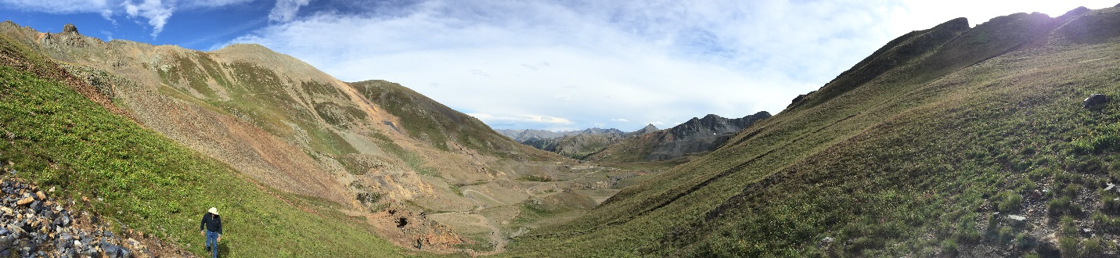
Bonita Peak Mining District
Technical Support Activities
Conducted 1-week site visit reconnaissance
Facilitated objective-focused, strategic planning effort
  Identified >350 action items during two meetings and one prior meeting
Developed Excel database matrix as collaborative management tool
  Strategic-, programmatic- and project-level activity planning and tracking
Proposed use of an integrated strategy for key site activities
  Enabled immediate planning for taking action on obvious site concerns
  Requires additional evaluation for regulatory process and funding
Bonita Peak Mining District, CO
Notes:
Kirby
Prior time – 68
Slide Time – 2
Running Total – 70

Slide 49
Lava Cap Mine Superfund Site
Site Information
Location
Sierra Nevada foothills; western Nevada County, CA
Approximately 33 acres in semi-rural, residential area
Mine Type
Gold and silver from underground workings
Initiated in 1861 and continued sporadically until 1943
Mine-related arsenic contamination in nearby drinking water wells
Cleanup Status
Remedial design stage; Record of Decision (ROD) signed Sept. 2008
Interim remedy for Groundwater Operable Unit (OU)
Construction of public water supply line to affected residences
Further study required to assess interactions between fractured bedrock aquifer and surface water
Two Optimization Reviews: Impoundment Focus; MIW Focus
Notes:
Jody
Prior time – 70
Slide Time – 1
Running Total – 71

Slide 50
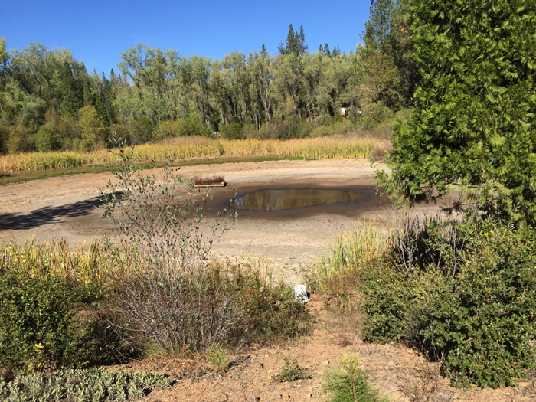
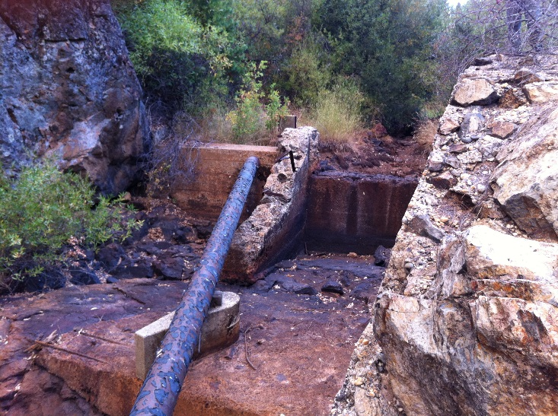
Lava Cap Mine Superfund Site
Key Optimization Review Findings
Dam Safety
Unregulated earth-rock embankment dam
Holds tailings and other wastes
Spillway inadequate for minimum flood flow and has deteriorated concrete components
Dam Characterization
  Approximately eight decades of operation and modifications
  Dam stability and composition not well-defined or documented
Seepage from Dam
  Active seepage from former mine workings
  Source of surface water contamination
Notes:
Jody
Prior time – 71
Slide Time – 1
Running Total – 72

Slide 51
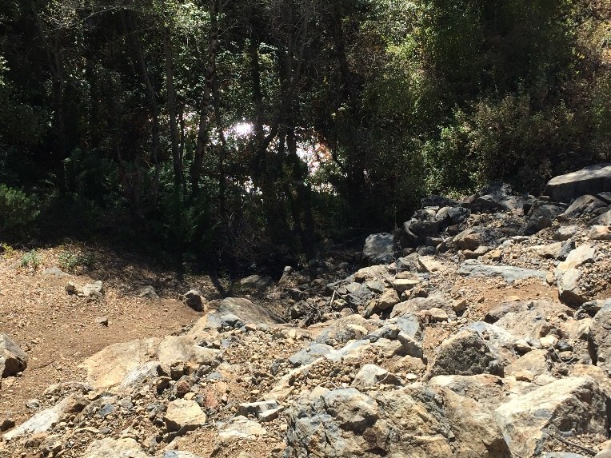
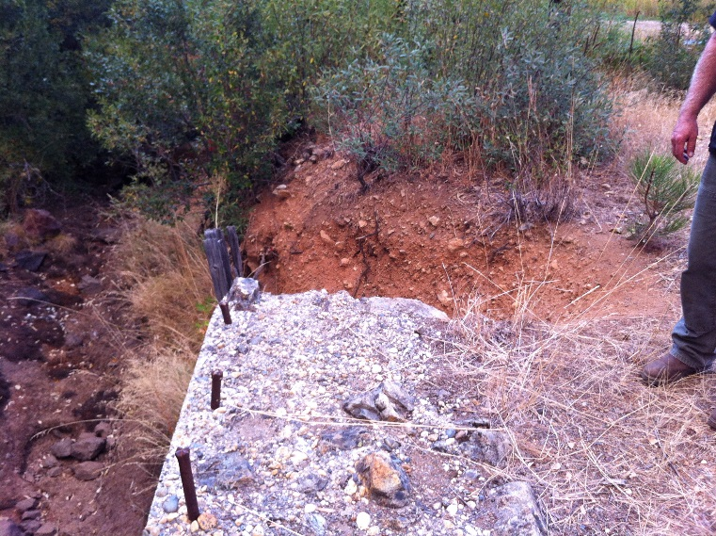
Lava Cap Mine Superfund Site
Key Review Recommendations
Embankment Plan
Conduct further investigations to support development of more realistic embankment model of dam stability
Perform stability analysis
Prevent Seepage
Identify seepage outlet
Quantify conditions to design mitigation
Install conduit plug to reduce seepage
Reduce Construction Activity
Use stability analysis as basis for developing closure alternatives that more efficiently satisfy dam safety requirements
Estimated 30 Year Cost Savings: $5.6M
Notes:
Jody
Prior time – 72
Slide Time – 1.5
Running Total – 73.5

Slide 52
Summitville Mine Superfund Site
Site Information
Location
San Juan Mountains south of Del Norte, CO
11,500 feet above sea level; ~2 miles east of the Continental Divide
Mine Type
Gold, copper and silver mining from underground workings and open pit
Initiated ~1870 and continued into the 1990s
Cleanup Status
Remedial Action stage
Several actions implemented to reduce MIW discharge
  Detoxifying, capping and revegetating a cyanide heap leach pad
  Removing waste rock piles and filling the mine pits
  Plugging adits and underground mine entrances
  Expanding water runoff holding ponds and operating on-site WTP
In preparation stages for transfer to State of Colorado
  Two Optimization Reviews: Whole Site Focus; State Transfer Focus
Notes:
Jody
Prior time – 73.5
Slide Time – 1.5
Running Total – 75

Slide 53
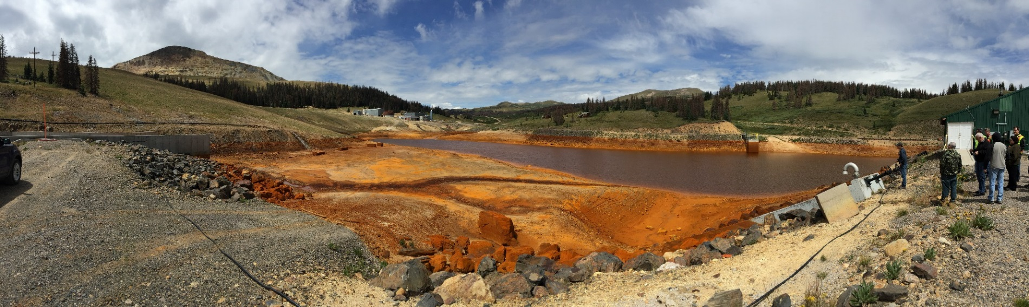
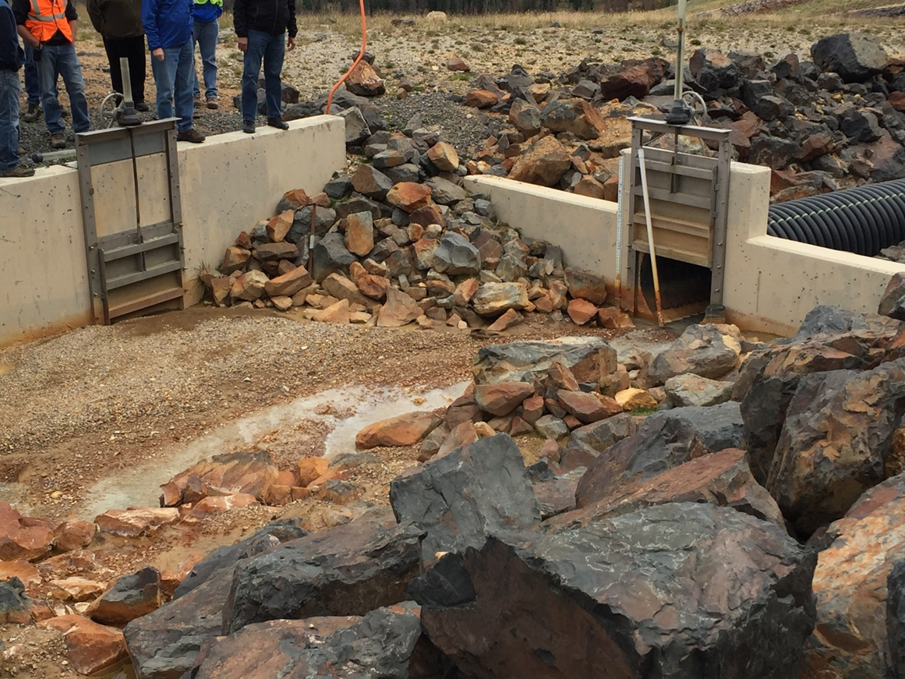
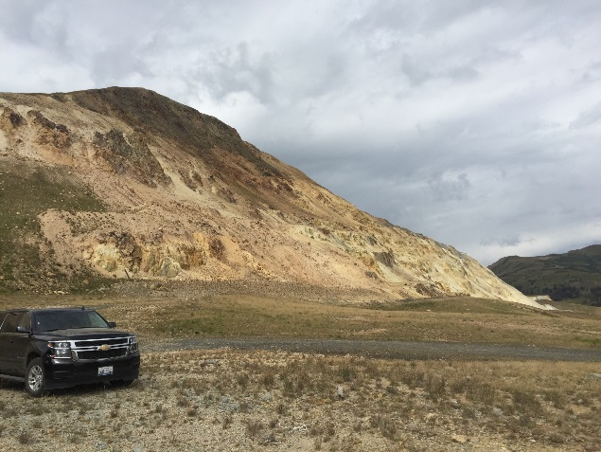
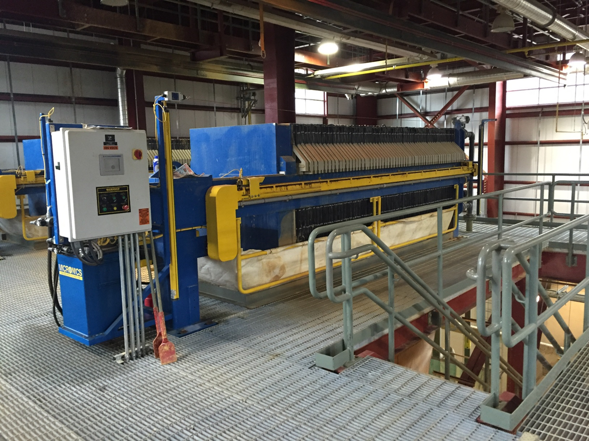
Summitville Mine Superfund Site
Site Information
Notes:
Jody
Prior time – 75
Slide Time – 1
Running Total – 76

Slide 54
Summitville Mine Superfund Site
Key Optimization Review Findings
Mine Pool
Elevated MIW pool water level
Hydraulic potential may affect migration of impacted groundwater through bedrock and subsequent discharge to surface water
Pump & Treat Capture Zone
High seasonal variability in groundwater flow
Uncaptured seeps and groundwater discharges impacting river
Remedy Operation
Remedy operating costs significantly high compared to similar sites
WTP
Current and planned remedies anticipated to require operation in perpetuity
Will result in high total costs
Notes:
Jody
Prior time – 76
Slide Time – 1
Running Total – 77

Slide 55
Summitville Mine Superfund Site
Key Review Recommendations
Lower Mine Pool Elevation
Evaluate options for maintaining lower water level in mine pool
Reduce effects of hydraulic potential on groundwater migration and discharge
Conduct Comprehensive Hydrogeologic Evaluation
Determine if planned interceptor trench along the northern boundary of the site will provide the expected capture of impacted groundwater and surface water
Reduce Monitoring Program
Evaluate need for continued extensive surface water sampling and analysis
Reduce Snow Removal
Eliminate potentially unnecessary seasonal maintenance snow removal
Address Perpetual WTP Operation
Consider remedial approaches that will not require perpetual water treatment
Estimated 30 Year Cost Savings: $13.8M
Notes:
Jody
Prior time – 77
Slide Time – 2
Running Total – 79

Slide 56
Central City/Clear Creek Site
Site Information
Location
Gilpin and Clear Creek Counties, CO
Consists of 400 mile² watershed
Mine Type
Gold and silver
Initiated in the mid-1800s and continued until the 1940’s
Most mines in watershed were underground mines
Site’s Argo Tunnel is major source of MIW discharge
Cleanup Status
Remedial Action stage
Remedies at the site’s four operable units (OUs) focus on water treatment and source control
  Simultaneous design, construction and operation activities
Notes:
Jody
Prior time – 79
Slide Time – 2
Running Total – 81

Slide 57
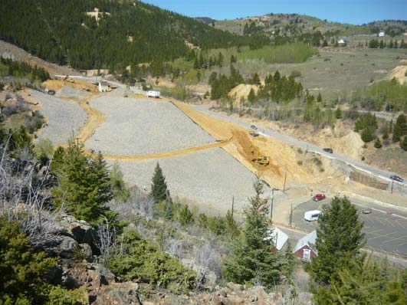
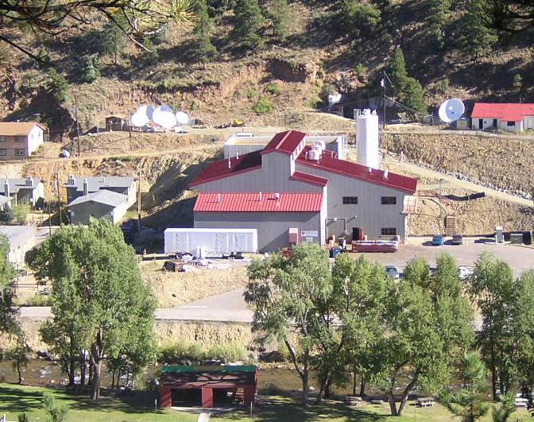
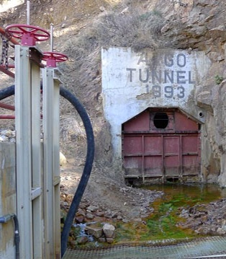
Central City/Clear Creek Site
Site Information
Notes:
Jody
Prior time – 81
Slide Time – .5
Running Total – 81.5

Slide 58
Central City/Clear Creek Site
Key Optimization Review Findings
Collection System and Treatment/Capacity
MIW collection system and 180 gpm WTP overwhelmed during high flows of groundwater and surface water
Untreated water discharged to Clear Creek
WTP Performance
Poor lime quality causes blockages and system failures
Results in discharge standards not being met
Weather
Weather conditions impact system performance and worker safety
Operations
WTP is attended less than half the day; operated remotely via laptop
Effluent Filters
Post-clarifier gravity filters commonly become clogged as WTP backwash systems do not function properly; this requires filters to be bypassed
Notes:
Jody
Prior time – 81.5
Slide Time – 2
Running Total – 83.5

Slide 59
Central City/Clear Creek Site
Key Review Recommendations
Contain Groundwater
Determine need for complete contaminated groundwater collection and treatment as well as blowout prevention to avoid untreated discharges
New Filter System
Install new automated filter presses to replace existing presses that require manual sludge movement
Improve Lime Delivery
Improve the lime delivery system to prevent blockages
Compressed Air Reliability
Provide additional compressed air capacity to improve system functionality
Essential for filter presses, waste evacuation pumps and other equipment
Consider Developing On-site Repository
To avoid the costs of disposing filter press solids at off-site landfill
Estimated 30 Year Cost Savings: $7.7M
Notes:
Jody
Prior time – 83.5
Slide Time – 2
Running Total – 85.5

Slide 60
Gilt Edge Mine Superfund Site
Site Information
Location
360-acre mining disturbed area near Lead, SD
Headwaters of cold-water fisheries and municipal water supplies of the northern Black Hills
Mine Type
Gold, copper and tungsten
initiated in 1876 and continued until late 1990s
Open pit mining and cyanide heap-leach operations
Prior mine exploration activities from various mining companies
Cleanup Status
Remedial Action stage
Interim remedies being undertaken at all three OUs while further study and final remedies are selected
WTP being operated as an interim remedy while a permanent water treatment remedy is evaluated and selected
Notes:
Jody
Prior time – 85.5
Slide Time – 2
Running Total – 87.5

Slide 61
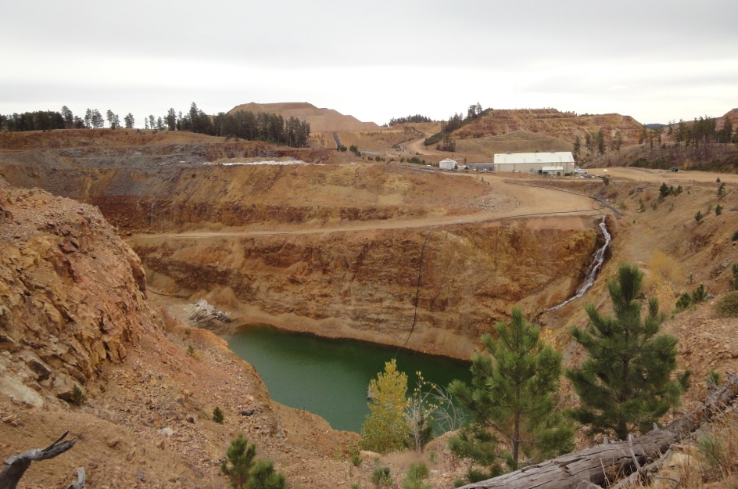
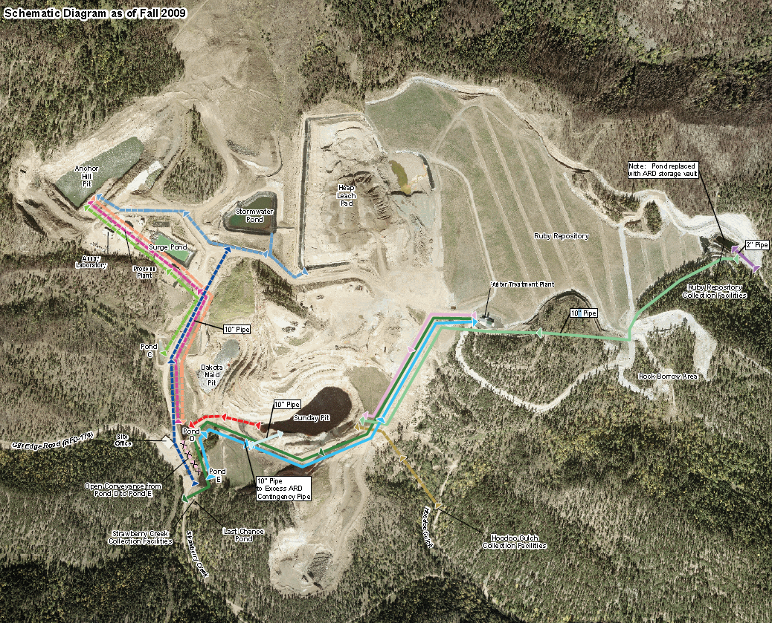
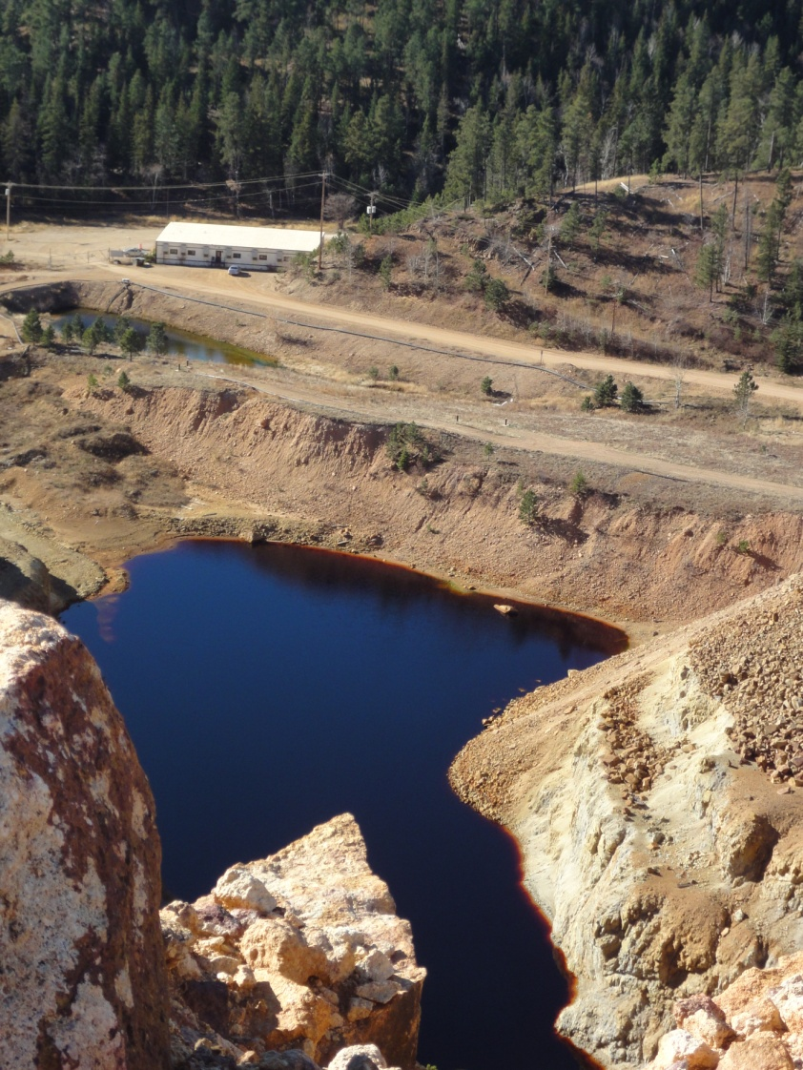
Gilt Edge Mine Superfund Site
Site Information
Anchor Hill Pit
Extensive MIW Collection & Conveyance System
Notes:
Jody
Prior time – 87.5
Slide Time – 1
Running Total – 88.5

Slide 62
Gilt Edge Mine Superfund Site
Key Optimization Review Findings
WTP
Three collection facilities capture and treat a significant portion of MIW
Continued MIW releases to surface water from un-captured seeps
WTP treats up to 325 gpm MIW to near S. Dakota surface water quality standards (SDSWQS)
Effluent Exceedances
Waiver allows selenium and total dissolved solids (TDS) discharge above SDSWQS
Cadmium exceeds SDSWQS chronic standard in creek and periodically exceeds effluent discharge limitations at WTP
Effluent periodically exceeds SDSWQS 30-day average conductivity standard
WTP Operations
WTP staffed 7 days per week, 24 hours per day with a total of 10 full-time staff
Plans exist to modify or replace WTP
Power and Fuel Costs
Electricity costs approximately $151,000 per year, for ~434 kilowatt electrical power demand
Fuel costs of $79,000 per year and propane heating costs of about $24,000 per year
Sampling and Analytical Cost
Approximately $125,000 per year for 352 samples and laboratory and reporting costs
Notes:
Jody
Prior time – 88.5
Slide Time – 2
Running Total – 90.5

Slide 63
Gilt Edge Mine Superfund Site
Key Review Recommendations
Pretreatment
Implement pretreatment for remaining high-sulfate MIW in pits
MIW Collection
Upgrade Hoodoo Gulch collection facility
Reduce Staffing Levels
Eliminate overnight staffing, reduce labor force and operate in batch mode
Reduce vehicle leases for snow removal
Reduce Sampling Frequency
Evaluate current monitoring requirements to identify savings that can be achieved by removing unnecessary or outdated monitoring requirements
Keep Existing WTP
Do not change existing WTP
Regularly evaluate collection system pumping requirements
Estimated 30 Year Cost Savings: $23.7M
Notes:
Jody
Prior time – 90.5
Slide Time – 2
Running Total – 92.5

Slide 64
Gilt Edge Mine Superfund Site
Implemented Recommendations
Installed SCADA*/Automation system; completed in the spring of 2016
  Cost approximately $950,000
  Remote operation and monitoring of MIW collection facilities and WTP
  Labor required for full time monitoring of collection facilities reduced
Overall site operations costs reduced
  From between $2M to $2.2M per year to approximately $1.5M per year
  Payback for investment will be approximately 2 years
Additional reductions from changes in contractor and contract mechanism
  Large to small business contractor
  Cost reimbursable to fixed price contract
  Outsourced oversight to U.S. Army Corps of Engineers
*SCADA = supervisory control and data acquisition
Notes:
Jody
Prior time – 92.5
Slide Time – 2
Running Total – 94.5

Slide 65
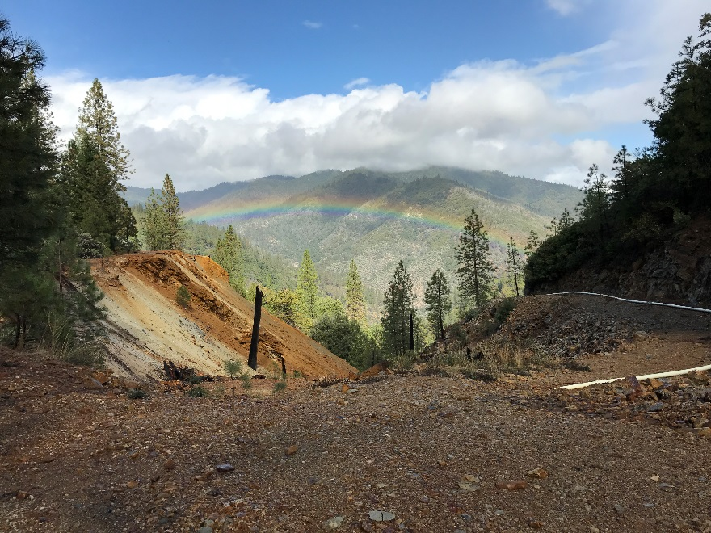
Summary
Optimization program standard EPA business practice
Standard process provides consistent review outcomes
Reviews improving performance of mine sites nationwide
  Improved effectiveness / protectiveness
  Solutions to complex site problems
  Increased stakeholder collaboration
  Advance progress toward closure
  Reduced costs
Lessons learned driving innovation in best practices for mine site characterization and remediation
Shasta Lakes Mining District, CA
Notes:
Kirby
Prior time – 94.5
Slide Time – 2
Running Total – 96.5

Slide 66

Questions
Kirby Biggs
National Optimization Coordinator
Office of Superfund Remediation and Technology Innovation
biggs.kirby@epa.gov
(703) 823-3081
Jody Edwards, P.G.
Principal Hydrogeologist
Optimization Services Leader
Tetra Tech Inc.
(802) 288-9485
jody.edwards@tetratech.com

