Slide 1
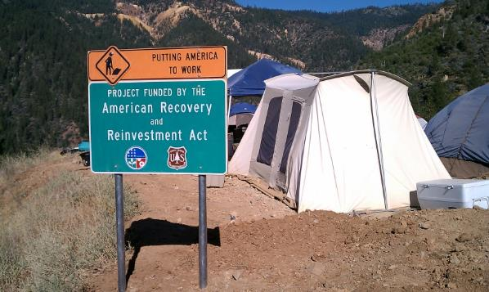
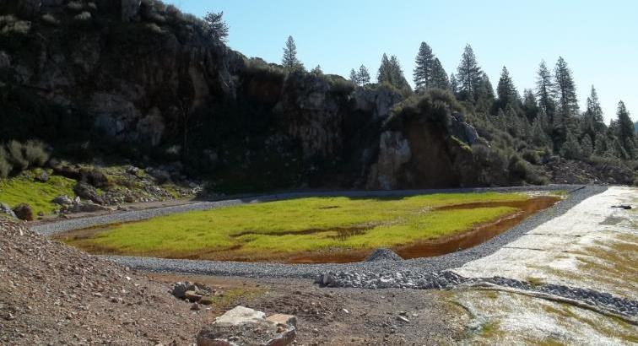
BIOCHEMICAL REACTOR CONSTRUCTION, MINE POOL CHEMISTRY CHANGES, & O & M GOLINSKY MINE, CALIFORNIA
Passive Treatment of Mining Influenced Water:
From Bench Scale to O & M
Jim Gusek, Sovereign Consulting Inc., and
Rick Weaver, US Dept. of Agriculture, Forest Service

Slide 2
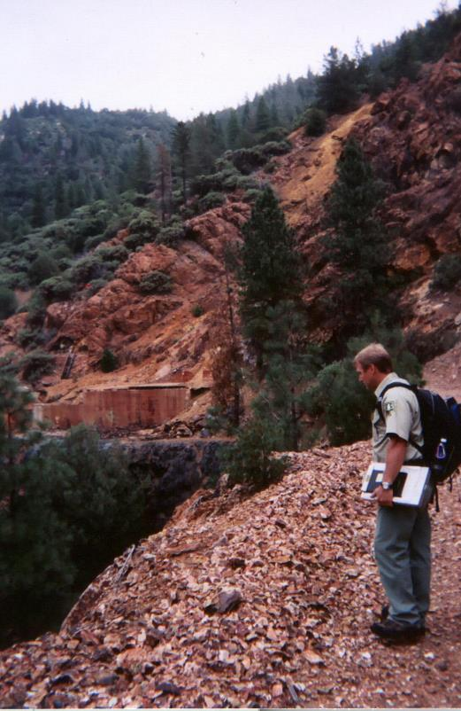
Golinsky Mine, Trinity National Forest
BCR Design & Construction
Mine Pool Improvements
Operation & Maintenance
Notes:
1937 closed, copper zinc mine with some precious metals 3 –adits, two are sealed off with bulkheads – third flows continuously all year. Two parts to the presentation BCR & Mine Pool changes

Slide 3
Site Location & Project History
Site/Project History
Mine Operates 1904 to 1938 (copper & gold)
USFS acquires property in 1944 through purchase
2004 - Bench Test Construction & Operation
2004 – Design/build buried pipeline
2004 – 2006 Pilot Scale Construction & Operation
2006 – Pilot decommissioning
2007 - Full Scale Module 1 Design
2010 – Full Scale Construction
2011 – Full Scale Start-up
2012-2016 Vicinity Drought
2016 – O&M Activity
Notes:
Mine location, limestone quarry, trip across lake, Show pipeline route
Railroad to mine was submerged when the lake began to fill in 1944. No place to build a passive treatment system full scale or otherwise, at the mine. There is adequate space at the abandoned limestone quarry.

Slide 4
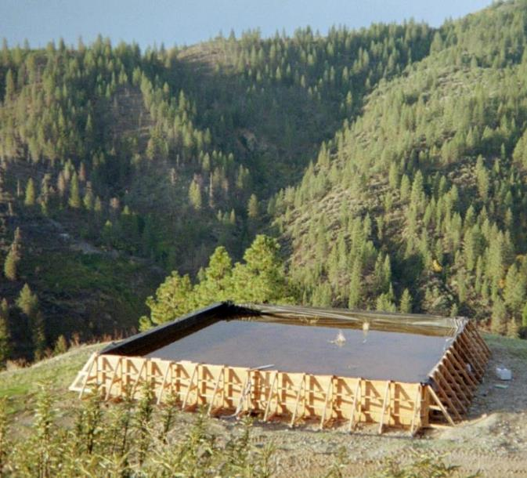
Bench Test & Pilot Test Setup
Modified Auto Sampler
4 Bench BCRs
ARD Holding Tank
17 Weeks Bench Flow Range:
8.5 to 16.4 Liters/day
Pilot Average Flow:
0.9 gpm

Slide 5
Mine Water Chemistry – Pilot Testing
Influent Water (Lower Portal)
pH – 2.7
Fe – 73 mg/L
Al – 23 mg/L
Mn – 0.85 mg/L
Zn – 37 mg/L
Cu – 12 mg/L
Ni – 0.031 mg/L
Cd – 0.47mg/L
SO₄ – 664 mg/L
Pilot BCR
Effluent
pH – 7.2
Fe – 0.8 mg/L
Al – 0.06 mg/L
Mn – 2.5 mg/L
Zn – 0.1 mg/L
Cu – <0.003 mg/L
Ni – 0.007mg/L
Cd – 0.006 mg/L
SO₄ – 488 mg/L

Slide 6
Passive Treatment Chemistry 101
SO₄⁻² + 2 CH₂O HS⁻ + 2HCO₃⁻ + H⁺
(Sulfate reduction and neutralization by bacteria)
Zn⁺² + HS⁻ ZnS (s) + H⁺
(Sulfide precipitation)
Fe⁺³ + 3 H₂O Fe(OH)₃ (s) + 3 H⁺
(Hydroxide precipitation)
H⁺ + CaCO₃ Ca⁺² + HCO₃⁻
(Limestone dissolution)
REDUCING/
ANAEROBIC CONDITIONS
OXIDIZING CONDITIONS
ALL
CONDITIONS

Slide 7
Module 1 Design Chemistry
Parameter | Lower Portal Estimate for Design (2007 data) |  | Lower Portal (Pilot average for 27 months - 2004 to 2006)
Flow, L/min | 37.8 |  | 3.6
Flow, gpm | 10 |  | 0.9
pH S.U. | 3.0 |  | 2.7
Fe, mg/L | 27 |  | 73
Cu, mg/L | 14 |  | 12
Zn, mg/L | 67 |  | 37
Cd, mg/L | 0.73 |  | 0.47
Al, mg/L | 31 |  | 23
Mn, mg/L | 0.42 |  | 0.85
Sulfate mg/L | <500 |  | 664

Slide 8
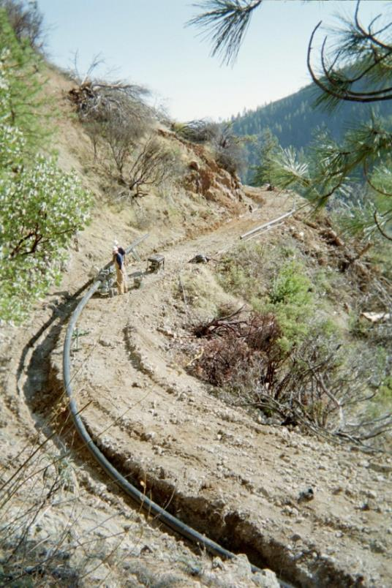
Mine, Pipeline, and Abandoned Limestone Quarry

Slide 9
Phased Module Implementation
Portal flow data suggests peak of 90 gpm during wet months
No available space at the mine site itself
Available space at the quarry only has room for 30 gpm
Site access is restricted; it’s difficult to build full PTS capacity in a single construction season
Limited funding supports design of 10 gpm “starter” module and monitor to see if addition modules are necessary

Slide 10
Overall Design Philosophy
All flows by gravity
Biochemical reactor sized for 10 gpm / 38 liters minute
Any by-passed flow (>10 gpm) would be neutralized by treated water in a mixing pond
Mixing pond effluent would be infiltrated into native ground in a “Flow Dispersion Zone”
“Tweak” substrate recipe based on experience at other sites

Slide 11
BCR Substrate Modification
Component | Pilot BCR | Full BCR
Rice Hulls | 10% | 10%
Wood Chips | 40% | 50%
Hay | 10% | 10%
Limestone | 30% | 30%
Manure¹ | 10% | <0.1%
Manure (and 6 cy of depleted pilot substrate) rototilled into upper 12 inches of substrate

Slide 12
Construction Challenges
Lake levels are the lowest in years due to drought
Good news: mobilization site close to Shasta Dam (2.4 miles from beach head)
Bad news: off-loading barges will be difficult on sloping shore at beach head
Drought ends from El Nina rains as bid walk is conducted (March 2010)
Lake levels rise, and rise, and rise some more…
Preferred mobilization site is submerged; alternate site is 6.9 miles from beach head

Slide 13
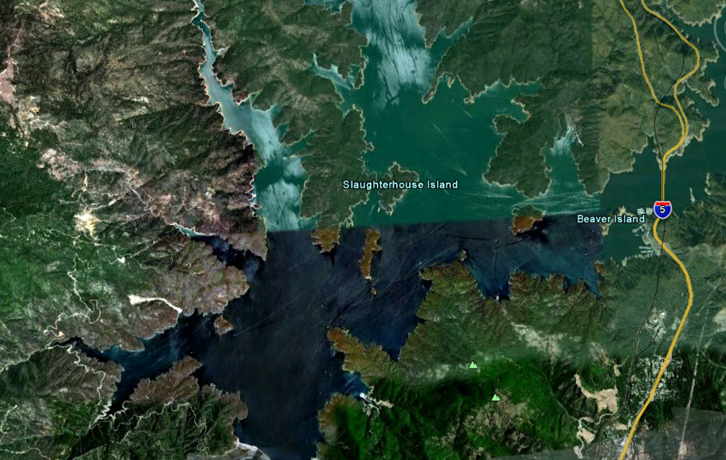
Lake level recovery: too much of a good thing
Final Contractor Mobilization Site
(6.9 miles)
Mine
Quarry
Beach head
Dam
Initial Contractor Mobilization Site (2.4 miles)

Slide 14
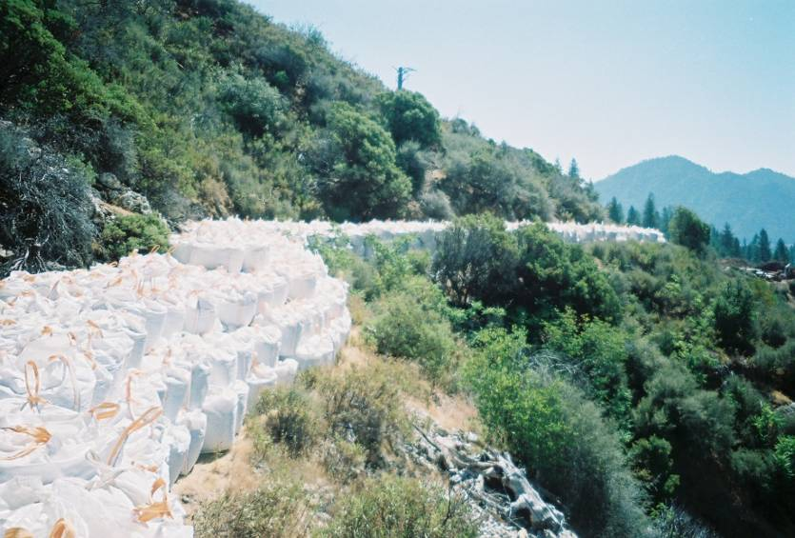
Construction Challenges (Continued)
Storing materials at a very constricted site

Slide 15
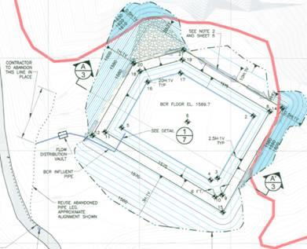
Construction Challenges (Continued)
Ground conditions in one corner of the quarry require field modification
BCR Footprint reduced by 3.6%

Slide 16
Construction Challenges (Continued)
Delayed start due to weather and storm water BMP’s puts project behind schedule and reduced available construction budget
Ground conditions in the mixing pond footprint spook contractor
Mixing pond is dropped from the contractor’s work scope (see paper [Gusek, 2011] for details)
Flow Dispersion Zone design is modified to minimize imported riprap

Slide 17
Golinsky BCR Construction, 2010 (with ARRA Funding)
Construction Cost: $1.3 million (about $0.012 per gallon for 20-yr life)
Notes:
BCRs are typically configured with raw water fed to the top of the cell and treated water flowing out the bottom. Kind of like a Brita filter.(click)
Here are some photos of the full-scale BCR under construction: The pipe collection network on the floor of the BCR, [click], covered with limestone gravel [click] all covered with the organic media comprised of wood chips, rice hulls, crushed limestone inoculated with composted cow manure. (click)

Slide 18
Final BCR As Built (January, 2011)

Slide 19
BCR Module 1 Commissioning Challenges
Portal 3 is the only mine pool plumbed into the quarry when the BCR is ready for commissioning (we used it for soil moisture, dust control)
Portal 3 sulfate concentration is only 8 to 10 mg/L
Lower Portal pipeline is plugged with iron precipitates;
Inclement weather prevented LP maintenance and the BCR filled with rain water
Solutions
Added 20 lbs or 9.1 kg of Epsom salt to BCR inflow
Added a 30 lbs or 13.4 kg “teabag” of agricultural gypsum to flow distribution vault
Influent sulfate 14 mg/L; effluent 4 mg/L
Lower Portal plumbed in January 25th 2011, no “transition” (sulfate @1,127 mg/L; pH 2.7)

Slide 20
BCR Receiving Lower Portal MIW (May 2011)

Slide 21
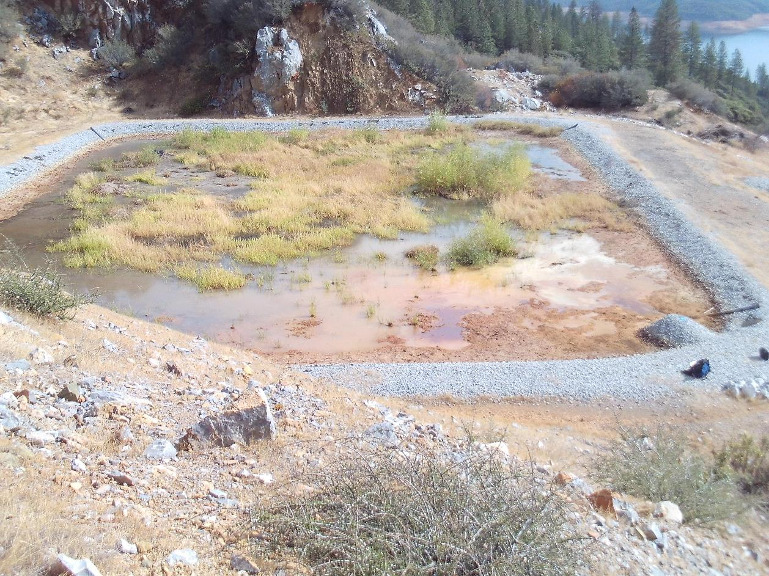
BCR Receiving Lower Portal MIW (October 12, 2016)
Intruding Willows Removed

Slide 22
BCR Results (6 Lower Portal MIW events)
Parameter | Influent | Effluent
pH | 2.7 s.u. | 6.45 s.u.
Iron | 97.2 mg/L | 6.1 mg/L
Aluminum | 28.6 mg/L | 0.03 mg/L
Copper | 19.3 mg/L | 0.005 mg/L
Zinc | 40.0 mg/L | 0.5 mg/L
Cadmium | 0.40 mg/L | 0.005 mg/L
Calcium | 19 mg/L | 206 mg/L
Manganese | 0.6 mg/L | 2.1 mg/L
Sulfate | 728 mg/L | 324 mg/L
ORP | 354 mv | -217 mv
97% metal removal efficiency in May 2011

Slide 23
PART II
PORTAL 3 MINE POOL IMPROVEMENTS

Slide 24
Full Scale Passive System Schematic Layout
ARD
Notes:
Original plans were to treat all three MIW sources

Slide 25
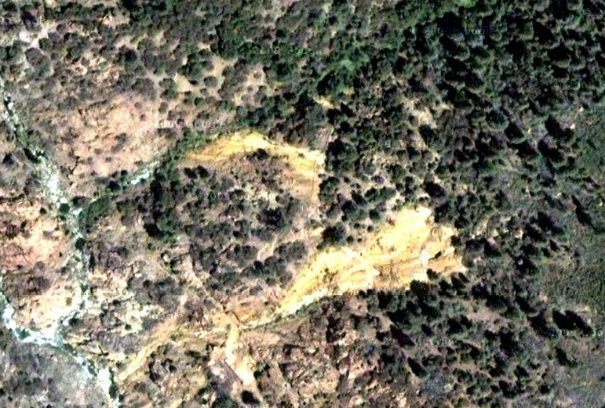
Portal 3 and Lower/Upper Portal Proximity
Portal 3
?
Drainage Swale
300 FT
ARD
Upper
Portal
?
?
Lower
Portal
Little Backbone Creek
Notes:
Portal 3 and the Lower Upper Portals are about 300 ft (100 meters) apart

Slide 26
Changes in Portal 3 Chemistry 2004-2016
Lower Portal Mine Pool
Drain-down begins
2004

Slide 27
Changes in Portal 3 Chemistry 2004-2016
2005

Slide 28
Changes in Portal 3 Chemistry 2004-2016
2006

Slide 29
Changes in Portal 3 Chemistry 2004-2016
2007

Slide 30
Changes in Portal 3 Chemistry 2004-2016
2009

Slide 31
Changes in Portal 3 Chemistry 2004-2016
October 12,
2016

Slide 32
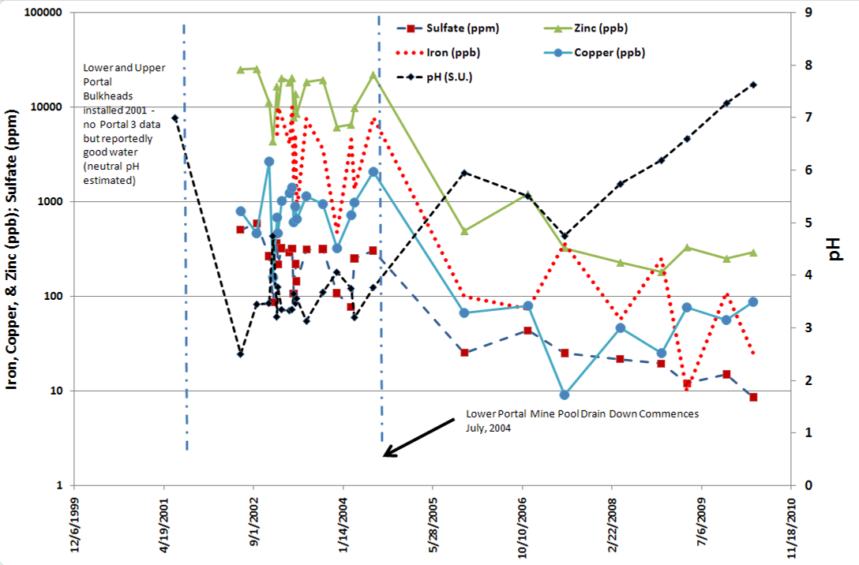
Portal 3 Water Chemistry Improvements
0.07 to 0.11 gpm of Lower Portal MIW satisfies metal load
in Portal 3 based on sulfate, zinc, and copper

Slide 33
Final Thoughts (Parts I & II)
Construction Cost: $1.3 million – ARRA funding with supplementary USFS funds
Seven year span from initial bench tests in late 2003 to startup in late 2010 – fully commissioned in June 2011
Safety record exemplary for remote site, heat stress, multiple water crossings
After five years, system appears to be performing as intended – no surprises (yet)
No ill effects due to prolonged drought

Slide 34
PART III
OPERATION & MAINTENANCE

Slide 35
BCR Commissioned in June 2011 & function as designed through 2012

Slide 36
In 2012 following dry season, flow data logger malfunctioning at BCR

Slide 37
Equipment mobilized to site with Landing Craft

Slide 38
Influence of vegetation potentially adversely affecting iron removal

Slide 39
Mini excavator used to pull willows

Slide 40
Mini excavator moving vegetation removed from BCR

Slide 41
BCR after willow removal

Slide 42
Repairing BMPs on access road using hand tools and mini excavator

Slide 43
Clearing access road of vegetation

Slide 44
Pipelines from Lower adit. Iron hydroxide sludge blockage

Slide 45
Upper Adit Link Seal and Stainless Steel Flexible Coupling installed to repair leak & stabilize pipe at bulkhead

Slide 46
Leak at Saddle Tee on Upper Adit Pipe Repairing Saddle Tee with Romax Clamp

Slide 47
Trash bag stuck in pipe causing plug

Slide 48
Lower Adit Bat Gate Sock Filter over Floor Drain

Slide 49
Winter to summer flow rate decrease from 4.5 gpm to 1.5 gpm between April 25 and June 6, 2016. Estimated cumulative total of 233,000 gallons received by the BCR.

Slide 50
Changing battery in data logger at BCR influent flume. Flow was 0.75 GPM on 10/12/16

Slide 51
Pipes replaced due to excessive iron hydroxide deposition

Slide 52
BCR at low water level on October 16, 2016 at end of dry summer

Slide 53
BCR on October 19, 2016 after 4 to 5 inches of rain in four days

Slide 54
Mass Removal Rates from Spring Monitoring

Slide 55
Conclusion of Spring Monitoring Report
Monitoring observations and data collected by ECM have concluded that the BCR is operating within design parameters and is effectively removing metals from mine impacted water.
The BCR appears to be treating the mine drainage successfully and the efficiency of removal for aluminum, cadmium, and copper is close to 100%, with zinc near 83% removed.

Slide 56
Are the exposure assumptions, toxicity data, cleanup levels, Removal Action Objectives used at the time of the removal action (RA) still valid?
Reduce or eliminate the release of acidity and heavy metals from the Site to surface water and meet ARARs,
Reduce or eliminate the release of acidity and heavy metals to from the Site to groundwater and meet ARARs, and
Reduce or eliminate the potential for exposure to humans, aquatic and terrestrial biota from ingestion or direct contact with AMD and potentially contaminated aquatic life.
Data indicate that the BCR is effective at treating MIW at the design flow rate of 10 gpm. The exposure assumptions, toxicity data, cleanup levels, and RAOs used at the time of the RA are still valid & the BCR system that was installed is protective.

Slide 57
Storm water runoff in swale only MIW discharged from site

Slide 58
Final Thoughts
Phased design approach minimizes risk
Bulkheading underground mine workings is not always a good idea (ARD is going to find its way out)
Passive treatment is LOW maintenance, not NO maintenance
Removal Action assumptions still valid; BCR system is protective
Special thanks to:
Brad Shipley (ret.), USFS P.O. 2003? to 2016, and
ECM Consultants, the current site monitoring and O & M contractor

Slide 59
Questions/Discussion??

