Slide 1


Passive Treatment of Mining-Influenced Water:
From Bench Scale to O&M
Amy G. Wolfe
Trout Unlimited
Director – Eastern Abandoned Mine & PA Coldwater Habitat Restoration Programs
awolfe@tu.org
www.tu.org
Dr. Robert Hedin
Hedin Environmental
President
bhedin@hedinenv.com
www.hedinenv.com

Slide 2
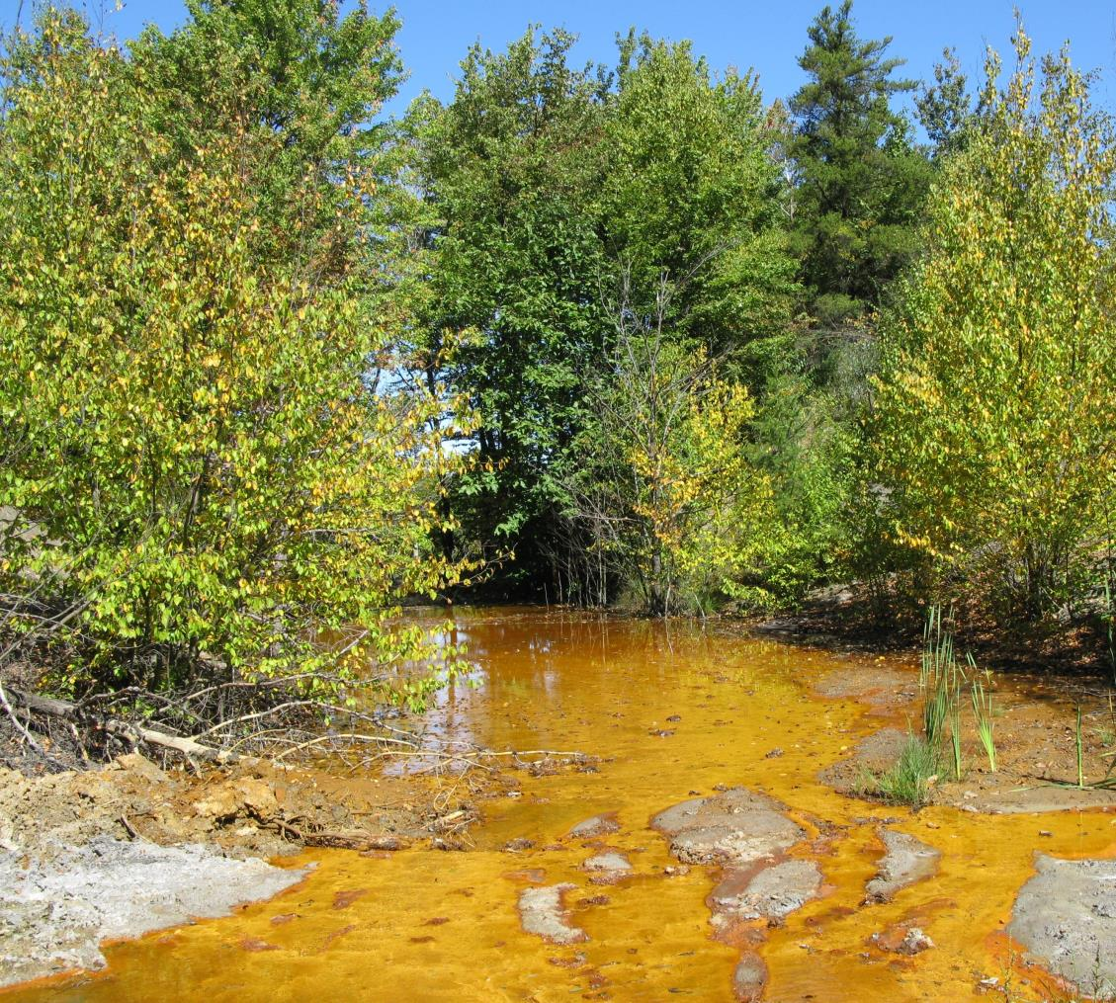
Abandoned Coal Mine Drainage
Abandoned
Site mined prior to 1977 Surface Mining Control & Reclamation Act (SMCRA)
Before SMCRA, little to no requirement for coal miners to reclaim land or treat polluted water
Coal mine drainage
Water that has become polluted by flowing through unreclaimed coal mines
Often called abandoned mine drainage (AMD)
AMD is commonly acidic (pH 2-4) with high metals such as iron and aluminum
AMD creates habitat unsuitable to support fish and other aquatic life
Notes:
Amy gives slide
Research what the funder wants: Find out everything you can about the funding entity, strategic plans/resource management plans/mission/etc, look into other projects that were funded (is funder big on partnerships, supporting innovative technology, does not like to fund salary/admin so all in-kind/match), geographic focus area, who will be reviewing (technical background? If not, will have to drum down the proposal) etc.
2

Slide 3
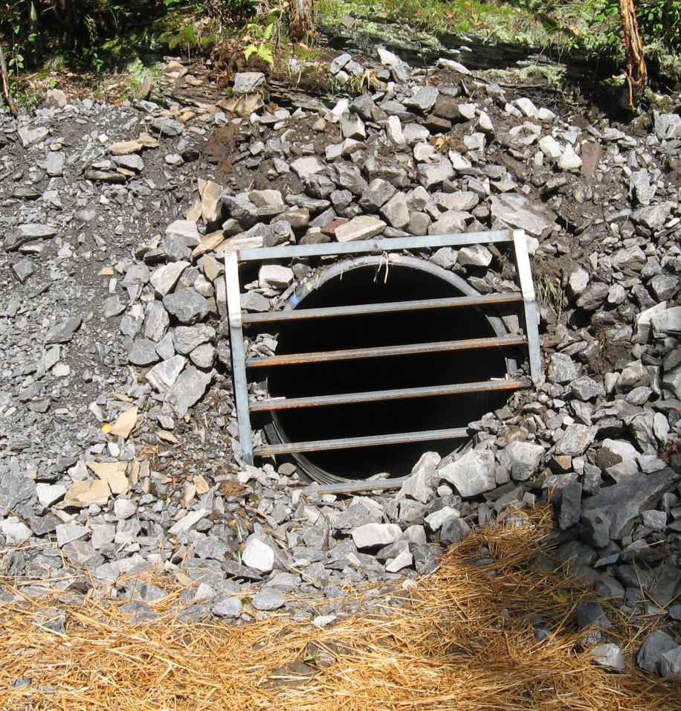
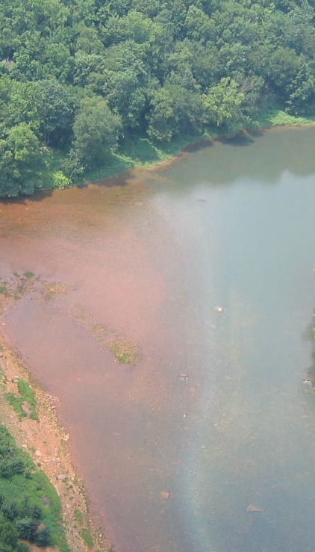
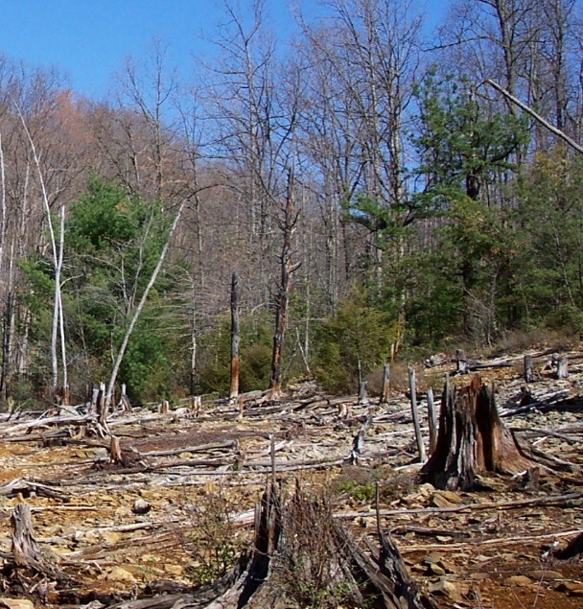
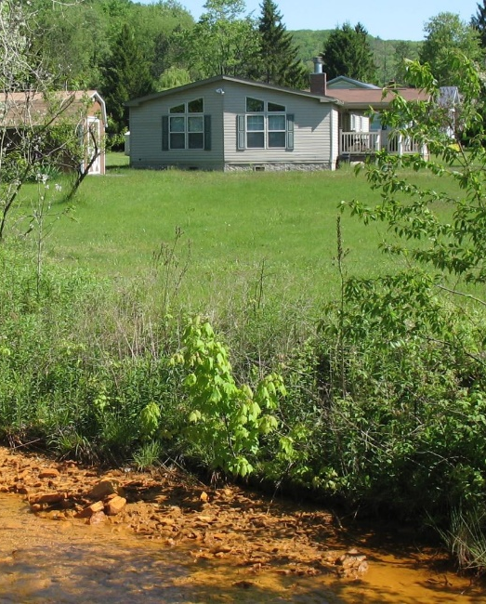

Slide 4
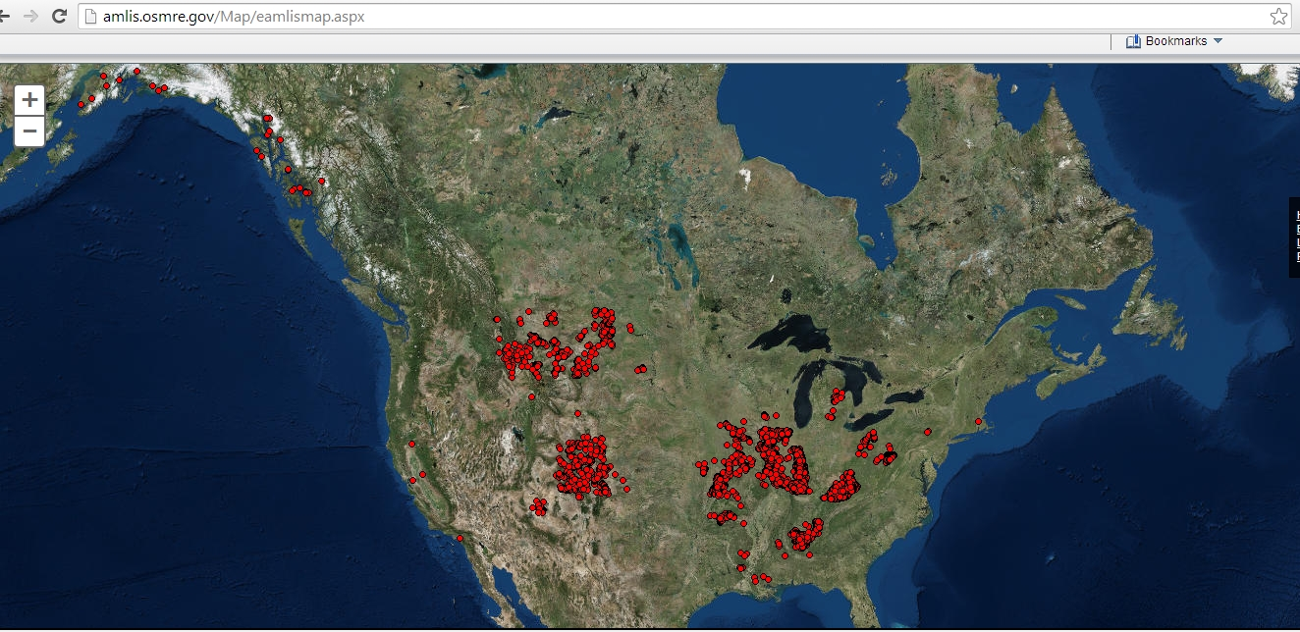
Abandoned coal mines are a nationwide problem – more than 10,500 mi polluted streams just in PA and WV
Notes:
Amy gives slide
Research what the funder wants: Find out everything you can about the funding entity, strategic plans/resource management plans/mission/etc, look into other projects that were funded (is funder big on partnerships, supporting innovative technology, does not like to fund salary/admin so all in-kind/match), geographic focus area, who will be reviewing (technical background? If not, will have to drum down the proposal) etc.
4

Slide 5
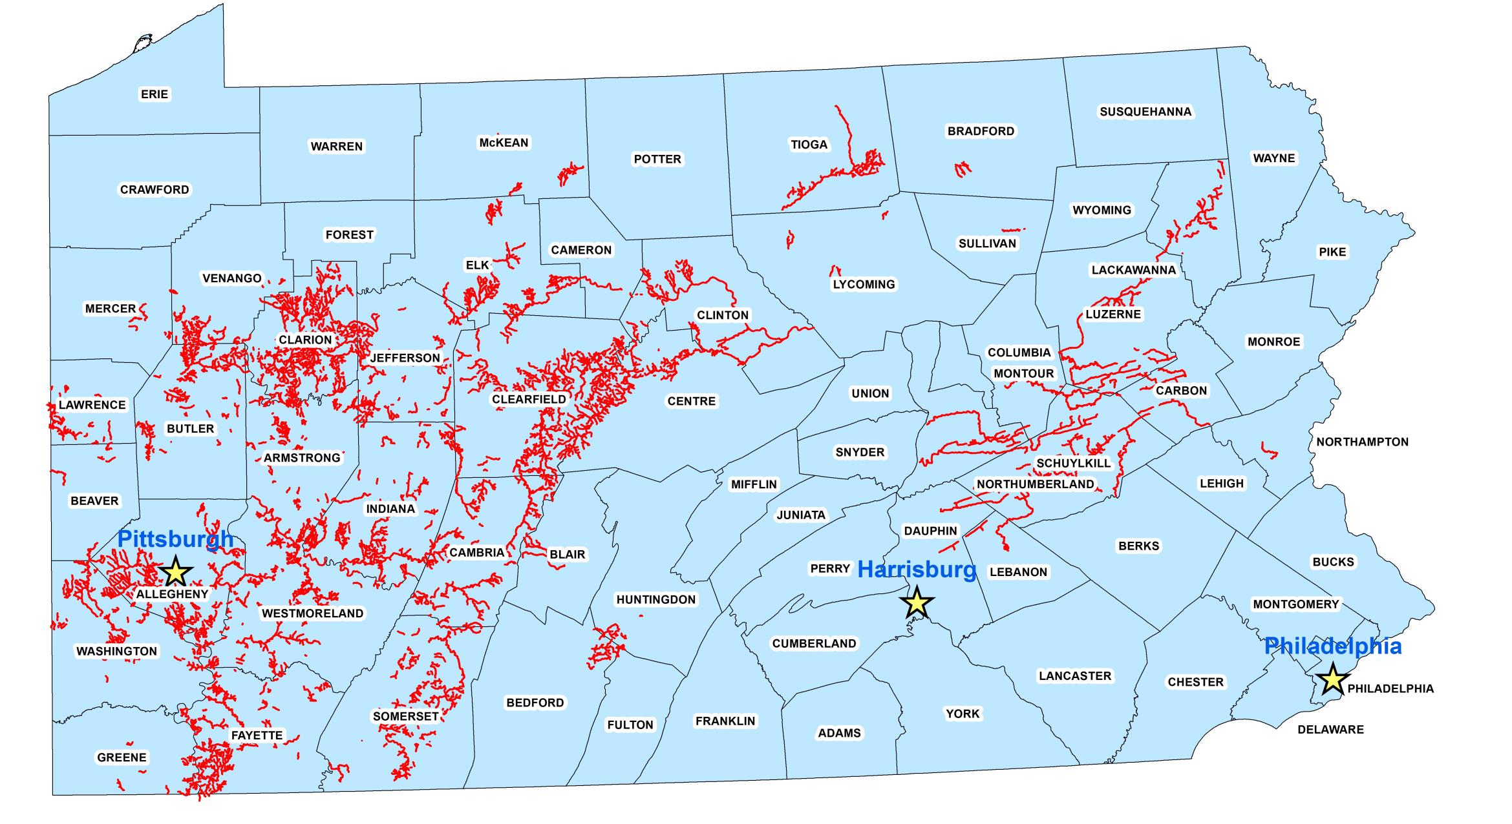

Slide 6
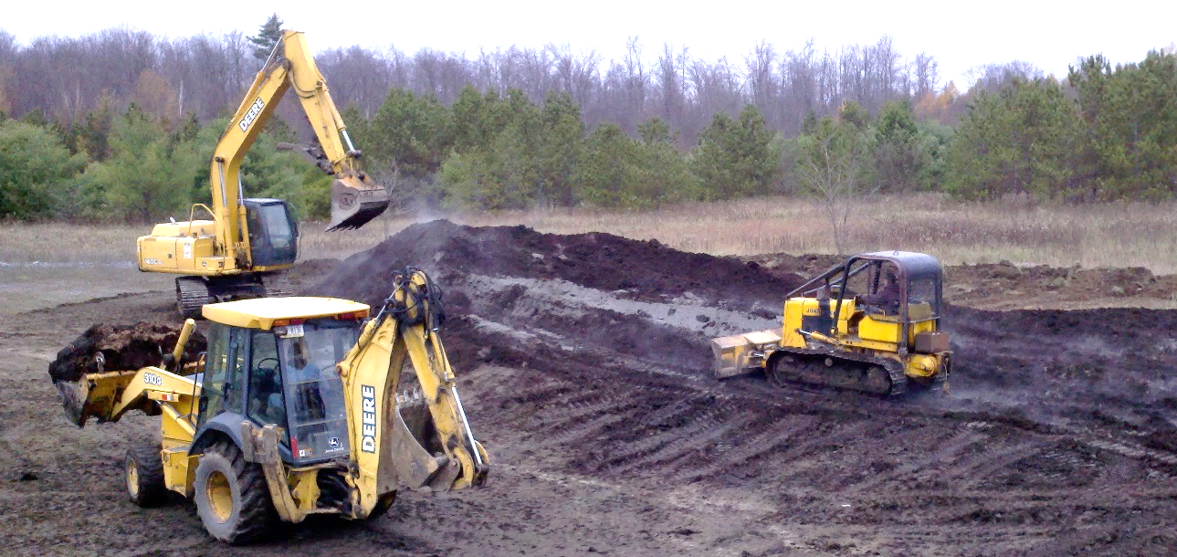
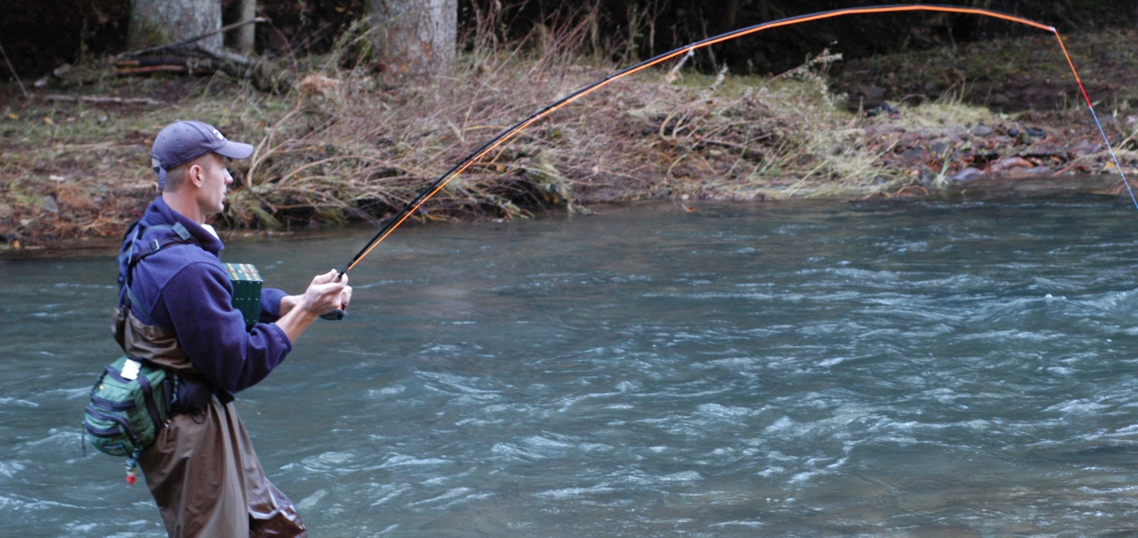
Cleaning up abandoned mines generates jobs –
Important to local, regional, and state economies
For every $1 spent on remediation, an additional $1.36 circulates through the local economy (multiplying factor)
Area property values increase ($2600 lost per acre for property adjacent to polluted stream)
Sport fishing opportunities and recreational spending increase ($20 million annually)
Drinking water supply options become cheaper and more plentiful

Slide 7
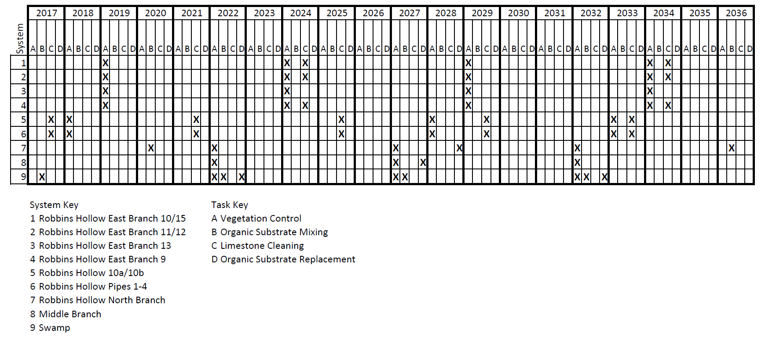
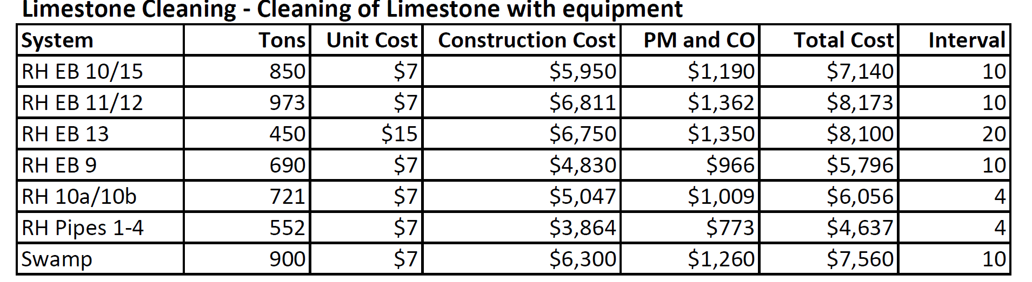
Long-term operation, maintenance, and rehab provides economic benefits
Develop schedule of OM&R activities over 20-yr period
Break down individual activity costs and intervals
Categorize and annualize all costs

Slide 8
Jobs analysis - Long-term OM&R
What would it would cost to fund a 20-year trust that would cover the necessary OM&R activities for 250 passive treatment systems across PA not eligible for funding from Title IV AML Set-Aside Fund?
Result: Fully funded 20-year trust would range from $39 million up to $47 million
Type I and Type II Regional Input-Output Modeling Systems utilized
Estimated annual cost of ongoing maintenance at all modeled sites throughout Pennsylvania totals $2.8 million (average of $11,200 per site per year).
OM&R expenditures would support 34 jobs per year
Notes:
Original workgroup was formed because DEP expected large investment through Growing Greener to build new treatment systems.
Final bullet – range is based on projected number (if any) of new treatment systems over the next 20 years

Slide 9
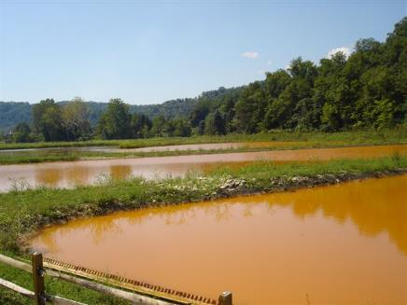
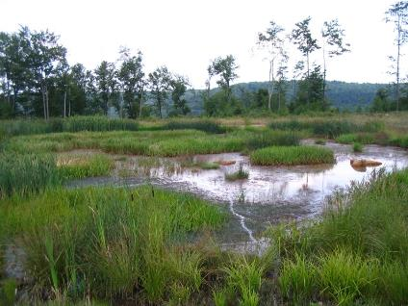
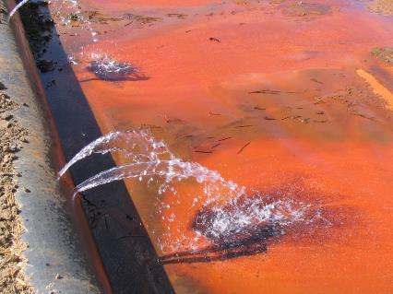
Passive Treatment of Coal Mine Drainage

Slide 10
Common Passive Technologies Used in the Eastern US for Coal Mine Drainage
Ponds
  oxidize Fe, settle solids, mixing
Constructed Wetlands
  polishing ,Mn and solids removal
Anoxic limestone beds
  alkalinity generation
Oxic limestone beds
  alkalinity generation, metal removal, polishing
Vertical flow ponds
  alkalinity generation and metal removal

Slide 11
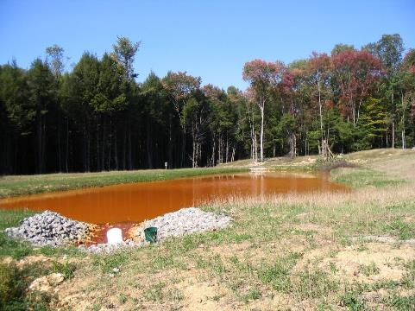
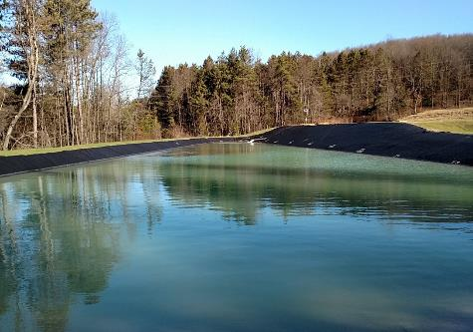
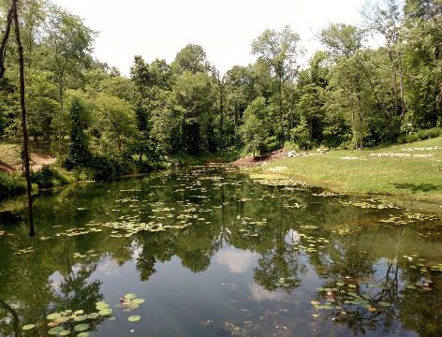
Ponds

Slide 12
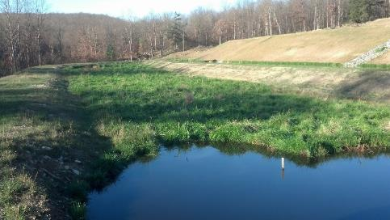

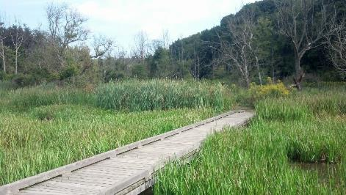
Constructed Wetlands

Slide 13
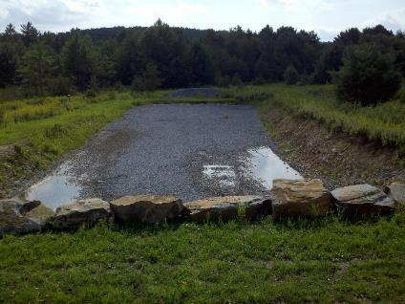
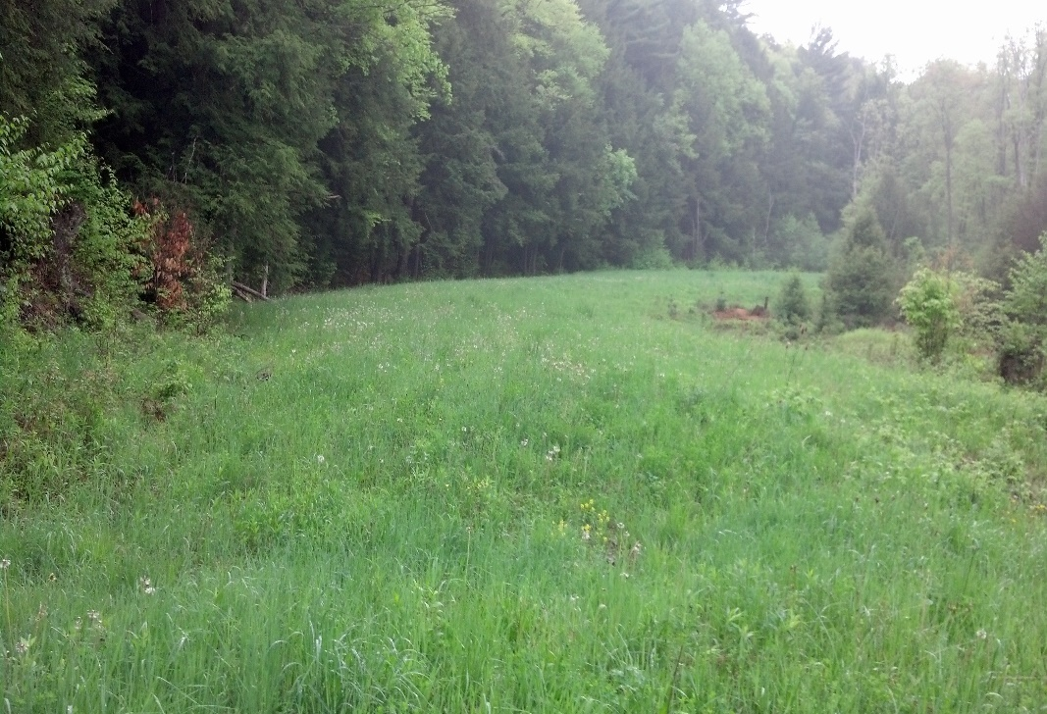
Limestone Beds
oxic
anoxic

Slide 14
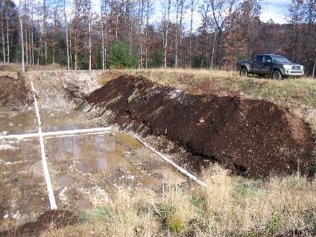
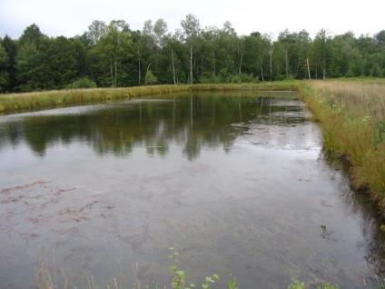
Vertical Flow Pond

Slide 15
Technology is based on chemistry
Sizing is based on loadings

Slide 16
Characterize Mine Water
Net alkaline
Net acid
DO, Fe³⁺, Al all < 1 mg/L
(high Fe²⁺)
DO, Fe³⁺, Al any > 1 mg/L
DO, Fe³⁺, Al any > 1 mg/L
Fe < 10 mg/L
Anoxic Limestone Bed
High Fe²⁺
Net
Alkaline
Net acid
Ponds
Ponds
Vertical Flow Pond
Oxic Limestone Bed (drainable)
Repeat As Needed
Wetland
Ponds
Ponds
Mn
Wetland
Oxic Limestone Bed
Mn
Final Discharge

Slide 17
Characterize Mine Water
Net alkaline
Net acid
DO, Fe³⁺, Al all < 1 mg/L
(high Fe²⁺)
DO, Fe³⁺, Al any > 1 mg/L
DO, Fe³⁺, Al any > 1 mg/L
Fe < 10 mg/L
Anoxic Limestone Bed
High Fe²⁺
Net
Alkaline
Net acid
Ponds
Ponds
Vertical Flow Pond
Oxic Limestone Bed (drainable)
Repeat As Needed
Wetland
Ponds
Ponds
Mn
Wetland
Oxic Limestone Bed
Mn
Final Discharge

Slide 18
Treatment of Net Alkaline Mine Water
Generation of alkalinity not required
Al is always < 1 mg/L
Fe and Mn removal by oxidizing processes

Slide 19
Characterize Mine Water
Net alkaline
(Fe and Mn)
Net acid (Fe, Al and Mn)
DO, Fe³⁺, Al all < 1 mg/L
(high Fe²⁺)
DO, Fe³⁺, Al any > 1 mg/L
DO, Fe³⁺, Al any > 1 mg/L
Fe < 10 mg/L
Anoxic Limestone Bed
High Fe²⁺
Net
Alkaline
Net acid
Ponds
Ponds
Vertical Flow Pond
Oxic Limestone Bed (drainable)
Repeat As Needed
Wetland
Ponds
Ponds
Mn
Wetland
Oxic Limestone Bed
Mn
Final Discharge

Slide 20
Treatment of Net Acidic Mine Water
Neutralize acidity
  Calcite dissolution
  Bacterial processes in organic substrate
Remove metal contaminants
  Al, Fe, Mn, others
  Primary removal as oxide and hydroxide solids
  Secondary removal as sulfides and carbonates

Slide 21
Characterize Mine Water
Net alkaline
(Fe and Mn)
Net acid (Fe, Al and Mn)
DO, Fe³⁺, Al all < 1 mg/L
(high Fe²⁺)
DO, Fe³⁺, Al any > 1 mg/L
DO, Fe³⁺, Al any > 1 mg/L
Fe < 10 mg/L
Anoxic Limestone Bed
High Fe²⁺
Net
Alkaline
Net acid
Ponds
Ponds
Vertical Flow Pond
Oxic Limestone Bed (drainable)
Repeat As Needed
Wetland
Ponds
Ponds
Mn
Wetland
Oxic Limestone Bed
Mn
Final Discharge

Slide 22
Long-term Performance and Costs: Marchand System
Case Studies

Slide 23
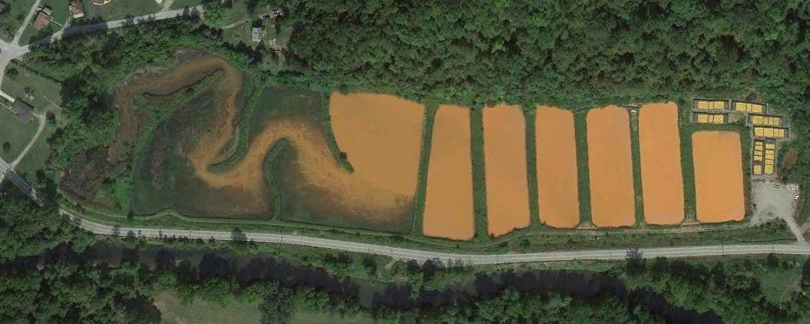
Marchand Passive System (Westmoreland County)
FeOOH recovered
in 2012
Wetland
Pond F
Pond E
Pond D
Pond C
Pond B
Wetland
Wetland
Pond A
Sewickley Creek
influent

Slide 24
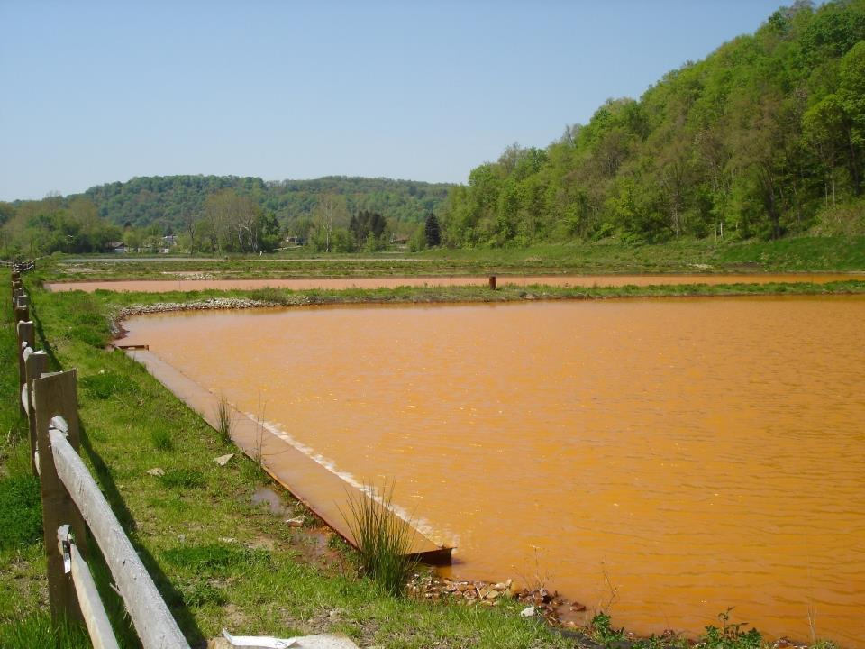
Net Alkaline Mine Water
Fe²⁺ + HCO₃⁻ + O₂ → FeOOH + H₂O + CO₂

Slide 25
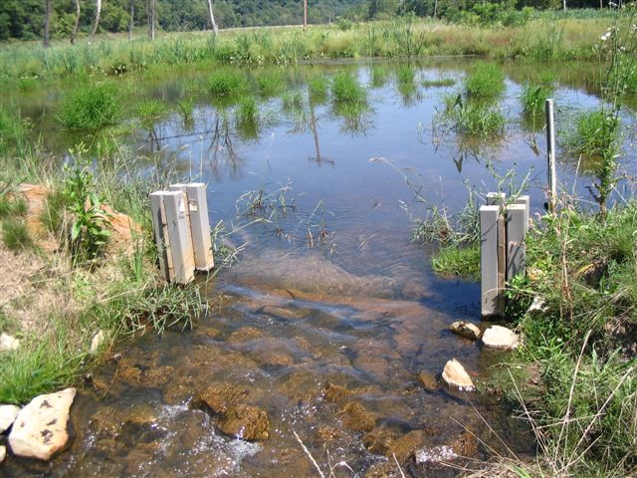

Slide 26
Marchand Time Line
Year | Activity
2000 | Grant to assess feasibility
2004 | Grant for design, permitting, construction
2006 | System operational
2010 | Berm repairs and pipe cleanout
2012 | Sludge removal and trough installation (3 ponds)
2016 | Trough installation (3 ponds)

Slide 27
Marchand system, Oct 2006 – April 2016
 | Flow | pH | Alk | Fe | Al | Mn | SO₄ | TSS
 | gpm | s.u. | --------------- mg/L -----------------
Inflow | 1,870 | 6.3 | 334 | 71.6 | <0.1 | 1.2 | 1,141 | 26
Effluent | na | 7.7 | 218 | 1.1 | <0.1 | 0.5 | 1,163 | <6

Slide 29
Operation and Maintenance
Routine inspections and sampling
  Quarterly, ½ day
System improvements
  Berm reinforcement; trough installations
Sludge management
  750,000 gallon/year sludge
  ~5% of pond volume

Slide 30
Sludge Management: 2012
Cleaned first three ponds
Installed bypass system to enable pond dewatering and continuous treatment
Replaced three problem pipes with open troughs

Slide 31
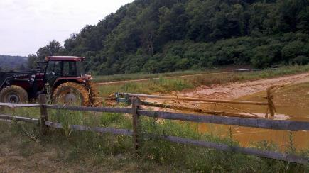
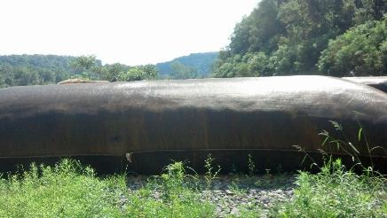
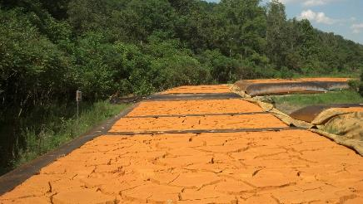
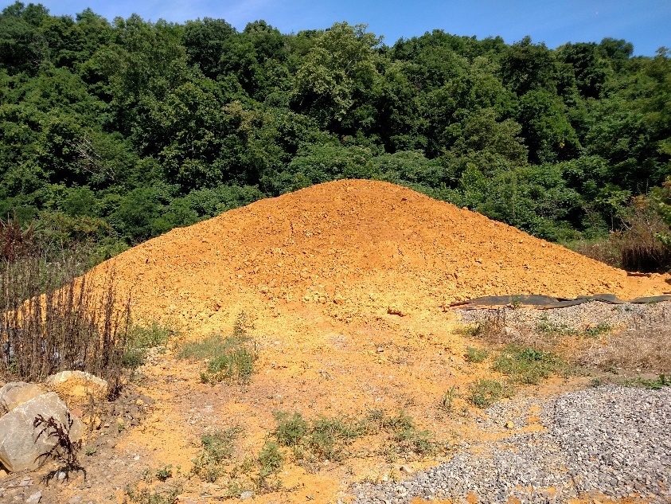

Slide 32


Elemental composition of solids
Al | C | Ca | Fe | K | Mg | Mn | Na | P | S | Si | LOI
% | % | % | % | % | % | % | % | % | % | % | %
0.2 | 0.7 | 0.6 | 52.6 | < 0.1 | 0.1 | < 0.1 | 0.1 | < 0.1 | 0.2 | 0.9 | 17
Solids are ~50% Fe and are mixture of FeOOH and Fe(OH)₃
Concentrations of hazardous metals all below limits in EPA Part 503 Biosolids rule
Solids have value as pigment and for remediation purposes

Slide 33
Marchand costs, 2000 – 2016
(1,850 gpm, 72 mg/L Fe)
Year | Cost | Activity
2000 | $105,000 | Treatment feasibility (PA DEP Grant)
2004 | $1,282,000 | System design, permitting, and construction
2010 | $15,000 | Berm repairs and pipe cleaning
2012 | $87,935 | Sludge removal (3 ponds); trough and bypass installation
2016 | $18,000 | Trough installation and repairs
Annual | $3,000/yr | Hedin Environmental and Sewickley Creek Watershed Association, quarterly inspections and routine maintenance
Periodic |  | Remove iron sludge every 7-10 years

Slide 34
Long-term Performance and Costs: Anna S Passive System Complex
Case Studies

Slide 35
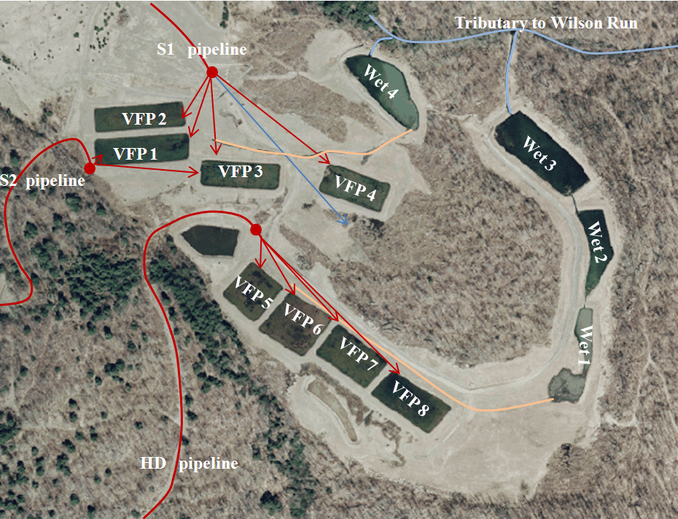

Slide 37
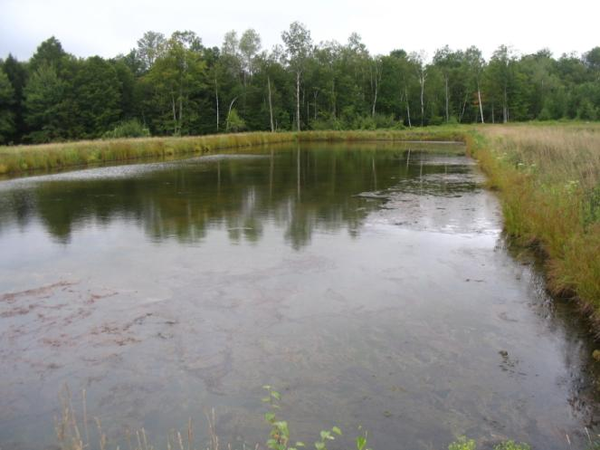
Acidic Mine Water
CaCO₃ + H⁺ → Ca²⁺ + HCO₃⁻
Fe³⁺ + Al³⁺ + HCO₃⁻ → FeOOH + Al(OH)₃
SO₄²⁻ + 2CH₂O → H₂S + 2HCO₃⁻
Fe³⁺ + Fe²⁺ H₂S → Fe²⁺, FeS, FeS₂, S⁰

Slide 38
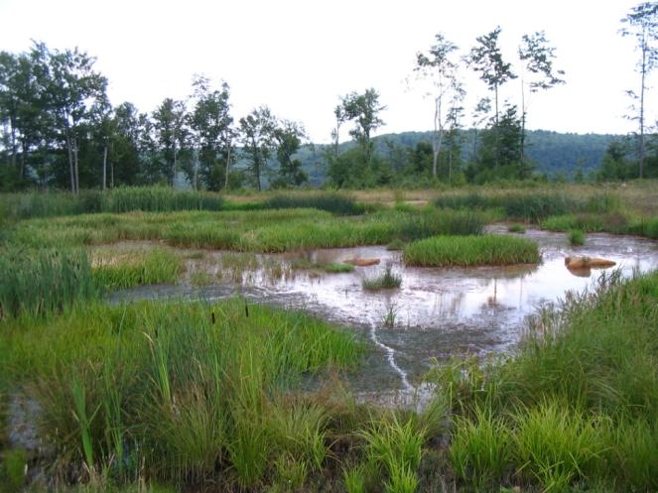

Slide 39
Anna S Passive Treatment Complex timeline
Year | Activity
1999 | Feasibility and conceptual design
2001 | Grant for final design, permitting, and construction
2004 | System operational
2013 | Replacement of organic substrate in Hunters Drift VFPs
2016 | Replacement of organic substrate in Anna S VFPs

Slide 40
Anna S passive systems, 2004 - 2016
 | Flow | pH | Alk | Acid | Fe | Al | Mn | SO₄
 | gpm | s.u. | mg/L CaCO₃ |  | mg/L | mg/L | mg/L | mg/L
Hunters Drift System
HD influent | 225 | 2.8 | 0 | 347 | 35.4 | 32.7 | 6.4 | 551
Final | na | 7.5 | 142 | -112 | 0.4 | 0.3 | 2.0 | 493
Anna System
S1 influent | 204 | 3.1 | 0 | 138 | 6.9 | 12.3 | 7.8 | 342
S2 influent | 27 | 3.8 | 0 | 32 | 1.7 | 5.7 | 1.8 | 130
Final | na | 7.5 | 119 | -99 | 0.8 | 0.3 | 3.2 | 302

Slide 42
Operation and Maintenance
Routine inspections and sampling
  Bi-monthly by Babb Creek Watershed Association
System improvements and minor maintenance
  Hunters Drift collection system upgrades; channel cleanouts
Organic substrate replacement

Slide 43
Organic Substrate Replacement
Drained individual VFPs and inspected substrate
  Black substrate (FeS) indicates reducing conditions and viability
  Brown/grey substrate indicates oxidizing conditions and accumulation of iron and Al hydroxides

Slide 44
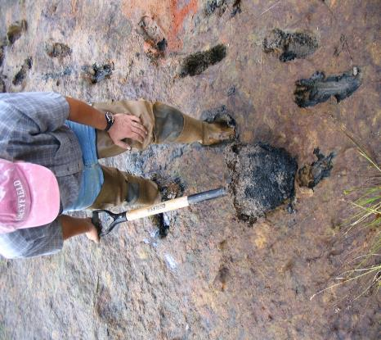
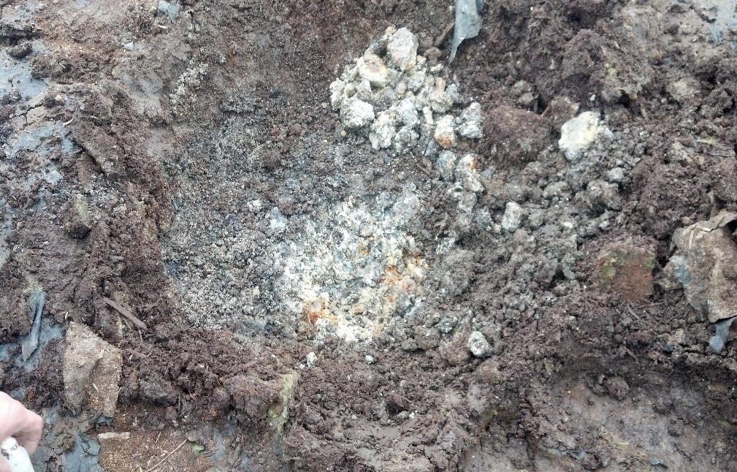
Photos of substrate

Slide 45
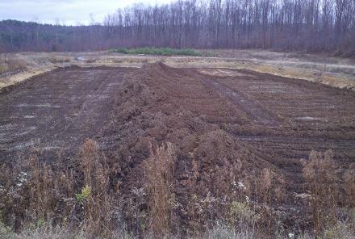
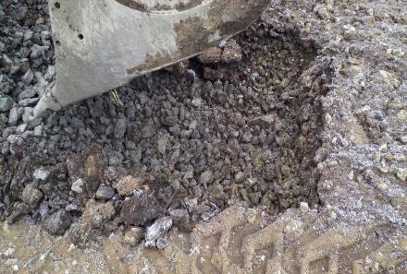
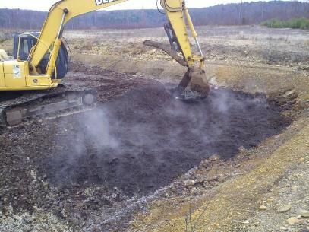
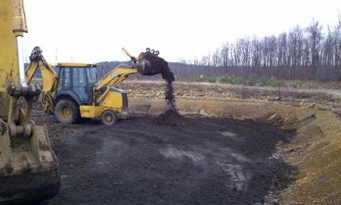

Slide 46
Anna S Passive Complex Costs, 1999 – 2016
(456 gpm, 235 mg/L acidity, 22 mg/L Al, 20 mg/L Fe)
Year | Cost | Activity
1999 | 25,000 | Feasibility and conceptual design
2002 | $2,512,000 | System design, permitting and construction
2012 | $210,008 | New organic substrate in four VFPs
2015 | $201,706 | New organic substrate in four VFPs
Annual | $7,670/yr | Babb Creek Watershed Association, bi-monthly inspections and routine maintenance
Periodic |  | Evaluate organic substrate condition every ten years

Slide 47
Tangascootack #1 Passive System
Oxic Limestone Bed (drainable)

Slide 48

Acidic Mine Water
CaCO₃ + H⁺ → Ca²⁺ + HCO₃⁻
Fe³⁺ + Al³⁺ + Mn²⁺ + HCO₃⁻ → FeOOH + Al(OH)₃ + MnO₂

Slide 49
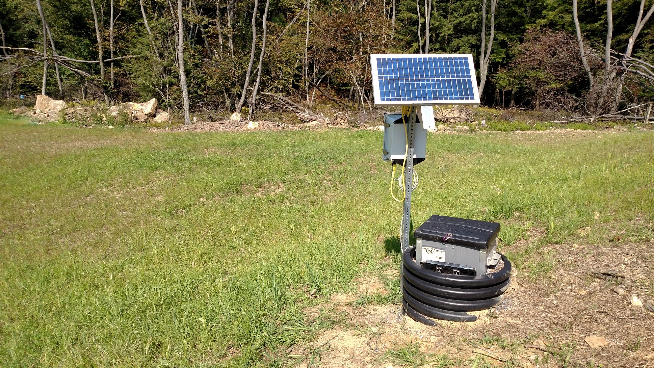
Agri Drain Smart Drainage System
(solar powered computer controlled gate valve)

Slide 50
Tangascootack #1 system, Nov 2010 – Apr 2014
 | Flow | pH | Alk | Acid | Fe | Al | Mn | SO₄
Inflow | na | 4.0 | 0 | 89 | 0.2 | 11.1 | 25.9 | 927
DLB out | 45 | 7.3 | 197 | -169 | 0.1 | 0.2 | 1.7 | 968

Slide 52
Operation and Maintenance
Routine inspections and sampling
  quarterly by Clinton County Conservation District
Major maintenance: solids management

Slide 53
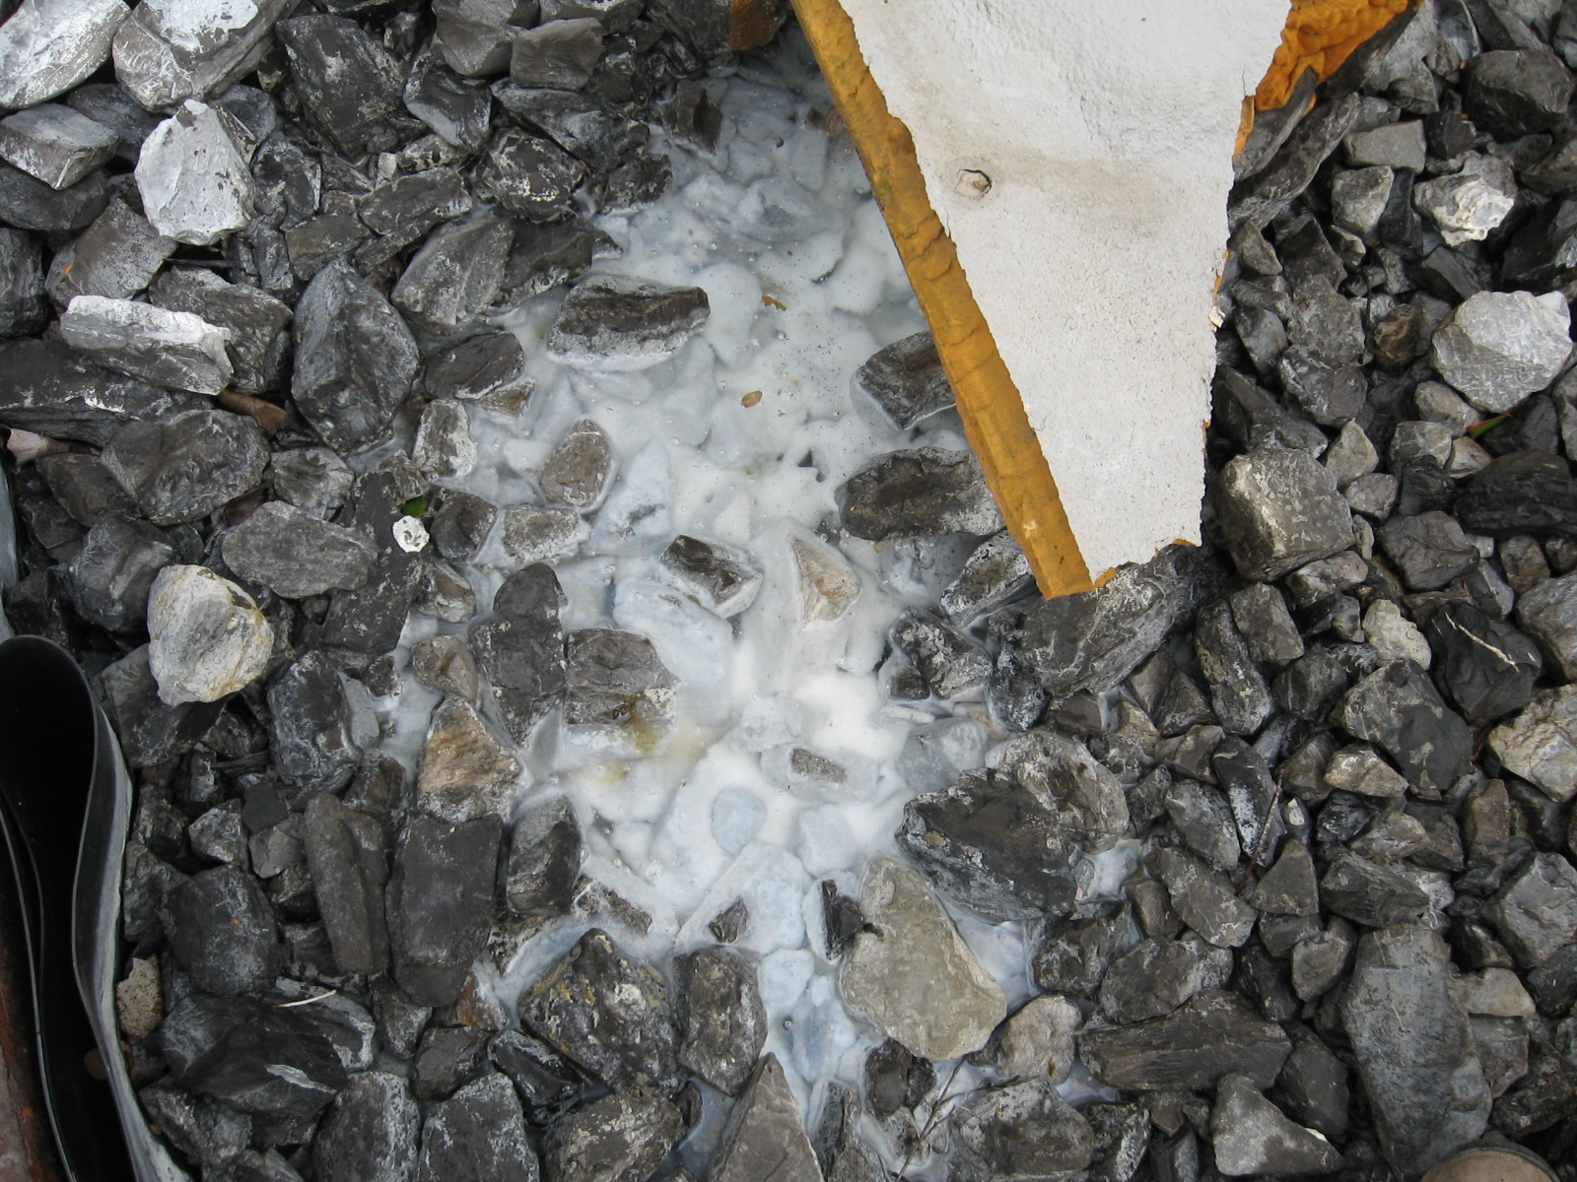
Solids Management
Routine draining removes portion of solids
Infrequent cleaning of stone removes remaining solids

Slide 54
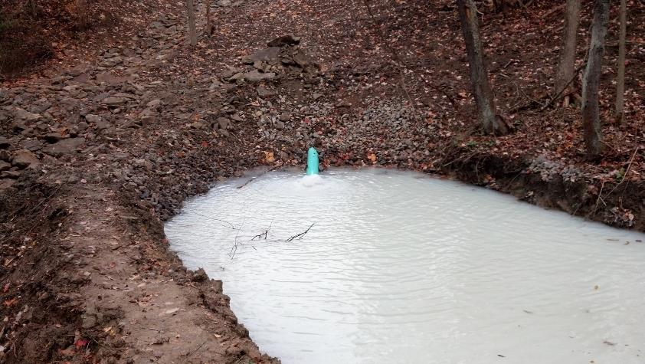
Pittsburgh Botanic Garden DLB solids basin during end of draining
71% of the Al retained in the DLB during routine operations released during draining

Slide 55
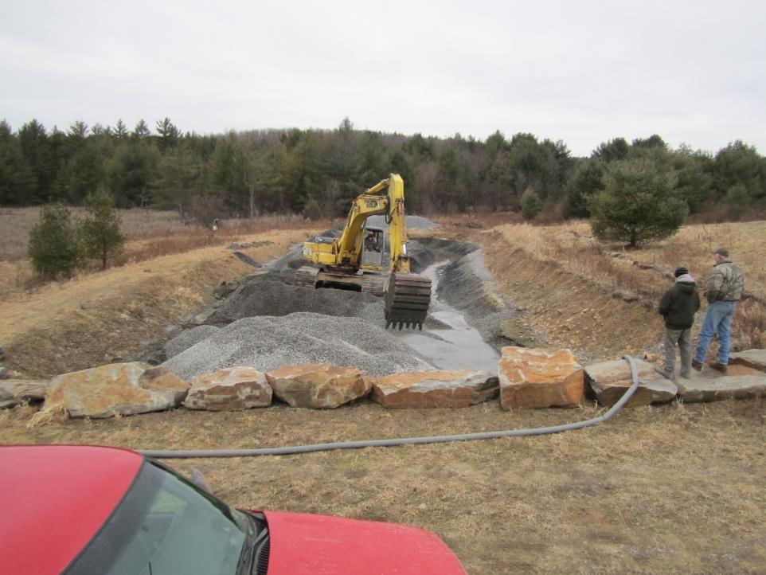

Slide 56
Tangascootac #1 Passive System Costs
(45 gpm, acidity 89 mg/L, Al 11 mg/L, Mn 26 mg/L)
Year | Cost | Activity
2009 | $65,572 | Design, permit and construction
2012 | $5,000 | Clean limestone aggregate
Annual | $2,000/yr | Clinton County Conservation District, quarterly inspections, sampling, and routine maintenance
Periodic |  | Clean and replace limestone aggregate; every four years; $5,000 per event

Slide 57
Projected 20 year treatment costs
 |  |  | 20 year unit costs
Site | Water chemistry | technology | $/1000 gal | $/lb-Fe | $/ton-CaCO₃
Marchand | Alkaline, Fe | Ponds & wetland | $0.09 | $0.15 | na
Anna | Acid, Fe, Al, Mn | Vertical flow ponds and wetlands | $0.65 | na | $435
Scootac #1 | Acid, Al, Mn | Drainable limestone bed and pond | $0.34 | na | $324

Slide 58
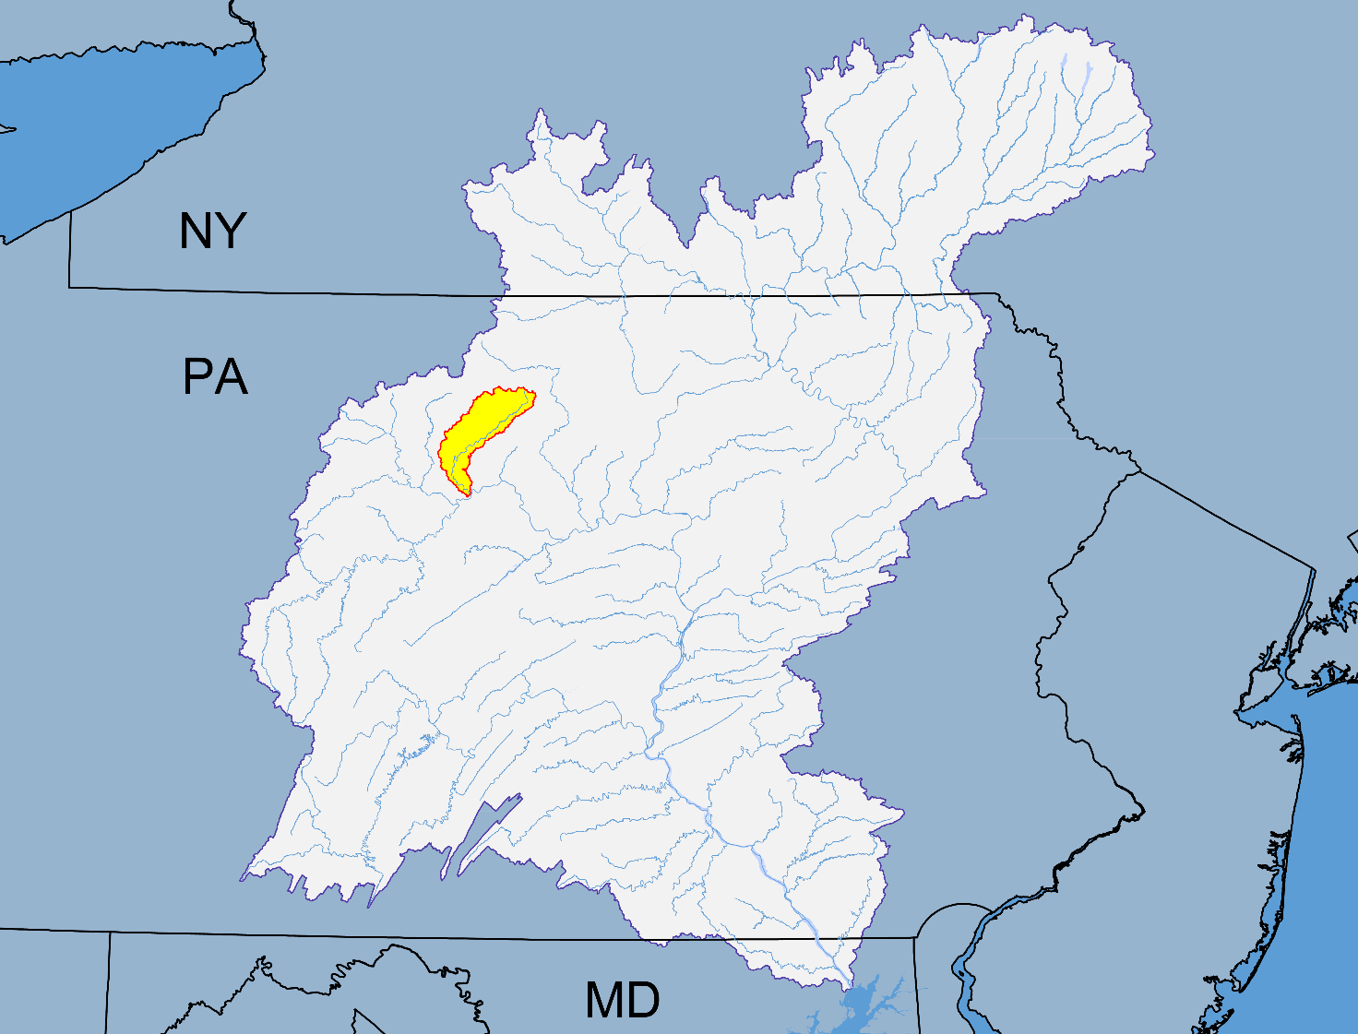
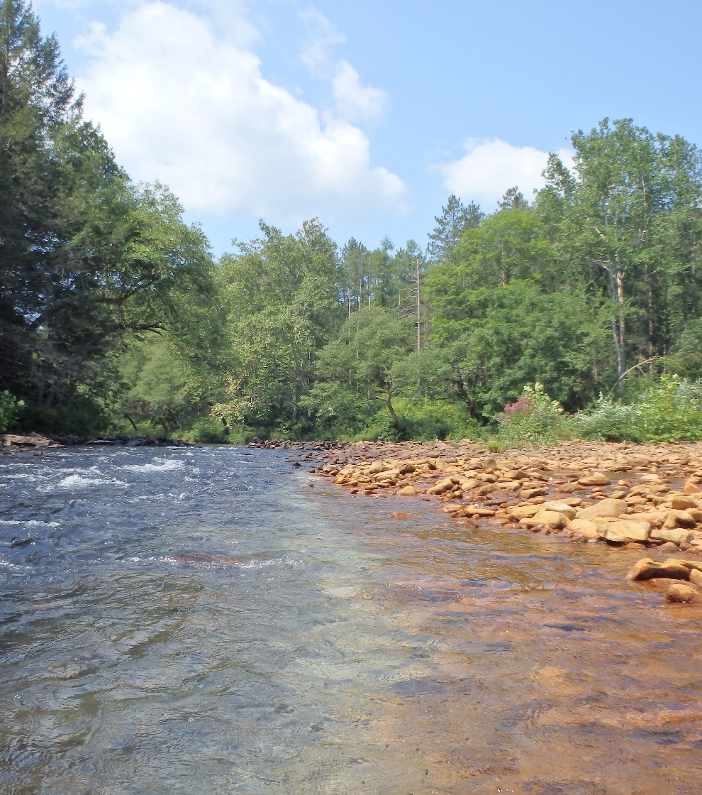
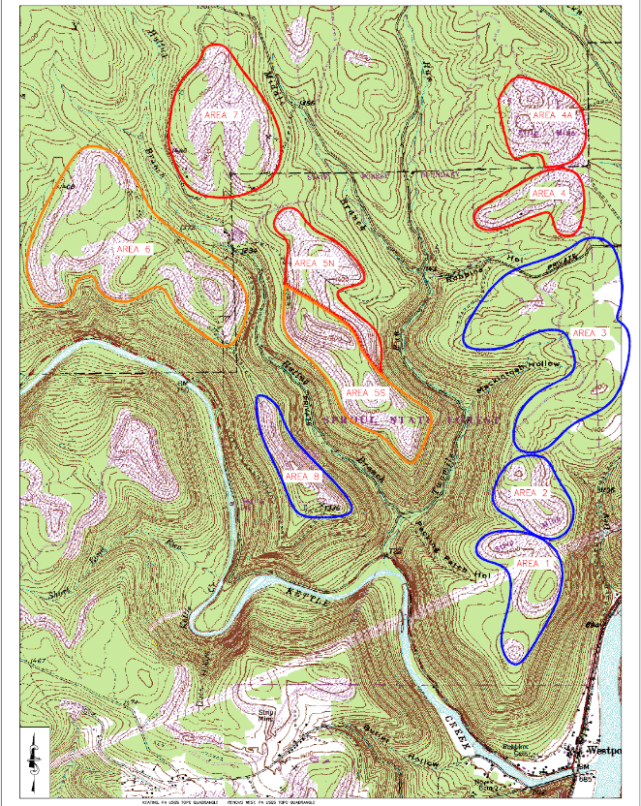
Lower Kettle Creek Watershed Restoration 1999-present

Slide 59
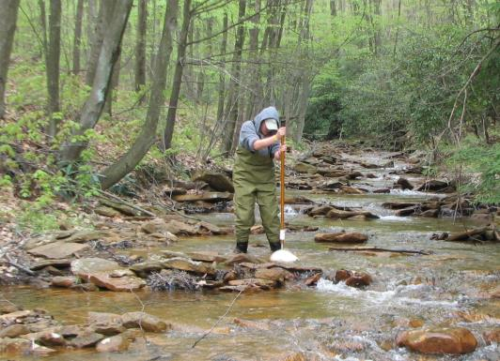
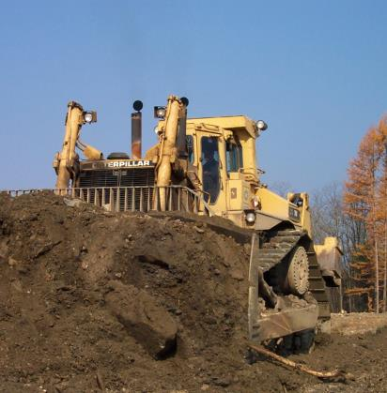
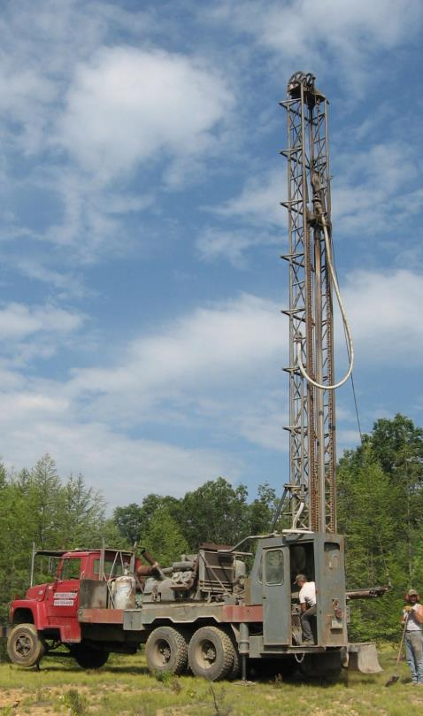
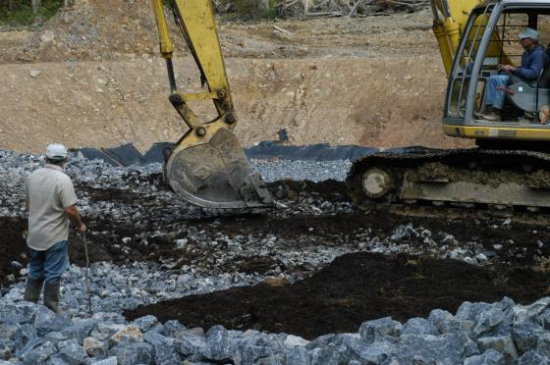








Intensive planning, data collection, and monitoring
Assessment and planning
Design, permitting, and construction
Follow-up assessment and planning
More design, permitting, and construction

Slide 60


Swamp Area passive treatment system
 | Flow | pH | Acid | Fe | Mn | Al
 | gpm |  | mg/L | mg/L | mg/L | mg/L
RAW Average | 59 | 3.0 | 430 | 63.2 | 24.9 | 39.0
TREATED Effluent Average | 59 | 7.6 | -149 | 0.4 | 9.4 | <0.3
Notes:
60

Slide 61


Robbins Hollow passive treatment systems (7)
Notes:
61

Slide 62

Robbins Hollow passive treatment – Highlighting VFP performance
 | Flow | pH | Acid | Fe | Mn | Al | SO₄
 | gpm |  | mg/L | mg/L | mg/L | mg/L | mg/L
RAW Average | 19 | 3.2 | 275 | 30.3 | 9.9 | 27.8 | 499
TREATED Effluent Average | 19 | 6.9 | -77 | 0.4 | 3.6 | 0.5 | 372
Notes:
62

Slide 63

Robbins Hollow Passive Treatment – Highlighting DLB performance
 | Flow | pH | Acid | Fe | Mn | Al | SO₄
 | gpm |  | mg/L | mg/L | mg/L | mg/L | mg/L
RAW Historical Average | 16 | 3.0 | 330 | 17.1 | 15.7 | 39.5 | 737
TREATED Average Effluent | 16 | 7.6 | -168 | <0.10 | 5.5 | 0.4 | 429
Notes:
63

Slide 64


Passive treatment systems have led to biological recovery
Nearly 7 miles of native brook trout habitat have been reconnected
Brook trout are now thriving and reproducing in previously dead stream sections

Slide 65




OM&R activities to date

Slide 66
Keys to ensuring long-term passive treatment success
Install water collection systems to monitor only AMD flows (minus clean surface water runoff)
Take time to collect adequate amount of water chemistry and flow data (minimum representation of at least one low flow sampling round and one high flow event)
Proper design – technology based on chemistry; sizing based on loading
Proper construction
Monitor instream and treatment system components quarterly
Conduct routine inspections, particularly following storm events
Follow through with routine maintenance
Decreased performance in one or more of system components is signal to begin planning for additional maintenance or rehab activities

Slide 67
Keys to ensuring long-term passive treatment success

Slide 68
Thank You!
Amy G. Wolfe
Trout Unlimited
Director – Eastern Abandoned Mine & PA Coldwater Habitat Restoration Programs
awolfe@tu.org
www.tu.org
Dr. Robert Hedin
Hedin Environmental
President
bhedin@hedinenv.com
www.hedinenv.com

