Slide 1


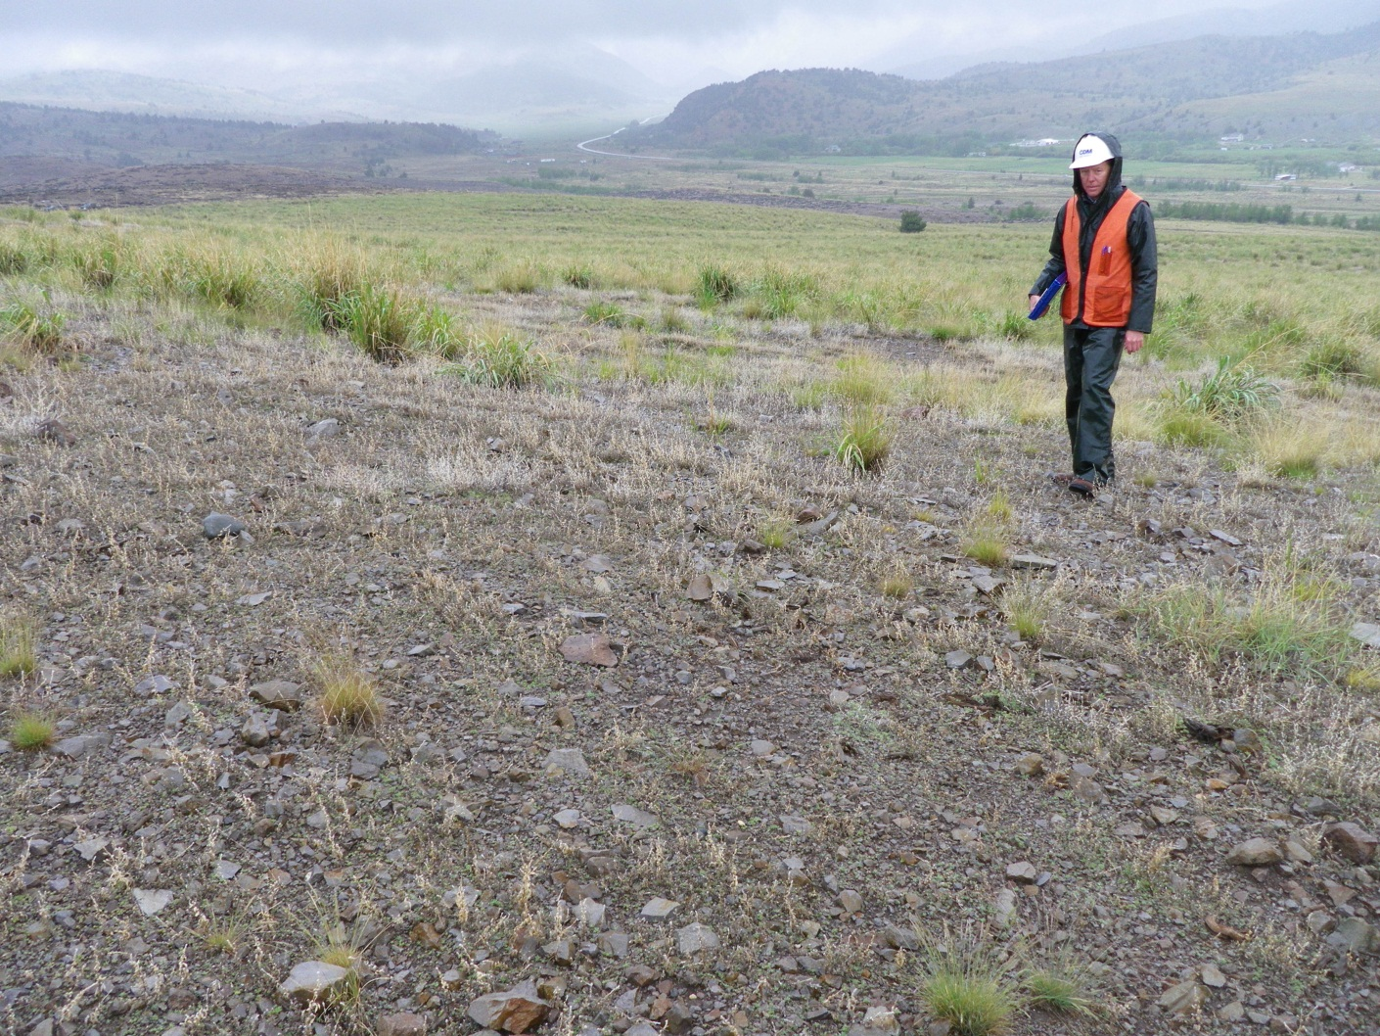
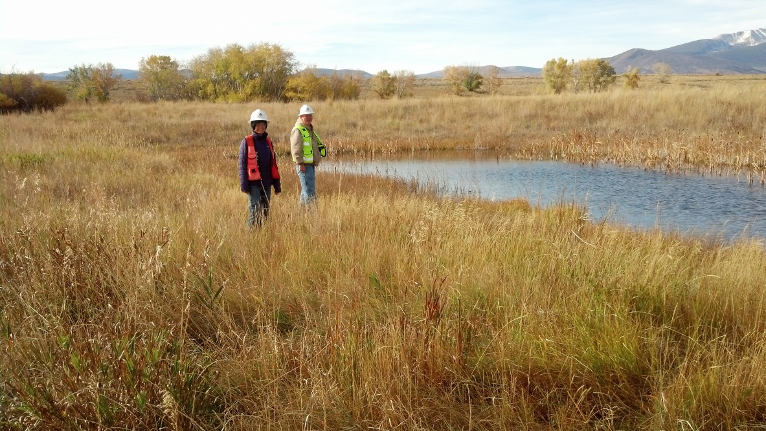
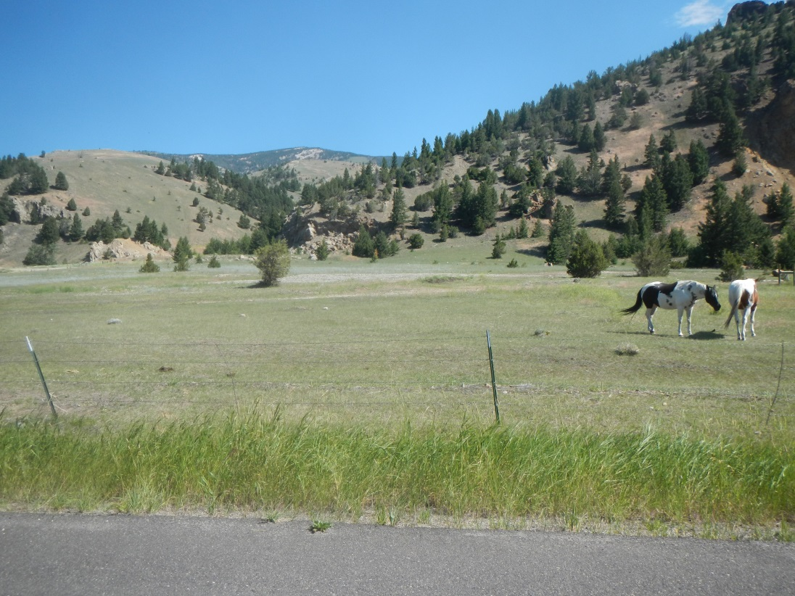
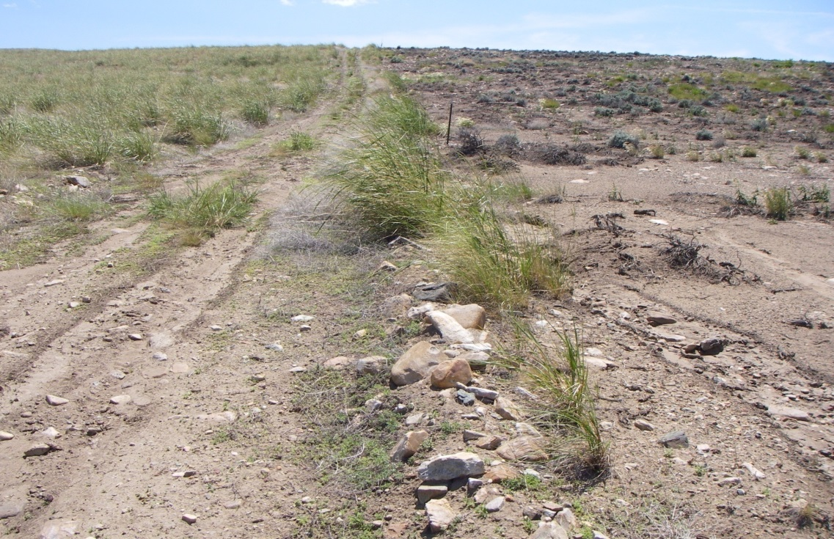
Remedial Action, Remedy Performance, and Long-Term Land Management
Anaconda Smelter NPL Site
June 2015
Charlie Coleman, EPA
Robert Rennick, CDM Smith
Gunnar Emilsson, CDM Smith
Charlie Coleman, EPA
Robert Rennick, CDM Smith
Gunnar Emilsson, CDM Smith

Slide 2

Contents
Introduction
Location, Mining/Smelting, Environmental Impacts, Regulatory History
Basis of Remedial Design
Land Reclamation Evaluation System (LRES)
Remedial Design/Remedial Action
Steep Slope Reclamation and In-Situ Soil Treatment (Phytostabilization)
Revegetation Success and Problems
Vegetation Response Investigation
Development of the Total Metal Index (TMI)
Evaluating Remedial Performance
Vegetation Management Plan (VMP)
Performance Criteria and Compliance Standards
Post Remediation Land Use and Land Management Plans
Land Classification (Categories 1 – 6)
Anaconda Smelter NPL Site

Slide 3
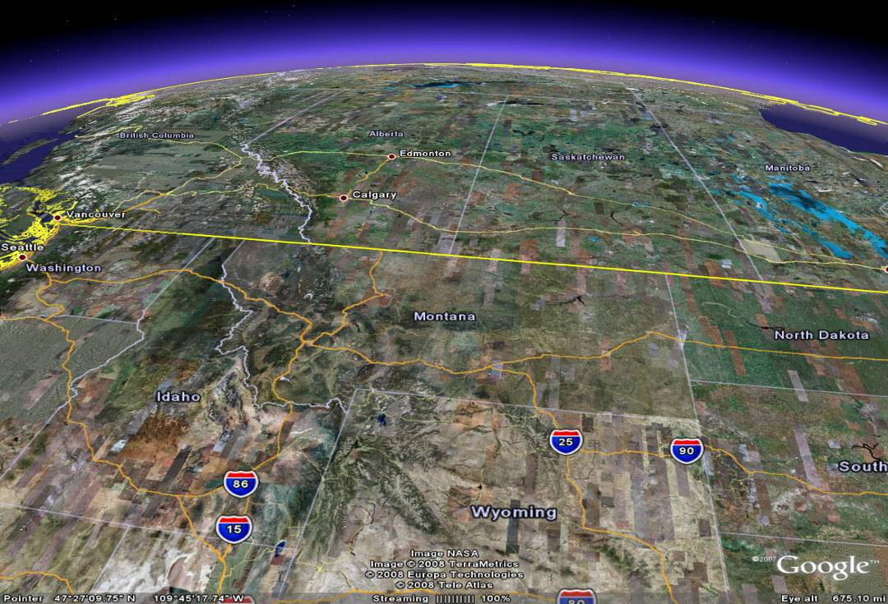
Anaconda Smelter NPL Site
Butte

Slide 4
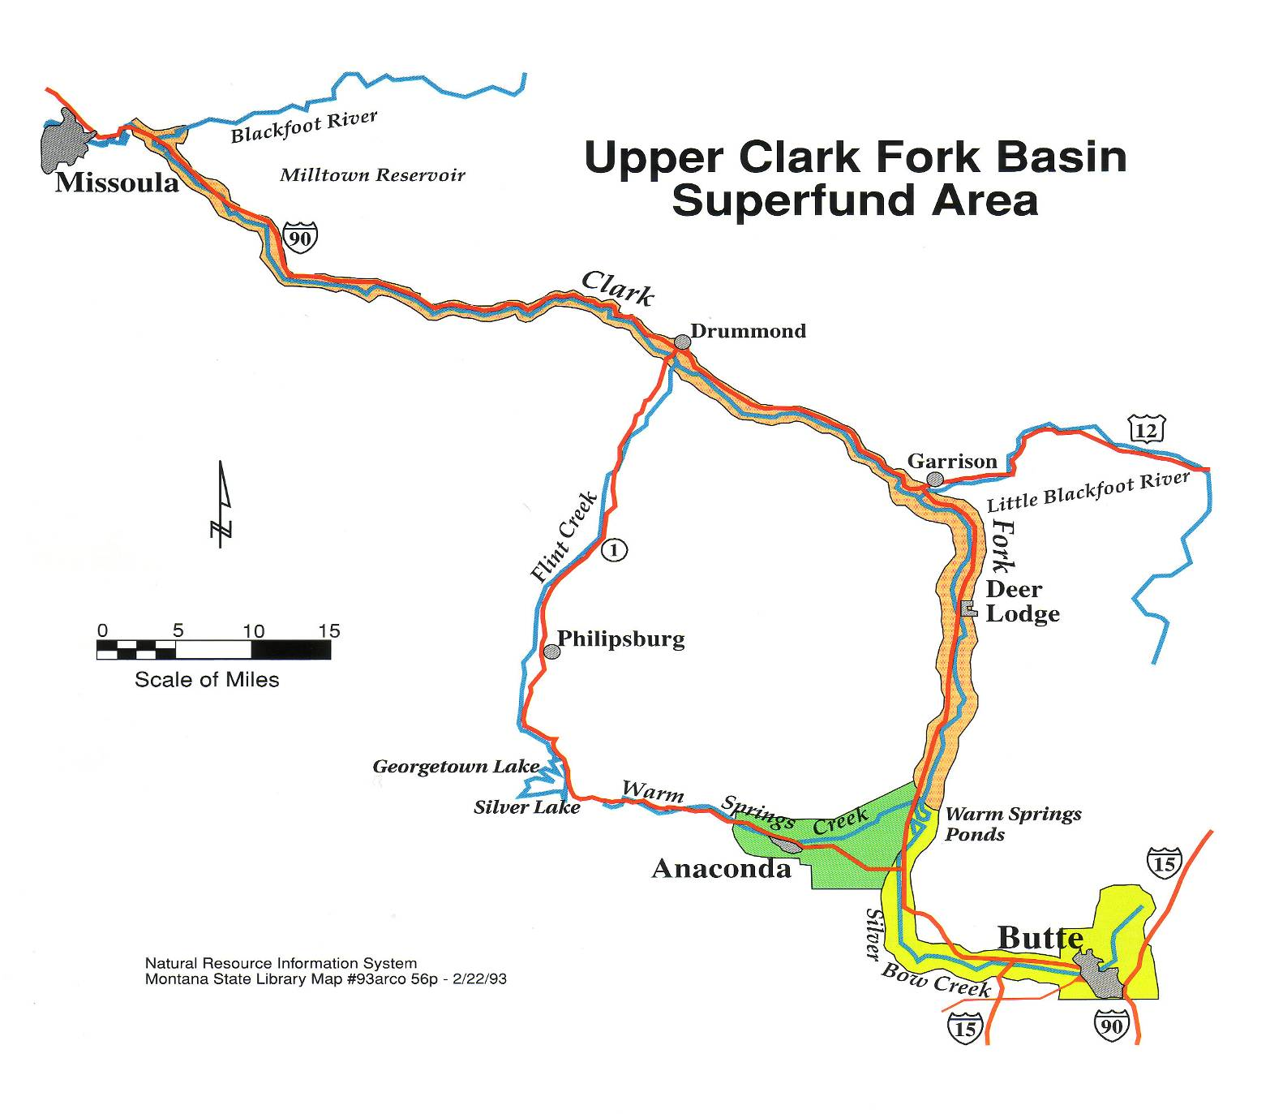
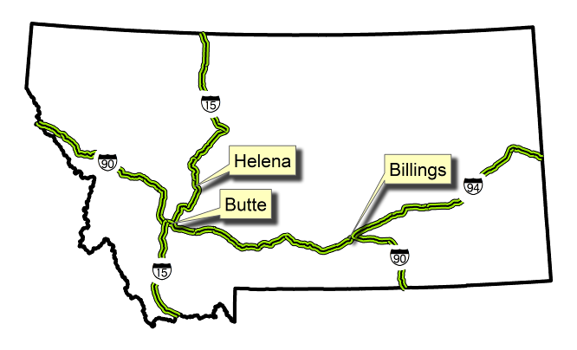
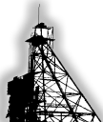
Location and History
Notes:
These sites are in and near the upper Clark Fork River valley and include the Butte site where ore was mined for more than 120 years and the Anaconda site where the ore was smelted up until 1983.

Slide 5
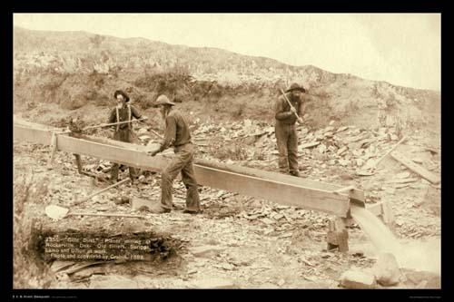
Placer mining began in the Clark Fork River Basin in the 1860s
Insert picture of placer mining
Location and History

Slide 6
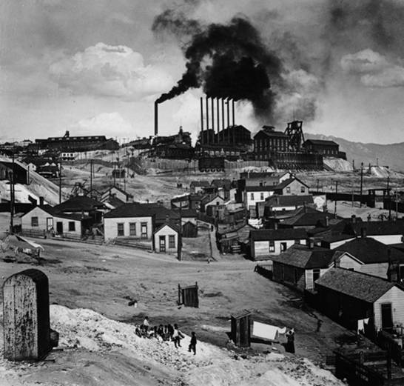
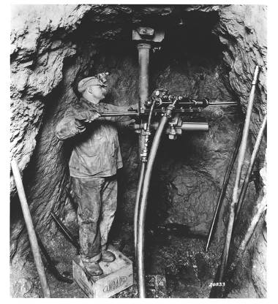
Butte - the “Richest Hill on Earth”
Underground mining, CIRCA 1910
Never Sweat and other underground mines on Butte Hill
Location and History
Notes:
1 Butte overlies a massive metallic ore body
2 Over 10,000 miles underground workings, 4 open pit mines, and an estimated 12.4 mcy of mining waste.

Slide 7
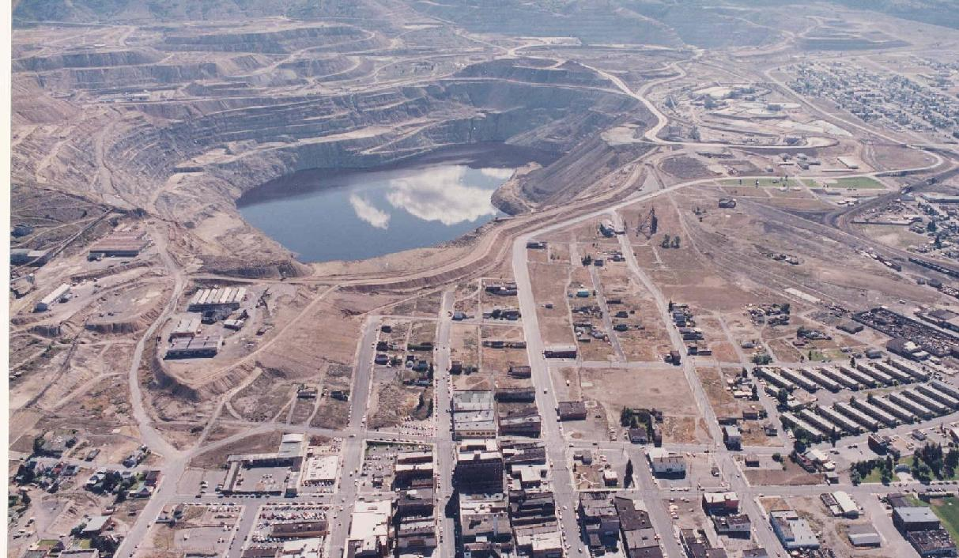
Open pit mining began in 1955 and continues today
The Berkeley Pit - mined until 1982
Location and History

Slide 8
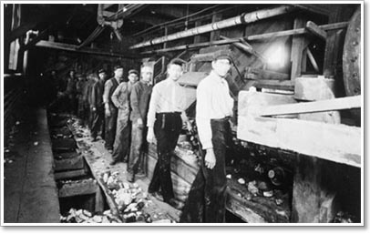
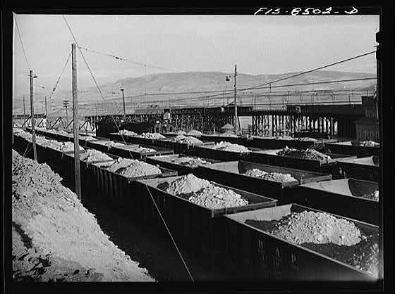
Smelting began in Anaconda, MT in the 1880’s
Butte mines and Anaconda smelters, owned by Marcus Daly, produced more than $300 billion worth of metal over its lifetime.
High wages - raised national standard of living
Raw material for many products
Contributed to war efforts
Location and History

Slide 9
Smelting Legacy at the Anaconda Site
Wastes
230 million yd³ of tailings
30 million yd³ of furnace slag
500 yd³ of flue dust
Impacted soils, plant communities, and habitats over a 300 square mile area*
*EPA Website 2012
Location and History

Slide 10
Brief Regulatory History
Smelter closed in 1980
Site listed 1983
Demolition of the smelting facilities 1983 - 1986
First Administrative Order with Atlantic Richfield 1986
Early studies/development of Operable Units (OUs) 1986-1988
Mill Creek Relocation Record of Decision (ROD) 1988
Removal Action 1989 – 1992
Flue Dust OU ROD 1991
Old Works/East Anaconda Development Area OU ROD 1994
Community Soils OU ROD 1996
Anaconda Regional Water, Waste &Soils OU ROD 1998
Location and History

Slide 11
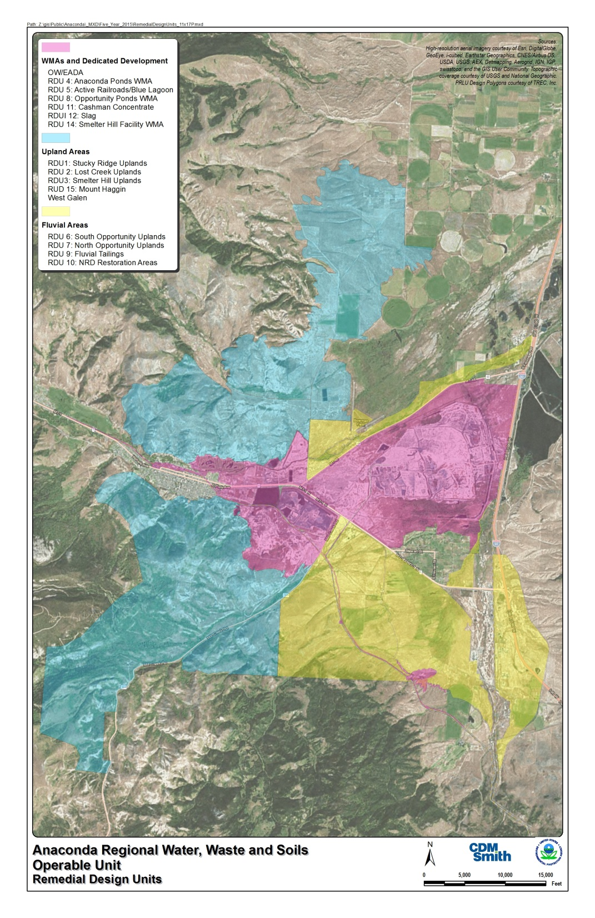
Anaconda Regional Water, Waste & Soils
Red Areas – Waste Management Areas (Tailings, Slag, other smelting wastes) and Dedicated Development (railroad built out of mine waste materials). Anaconda Ponds tailings impoundment nearly 100 feet thick
Yellow Areas – Lowland areas impacted by deposition of fluvially-deposited wastes (sulfidic mine tailings) from historic flood events and subsequent irrigation practices. Thickness ranges from less than an inch to several feet in historic stream channels. Despite metals, subirrigated areas are typically well-vegetated.
Blue Areas – Upland areas impacted solely by aerial deposition of smelter emissions. Contaminants most concentrated in upper 2 inches, but low pH and limited soil buffering capacity may leach copper and zinc to 18 inches in some areas.
Location and History

Slide 12
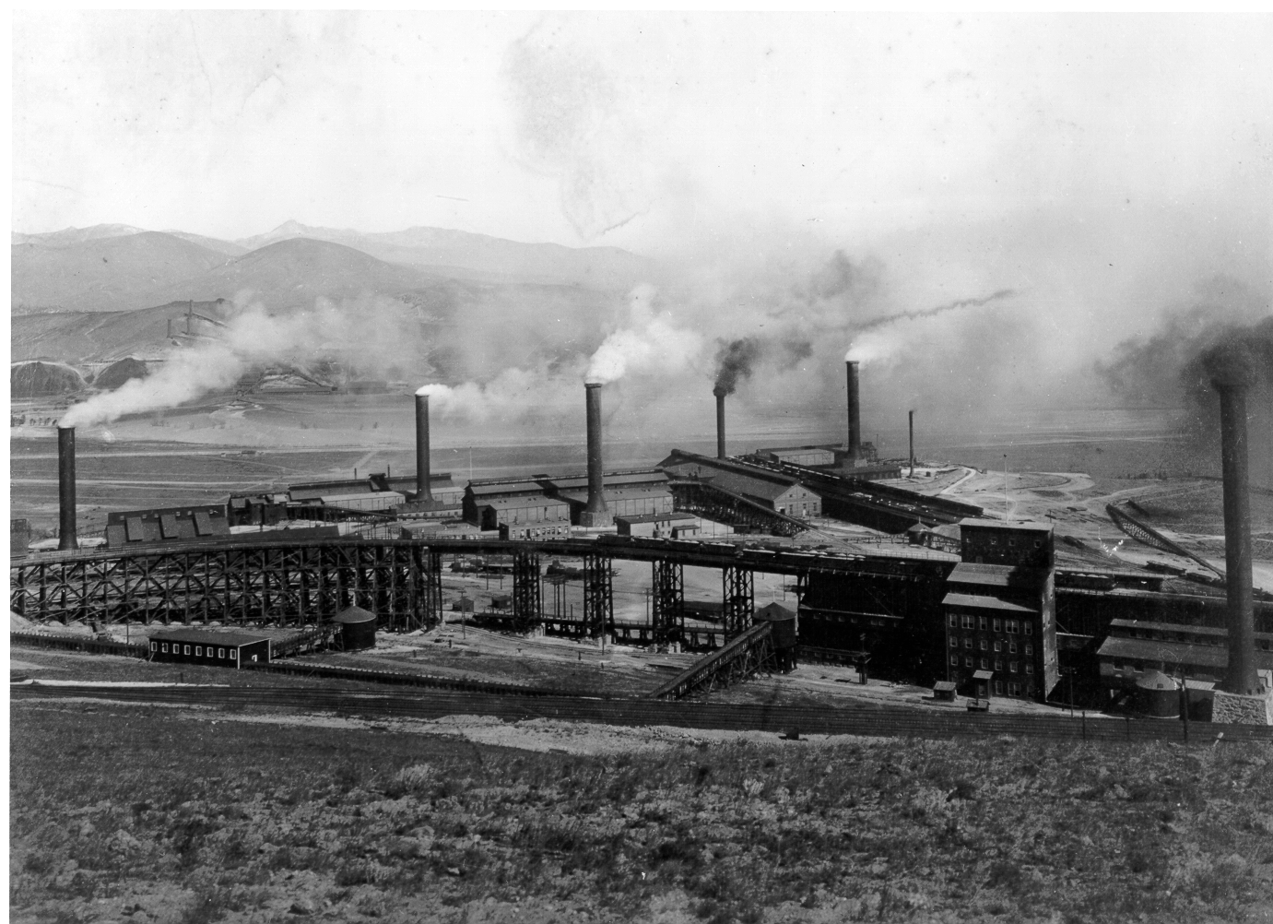
Smelter Complex, Anaconda, MT 1903
Contaminant Releases from Smelter Complex
1907: 37 tons/day of As, Cu, Pb, and Zn from main chimney
1914-1918: Arsenic release averaged 40-62 tons/day
October 1976: 578 tons/day of As, Cu, Pb, Zn, and Sulfur
Location and History

Slide 13
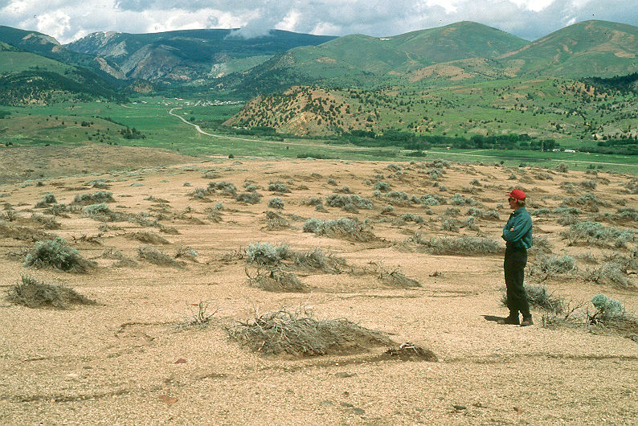
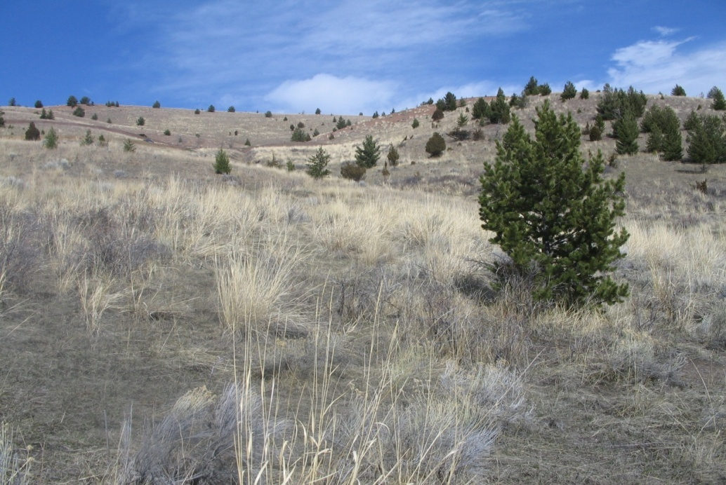
Smelting Impacts Near Anaconda
Immediate, severe impacts to natural environments near the smelters
Long-term impairment to plant/soil systems
Location and History

Slide 14
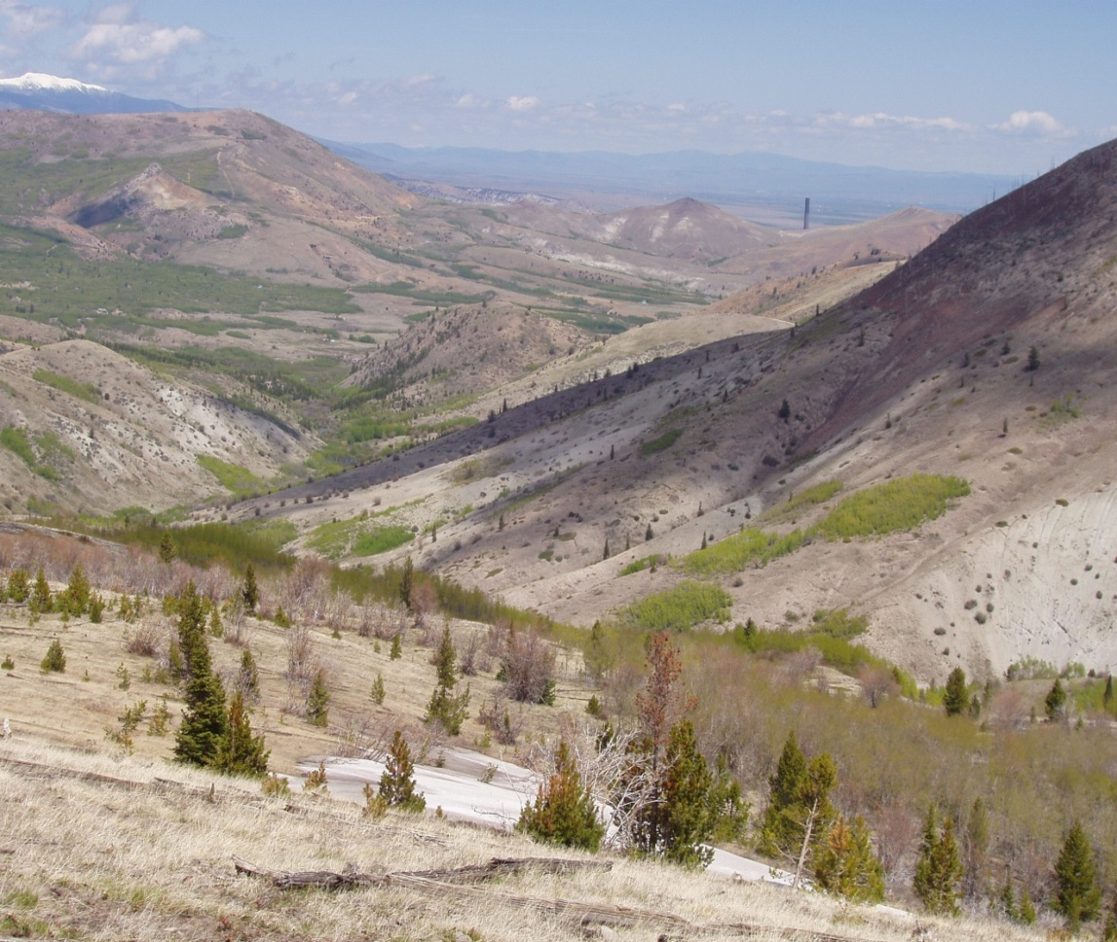
Smelting Impacts Near Anaconda
1910-1911 Forest Survey*
“All trees dead or dying within eight miles of smelter”
Affected Trees
-Engelmann spruce up to 15 miles
-Lodgepole pine up to 18 mile
-Douglas fir up to 20 miles
-Subalpine fir up to 22 miles
*USDA Technical Bulletin 1117
Location and History

Slide 15
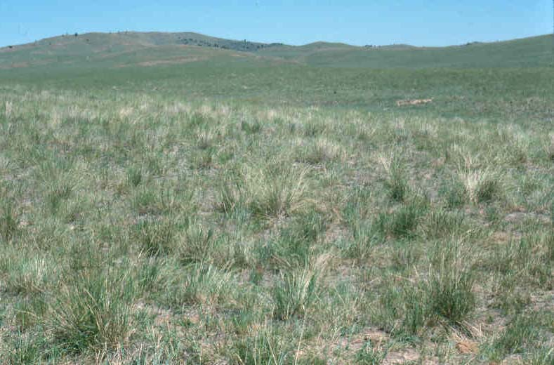
Perspective: Uncontaminated Rangeland in SW Montana
A common grassland type:
Idaho fescue (Festuca idahoensis) /Bluebunch wheatgrass (Pseudoroegneria spicata)
Canopy Cover* | Shrubs | Grasses | Forbs | No. Species
Mean | 4 | 62 | 28 | 33
Range | 0-15 | 25-86 | 10-55 | 22-50
*From: Mueggler and Stewart, 1980. USDA Forest Service, INT-66
Location and History

Slide 16
EPA’s Remedial Action Objectives for the ARWW&S OU*
Establish a self-sustaining assemblage of plant species capable of:
1) stabilizing the soils against erosion and minimizing transport of contaminants to surface and ground water to meet water quality standards
2) preventing human contact with contaminants
3) maximizing water usage;
3) re-establishing wildlife habitat; and
4) accelerating successional processes.
Successfully reclaim contaminated land, defined as:
1) establishing self-perpetuating plant communities capable of stabilizing contaminated soils;
2) reducing risks to human health and the environment; and
3) compliance with ARARs, in perpetuity.
*Anaconda Regional Water, Waste & Soils Operable Unit ROD, 1998

Slide 17
Part 2 – Basis of Remedial Design (1998-2006)
Quantifying the impact of smelting on native plant communities and the soil resource
Selecting remediation techniques

Slide 18
Basis of Remedial Design for the ARWW&S OU
Goal: Select the type and intensity of reclamation to meet the RAOs for each discrete land parcel within the operable unit
Challenge: Develop a method to determine the level of ecological dysfunction and the remedial approaches for 30,000+ impacted acres
Remedial Design

Slide 19
Basis of Remedial Design for the ARWW&S OU
The evaluation method must:
Be easy and quick to apply
Utilize a minimum amount of equipment
Use standard soil and vegetation evaluation techniques
Be as quantitative as possible
Provide precise (i.e., reproducible) results
Method simplicity and evaluator experience/training
Identify specific remedial approaches
Consider historic, social, economic, ownership, and other values
Be developed with buy in from stakeholders
Remedial Design

Slide 20
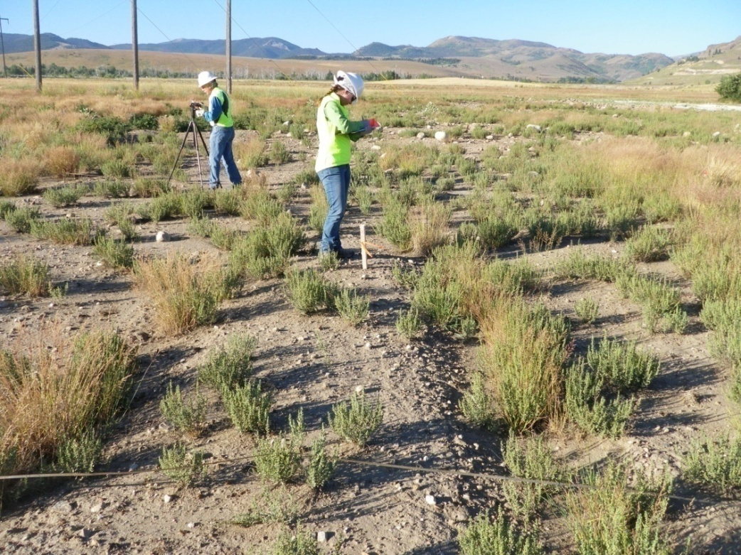
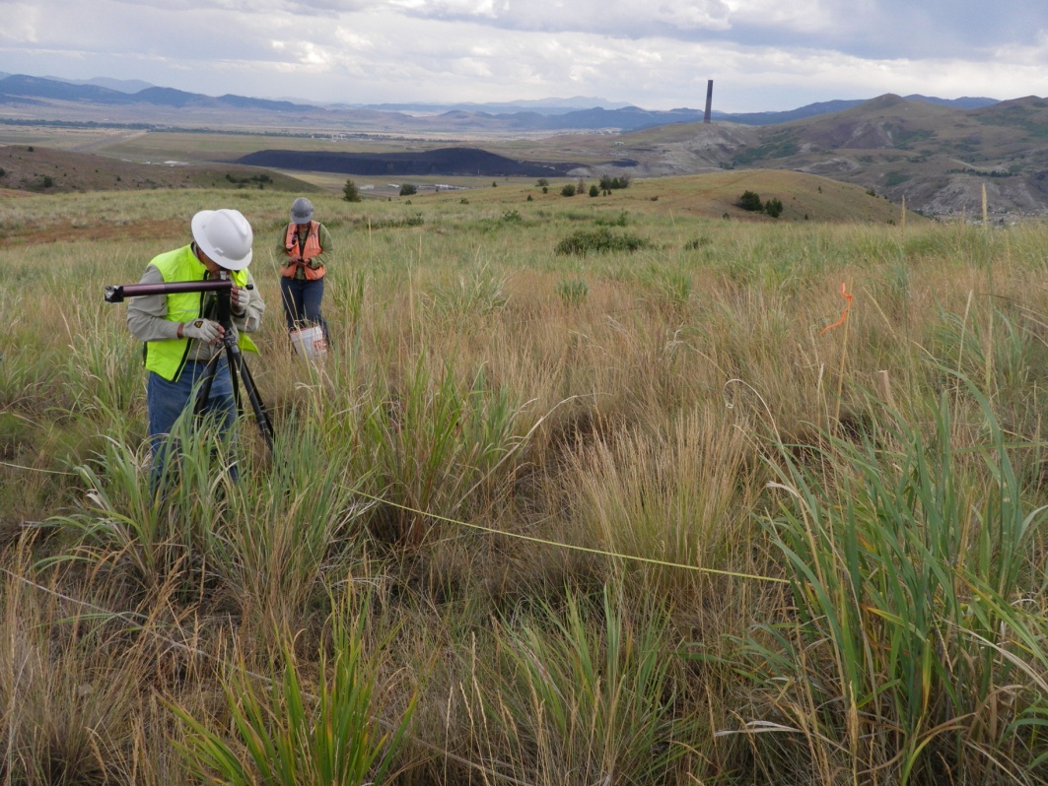
Method Development Process
Identified a set of sites with full range of impacts
Began with large set of possible vegetation and soil parameters
Assigned points to the parameters and adjusted point distribution among parameters through trial and error (calibration step)
Testing and final point adjustments until scores reflected best professional decisions (the validation step)
Remedial Design

Slide 21
Land Reclamation Evaluation System (LRES)
Method Components:
Numeric scoring based on vegetation attributes
Numeric scoring based on soil stability attributes
Remedial decision modifying criteria
Remedial Design
Notes:
Evaluation method needed to be as objective as possible.
The primary components of the pre-reclamation decision tool are a numeric scoring system that focuses on the condition of the vegetation and soils, and what we call decision modifying criteria.

Slide 22
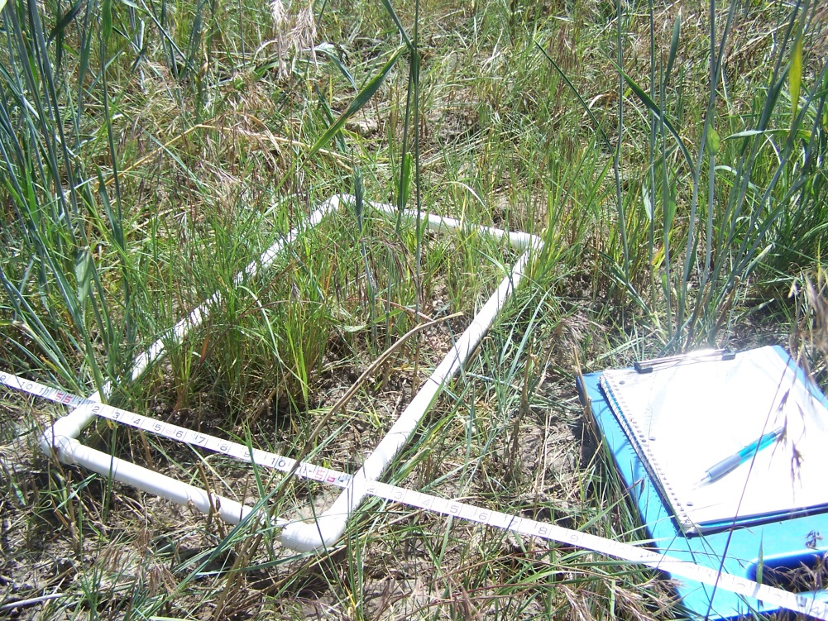
Vegetation Point Distribution (100 point max)
Percent Vegetation Cover (25 points)
Uniformity of Vegetation Cover (10 points)
Evidence of Reproduction (15 points)
Plant Litter Accumulation (15 points)
Community Dominance (5 points)
Estimated Plant Density (10 points)
Species Richness (20 points)
Remedial Design
Notes:
Based on trial and error, the team developed a system of 100 points to rate the quality of the plant community. The parameters used are mean cover, uniformity of cover, plant reproduction, litter, plant dominance, plant density, and species richness.

Slide 23
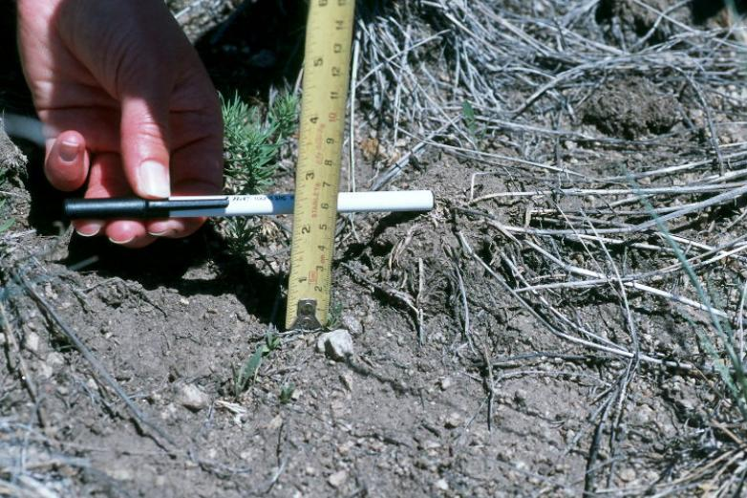
Soil Point Distribution (75 point max)
Water erosion (40 points)
Potential wind erosion (15 points)
Soil pH (20 points)
Surface tailings and/or metal salts (0 point addition and up to 20 point reduction)
Remedial Design
Notes:
The soils portion of the scoring system has a total of 75 points and considered water erosion, soil pH, potential for wind erosion, and the presence of tailings or metal salts.
Based on repeated use of the scoring system, the team determined that a total of about 115 points (for both soil and vegetation) was the cutoff for deciding whether some type of reclamation action was needed.

Slide 24
Decision Modifying Criteria
These are key historic, ecological, social and economic factors
Included:
Land ownership
Historic features
Land use
Watershed boundaries
Natural recovery
Remedial Design
Notes:
While in the field, the evaluators also collect other types of information that may be important to making the reclamation decision.
The decision modifying criteria include a whole host of political, ecological, social, and economics factor that can effect a remedial decision.
The list of modifying criteria contains about 30 different items to consider. Some of the key criteria are things such as land ownership boundaries, historic features, watershed boundaries, and whether natural site recovery is occurring.

Slide 25
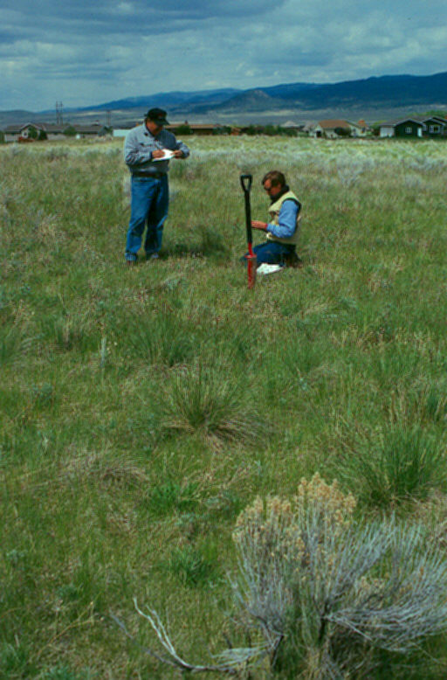
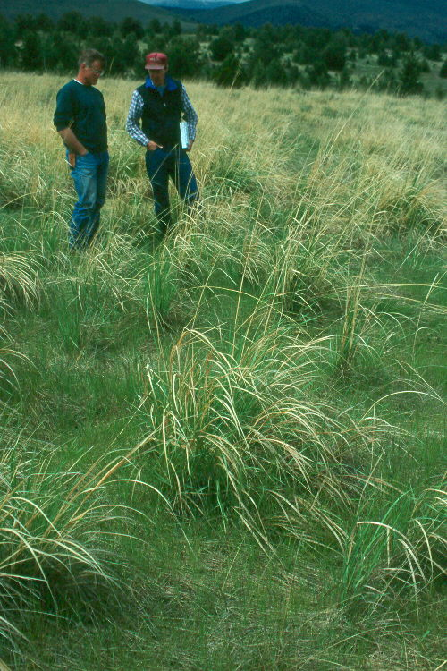
Example Sites and Remedial Decisions
Vegetation Score = 73
Soil Score = 69
Total Score = 142
Decision: No Action
Vegetation Score = 63
Soil Score = 55
Total Score = 118
Decision: Monitoring
Remedial Design
Notes:
The following set of slides show how some sites were scored and what reclamation approach was taken.
The site on the left had a total vegetation/soil score of 142. The decision for this site was “no action”. This site was definite a candidate for de-listing.
The decision for the site on the right, which had a score of 118 was to continue to monitor it to determine if conditions were improving.

Slide 26
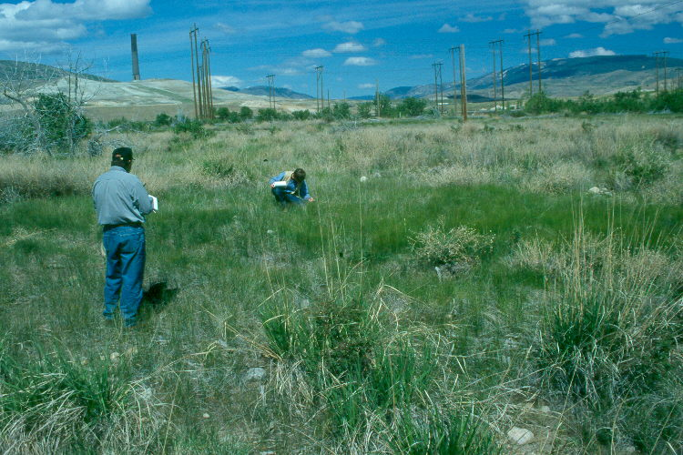
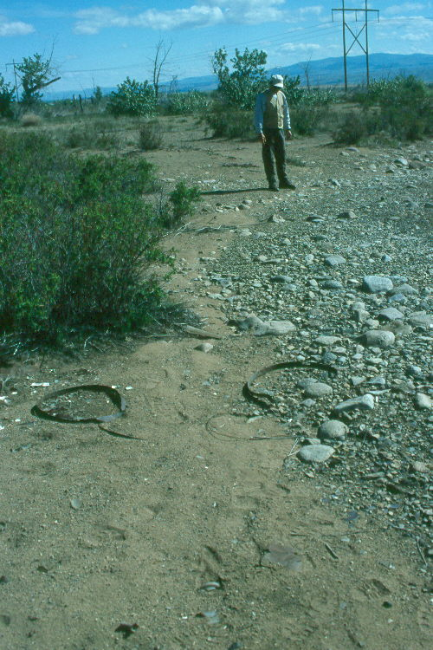
Example Sites and Remedial Decisions
Vegetation Score = 43
Soil Score = 52
Total Score = 95
Decision: Weed Spraying
Vegetation Score = 29
Soil Score = 42
Total Score = 71
Decision: Shallow Tilling Plus Amendments
Notes:
The site on the left is in relatively good condition and is begin sprayed to control weeds. This site is being monitored year to year to see if it improves.
The site on the right scored 71points and is being reclaimed using swallow tilling and low quantities of lime and organic amendments.

Slide 27
Example Sites and Remedial Decisions
Vegetation Score = 7
Soil Score = 19
Total Score = 26
Decision: Deep Plowing Plus Amendments
Remedial Design
Notes:
This site is adjacent to the old smelter at Anaconda. The decision for this severely impacted site is deep plowing and the application of lime and organic amendments.

Slide 28
Results
Land reclamation remedial alternatives applied to 233 land parcels
Conceptual-level design for contaminated uplands
Used by decision makers, engineers and scientists to prepare the remedial action work plans and design reports (2005-2006)
Evaluation technique termed: the Anaconda Land Reclamation Evaluation System (LRES)

Slide 29
Questions?

Slide 30
Part 3 – Remedial Design and Remedial Action
Using the LRES to determine the appropriate remedial action
Steep Slope Reclamation
Basis of Design for Soil Treatment
Implementation of Soil Treatment

Slide 31
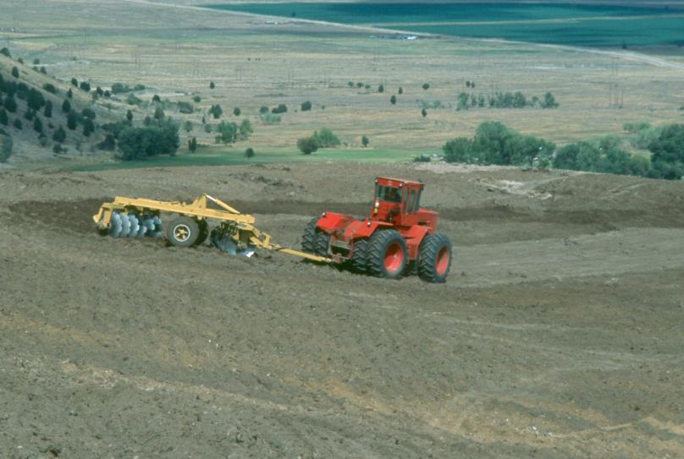
Remedial Action - Large Open Space Areas of ARWW&S OU
Coversoil or soil removal for severely contaminated areas
In-place soil tillage for metals dilution (6, 12, 18”)
Amendments: organic matter, fertilizers, and lime for pH adjustment
Custom seed mixtures for soil conditions and land uses
Special “Steep Slope Reclamation” techniques for areas greater than 3H:1V
Remedial Design/Remedial Action

Slide 32
Steep Slope Reclamation
Slopes steeper than 3H:1V cannot be tilled with conventional equipment
Various degrees of steep slope reclamation, ranging from planting of trees, shrubs and grasses to on-slop grading with dozers, as determined through the LRES
Storm water engineered controls constructed at most highly impacted areas
Storm water best management practices constructed at lesser impacted areas or where engineered controls are infeasible
Still evaluating new techniques (fertilizer demonstrations, aerial application of amendments, etc.)
Remedial Design/Remedial Action

Slide 33
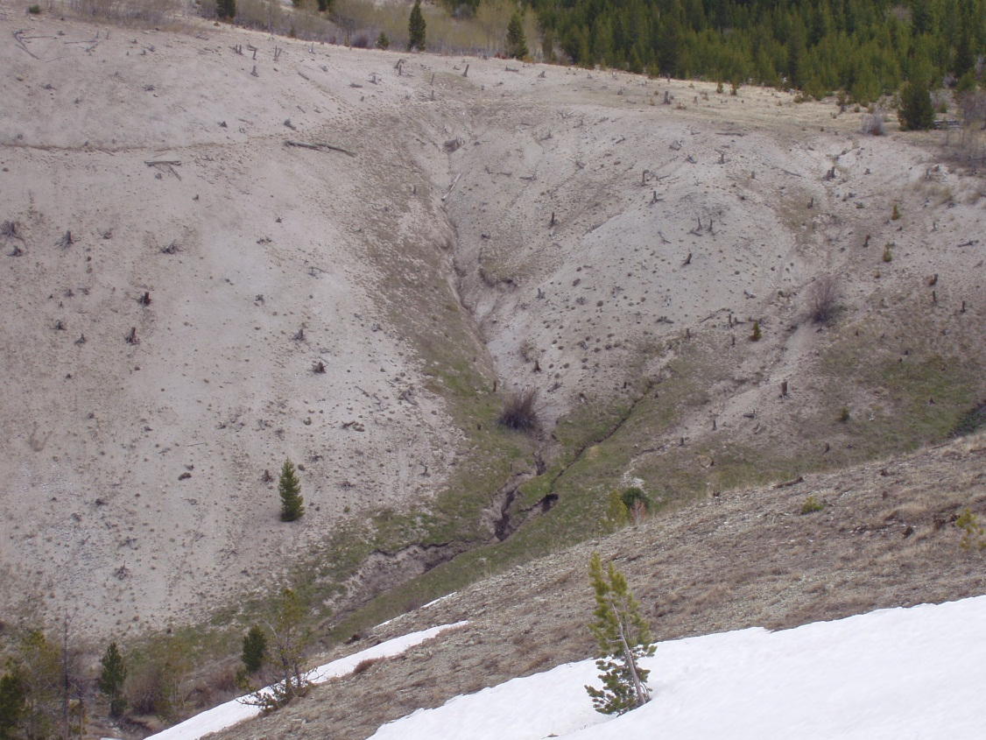
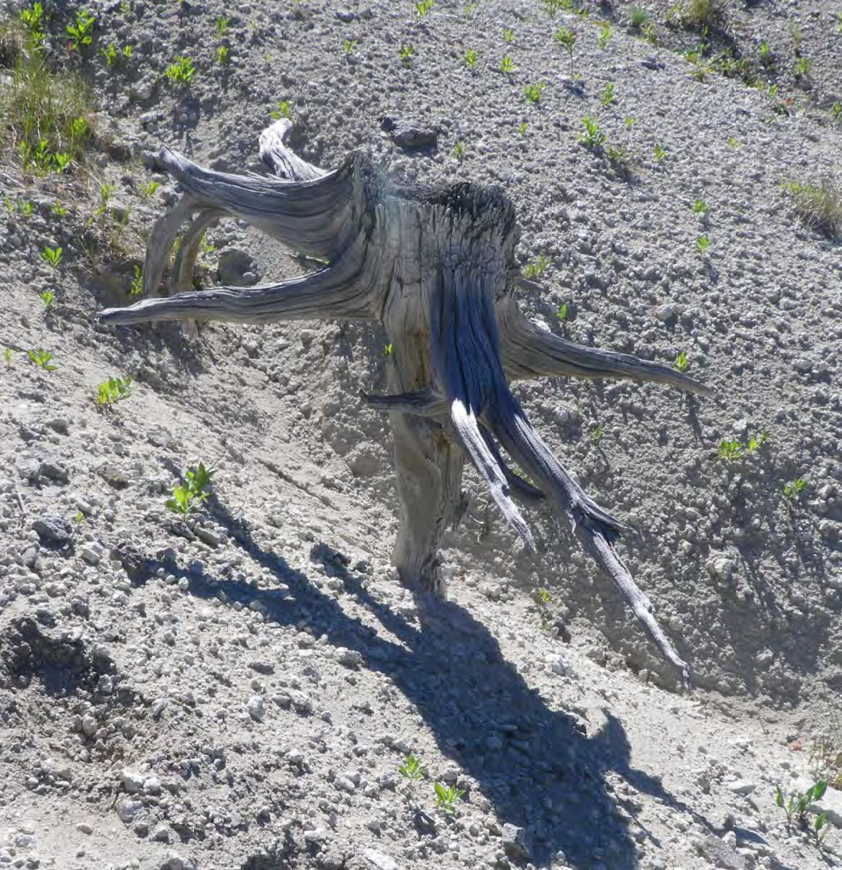
Steep slopes in the Mount Haggin
Wildlife Management Area
Remedial Design/Remedial Action

Slide 34
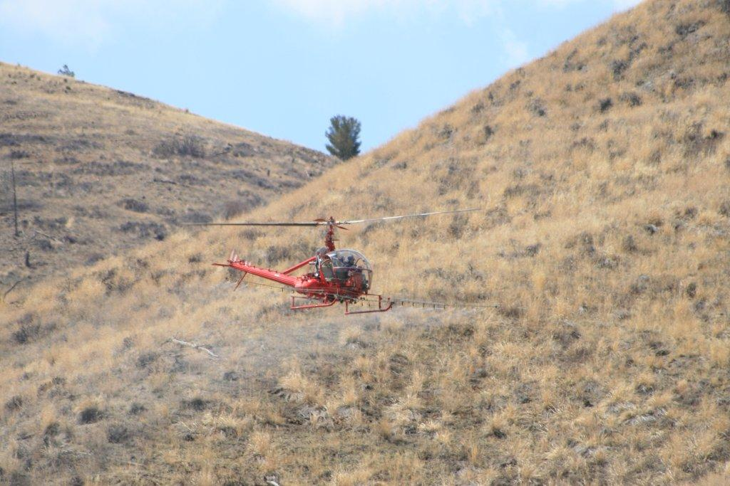
Aerial application of herbicide to control noxious weeds
Steep Slope Reclamation
Image courtesy of Greg Mullen

Slide 35
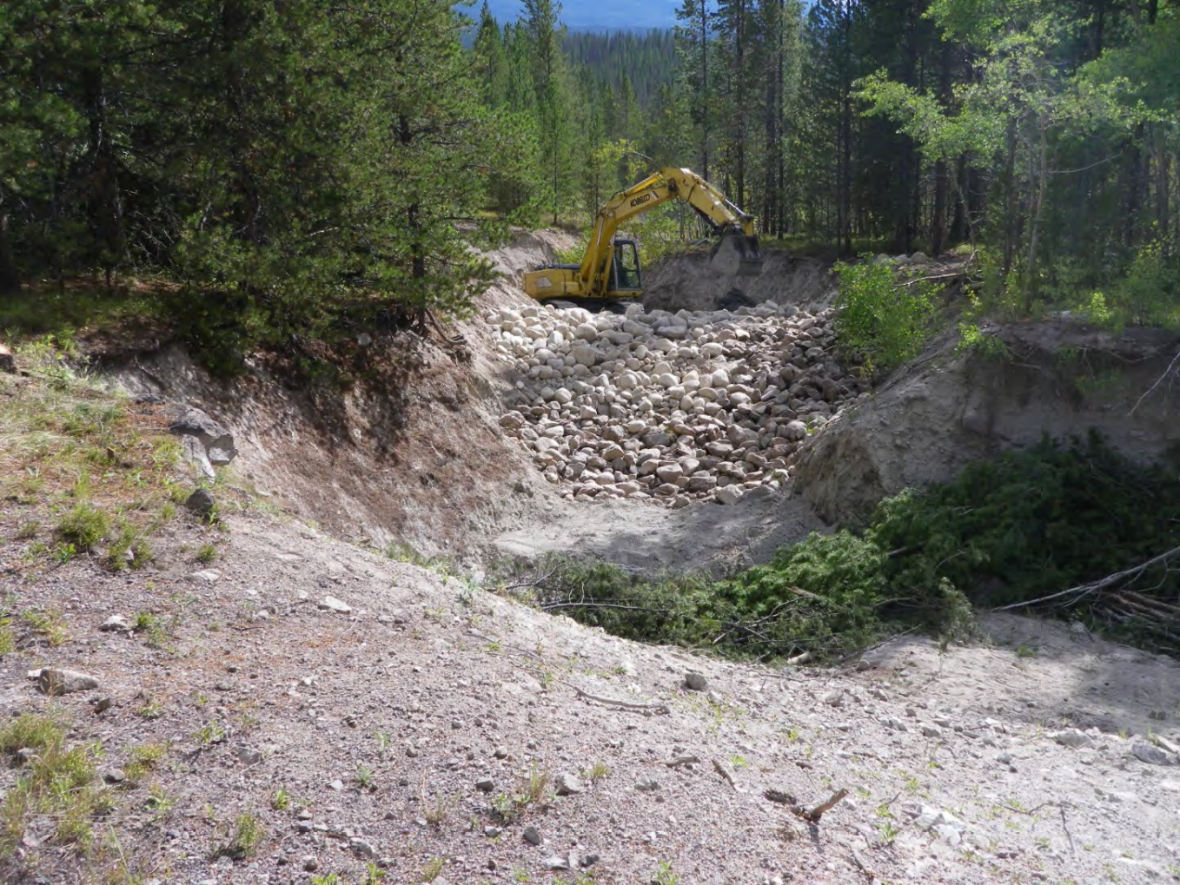
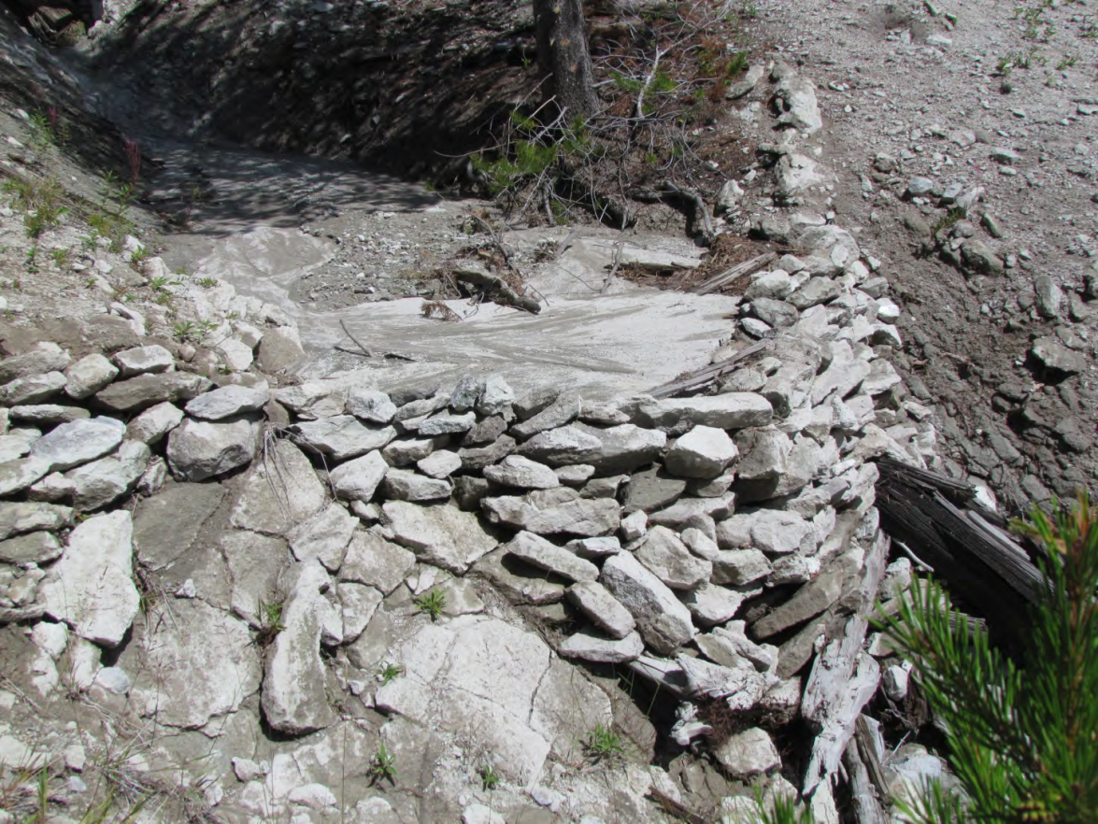
Constructing Rock Check Dams
Rock Check Dams work well, but rock is hard to find, and they fill up with sediment after 1-2 field seasons
Remedial Design/Remedial Action
Images courtesy of Stuart Jennings

Slide 36
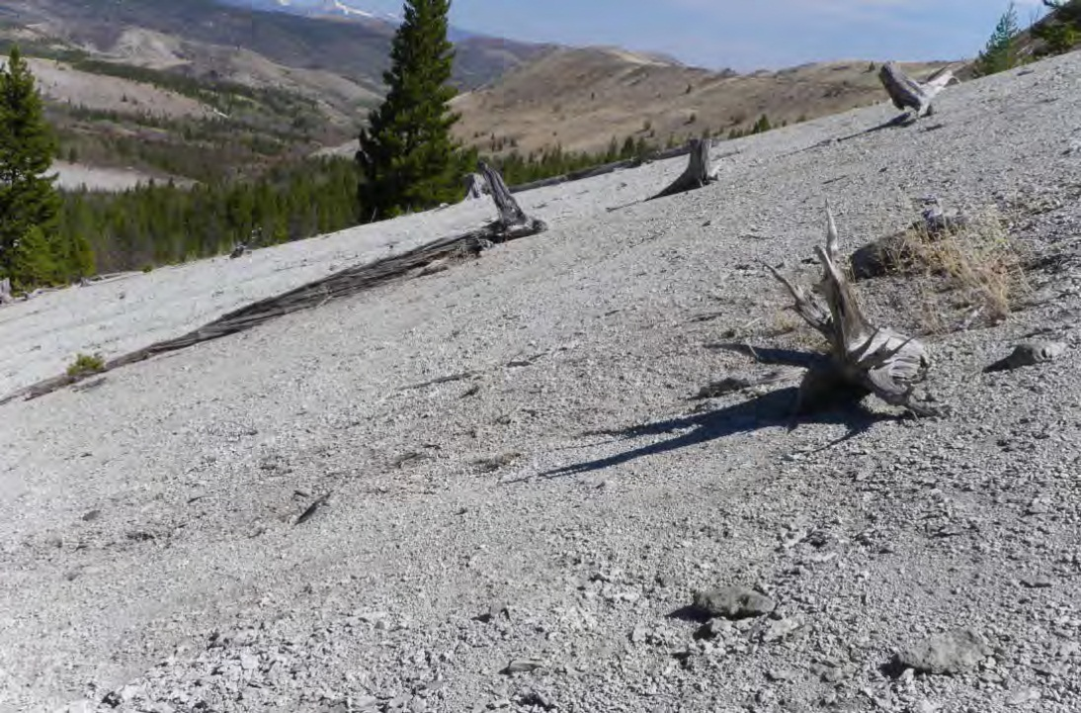
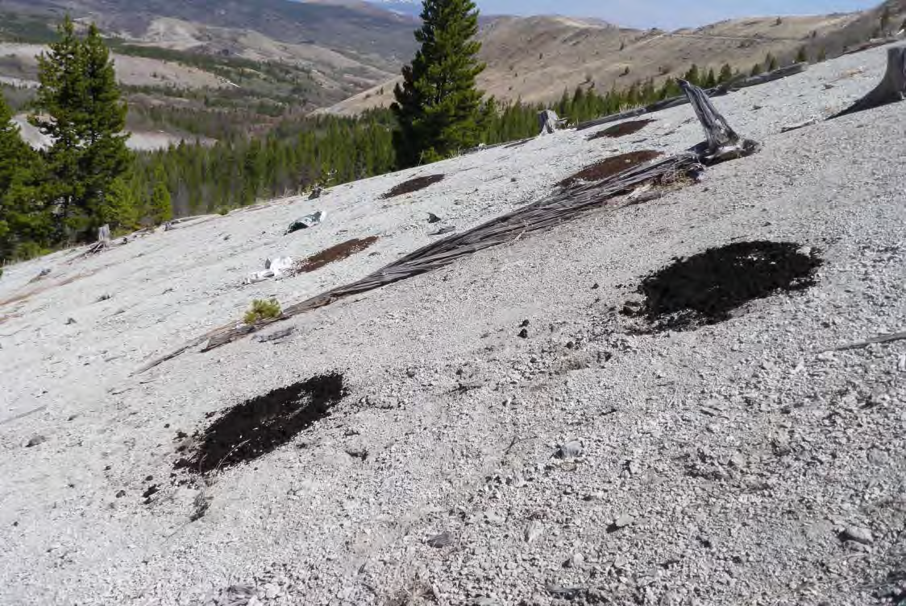
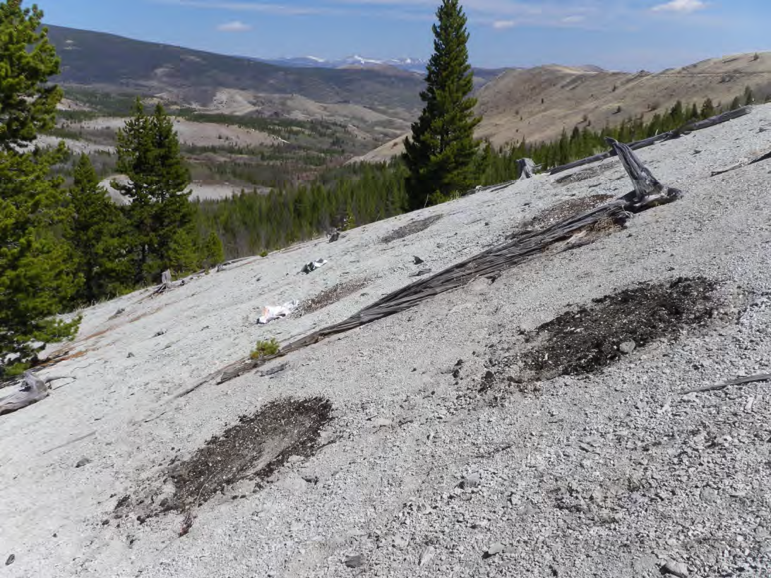
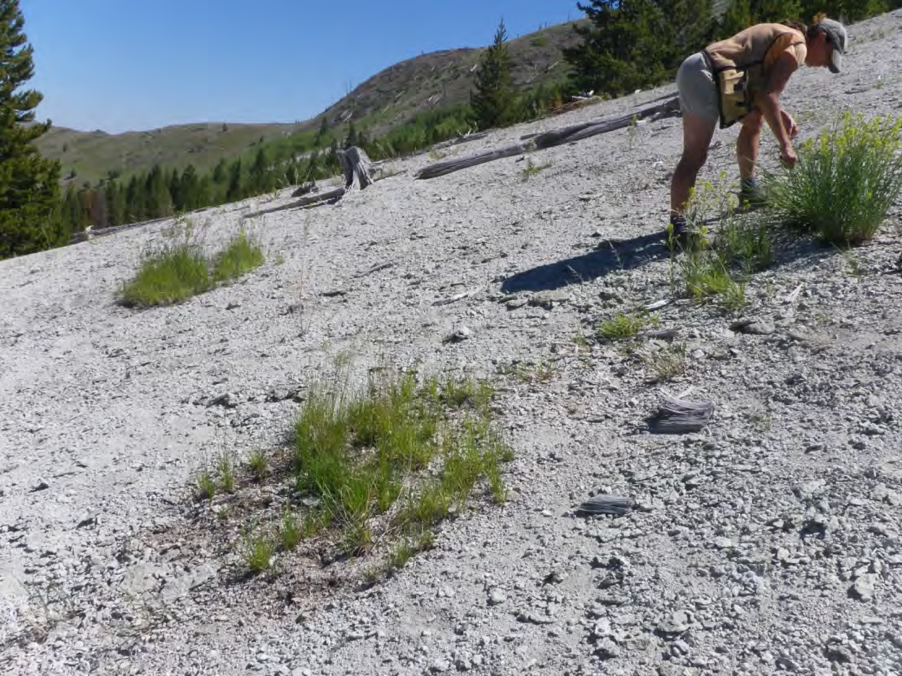
May 2012
OM test plots
July 2014
Incorporation by Hand
Steep Slope Reclamation
Fertilizer Demonstration Plots
Images courtesy of Stuart Jennings

Slide 37
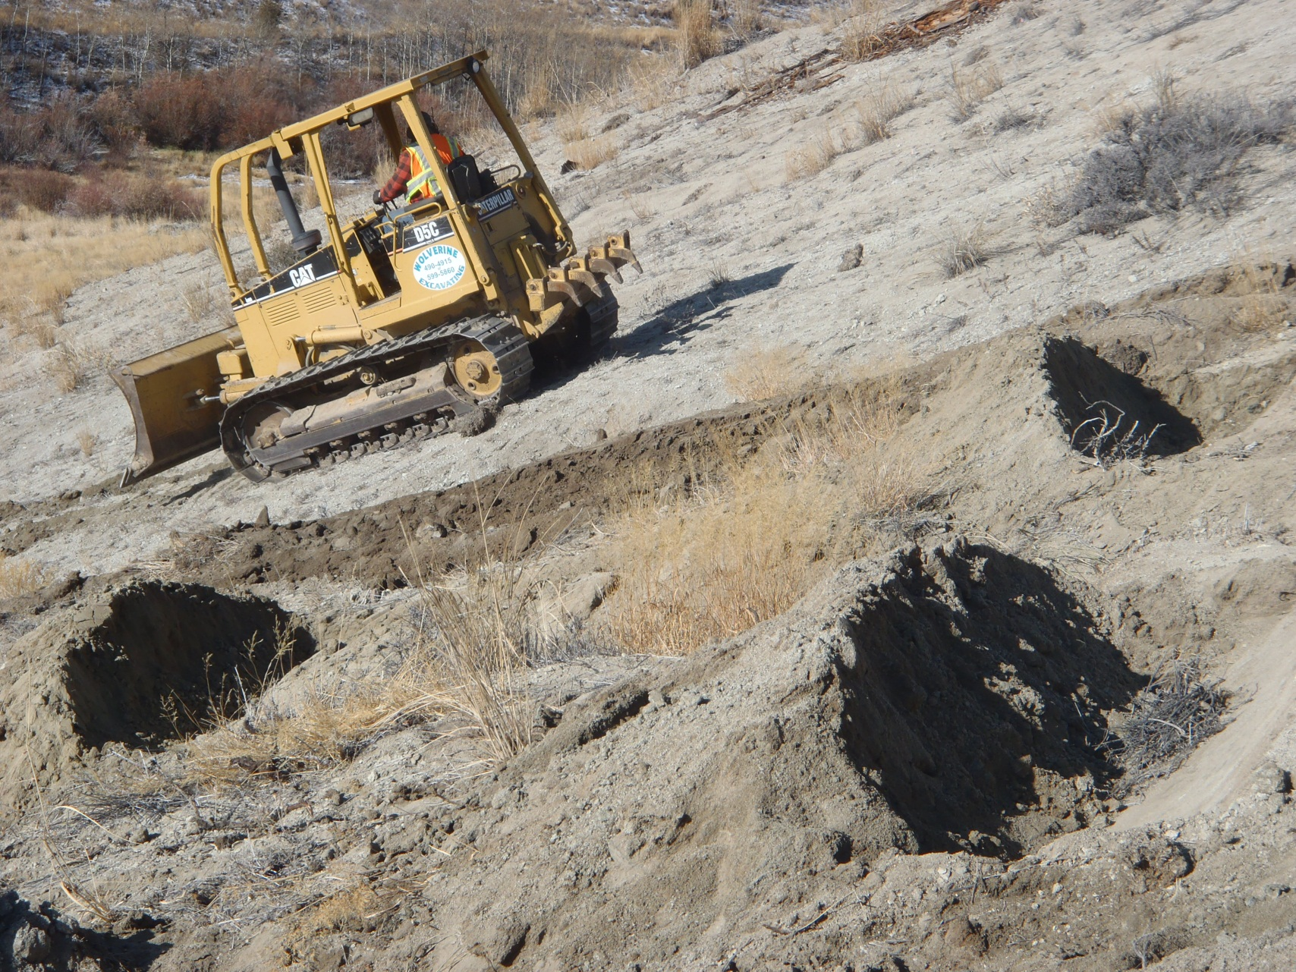
Constructing Dozer Basins
Steep Slope Reclamation
Image courtesy of Greg Mullen

Slide 38
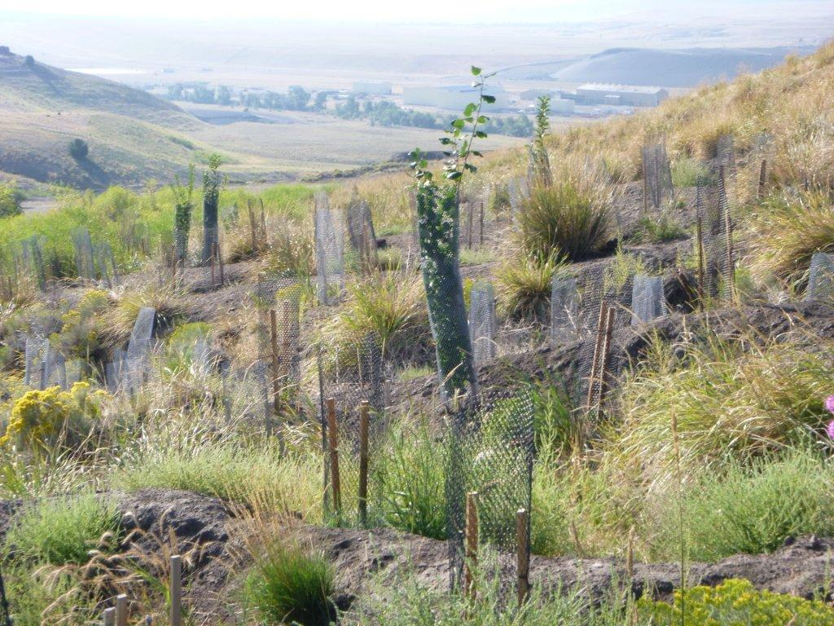
Planting of Trees, Shrubs and Grasses
Steep Slope Reclamation
Image courtesy of Greg Mullen

Slide 39
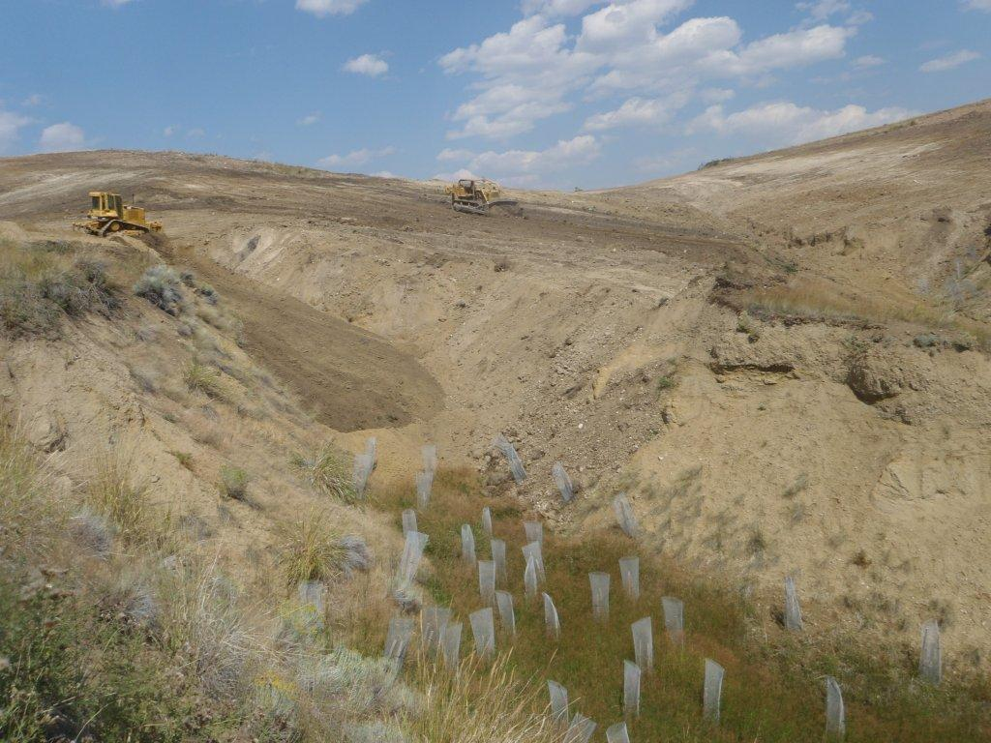
Grading Steep Gullies on Stucky Ridge
Steep Slope Reclamation
Image courtesy of Greg Mullen

Slide 40
Basis of Design for Soil Treatment
Anaconda Revegetation Treatability Studies (ARTS)
Stucky Ridge 1995 and 1999 Demonstrations
Opportunity Ponds Vegetation Improvement Demonstration
Previously completed remedial actions using in situ treatment as a component of remedy
Drag Strip
Old Works Industrial Area
Successes and Failures

Slide 41
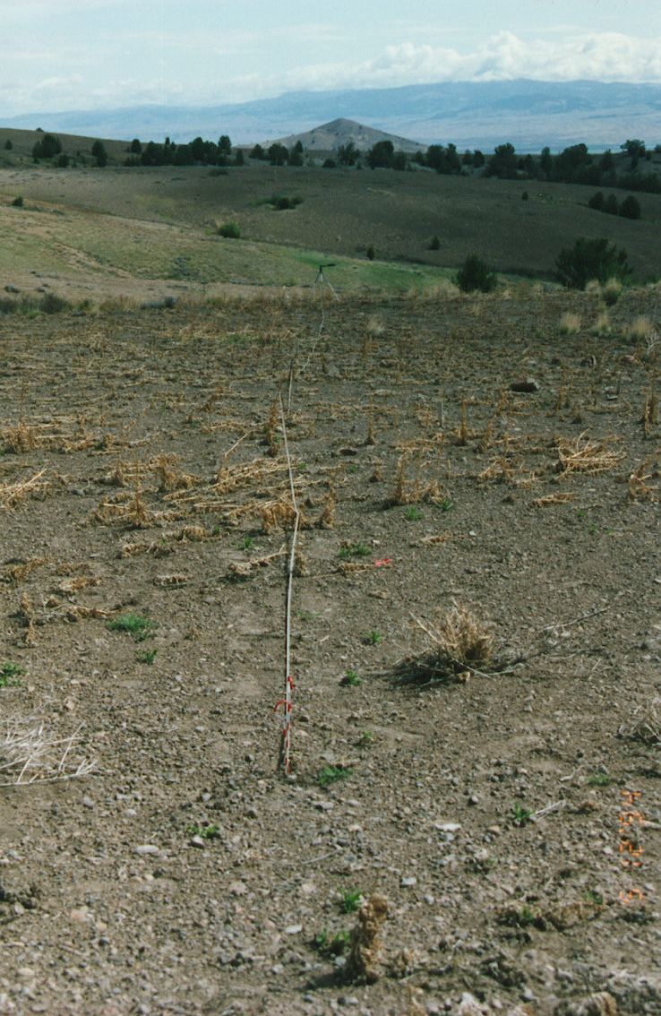

Slide 42
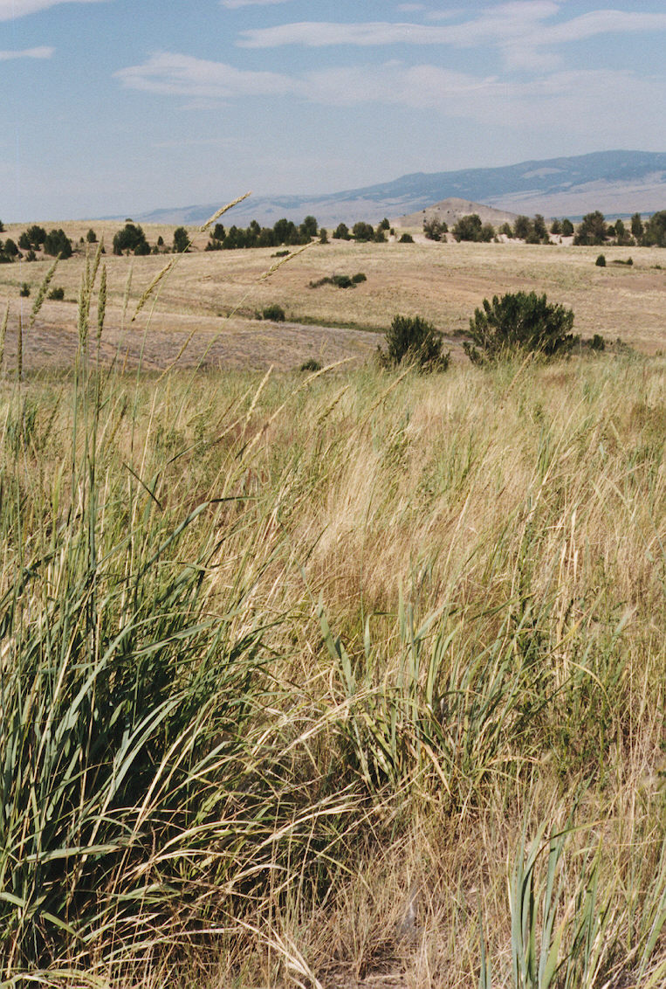

Slide 43
Soil Treatment Design Criteria Issues
pH
Organic Matter
Depth of Treatment
Liming Rates
Alkaline Amendment Sources
Steep Slopes
Phytotoxicity - Contaminant of Concern (COC) concentrations

Slide 44
Depth of Treatment
Minimum depth of plant growth media of 18 inches based on >20 years of success/failure
Depth of incorporation in 6 inch intervals based on experience with equipment (T6 = Treatment to 6 inches)
T6, T12 – done with conventional tilling equipment (Rhome disc)
T18 – significantly more expensive (Bomag rotary mixer)
T12 limitation for aerially-contaminated soils

Slide 45
pH
Treatment Trigger
0-6 inch interval, must be 6.5 or greater
Deeper intervals, must be 6.0 or greater
Growth Media Treatment Requirements
Between 6.5 and 8.5 for tilling alone
Between 7.0 and 8.5 if neutralizing amendments are used

Slide 46
Alkaline Amendments
High cost of lime drove evaluation of alkaline waste by-products (cement and lime kiln dust)
Concern over trace metals in these materials necessitated greenhouse studies
Many amendments approved
increasing alkaline amendment rates equated to decreased plant productivity based on greenhouse studies

Slide 47
Lime Equation for Soil Treatment
Lime Rate (tons CaCO3/1000 tons waste) =
[(HNO3-S + Residual-S)31.25 + (HCl-S)23.44 + [SMP buffer]]1.25
Modified for areas impacted solely by smelter emissions:
Lime Rate (tons CaCO3/1000 tons waste) = [SMP buffer]1.00

Slide 48
Organic Matter (OM)
OM content in top six inches of treated growth media must be 1.5%
Although vegetation is sparse or barren, many areas have intact soil “A” horizons
Stucky Ridge studies show that intact soil horizons meet the criteria, even after mixing
Areas with no or partial “A” horizons require post-treatment testing to determine organic matter requirement

Slide 49
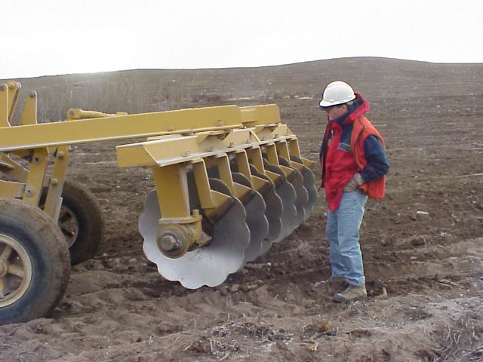

Slide 50
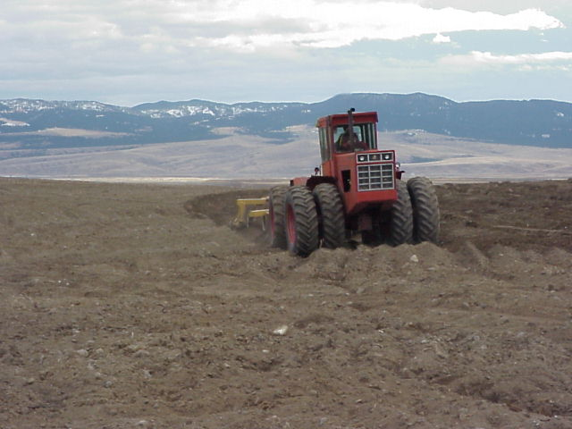

Slide 51
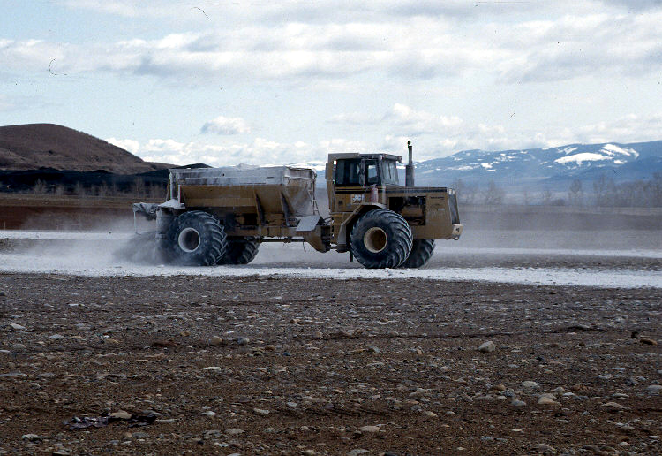

Slide 52
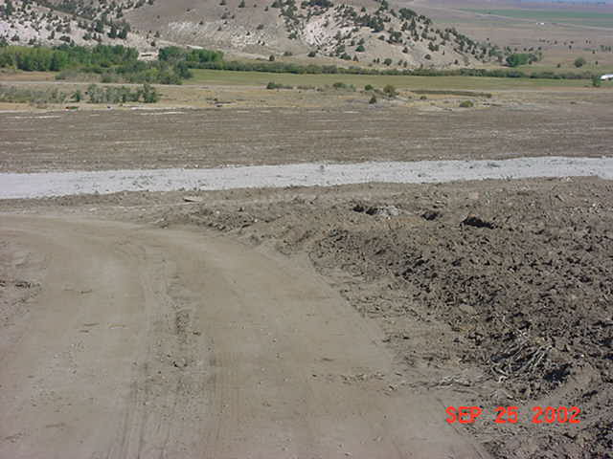

Slide 53
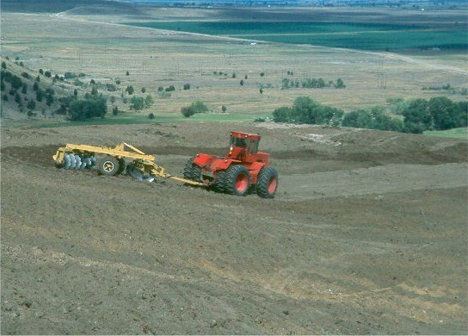

Slide 55
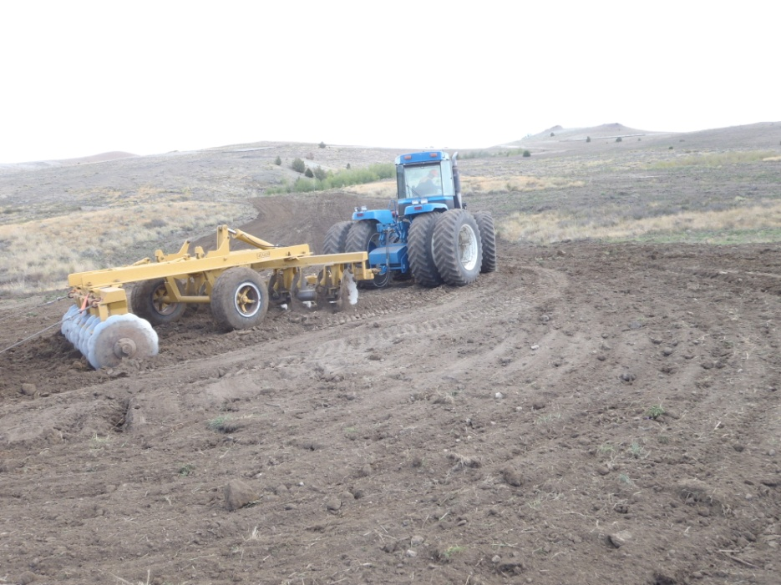
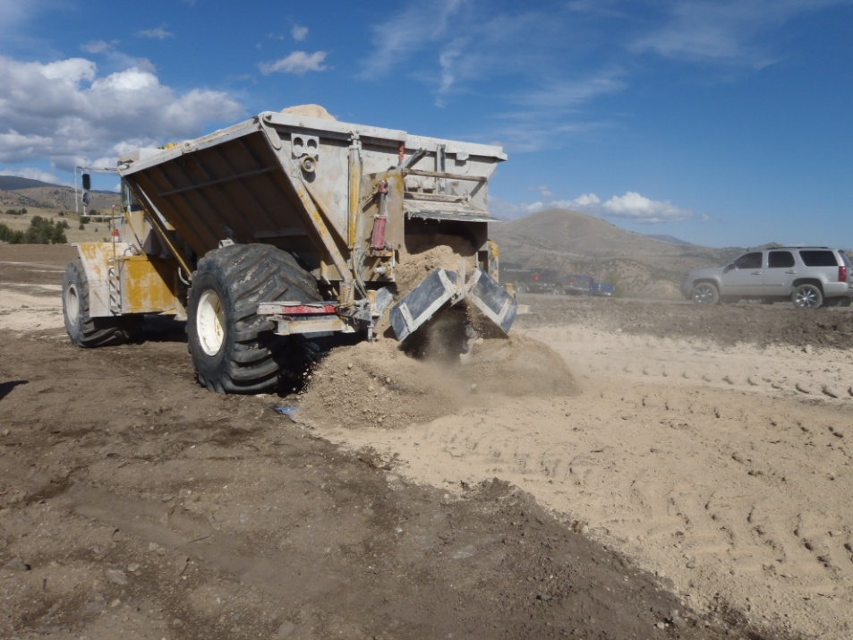

Deep tillage on Stucky Ridge, 2011
Terrogator spreading sugar beet lime
Spreading composted manure
Remedial Action

Slide 56

RDU1 Stucky Ridge – Remedial Design
Remedial Design/Remedial Action

Slide 57
Questions?
Remedial Design
Basis of Design
Implementation

Slide 58
Part 4 - Revegetation Success and Problems (2009-2012)
Topics
Reclamation success rate and the identification of problem areas (Five-Year Review)
Vegetation Response Investigation
Development of the Total Metal Index (TMI) for soil
Revegetation Success and Problems

Slide 59
Remediation Success
2010 Five Year Review inspected approximately 3,500 acres
Included all lands remediated from the 1990s through 2009
Most areas (~95%) were determined to be successfully reclaimed
Revegetation Success and Problems

Slide 60



2010 Anaconda Five Year Review Results
Examples of successfully treated areas
Revegetation Success and Problems
Notes:
Bunch of unanswered questions. Include: 1) how well are we meeting EPA’s objectives? 2) are soil conditions conducive to development of natural micro- flora and faunal populations necessary for natural nutrient cycling. A big problem is residual phytotoxicity.

Slide 61



2010 Anaconda Five Year Review Results
Examples of Poor Plant Establishment and Site Conditions
3 Years Old
12+ Years Old
8 Years Old
Residual Soil Phytotoxicity?
Revegetation Success and Problems

Slide 62


Stressed, chlorotic bunchgrasses in the Stucky Ridge Moto-X Demo Plots Photograph taken in July 2010 during FYR site inspection
2010 Anaconda Five Year Review Results
Revegetation Success and Problems

Slide 63

2010 Anaconda Five Year Review Results
Poor root development on trees dug up 8 years after planting (10 year old plant material)
Photograph taken in July 2010 during FYR site inspection
Revegetation Success and Problems

Slide 64
Concerns Identified in 2010 ARWW&S OU Five Year Review
Issues:
“The ground surface in some in-place treated areas is barren and unprotected; exposed to wind and water erosion. These areas have signs of phytotoxicity”
“Concerns with phytotoxicity and the long-term permanence of vegetation”
Recommendation:
“Determine why certain in-place treated areas have poor plant establishment”
Revegetation Success and Problems

Slide 65
Principal Study Questions for Vegetation Response Investigation
Soil Properties/Vegetation Response
What are the primary causes of revegetation shortcomings observed for in-place treated areas?
To what degree are residual metal concentrations limiting the establishment and development of the reclamation plant species?
Can the concentration of metals in the root zone be correlated to vegetation response?
Is there a metal threshold above which in-place soil treatment is likely to fail and the selected remedy should be stripping/removal or coversoil application?
Vegetation Response Investigation

Slide 66
Principal Study Questions (cont)
Long-term Protection of the Remedial Action
Can the total residual soil metal concentration be related to the vulnerability of the reestablished plant community?
What lands may require specific land management practices and more frequent inspections to protect the remedy?
What are the appropriate types of post-RA land uses given different levels of residual root zone contamination?
Vegetation Response Investigation

Slide 67

2011 Vegetation Response Study Approach
Correlate soil and vegetation data from in-place treated sites
Evaluate metal/vegetation response literature
- General literature
- Upper Clark Fork River ecological risk studies and models
Evaluate data from previous Anaconda vegetation/soil greenhouse studies
Vegetation Response Investigation

Slide 68
2011 Vegetation Response Study Parameters
Total metal concentrations (As, Cd, Cu, Pb, Mn, and Zn)
Soluble metal, cation, and anion concentrations (As, Cd, Cu, Pb, Mn, Zn, Ca, Mg, Na, NO₃, SO₄ )
pH and electrical conductivity
Exchangeable metal and cation concentrations (As, Cd, Cu, Pb, Mn, Zn, Ca, Mg, Na and K)
Cation exchange capacity
Particle size and texture classification
Percent rock fragments
Acid base account
Fertility (available N, P, and K)
Organic matter
Soil respiration
Vegetation cover measurements
Vegetation Response Investigation

Slide 69

2011 Vegetation Response Study
30 sites investigated:
26 in-place treated sites
1 stripped and treated site
3 untreated sites
Sites ranged in age from 3 to 16 years
Located 0.25 to 6.5 miles from smelters
Soil contamination ranges from background to very high metal levels
Vegetation Response Investigation

Slide 70
Regional Phytotoxicity and Ecological Risk Research
Upper Clark Fork River NPL Sites
EPA Baseline Risk Assessments for Anaconda Smelter and Clark Fork River NPL Sites
ARCO Regional Ecorisk Field Investigation, Upper Clark Fork River Basin
Several independent investigation of metal and arsenic impacts to soils, vegetation, and habitat in riparian and upland environments near Anaconda
Spatial effects modeling of plant growth and soil metal concentrations associated with Anaconda smelter
East Helena (Montana) NPL Site
East Helena Smelter NPL Site metal toxicity investigations
Vegetation Response Investigation

Slide 71


Anaconda Plant Growth Studies
Three well controlled greenhouse studies using Anaconda soil
Smelter Hill Borrow Soil Greenhouse Investigation (ARCO 2002)
Clear and Grub Greenhouse Investigation (ARCO 2005)
Emergence and Growth Investigation (Martin 2009, Montana State Univ.)
Vegetation Response Investigation

Slide 72

2011 EPA Field Work Results
Vegetation Response Investigation

Slide 73

Smelter Hill Borrow Study Results (ARCO 2002)
Average Plant growth reduction for all species and soil types
Vegetation Response Investigation

Slide 74

Clear and Grub Study Results (ARCO 2005)
Vegetation Response Investigation

Slide 75

Martin (MSU) Study Results
Vegetation Response Investigation

Slide 76

Curves for all species in each greenhouse study
Vegetation Response Investigation
Notes:
Comparison between three ARWW&S phytotoxicity models based on soil total metal levels and greenhouse measured reductions in plant root and shoot biomass across all species.
The field metal concentrations measured during the 2011 VS Investigation are plotted against each model suggesting expected reductions in field plant growth using greenhouse measured plant response.

Slide 77
Conclusions From 2011 Vegetation Response Investigation
Both the 2011-collected data and the previously conducted greenhouse biomass data showed similar trends:
At near neutral soil pH, decreases in plant attributes occur with increasing soil contaminant concentrations
Once soil pH is near neutral, successful revegetation is likely when the sum of total As+Cd+Cu+Pb+Zn concentration is less than about 1,000 mg/kg
Highly contaminated soil can be revegetated, but when the total As+Cd+Cu+Pb+Zn concentration is more than about 2,000 mg/kg, successful revegetation is significantly jeopardized
But what is the in-place remediation risk threshold?
Vegetation Response Investigation

Slide 78
Development of the Total Metal Index (TMI)
Developed in 2012 based on the results of the vegetation response study, a soil metal/plant growth index was derived to:
describe the general level of contaminant-related plant stress
be a remedial decision guideline to predict when in-place soil treatment is likely to result in a remediation failure
identify areas that may be under elevated metal-related stress and therefore heightened susceptibility to the additional stress of livestock grazing and other post-reclamation land uses
help land managers protect and promote the newly established plant communities on these lands.
Total Metal index

Slide 79
ARWW&S OU Total Metal Index (TMI)
Soil Metal Index (Sum of Total As+Cu+Zn in mg/kg) | Soil Arsenic Index (mg/kg) | General Plant Stress Level Due to Soil Contaminants
700- | 166- | Very Low
1,200 | 245 | Low
1,450 | 290 | Low-Moderate
1,700 | 330 | Moderate
2,300 | 430 | Moderate-High
2,900 | 530 | High
3,500+ | 630+ | Very High
Soil arsenic concentrations correlate well with the TMI and therefore represents a reasonable and valid means to identify areas where residual phytotoxic conditions are likely to exist
Total Metal index

Slide 80
Questions?
Vegetation Response Investigation
Total Metal Index (TMI)
Vegetation Response Investigation

Slide 81
Part 5 - Evaluating Remedial Performance (since 2005)
Vegetation Management Plan (VMP)
Performance Criteria and Compliance Standards
Remedial Contingencies
Evaluating Remedial Performance

Slide 82
Vegetation Management Plan (VMP)
Developed starting in 2003 and approved in 2009
Revised in 2013
Describes EPA’s requirements for remediated land at ARWW&S OU pursuant to provisions set forth in the 1998 ROD and 2011 ROD Amendment.
Specifically, the VMP identifies:
Agency and PRP responsibilities with respect to monitoring and inspecting reclaimed areas;
Evaluation methods and performance standards, and;
Requirements for conducting maintenance activities.
Evaluating Remedial Performance

Slide 83
Remedial Action Performance Evaluations
Steps
Vegetation establishment and site stability (marks end of construction phase)
Monitoring and maintenance
Compliance determination
Criteria and Standards
Qualitative inspection by EPA using Operational and Functional (O&F) criteria. Performed after first full growing season
Monitoring and maintenance by Atlantic Richfield and EPA. Performed in years 2-10.
Compliance determination by EPA. Sites that pass are successfully remediated and move into Long-Term Inspection and Maintenance phase
Evaluating Remedial Performance

Slide 84


Stripped, amended, tilled, and seeded – judged to be operational and functional (O&F)
Step 1 - Vegetation Establishment
Conducted by CDM Smith for EPA
Treated In-Place and seeded (non-O&F)
Evaluating Remedial Performance

Slide 85


Step 2 - Short-term Monitoring and Maintenance
Conducted by Atlantic Richfield
Simplistic, annual evaluation:
- vegetation condition
- site stability
- BMPs
Generally lasts from 2-10 years
Pre-compliance application
Evaluating Remedial Performance

Slide 86

Step 3 - Compliance Determination
Conducted by CDM Smith for EPA
Separate methods and criteria for:
- Upland Areas
- Waste Management Areas (WMAs)
- Steep Slope Areas (SSAs)
Evaluating Remedial Performance

Slide 87
Performance Compliance Standard for Upland Areas
Reclaimed Area Attributes | Standard | Description
Plant Community Measures and Soil Stability Indicators | LRES total score >115 points | Site is evaluated using LRES methodology. Involves scoring vegetation and soil attributes.
Evaluating Remedial Performance

Slide 88
Performance Standards for Other Areas
Waste Management Areas
Semi-quantitative estimates of perennial plant cover, noxious weeds, bare areas, and erosion.
Steep Slope Areas
Semi-quantitative estimates woody plant density and erosion

Slide 89
Questions?
Vegetation Monitoring
Performance Standards
Evaluating Remedial Performance

Slide 90
Part 6 Post Remediation Land Use and Management
Coordination with landowners
Categories
Land management plans
Revised Vegetation Management Plan

Slide 91
Coordination with Landowners
Early soil remediation work was focused on property owned by the responsible party
As work moved to private property, landowners wanted compensation for loss of grazing land
Achievement of vegetation performance standards may take several years
For rural residential developments, developers wanted cleanup to unrestricted use
Post Remediation Land Use and Management

Slide 92
Changes to the Vegetation Management Plan
2009 Original VMP
Considered only vegetation response
All remediated soil areas treated the same, regardless of the contaminant concentrations remaining in the soil
Required a LRES score of 115 for two consecutive years to meet performance standards
2013 Revised VMP
Used knowledge gained from Vegetation Response Study to develop 6 land management categories
Early “off ramp” for sites cleaned to the highest land use (residential development)
Constructing storm water engineered controls around most contaminated lands reduce restrictions on private property
Post Remediation Land Use and Management

Slide 93
Long Term Land Management
Three Areas/Different Requirements
Waste Management Areas
- owned by PRP
- long term I&M plan
- EPA five year review
Outer Areas (low metals/plant stress)
- privately owned and managed
- EPA five year review (only monitoring requirement, not for Category 1 and 2)
Vegetation Management Areas
- privately owned and managed
- Land Management Plan required
- PRP annual monitoring required
- EPA five year review

Slide 94
Land Management Categories
Based on the wide range of post-RA soil contaminant concentration levels, land ownership, and the various types of anticipated land uses, properties have been divided into six categories for the purposes of monitoring, maintenance, institutional controls, and determining compliance
Category 1. Unrestricted Use Properties – soil less than 250 mg/kg arsenic;
Category 2. Upland Properties - Low to Moderate (up to 1,700 mg/kg) total metal index (TMI) having enhanced reclamation;
Category 3. Upland Properties - Moderate to High (>1,701 mg/kg) TMI having enhanced reclamation and design;
Category 4. Upland Properties - Moderate to High (>1,701 mg/kg) TMI having enhanced reclamation and a land management plan where enhanced design is not feasible;
Category 5. High Arsenic Areas (HAAs), and;
Category 6. Waste Management Areas (WMAs).
Post Remediation Land Use and Management

Slide 95
Benefits of Improved Vegetation Management Plan
2009 Vegetation Management Plan
Reduce arsenic concentrations below the 1,000 mg/kg recreational/open space agricultural land use action level
Meet vegetation performance standards (can take up to 10 years)
2013 Revised Vegetation Management Plan
Creates incentives for responsible party to complete better cleanup (e.g., further reduce arsenic and metals concentrations means less restrictions, monitoring, and maintenance)
Private landowners get property back quicker and with less restrictions – “ready for reuse”
Better cleanup means less emphasis on institutional controls
Post Remediation Land Use and Management

Slide 96

Questions?

