Slide 1
Characterization and Remediation of Iron(III) Oxide-rich Scale in a Pipeline Carrying Acid Mine Drainage at Iron Mountain Mine, California, USA
Kate Campbell¹, Charles Alpers², D. Kirk Nordstrom¹, and Alex Blum¹
¹USGS, Boulder, CO
²USGS, Sacramento, CA

Slide 2
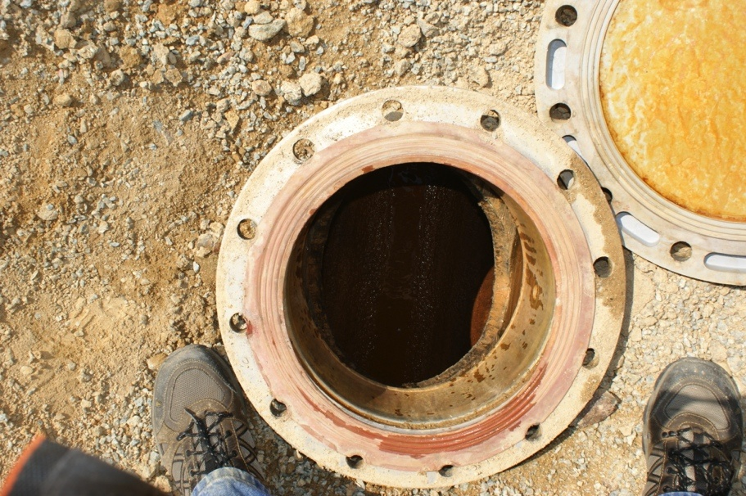
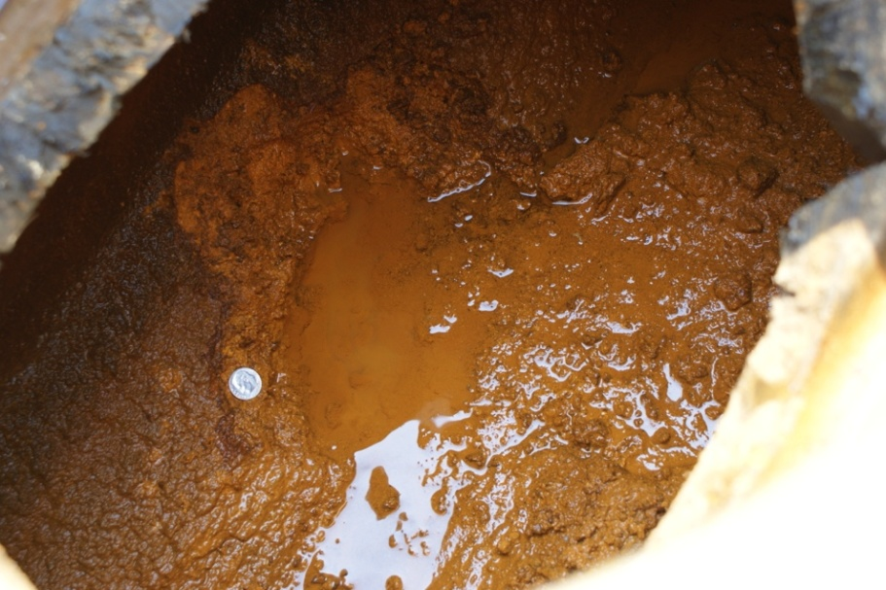
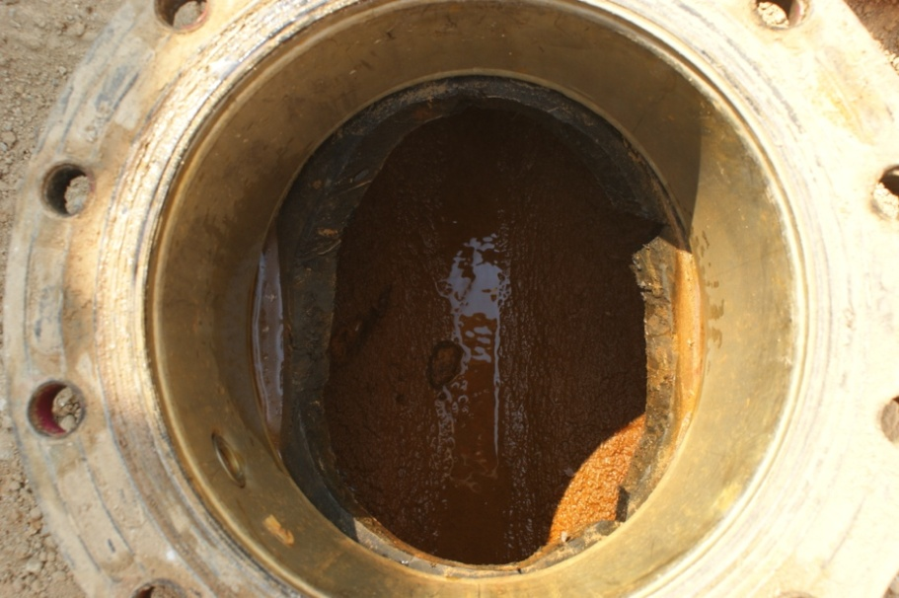
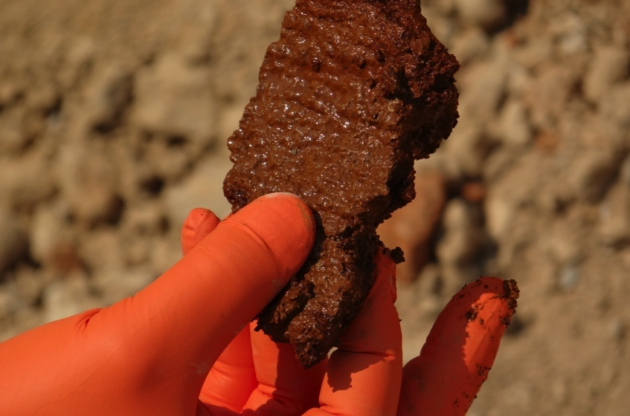
Pipe scale in AMD pipeline
Pipe scale causes clogging and requires costly clean-out every 2-4 years
Introduction

Slide 3
Pipelines and water treatment at IMM
Introduction

Slide 4
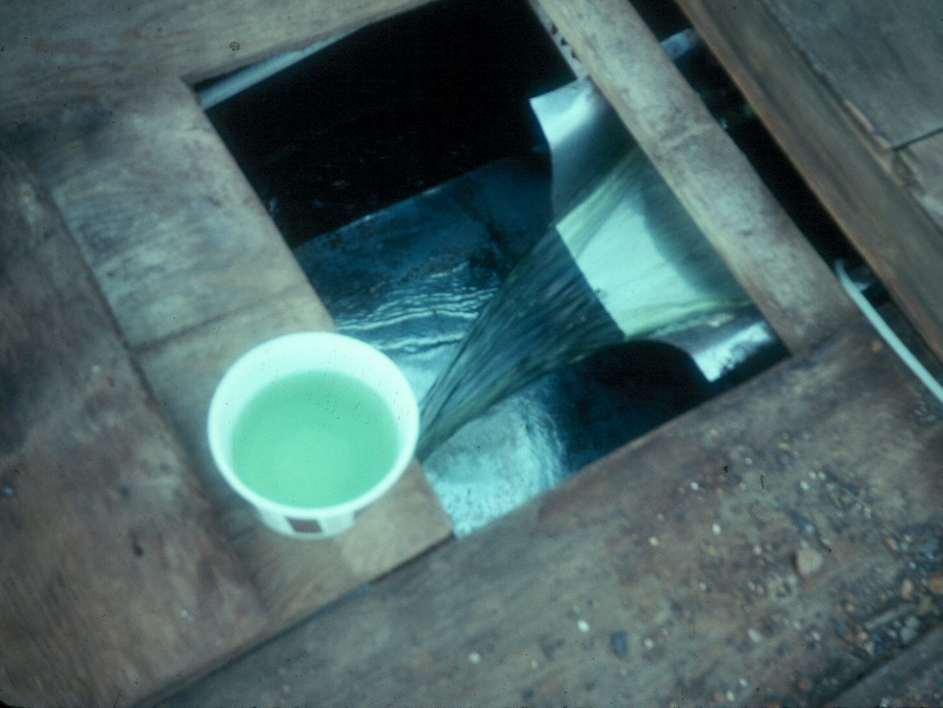
Influent water to pipelines
Richmond
PW3
pH = 0.5
Fe = 12,000 mg/L
Sulfate = 49,000 mg/L
pH = 2.6
Fe = 1,400 mg/L
Sulfate = 7,000 mg/L
Introduction

Slide 5
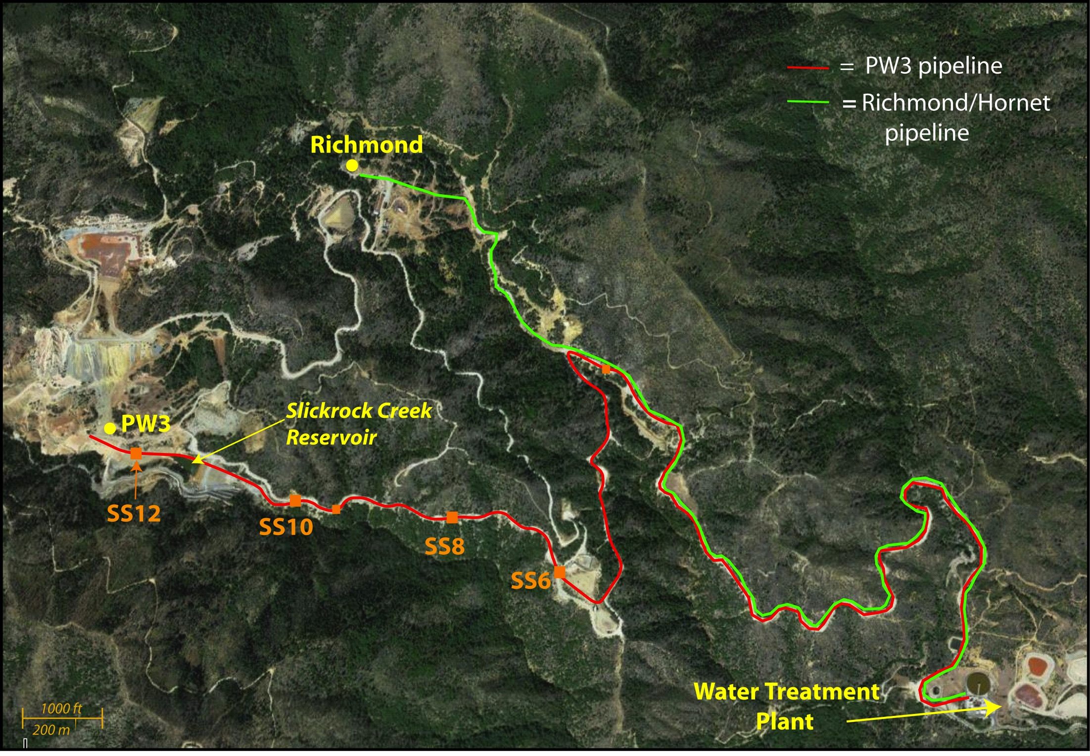
Water and Scale Sample Collection
Introduction

Slide 6
Research Objectives
Characterize water chemistry and pipe scale composition
Identify biogeochemical processes leading to scale formation
Identify strategies to prevent or retard scale formation in the pipeline
Introduction

Slide 7
Pipeline Water Chemistry
Site name | pH | Fe(T) | Fe(II) | Fe(III) | Sulfate
 |  | mg/L | mg/L | mg/L | mg/L
PW3 | 2.62 | 1460 | 1440 | <40 | 6890
SS12 | 2.63 | 1400 | 1400 | <40 | 6690
SS10 | 2.71 | 1390 | 1320 | 70 | 6480
SS8 | 2.73 | 1360 | 1040 | 320 | 6820
SS6 | 2.74 | 1360 | 1060 | 300 | 6770
Portal
downstream
Fe(II) oxidation and Fe(III) precipitation
Introduction ➔ Objective 1

Slide 8
Characterization of Pipe Scale
XRD, SEM
deionized water
Least aggressive
Wet chemical extractions
0.2M ammonium oxalate
Total elemental digestion
0.5M HCl
0.5M HCl
0.5M hydroxylamine HCl
C and N analysis (biomass)
Most aggressive
Microbial community
(16S rRNA by 454-pyrosequencing)
Fe oxidizing bacteria (MPNs)
Schwertmannite (Fe₈O₈(OH)₆SO₄) and Goethite (FeOOH) reference compounds
Introduction ➔ Objective 1

Slide 9
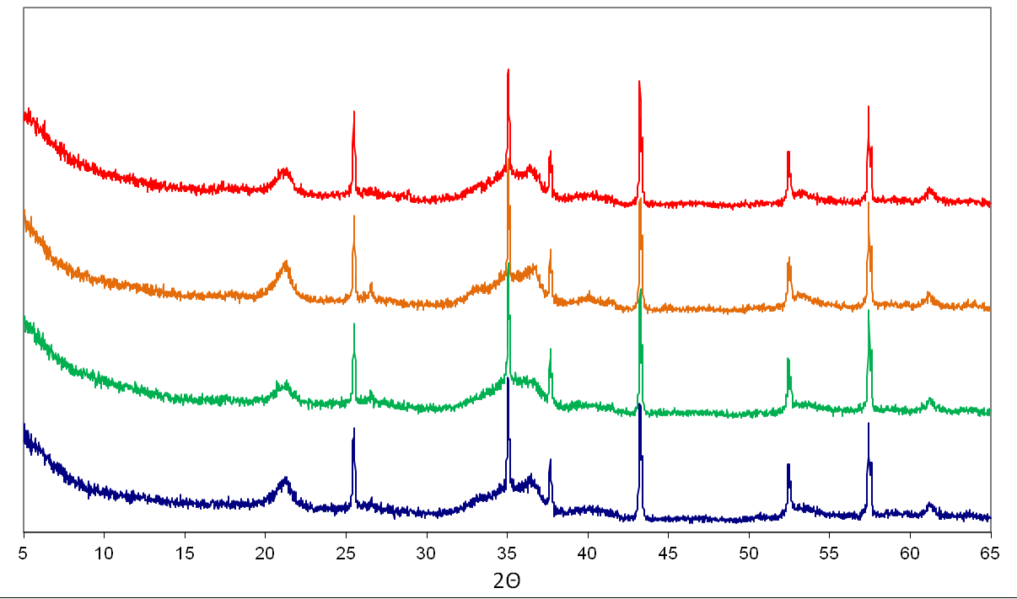
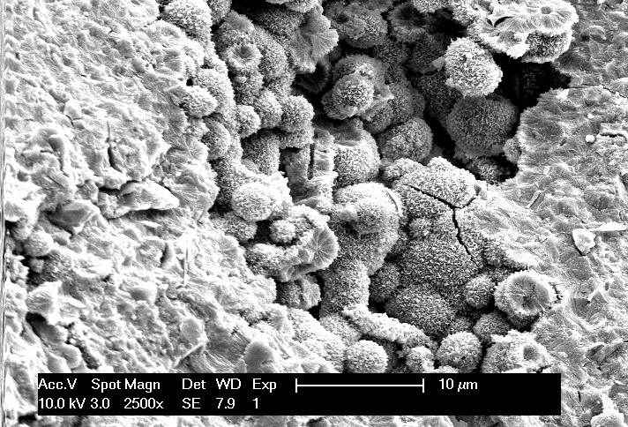
Characterization of Pipe Scale
Schwertmannite (broad peak) + goethite
Sharp peaks = corundum internal standard
Goethite
SS12
SS10
SS8
SS6
Bulk mineralogy is similar in all scale:
Primarily Schwertmannite [ideal composition: Fe₈O₈(OH)₆SO₄] with minor Goethite [FeOOH]
SEM courtesy of Amy Williams
Introduction ➔ Objective 1

Slide 10
Characterization of Pipe Scale
Fe
S
Fe and S were dominant elements in extractions –
Schwertmannite as primary phase
Similar amounts of Fe and S extracted in all 4 scale samples –
Bulk mineralogy is similar along the pipeline
Introduction ➔ Objective 1

Slide 11
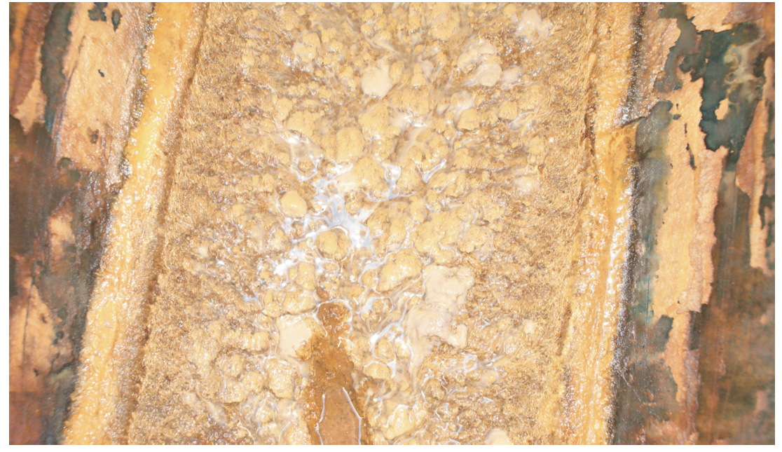
Characterization of Pipe Scale
Total C and N
SS12
~0.2m
Phosphate-extractable cells also highest in SS12
Most Probable Number (MPNs) for iron oxidizing bacteria
Biomass decreases along pipeline
Certain trace elements decrease along pipeline
Introduction ➔ Objective 1
Notes:
Plastic pipe
Macroscopic biomass

Slide 12
Scale Microbial Community (16S)
Dominant classifications:
Spirochaetales
Xanthomonadales
Burkholdariales
Acidithiobacillales
Nitrosprales
Holophagales
Chloroflexi
Propionobacteriales
Acidibacteriales
Thermoplasma
Diverse microbial community
Different community up-and down-stream
Many groups with known Fe oxidizers and other C,N metabolisms
Introduction ➔ Objective 1
Notes:
16S 454-pyrosequencing

Slide 13
Research Objective 1
Fe(II) is oxidized to Fe(III) in the pipeline, resulting in scale precipitation
Scale mineralogy: schwertmannite with trace amounts of goethite, jarosite
Biomass and trace elements in scale decrease along the length of the pipeline
Microbial community is diverse and is different between upstream and downstream scale
Introduction ➔ Objective 1

Slide 14
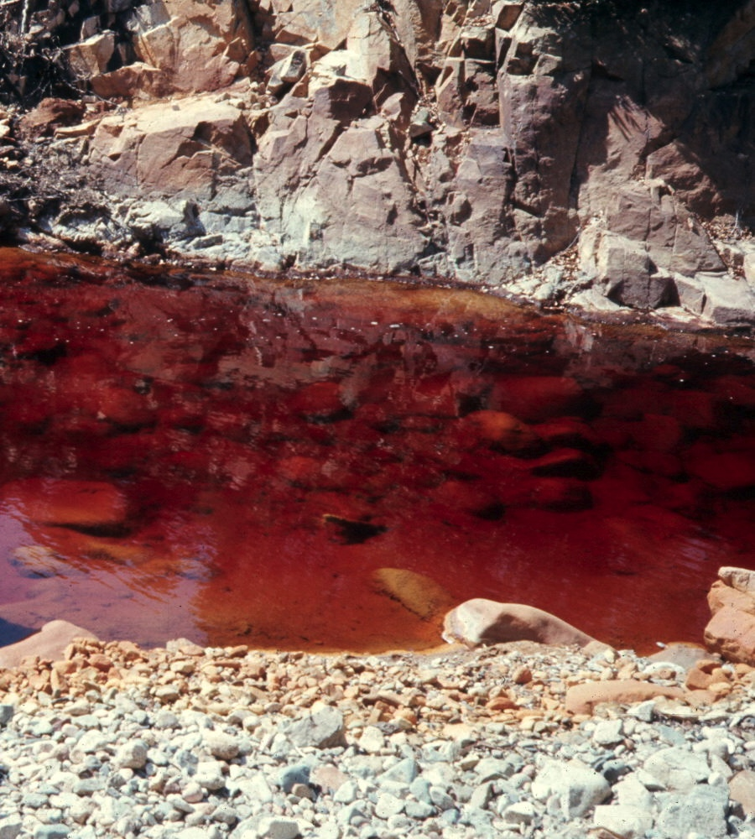
Research Objective 2: biogeochemical mechanisms
Iron(II) oxidation at pH <3:
Abiotic oxidation is slow…
… but microbially-mediated Fe(II) oxidation has been well-documented
Acidithiobacillus, Leptosprillium, Ferroplasma, Sulfobacillus, Acidimicrobium…
Introduction ➔ Objective 1 ➔ Objective 2

Slide 15
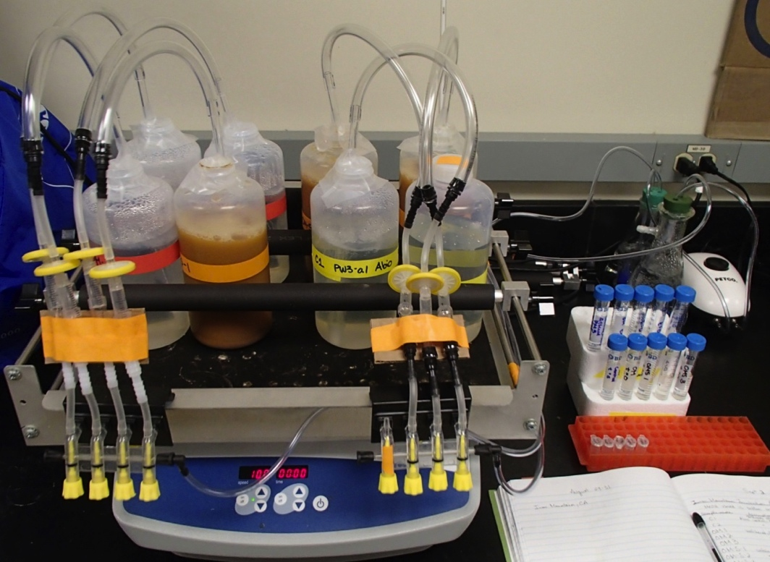
Research Objective 2: biogeochemical mechanisms
Batch experiments:
Water only = Biotic Fe(II) oxidation
Unfiltered
PW3
water
Water + scale = Biotic Fe(II) oxidation, effect of scale
0.1μm filtration
Control = Abiotic Fe(II) oxidation
Introduction ➔ Objective 1 ➔ Objective 2

Slide 16
Microbial Iron(II) Oxidation
Abiotic controls
Unfiltered water
Unfiltered water + scale
Fe(II) oxidation is a biotic process
Presence of scale impacts iron oxidation rates
Introduction ➔ Objective 1 ➔ Objective 2

Slide 17
Microbial Iron(II) Oxidation
Abiotic controls
Iron oxidation = increase pH
Iron precipitation = decrease pH
Iron precipitation is “seeded” by scale
Precipitate formed in water only condition is Schwertmannite
Unfiltered water + scale
Unfiltered water
Microbial Fe(II) oxidation
4Fe²⁺ + O₂ + 4H⁺ → 4Fe³⁺ + 2H₂O
Fe(III) hydrolysis/polymerization
Fe³⁺ + H₂O → FeOH²⁺ + H⁺
Schwertmannite precipitation
8Fe³⁺ + SO₄²⁻ + 14H₂O → Fe₈O₈(OH)₆(SO₄) + 22H⁺
Introduction ➔ Objective 1 ➔ Objective 2

Slide 18
Batch model: water only condition
Microbial Fe(II) oxidation kinetics
Kinetic schwertmannite precipitation
Dissolved Fe(III) polymer included
Introduction ➔ Objective 1 ➔ Objective 2
Notes:
Instead of jarosite, schwertmannite
Not just adding parameters – we are fitting as much as possible to data

Slide 19
Batch model: water + scale condition
Water only condition
Microbial Fe(II) oxidation kinetics
Schwertmannite precipitation kinetics
Kinetic surface pH buffering reaction
Introduction ➔ Objective 1 ➔ Objective 2

Slide 20
LiCl Tracer test for 1D reactive transport model
Introduction ➔ Objective 1 ➔ Objective 2

Slide 21
Research Objective 2
Iron oxidation is biotic
Iron precipitation is “seeded” by scale
Precipitate formed in batch experiments is similar to scale
Batch geochemical model
Kinetics: Microbial Fe oxidation, precipitation, surface buffering
Field scale processes
In situ rates of Fe oxidation
1D reactive transport model
test remediation strategies
application to other sites with pipe scaling
Introduction ➔ Objective 1 ➔ Objective 2

Slide 22
Research Objective 3 - mitigation
Mixing PW3 and Richmond waters:
Fe(II) oxidation may be hard to control
Precipitation can be prevented by decreasing pH
PHREEQC calculations of saturation index of schwertmannite
Variable Fe(III) concentrations, mixing ratios (pH)
~5% Richmond + 95% PW3
Batch experiments:
1%, 5%, 10% Richmond water, balance PW3
With and without scale (effect of pre-existing scale)
Range of Fe(III) conditions by inoculating with a microbial culture
Introduction ➔ Objective 1 ➔ Objective 2 ➔ Objective 3

Slide 23
Pipe Scale Mitigation
no scale
with scale
10%
10%
5%
5%
Fe(T)
1%
1%
pH
Precipitation in 1% Richmond – none in 5%, 10%
Scale buffers pH to 2.1-2.2
Decreasing pH by mixing with Richmond effective in preventing scale formation
Introduction ➔ Objective 1 ➔ Objective 2 ➔ Objective 3

Slide 24
Conclusions
Fe(II) is oxidized to Fe(III) in pipeline, resulting in precipitation
Fe(II) oxidation is microbially mediated
Scale is composed of schwertmannite, with minor goethite
Presence of scale “seeds” precipitation
Mixing of Richmond and PW3 as potential mitigation strategy
Confirm with field tests, over range of chemistry
Presence of scale strongly buffers pH
Buffering capacity of scale and rate of scale dissolution are important considerations for other mitigation strategies
1D reactive transport model for testing biogeochemical processes, remediation strategies
Field-scale modeling as guidance for effective planning
Introduction ➔ Objective 1 ➔ Objective 2 ➔ Objective 3 ➔ Conclusions

Slide 25
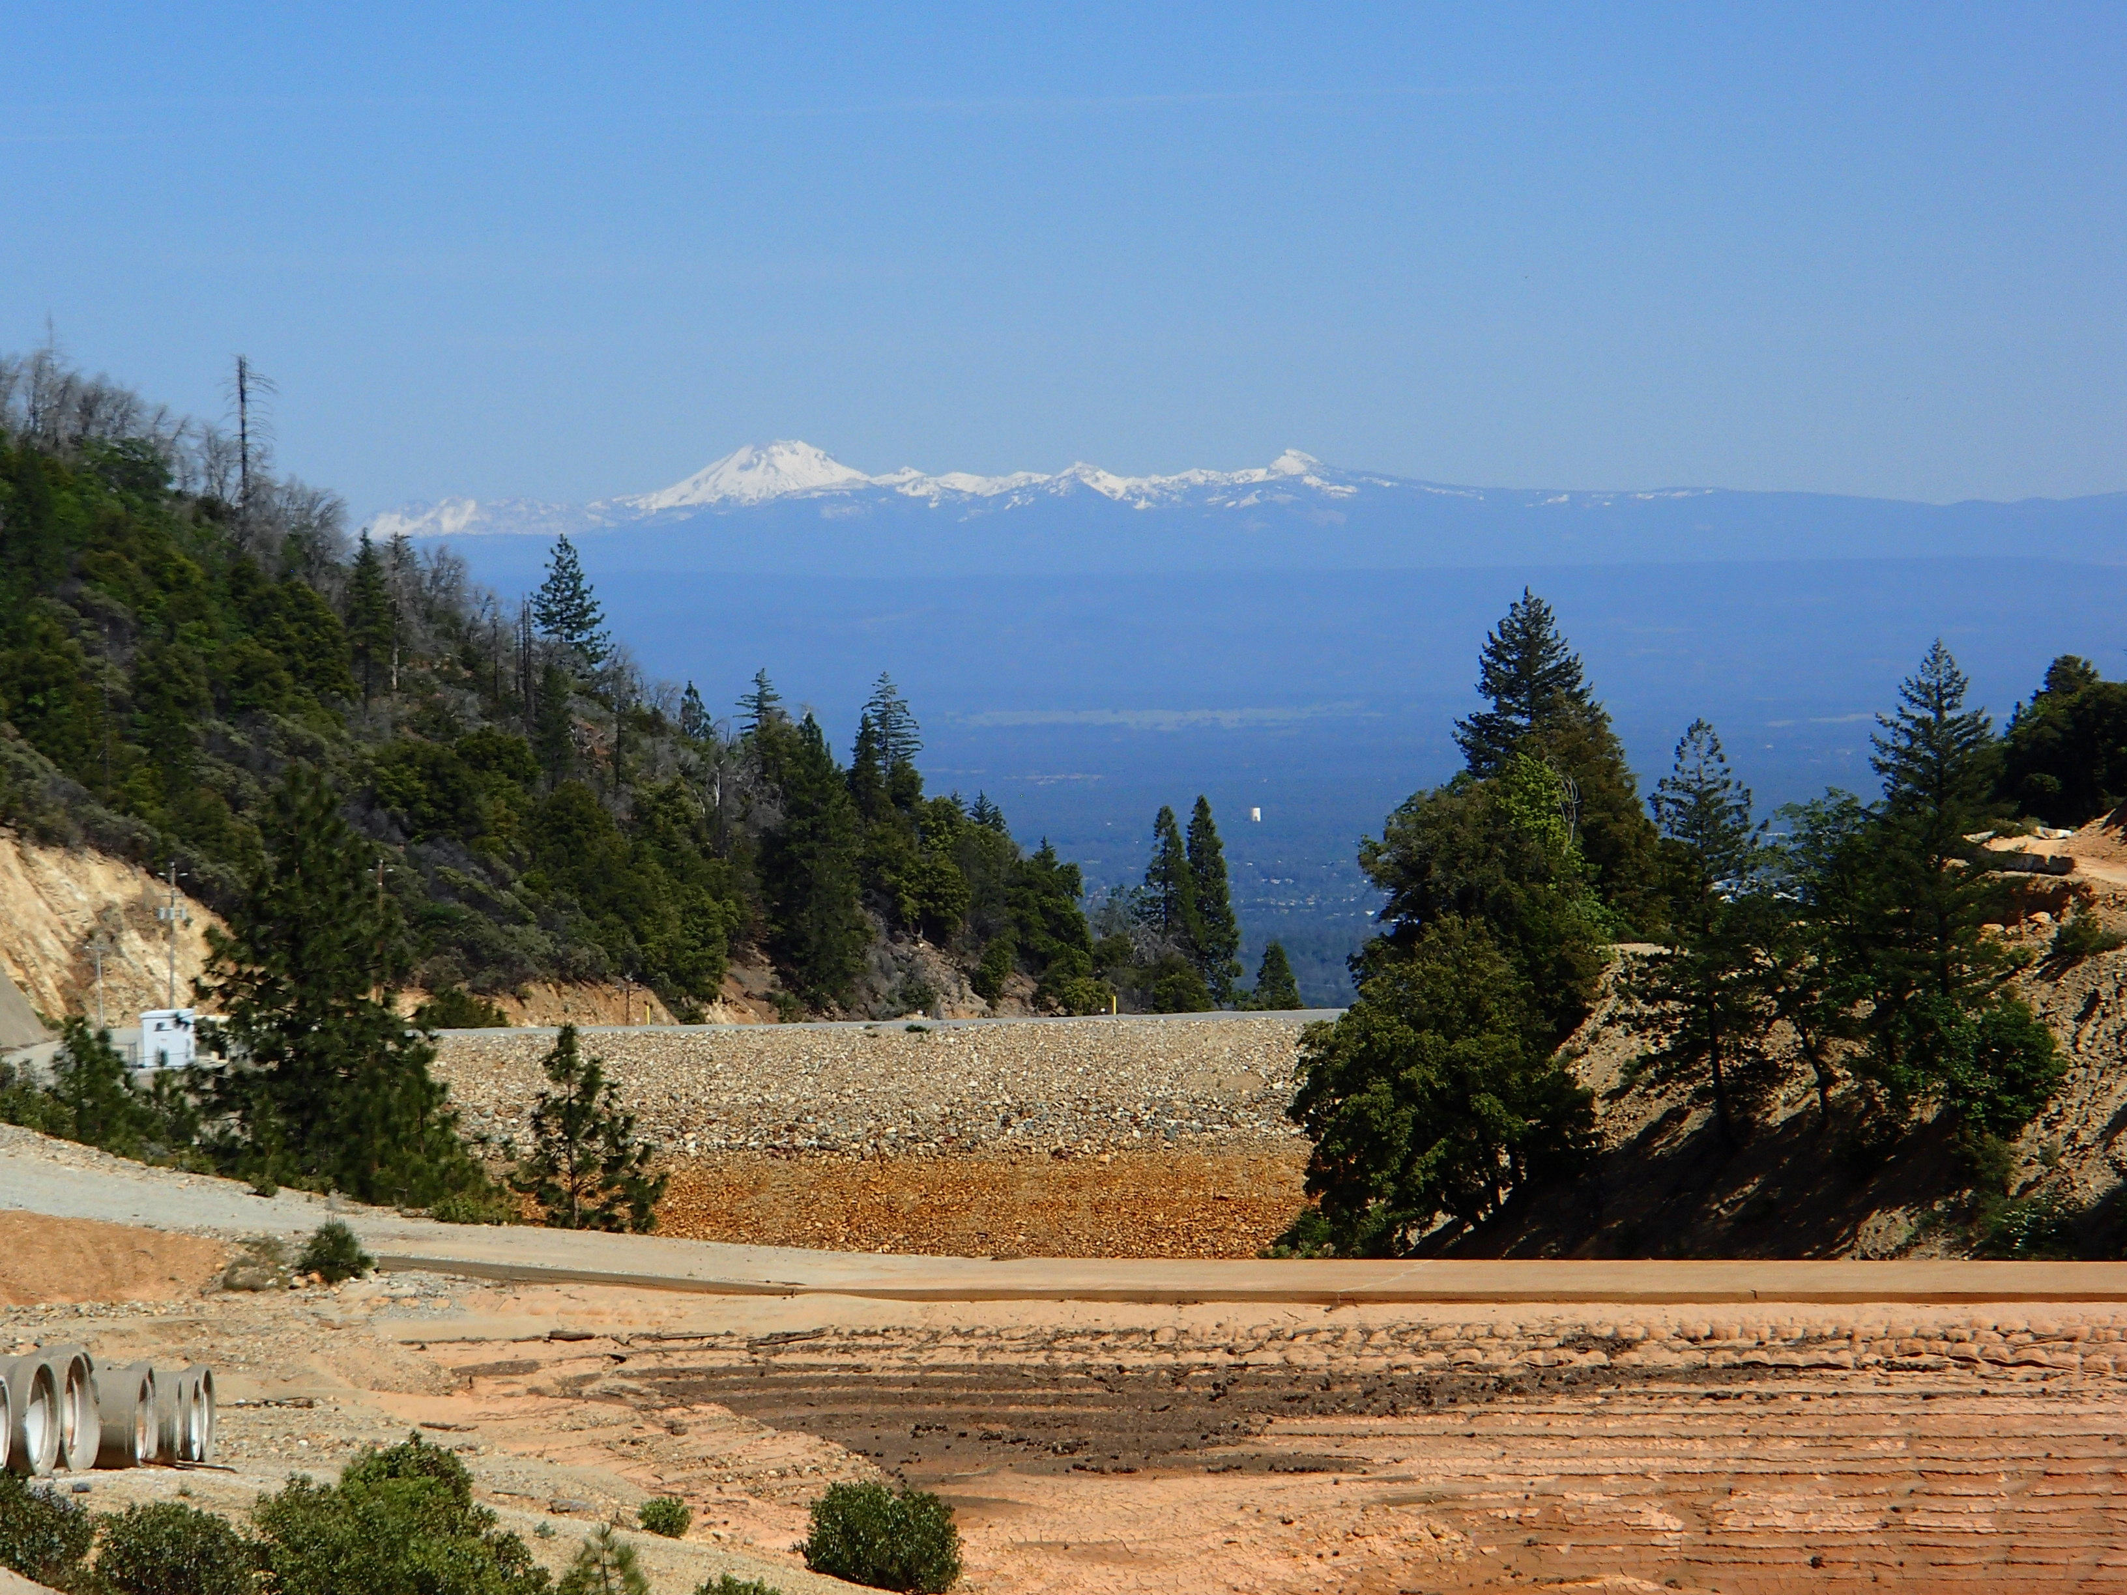
Thank you for your attention!
Acknowledgements:
James Sickles (US EPA)
Amy Williams (UC Davis)
Lily Tavassoli (US EPA)
Rudy Carver (Iron Mountain Operations)
Theron Elbe (Iron Mountain Operations)
Don Odean (Iron Mountain Operations)
Gary Campbell (USGS)
JoAnna Barrell (Colorado School of Mines)
David Metge (USGS)
Deb Repert (USGS

