Slide 1
Iron Mountain Mine Superfund Site Long Term O&M Challenges
December 17, 2014 James Sickles, U.S. EPA Region 9
Water Treatment: Iron Mountain Mine and Bunker Hill Mining and Metallurgical Complex Superfund Sites
Notes:
View of Slickrock Creek Retention Reservoir – Slickrock Creek drainage – 150 acres – 220 ac ft capacity – Slickrock Creek landsilde – 24 m (80 feet) in 1955

Slide 2
Iron Mountain Mine Site
Site Setting
Mining Impacts
Geologic Setting
Mining Chronology
Mining Processes
Site Remedial Components
O&M Challenges
Issues and the Future

Slide 3
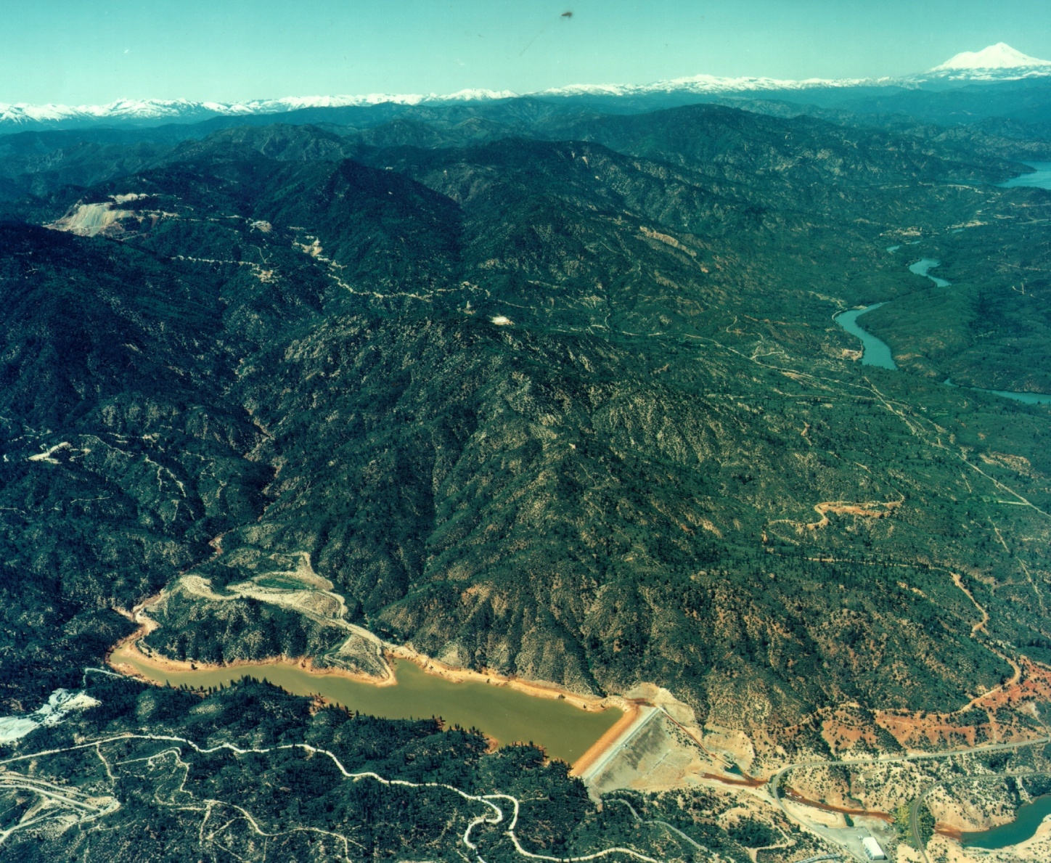
Site Setting
Located 9 miles northwest of Redding, CA
Consists of more than a dozen sulfide mines
Covers approximately 4,400 acres, with over 2,500 feet of relief
Mines produced silver, copper, zinc and pyrite
Iron Mountain
Shasta Lake
Sacramento River
Spring Creek Reservoir
Notes:
Top of mountain at 3,538 feet - 3000 feet to Sacramento River –drops 1 to 2 feet for every 2 feet horizontal
Spring Creek Debris dam constructed 1963 by Bureau of Reclamation stops buildup in raceway of Spring Creek Power Plant part of Whiskeytown Reservoir – 1943 Shasta Dam – 1950 Keswick Dam
Redding – 90,000 – 3 miles from Keswick – 450
Central Valley project – 7,000,000 ac ft – 17% of state total of 40,000,000 – water for top 10 ag counties
5 interim RODs – approximately $500 million cleanup –listed on NPL in 1983

Slide 4
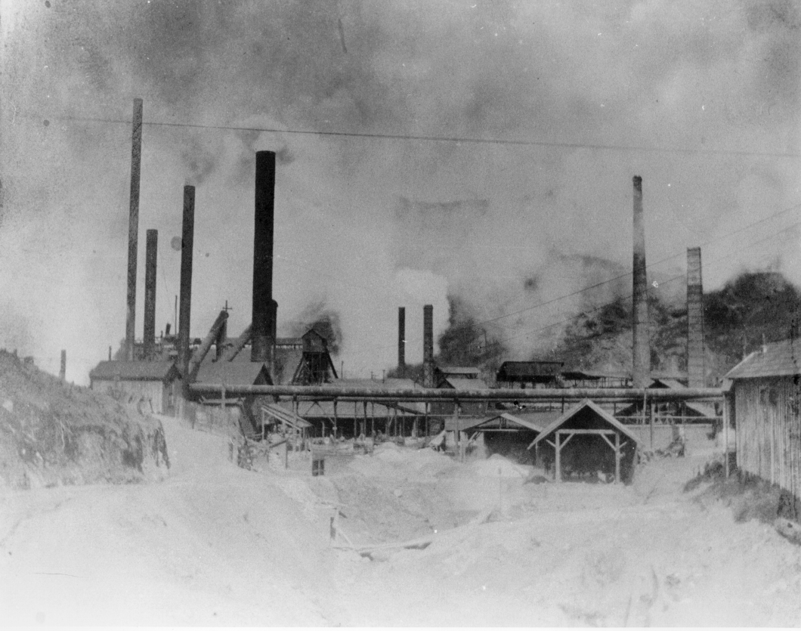
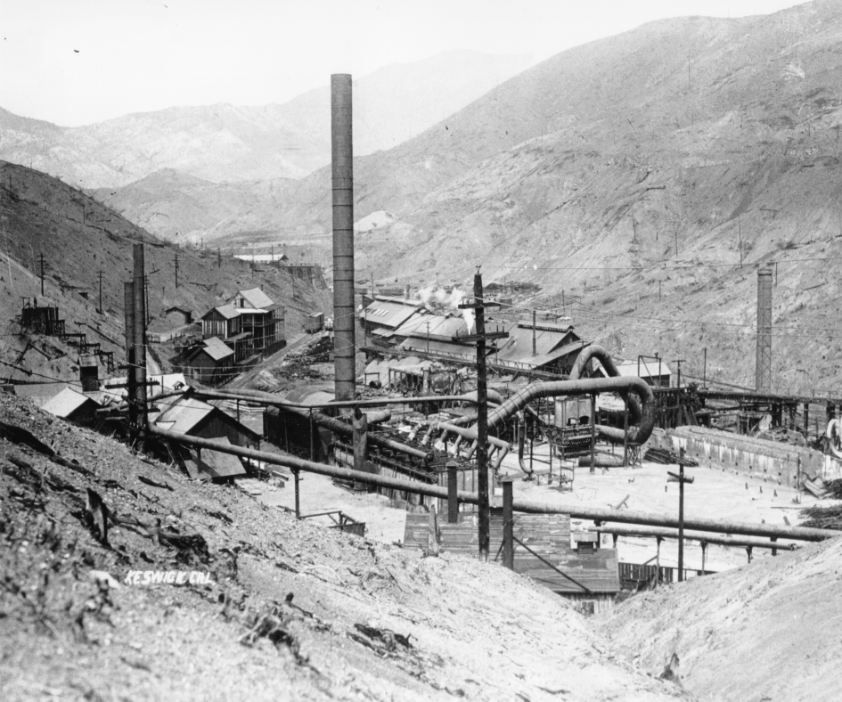
Mining Impacts
Fish kills in the Sacramento River
Open-air heap roasting and smelters stripped the land of vegetation for over 100 square miles along lower Spring Creek
Acid mine water seeping into the Sacramento River, created sediment deposits in Keswick Reservoir
Drinking water source for the city of Redding is the Sacramento River downstream
Keswick Smelter Operations 1895 - 1907
Notes:
Fish kills since 1899 – 30 documented – (four over 25,000 fish)
Habitat for steelhead and four runs of Chinook salmon - Most valuable salmon spawning habitat in CA
1896 narrow-gauge RR from mine 18 km to Keswick - Stripped vegetation around Keswick – 1898-1904 sued for vegetation loss due to smelting – 1907 shut down moved smelter to Carquinez

Slide 5
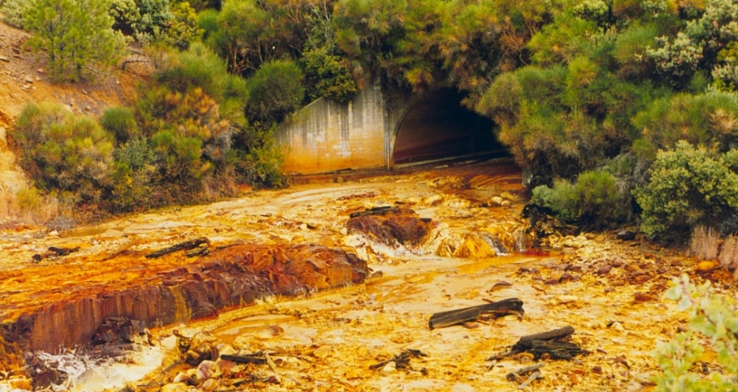
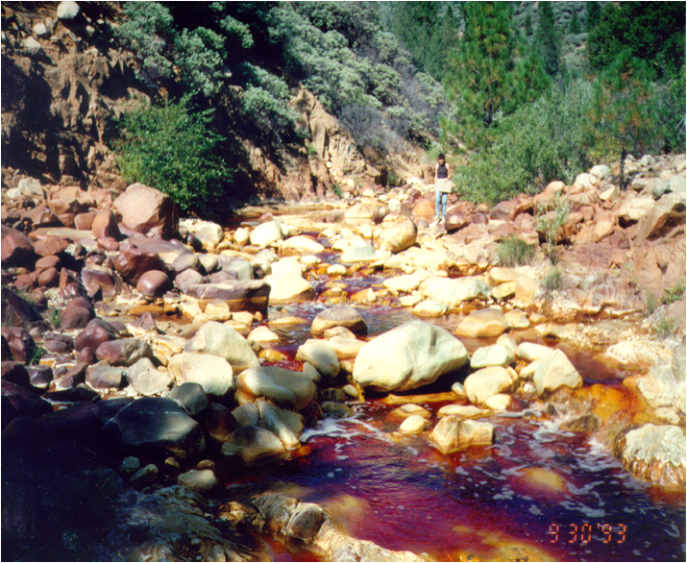
Mining Impacts
Mining influenced waters (MIW) with pH as low as -3.6 found in Richmond Mine workings
10,000 pounds of iron, 650 pounds of copper, and 1,800 pounds of zinc were discharged per day prior to remediation
AMD entering Keswick Reservoir precipitated more than 200,000 cubic yards of metal rich sediment into the Spring Creek Arm
Notes:
Sludge at Spring Creek debris dam – Boulder creek – prior to cleanup – Post construction of Keswick dam from 1950-1960 formed delta 838 m long, 60 to 140 m wide and up to 12 m thick- total of 574,000 cubic meters toxic hydrous Fe and Al hydroxides – toxic porewater was from Fe and Al – in three piles

Slide 6
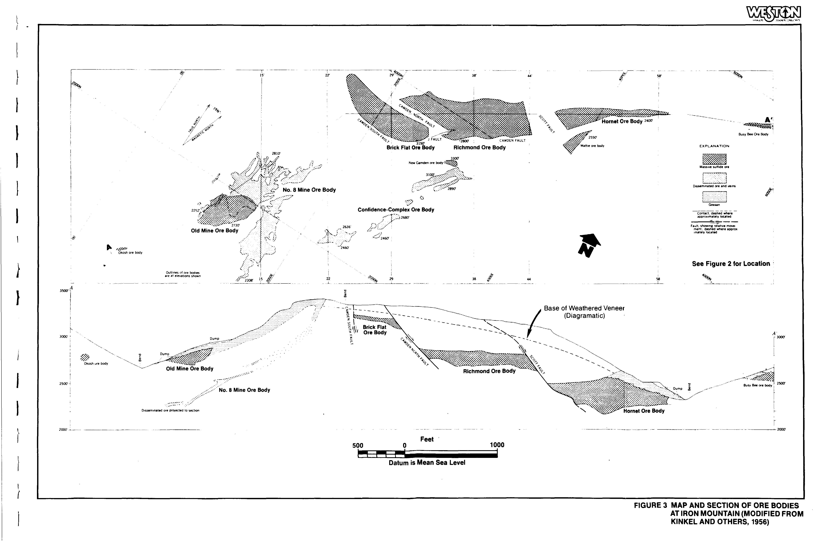
Geologic Setting
Complex of nearly pure sulfide (massive sulfide deposit) and several small massive sulfide deposits
Several zones of disseminated sulfides and a gossan (a weathered zone of iron and heavy metals, aka “Iron Mountain”)
Country rock is rhyolite, low porosity with jointing and faulting
Notes:
20.5 million tons of massive sulfide- mined out 6.8 Million tons, 13.5 million left –southernmost deposits in Shasta Mining District – massive sulfide lenses up to 60m thick – 95% pyrite variable chalcopyrite and sphalerite – 1% Cu and 2% Zn – enriched 5 to 10% Cu and Ag 27 gm/ton – Brick Flat/Richmond/ Hornet – single massive sulfide 1.4 km long up to 300 m wide and 60 m thick offset by faulting – disseminated sulfides on south flank- host rocks Balaklala meta-rhyolite and Copley Greenstone – volcanogenic massive sulfide deposit -Devonion age -Kuroko type deposit island arc environment

Slide 7
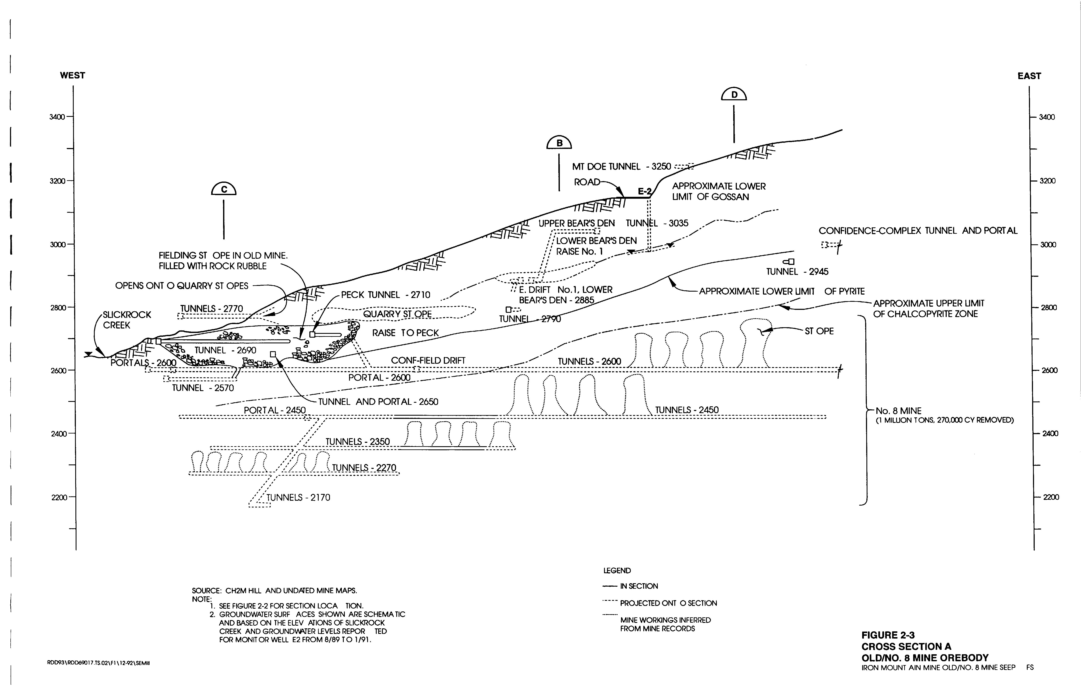
Mining Chronology
Underground mining on south flank starting in 1880s
In the first quarter of the 20th century was the largest copper producer in California and the sixth largest in the U.S.
Underground mining on north flank started in 1907
Brick Flat Pit mined by open pit method starting in 1920s
Mining ended in 1962 with copper recovery by cementation plants in the 1970s
Typical Mine Workings on South Flank
Notes:
Mined Ag, Au, Cu, Fe, Zn, and pyrite for sulfuric acid production –Silver and gold mining of gossan in 1879 – CuS in 1895 -1928 – Brick Flat pit for gossan – cyanide plant in Slickrock Creek for Au and Ag – left high As tailings – 1955 to 1962 Brick Flat pit for pyrite for sulfuric acid production at Martinez by way of Matheson loading by rail – sulfuric acid to petroleum refiners – little mining for Cu in 1920s and 1930s –during this period mined for pyrite –prior to 1939 and mining at Richmond AMD not as large

Slide 8
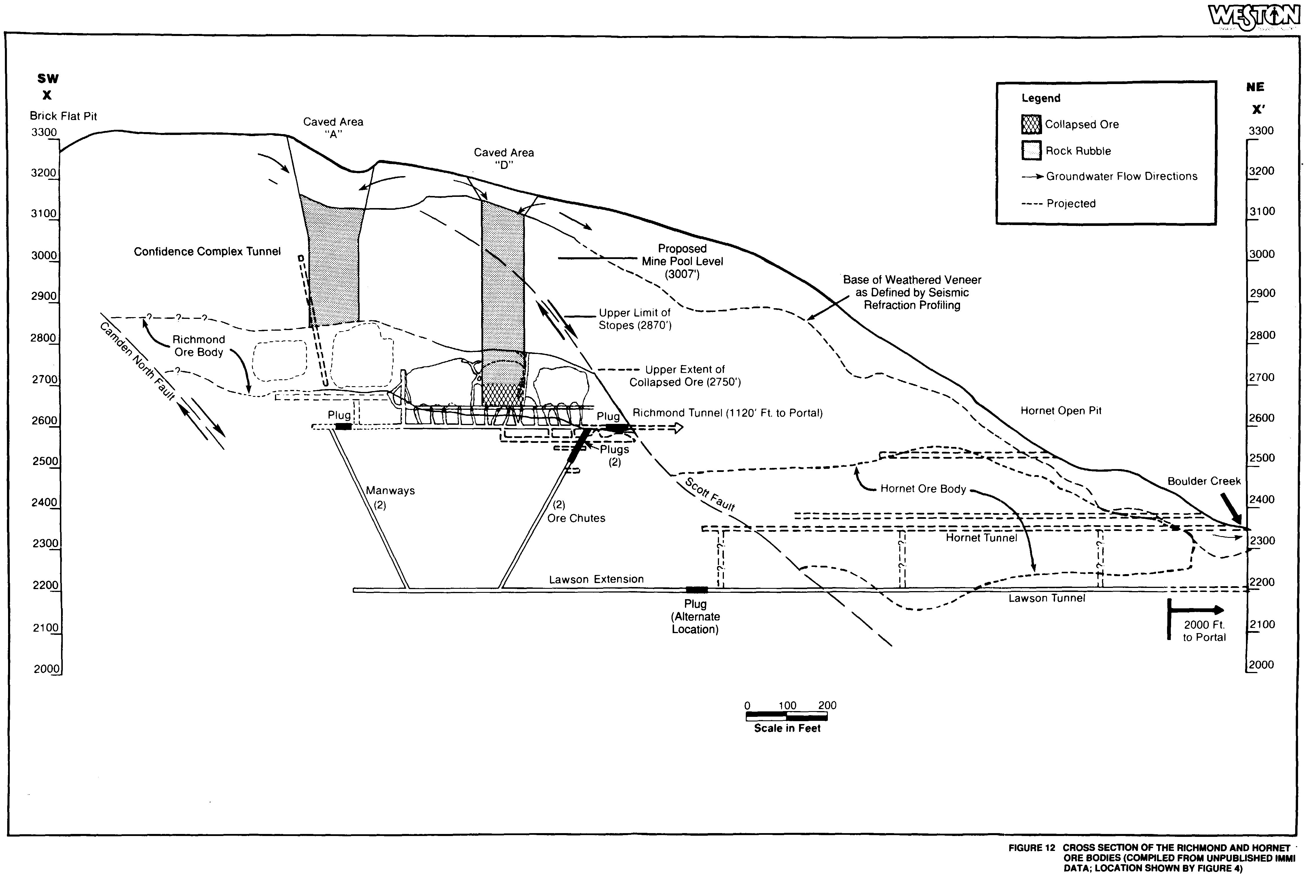
Mining Processes
Mining used: 1) Stoping and block caving; 2) Room and pillar; 3)Side-hill; and 4)open pit at the surface
Collapse of workings fractured overlying rock 400 feet to the surface
Pathways opened for air and water flow
Massive sulfides in the unsaturated zone and can oxidize and induce convective air flow
Typical Mine Workings on North Flank with Collapse Features
Notes:
Hornet accessed from Lawson adit – Richmond accessed from extension from Lawson 400 feet below then Richmond adit at 2600 feet – then 2650 base of Richmond workings – third connection Confidence Complex adit 400 feet higher at 3007 feet goes to south flank- 23 stopes and smaller areas – mined from bottom by roof caving – inner part of mine by room and pillar – 10 to 15 acres collapsed at surface in six subsidence – total Richmond volume – 20 miilion cubic feet (460 acre feet)
Mining related characteristics in combination with nearly pure massive sulfide deposits surrounded by bedrock with no neutralizing capacity – create a unique hydrogeochemical reactor that is nearly optimal for maximum production of AMD (Nordstrom and Alpers 1990)

Slide 9
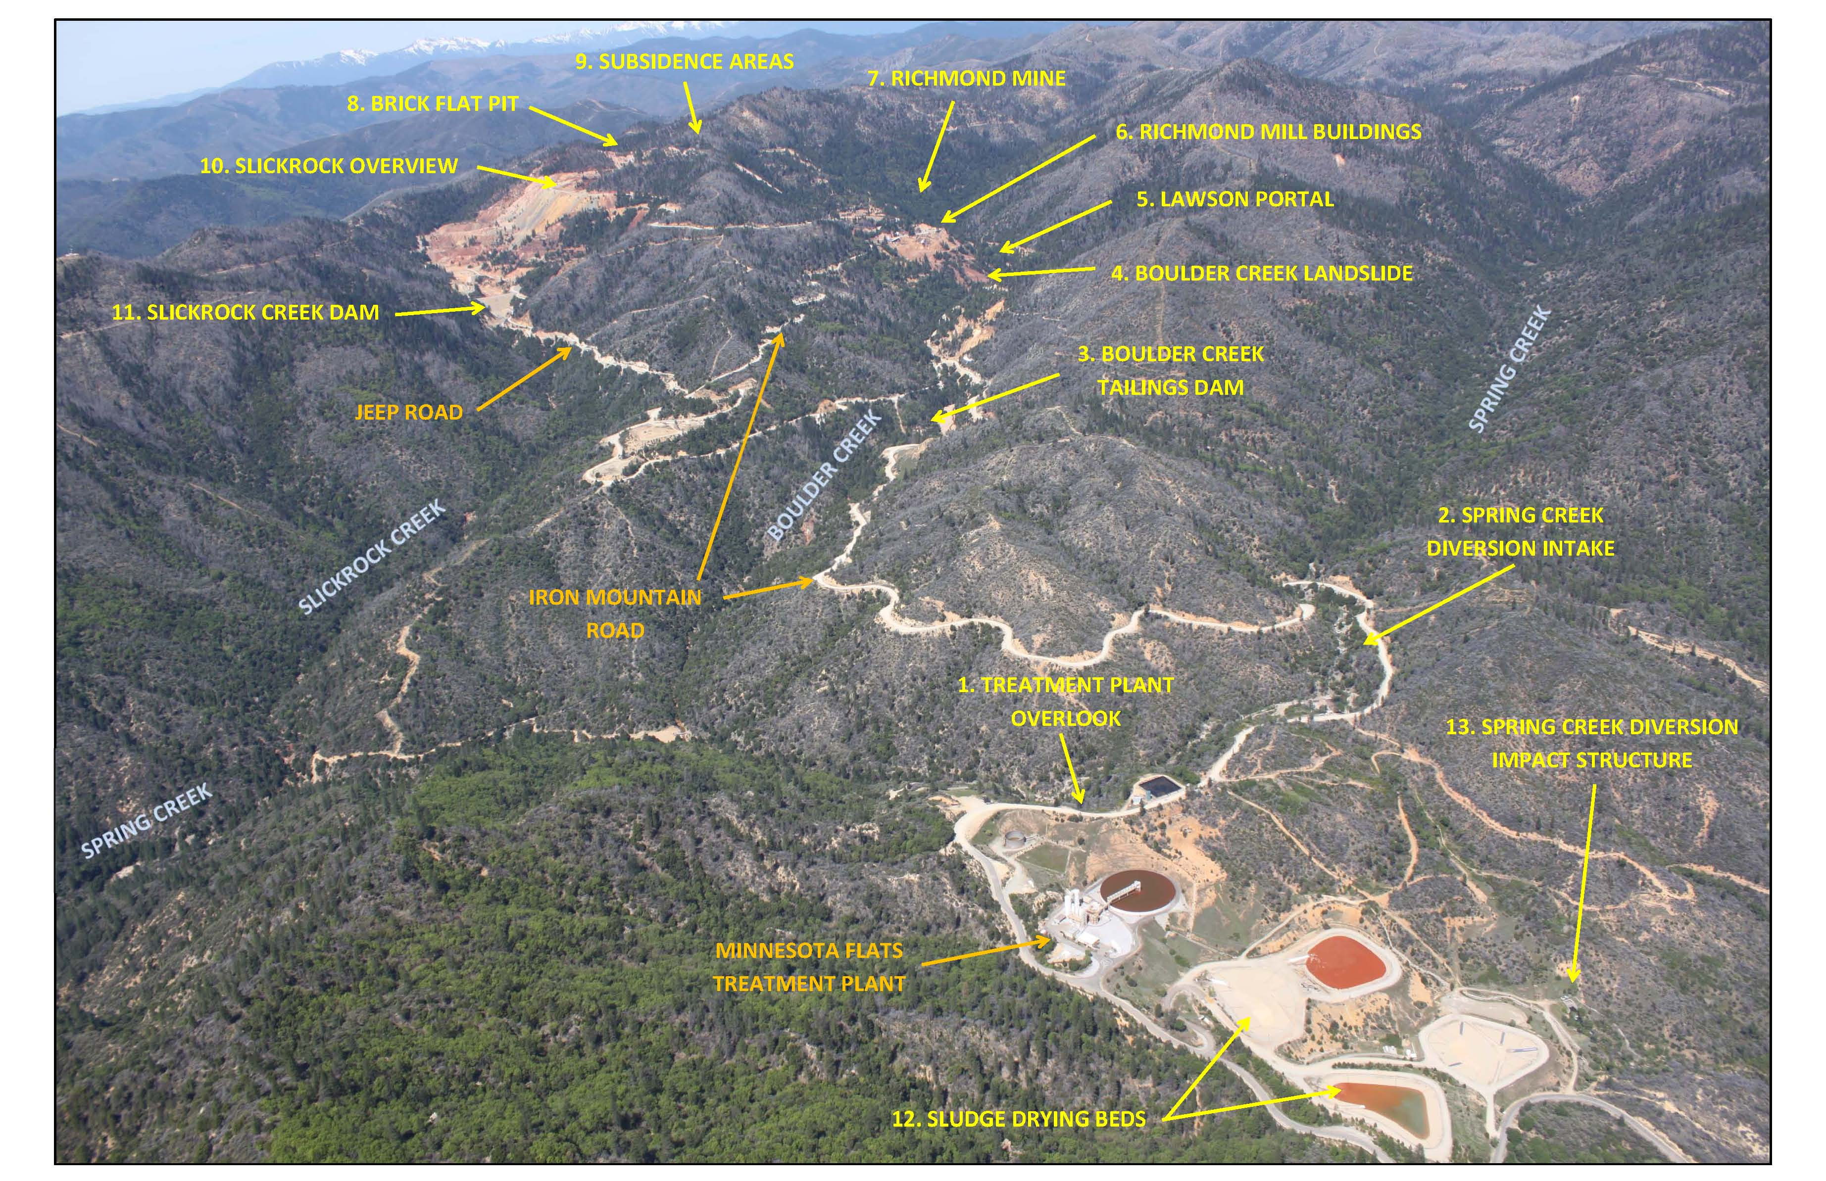
Site Remedial Components
Notes:
MIW source Richmond –Lawson adits on Boulder Creek – extraction wells at Old/No. 3 PW-3 – Slickrock Creek Retention Reservoir and surface water controls
MIW conveyance systems – AMD lines from Slickrock Creek to Boulder Creek to MFTP
Clean water diversions – Slickrock Creek and Upper Spring Creek
Mine waste disposal – Brick Flat Pit Matheson cell, muck waste cell – waste rock cells in Boulder creek and CDF above Spring Creek Reservoir
MIW treatment – lime neutralization/HDS at MFTP

Slide 10
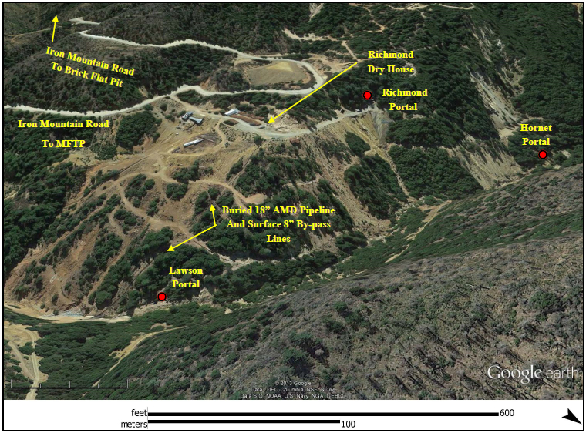
MIW Collection Systems Major AMD Sources
Richmond and Lawson Adits – pH ranges 0.8 to 2.6 – flow rates up to 1,400 gpm in winter storms
Old/No. 8 extraction wells – pH ranges 2.5 to 2.8 – flow rates up to 175 gpm
Slickrock Creek Retention Reservoir – pH ranges 2.8 to 3.0 – flow up to 3,250 gpm
Notes:
Example of sources – March 2013 – 13.28 inches (1997 – 24 inches in 7 days)
Richmond – 15-110 gpm, pH at 5 way – 0.8 to 1.1, portal 2.3 to 2.4 – Cu 170 mg/l; Zn 1740 mg/l; Cd 11.4 mg/l
Lawson – 15-33 gpm, pH – 1.7 to 1.9 – Cu 86 mg; Zn 870 mg; Cd 1.9 mg
Old/No. 8 – 75 to 104 gpm, pH – 2.7-2.8, Cu 73.5; Zn 34.9mg; Cd .27 mg
Slickrock Creek RR – 82 to 1,402 gpm pH 2.7-3.0 Cu 7.8 mg, Zn 6.9 mg, Cd .05 mg
MFTP – 266 to 2516 gpm – pH 1.5 to 2.2 Cu 43.4 mg, Zn 202 mg, Cd 1.4 mg lime 5.3 to 15.8 tons/day
Keswick Cu =5.0 ug/ l, 0.22 ppb Cd, 16 ppb Zn

Slide 11
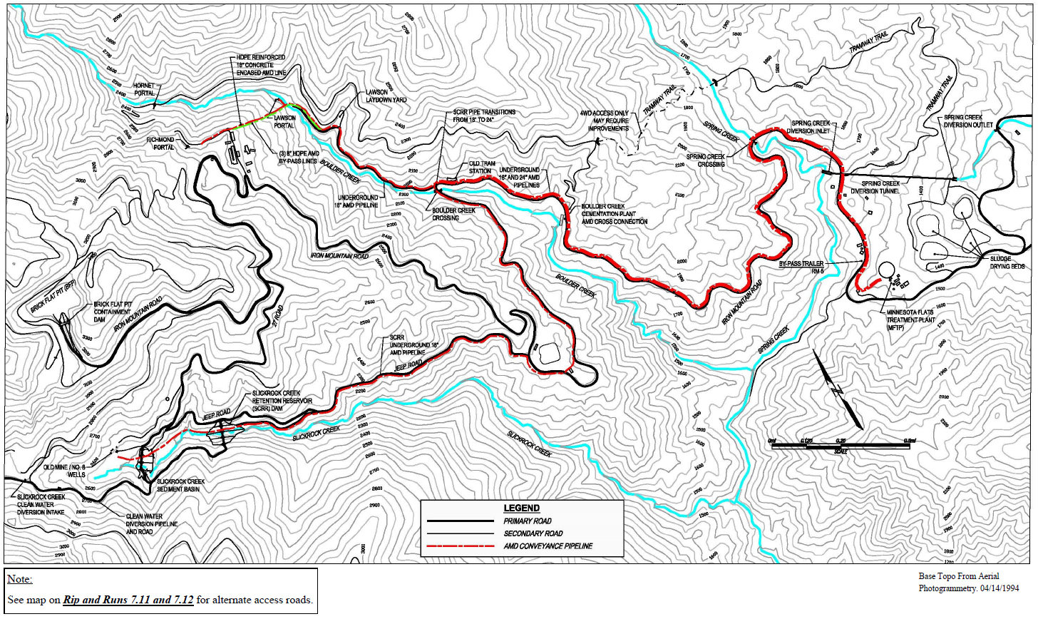
Conveyance Systems and Clean Water Diversions
MIW Pipelines
Over 28,000 feet of 12 to 24 inch HDPE piping carrying AMD by gravity flow from the major sources on the north and south flanks to treatment Plant
Clean Water Diversions
Slickrock Creek Clean Water Diversion which routes clean water around tailings and waste rock in Slickrock Creek drainage
2) the Upper Spring Creek Diversion which routes clean water from upper Spring Creek and empties into Flat Creek

Slide 12
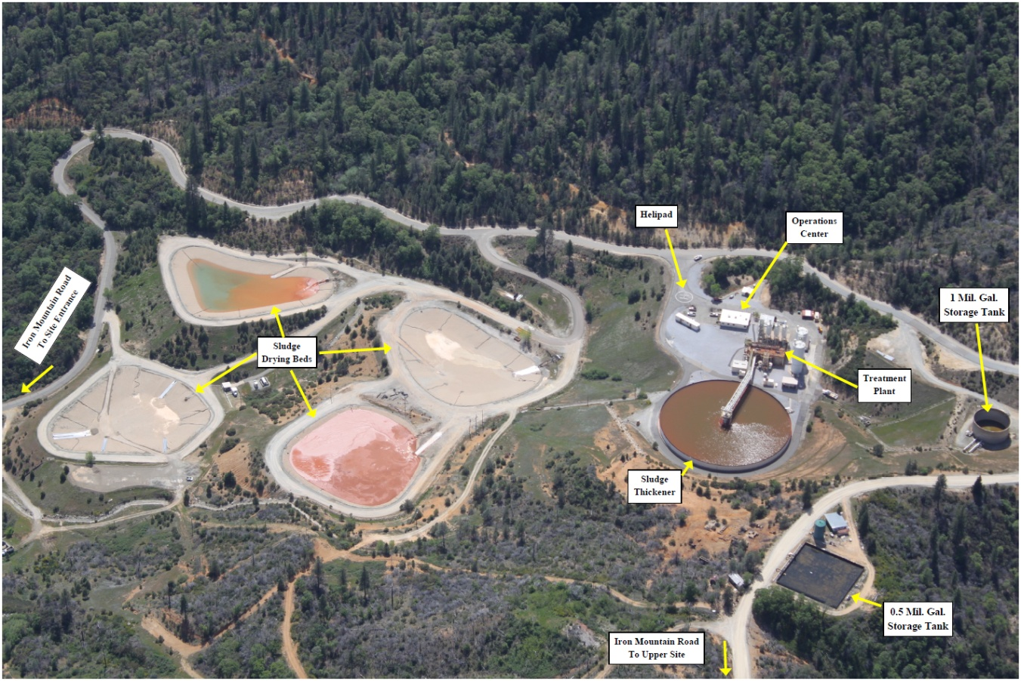
MIW Treatment Plant
Minnesota Flats Treatment Plant
Lime neutralization/high density sludge plant – design capacity of 6,500 gpm (53.5 million gals per day)
280 foot diameter thickener tank – Plant generates approximately 20,000 cubic yards of HDS per year that is placed in Brick Flat Pit
The plant has a 1 million gallon AMD emergency storage tank that can handle 2 weeks of flow in the summer and less than a day in large winter storms
Notes:
MFTP handles average of 1.5 cubic meters per year
Ave Cu 55 mg/l
Ave Zn 210 mg/l
SO4 and Fe conc X 100s
Ave cost $6m per year – 80% of cost for staff/mech/elect/ sludge and tailings management
14 staff – 8 plant operators staffed 24 hours/day – 3 in daytime and 1 at night – lime by 40 foot tanker trailers rail cars in Redding
Compounding emergency events = 2008 fire – 1997 storm 24 inches in 7 days 12/30 to 1/6 (BCMO Cu at 36 lbs per day to 1,686 lbs per day – 50% Richmond

Slide 13
O&M Challenges at Iron Mountain Mine
Mineral precipitates in the MIW pipelines due to microbial FE(II) oxidation occurs over short timeframes, results in loss of up to 40% of pipe capacity and air vent spills
Deterioration of polyurethane liner in Upper Spring Creek Diversion, due to steep elevation drop and excessive flow velocities
Significant loss of leachate from HDS stored in the lined Brick Flat Pit landfill due to potential leakage into open fractures in pit wall and/or into underlying mine workings
Deterioration of concrete plugged ore chutes in the Richmond Mine

Slide 14
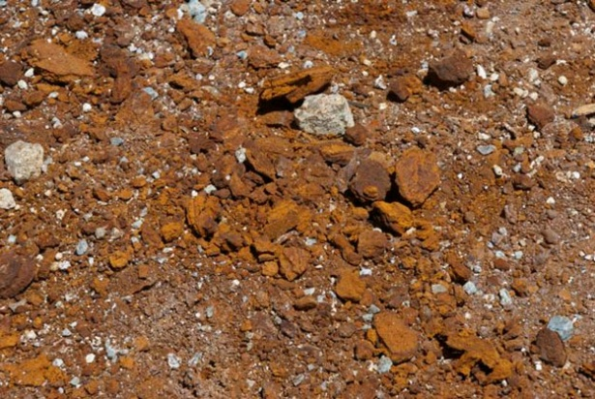
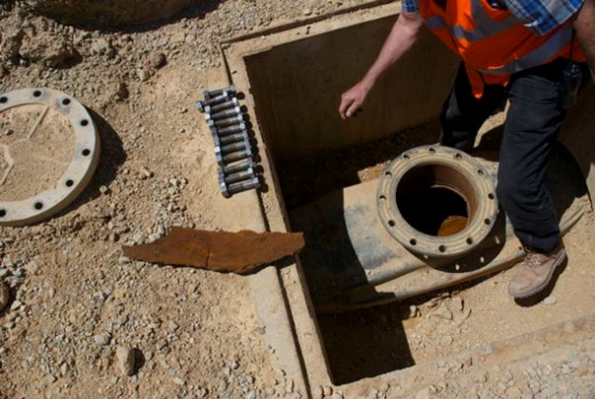
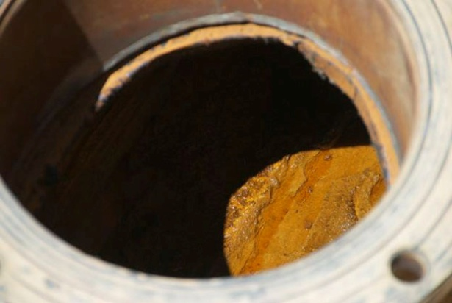
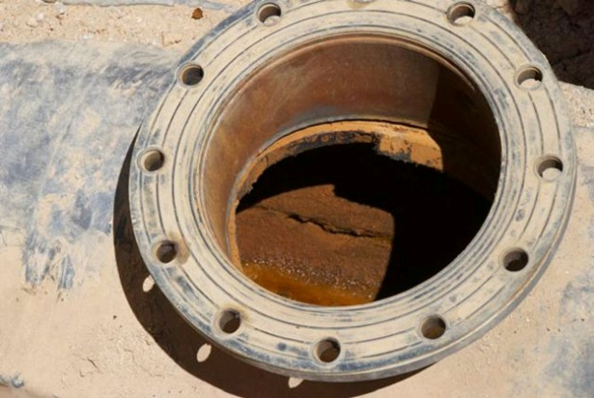
O&M Challenge – Formation of Pipe Scale
Pipe scale formed by varying pH in MIW due to microbial oxidation of FE(II) in piping scale, as has been shown by USGS research
Precipitation of scale occurs in short time frame, reduces up to 40% of pipe capacity causing blockage and releases through air vents
Traditional cleaning methods problematic due to HDPE piping and burial of piping distorting pipe shape

Slide 15
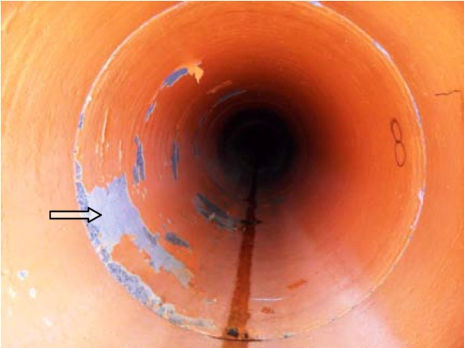
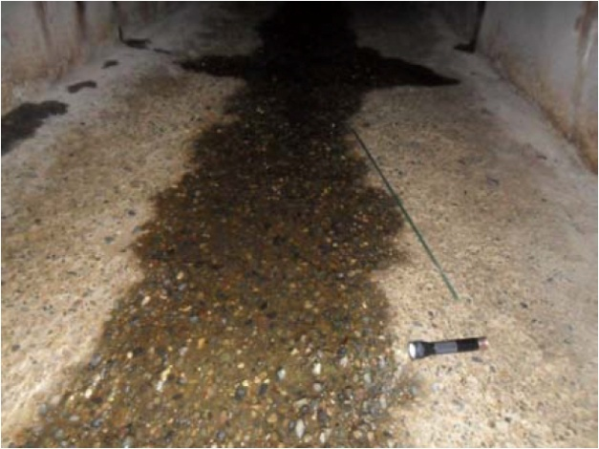
O&M Challenge – Deterioration of Liner in Upper Spring Creek Diversion
Diversion is 1,200 feet long unlined concrete arch tunnel and reinforced concrete pipe
Diversion system drops 280 feet in elevation from upper Spring Creek to Flat Creek – designed to convey 800 cubic feet per second (cfs)
Flow velocities at 800 cfs range from 15 feet per second (fps) to 70 fps. Usual design flow is 15 fps
High flow velocities in winter storms result in abrasion-erosion and cavitation with loss of cement up to 1 ¼ inch and lining failures of up to 40%
Liner Failure in Pipe
Erosion of Concrete Approximately 1” Deep
Notes:
USCD unlined drop inlet cast in place concrete screened for 1 ½ inch – unlined 8X8 concrete arched tunnel – reinforced concrete pipe 54 inches two coats flexible polyurethane coating – cast in place concrete impact structure
Depth of concrete paste erosion – ½ to 1 ¼ inches – 61 % loss of 10% or less – 38% 15 to 80% loss- 10% greater than 40% loss –lining failure at bottom and at downstream ends of pipe joints
Reline, HDPE slip lining, improve screen on inlet

Slide 16
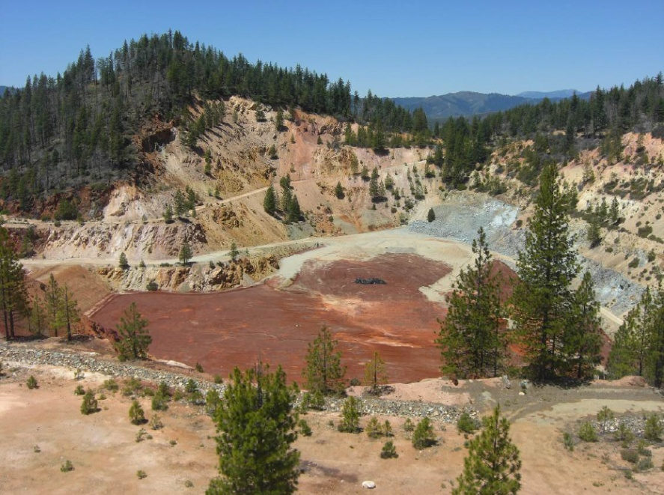
O&M Challenge – Brick Flat Pit Landfill Leachate Leakage
Brick Flat Pit was first lined in 1989 and designed to place waste materials from site. It was expanded in 1993-1994
Currently estimated to cover 44 acres and contain 494,000 cubic yards of sludge with a depth of 80 feet
At the current fill rate of 20 to 25,000 cubic yards per year; a third phase of the containment dam will be needed to allow another 150 years of use

Slide 17
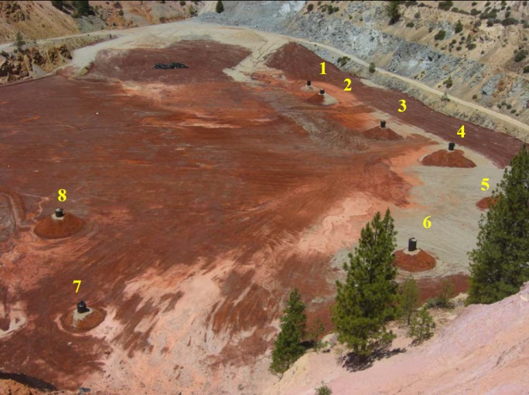
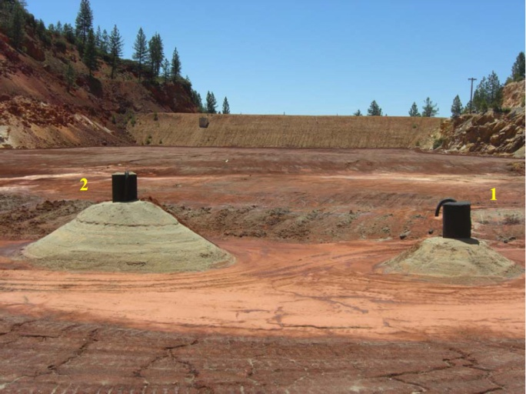
O&M Challenge – Brick Flat Pit Leachate Leakage
Filtrate flow in 2004 dropped from up to 100 gpm discharge to a trickle during winter operations
Summer 2004 tracer study and investigation have not been able to trace leakage – assumed to be leaking through fractured rock in unlined side walls of pit
Investigation into loss of filtrate being evaluated to determine path of leakage and how to address in needed

Slide 18
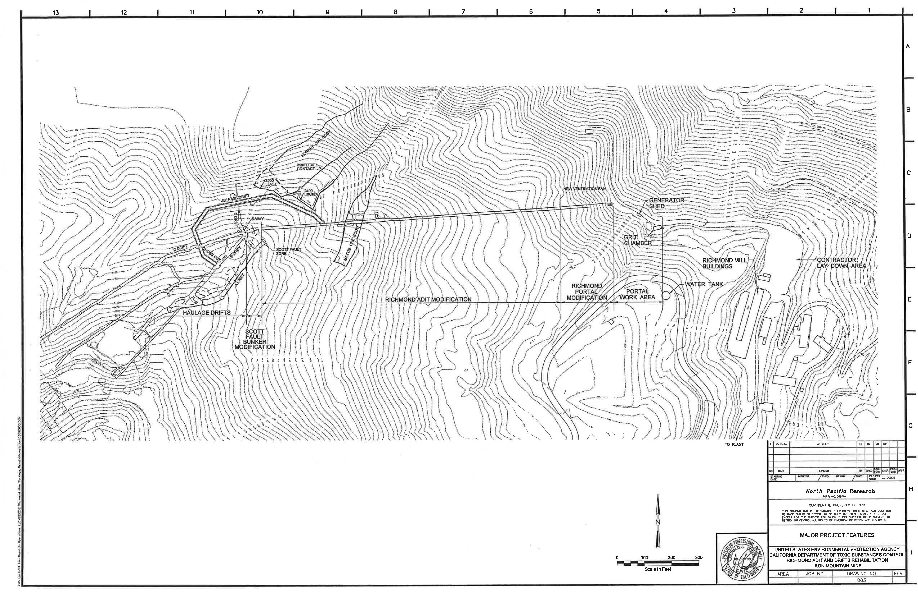
O&M Challenge – Richmond Adit Chute Plugs
Rehabilitated in 1989-90 and again in 2001-2003 creating configuration of the “ 5-way” catch basin (sump) where four haulage drifts intersect 1,400 feet inside mountain
The “5-way” catch basin captures AMD from AMD dams in the A Drift, B Drift, and C Drift
18 inch pipeline extends from the “5 way” to a grit chamber outside the portal with a 6,000 to 7,000 gpm capacity
Typical AMD pH ranges from 0.6 to 1.4 (lower pH in the stopes above)
Notes:
pH greater than 3 chemically driven pH below 2 biologically driven
Microbially driven – acidithiobacillus oxidans in outer ore body – pH 2.0 – ferroplasma acidarmanus and leptospirillium ferrooxidans in inner deposit
1 inch mild steel rebar dissolve to a thread is stuck in muck in the invert for 36 hours
Prior to rehab muck piles and dams up to 600 feet in drift
Dynastone in some areas more resistant but still problematic

Slide 19
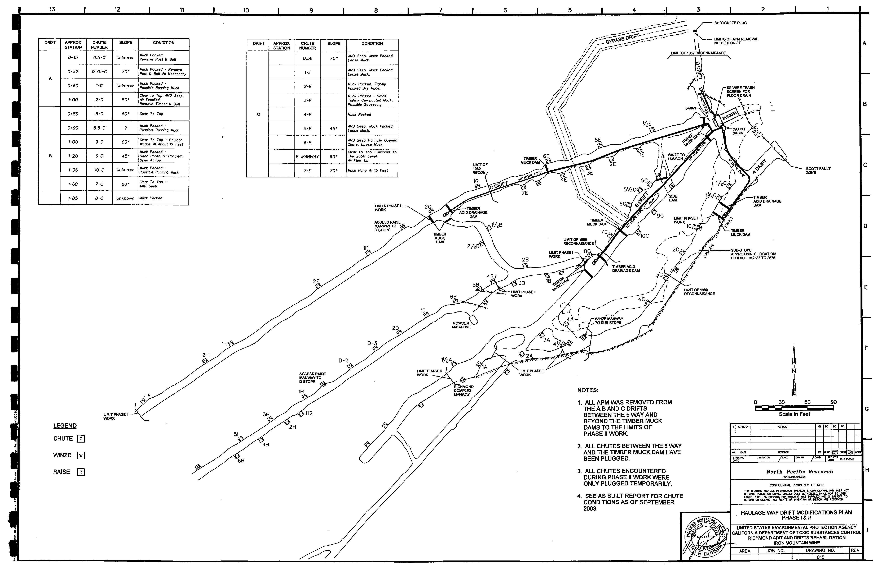
O&M Challenge – Richmond Adit Chute Plugs
Timber and stainless steel AMD dams, 4 to 5 feet high, with AMD intakes constructed in A, B, and C drifts downstream from muck timber dams
Muck is waste rock, mine debris and fine-grained, silty, and pyritic material with “quick” characteristics (sudden impacts causes the material become liquid) found throughout the workings
22 ore chutes from overlying stopes were plugged with concrete and shotcrete due to past surges of up to 3,000 gals of extremely acidic MIW and mine debris
Notes:
Richmond adit 11X11 horseshoe shaped – 3 to 6 inch thick (some areas up to 10 inches shotcrete some areas 8 foot rock bolts such as 5 way and mattie
Extensometers – chute labels refer to stope = 1C 2C, 1 D etc.
A drift - 10% of low pH – 1.2 to 1.5 - 100 degrees
B drift – 50% of low pH – 0.0 – 95 degrees
C drift – 40% of flow
AMD intakes 10” lines combined 15,000 gpm
Bypass Dam and 5 way dam store AMD

Slide 20
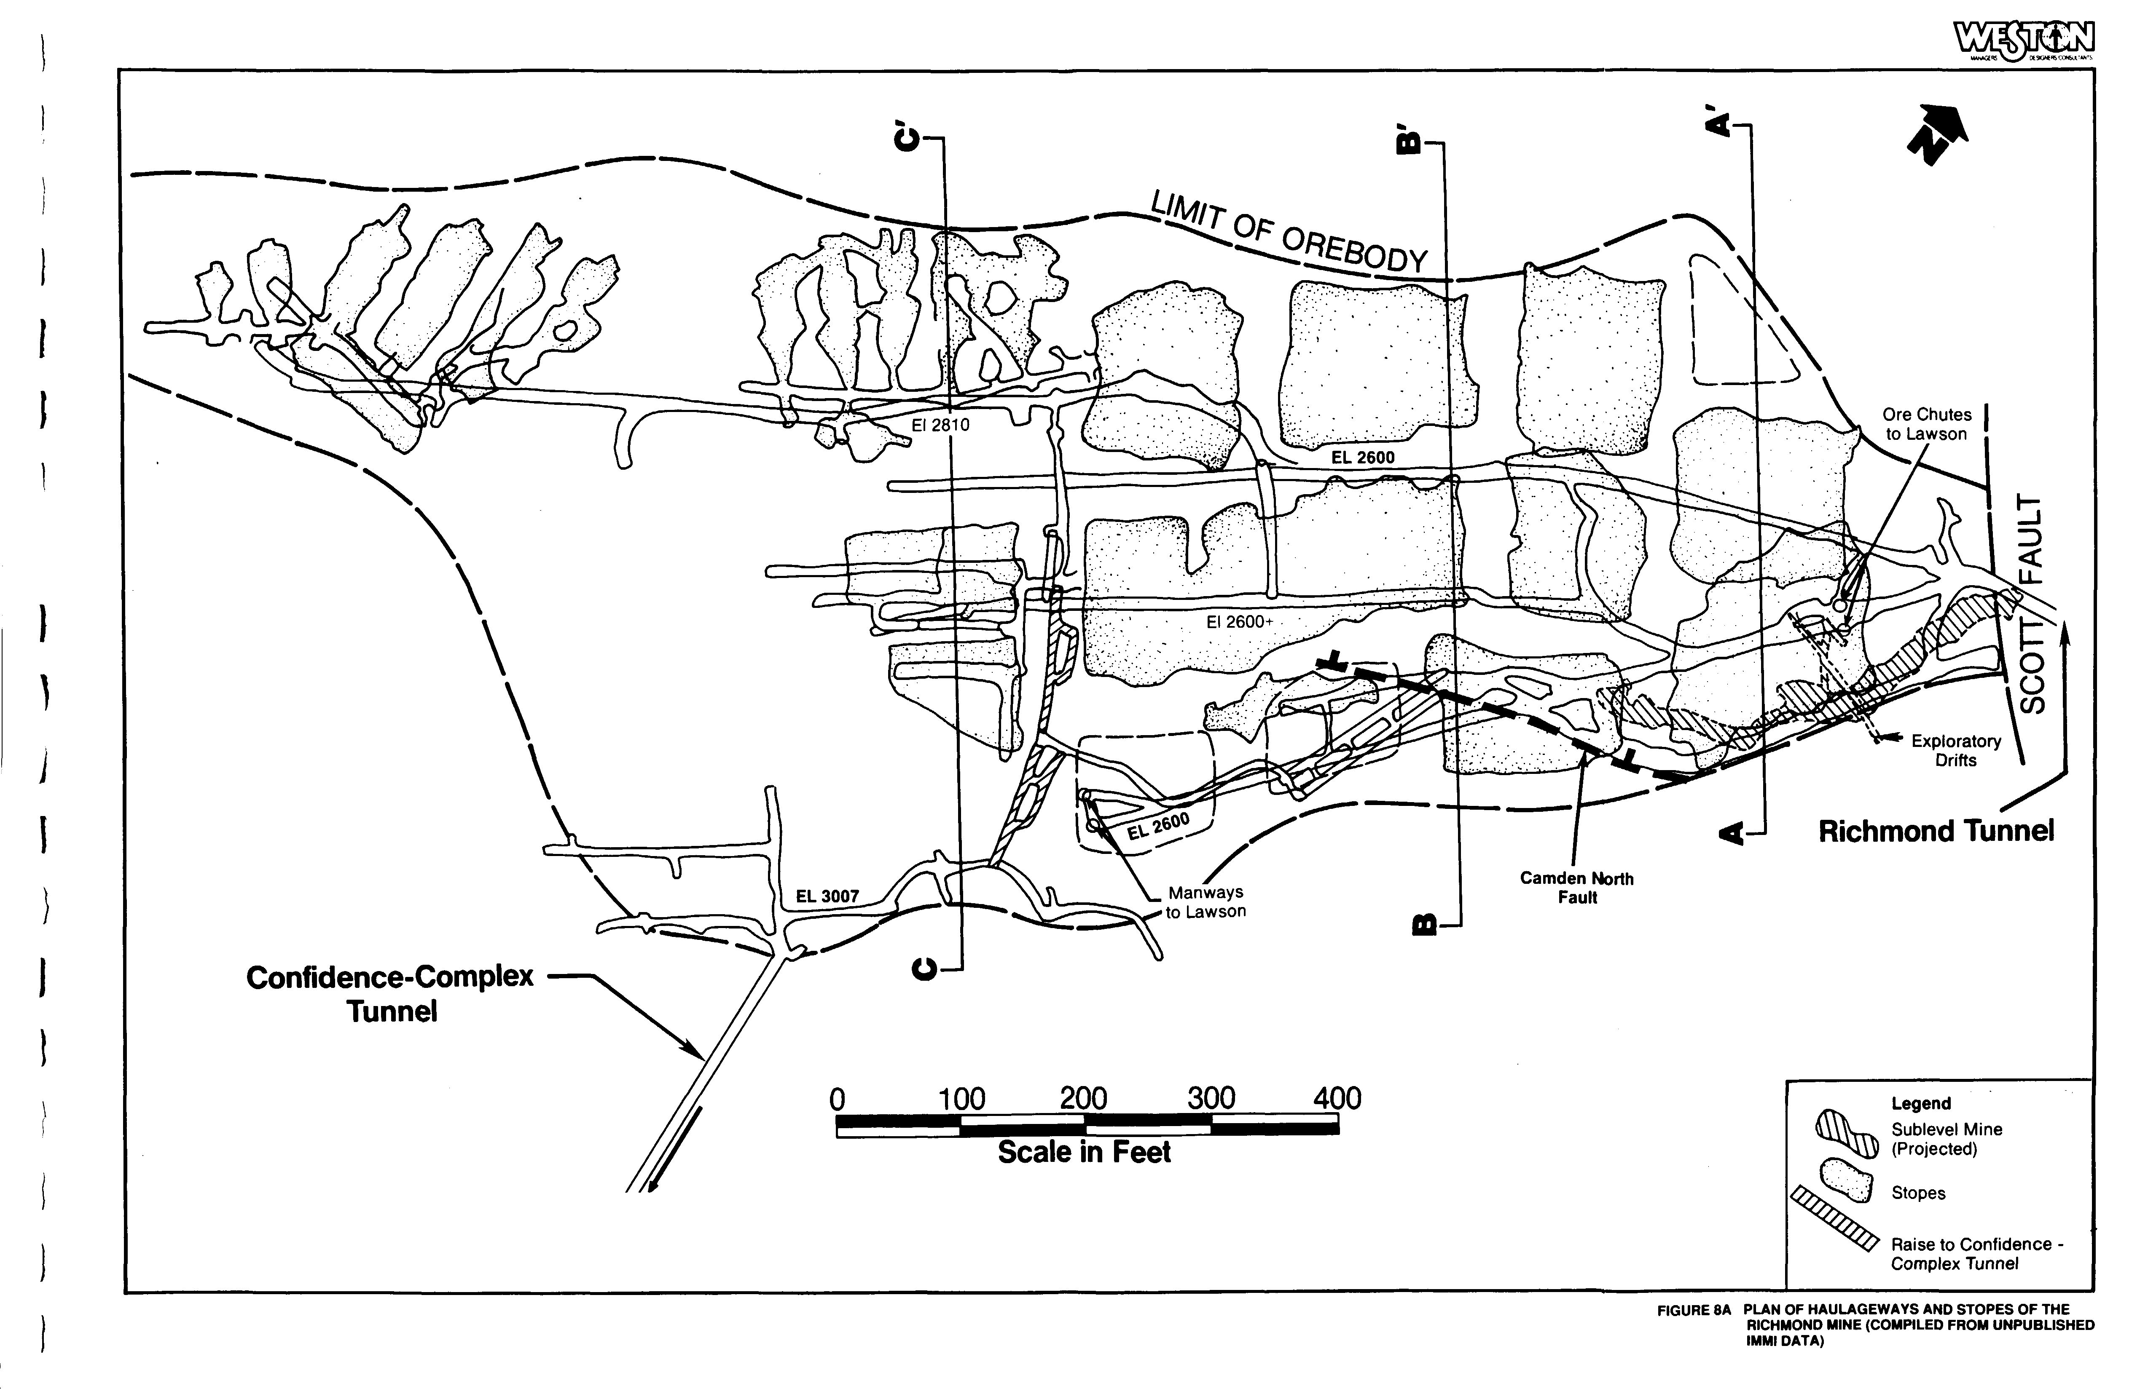
O&M Challenge – Richmond Adit Chute Plugs
Drifts A,B, and C are flat at the 2,600 level with multiple chutes, raises and manways – ore chutes extend upward from the drifts to an access level at 2650. Ore mined above at the 2700 level were dumped through the chutes to the haulage adit
Five major levels occur in the Richmond above the drifts up to the 3000 level – Larger stopes were rectangular and 60 to 150 feet on a side and 60 to 200 feet high with 40 to 80 foot unsupported spans.
Ore chutes were packed with sulfide muck and clayey waste, others with large rocks suspended in the chute – some with pooled AMD or wet muck at up to 100 degrees
Notes:
A drift = A and C stopes
B Drift = B,C,D,H, and J stopes along with A/B substope
C drift = E,F,G,I,J,K stopes
D drift exploratory

Slide 21
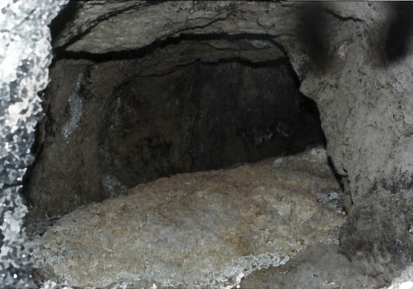
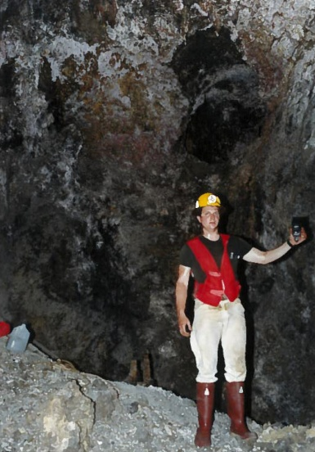
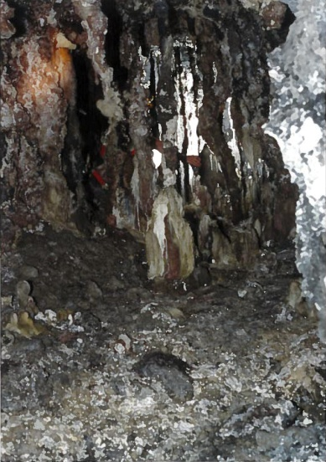
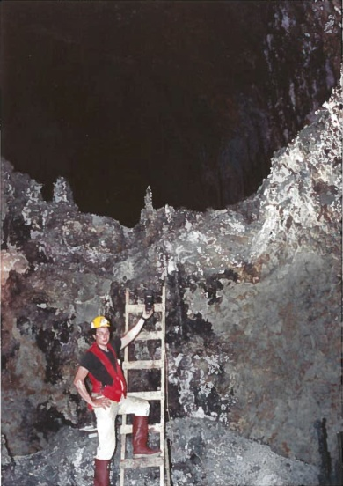
O&M Challenge – Richmond Adit Chute Plugs
The 2650 level entered in 1990 and 1991 to evaluate conditions and compare historical mine mapping with actual conditions
Re-entry encountered extreme heat – greater than 120 degrees due to exothermic reactions of bacterially driven oxidation of massive pyrites
AMD did not appear to be pooled at the bottom of the stopes except at isolated locations
AMD pH was measured as low as -3.6 along with abundant crystallization of acid sulfate salts
Notes:
Slusher level for grizzly – bottom of stopes have several ore chutes to slusher level - spacing determined by slusher drag line – collars around ore chutes – 10 mineral salts- early formed - melanterite- copiapite – rhomboclase and voltaite – starts as ferrous Fe on pyrite – rapid water stays in ferrous then then goes to ferric at end with Voltaite

Slide 22
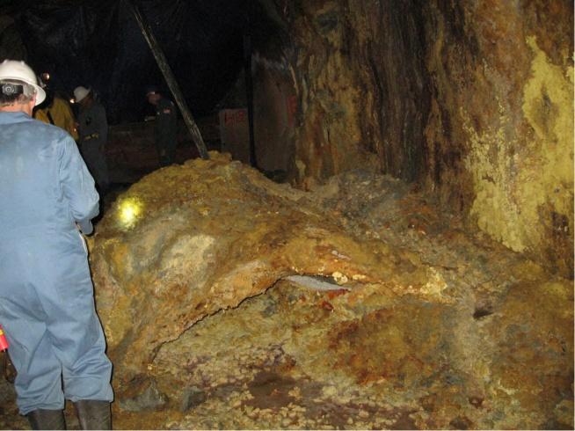
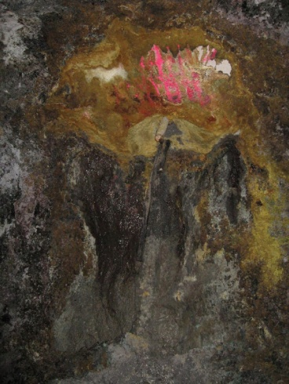
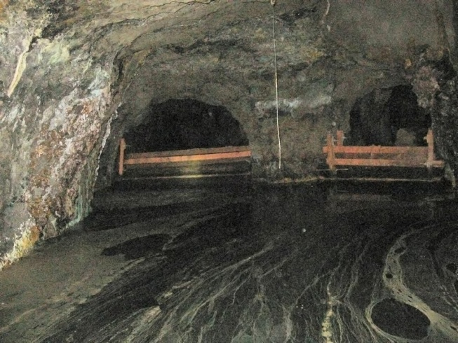
O&M Challenge – Richmond Adit Chute Plugs
Inspected annually – usually in the summer to avoid wet winter conditions
As of the 2013 inspection all ore chutes are considered to be dangerous and to be avoided. Shotcrete on walls and ceilings of drifts is spalling and to be avoided
A drift has two leaking chute plugs, B drift has seven leaking chute plugs, C drift has nine leaking chute plugs, one of which is leaking at greater than 5 gpm
Notes:
Dry season base flow – Fe sulfates form in seeps and from AMD – first flush – creates rinse out – get step wise increase in metals - higher concentration of Fe, Al, Cu, Zn
Cu, Zn and Cd dependent on quantity of water flow – Cu increases rapidly with first large flow then decreases until next big flow (overall Cu increases in wet season but decreases in dry season) – Zn and Cd are the opposite – decrease with big flow and then increase ( decreases rapidly during wet season and increases slowly during dry season)

Slide 23
O&M Challenge – Richmond Adit Chute Plugs
Study to evaluate a subset of previously treated chutes that were plugged with concrete and those not treated but plugged with cemented mine muck
Techniques to be used
surfacial evaluation of concrete and rock
non-destructive testing using hammer sounding, impulse response, impact echo and rebound hammer
ultrasonic pulse velocity to measure stress and shear wave velocities
petrographic analysis of concrete and materials
Re-enter 2650 level to compare existing conditions with 1990 reconnaissance
Compile a 3-D map of the mine workings to better evaluate orientations of mine workings and ore chute configurations

Slide 24
Issues and the Future
Current O&M Issues consists of:
1)Mineral Scale
2)Liner Failure in Upper Spring Creek Diversion
3)Brick Flat Pit Landfill Leakage
4)Richmond Adit Ore Chute Plugs Deterioration
O&M conducted by Iron Mountain Operations under contract to AIG Insurance until 2030
Future O&M Issues
EPA is responsible for O&M in 2030 – will receive $514 million to pay for all future O&M in perpetuity
1,800 to 3,200 years of acid generating potential remaining
Future evaluation of new remedial technologies and potential metals recovery from AMD and mine wastes
Notes:
1300 to 1600 years of acid generating potential over $500M cleanup so far
EPA will be responsible for remedy O&M in 2030 under CD with Aventis CropScience (Rhone Polenc) – AIG and IMO responsible until then current SOW – at 2030 EPA gets a check for $514M to continue O&M
EPA needs to assure that remedy is in good condition at transfer – currently putting together a 15 year plan to prepare for 2030- looking at metals recovery to reduce O&M costs, re-evaluate remedy – new technologies – how to work with DTSC, Water Board, Cal F&G and Bureau of Rec

Slide 25
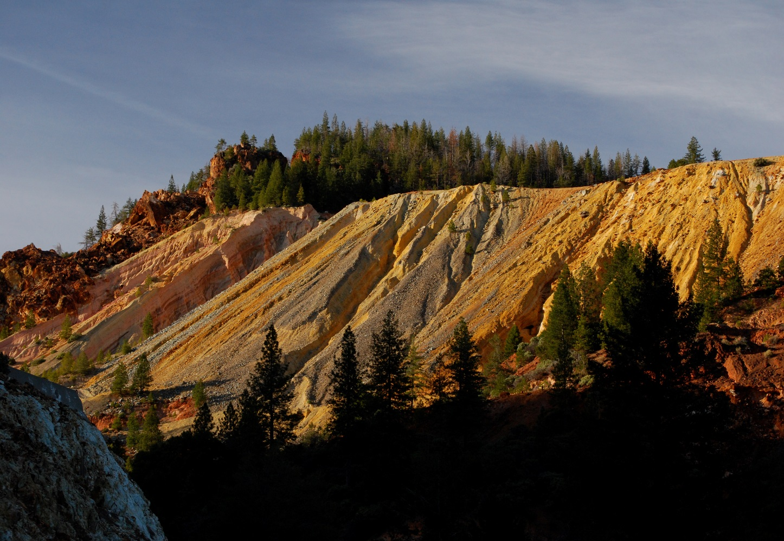
Questions?
Sunset at Iron Mountain Mine

