Slide 1


The Use of Passive Samplers to Monitor Organic Contaminants at Superfund Sediment Sites:
Concepts, Samplers, Methods & Applications
Robert M Burgess
Office of Research and Development, NHEERL, Atlantic Ecology Division
Narragansett, Rhode Island 02882
burgess.robert@epa.gov
&
Marc S Greenberg
Office of Solid Waste and Emergency Response
OSRTI/TIFSD/Environmental Response Team
Edison, New Jersey
greenberg.marc@epa.gov
26 August
2013

Slide 2
SAMS #3
Portions of presentation will follow the outline of this document
  Released December 2012
  Provides introduction to passive sampling
  Intended for use by remedial project managers (RPMs)
26 August
2013
The Use of Passive Samplers to Monitor Organic Contaminants at Superfund Sediment Sites

Slide 3
Outline
Why use passive samplers and what they tell us
Types of passive samplers and how they work
Selecting, preparing, deploying, recovering, and storing passive samplers
Analyzing passive sampler data and a brief case study
Scientific challenges in using passive samplers
US EPA contacts working with passive samplers
Application at Superfund Sites
Summary
26 August
2013
The Use of Passive Samplers to Monitor Organic Contaminants at Superfund Sediment Sites

Slide 4
Conceptual Model (i.e., Cartoon) of Relationship Between
Contaminated Sediments and Aquatic Life
Atmosphere
Water
Dissolved and Bioavailable
Concentration
PCB
Molecule
Dissolved and Bioavailable
Concentration
Sediment
Particle
Interstitial
Water
Contaminated Sediments
Diffusion/Advection

Slide 5
Is there another sampling method for collecting and measuring dissolved and bioavailable contaminants?
Introduction
How to determine or measure dissolved and bioavailable concentrations in the water column and interstitial waters?
  Why not continue to use conventional sampling methods? Some problems:
  Water Column
    Logistically and technically difficult to collect large volumes of surface water and extract
    Several artifacts including losses to filters and surfaces and contamination by colloids and small particles reduce accuracy of analysis
    Analytical detection limits are often not sufficiently low
  Interstitial Water
    Centrifuge or squeeze interstitial water results in limited volumes
    Similar artifacts as water column
    Collecting large volumes of interstitial waters is logistically challenging, scientifically dodgy and generally expensive
√
√
26 August
2013
The Use of Passive Samplers to Monitor Organic Contaminants at Superfund Sediment Sites

Slide 6
Introduction
Passive sampling
  Developed in the 1980s
    Analytical chemistry, food sciences, pharmaceuticals
  Used in environmental sciences since the early 1990s
    Water column, soils, groundwater, sediments
  Consist of an organic phase (i.e., simple organic film or polymer) which accumulates contaminants from the dissolved phase
    Polyethylene (PE)
    Polyoxymethylene (POM)
    Solid phase micro-extraction (SPME)
    Semi-permeable membrane devices (SPMDs)
26 August
2013
The Use of Passive Samplers to Monitor Organic Contaminants at Superfund Sediment Sites

Slide 7
Introduction
Types of contaminants sampled
  Hydrophobic or Nonionic Organic Contaminants
    Low water solubility
    Highly lipiphillic and bioaccumulating (medium to large K_{OW}s)
    Contaminants of Concern (e.g., PCBs, PAHs, Chlorinated pesticides, Dioxins/Furans)
  Not Metals
    Methods are under-development
    Not as advanced or established as methods for hydrophobic organic contaminants
26 August
2013
The Use of Passive Samplers to Monitor Organic Contaminants at Superfund Sediment Sites

Slide 8
Why Use Passive Samplers?
The Advantages
√
Analytically
  Passive samplers accumulate contaminants over time during their deployment
  Detection limits are less of a problem
Representativeness of data
  Passive samplers are deployed in the environment for prolonged periods of time
  “Time-averaged” or “time-integrated” measurement
  Reflects representative concentrations at a site rather than “snap-shot” of conditions
√
26 August
2013
The Use of Passive Samplers to Monitor Organic Contaminants at Superfund Sediment Sites

Slide 9
Why Use Passive Samplers?
The Advantages
Table 2. Comparison of costs for analyzing different types of samples for 20 National Oceanic and Atmospheric Administration (NOAA) PCBs.
Expense
  Preparation and chemical analysis of passive samplers is about $100 - $200 less than the conventional method
    As commercial laboratories establish experience with extracting and analyzing passive samplers – the prices are likely to drop
    Extraction/analyses of passive samplers is less challenging than sediment/soil or tissue samples
  Passive samplers are inexpensive
    If lost during deployment (e.g., storm, vandalism) not a great cost
Expense
Type of Water Column Sample | Materials (samplers & deployment equipment) ($) | Preparation of Extract & Chemical Analysis ($) | Total ($)
Water (5 L by conventional method) | <5 | 525 | 530
Polyethylene (PE) | ~5 | 375 | 380
Polyoxymethylene (POM) | ~50 | 375 | 425
Solid Phase Micro-extraction (SPME) | ~35 | 275 | 310
ª Costs provided courtesy of an independent laboratory. Cost values in dollars are reported per sample.
^{b} Assume 10 - 20 samples, GC/MS analysis of NOAA PCB list (20 congeners)
26 August
2013
The Use of Passive Samplers to Monitor Organic Contaminants at Superfund Sediment Sites

Slide 10
What Passive Samplers Tell Us
  (1) Concentration of COCs in passive sampler
    Evidence of correlation with bioaccumulation by aquatic organisms
    Serve as surrogates for biomonitoring organisms
      Especially in situations where mussels or fish cannot be used (e.g., low dissolved oxygen, toxicity, low/high temperature constraints)
  (2) Dissolved concentrations of COCs in water around passive sampler
    Water column
    Interstitial water
    Compare to Water Quality Criteria (WQC) or other water quality standards or toxicity data
√
√
26 August
2013
The Use of Passive Samplers to Monitor Organic Contaminants at Superfund Sediment Sites

Slide 11
What Passive Samplers Tell Us
Storm event with
sediment resuspension
Ship traffic with
sediment resuspension
Actual
concentration
Dissolved Concentration (ng/L)
“Time-averaged” or
“time-integrated”
measurement
Passive sampler-based
concentration
Flooding
0
Time (days)
30
26 August
2013
The Use of Passive Samplers to Monitor Organic Contaminants at Superfund Sediment Sites

Slide 12
Conceptual Model (i.e., Cartoon) of Relationship Between
Contaminated Sediments and Aquatic Life
Atmosphere
Atmosphere
Water
Water
Dissolved and Bioavailable
Concentration
Contaminated Sediments
Contaminated Sediments

Slide 13
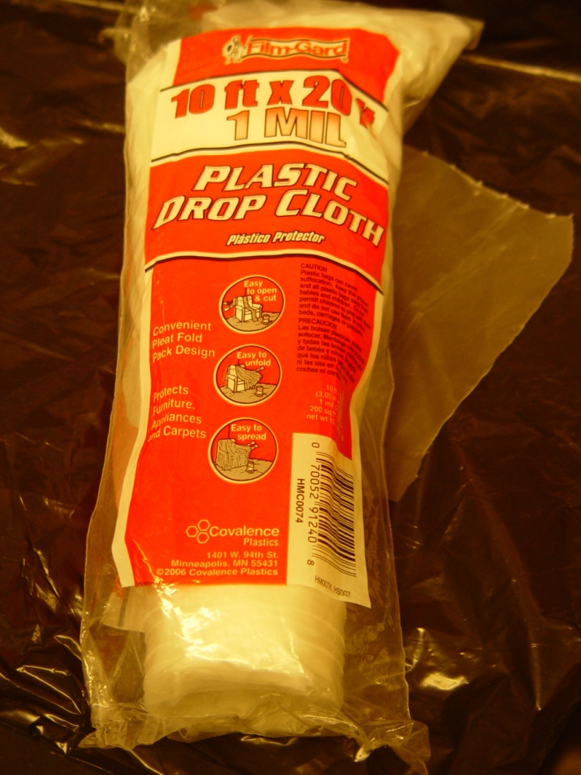

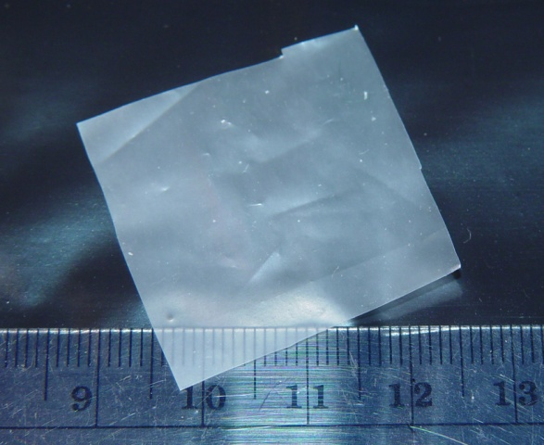

Types of Passive Samplers
Polyethylene (PE)
Polyoxymethylene (POM)
25 - 50 µm thick
PE
75 µm thick
POM
26 August
2013
The Use of Passive Samplers to Monitor Organic Contaminants at Superfund Sediment Sites

Slide 14
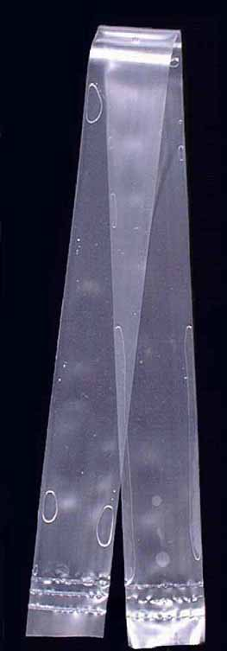
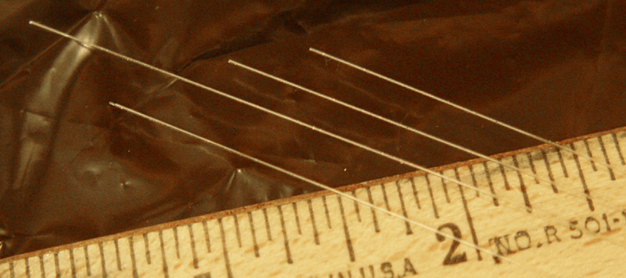
Types of Passive Samplers
fiber-optic cable
210 um inner
glass core
2.5 cm
10 - 100 um outer
polydimethylsiloxane (PDMS)
coating
cross-section SPMD
0.25 m
2.5 cm
SPME
triolien layer
50 - 95 um thick polyethylene shell
containing synthetic lipid triolien
2.5 cm
Solid Phase
Microextraction (SPME)
Semi-Permeable
Membrane Device (SPMD)
26 August
2013
The Use of Passive Samplers to Monitor Organic Contaminants at Superfund Sediment Sites

Slide 15
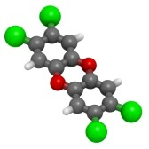
Types of Passive Samplers
Dioxin molecule
(green = chlorine)
Polyethylene
Atom Key:
White = Hydrogen
Black = Carbon
Red = Oxygen
Grey = Silicon
Polyoxymethylene
“Like Dissolves Like”
(i.e., contaminants dissolve into the polymers)
Polydimethylsiloxane
26 August
2013
The Use of Passive Samplers to Monitor Organic Contaminants at Superfund Sediment Sites

Slide 16
Some Theory on How Passive Samplers Work
PCB molecule
Water Column
50 um
Passive Sampler
(e.g., PE or POM)
Initial concentration of PCBs in
passive sampler = 0 ng/g
26 August
2013
The Use of Passive Samplers to Monitor Organic Contaminants at Superfund Sediment Sites

Slide 17
Some Theory on How Passive Samplers Work
Equilibrium Sampling
Concentration
(ng/g Passive Sampler)
Deployment Time (days)
26 August
2013
The Use of Passive Samplers to Monitor Organic Contaminants at Superfund Sediment Sites

Slide 18
Some Theory on How Passive Samplers Work
Equilibrium Sampling
* = Equilibrium
*
where,
C_{D} is the dissolved concentration
of a contaminant (ng/mL),
C_{Sampler} is the passive sampler
concentration (ng/g),
K_{Sampler-D} is the passive sampler-dissolved partition coefficient (mL/g)
Concentration
(ng/g Passive Sampler)
√
√
Dissolved and
Bioavailable
Concentration
√
Deployment Time (days)
26 August
2013
The Use of Passive Samplers to Monitor Organic Contaminants at Superfund Sediment Sites

Slide 19
Preparing, Deploying, Recovering, and Storing Passive Samplers
General guidance presented today (SAMS #3 document)
Society of Environmental Toxicology and Chemistry (SETAC)
  Pellston Technical Workshop on passive sampling (Fall 2012)
  Series of scientific papers to be published in 2014 including practical guidance for field deployments (e.g., QA/QC)
Strategic Environmental Research and Development Program (SERDP) and Environmental Security Technology Certification Program (ESTCP)
  Funding project developing specific guidance using passive samplers at contaminated sites (due late 2014/early 2015)
  Published as a U.S. EPA document
  Contents: SOPs for field deployment/recovery, chemical analysis, QA/QC considerations
  Designed for use by contractors and contract laboratories
√
26 August
2013
The Use of Passive Samplers to Monitor Organic Contaminants at Superfund Sediment Sites

Slide 20
Preparing, Deploying, Recovering, and Storing Passive Samplers
Samplers must be free of contaminants prior to deployment
  Samplers soaked in organic solvent to remove organic contaminants & soaked in deionized water to remove organic solvent from polymer structure
  Samplers wrapped in aluminum foil, placed into a plastic bag, and stored at - 4ºC until deployment
  Samplers transported to the field in clean ice-filled cooler(s)
26 August
2013
The Use of Passive Samplers to Monitor Organic Contaminants at Superfund Sediment Sites

Slide 21
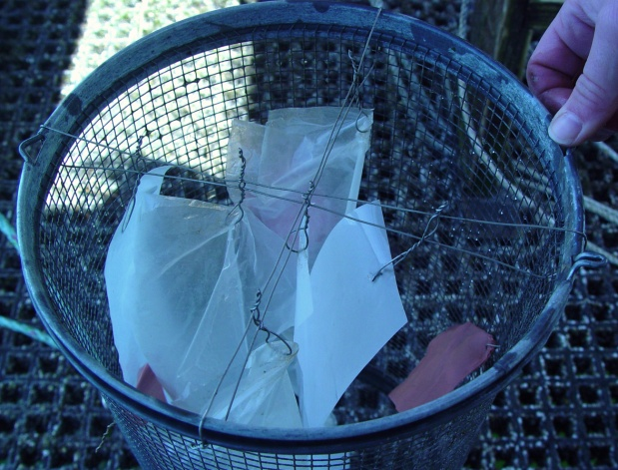
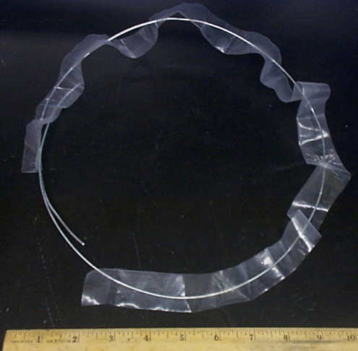
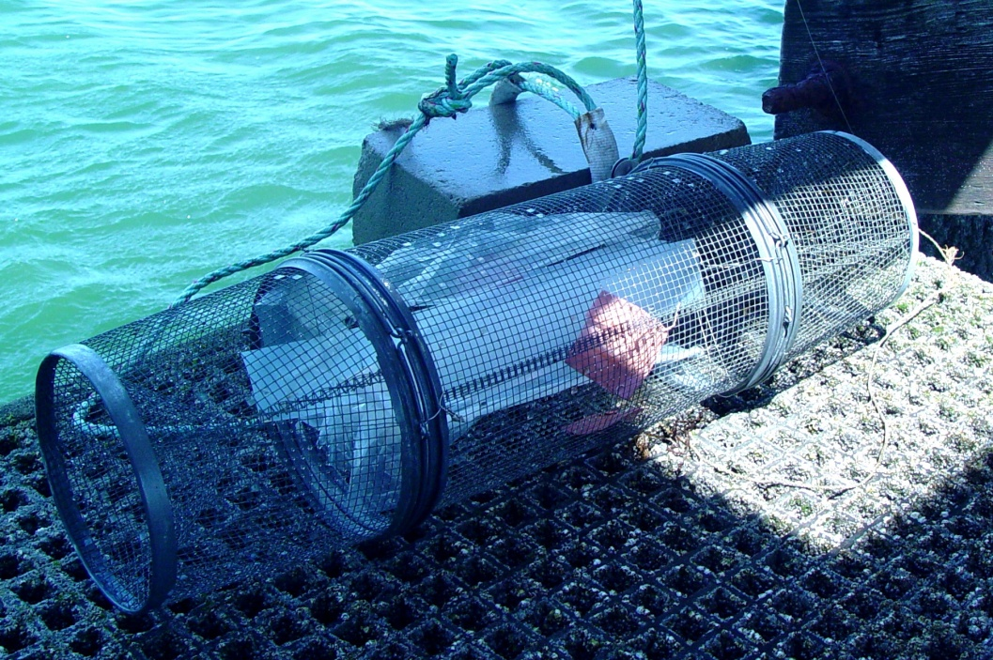
Preparing, Deploying, Recovering, and Storing Passive Samplers
PE
POM
Water Column Deployment
PE
SPME (in copper
mesh envelope)
Stainless steel ring
Minnow trap
(NHEERL & Brown U)
(NHEERL & MIT)
26 August
2013
The Use of Passive Samplers to Monitor Organic Contaminants at Superfund Sediment Sites

Slide 22
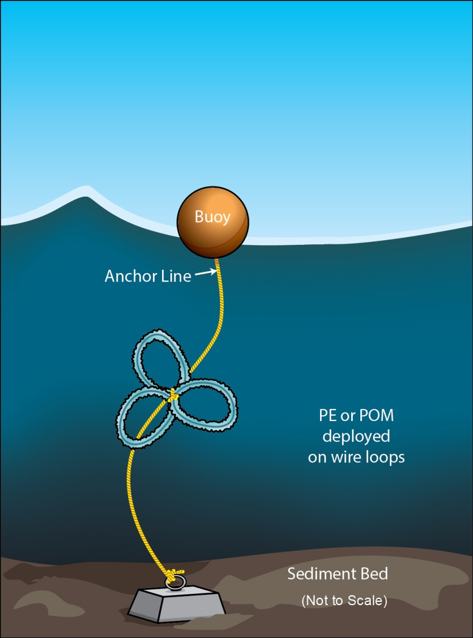
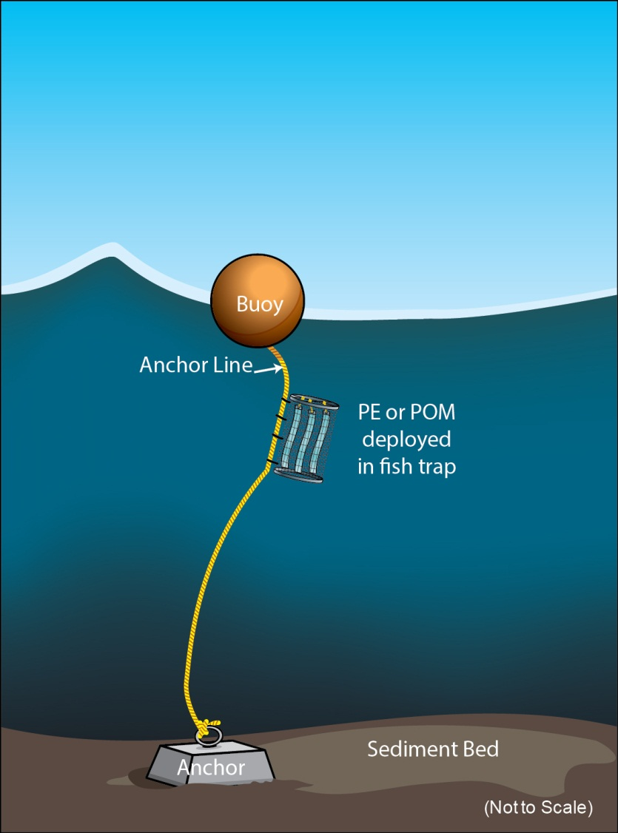
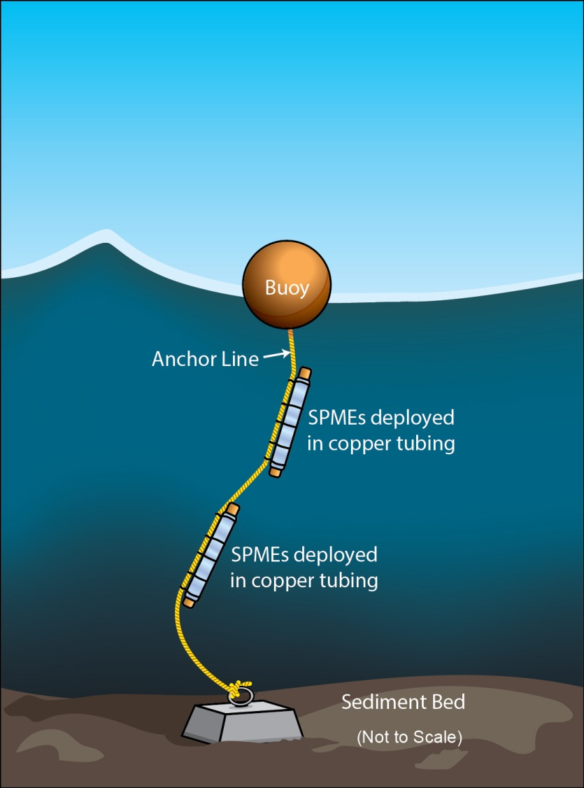
Preparing, Deploying, Recovering, and Storing Passive Samplers
Water Column Deployment
26 August
2013
The Use of Passive Samplers to Monitor Organic Contaminants at Superfund Sediment Sites

Slide 23
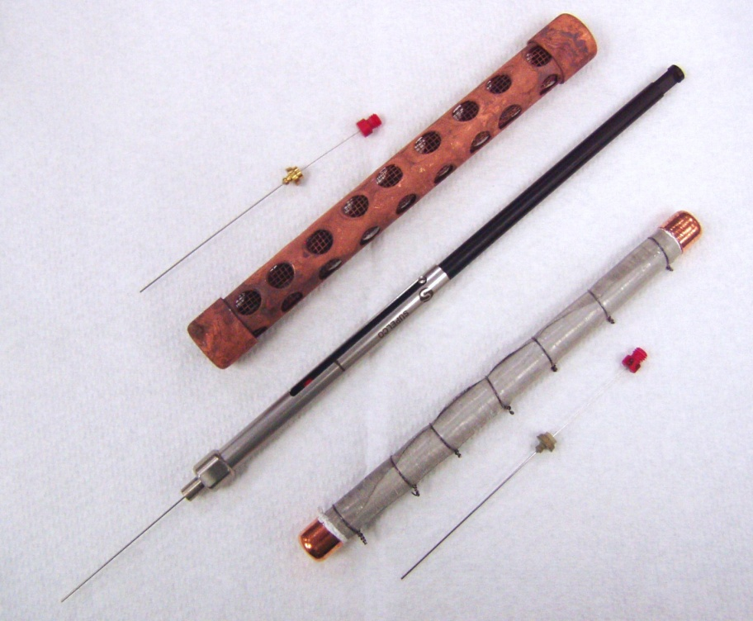
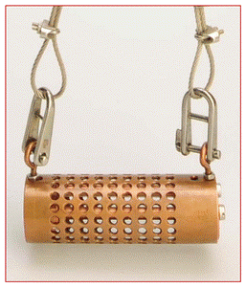
Preparing, Deploying, Recovering, and Storing Passive Samplers
Sediment Deployment
SPME (inside
stainless steel tube)
SPME (in
protective syringe)
Copper tubing
housing
(Aarhus U, Denmark)
(SCCWRP)
SPME (in
protective syringe)
26 August
2013
(U Texas)
The Use of Passive Samplers to Monitor Organic Contaminants at Superfund Sediment Sites

Slide 24
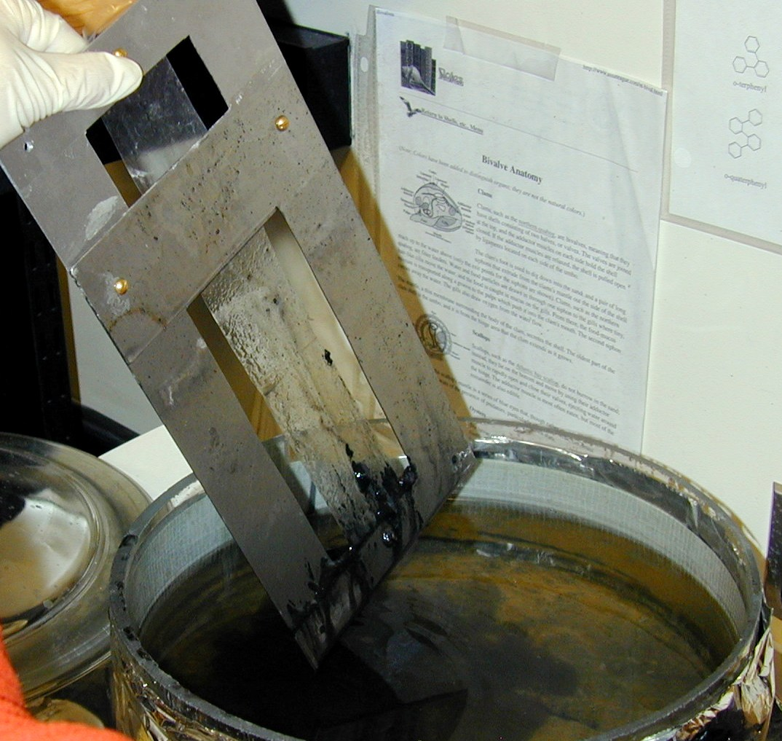
Preparing, Deploying, Recovering, and Storing Passive Samplers
Sediment Deployment
(MIT)
PE or POM (in aluminum frame)
(MIT)
PE or POM (in aluminum frame)
26 August
2013
The Use of Passive Samplers to Monitor Organic Contaminants at Superfund Sediment Sites

Slide 25
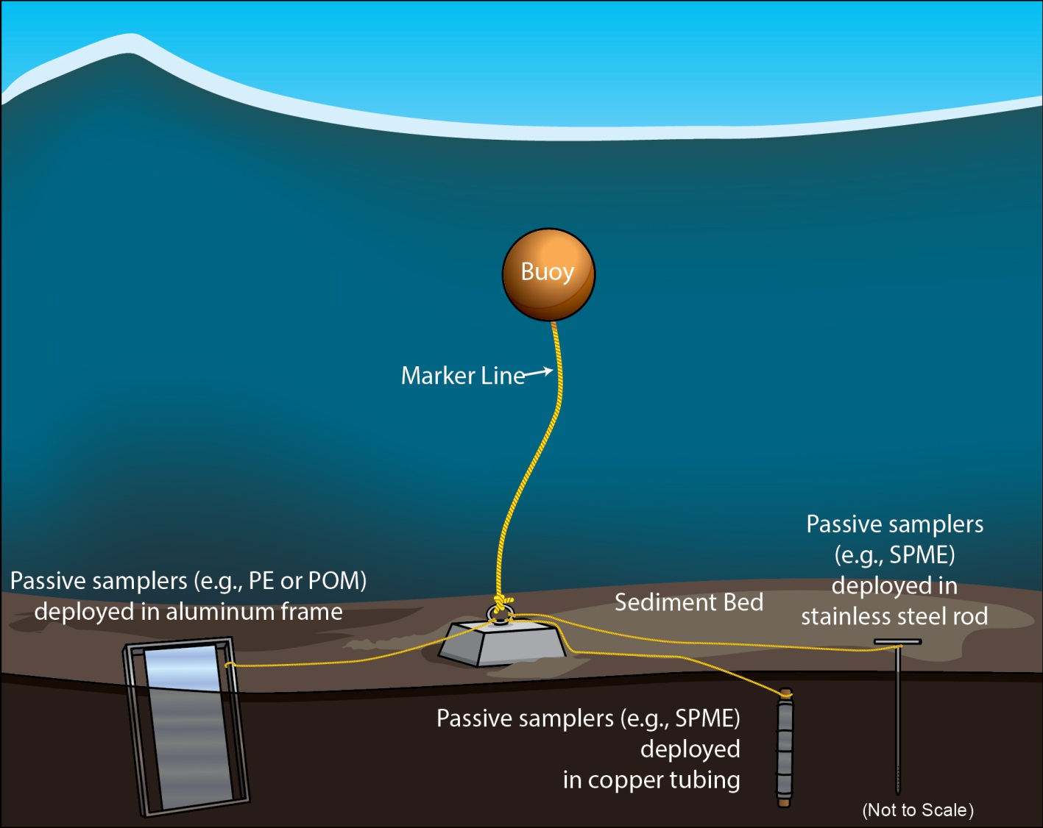
Preparing, Deploying, Recovering, and Storing Passive Samplers
Sediment Deployment
26 August
2013
The Use of Passive Samplers to Monitor Organic Contaminants at Superfund Sediment Sites

Slide 26
Preparing, Deploying, Recovering, and Storing Passive Samplers
Sediment
Deployment
Diver-assisted
sediment deployment
(MIT & Region 9)
OSRTI’s Environmental Response Team Dive Team & Region 10’s Dive Team have extensive experience deploying and recovering passive samplers – cost-effective resource
26 August
2013
The Use of Passive Samplers to Monitor Organic Contaminants at Superfund Sediment Sites

Slide 27
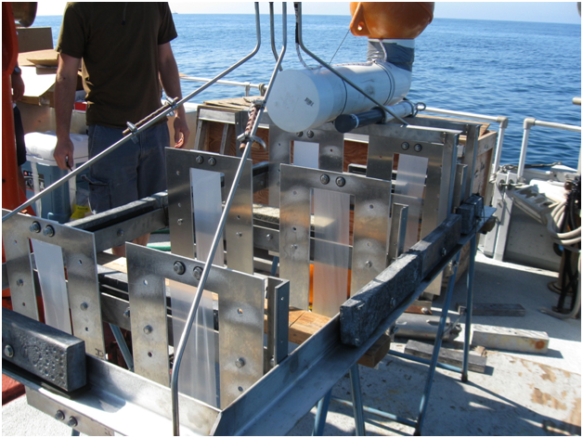
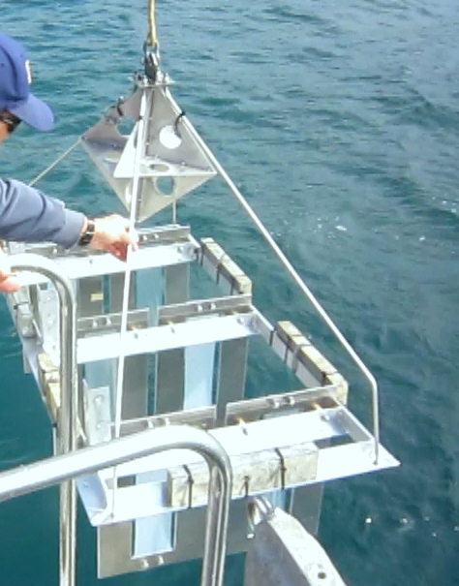
Preparing, Deploying, Recovering, and Storing Passive Samplers
SPME in copper tubing
Sediment
Deployment
PE and POM
(in aluminum frames)
Measure of
contaminant flux into
the water column
Samplers above
sediment surface
Samplers below
sediment surface
Platform when deployed
(NHEERL )
(NHEERL )
26 August
2013
The Use of Passive Samplers to Monitor Organic Contaminants at Superfund Sediment Sites

Slide 28
Preparing, Deploying, Recovering, and Storing Passive Samplers
After the deployment period (~ 28 days)
  Samplers removed from deployment gear (e.g., stainless steel rings, copper tubing, minnow cages, frames)
  Samplers wiped clean with laboratory tissue and/or quickly rinsed with clean water
  Samplers wrapped in aluminum foil or placed in clean glass jars (with teflon-lined lids) and returned to the laboratory in a clean cooler(s) on ice (as soon as possible)
  Samplers stored at - 4ºC in the dark until organic solvent extraction and chemical analyses are performed
26 August
2013
The Use of Passive Samplers to Monitor Organic Contaminants at Superfund Sediment Sites

Slide 29
Selecting Passive Samplers
Passive Sampler | Advantages | Disadvantages
Polyethylene (PE) | ● Inexpensive polymer ● Robust and rugged ● Easy to work with ● Simple to deploy and recover ● Not limited by sample mass (greater analytical sensitivity) ● Will stretch during deployment before it rips ● Increasing use globally ● Good for both water column and sediment deployments | ● Slower equilibration than SPME ● Folds on itself, making cleaning difficult
Polyoxymethylene (POM) | ● Inexpensive polymer ● Robust and rugged ● Easy to work with ● Simple to deploy and recover ● Not limited by sample mass (greater analytical sensitivity) ● Cleans easily ● Increasing use globally ● Good for both water column and sediment deployments | ● Slower equilibration than SPME ● Can rip easily compared with PE
Solid Phase Microextraction (SPME) | ● Inexpensive polymer fibers ● Rapid equilibrium ● Widely used globally ● Once protected, simple to deploy and recover ● Clean easily ● Good for sediment deployments | ● Fragile – need to protect during deployment ● Relatively difficult to handle ● Limited polymer mass (less analytical sensitivity) ● Poor for water column deployments because of the limited polymer mass
26 August
2013
The Use of Passive Samplers to Monitor Organic Contaminants at Superfund Sediment Sites

Slide 30
Analyzing Passive Sampler Data
Raw data (from the analytical laboratory)
  Measured concentration of contaminants in the passive sampler (C_{Sampler})
    Units
      µg/g sampler
      µg/mL sampler (convert to µg/g sampler by dividing by the passive sampler density (e.g., PE = 0.92 g/mL))
Calculate contaminant dissolved concentration (C_{D}) (g/mL):
Sampler-Dissolved Partition Coefficient (mL/g):
Several are available in the SAMS #3 document,
the SETAC papers, the SERDP/ESTCP guidance, the scientific literature
26 August
2013
The Use of Passive Samplers to Monitor Organic Contaminants at Superfund Sediment Sites

Slide 31
Brief Case Study
Palos Verdes Shelf Superfund Site
  Water Column and Sediment Deployments
    Located off of the coast of Los Angeles (CA)
    Carmen White and Judy Huang (RPMs)
    Deep water marine site (60 m)
    Contaminants of Concern: DDTs & PCBs
    12 water column stations
      5 m from surface; 30 m; 5 m above bottom
    Five sediment stations
  Objectives
    Determine water column concentrations of contaminants resulting from remediation activity (before, during, after)
    Determine magnitude of flux of contaminants into the water column from sediment stations
    Compare different types of passive samplers (PE, POM, SPME)
√
√
√
26 August
2013
The Use of Passive Samplers to Monitor Organic Contaminants at Superfund Sediment Sites

Slide 32
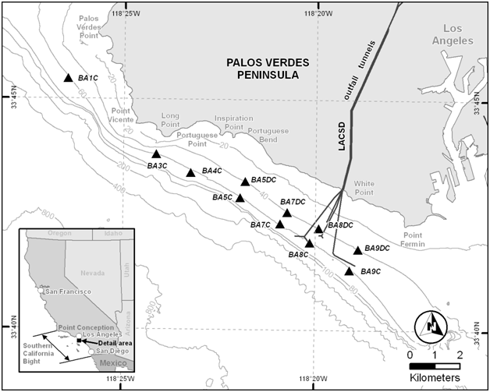
Brief Case Study
Water Column Deployment Stations (2010)
26 August
2013
The Use of Passive Samplers to Monitor Organic Contaminants at Superfund Sediment Sites

Slide 33
Brief Case Study
PE-based p,p’ DDE Dissolved Concentrations (5 m above bottom)
26 August
2013
The Use of Passive Samplers to Monitor Organic Contaminants at Superfund Sediment Sites

Slide 34
Brief Case Study
PE-based Total PCB Dissolved Concentrations (5 m above bottom)
26 August
2013
The Use of Passive Samplers to Monitor Organic Contaminants at Superfund Sediment Sites

Slide 35
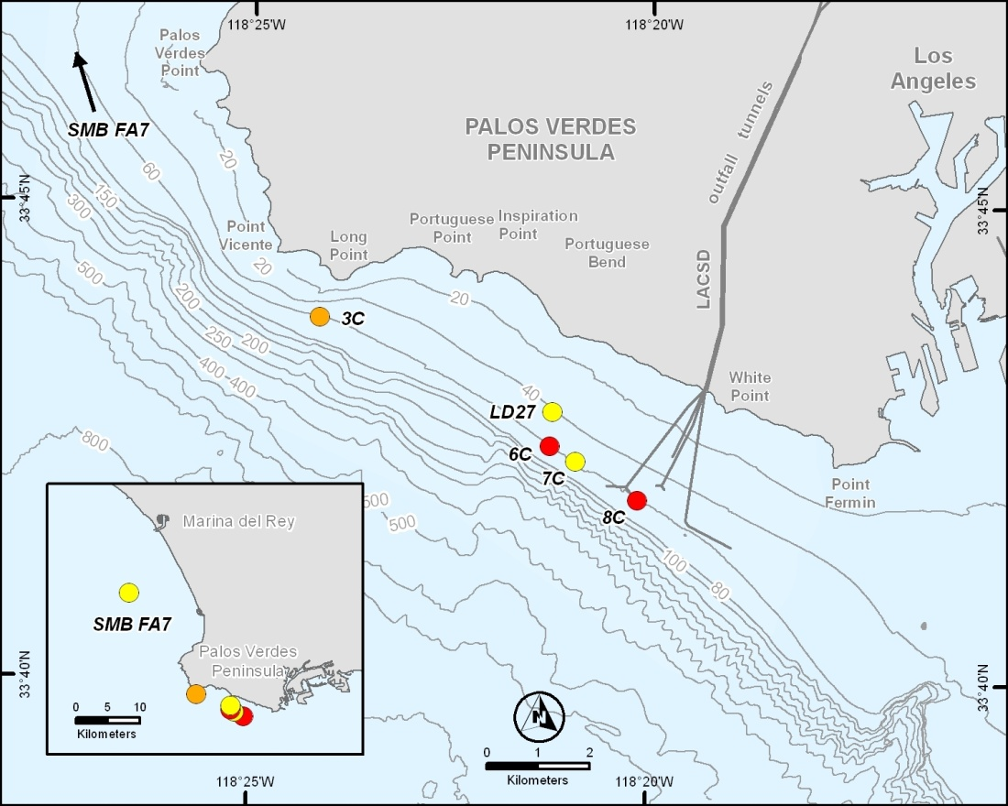
Brief Case Study
Sediment Deployment Stations (2011)
p,p’-DDE Station 6C
25
15
5
-5
-15
-25
Water Column
Flux = 260 ng
p,p’-DDE/cm² y
Depth (cm)
Sediment
Dissolved Concentration
(ng/L)
26 August
2013
The Use of Passive Samplers to Monitor Organic Contaminants at Superfund Sediment Sites

Slide 36
Scientific Challenges in using Passive Samplers
Establishing when equilibrium between the contaminants and passive sampler occurs
  Unless deployment time series data is available (i.e., $$$)
  Challenge in all monitoring (including biomonitoring)
  Solution: Use of performance reference compounds (PRCs) loaded into the passive sampler to predict equilibrium
    PED, POM
    SPME assume very rapid equilibration
*
Concentration
(ng/g Passive Sampler)
Deployment Time (days)
26 August
2013
The Use of Passive Samplers to Monitor Organic Contaminants at Superfund Sediment Sites

Slide 37
Scientific Challenges in using Passive Samplers
Water Column
Polybrominated
biphenyl ether
(PBDE)
50 um
Polyethylene
Initial concentration of PBDEs in
passive samplers is known

Slide 38
Scientific Challenges in using Passive Samplers
Concentration
(ng/g Passive Sampler)
Deployment Time (days)
26 August
2013
The Use of Passive Samplers to Monitor Organic Contaminants at Superfund Sediment Sites

Slide 39
Scientific Challenges in using Passive Samplers
PCB
Concentration
(ng/g Passive Sampler)
C_{Sampler –Equilibrium Adjusted}
PRC
Deployment Time (days)
26 August
2013
The Use of Passive Samplers to Monitor Organic Contaminants at Superfund Sediment Sites

Slide 40
Scientific Challenges in using Passive Samplers
Friedman et al. (2009)
Relating passive sampler uptake of contaminants to animal bioaccumulation
  Critical for determining how to interpret passive sampler data
  Dataset comparing passive sampler uptake to animal bioaccumulation is being established
  Solution: Generate general linear models:
1:1 Line
?
=
Passive Sampler (e.g., PE or POM)
Mussels
r² = 0.88
Animal Concentration (ng/g) = ά + β*Sampler Concentration (ng/g)
26 August
2013
The Use of Passive Samplers to Monitor Organic Contaminants at Superfund Sediment Sites

Slide 41
US EPA Contacts Working with Passive Samplers
Name | Office and Location | e-mail
Robert Burgess | ORD/NHEERL/AED-Narragansett, RI | burgess.robert@epa.gov
Lawrence Burkhard | ORD/NHEERL/MED-Duluth, MN | burkhard.lawrence@epa.gov
Mark Cantwell | ORD/NHEERL/AED-Narragansett, RI | cantwell.mark@epa.gov
Bruce Duncan | Region 10 – Seattle, WA | duncan.bruce@epa.gov
Marc Greenberg | OSWER/OSRTI/ERT-Edison, NJ | greenberg.marc@epa.gov
Judy Huang | Region 9 - San Francisco, CA | huang.judy@epa.gov
Matthew Lambert | OSWER/OSRTI/Washington, DC | lambert.matthew@epa.gov
Marc Mills | ORD/NRMRL/ LRPCD-Cincinnati, OH | mills.marc@epa.gov
Joseph Schubauer-Berigan | ORD/NRMRL/ LRPCD-Cincinnati, OH | schubauer-berigan.joseph@epa.gov
Sean Sheldrake | Region 10 - Seattle, WA | sheldrake.sean@epa.gov
Rachelle Thompson | Region 9 - San Francisco, CA | thompson.rachelle@epa.gov
26 August
2013
The Use of Passive Samplers to Monitor Organic Contaminants at Superfund Sediment Sites

Slide 42
Summary
Passive sampling is a scientifically sound and cost-effective approach for monitoring contaminant concentrations
  water column
  sediment interstitial waters
Passive samplers provide information on:
  Dissolved and bioavailable contaminant concentrations
  Sampler uptake may serve as a surrogate for animal bioaccumulation
Applications include:
  Monitoring water column and interstitial water concentrations before, during and after remediation
  Determining sources of contaminants released from sediments to the water column (e.g., site model development)
  For many applications, passive sampling is the future of environmental sampling
  √
  √
  √
26 August
2013
The Use of Passive Samplers to Monitor Organic Contaminants at Superfund Sediment Sites

Slide 43
Acknowledgements
OSWER, specifically OSRTI (e.g., S. Ells, M. Lambert)
L. Fernandez (U.S. EPA/Northeastern Univ.) & M. Perron (U.S. EPA)
Y. Burhan (Tetra Tech)
Reviewers of the SAMS document
Sources of photographs in the SAMS document
See SAMS document for more specifics
26 August
2013
The Use of Passive Samplers to Monitor Organic Contaminants at Superfund Sediment Sites

