Slide 1
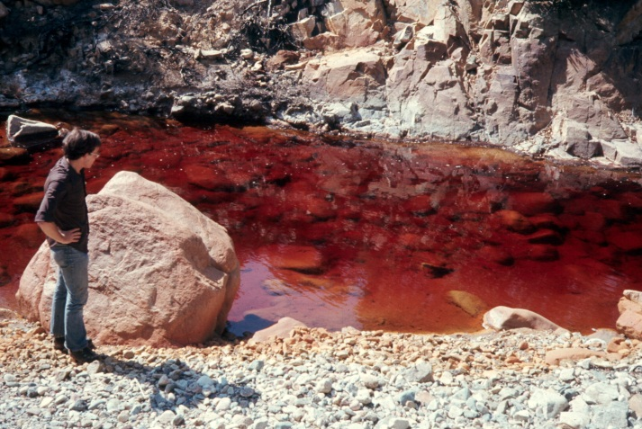
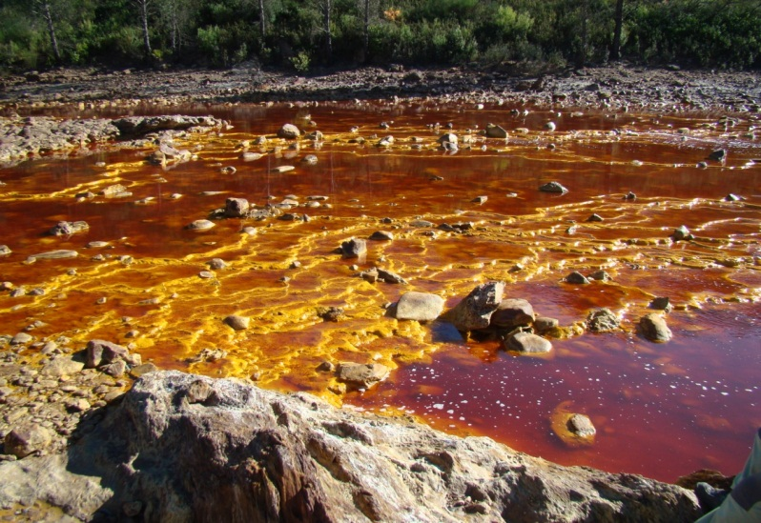
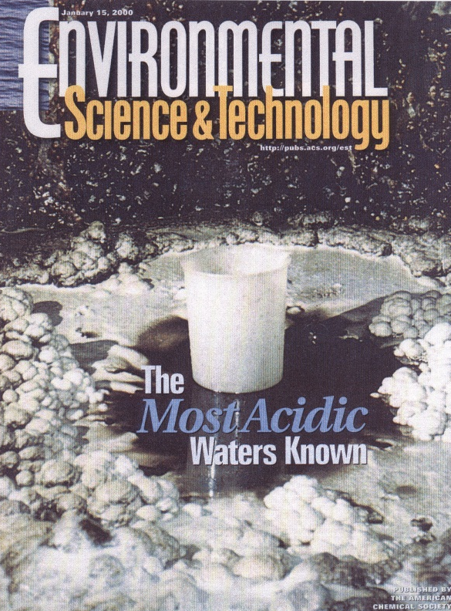
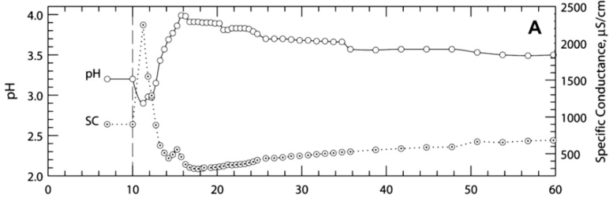
Predicting and modeling water chemistry associated with hardrock mine sites
EPA Workshop Webinar Series on
Hardrock Mining Geochemistry and Hydrology:
Theme #1 Evaluating water chemistry predictions at Hardrock Mine Sites
February 13, 2013
D. Kirk Nordstrom, US Geological Survey, Boulder, CO, USA
Notes:
Welcome, everyone, to this webinar. I shall start with a warning that this subject is normally taught over the space of weeks to months to years depending on one’s background level of expertise; it is complex and highly technical material. Hence, I’ll be presenting a short overview, emphasizing what I consider to be some of the most important aspects within a regulatory framework and some glimpses into the state-of-the-art.

Slide 2
Introduction to models
“In chess, we have both complete knowledge of the governing rules and perfect information – there are a finite number of chess pieces, and they’re right there in plain sight. But the game is still very difficult for us……
Both computer programs and human chess masters therefore rely on making simplifications to forecast the outcome of the game. We can think of these simplifications as ‘models,’ …” (Silver, 2012)
Notes:
I thought this was a rather good analogy that puts the issue of modeling and its reliability into perspective. Here you have an example of the difficulty of modeling some aspect of the environment. It’s worse than chess. Anyone who thinks that a model can provide accurate and reliable knowledge, whether it be characterization or prediction, has not heard of Murphy’s Laws. Note that I partly disagree with nate Silver’s statement: computer programs don’t rely on simplifications. It is the model they embody that relies on simplifications.

Slide 3
On models: A. Scientific models ARE
Simplifications
Idealizations
Approximations
Representations of our thinking about physical reality
Inexact and non-unique
Useful
Notes:
There persists some confusion about what a model is or isn’t and it is important to recognize these characteristics. A model is always a simplification. We never know enough for it to be anything else. We simplify by idealizing, hence models are also idealizations and approximations. The important question is: are the approximate results calculated by the model useful? We often say that models represent reality but they don’t; they represent our thinking about reality. So the question becomes: How good is our thinking? The answer to that depends on education, training, experience, and creativity. Models come from concepts; if we don’t have the concepts right then the models will be flawed. Another consequence of simplification is that models are inexact and non-unique. Nevertheless, models can be very useful – mostly for enhancing our understanding, not necessarily for regulatory purposes. If the regulatory purpose includes improved understanding of the geochemical processes at a mine site, then models can be useful; if regulatory purpose is ONLY focused on compliance requirements or permitting, then models are probably not useful.

Slide 4
On models: B. Scientific models are NOT
Codes
Representations of reality
Only mathematical equations
Statistics
Unique
Exact, complete, accurate, true
Totally or wrong or totally right
Useless
Notes:
People often refer to the MINTEQ model, or the PHREEQC model, but that is incorrect. These are not models! They are computer programs or codes. If someone says they used the PHREEQC model to compute something, ask them what the model is and remind them that PHREEQC is a code that has gone through numerous versions and incorporates several models (such as the ion-association model and the Pitzer ion-interaction model) and has several databases. They need to spell out which models and databases they are using, not only which codes. Models don’t change nearly as much as codes do.
Models are not “representations of reality” because (1) we don’t know what reality is to begin with (if we did we wouldn’t need a model) and (2) we cannot represent reality, we can only represent our thinking about reality. We don’t know what it means to represent reality. We don’t know what it means to represent something we can’t define and by using language we limit our ability to express that representation. [Gregory quote, p. 1912 of Nordstrom, 2012]. “The minute we begin to talk about this world, however, it somehow becomes transformed into another world, an interpreted world, a world delimited by language.” Some people are so immersed in mathematics that they think models are only mathematical equations. Most field-based scientists understand that there is far more to modeling than the application of mathematics. Likewise with statistics. Applying statistics to a set of data does not a scientific model make. It requires interpretation.
Models are not unique, exact, complete, accurate, or true. Models are also not totally wrong nor useless nor totally incorrect. You have to be careful of this tendency to put things into B&W boxes. The world is grey. Some people are fond of the quote “All models are wrong, some are just more useful than others.” I don’t agree because this statement is another B&W type statement. We shouldn’t say that all models are wrong or any model is right because it is too simple a statement. We should simply say that all models are approximations and some are better approximations than others depending on the objectives, the system being studied, and the limitations of the model for the specified conditions.

Slide 5
C. Scientific models are useful because:
They can lead to new insights and increase our understanding
They help conceptualize and integrate large amounts of data and information
They can be tested by comparing their consequences or their predictions with independent observations
Notes:
It is important to recognize that we compare the consequences of our models with independent observations, not the model itself. Einstein and Infeld (1938, The Evolution of Physics) made it clear that we cannot compare our theories with the real world; we can only compare the predictions from our theories with our theory-laden observations of the world.

Slide 6
D. Scientific models are not necessarily useful in a regulatory environment because:
They can be misleading
It is possible to demonstrate any preconceived idea with a particular choice of data, codes, and assumptions
If the results from model concepts and/or calculations cannot be confirmed or tested with observational data, there is no way to determine the reliability of these results
Notes:
So if someone says that they have predicted the water chemistry of a pit lake 50 years into the future – the important question to ask is where is the data to show that such a prediction has been tested and shown to have agreed with observation?! How well do these types of models really predict? They would have a hard time answering that question because of the lack of data. If we don’t have a confirmation from a test of the model, then we have no basis to have any confidence in the model. Without confirmation, it’s guesswork, not science.

Slide 7
E. Scientific models are not necessarily useful in a regulatory environment because of:
The complexity paradox
The more sophisticated a model and the more complex the code, the more difficult it is to test the code and determine if it is working properly, or even to understand how it works [Oreskes, 2000]
Loss of meaning and representation
“Needlessly complicated models may fit the noise in a problem rather than the signal, doing a poor job of replicating its underlying structure and causing predictions to be worse.” [Silver, 2012]

Slide 8
On predictions
2 meanings
Logical (or phenomenological) prediction
Temporal (or chronological) prediction
Logical prediction: a prediction based on scientific principles along with necessary assumptions to form a logical construct with testable consequences (what science does)
Temporal prediction: a prediction that foretells the future (betting on horses, predicting the world apocalypse, foretelling the day and hour you will die, etc.; not what science does)

Slide 9
Logical prediction: 2 types
Time-independent
If I mix pH 2 AMD with an equal amount of pH 12.5 slaked lime solution [Ca(OH)₂], I predict a massive precipitate of hydrous ferric oxides and other metals
Time-dependent
If I mix 100 millimoles of pyrite in a sulfuric acid solution of pH 2 and 10⁸ cells/mL of iron-oxidizing microbes, the pyrite will be half gone in a little more than 2 days
Notes:
Another source of confusion, even for modelers, is the difference between time-dependent prediction and time-independent prediction. [read slide here]. Groundwater modelers and reactive-transport modelers are always working with time as an explicit variable, geochemists often work with time as an implicit or non-existent variable. Geochemists who produce kinetic data on the dissolution or precipitation rates of minerals are working explicitly in time but it is “lab” time which does not necessarily have anything to do with “field” time. In making future predictions, such as predicting groundwater conditions given certain properties and boundary conditions, we are actually trying to make our logical predictions conform to temporal predictions. In so doing, we have to acknowledge that there are some serious limitations in this endeavor because there are some factors that are beyond our ability to predict. This issue was brought out nicely by research in the field of chaos theory and non-linear dynamics (remember the “butterfly effect”).

Slide 10
More definitions
Chemical model – a theoretical construct that permits the calculation of thermodynamic, kinetic, or quantum mechanical properties of a system
Geochemical model – a chemical model applied to a geologic system

Slide 11
Pyrite oxidation: the chemical model
FeS₂ + 3.5O₂ + H₂O  Fe²⁺ + 2SO₄²⁻ + 2H⁺
Pyrite + air + water  acid ferrous sulfate soln
Fe²⁺ + H⁺ + ¼O₂  Fe³⁺ + ½H₂O
Ferrous iron oxidation
FeS₂ + 3.75O₂ + ½H₂O  Fe³⁺ + 2SO₄²⁻ + H⁺
Pyrite + air + water  acid ferric sulfate soln
Fe³⁺ + 2H₂O  Fe(OH)₂⁺ + 2H⁺
Hydrolysis of acid ferric sulfate soln
FeS₂ + 3.75O₂ + 2.5H₂O  Fe(OH)₂⁺ + 2SO₄²⁻ + 3H⁺
Pyrite + air + water  hydrolyzed ferric sulfate soln
FeS₂ + 3.75O₂ + 3.5H₂O  Fe(OH)_{3(s)} + 2SO₄²⁻ + 4H⁺
Pyrite + air + water  iron ppt + sulfuric acid
Notes:
Pyrite oxidation is actually a rather complex process. It involves the transfer of 14 electrons from the S₂²⁻ entity in pyrite to sulfate. This does not happen in one step. I have not shown all the steps because it is beyond the scope of today’s presentation and today’s presentation is complicated enough. Also, pyrite is directly oxidized by Fe³⁺ (ferric iron) not oxygen. The overall process comes out to the same results whichever oxidant is used. I have also not mentioned the very important catalysts in the system, iron- and sulfur-oxidizing microbes. That would be another subject for discussion in another workshop. Basically, without the chemoautotrophic bacteria and archaea, the reactions that produce AMD would be much slower.

Slide 12
Example 1: Can we predict water chemistry from pyrite oxidation?
Yes, BUT ONLY IF
We know how much pyrite has oxidized
We assume an unlimited supply of O₂
We assume equilibrium solution speciation
We only consider initial/final states, not intermediate states that require knowledge of reaction rates
We assume no other minerals are reacting
Are these assumptions technically correct?
No – but a few waters do approximate these conditions
We need actual water chemistry data with mass balances to know the amount of pyrite oxidized

Slide 13
Example 1.1 Mass Balance Modeling Pyrite oxidation with gypsum dissolution
If a water analysis contains 480 mg/L SO₄ (5 mmol) and mass balances show that 75% came from pyrite oxidation and 25% from gypsum dissolution, then
1.875 mmol of FeS₂ dissolved and
1.25 mmol of CaSO₄·2H₂O dissolved
Notes:
Here is what we mean by mass balances.

Slide 14
Example 1.2 Mass balance on a natural acidic drainage water [rock is andesite and rhyolite mineralized with pyrite, gypsum, sulfides, etc.]
Solute | Concentration
pH | 2.98
Ca | 8.72 mM
Mg | 4.64 mM
Na | 0.35 mM
K | 0.019 mM
SO₄ | 21.1 mM
F | 0.40 mM
SiO₂ | 1.23 mM
Al | 3.39 mM
Fe | 1.16 mM
Zn | 7.63 mM
Cu | 0.029 mM
Initial state = pure H₂O/ final state = water composition
Pyrite . . . . . . . . . . . . . . . . 8.66 mmol/kg
Gypsum . . . . . . . . . . . . . . 3.78 mmol/kg
Dolomite . . . . . . . . . . . . . . 4.64 mmol/kg
Kaolinite . . . . . . . . . . . . . . .1.40 mmol/kg
Oligoclase . . . . . . . . . . . . . 0.44 mmol/kg
Fluorite . . . . . . . . . . . . . . . 0.20 mmol/kg
Sphalerite . . . . . . . . . . . . . 0.11 mmol/kg
Illite/Sericite . . . . . . . . . . . 0.032 mmol/kg
Chalcopyrite . . . . . . . . . . . 0.029 mmol/kg
Goethite . . . . . . . . . . . . . . -7.40 mmol/kg
Silica . . . . . . . . . . . . . . . . -2.89 mmol/kg

Slide 15
Pyrite oxidation: the chemical model
FeS₂ + 3.5O₂ + H₂O  Fe²⁺ + 2SO₄²⁻ + 2H⁺
Pyrite + air + water  acid ferrous sulfate soln
FeS₂ + 3.75O₂ + 2.5H₂O  Fe(OH)₂⁺ + 2SO₄²⁻ + 3H⁺
Pyrite + air + water  hydrolyzed ferric sulfate soln
FeS₂ + 3.75O₂ + 3.5H₂O  Fe(OH)₃ + 2SO₄²⁻ + 4H⁺
Pyrite + air + water  sulfuric acid + iron ppt

Slide 16
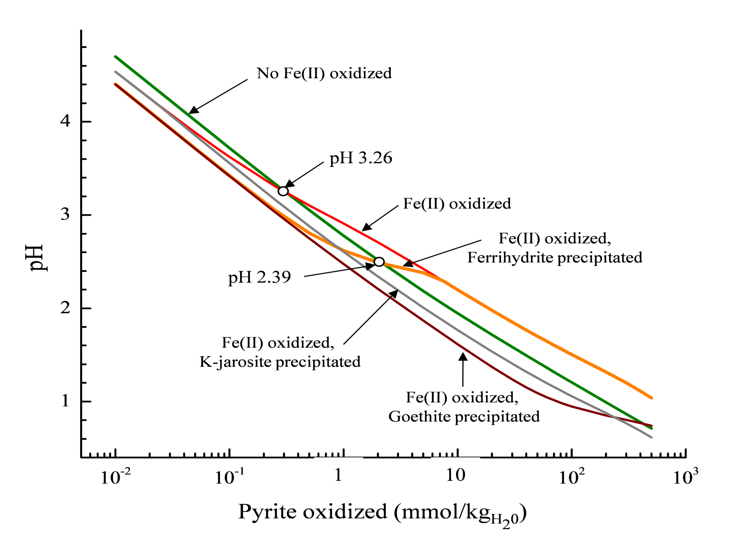
Example 1.3 Pyrite oxidation: the graphical model (new insights)
Simulation of pyrite+ O₂ + H₂O Fe(II/III) + H₂SO₄
from Nordstrom and Campbell (2013) Modeling low-temperature geochemical processes, vol. 5, ch. 2, Treatise on Geochemistry
using the PHREEQC code

Slide 17
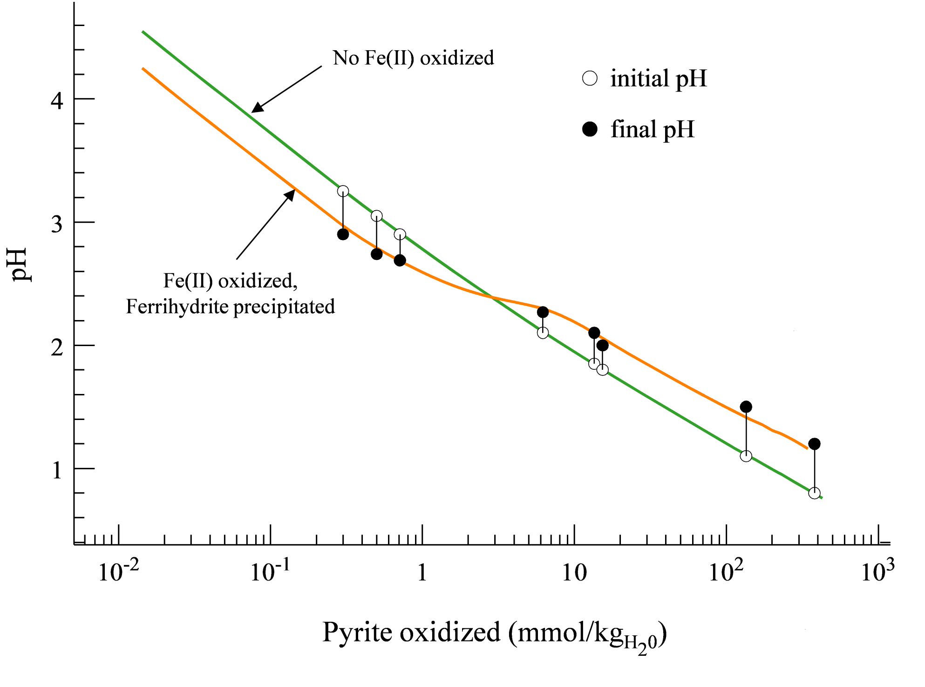
Example 1.4. Model testing with field data: confirmation

Slide 18
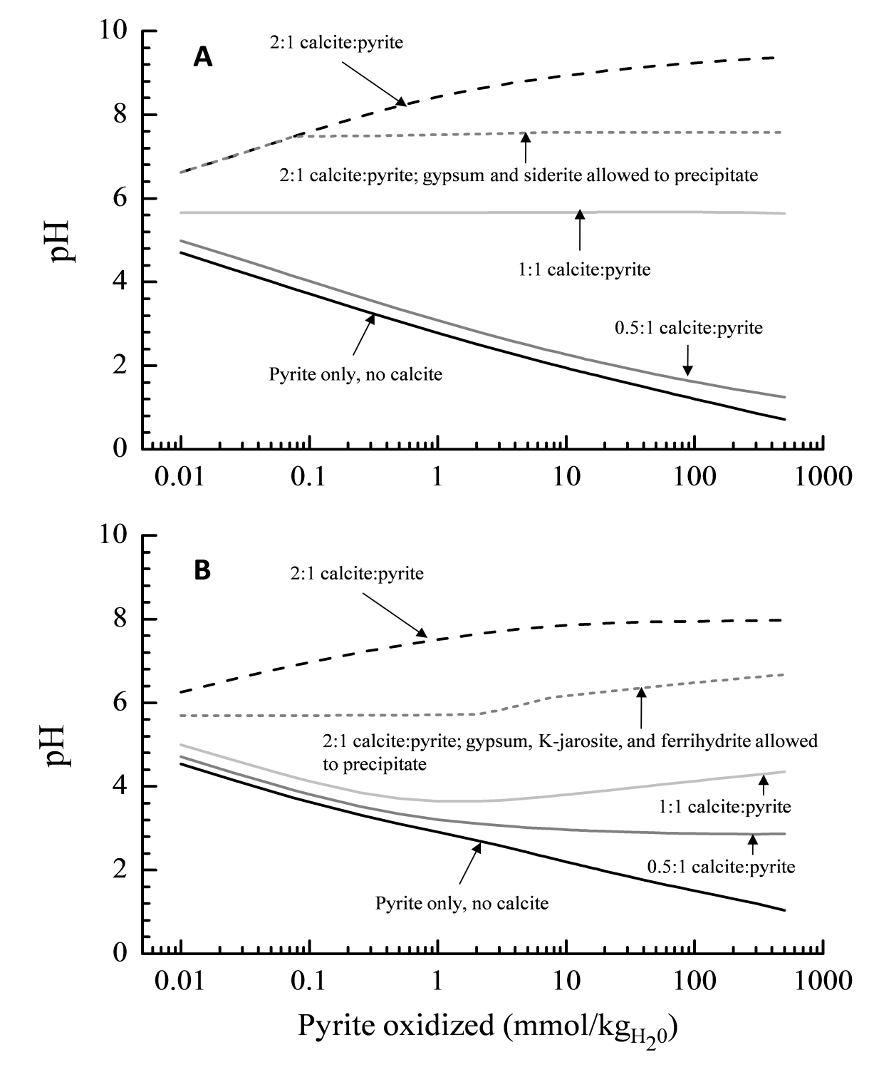
Example 1.5. Modeling of pyrite + calcite dissolution
Without oxidation of dissolved Fe
With oxidation of Fe
from Nordstrom and Campbell (2013) Modeling low-temperature geochemical processes, vol. 5, ch. 2, Treatise on Geochemistry (in press)

Slide 19
These are examples of geochemical modeling included speciation, redox, and mass transfer but no mass transport:
2. Types of geochemical modeling –
Equilibrium: space and time independent parameters
Steady-State: space-dependent but time-independent
Transient-State: space- and time-dependent
Speciation: distribution of the total amount of a component into different species forms
Mass transfer: transfer of a component from one phase to another (mineral dissolution or precipitation, gas evolution or uptake, flora or fauna uptake, etc.)
Reactive transport: mass transfer with mass transport
Kinetic modeling requires knowledge of reaction rates
Notes:
If kinetic modeling is included, everything gets very complicated and it becomes much easier to tweek code calculations so that the results come out anyway you want. Then the assumptions become very important and must be spelled out.

Slide 20
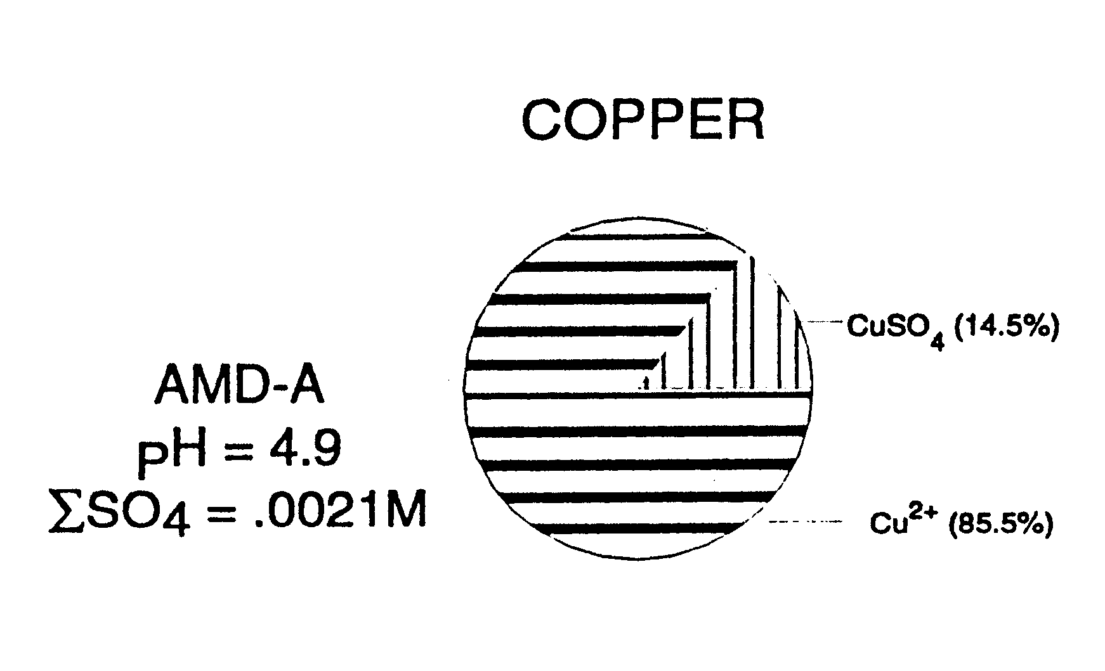
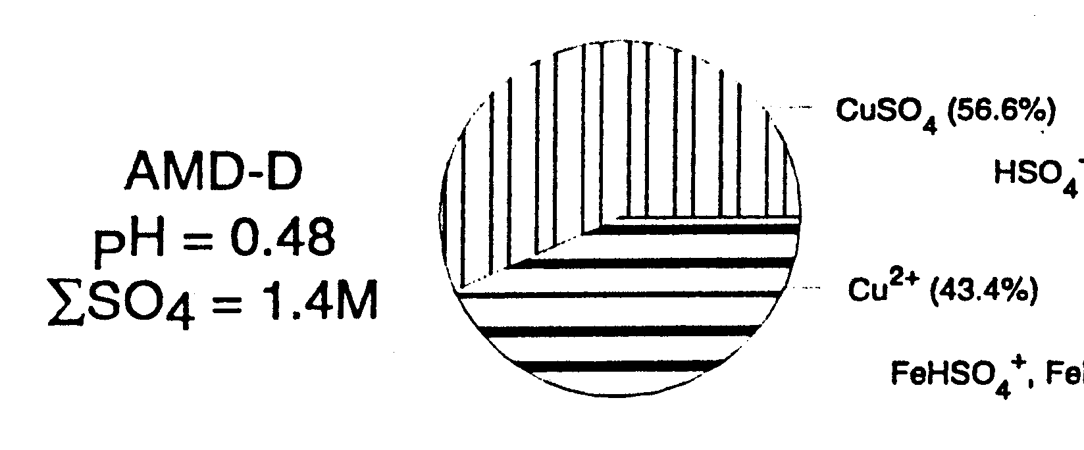
Example 2.1 Types of geochemical modeling: Aqueous speciation
(ion-association model; allows calculation of SIs)
AMD-A, Cu = 0.09 mg/L AMD-D, Cu = 290 mg/L
AMD-A: Cu/SO₄ = 0.45
AMD-D: Cu/SO₄ = 0.002 much higher amount of Cu-SO₄ complexing

Slide 21
Two more important types of modeling
Forward geochemical modeling: given initial conditions such as a specific rock type with a known mineralogy and an initial water composition, a model is used to calculate evolutionary changes in water chemistry and minerals dissolved and precipitated
Inverse geochemical modeling (mass balances): uses the available data on water chemistry, mineralogy, hydrologic conditions, and isotopes to constrain the possible geochemical reactions
Notes:
It is important to distinguish between these 2 types of modeling. Forward modeling might be used when there is little or no site data or lab data. Inverse modeling makes maximum use of field data. Forward modeling puts a huge burden on the modeler to know a great deal about geochemical, hydrological, and microbiological processes and site conditions. It is much harder to have confidence that forward modeling is useful by itself – far too much uncertainty. The optimal approach is to collect as much field data as possible and then fill in aspects of the geochemistry with forward modeling where there is insufficient data (see Glynn and Brown, 2012). IMHO, for regulatory purposes, if insufficient site data exists to do inverse modeling then any modeling is likely to be highly unreliable.

Slide 22
There are also different methods for calculating activity coefficients
The important point here is that if the ionic strength of the waters to be modeled is greater than 1 molal then the Pitzer ion-interaction model must be used. The Pitzer model does not have all the parameters needed for all metals yet but its database is improving.

Slide 23
Input data:
Field data – must follow proper QA/QC procedures; beware that pH, redox, and sample collection is often done by the lowest salaried person and the data can be grossly in error (were 2 standard buffers that bracketed the sample pH used for calibration? Was the pH calibration checked at regular intervals? Who checked the analytical results and what experience have they had in analytical chemistry?)
Analytical data – was the charge balance done? Is it within 10%? Were redox species measured? [H₂S, O₂, CH₄, Fe(2/3), As(3/5), Se(4/6), etc.]
Redox potential – generally not a helpful parameter; not worth measuring most of the time
Notes:
Remember it is absolutely imperative to measure any important redox species for the purposes of chemical modeling. It is not possible to take a redox potential measurement with an electrode and determine the concentration of As(3/5) or U(4/6) – maybe Fe(2/3) under optimal conditions, but not recommended (especially because it is so easy to measure directly).

Slide 24
Why is direct measurement of aqueous
redox species essential to geochemical modeling?
Element | Reduced form | Oxidized form
Fe | Fe(II), soluble | Fe(III), insoluble
As | As(III), soluble + more toxic | As(V), insoluble
Se | Se(IV), insoluble | Se(VI), soluble + more toxic
Cr | Cr(III), insoluble | Cr(VI), soluble + much more toxic
If Fe is a dominant cation in the sample, then the redox species must be analytically determined for charge balance as well as any speciation modeling.
[These solubility generalizations do not hold for all situations]

Slide 25
Saturation indices can be helpful guides as to whether a mineral could precipitate or not. Data from 1380 samples of AMD throughout the western US. Results show unreasonable supersaturation (up to 3.5 orders of magnitude). (Nordstrom, 2011)

Slide 26
Comparison of Eh calculated from speciation code and Fe(II/III) determinations with redox potential Eh
Revised comparison after accounting for detection limits
Revised SIs of Fe(OH)₃

Slide 27
Chemical database –
a) thermodynamic data and b) kinetic data
several to choose from; also should follow QA/QC procedures; has the database and the code been checked out against well-established independent data?? Can the modeler demonstrate that his calculations compare well with test cases or examples that have been done by other codes? Tests should include speciation, redox potential, saturation indices, mineral dissolution and precipitation rates if kinetics are involved, and reactive transport if relevant. What database was used and how does the modeler know that it is reliable?
Note: no thermodynamic or kinetic database is necessary for mass balances

Slide 28
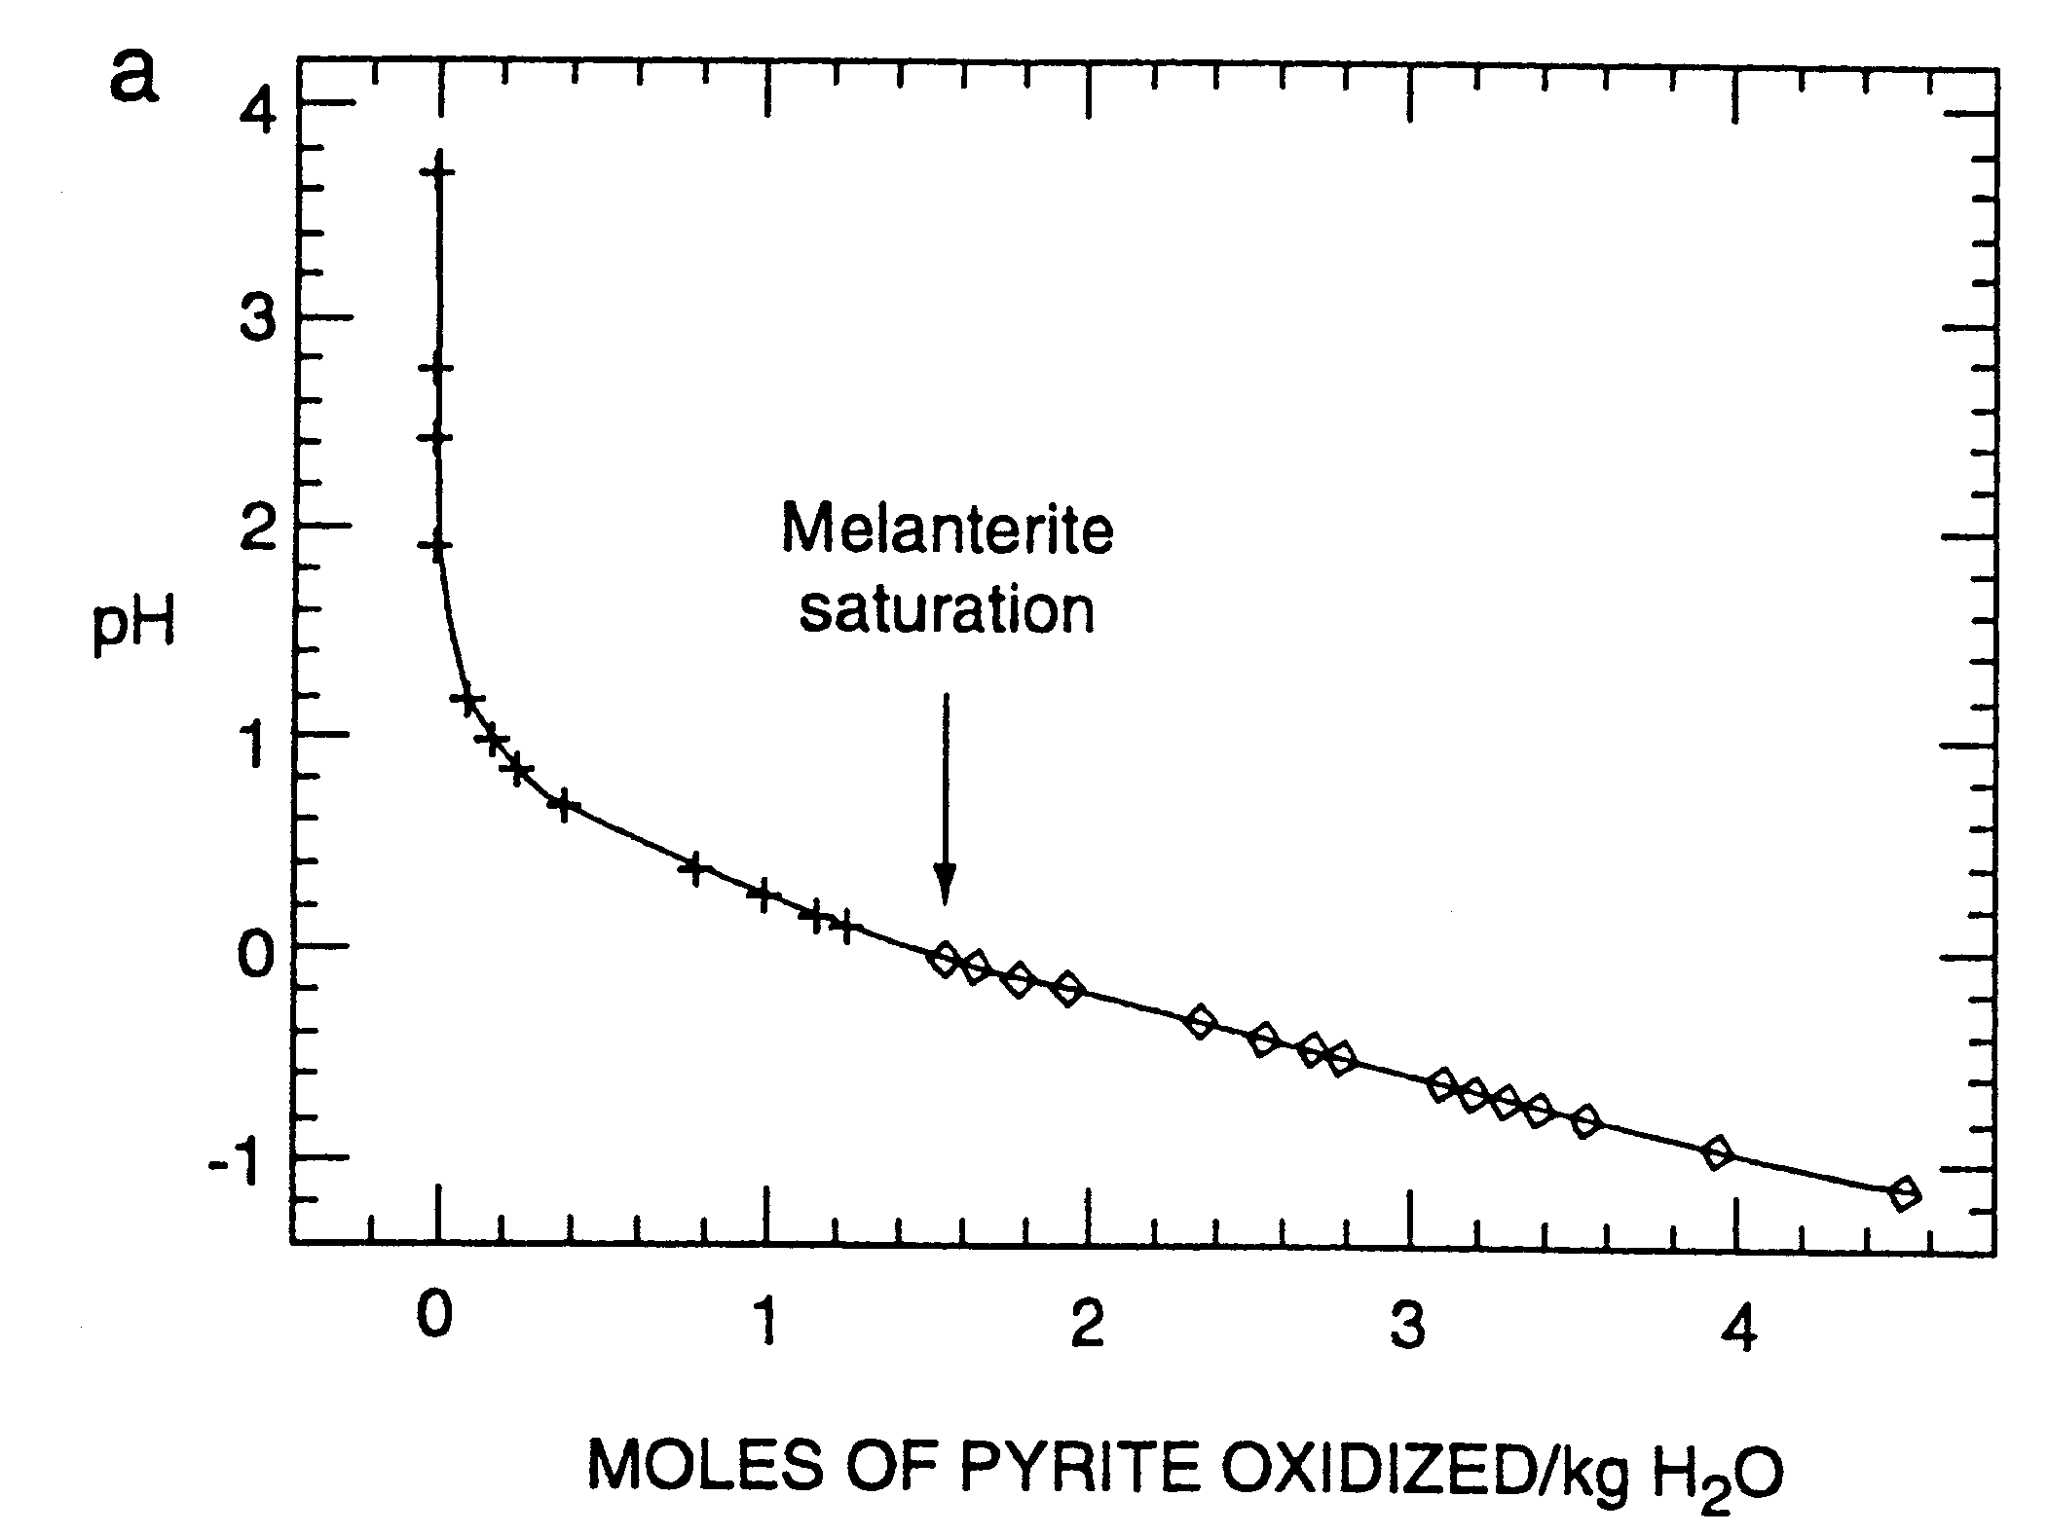
Example 2.2 Types of geochemical modeling: Mass transfer
Pyrite dissolution with melanterite precipitation (melanterite = FeSO₄•7H₂O) using PHREEQPITZ code
Notes:
This computation tells us that melanterite should be forming from waters that have negative pH values. We have a confirmation of this from field data collected at Iron Mountain Mines Superfund site.

Slide 29
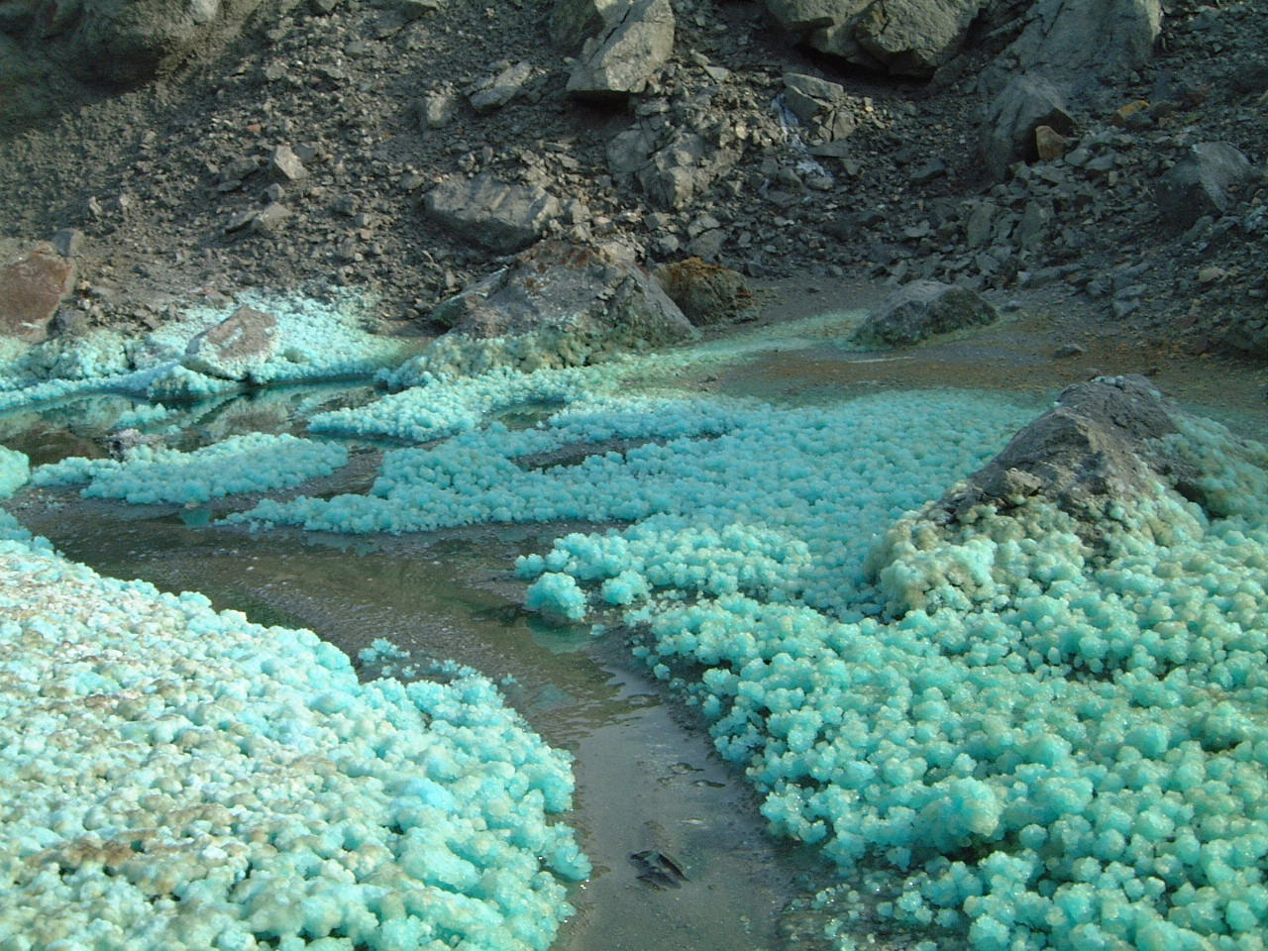
Melanterite forming on pyritic waste piles, San Telmo, Spain

Slide 30
Underground at Iron Mountain
Notes:
A stalactite of melanterite was found underground at Iron Mountain Mines with water dripping from its tip with pH of -0.7 (the beaker is 2 liters for scale). Also this water had a temperature of 35°C underground and when it was brought outside to cooler temperatures of about 22°C, about a third of the water crystallized to melanterite, suggesting it was near equilibrium conditions.

Slide 31
Another example of mass transfer: Al precipitation, very common in mine drainage – from modeling we have been able to understand and generalize the geochemical behavior of Al in aqueous systems: precipitation occurs at pH ≥ 5.0 (pK₁=5.0)

Slide 32
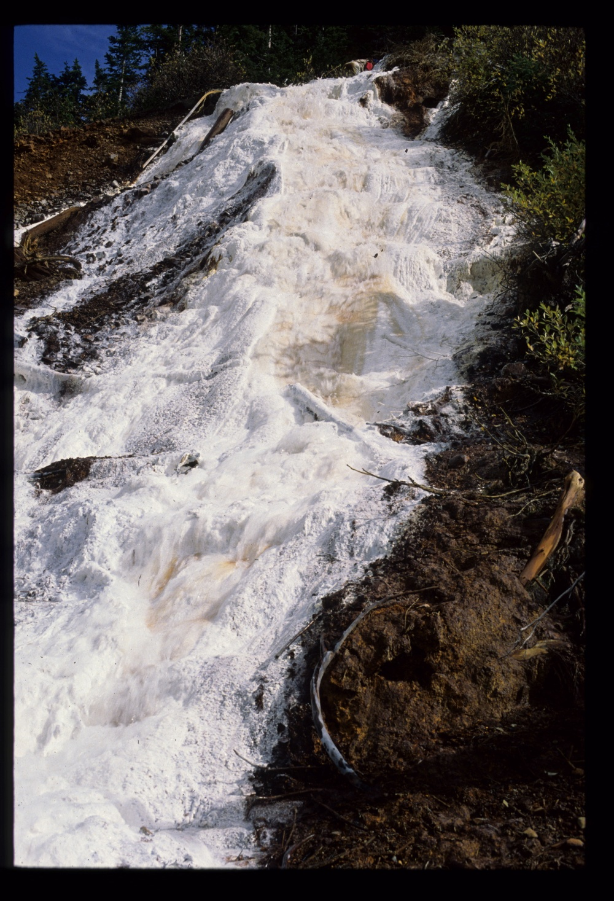
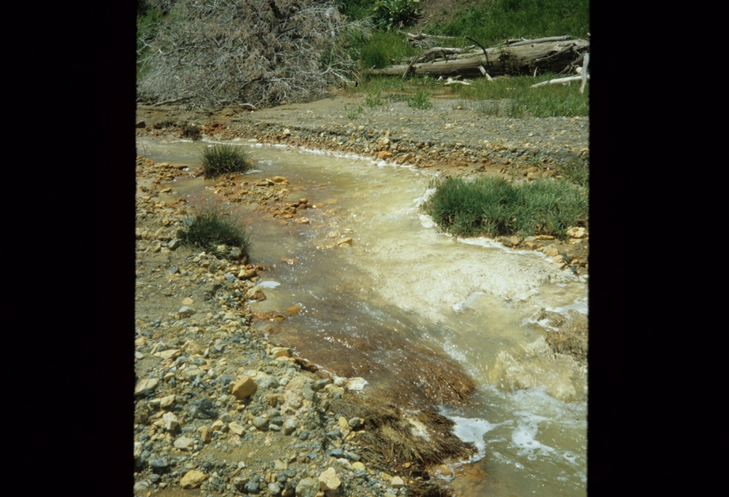
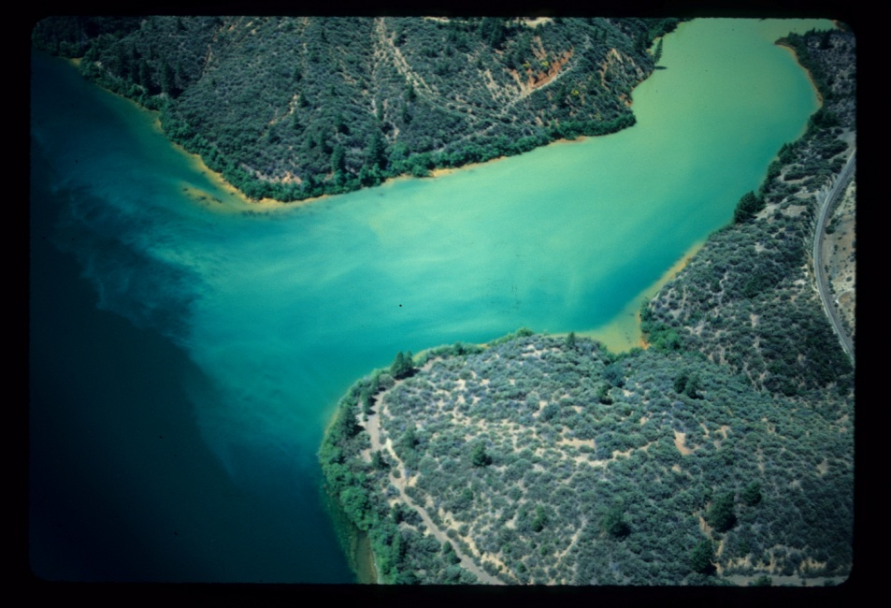
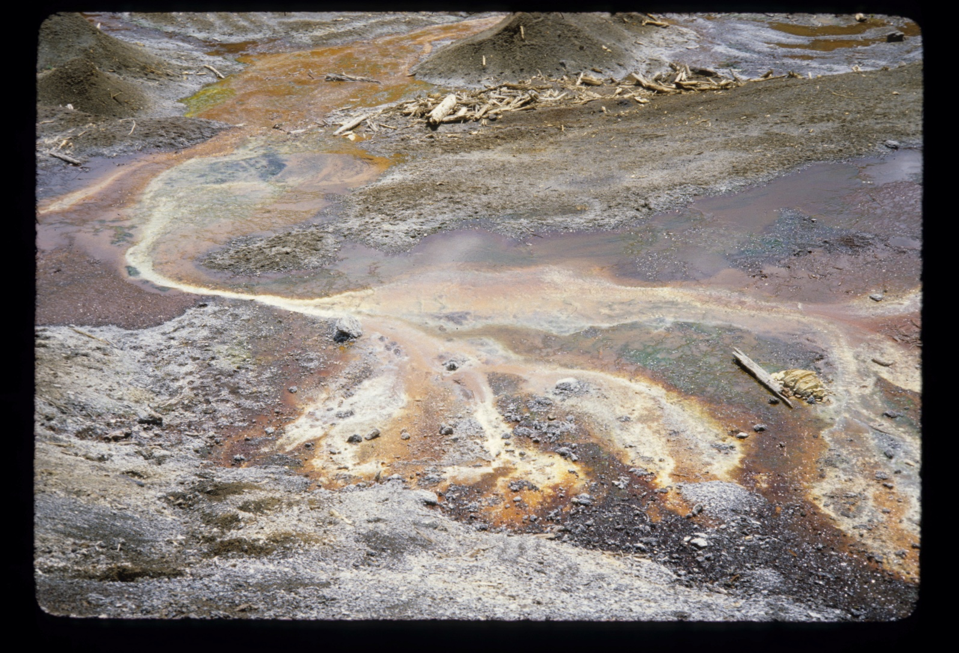
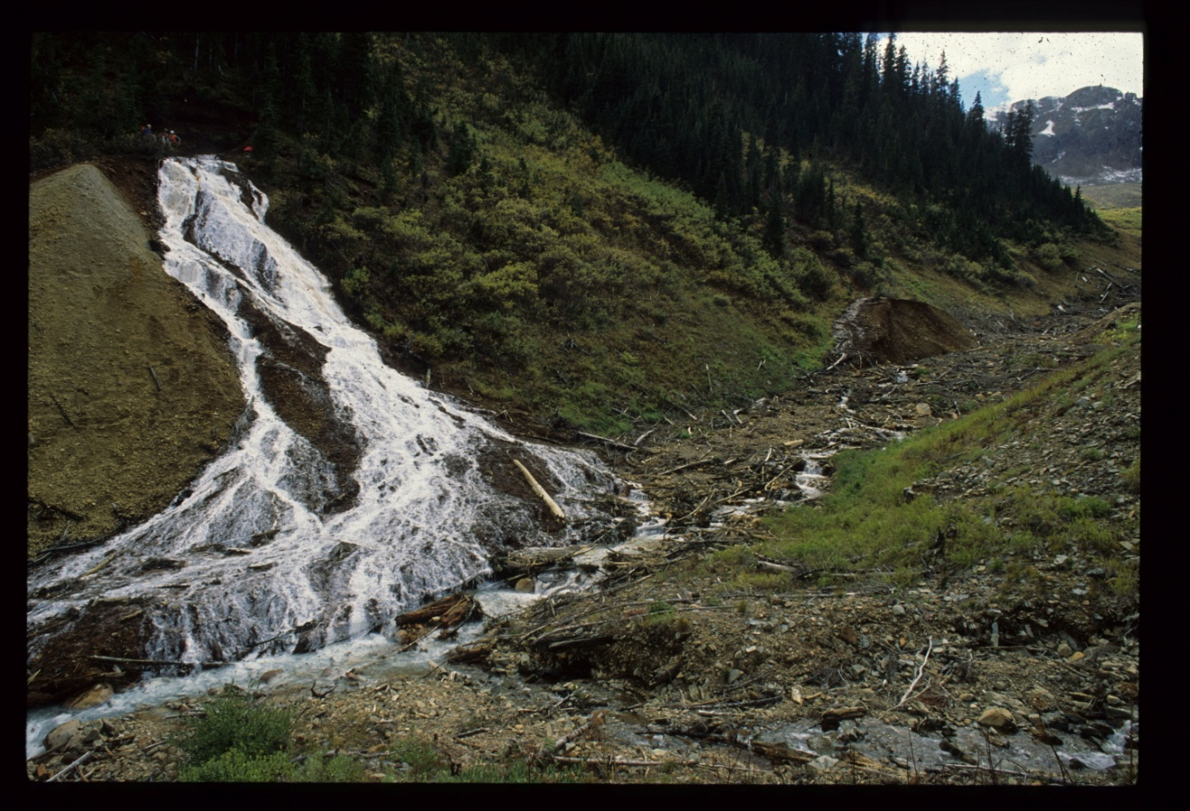
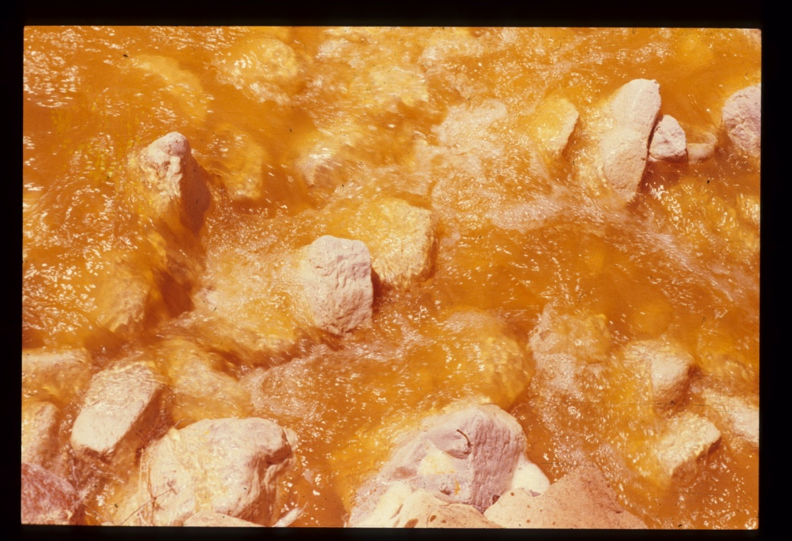
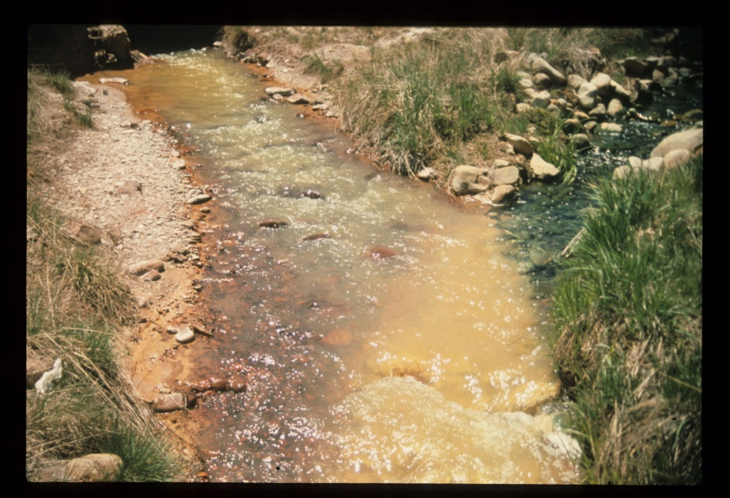
From Leviathan
From Iron Mountain
From Paradise Portal, Silverton, CO
From Bog Iron Deposit at Ophir, CO

Slide 33
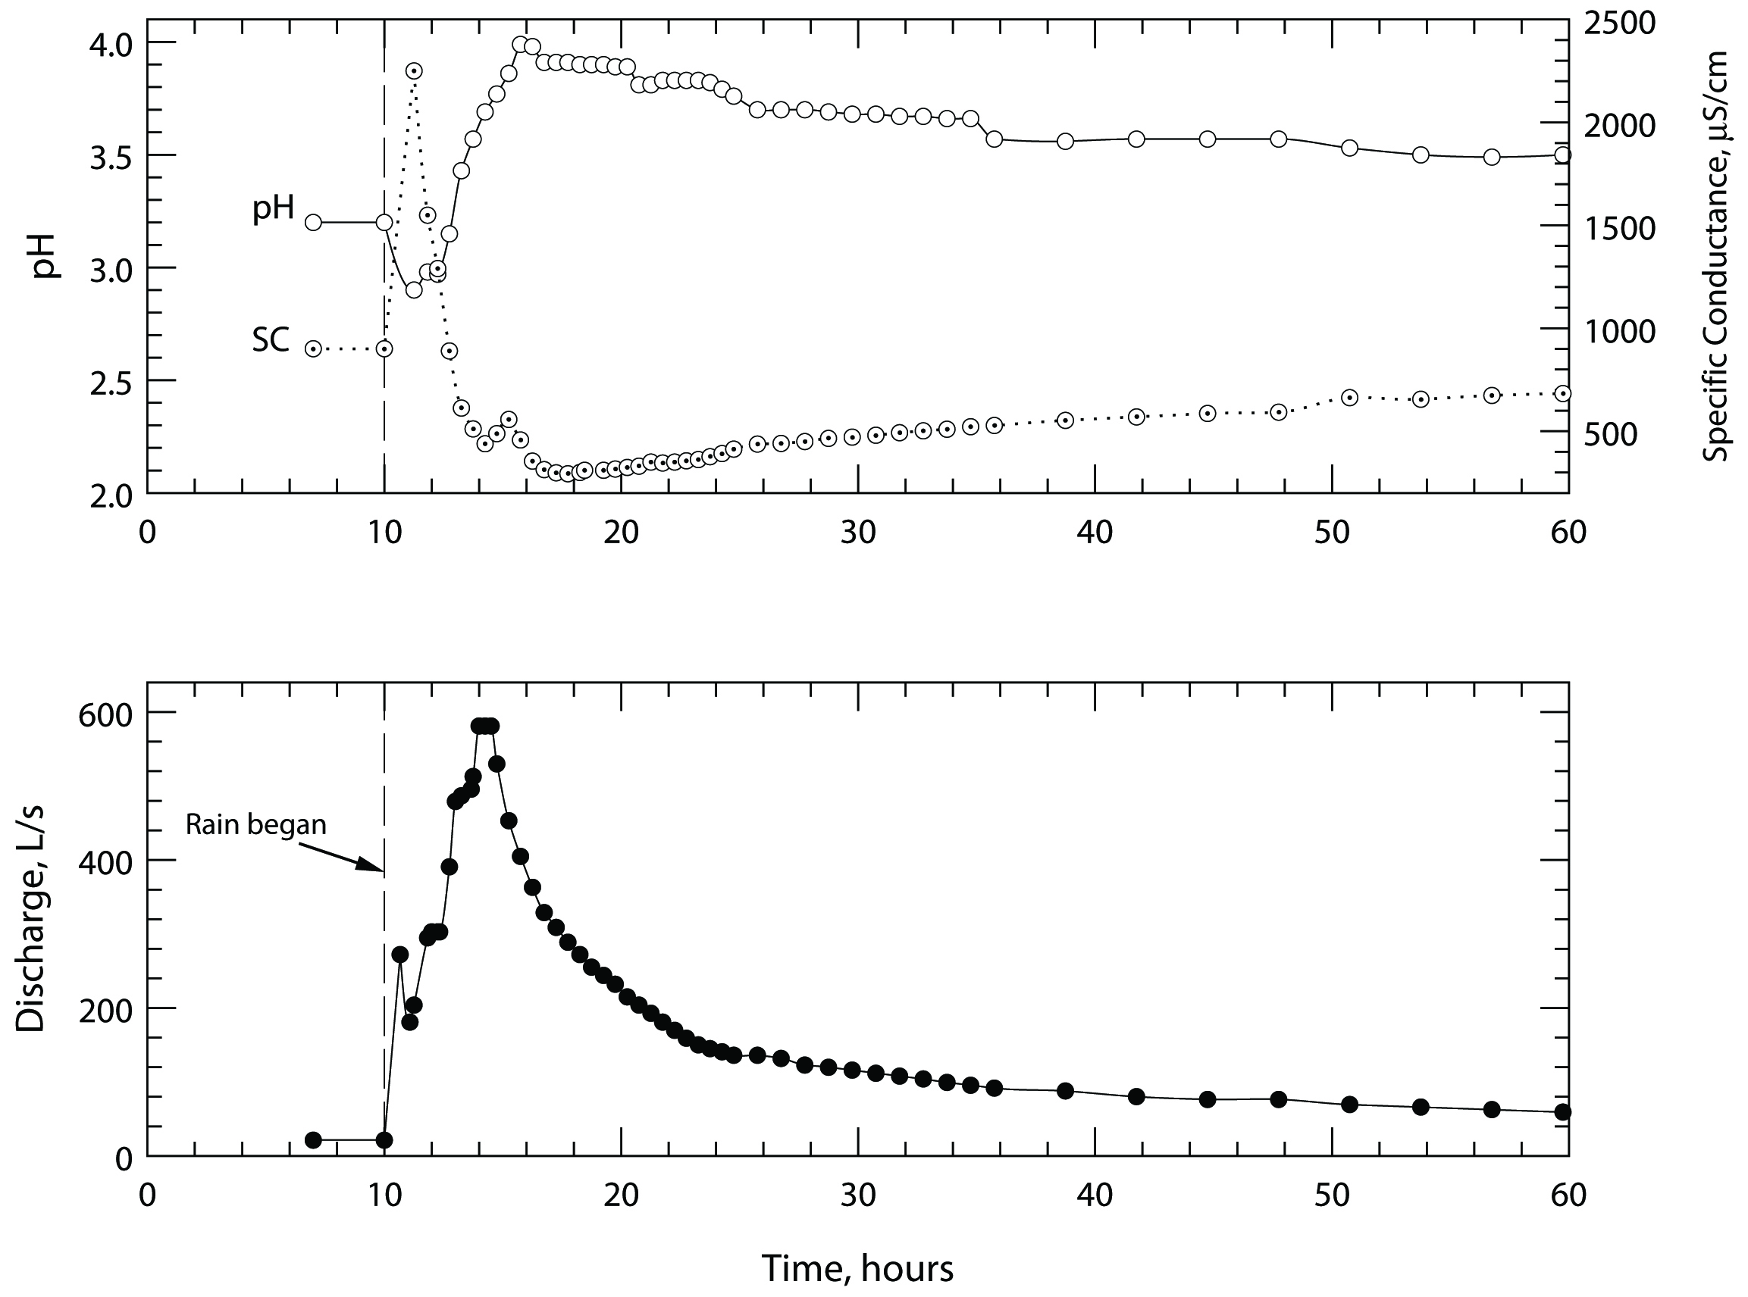
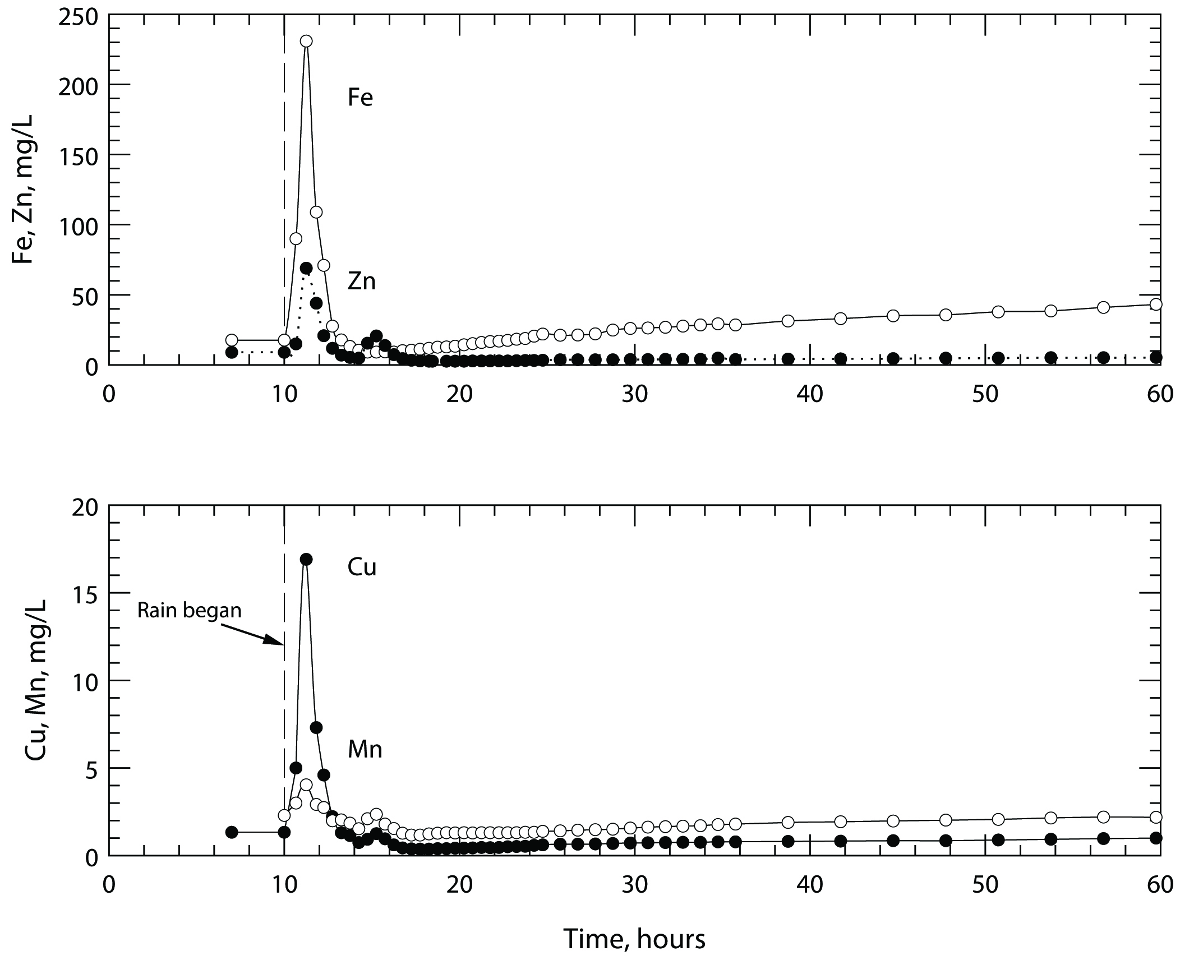
2.5 Example of : transient state (no modeling)
Contrary Ck,
Virginia [MS thesis, T.V. Dagenhart, 1980]
Transient signal from flushout of soluble salts on tailings piles from a rainstorm
Can we predict this event? Qualitatively – in the sense that we know it happens, but not quantitatively

Slide 34
What about modeling rates??
Comparison of lab-based mineral dissolution rates and field-based weathering studies of catchments have found that there is little agreement between the two. Usually there are orders of magnitude difference.
Numerous reasons have been given:
Lab samples were ground and much more reactive
Field samples have developed clay or silica coatings
Reactive surface areas in contact with water are not known for field studies (surface areas and exact flow paths are unknown)
Temperature and gas gradients occur in the field
Organic matter and microbial activity affect weathering in the field in ways that are difficult to determine quantitatively
Wet/dry cycles and seasonal changes occur in the field
Residence time in weathering zone is much longer in the field and is not often measured
It is not widely recognized that a lab-based study is a “generation” or “production” or “reaction” rate, whereas a field measurement is usually a “flux” or “transport” rate

Slide 35
Consequently
Lab rates cannot yet be used quantitatively for most field applications (best for well-constrained situations such as flow with reaction through a pipe, or homogeneous solution kinetics)
And it depends on water flow rates (water balance, variable seasonal flow rates, groundwater-surface flow)
Notes:
We are currently engaged with the Iron Mountain Mines Superfund site, determining the rates of iron oxidation and precipitation in a diversion pipeline and the geochemical and microbiological factors. Stay tuned.

Slide 36
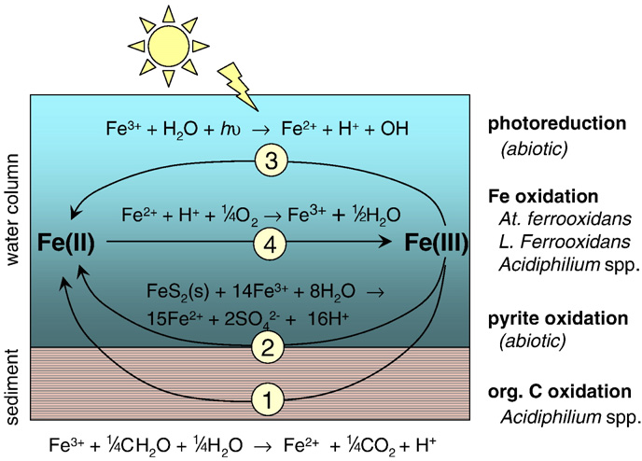
4 redox processes that can oxidize or reduce dissolved Fe in AMD
From Gammons et al (2008) Chemical Geology 252, 202-213
Notes:
Here are the 4 processes that can oxidize or reduce dissolved Fe in AMD. One can measure the net result (as Gammons et al did for the Rio Tinto, Rio Agrio, and Rio Odiel) and recognizing that microbial oxidation and photoreduction for surface waters are predominant in controlling Fe(II/III) concentrations and measuring concentrations over time during night and day, these investigators were able to determine each rate. This study is an excellent review and application of the state-of-the-art with respect to Fe(II) oxidation and Fe(III) reduction in AMD.

Slide 37
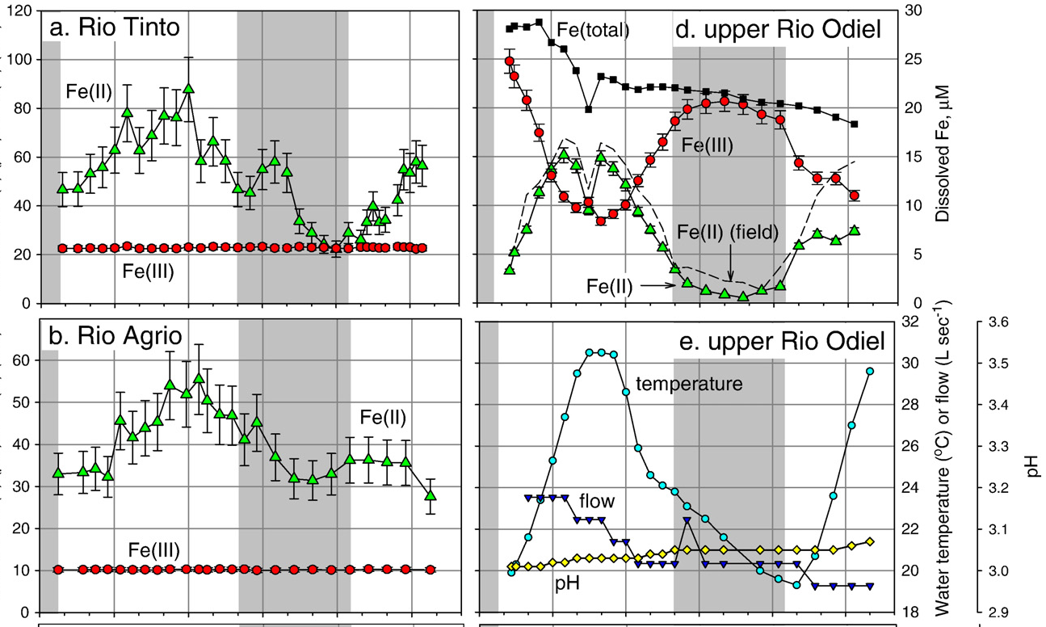
2.7 Examples of microbial oxidation and photoreduction in the Rio Tinto, Rio Agrio, and Rio Odiel, Spain
From Gammons et al (2008) Chemical Geology 252, 202-213
(μM)
(mM)
0600 1200 1800 2400 0600 1200
0600 1200 1800 2400 0600 1200
Notes:
The fact that the Fe(II) concentrations never go to zero (except in the upper Rio Odiel) suggests there may be some Fe reduction in the sediments and diffusion of Fe(II) into the water column. Although lab and field rates are somewhat similar, there are some differences and if you want to know field rates, you have to measure them. One obvious source of uncertainty in any prediction is how much cloud cover will there be?

Slide 38
Can geochemical models be used to deterministically predict future scenarios at potential mine sites? Some summary comments….
- 50-100% of mine sites exceeded their predicted water quality conditions (see Kuipers et al., 2006)
“The computational capabilities of today’s codes and advanced computers exceeds the ability of hydrogeologists and geochemists to represent the physical and chemical properties of the site or to test the outcome of the model.” Maest et al. (2009)

Slide 39
Can reactive transport models be used to deterministically predict future scenarios at potential mine sites? Some summary comments….
“Tempting as it will be to government bureaucrats to continue the use of models, the predictive models for the long-term quality of water in abandoned open-pit mines should themselves be abandoned.” Pilkey and Pilkey-Jarvis (2007)
“Just as in other modeling arenas we have discussed, accurate prediction of future water quality is a fantasy supported by a hyperreligious faith in the predictive power of numbers.” Pilkey and Pilkey-Jarvis (2007)

Slide 40
Can reactive transport models be used to predict deterministically future scenarios at potential mine sites?
“Reactive transport models cannot solve the problem of the apparent discrepancy between laboratory and field rates by themselves….” Steefel et al. (2005)
“… the reactive transport modeling can be used to narrow down the possible explanations for the overall rates observed in the field.” Steefel et al. (2005)
“Another possible approach is to choose field sites where the transport rates can be modeled accurately and deterministically because gross physical heterogeneities are absent.” Steefel et al. (2005)
Do such places exist? Not at hardrock mine sites!

Slide 41
Validation & Verification
“Does good agreement between a model result or prediction and observational measurements mean the model is correct?
No, for 3 possible reasons, (1) if model parameters are not independent from the measurements they are being compared to, they should agree regardless of the correctness of the model, (2) if the measurements are in error then both the measurements and the model could be in error, and (3) the model results might agree with reliable measurements for the wrong reasons.
Does poor agreement between a model result and observations mean the model is incorrect?
No, for similar possible reasons, (1) if the measurements are unreliable, the model may still be correct, (2) model calculations could be in error whereas the conceptual model could be correct, and (3) the criteria for what constitutes good and poor agreement may be incompatible with the limitations and uncertainties of the model.” [Nordstrom, 2012] The criteria for agreement could be made too broad or too confined. Hence, a model could be validated or invalidated according to preconceived agendas.

Slide 42
Recommendations
Don’t use the word validation with respect to a scientific model; it doesn’t apply [see Nordstrom, 2012]
If someone says a model has been validated, ask him/her to invalidate it (it can always be done); then have them draw their own conclusions
Remember: models are not unique or exact!

Slide 43
Recommendations
It is the quality of the conceptual model that determines the usefulness and relevance of any modeling; the conceptual model needs peer review
There will always be unknown factors that affect our confidence in modeling
Computer codes in the regulatory realm must be transparent!
Is it necessary to predict far into the future? Or is it better to use best available technology and protect the public and the environment through other means (liability)

Slide 44
Additional considerations
Has the problem been well-defined?
And the model suitable for the purpose?
Has Chamberlin’s (1897) method of multiple working hypothesis been applied?**
Has the modeler explained the results in a manner that anyone can fully understand?
Notes:
**An appropriate corollary of Chamberlin’s method is that if someone has presented what you feel is a best-case scenario prediction, have them do a worst-case scenario. If someone has “validated” their model, have them also invalidate it!

Slide 45
Conclusions?
With models we can constrain the possible explanations for our observations.
We cannot model without observations.
The more observations we have the better will be our modeling.
With enough observations, we don’t need a model.

Slide 46
“More broadly, it means recognizing that the amount of confidence someone expresses in a prediction is not a good indication of its accuracy – to the contrary, these qualities are often inversely correlated.”
(Silver, 2012)
“It isn’t what we don’t know that causes the trouble, it’s what we think we know that just ain’t so.” Will Rogers

