Slide 1
Fan 16 live example
General input/interface comments and hints
Data entry (direct access files)
archive important projects (better than I have…)
Enhancements (font size)
Units conversion
Coordinate system
Creating and saving files, vpp and ambient
Menus
where the models are
bak files ….
diffuser, flow, densimetric Froude #, time-series linkage
text panel, ambient file list, model configuration
text
graphics
continued

Slide 2
Fan 16 live example, continued
VP I/O file handling maintenance, project files
fan-run-16.vpp.db (database file of diffuser tab)
fan-run-16.001.db (database file of ambient tab/files)
Fan-run-16.lst (FLAT file of input settings, NOTEPAD)
DKHw, NRFIELD, PDS, 3plumes a, exe (independent models)
VP prepares input files
VP calls the exe
VP parses output and displays it in VP text and graphics
VP can post-process (like find surface hit), but…
Looks wrong? Is it VP or the independent model?
Where the output is
udf.in, DKHWISP.out, results.out ….
Do independent checks, even runs

Slide 3
Fan 16 live example
Ruts: projects have focus that can get one in a rut
lots of capabilities, easy to lose track
think “that should be possible?” consult the manual
need more? wefrick@yahoo.com (send the project files)
Partnership (this person with “Oldtimers” depends on it)
reminders
Far-field cross-over transition
Nascent density….
Expectations
I hope for a smooth and flawless demonstration
But, just in case, I ask for your patience and forgiveness

Slide 4
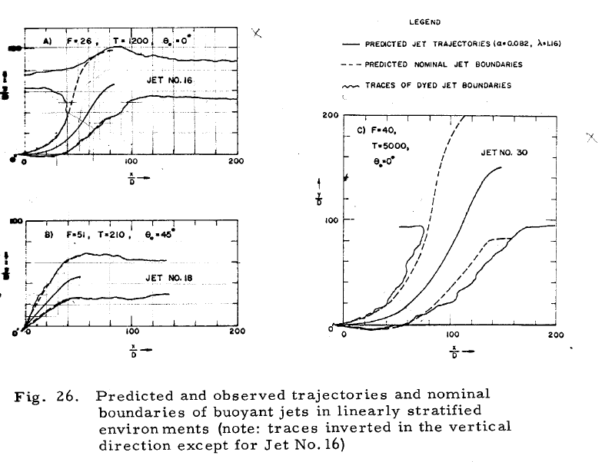
Fan 16 graph (Fan 1967)

Slide 5
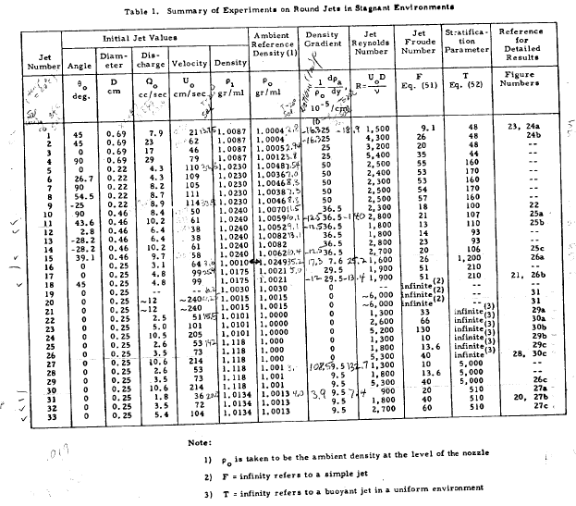
Fan 16 data (Fan 1967)
Fan Run 16

Slide 6
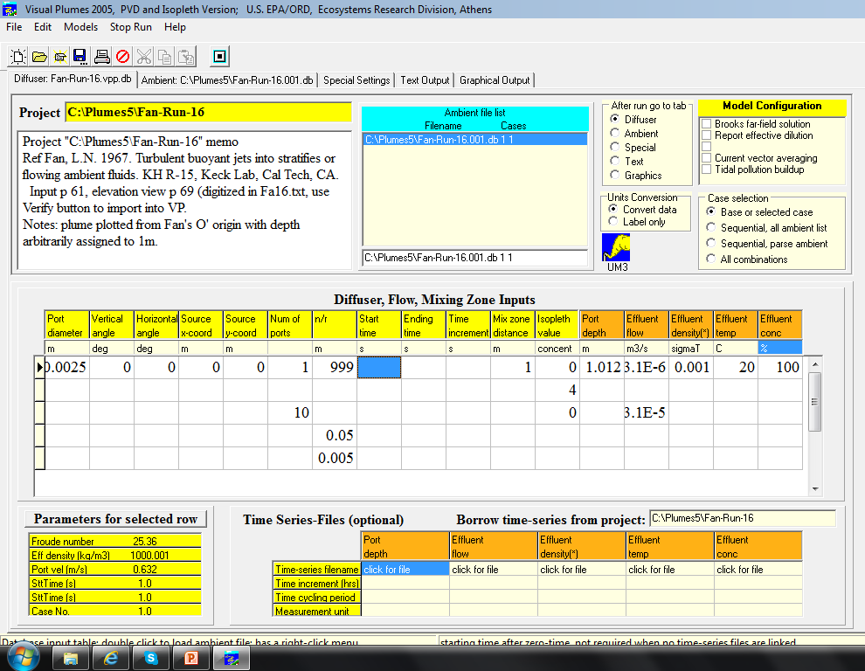
Fan 16 diffuser tab
Case 1: Fan Run 16 (single port)
Cases 2-5: training modifications

Slide 7
ambient direction, time series, Fan 16
1.0 37 deg 0.0 constant extra m 0 1 Fan-Run-16.dir
90 90
80 80
70 70
60 60
50 50
40 40
30 30
20 20
10 10
0 0
-10 -10
-20 -20
-30 -30
-40 -40
-50 -50
-60 -60
-70 -70
-80 -80
-90 -90 [continued right text box]
[continued]
-100 -100
-110 -110
-120 -120
-130 -130
-140 -140
-150 -150
-160 -160
-170 -170
-180 -180
180 180
170 170
160 160
150 150
140 140
130 130
120 120
110 110
100 100
See VP manual
p. 5.3
See Fan 16 trace coordinates in Notes (Click to add notes section)
Notes:
side view
0.0001 1.0145
0.0068 1.0157
0.0149 1.0158
0.0197 1.0161
0.0264 1.0159
0.0339 1.0164
0.0423 1.0182
0.0491 1.0191
0.0565 1.0180
0.0638 1.0180
0.0676 1.0186
0.0776 1.0177
0.0830 1.0169
0.0912 1.0146
0.1000 1.0118
0.1084 1.0100
0.1155 1.0053
0.1181 1.0024
0.1236 1.0003
0.1285 0.9976
0.1336 0.9924
0.1391 0.9854
0.1420 0.9819
0.1482 0.9789
0.1543 0.9758
0.1585 0.9709
0.1642 0.9662
0.1709 0.9600
0.1773 0.9530
0.1835 0.9500
0.1889 0.9468
0.1950 0.9400
0.1999 0.9343
0.2023 0.9303
0.2092 0.9261
0.2168 0.9239
0.2253 0.9205
0.2327 0.9173
0.2385 0.9114
0.2422 0.9049
0.2431 0.9019
0.2478 0.8989
0.2504 0.8942
0.2550 0.8907
0.2615 0.8878
0.2684 0.8849
0.2777 0.8826
0.2865 0.8804
0.2968 0.8786
0.3072 0.8770
0.3134 0.8768
0.3239 0.8781
0.3308 0.8799
0.3395 0.8789
0.3428 0.8777
0.3528 0.8789
0.3616 0.8796
0.3701 0.8795
0.3777 0.8792
0.3876 0.8796
0.3947 0.8796
0.4032 0.8812
0.4095 0.8827
0.4193 0.8832
0.4288 0.8831
0.4373 0.8854
0.4468 0.8878
0.4047 0.7966
0.3985 0.7965
0.3920 0.7966
0.3855 0.7961
0.3800 0.7961
0.3723 0.7958
0.3651 0.7943
0.3581 0.7932
0.3536 0.7918
0.3477 0.7923
0.3420 0.7927
0.3353 0.7920
0.3286 0.7884
0.3254 0.7864
0.3211 0.7843
0.3169 0.7831
0.3116 0.7834
0.3077 0.7838
0.3027 0.7849
0.2977 0.7858
0.2934 0.7868
0.2899 0.7850
0.2864 0.7830
0.2838 0.7826
0.2791 0.7826
0.2762 0.7826
0.2739 0.7804
0.2674 0.7762
0.2626 0.7728
0.2568 0.7707
0.2507 0.7673
0.2435 0.7646
0.2351 0.7643
0.2262 0.7635
0.2165 0.7647
0.2086 0.7668
0.2035 0.7691
0.1999 0.7749
0.1945 0.7786
0.1870 0.7816
0.1800 0.7843
0.1714 0.7882
0.1659 0.7926
0.1586 0.7973
0.1519 0.8016
0.1441 0.8049
0.1376 0.8078
0.1293 0.8107
0.1184 0.8134
0.1097 0.8153
0.1020 0.8166
0.0942 0.8172
0.0847 0.8176
0.0769 0.8193
0.0672 0.8201
0.0595 0.8228
0.0514 0.8216
0.0457 0.8208
0.0408 0.8236
0.0338 0.8266
0.0291 0.8284
0.0199 0.8291
0.0170 0.8577
0.0212 0.8574
0.0278 0.8569
0.0358 0.8608
0.0459 0.8615
0.0530 0.8605
0.0630 0.8591
0.0726 0.8601
0.0808 0.8641
0.0884 0.8705
0.0953 0.8736
0.1012 0.8759
0.1061 0.8820
0.1100 0.8908
0.1105 0.8977
0.1100 0.9073
0.1101 0.9118
0.1111 0.9166
0.1123 0.9216
0.1124 0.9236
0.1100 0.9304
0.1073 0.9380
0.1026 0.9464
0.0997 0.9524
0.0962 0.9597
0.0924 0.9673
0.0839 0.9769
0.0777 0.9828
0.0693 0.9870
0.0624 0.9920
0.0541 0.9959
0.0485 0.9988
0.0411 1.0011
0.0343 1.0028
0.0273 1.0065
0.0212 1.0084
0.0168 1.0095
0.0099 1.0114
0.0042 1.0126
-0.0001 1.0124
density profile
17.3 0.0
25.2 1.0

Slide 8
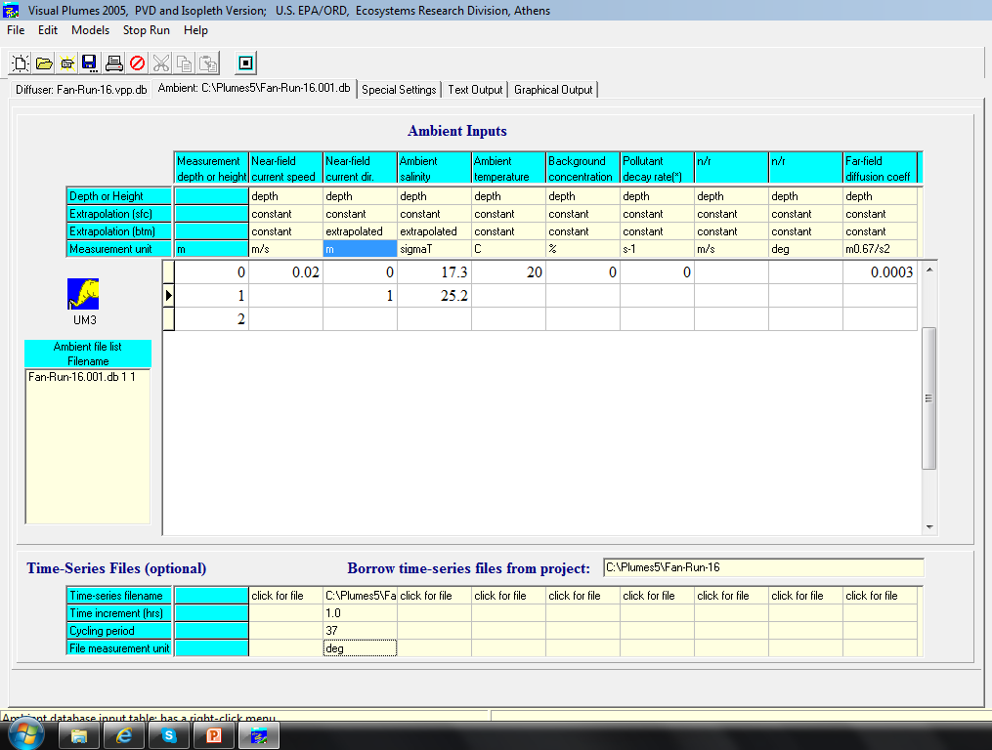
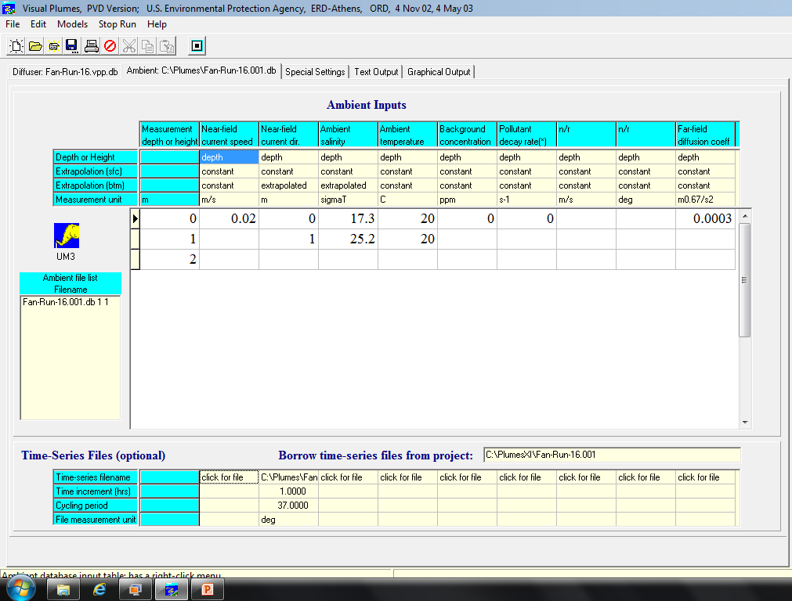
Fan 16 ambient tab
Fan’s current was 0.0. A current is introduced here. Note time-series file linkage

Slide 9
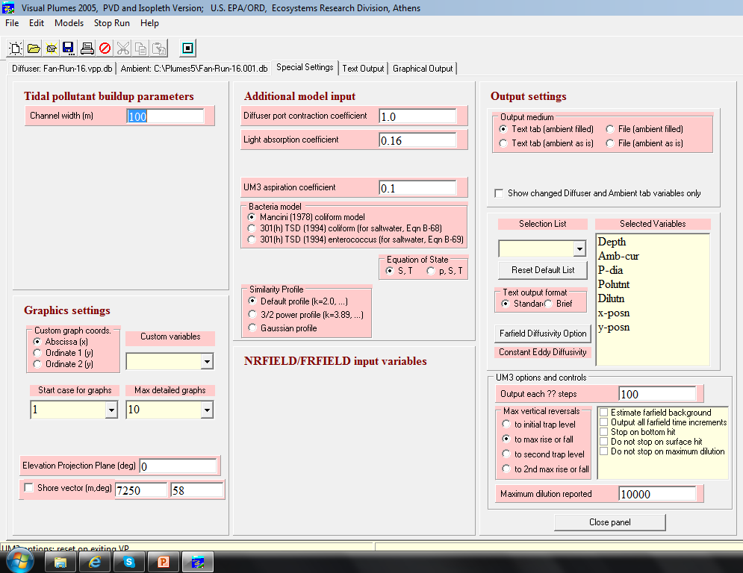
Fan 16 Settings tab

Slide 10
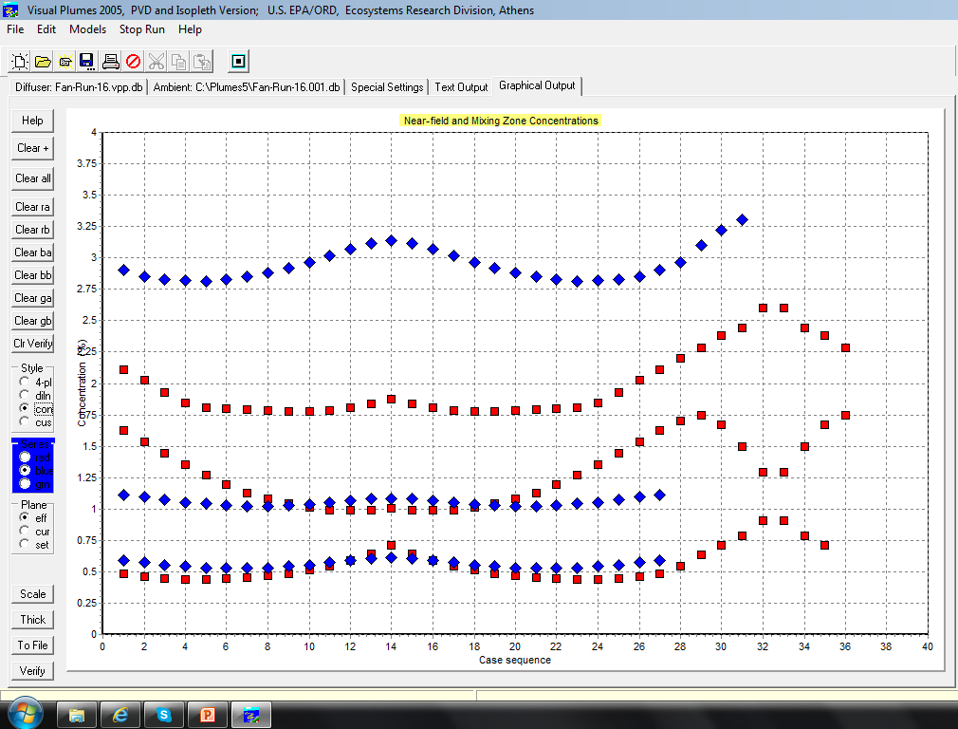
Fan 16 graphics tab (red)

Slide 11
Rsbcheck project input

Slide 12
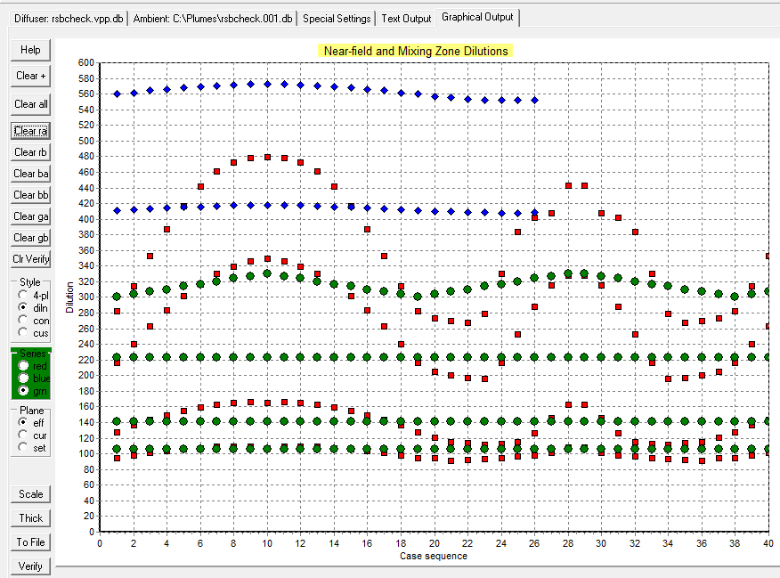
Rsbcheck project, more runs
blue cases 27-40 crashed at 27
Max rise dilutions with direction increasing in 10deg increments.
Spacing: Red, green points: 10, 5, 1, 0.5m
blue: 10, 5m(1, 0.5m, all terminate prematurely because VP does not process the full run)

Slide 13
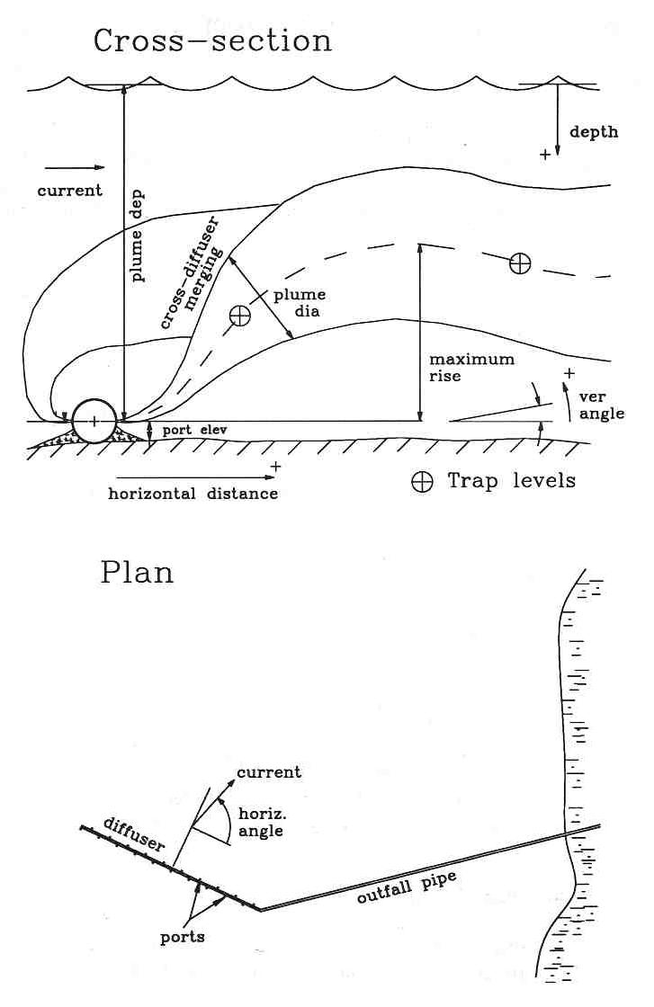
DOS manual on merging
Cross-diffuser merging
½ spacing or ambient background?

Slide 14
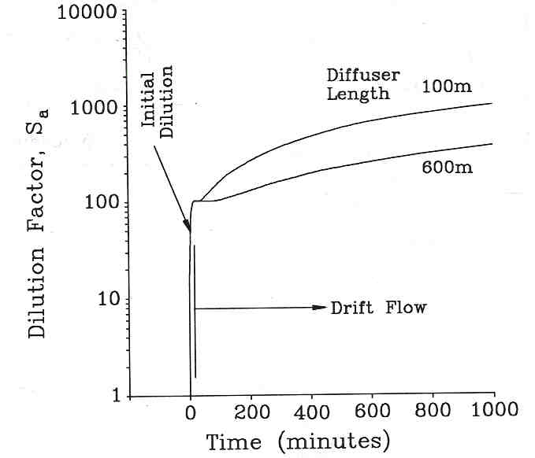
DOS manual on far-field
Comparing ID and far-field dispersion

Slide 15
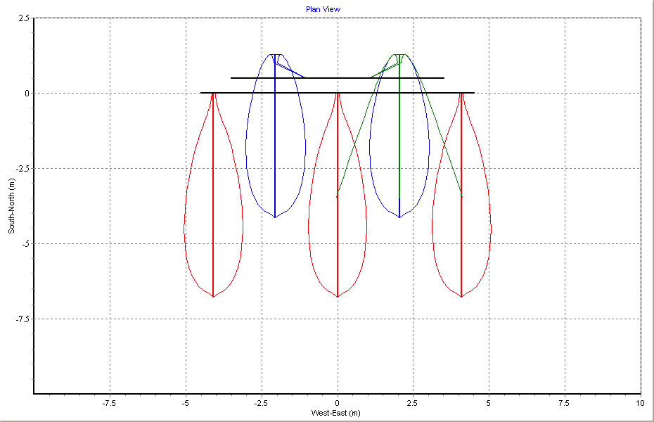
Experimental VP Sausalito plan view
Physical outline
(green)
Closed contours:
0.7%
current
Plume merging
Notes:
How a few plumes appear when modeled with an experimental version of VP. This capability (of plotting plumes in context of their relative location to each other) is not available in Plumes60.exe.

Slide 16
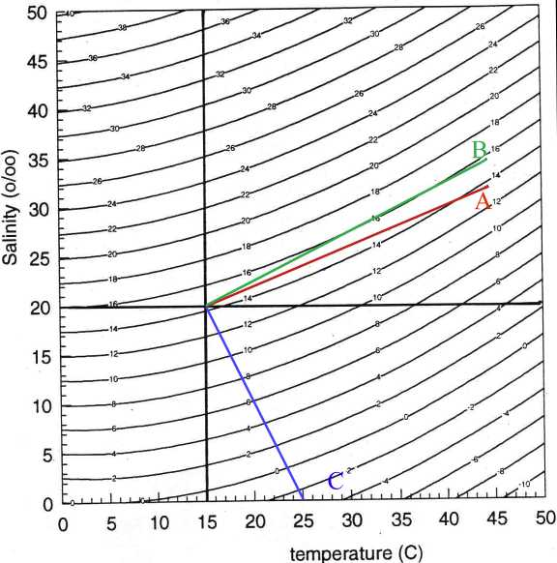
Eqn. of State of Water
Plume B is always denser than ambient, Plume C is always buoyant. However, Plume A is initially buoyant before becoming negatively buoyant.

Slide 17
Analyzing the Sausalito outfall with Visual Plumes
Walter E. Frick, Oceanographer
US EPA, Ecosystems Research Div., NERL
Athens, Georgia, USA
and
Philip J. W. Roberts, Professor
Georgia Institute of Technology
Atlanta, GA
Visual Plumes
Mixing Zone
Modeling Course
A 2-day course
Sacramento, California
August 30-31, 2007

Slide 18
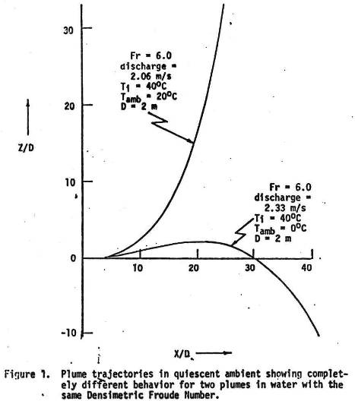
Life is uncertain
Identical thermal effluents discharged to ambient waters at 20 and 0 C. According to densimetric Froude number similarity, the trajectories should be identical in dimensionless terms. However, because the plume discharged to freezing water passes through the point of maximum water density (4C), it becomes denser than the ambient and ultimately sinks.
How wrong models have been

Slide 19
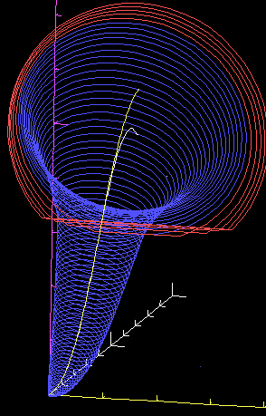
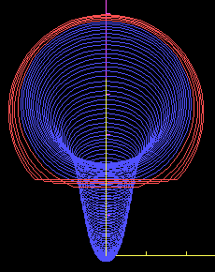
Coordinate system
Models
Simpler than finite-element models
Average properties
Similarities to Visual Plumes (VP)
Similar to Windows UM and JetLag in concept
Three-dimensional
Lagrangian dream model
Notes:
These 3-dimensional plume predictions are from a Lagrangian model that led to the development of the Visual Plumes UM3 model. Note the time averaging implicit in comparing such simulations to actual plumes. The red circles depict regions affected by the mathematical overlap artifact, an anomaly that affects both Lagrangian and Eulerian integral flux formulations, leading to modeling uncertainty.

Slide 20
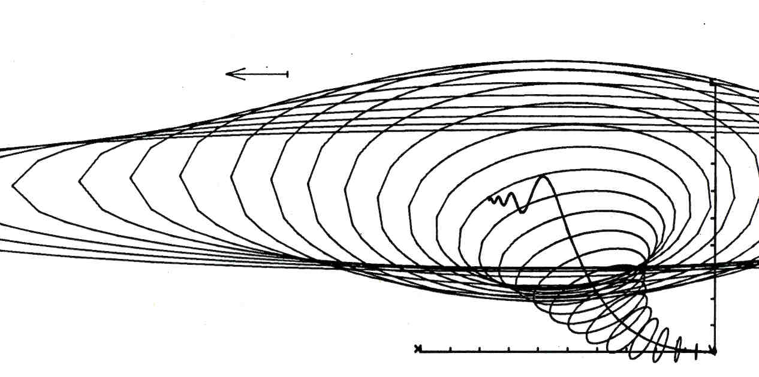
The Future of Lagrangian Modeling
Output on the experimental Gem 3-D vector plume model with gravitational collapse

