Slide 1

Introduction to Mixing Zones
Ben Cope
Office of Environmental Assessment
EPA Region 10
January 2013

Slide 2
Disclaimer
This webinar series is for training purposes only. It does not represent EPA policy or guidance.

Slide 3

Topics of this Intro
What is a Mixing Zone?
Basic concepts and terminology
Varied state mixing zone restrictions
Range of complexity in problems and tools
Simplest analyses…and when they don’t work
Setting the MZ - forward or backward, or both
Fortitude and environmental protection

Slide 4
Terminology Tangle
Mixing
Dilution
Mixing zone
Dilution Factor
Zone of Initial Dilution
Centerline dilution
Complete Mix
Far field mixing
Plume
Reflux

Slide 5
Making sense of it
Concepts can be difficult – e.g., mixing in 1D, 2D, 3D
Some tricky and inconsistent language out there
Ask for clarification!

Slide 6
What is a Mixing Zone?
EPA’s TSD for Water Quality-based Toxics Control:
“A mixing zone is an area where an effluent discharge undergoes initial dilution and is extended to cover the secondary mixing in the ambient waterbody. A mixing zone is an allocated impact zone where water quality criteria can be exceeded as long as acutely toxic conditions are prevented.”

Slide 7
State of Washington
“Mixing Zone” means that portion of a water body adjacent to an effluent outfall where mixing results in the dilution of the effluent with the receiving water. Water quality criteria may be exceeded in a mixing zone as conditioned and provided for in WAC 173-201A-400.

Slide 8
Ultra-concise definition
“Mixing Zone” – portion of a waterbody where a discharge is allowed to exceed water quality criteria by certification under the Clean Water Act (section 401).
NOT a term describing the mixing process or where mixing occurs

Slide 9
What is “Dilution”?
Websters: “Dilute” – 1. to thin or reduce the concentration of.
EPA Dilution Modeling Guidance (1994, 2003):
  “Dilution” – ratio of parts ambient to parts effluent at a given location in a waste plume (volumetric).
    Think Physical Mixing.
  “Effective Dilution” - ratio of the effluent concentration to the plume concentration.
    Think Chemical Thinning.

Slide 10
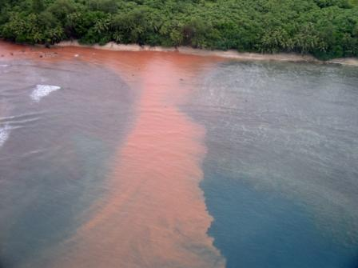
Other word problems
“Mixing Zone” vs “Zone of Initial Dilution” (301h)
“Complete” vs “Incomplete Mix”
  In what sense? Virtually all mixing takes time/space
“Model assumptions”
  Built into the selection of the model
  User defined
Again, ask for clarification often!

Slide 11
Mixing zone rules vary
Examples: Numeric rules or guidelines for rivers across EPA Region 10
Alaska
  No numeric guidelines
Idaho
  25% of the flow volume and width
Oregon
  25% of the flow volume and width
  60-200 ft length depending on size of stream
Washington
  25% of flow volume and width
  300 feet + depth of water downstream
  Acute: 10% of chronic zone, 2.5% of flow volume, 25% of width
Numerous, important narrative rules that may affect sizing
  e.g., critical habitat, municipal water intakes, overlapping mixing zones, etc.

Slide 12
Simplest example
State allows 25% of 7Q10 flow for chronic mz and 25% of river width
Proposed discharge meets acute criterion
Single port discharge in a shallow river
Background is zero
Shallow – OK to assume vertical complete mix
WLA = ((0.25 x Qriv)/Qeff) x criterion
Done!

Slide 13
Average Flow
7Q10 Flow
e.g., 25% of 7Q10 Flow

Slide 14
Mass Balance
Reduce Qup to allowable flow in mixing zone regs
Replace Cdown with water quality criterion (Cwqc)
Re-arrange the equation
Conservative values needed!
Qup => low (e.g., 25% of 7Q10)
Qeff => high (e.g., design flow)
Cup => high (e.g., 95th percentile)

Slide 15
Assumptions of a mass balance approach
Instantaneous mixing of effluent and receiving water (or fraction of it)
  Specific plume conditions near outfall not a major concern
No settling, uptake, transformation of pollutant
  Common assumption in mixing zones and permit limit derivation

Slide 16
Complications
Need for more detail – even in simple situation
  More complicated mixing zone standards
Deep river, reservoir…not 1D
Estuary…salinity, bouyancy, currents, etc.
Multi-port diffuser, not simple pipe
Situations that don’t fit the mold
  Unknown or unusual diffuser features
  Above surface discharges
  Intermittent discharges
  Banks and other structures near outfall

Slide 17

Rivers - One step up in complexity
Lateral mixing analysis (2D)
Issue: MZ length in addition to width/volume
Spreadsheet tools (e.g., WA’s rivplum6)
Estimate rate of lateral mixing based on Manning’s equation and shear velocity

Slide 18
Levels of Difficulty - Rivers
1 – mass balance approach, % of low flow, no background, single pollutant
2 - multiple pollutants, measurable background levels
3 – need plume info, aka dilution modeling
4 – dilution modeling is “non-standard”
  e.g., workarounds, expert advice needed

Slide 19
Model Selection
Freshwater
Or
Marine?
fresh
marine
Instantaneous Mix Assumption OK?
Unusually Poor Flushing ?
yes
yes
no
no
Mass Balance Model
Lateral Mixing
or
Plume Model
Waterbody Model
Plume Model

Slide 20
Marine
Discharges
Near Field
“Zone of Initial Dilution”
Far Field
Passive Dilution
Trapping depth
Buoyancy-driven
Ambient current
Jet-driven

Slide 21
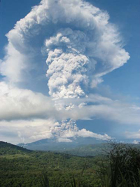
It’s a Bird, It’s a Plume…
trapping
far field mixing
Initial buoyancy-driven mixing
http://www.noaa.gov/features/protecting_0808/volcanoes.html

Slide 22
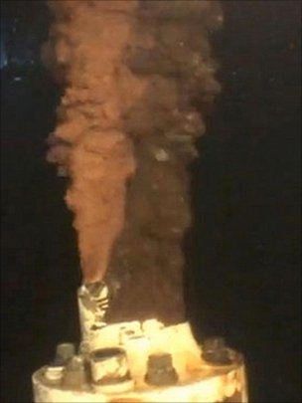
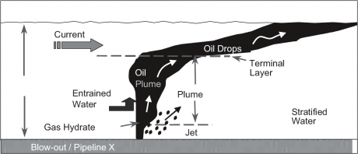
A highly publicized and disastrous plume
2003 Nat’l Academies, “Oil in the Sea III”

Slide 23
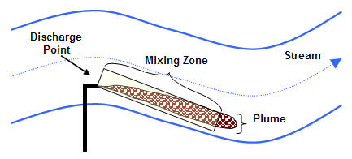
Plumes in rivers
http://www.deq.state.or.us/wq/wqpermit/mixingzones.htm

Slide 24
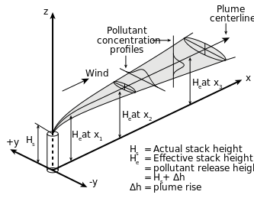
2 Workhorse Dilution Models
VISUAL PLUMES
CORMIX
Provide anatomy
of the plume
Key metric – dilution with distance
http://en.wikipedia.org/wiki/File:Gaussian_Plume_(SVG).svg

Slide 25
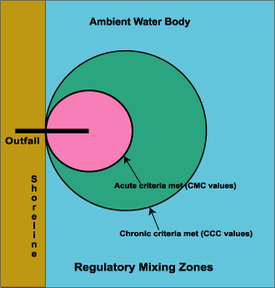
Technical meets Regulatory
http://en.wikipedia.org/wiki/File:Gaussian_Plume_(SVG).svg

Slide 26
The “answer” provided by a dilution modeling analysis
Concentration
Assumed end of pipe
Acute criterion
Chronic criterion
Acute MZ
radius
Chronic MZ
radius
Distance from Outfall

Slide 27
What is a dilution factor?
Same potential confusion
  Physical mixing vs chemical thinning
Simple case is not confusing
  Example: River = 99 cfs, Effluent = 1 cfs, complete mix
  Dilution Factor (volumetric) is 100:1
  If Background=0, Effective Dilution Factor (chemical) is also 100:1
  They can discharge 100x the criterion and the mixture will match the criterion.

Slide 28
“Dilution factor”…continued
But if background > 0, not so simple
  Example: River = 99 cfs, Effluent = 1 cfs
  Dilution Factor (volumetric) is still 100:1
  If background is half the criterion level, the Dilution Factor (chemical) is 50:1
  They can only discharge 50x the criterion
  Some call the 50:1 factor above the “effective dilution factor”

Slide 29
Less terminology, more stepwise process
Always distinguish between volumetric dilution and chemical dilution
First, get volumetric dilution vs distance
Next, decide the mixing zone size allowable
Find the volumetric dilution at that distance
Analyze chemicals of concern separately
  Different background concentration for each

Slide 30
Volumetric Dilution vs Distance
Useful core info from plume model
Minimum Dilution
Acute MZ
radius
Chronic MZ
radius
Distance from Outfall

Slide 31
In math speak, focus on finding S
Where,
S = dilution (volumetric)
C_{p} = concentration in the waste plume
C_{a} = ambient concentration
C_{e} = effluent concentration

Slide 32
Rearranging into a back-calculator
Where,
C_{p} = concentration in the waste plume
C_{a} = ambient concentration
C_{e} = effluent concentration
S = dilution (volumetric)

Slide 33
Levels of Difficulty – Estuary/Ocean
1 – dilution model required, no background, single pollutant
2 - multiple pollutants, measurable background levels
3 - modeling is “non-standard”
4 - very poor flushing area, waterbody model needed.

Slide 34
Two directions of analysis
Direction 1:
Start with allowable size based on state rules, determine dilution with distance using mass balance or model, and back-calculate the allowable effluent concentration.
1
Mixing zone extent defined upfront by regs
3
Dilution, background conc., and WQ criterion used to back-calculate limit
2
Volumetric dilution at edge of mixing zone

Slide 35
…The other direction…
Direction 2
Start with the expected effluent concentration, determine dilution with distance using mass balance or model, and estimate the distance to point where the waste field is diluted to the standard.
3
Mixing zone extent defined by expected effluent and dilution
1
Expected discharge concentration identified
upfront
2
Accounting for background, determine distance from outfall where WQC are met

Slide 36
Iterative process
One option: Run calculations in both directions, then ask questions:
  Is past maximum effluent concentration particularly high, leading to a large mixing zone size?
  Could/should add’l treatment be required (and/or a better outfall location or design)?
  Do state mixing zone restrictions drive the need for improvement (direction 1) or a treatment inadequacy at the facility (direction 2), or both?
  Iterate until a good mixing zone decision is made

Slide 37
Science + Mission
MISSION: Protect human health and environment
Permit writers often have authority/duty to:
Require a discharge to be submerged and re-located off the bank
Require a major discharge to have a diffuser
Require treatment upgrades to minimize mixing zone size
All provide faster mixing and/or smaller mixing zones
➔ less biota exposure

Slide 38
Science + Mission
Continued…
By definition, no mixing zone if impaired
    criteria at end-of-pipe until a TMDL is developed
Rules/circumstances may warrant denial of mixing zones
  e.g., bioaccumulative pollutants, endangered species concerns
Mixing zone studies must be well-documented
  All relevant info, assumptions, model inputs, etc.
  If not, return to sender
State must explicitly authorize the mixing zone in state certification
  If no state authorization, all limits are criteria at end-of-pipe

Slide 39
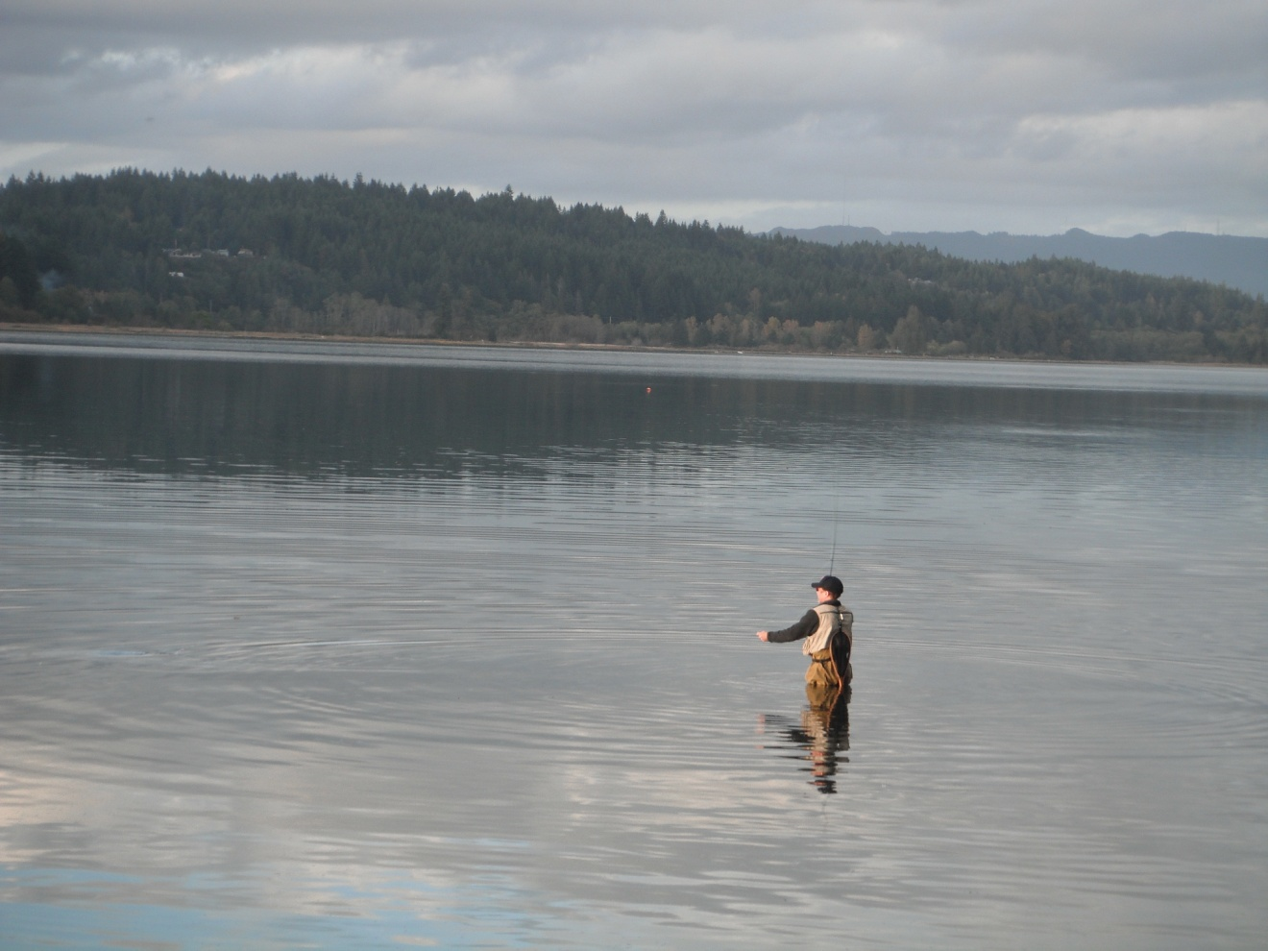
The End…Questions?

