Slide 1



Introduction to Visual Plumes
Walter E. Frick
Visual Plumes Consultants,
1541 NW Spring Street, Newport, OR 97365, USA
Contents and Schedule
Purpose and intended audience (Ben Cope and others)
Visual Plumes (VP) software and systems notes and caveats
Theoretical basis, emphasis: the Lagrangian UM3 model
Visual Plumes—familiarization by basic example, the single port plume
Break
Multi-port diffuser example
Special capabilities
  a) transition to far-field dispersion
  b) the shallow water approximation technique
  c) preparing and linking time-series files
  d) background buildup
Ramifications
Questions
Abstract
Notes (in the “Click to add notes” ppt space) give more detail
= animation
Notes:
To help re-establish context for anyone involved subsequent future study of this presentation:
Purpose and intended audience
The purpose of these workshops is to help EPA’s ORD, Regions, and headquarters, as well as tribes, states, and other federal agencies build capacity in mixing zone modeling. The workshops will “demystify” mixing zone studies and provide participants context to understand them. The overarching goals of the workshops are to help participants develop and maintain basic capacity in mixing zone assessment and modeling, train staff on what to look for when reviewing a mixing zone study, discuss current trends in mixing zone assessment and modeling, and encourage collaboration and consistency between EPA regions and state partners with regards to mixing zone assessment and modeling. Specifically, the workshop will train participants on:
1. The basic science behind the mixing of effluent in the environment.
2. What to look for when reviewing mixing zone studies.
3. How various assumptions affect dilution results.
4. How to interpret mixing zone modeling results.

Slide 2
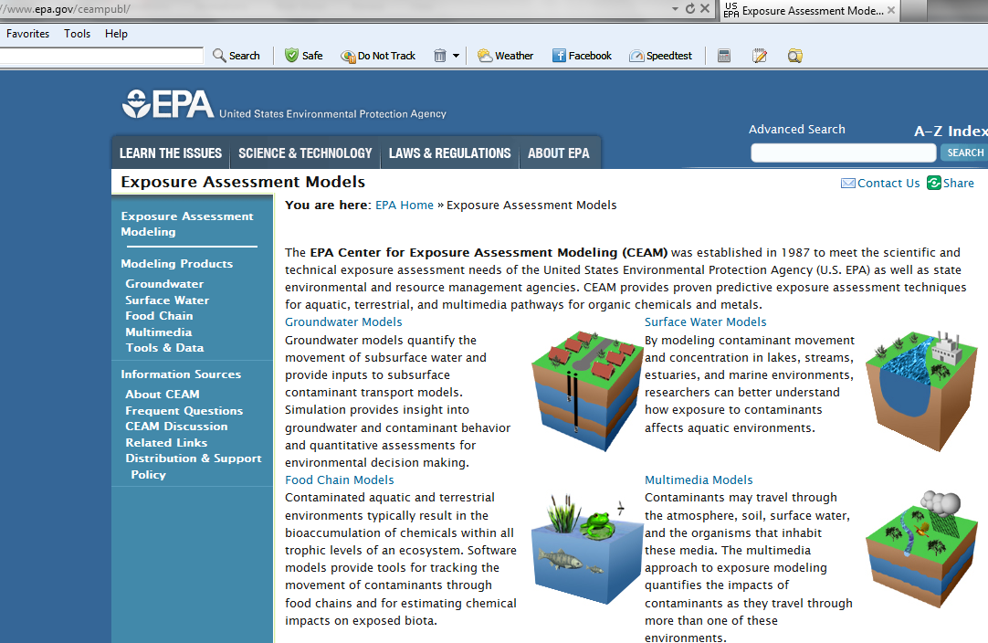
Software and systems notes and caveats
  Visual Plumes, a model platform available through EPA:
  CEAM at Athens, Georgia: http://www.epa.gov/ceampubl/
  Manual: http://www.epa.gov/ceampubl/swater/vplume/VP-Manual.pdf
  Software and update: http://www.epa.gov/ceampubl/swater/vplume/index.html

Slide 3

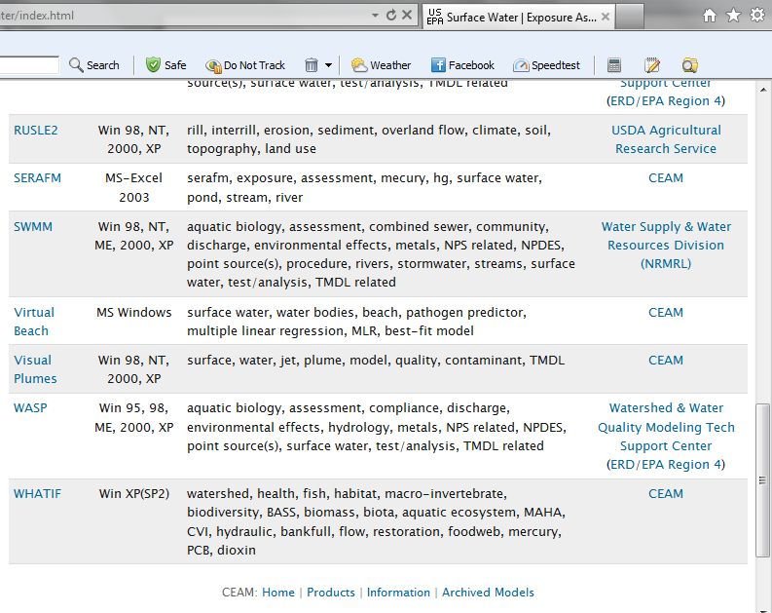
Software and systems: CEAM website
  Software and update: http://www.epa.gov/ceampubl/swater/vplume/index.html
Virtual Beach
Authors of Ver. 1 (Research)
Frick and Ge

Slide 4
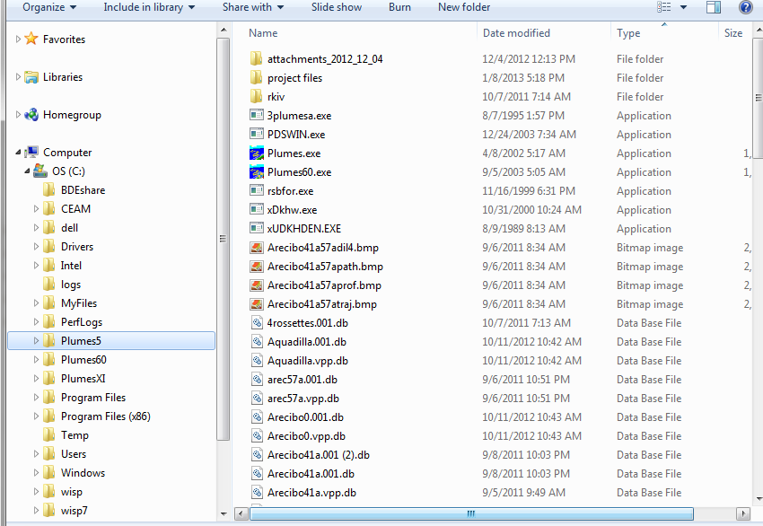
Software and systems: install and setup
DOS Plumes
Visual Plumes
  Software
calleable VP
external exe’s
Project files

Slide 5
After setup:
Software and systems: OS and use issues
Most of VP: Windows XP and earlier
Coding: Delphi 7 (no relation to Windows 7) and earlier
90% interface
Dependence on DLLs
Borland Database Engine (e.g. BDEinfosetup.exe)
Vista, Windows 7, Windows 8
Users Operating System experience
User as novice: most issues can be resolved, not always easily
VP Upgrade example: install the BDE somehow;
then, open Plumes.exe as Administrator; if vptempstorage error, retry; choose No, start a new project; UM3; if the error recurs, try again
Notes
Notes:
Visual Plumes was developed in Windows XP and earlier versions of Microsoft Windows Operating System (OS). Beginning with Windows Vista it became difficult to compile VP (convert the computer code into executable language) VP. At this time VP is compiled on a Windows 7 machine through a Windows XP emulator. The computer language is Delphi 7 (a superset of Pascal) .
VP uses the Borland Database Engine (BDE), software that supports the handling of the diffuser and ambient tables used in VP. Various other software applications also use the BDE engine. If the BDE engine is installed on any given computer (due to other prior application installations) then VP works directly after installing VP. If not, it is necessary to find a application which will install the BDE components. One such application is called BDEinfosetup.exe. While VPC owns the file, it is not clear that VPC can legally distribute it. Therefore, VPC depends on the user to acquire the necessary software. It may be possible that EPA could bundled the application with VP on the CEAM website.
Users should also be aware that there are a few known bugs in VP that have not been fully identified and corrected. In some instances these are initialization problems that can be overcome by repeating the action again. In any case, the user is invited to report bugs so that future versions of VP may be corrected.
VPC seeks to maintain VP in the public domain and offers to update older versions of VP for inclusion as updates on the EPA CEAM website.

Slide 6
Terms and definitions
Terms and Definitions
Aspiration entrainment: tends to be the dominant entrainment mechanism in low currents, including stagnant ambient; in UM3 it is proportional to the area the plume shares with the ambient fluid; where plumes are merged and are demarcated by vertical reflection planes it is assumed that the plume and its neighbor gain and lose equivalent amounts of mass so that no net entrainment occurs across those vertical surfaces, only over the surfaces still exposed to ambient fluid admittedly
Background buildup technique: an alternative approach to simulating the effects of merging; plumes are not restricted to the reflection technique but rather act in isolation with the effects of merging accounted for through changes to the plume’s background conditions, particularly the background pollutant concentration; the approach more closely mimics actual mixing mechanisms but, to be rigorous, would involve not only adjusting the background concentration due to the presence of upstream plumes but the physical environment the plume in question occupies, including all variables and velocities
Co-flowing plumes: the condition where the effluent discharge and the ambient current flow in the same direction
Control volume: the modeling analogue of the plume element in the Eulerian plume model formulation, integral flux equations; unlike the plume element, the model accounts for flux changes as a function of s, the distance along the plume trajectory, the integration step being ds; the stiffness of the model equations requires management of ds that can lead to discontinuous changes in the endpoint dilution as input conditions are changed only incrementally; also sometimes referred to as the plume element, the analogous Lagrangian control volume
Counter-flowing plumes: the condition where the effluent discharge flows in the opposite direction of the ambient current
Critical Initial Dilution: the flow weighted average of a diffuser plumes’ endpoint dilutions; this review recommends that for the purposes of calculating the CID that merged plumes be treated as grouped entities each with their combined CID
Cross-current: ambient current not either co-flowing or counter-flowing will possess a component of velocity that is perpendicular to the plume at the port; cross-currents add another term to the entrainment equations, for example, as in UM3, and will tend to increase overall entrainment in the absence of merging; it is important in reducing the spacing between plumes to values less than the physical spacing
Deep-water assumption: integral plume models such as UD and UM3 were developed with the assumption that water depth would not constrain the motion of the plume; the reason for adopting the assumption was to simplify the theory; the models do not plume-water surface interaction; other steps or models must be taken to model the plume beyond the point where any part of it hits the surface (although some relaxation for slightly grazing the surface might be tolerable)
Densimetric Froude number: this is a similarity parameter that expresses the relative importance (ratio) of kinetic and potential energy inherent in the plume element at the source; small values represent pure plumes that possess little or no initial velocity (like a heated plate), large values are momentum dominated jets with little or no buoyancy perhaps requiring pump pressure to attain the high velocities; in vertical plumes (like natural draft cooling towers) values less than unity are plumes that possess excess buoyancy to briefly accelerate the plume element at the source causing it to stretch out and dynamically contract its diameter, the analogous mechanism experienced in seawater intrusion; finally, the similarity property allows plumes to be compared across spatial scales, plumes with the same similarity parameters exhibiting the same morphology (plume shape) when plotted in dimensionless terms (for example, in terms of diameters downstream and vertically)
DKHw.exe: a version of UDKHDEN that was developed explicitly for use with Visual Plumes (Frick et al. 2004); replaced in this review by an updated version of UDKHDEN (called UD) after DKHw was found to exhibit spurious density behavior in isolated instances and its further use was suspended
Effective dilution: effective dilution is the ratio of effluent concentration to plume element concentration, particularly plume element concentration at an endpoint condition; when the ambient concentration is zero the effective dilution is equal to the volume dilution, or more correctly, the mass dilution; judged from an environmental perspective, as opposed to a mechanical mixing perspective, the effective dilution is a better measure of plume performance than volume dilution
Effective spacing: is the spacing between centerlines of plumes measured perpendiculat to their trajectories at given points; in terms of the mathematics of the plume model, it continuously estimates the separation between the vertical reflection planes used to constrain the plume element to its allotment of space
Endpoint criterion: Initial Dilution models usually report when significant conditions are met, for example trapping level, maximum rise, merging, and surface hit; these conditions can serve as endpoint markers, or criteria, for modeling or regulatory purposes
Endpoint dilution: the dilution corresponding to some regulatory or modeling criterion for determining diffuser performance, like the trapping level, maximum rise, or surface hit condition
Entrainment: discharged plumes are usually energetic, possessing kinetic energy (great velocity or momentum) and potential energy of buoyancy that converts into kinetic energy along the plume trajectory; through the Bernoulli effect the plume shear velocity aspirates, or entrains, ambient fluid into the plume; ambient water delivered at the plume boundary by current is also entrained by virtue of the turbulence in the plume
Far-field: when using integral models such as UD and UM3 the modeling domain is often divided into near-field and far-field subdomains; far-field dispersion is dominated by ambient passive diffusion processes and the rate of dilution is comparatively small; in VP the Brooks far-field algorithm may be used to estimate additional plume dilution
Forced entrainment: tends to be the dominant entrainment mechanism in moderate and high currents; in UM3 it is proportional to the area the plume projects to the current and is developed using the Projected Area Entrainment Hypothesis; where plumes are merged and are demarcated by vertical reflection planes it is assumed that the plume and its neighbor gain and lose equivalent amounts of mass so that no net entrainment occurs across those vertical surfaces, only over the surfaces still exposed to ambient fluid
Grouped plumes: plumes that fully merge into a single entity as would be seen by an observer located at the downstream mixing zone boundary; the CID of grouped plumes would be based on the product of a single joint representative initial dilution and the combined flow of all contributing plumes
Guidelines: the Puerto Rico EQB April 1988 interim guidelines—Mixing Zone and Bioassay Guidelines
Half-spacing technique: a simplifying technique to simulate cross-diffuser merging the basic assumption being that counter-flowing plumes will flow across the diffuser and merge with the co-flowing plumes on the other side and will do so achieving about the same mass or volume dilution; seen at some distance downstream, as at the mixing zone boundary, the coflowing and counterflowing plumes’ details are considered relatively unimportant and it appears as if two plumes at half the spacing are issued from downstream side of the diffuser; used in lieu of the more rigorous background buildup technique
Initial dilution: the plume dilution that results from the action of internal plume turbulence; the turbulence arises from velocity shear between the plume and the ambient; plume velocity, or momentum, is provided at the source and maintained to greater or lesser extent by the conversion of buoyancy into vertical velocity; experiments show that plume turbulence generally “collapses” near, but beyond, the point of maximum rise, hence it is often used as the endpoint for the initial dilution process
Isolated plumes: either plumes from single port discharges or plume from multiport discharges that do not interact with other plumes; the definition can be troublesome when plumes do not merge in their near-field regions but a far-field portion of the upstream plume recirculates and interacts with the downstream plume in its near-field, then the downstream plume cannot be considered to be isolated and merging techniques should be considered
Lmz, mixing zone length scale: for both UD and UM3 simulations Visual Plumes can display the trajectory of a plume and the plume boundaries, i.e. its variable diameter, in plan view, i.e., as if on a map; given the coordinates are provided, VP can also display the configuration of the diffuser, like the diffuser axis; Lmz is the distance between outermost end of the diameter drawn perpendicular to the plume trajectory at the endpoint dilution and the nearest point on the diffuser axis, i.e. perpendicular to the diffuser axis
Maximum rise: the greatest rise of buoyant plumes in density stratified medium often considered to be the end of the initial dilution region, thus an endpoint criterion
Merging plumes: many discharges involve multiple plumes issuing from submerged diffusers; depending on the spacing between them, these plumes will generally interact with each other either in the initial dilution or the far-field region; Initial Dilution models such as DKHDEN and UM3 were originally developed around single plumes discharged to deep water and use the reflection technique to estimate the effects of merging on dilution
Near-field: when using integral models such as UD and UM3 the modeling domain is often divided into near-field and far-field subdomains; the near-field is the region in which initial dilution occurs and the plume element moves from source to maximum rise, other endpoint criteria not encountered; the energy of the plume is the primary generator of internal turbulence that serves to entrain ambient fluid
Normal: used synonymously with perpendicular
Perpendicular: used synonymously with normal or normal to
Physical spacing: at its most elemental is the physical distance between neighboring ports as from port centerline to centerline; the physical spacing, the diffuser geometry, the current angle, and the merging technique together determine the spacing that defines the separation between plume centerlines at different points along the trajectory
Plume element: in the Lagrangian framework on which UM3 is based the plume element is initially defined to be a right cylinder with the diameter of the port or vena contracta and an arbitrary but small height, h; a fundamental axiom of the model is that all mass originally in the plume element remains in the plume element even as it grows from entrainment and moves along its trajectory; the steady state assumption allows h to be computed at any point and forms the basis for the “jelly sandwich” equation (redistribution of mass normal to the plume axis); in general, the plume element takes on the shape of a circular wedge with its faces normal to the plume axis; the independent variable is time and quantities such as the amount of entrainment are computed in small time steps; the term plume element may also include the analogous concept of the control volume
Projected area: the apparent area of the plume element seen by an observer sighting along the direction of the current approaching the plume; the mathematical projection of the plume element onto a vertical plane normal to the current direction; the total area projected by the entire plume onto a vertical plane normal to the current direction; the total forced entrainment would be proportional to the total projected area excluding area above the water surface
Quarter-spacing technique: a simplifying technique to simultaneously simulate cross-diffuser and cross-leg merging in wye diffuser configuration where the plumes from the upstream leg are believed to flow into and merge with plumes of the downstream leg; seen at some distance downstream, as at the most downstream mixing zone boundary, the coflowing and counterflowing plumes’ details are considered relatively unimportant and it appears as if four plumes at quarter spacing are issued from downstream side of the downstream leg of the diffuser; often used in lieu of the more rigorous background buildup technique
Reflection technique: at their common boundaries merging plumes entrain each other, one’s diameter intrudes into the body of the other, and vice versa; any mass common to two entities requires careful accounting for mass to assure there is not double accounting; the reflection technique provides imaginary vertical planes between plumes that assure the conservation of mass; each plume is allotted its own space into which to develop; both entrainment and growth must occur at the remaining free surface the plume shares with the ambient fluid
Spacing distance: the spacing between plumes determines how much of the plumes trajectory is subject to plume merging; measured horizontally perpendicular to the plume centerline trajectory, merging begins when the plume diameter becomes larger than the spacing distance; in general, the spacing distance varies along the plume trajectory because the plume trajectory will bend into cross-currents and therefore identical trajectories from neighboring plumes spacing distance will be a function of where the plume element is along the trajectory at the time of interest
Steady state: an important assumption that makes the mathematical formulation of entrainment models tractable; steady state implies the morphology, or shape or envelope, of the plumes are invariant in time; successive releases of effluent (the initial control volume or plume element) perform the same motions as they flow through the stationary envelope from discharge to maximum rise (and beyond); in UM3 the assumption makes it possible to calculate the length of the plume element at any point along the trajectory, that, coupled with the change in mass during the time step and the equation of state, allows the plume diameter to be computed at any point; steady state also indirectly determines the spacing between plumes
Surface hit criterion: entrainment is a plume surface phenomenon, when plume boundaries reach the surface the plume area available to entrainment is reduced or cut off and the underlying model assumptions are no longer satisfied in the way the model was developed; to be conservative the criterion should be considered to be an endpoint condition for initial dilution
Trapping level: the depth at which the plume control volume or plume element possesses the same density as the ambient fluid at that depth; in many instances the plume continues to develop beyond this point, ultimately reaching its maximum rise or the surface water depth and density stratification permitting; in the early days of modeling this was the most popular modeling endpoint but most modelers agree that maximum rise or surface hit are the important endpoints in determining initial dilution
UD: the most recent version of the DKHDEN three-dimensional Eulerian integral flux plume model; a subroutine has been written for Visual Plumes to read and interpret UD output, providing information of the plume boundary surface hit condition and set up with an estimate of the reduced spacing when run from VP
UDKHDEN: a three-dimensional Eulerian integral flux plume model; a version, DKHw, was developed to run in Visual Plumes; a 2011 updated version UD is used herein; other models include UM3, a Lagrangian model, and NRFIELD, an empirical model of multi-port diffusers; UM3 is developed around the concept of the plume element
UM3: a three-dimensional Lagrangian plume model found in Visual Plumes, other models include DKHw, an Eulerian integral flux model, and Nearfield, an empirical model of multi-port diffusers; UM3 is developed around the concept of the plume element
Vena contracta: the minimum area cross-section in the fluid stream discharging from a port or any orifice; the area and velocity at that point are used to help define the initial conditions for model input
Visual Plumes: the EPA platform for running several plume models in common, including UD, UM3, and NRFIELD
Volume dilution: the common quantity used to characterize the effectiveness of a diffuser; the problem with volume dilution is that often it does not differentiate between water volume entrained from the prevailing ambient fluid and water volume representing entrained plume fluid; the half and quarter spacing techniques normally would guard against misuse of volume dilution but, with wye diffusers, generally the half-spacing technique alone would not; effective dilution avoids the pitfalls of volume dilution and represents the mass balance of both effluent and entrained sources
Wastefield width and merging: one way to better estimate the effects of merging plumes issued from a cluster of sources is to run the individual plumes in the context of the current speed and direction (plan view geometry) to estimate the wastefield width and use that information to estimate the effective reduced spacing, and, finally, rerun the plumes with the reduced spacing to obtain a final estimate of the initial dilution
Worst case conditions: as a substitute for a lack of ambient measurements or to simplify the process of modeling all possible conditions and analyzing the results statistically, worst case conditions may be developed that will provide a conservative initial dilution estimate when used as input conditions to the model of choice; worst case conditions are often limited to a low current speed (like ten percentile) and a stable ambient density (or salinity and temperature) stratification; for merging plumes this approach should be expanded to include current direction, as co-flowing plumes will generally not represent the worst case
Reference material
(also, when slides are viewed in Powerpoint, check for additional notes)
Notes
Notes:
This slide is intended as a reference for future study

Slide 7
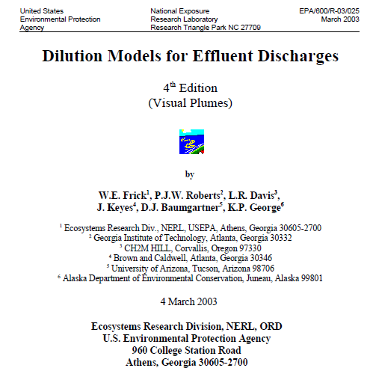
Recommended Tutorial
Get the VP manual!! Tutorial starts on page
4.7 to 4.20

Slide 8
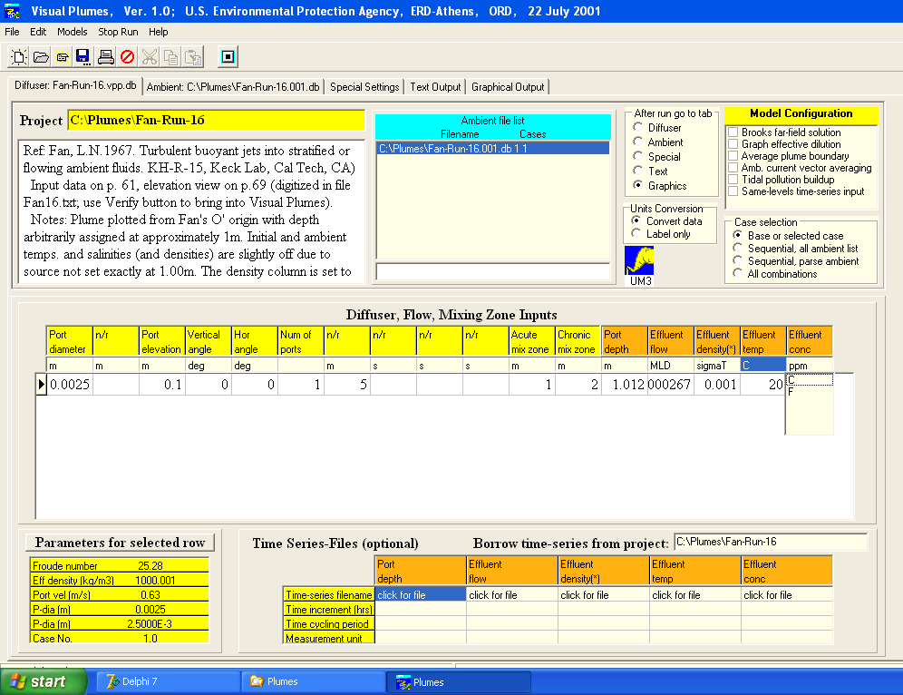
Visual Plumes Manager/ Model Platform
VP’s main tab: the Diffuser tab

Slide 9
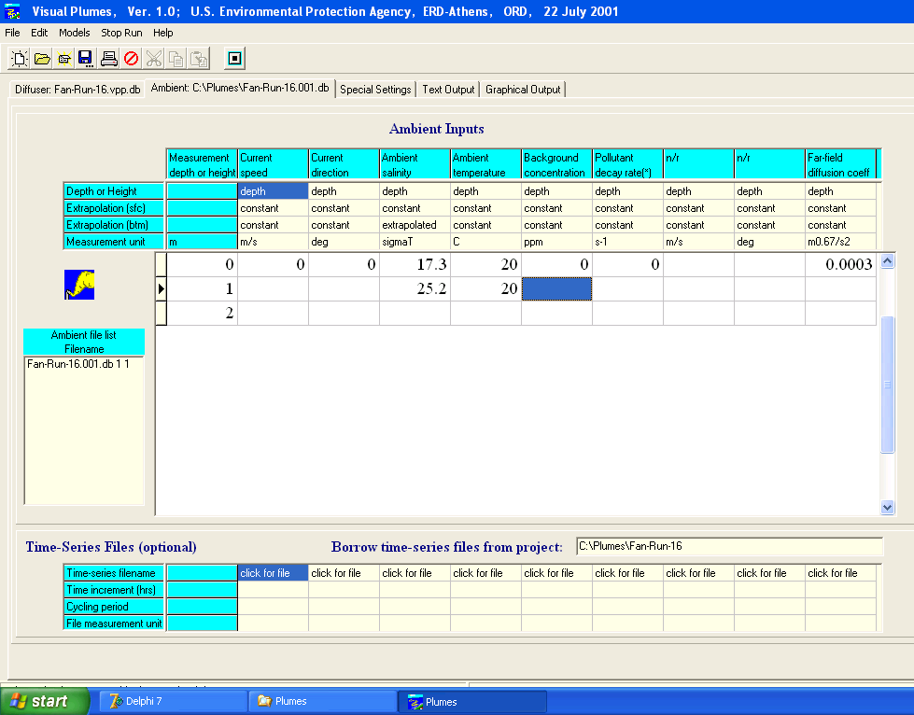
The Ambient tab

Slide 10
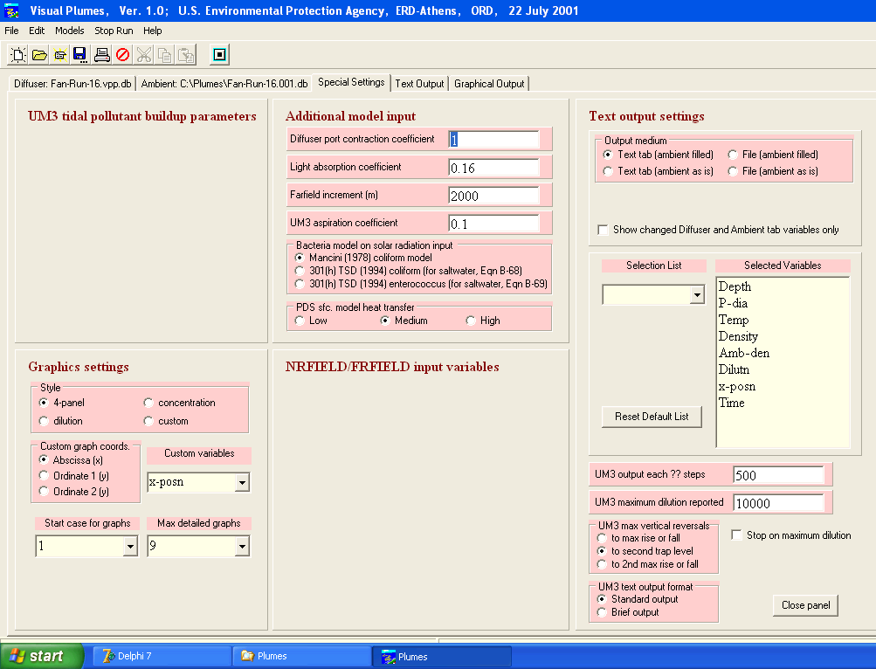
The Settings tab

Slide 11

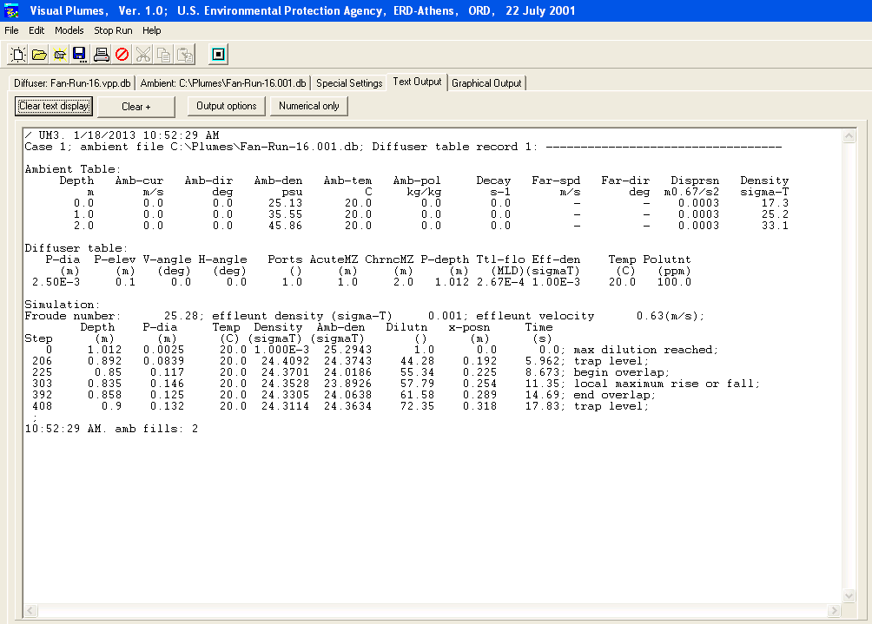
The Text tab

Slide 12
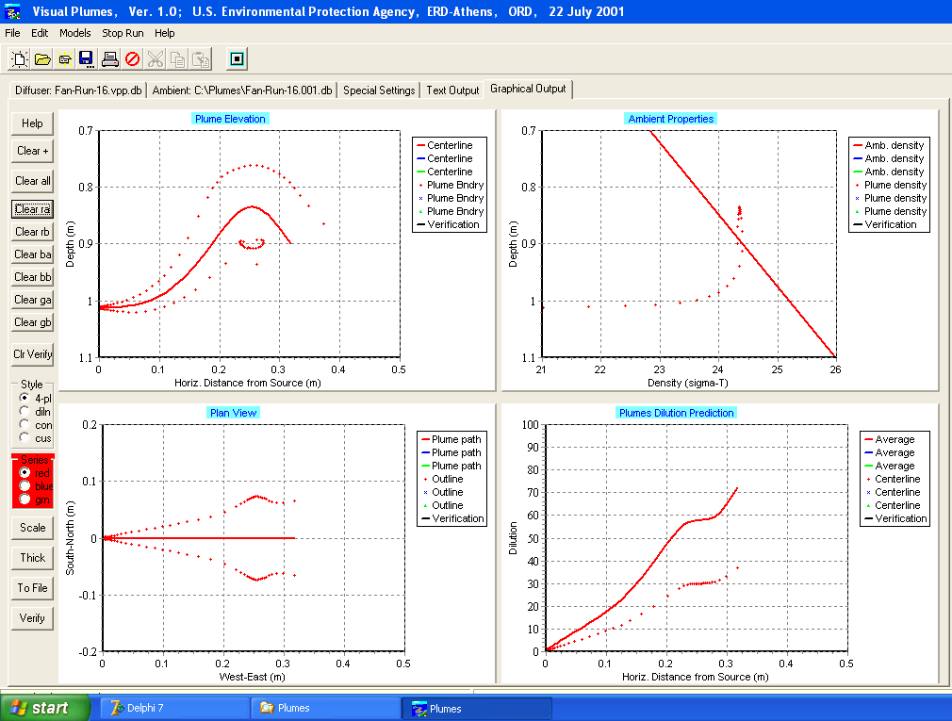
The Graphics tab

Slide 13
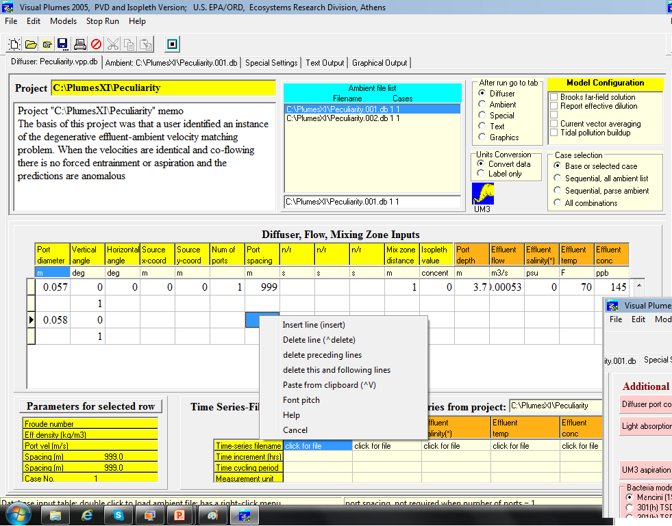
Example r-click pop-up menu

Slide 14

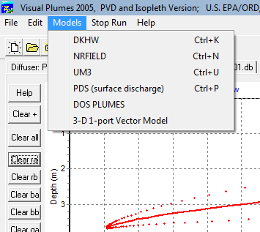
Visual Plumes Model Suite
DKHW: Physics-based exe, Eulerian numerical formulation, integral flux model. One or multi-port diffusers.
NRFIELD: Empirical, dimensional analysis and curves fit to data; exe.
Based on T-risers, for 4 or more ports.
UM3: Physics-based native, Lagrangian numerical formulation, material element model. One or multi-port diffusers. el
PDS: Eulerian integral flux surface plume model; exe. Buoyant discharges
DOS Plumes: predecessor of Visual Plumes, runs RSB (pre-NRFIELD) and UM (Updated Merge model; pre-UM3). Features auto cell-fill: displays similarity parameters, length scales, cormix classes.
Dreamware prototype depicts wire-mesh graphics, like UM3, vector based.
All but PDS link to the Brooks far-field algorithm, far-field dispersion model.
Notes
Notes:
Models such as DKHw are external executable files (exe). VP sets up their input files, calls the exe, waits for the exe to finish, then looks for the output file, reads it, and interprets the information on the text and graphics tabs. Problems can arise when the exe terminates abnormally. A file handling problem can arise when VP then reads an older output file, which is not always apparent when several consecutive cases are involved.
UM3 is a native model so called because it is coded into the VP code. This makes for easier control for the developer as model and interface are compiled together.
DKHw, NRFIELD, and UM3 are initial dilution models that can be linked with the Brooks far-field model.
What is in the names:
DKHW: Physics-based exe, Eulerian numerical formulation, integral flux model. One or multi-port diffusers.
Acronyms: Davis, Kannberg, Hirst model (w = Windows; Windows VP package). Previous versions DKHDEN, UDKHDEN (1985)…. Later compilations up to 2011….
NRFIELD: Empirical, dimensional analysis and curves fit to data; exe.
Based on T-risers, for 4 or more ports. RSB in DOS Plumes, native, Roberts, Snyder, Baumgartner model.
Roberts continues work on NRFIELD currently conducting experiments with dense discharges.
UM3: Physics-based native, Lagrangian numerical formulation, material element model. One or multi-port diffusers. Merge (pre 1985), UMERGE (1985), UM (1993), UM3, Updated Merge 3-D model.
PDS: Eulerian integral flux surface plume model; exe. Buoyant discharges. Acronym: Prych, Davis, Shirazi model.
DOS Plumes: predecessor of Visual Plumes, runs RSB (pre-NRFIELD) and UM (Updated Merge model; pre-UM3). Features auto cell-fill: displays similarity parameters, length scales, cormix classes.
Dreamware prototype depicts wire-mesh graphics, like UM3, vector based.
Brooks far-field algorithm is a set of equations for estimating dispersion (dilution) in the far-field, beyond the initial dilution phase of plume development.

Slide 15
More to come
There is more to follow on empirical, hydrodynamic fluid dynamic codes, empirical, Eulerian integral flux and Lagrangian plume models.
explain
illustrate
“demystify“
touch on basic principles of physics
mathematical formulations
modeling assumptions
UM3 examples (built into Visual Plumes--not an external application)
examples chosen for simplicity, generality, and teaching potential
VP is public domain software

Slide 16
Mixing Zone analysis
What’s the answer?
What’s the answer?
Client
World
What’s the answer?
Here are THREE
3-)
VP:
dkh, nfd, um3…
User
Answers, yes, but no one knows it all (otherwise there’d one). MZ analysis is a partnership

Slide 17
The problem/model universe
Whom to believe, best? How feasible?
Problem domain
Visjet…
TOE
VP
Cormix
VP is public domain software
Everyone can be on the same page
Facilitates inter-model comparison & competition

Slide 18
Mixing effluent in environment—basic science
Before illustrating by example:
Let us take a brief tour of plume
problem, physics, and prediction
Touch on:
capabilities
limitations
pitfalls
mystery and ambiguity
And end with promise:
A bonus rule
Reason for optimism and confidence
Notes
Notes:
Even at its simplest, plume modeling guidance can appear mysterious and ambiguous. Understanding the capabilities and limitations of available models can help avoid pitfalls and confusion and promote confidence in model outputs. This section seeks to help the user demystify the art and science of plume modeling for themselves.

Slide 19
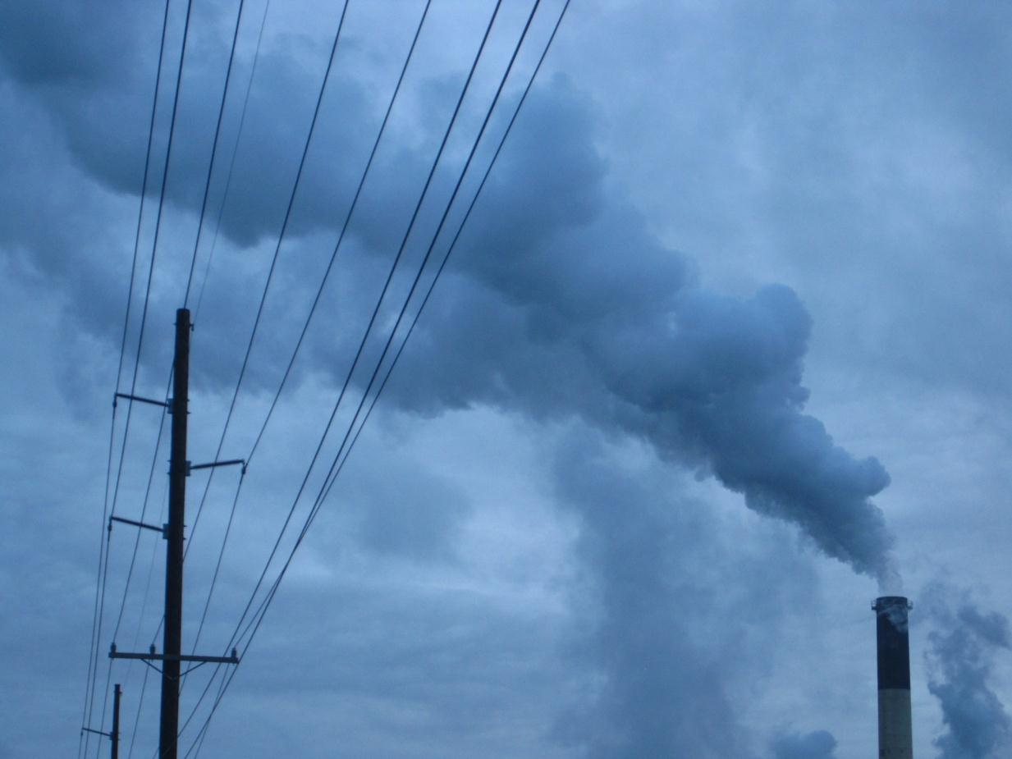

Conceptual model in a snapshot: it’s air but, by similarity, it could be water
Some questions:
Current?
Steady?
Cross-section round?
Jet or plume?
Phase changes?
Ambient stratification?
Dimension imply dilution?
source
plume
Receptor (somewhere)
other plumes

Slide 20
Why not the TOE for Visual Plumes?
  Theory of Everything
  “A theory of everything (ToE) or final theory is a putative theory of theoretical physics that fully explains and links together all known physical phenomena, and predicts the outcome of any experiment that could be carried out in principle.”
  http://en.wikipedia.org/wiki/Theory_of_everything
  In plume modeling this dream is called Computational Fluid Dynamics (CFD). In principle a comprehensive CFD model could model any plume in relationship to other plumes and their bathymetric, chemical, and physical environments. All that is required is precise and accurate knowledge of
  Initial conditions (IC)
  Boundary conditions (BC)
  Forcing functions
  Chemistry
  Physics
  Thermodynamics….

Slide 21
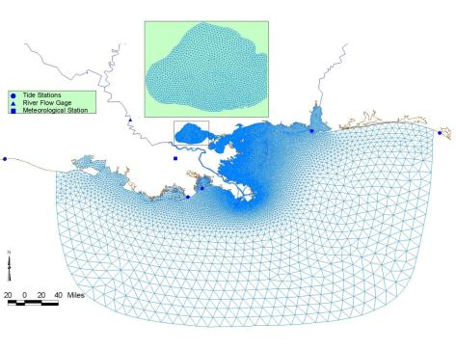
Meet a CFD model: grid and input
Model tidal forcing
Model tidal forcing
River flow
FVCOM unstructured model grid
Zooming would reveal fine structure, sources, etc.
Wind
Notes
Notes:
This work concerned events surrounding Hurricane Katrina, 2005.
Note the Mississippi River flow at Baton Rouge, 6000 cubic meters per second equals about 212,000cfs. This is about 3 times larger than the tidal Yaquina River, Oregon, however, the Mississippi has multiple mouths, including the Atchafalaya River that discharges near Morgan City, west of New Orleans (not shown here). (This note refers to another comparisons including use of the Visual Plumes PDS river discharge model.)

Slide 22

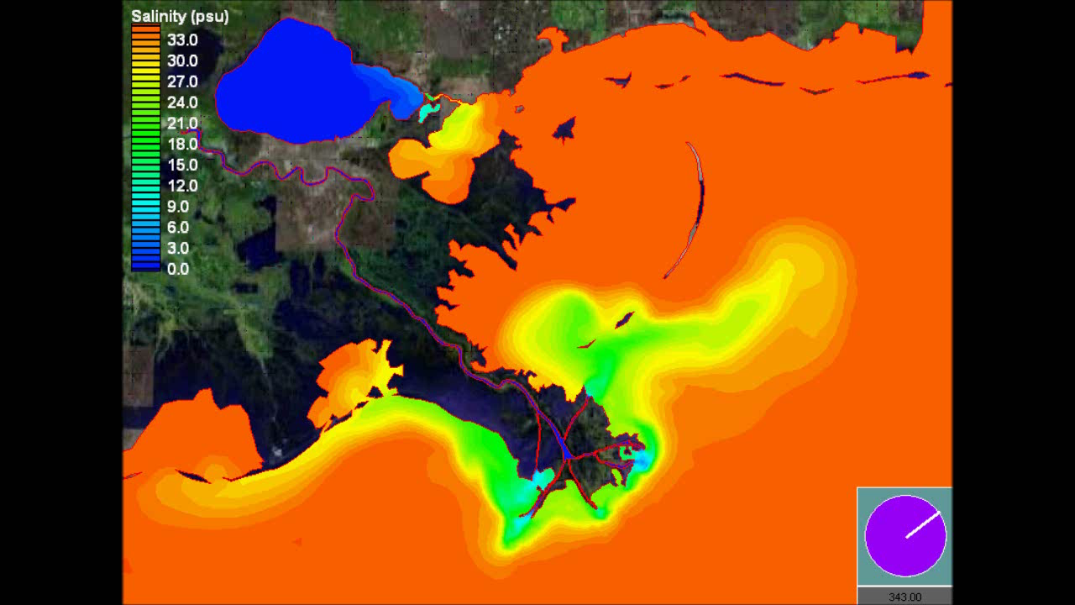
CFD model output: salinity animation
Points to watch
1) Lake Pont. outflow
2) river plume length
20 km
Discharge from Lake Pontchartrain after Katrina
Courtesy Tarang Khangaonkar et al., 2005
Notes
hrs
Notes:
Another output of the modeling. Note the intense parts of the plumes penetrate about 5km into the Gulf.

Slide 23
Zooming in a little
Discharge from Lake Pontchartrain after Katrina
Courtesy Tarang Khangaonkar et al., 2005
Notes
hrs
Notes:
The intense parts of the plumes penetrate about 5km into the Gulf.

Slide 24
Done! Except….
  In theory, we can accurately model plumes using accurate CFD models.
  However, consider the
  Resources
  Setup
  Data collection (IC, BC….)
  Expense….
  We (modelers, users…) must formulate dispersion coefficients everywhere (eddies and turbulence) (models in themselves)
  A dream for most of us. On to Visual Plumes’ imperfect answers.

Slide 25
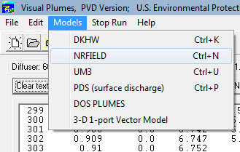
One alternative: empirical modeling
  While we wait for CFD, how about going to the laboratory for solutions? Empirical models.
  Visual Plumes comes bundled with an older version of the NRFIELD empirical model. (This is essentially the Roberts, Snyder, Baumgartner model, RSB, found in DOS Plumes.) NRFIELD is a stand-alone executable that can be called by VP:
  VP creates the input file
  VP initiates NRFIELD execution
  VP reads the output file and displays output
  Considerations:
  NRFIELD addresses multiple merging plume problems
  It is an endpoint model…
Notes
Notes:
Empirical models are based on laboratory measurements. Lab results may be fitted to model parameters that are derived through dimensional analysis or other techniques. Coefficients are established that produce the best fits and similarity theory may be used to generalize the results, making it possible to adapt results to larger or smaller length scales. Similarity may be achieved by matching Froude number, stratification number, Reynolds number and other similarity parameters or length scales. Non-linear effects like the density of water near freezing temperature can complicate similarity theory, sometimes with unexpected and significant consequences.

Slide 26
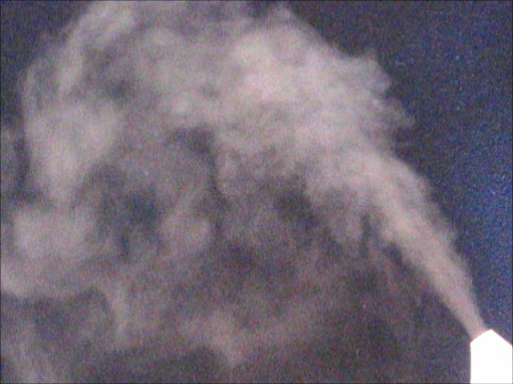
A dense plume
The “plume envelope” or plume boundary maintains a steady appearance
Evidence of detraining fluid
A household dehumidifier plume showing evidence of unexpected behavior. Mimicking the laboratory, will NRFIELD be the first model modified to explain observations?

Slide 27
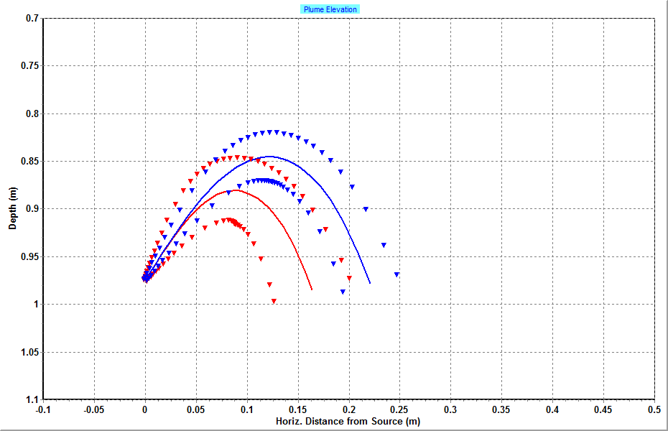
UM3 dense plumes
Focus on rise and impact point.
Red: aspiration coefficient the standard 0.10; blue: 0.05.

Slide 28
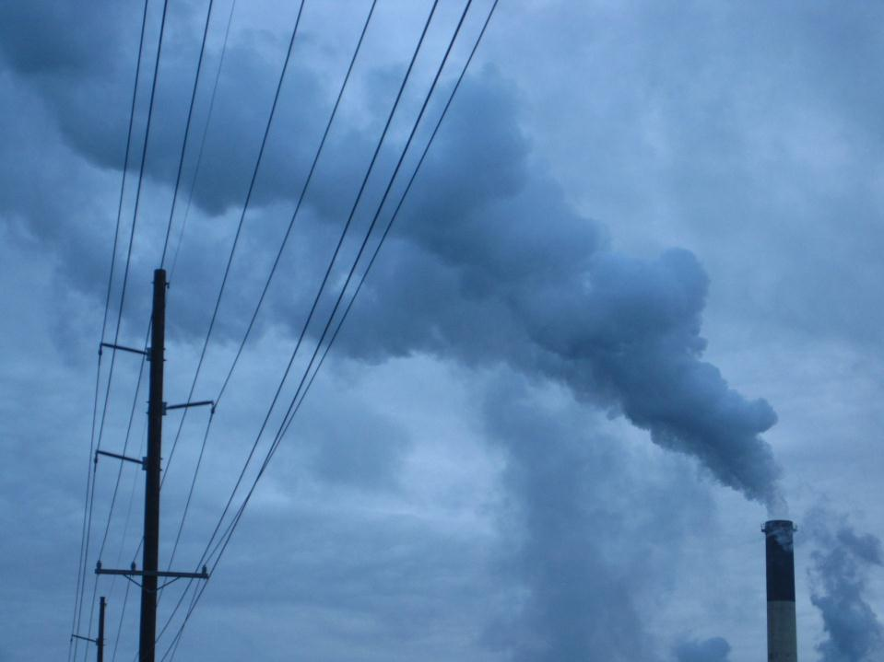
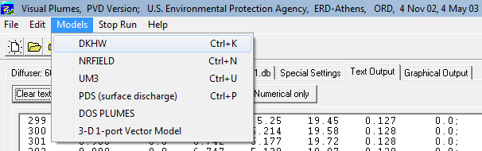
Eulerian integral flux models
VP example:
DKHW or UDKHDEN
Differential equations
Physics of mass, momentum, energy…
Integrating factor: ds
Flux balances over control volumesfixed in space
Steady state assumed
Notes
Notes:
Corjet, one of the models in Cormix, is also an Eulerian integral flux model.
DKH refers to Davis, Kannberg, and Hirst, the original authors of DKHden even before the UDKHDEN and UMERGE (now UM3) models were published in the EPA publication of EPA/600/3-85/073a and b: “Initial mixing characteristics of municipal ocean discharges” in 1985. (Muellenhoff, Soldate, Baumgartner, Schuldt, Davis, and Frick.) The U stood for Universal because each included model used the same input format called Universal Data Files (UDF) files. UM3 now might suggest the “Updated Merge 3-dimensional” model. UMERGE was a quasi 3-D model whereas UM3 is fully three-dimensional when modeling individual plumes, making full use of vector algebra to represent three-dimensional physics.
Cautionary DKHw and UDKHDEN notes for the record:
1) they do not report when the plumes intersect the receiving water surface
2) they hold plume spacing constant even when the current is not perpendicular to the diffuser axis (to be conservative the user should input the reduced spacing, the spacing distance projected to the current)

Slide 29
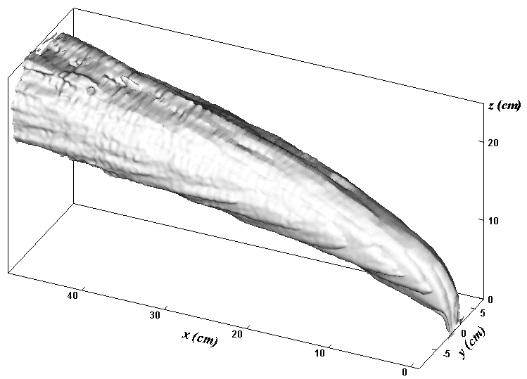
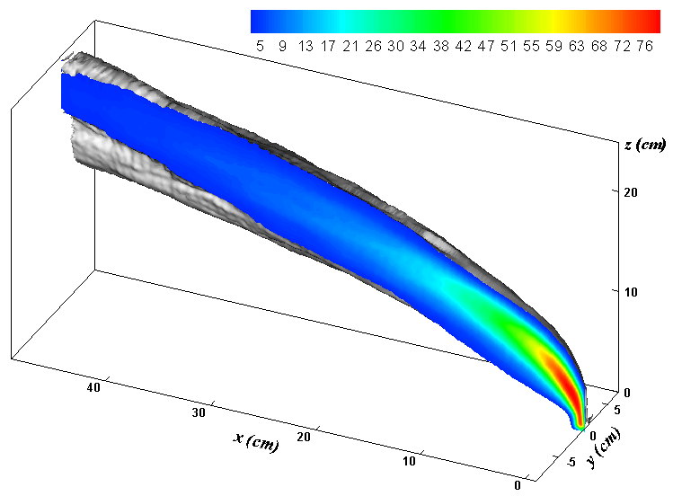
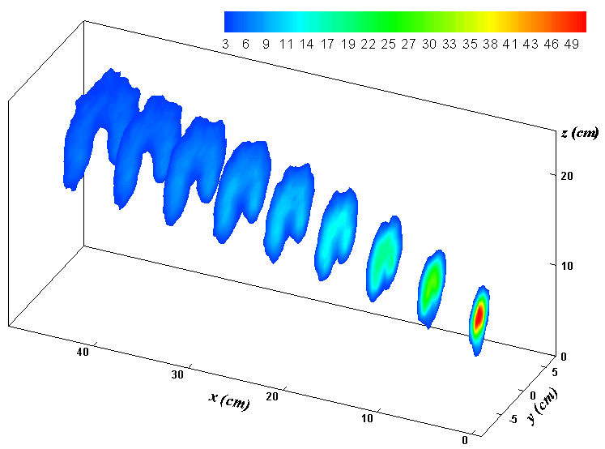
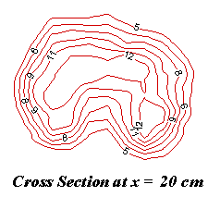
Unstratified buoyant jet in the lab
Conceptual morphing
We see evidence of steady state, time-averaging, plume morphology (round plume assumption)…
Notes
Notes:
This presentation covers a lot of ground. For the sake of time some aspects of modeling are emphasized at the expense of other aspects. The previous Eulerian model simulations are based on the concept of steady state. This means that the predictions represent time-averaged behavior. We may think of averaging together many snapshots of the instantaneous plumes that are quite turbulent and heterogeneous. The result of this averaging is to produce smooth surfaces and concentration patterns as shown in the upper right panel. It is such patterns and concentrations we attempt to simulate. To make the problem tractable we assume the cross-section is round but already recognize that this is a simplification which can have significant consequences. In current the plumes are often kidney shaped as shown in the lower right panel. If stratification is strong the cross-section can become even more flattened in shape. This can affect our interpretation of when the plume’s upper surface intersects the water surface.

Slide 30
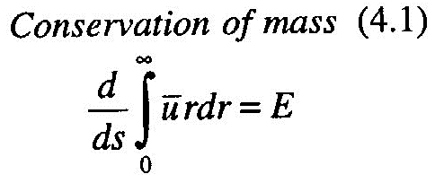
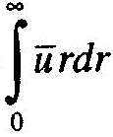

How does numerical Eulerian method work?
Derive (compute)…
density
buoyancy
area…
mass flux
momentum flux
energy flux
…
Define the source:
IC, BC..
velocity vector
radius
temperature
salinity
concentration
current
orientation...
( )_{s+Δs} = ( )_{s} + EΔs
By the way, the integral
is the mass flux
Define coordinate
system and location
z
Δs
y
x

Slide 31
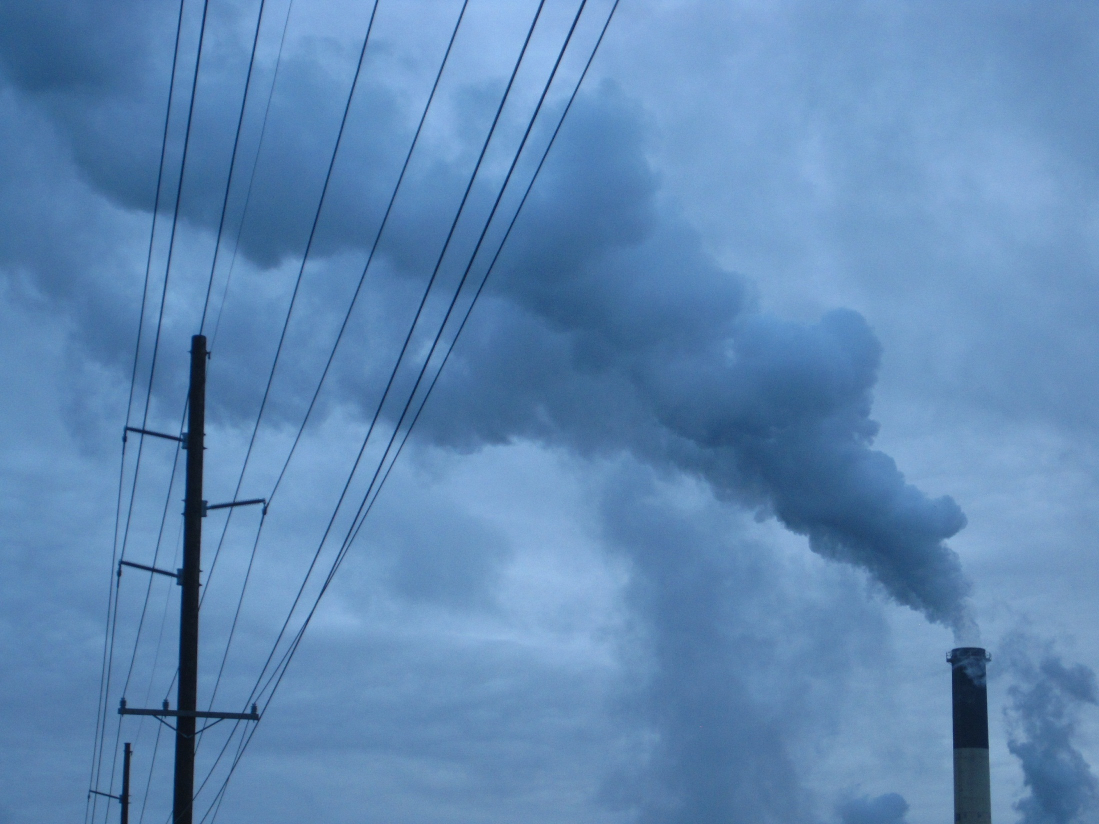
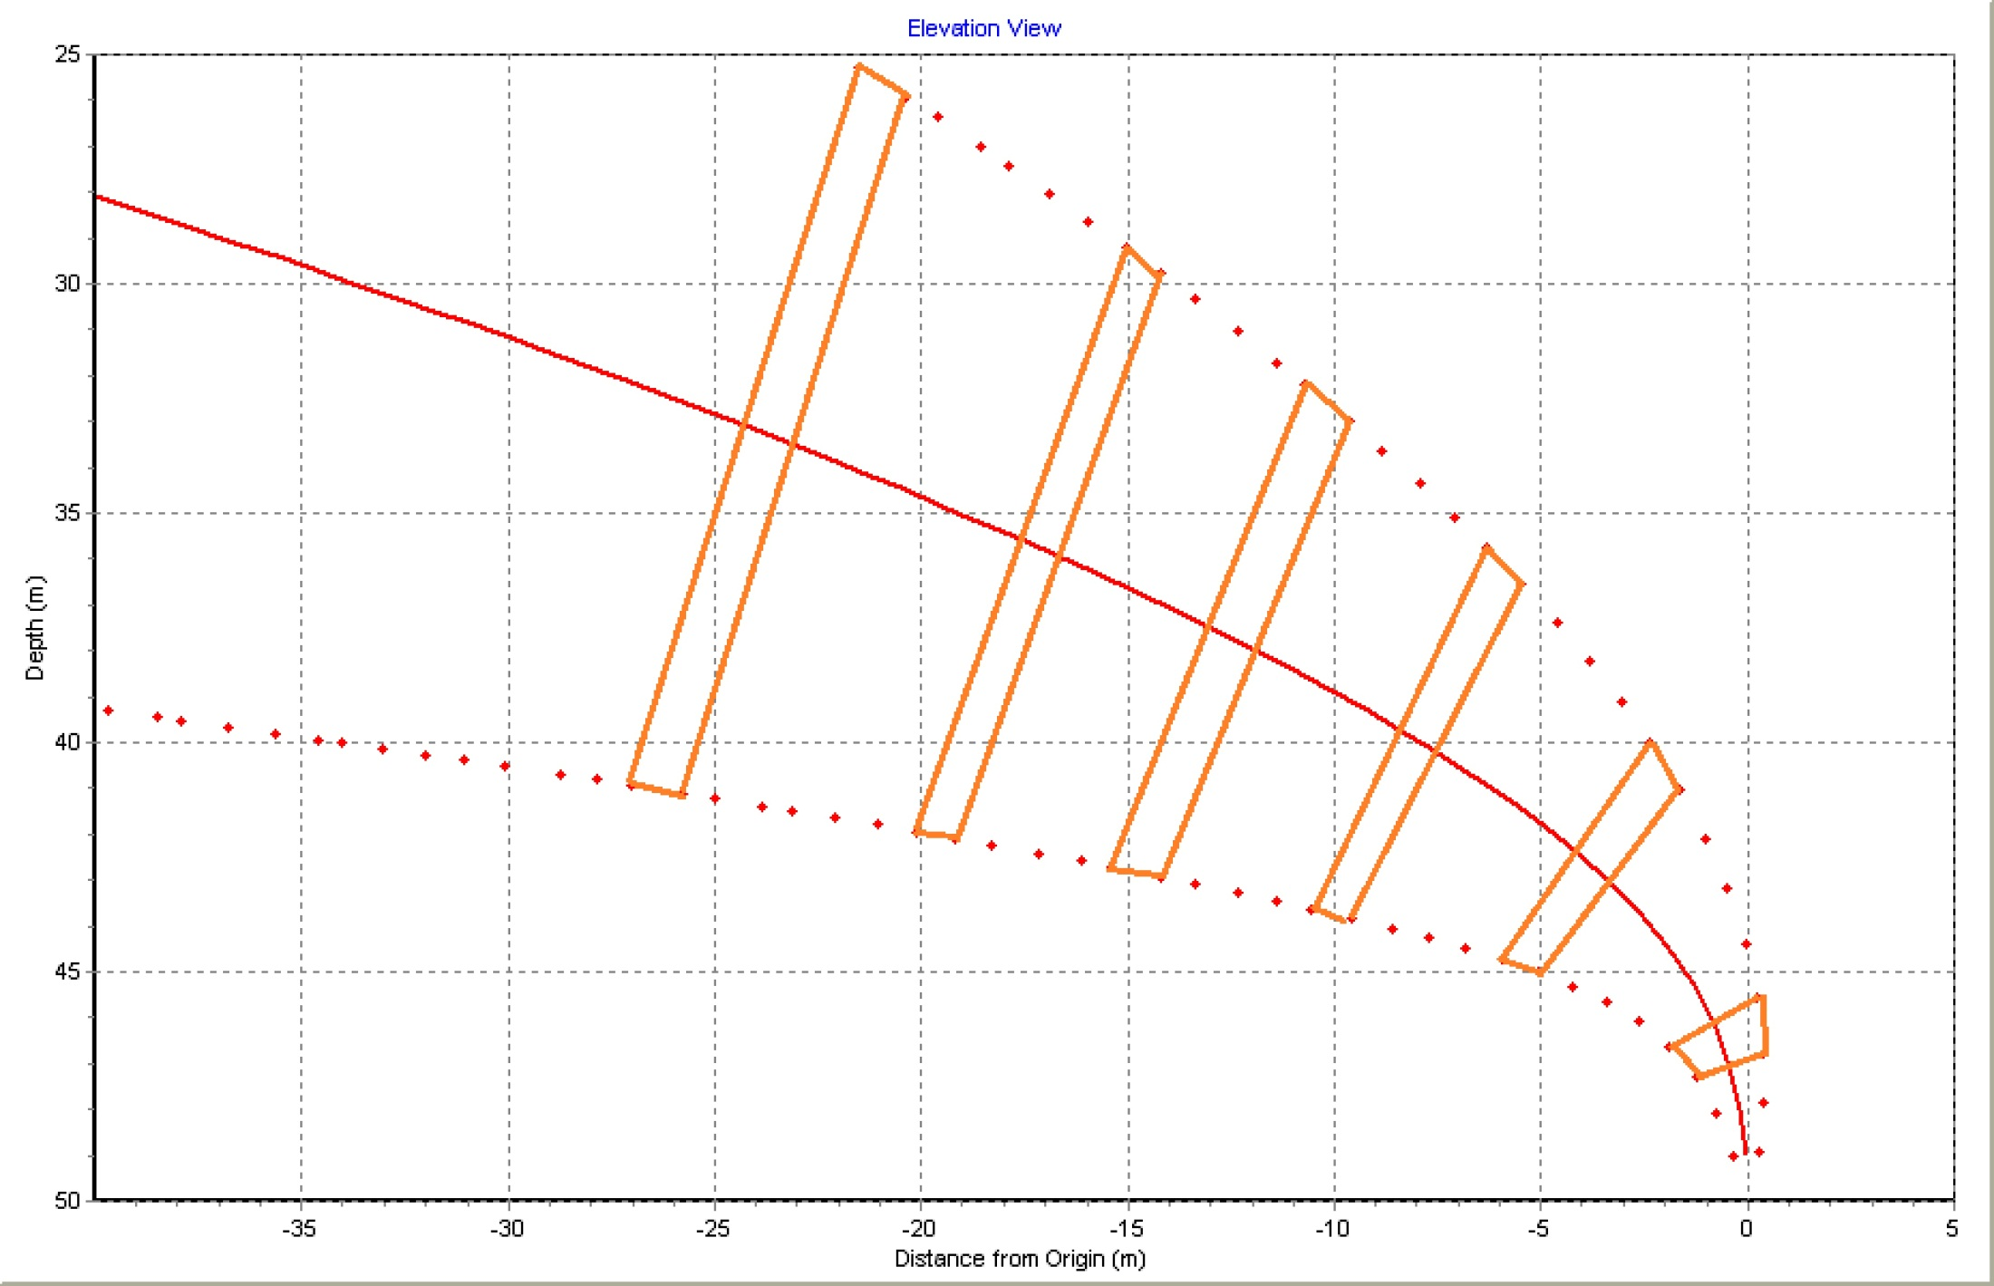

An Eulerian simulation
“stacking” the control volumes
trajectory
distance s
An Eulerian control volume
volume “frames” are stationary
mass enters right
mass enters around edge
(entrainment)
mass exits left
ds (or Δs) ̴̴ 1.0 port dia
Mass flux increases
Notes
Notes:
This simulation is not based on actual input conditions, which are unknown. This is a crude example of similarity. The actual medium is air, the model medium is water. Input conditions were varied until a fit, relative to a common diameter, was obtained. Output was set up to plot diameters (denoted by red dots) and at constant intervals to help represent the concept of control volumes.
Shown is a UM3 simulation. UM3 was modified to output plume diameters (diameter endpoints) whenever the travel distance increased by more than the criterion distance after the previous diameter output. The apparent lengthsds of the control volumes, which should be equal, differ slightly from one control volume to the next because the integration step is variable and finite (though small). As several steps of variable size are involved between outputs, the accumulated distance varies from one cross-section to the next.
The control volume length could be varied as part of a model convergence scheme but the main idea is that the volumes are stationary with mass flux in (from the source, from the upstream control volume, or from the surroundings) or out (to enter the downstream control volume).

Slide 32
Any handy laws/rules on dilution?
  As the fluid entering the bottom of the control volume, augmented by the entrained fluid coming in from the ambient, all exits the top of the control volume we may ask:
  At some travel distance s, is dilution approximately directly proportional to the area of the cross-section of the plume?
  Yes or no?
  Other than holding the plume shape constant, the significance of steady state is a little obscure (implicit?) with Eulerian models. Does it help answer the question? More to follow.
Notes

Slide 33

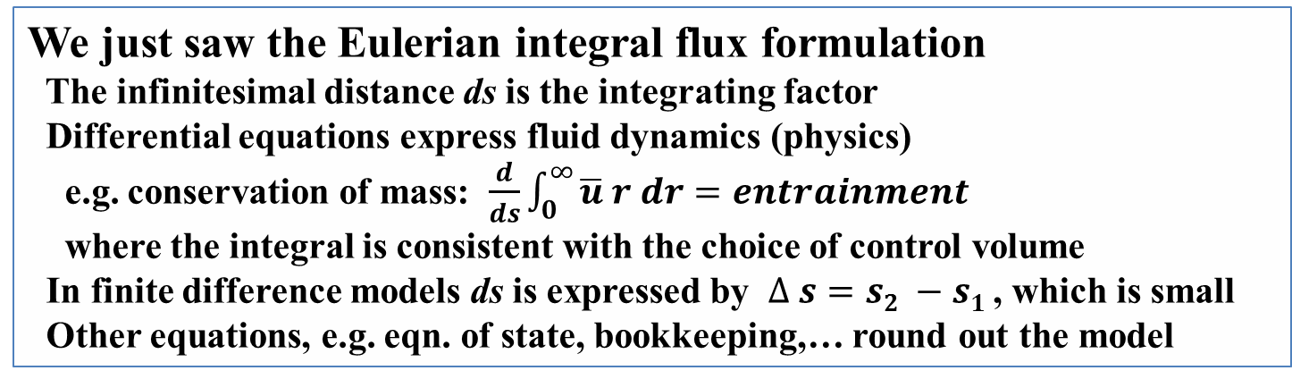
Finite difference plume model comparison
We just saw the Eulerian integral flux formulation
The infinitesimal distance ds is the integrating factor
Differential equations express fluid dynamics (physics)
e.g. conservation of mass: $\frac{d}{ds}\int_{0}^{∞}{\overline{u} r dr=entrainment}$
where the integral is consistent with the choice of control volume
In finite difference models ds is expressed by $∆ s=s2 −s1$, which is small
Other equations, e.g. eqn. of state, bookkeeping,… round out the model
With the Lagrangian integral flux formulation we will find
The infinitesimal time dt is the integrating factor
The control volume is called the plume element
It is a material (coherent) element
Again, differential equations express fluid dynamics (physics)
e.g. conservation of mass: $\frac{dm}{dt}=entrainment$
where $m= ρ_{plume element} {vol}_{plume element}$
In finite difference models dt is expressed by $∆ t=t2 −t1$, which is small
Again, other equations, e.g. eqn. of state, bookkeeping,… round out the model
Notes
Notes:
The DOS Plumes manual covers the Lagrangian theory in some detail. The first journal article to outline the complete plume theory (excluding merging and other out of scope complications) was published in 1984. The finite-difference model, which is very useful for understanding the practicalities of numerical modeling of this type, is found in EPA-600/3-76-100 (Cooling tower plume model), 1976.

Slide 34
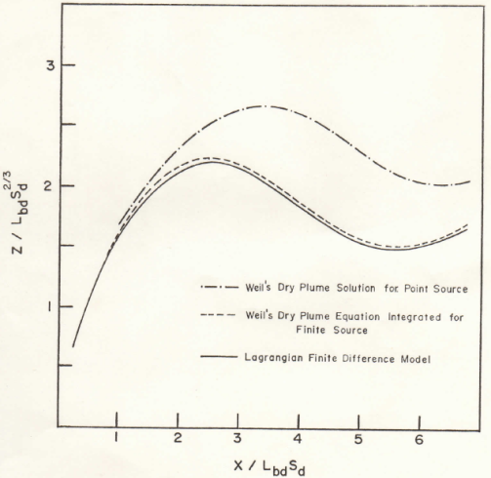
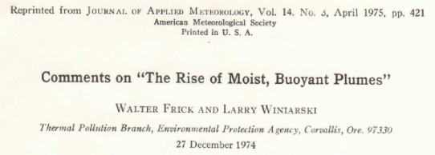
Replication: proving the Lagrangian model
Eulerian plume models came first (Fan 1967, Weil 1974….)
Late to the party, when Winiarski & Frick developed the Lagrangian plume model formulation they set out to prove its equivalence to the Eulerian formulation
This was successful given the same assumptions: a round plume, steady state, equations of state,….
The proof was published and clarified the initial conditions of Weil’s Eulerian plume model integration (upper and middle traces).
Notes
Notes:
Presumably no Eulerian modeler has to prove equivalence with the Lagrangian formulation ☺

Slide 35
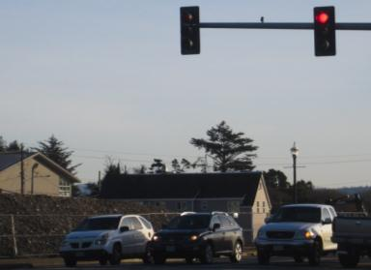
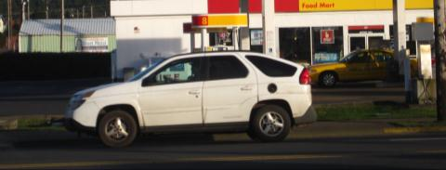
steady state leads to bonus ? answer
  Two cars stopped, after they start how far apart are they when they reach the open road traveling, say, 60mph (88fps)?
  Car 1!!
  Car 2
  Car 2
  Car 1
  Trick question, we don’t know the answer. However, we would if (1) we knew the time between Car 1 and Car 2 starting, and,
  (2) both drivers drove identically (same time history, steady state).
  E.g., if they started 1.00sec apart, they would always be 1.00sec apart, which translates to 88ft at 60mph, 44ft at 30mph, etc.
Notes
Notes:
Actually, a more useful analogy to plumes would be two cars possessing the same speed as they pass through the light but car 2 passing that point one second behind car 1. If they practice the same driving pattern (steady state) their distance apart will either increase or decrease depending on whether they speed up or slow down down the road.
Now you know why trucks are usually closer together on steep grades. They may be spacing themselves, say, 2 seconds apart.

Slide 36
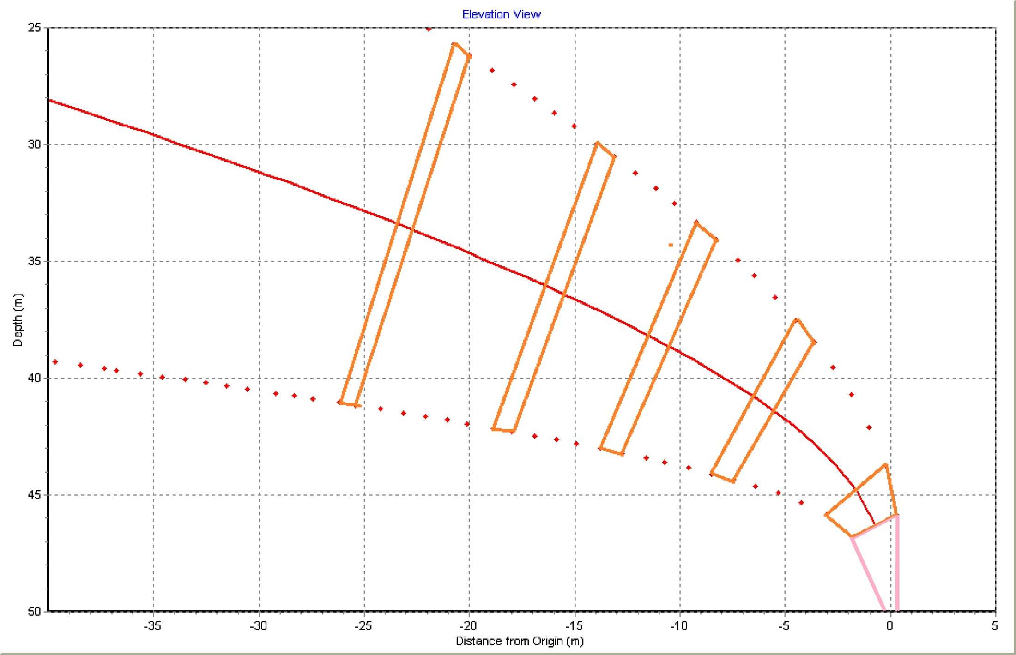


Lagrangian plume element
Lagrangian material elements trace through time, all contain the same effluent they had at age 0
Here, dt = t_{lead} – t_{trail} = 4sec
Element age (r to l):
0, 4, 24, 44, 64, and 94 sec
Cross-section round….
Length (h) is variable, WHY?
h(t=24)
h(t=4)
h(t=0)
Notes
Notes:
In Lagrangian theory all the material in the plume element at its inception remain in the plume element. In this sense it is a material element. Its increase in volume is due to entrainment plus changes in density that come about from water’s density non-linear response to salinity and temperature.
As the leading and trailing faces occupy position a given amount of time different in age, h = (instantaneous speed)(t₂-t₁). Given steady state, the height h is a only a function of the instantaneous speed because t₂-t₁) is constant while steady state is maintained.
Actual plume elements are shorter, exaggerated here for instructional purposes. In initializing conditions UM3 sets h(0) to one-tenth of the initial diameter. The initial time step (Δt)_{o} is correspondingly small.

Slide 37
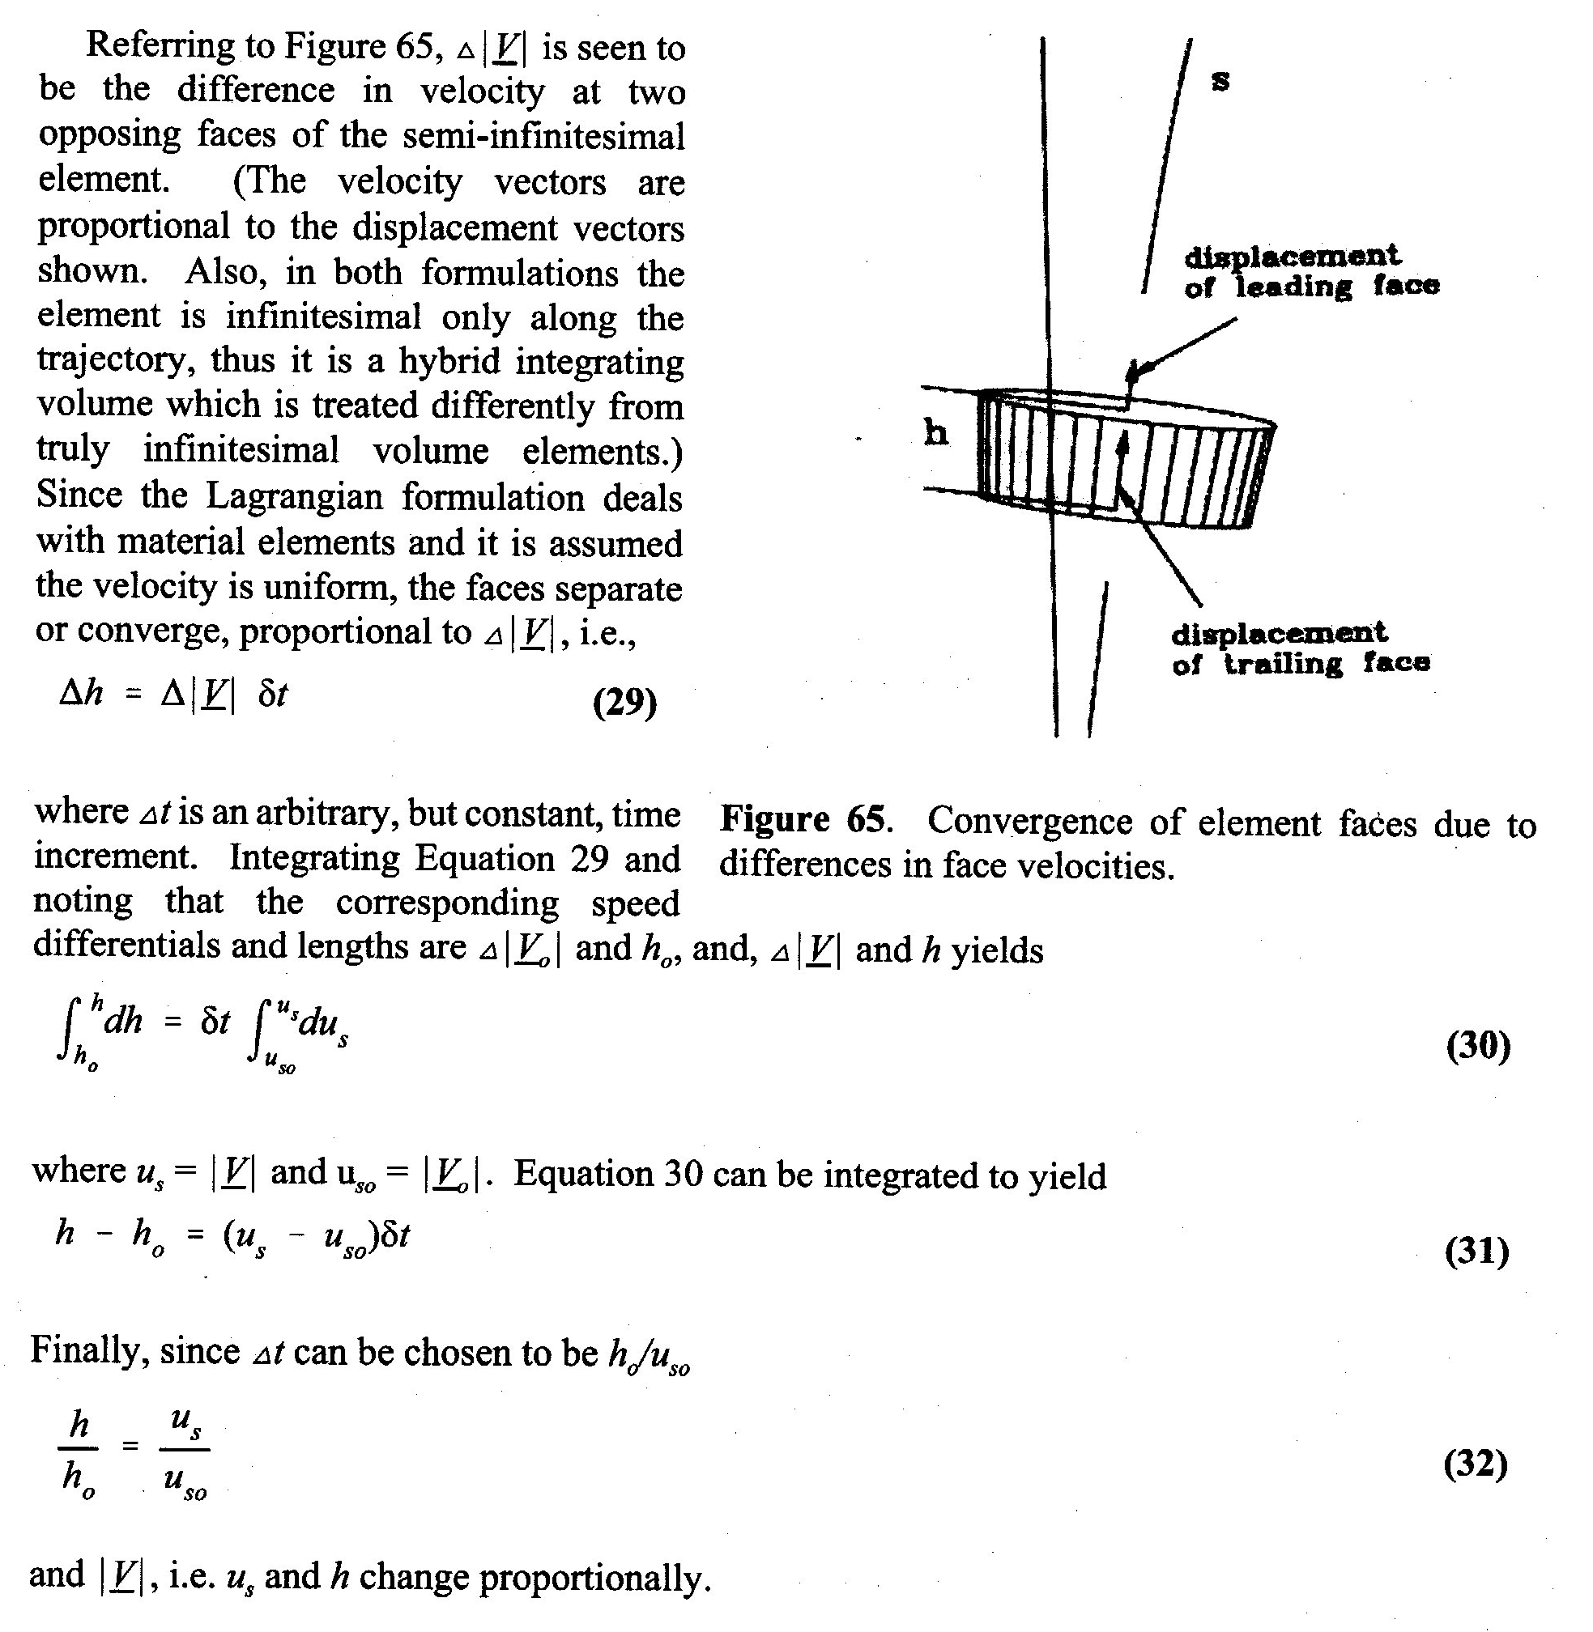
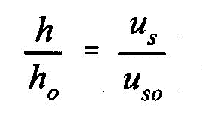
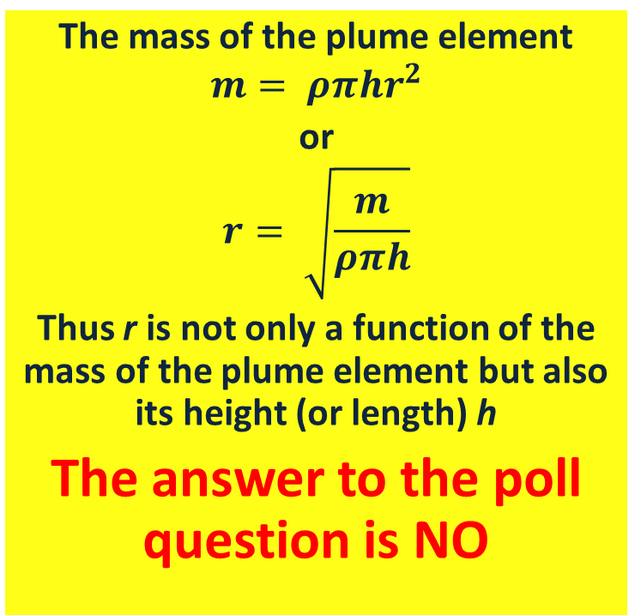
Steady state and plume element length, h; the “free” equation gives the answer
Eulerian pl
The mass of the plume element
$$m= ρπhr^{2}$$
or
$$r= \sqrt{\frac{m}{ρπh}}$$
Thus r is not only a function of the mass of the plume element but also its height (or length) h
The answer to the poll question is NO
Notes
Notes:
This effect is sometimes referred to as the “jelly sandwich” equation. Squeeze both ends and the diameter increases. Pull both ends outward, like bellows, and the diameter decreases. This is in the absence of entrainment, which may mask some of the jelly-sandwich effect.

Slide 38
Corollaries (bonuses)
A plume discharged to high current will be thin
(Dye studies in high current areas will have trouble finding the plume)
A plume discharged to low current will be fat, surface hit issues
The “free” equation completes the equivalence with the Eulerian formulation
Explicit with UM3, these truths are implicit in the Eulerian models

Slide 39
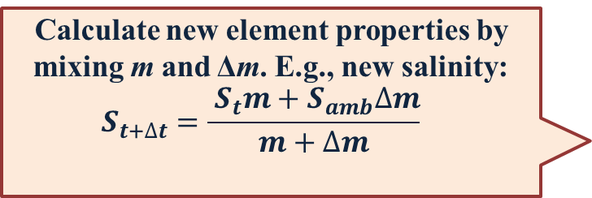
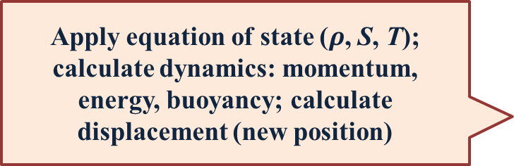
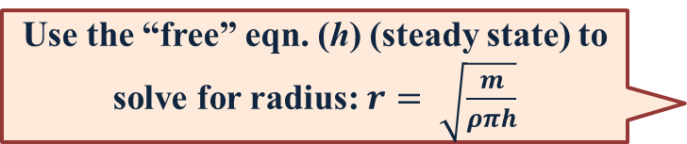
UM3 skeleton or flow chart
Define initial conditions (IC): element mass m, properties (temperature T, salinity, time, position…), radius r, and, of course, h (or h_{o}) and Δt
Define boundary conditions (BC): ambient properties (temperature T, salinity, current, concentration, decay), stratification of properties
Begin model loop
Bookkeeping: interpret and interpolate the ambient array of properties
Calculate Δm, the mass entrained into the plume element in the time step Δt. Requires an entrainment function
Calculate new element properties by mixing m and Δm. E.g., new salinity:
$$S_{t+∆t}={\frac{{ S}_{t}m+S_{amb}∆m}{m+∆m}}_{}$$
Apply equation of state ($ρ$, S, T); calculate dynamics: momentum, energy, buoyancy; calculate displacement (new position)
Use the “free” eqn. (h) (steady state) to solve for radius: $r= \sqrt{\frac{m}{ρπh}}$
More bookkeeping, like output.
Finally, return to the beginning of the model loop

Slide 40

The name of the game: entrainment
Considering that identical assumptions result in Eulerian integral flux and Lagrangian model equivalence, what sets integral models apart are the assumptions (if the underlying assumptions are different)
  entrainment hypotheses (functions)
  numerical convergence scheme
  ancillary capabilities like plume merging and treatment of surfaces
  Facilities: unit conversion, time-series input, and other capabilities or constraints
  Given the assessment satisfies the underlying assumptions used in model development (viz. deep water and steady state) the entrainment functions deserve the greatest attention.

Slide 41
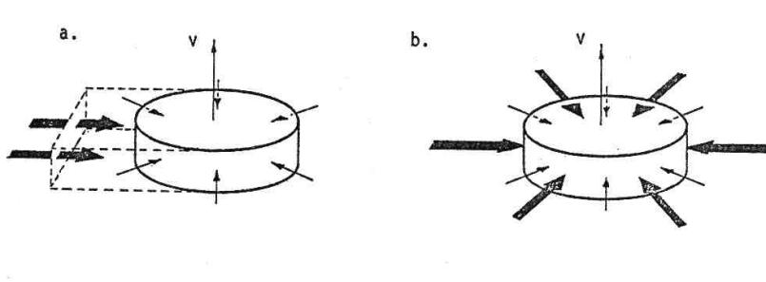
Early entrainment conception
historical context
a) forced entrainment due to current (more next 3 slides)
b) aspiration entrainment due to suction: this mechanism is due to the Bernoulli effect; the inflow velocity is proportional to the surface area of the element and the velocity shear between the average plume element velocity and the ambient velocity; it is governed by an adjustable aspiration entrainment coefficient

Slide 42
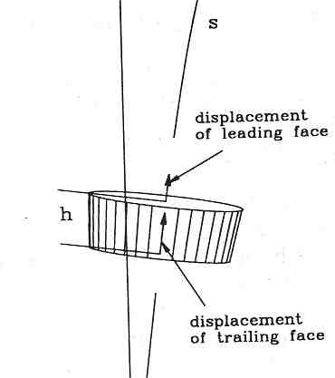
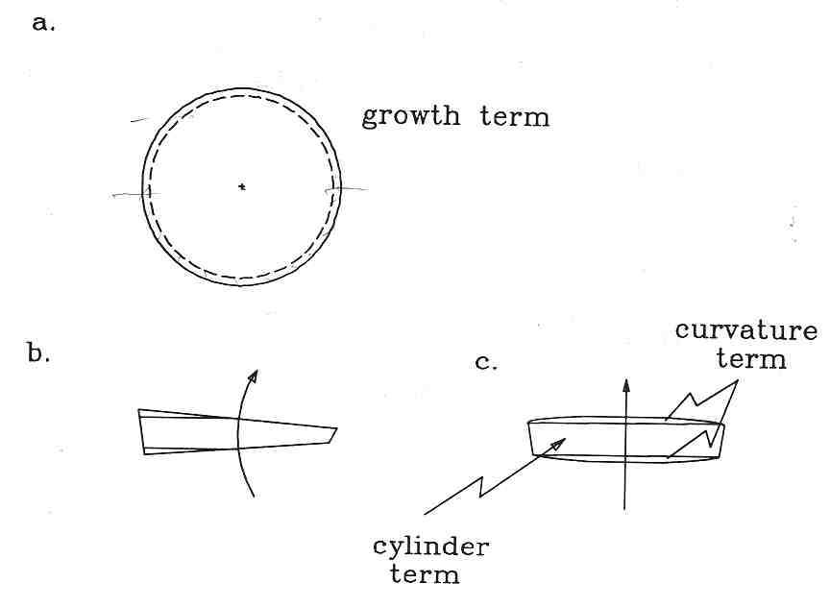
Projected Area Entrainment (PAE)
Perspective and three orthogonal views of the plume element as conceived in UM3
(in a. it’s the area of the ring)
The PAE hypothesis postulates forced entrainment =
(ambient density)*( current)*(total area projected to the current)
Total projected area of the plume element (3D conception) =
(a) growth + (b) cross-flow + (c) cylinder and curvature
The PAE hypothesis appears to require no adjustment; the coefficient is 1.0.

Slide 43
Follow science for the answer--yes, but…
  Before recognizing the significance of steady state (aka jse)
  Developing the Lagrangian “pre-UM3” from scratch took about a year.
  ?About how many entrainment assumptions/hypotheses did W&F try in the effort to obtain good fit to Fan’s data?
  1, 2, 5, 10, 20, 50?
  ?After adding the “free” equation for plume element length, how many revisions before formulating the forced entrainment equation as a function of r, h, and θ?
  1, 2, 5, 10?
Notes
Notes:
Understanding the significance of the steady state assumption ultimately lead to a completely new conception of the plume element. The right-cylinder tuna can was replaced by a section from a bent cone. The trick became to accurately derive the projected area of the plume element’s surface as a function of r, h, and θ, the trajectory inclination angle to the horizontal axis.
First assuming that the plume element height (h) was constant (the “tuna can,” right cylinder conception of the Lagrangian plume element) Winiarski and Frick formulated about 20 different entrainment functions, some leading to fabulous, but wrong, solutions, like blowing up.
After suspecting that perhaps h could not be assumed constant, W&F rather quickly formulated the current expression for forced entrainment, probably less than 5. First, an examination of Fan’s dilution and radii data confirmed that they were not directly proportional or linearly related. Something like the car analogy, followed by the rigorous integration found in the DOS Plumes manual, was then used to develop the “free” equation for h.
UM3 equations are based on the “top hat” assumption, that plume properties are average values when it comes to expressing the equations of motion. This is an idealization, obviously plume centerline properties are different from edge properties. In omitting a pressure force on the plume, they reasoned that plume properties “feathered” into ambient properties at the plume’s edge, hence no pressure force as would be experienced by a solid object.

Slide 44
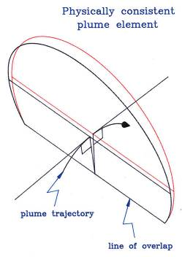
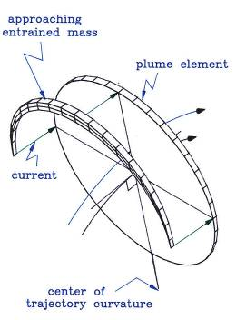
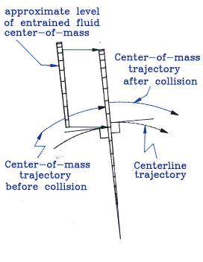
Dream model element & entrainment
Wedge shape and overlap (left)
The concept of all approaching ambient fluid being captured by the plume element (middle and right)
Notes
Notes:
Dream model consider mass distribution about the center of mass (not the center of the cross section). Overlap is dealt with explicitly.
Schematic diagrams illustrating details of plume merging theory; the plume element as a wedge-shaped, overlapped entity; mass about to collide with the plume to become entrained mass—part of the plume.

Slide 45
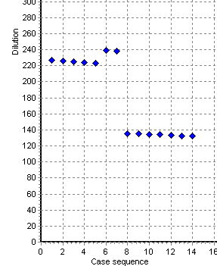
Model convergence scheme discontinuity
Differential equations (DE) express changes with time or distance
that cannot be solved exactly (analytically).
Solving stiff equations means, in UM3, a new Δt = t₂ – t₁ each step
UM3: Δt changes gradually & smoothly
DKH: Δs changes relatively larger
2.5” ports
3.5” ports
Figure: Two diffuser sections. Each of the 6 dilution estimates correspond to port spacing varying from 3.66 to 3.565m, very little. Between 3.570 and 3.565m the predicted DKH dilution increases over 8%.
Which side of the discontinuity has the more accurate solution?
Notes
Notes:
Differential equations (DE) express changes with time or distance
Usually the changes are smooth and continuous
The plume DE can not be solved analytically
The DE must be solved numerically: a finite difference approach
For the Lagrangian model the infinitesimal integrating factor like dt is replaced by Δt: t₂ – t₁
For the Eulerian integral flux the infinitesimal integrating factor ds is replaced by Δs: s₂ – s₁
The numeric integration is stepwise
If Δt or Δs are too large the solution diverges from the true solution
because the Δt or Δs too crude to capture rapid changes
If Δt or Δs are too small the solution diverges from truncation errors
The plume equations are sometimes called stiff:
at first Δt or Δs must be tiny but if constant truncation errors build up
Convergence schemes are needed, for example, dt must increase as the plume solution develops
Good increase schemes for Δt or Δs yield solutions that converge
Crude schemes cause divergence or quantum jumps, i.e., a tiny change in current angle will cause a not insignificant change in dilution prediction simply because the integrating factor adjustment was too coarse.
UM3 is very continuous

Slide 46
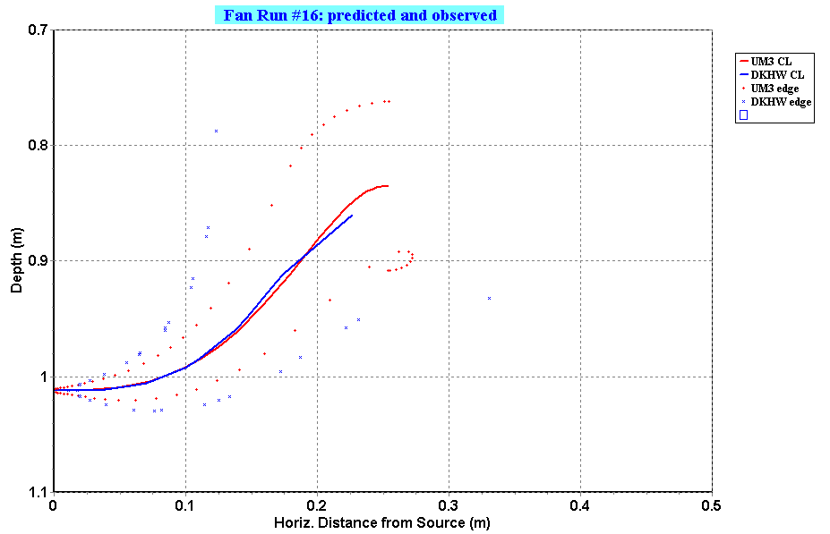
Model comparison example: 1-port
Fan Run 16 input; DKHW (blue) and UM3 (red) simulations. Stagnant, density stratified environment.

Slide 47
VP verification example
Same input as previous slide. VP allows input from text files, a capability used to show the experimental plume trace.

Slide 48
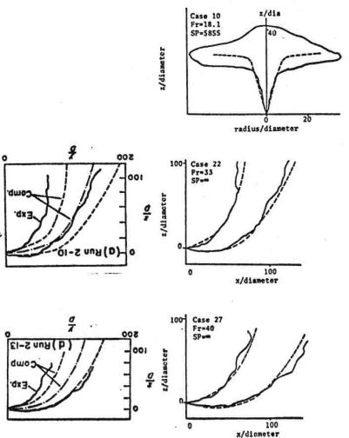
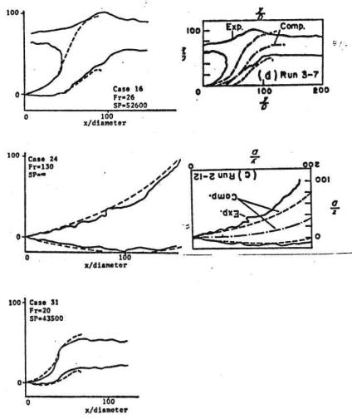
Example UM3 verification
Six center panels, UMERGE (UM3 predecessor) model predictions. Schatzmann’s multi-parameter model predictions in margins. Data from Fan, 1967.

Slide 49
Preface to the live demonstration

Slide 50
Fan 16 diffuser tab
menus, buttons
Active tabs
Project title
set tab jump
configure models
space for project notes
Ambient file list
(one shown,
r-click menu)
selected model
run scheme
adjust units
click unit for menu
selected case and input
diffuser table
show parameters
click in time-series files

Slide 51
Fan 16 diffuser tab
menus, buttons
Active tabs
extrapolation modes
select units
run active model
sparse input
sparse input
Ambient file list
ambient table
file redirection
click in time-series files

Slide 52
Fan 16 settings tab
text output appearance
context sensitive cells
parameter settings
Sub-model selection
active output variable list
output variable selection
reserved
graphics control
contour concentration
UM3 settings

Slide 53
Fan 16 text output tab, UM3
data post process options
model ID, case #, project ID
ambient table
diffuser and effluent echo
initial dilution simulation
endpoint notes
Dilution factor
far-field simulation if Brooks far-field algorithm linkage is set

Slide 54
Fan 16 text graphics tab, UM3
4-panel view
elevation view
plume & density stratification
2-click in margins for graph settings
clear modes
4-panel or endpoint grahps
plan view
dilution or effective dilution graphic
Color
auto scale
line thickness
save to file
Import data

Slide 55

After Fan data import
4-panel view
New trace in black
New trace in black
Text file dialog
Import data

Slide 56
Flat data text file
side view
0.0001 1.0145
0.0068 1.0157
0.0149 1.0158
0.0197 1.0161
0.0264 1.0159
0.0339 1.0164
0.0423 1.0182
0.0491 1.0191
0.0565 1.0180
0.0638 1.0180
0.0676 1.0186
0.0776 1.0177
0.0830 1.0169
0.0912 1.0146
0.1000 1.0118
0.1084 1.0100
0.1155 1.0053
0.1181 1.0024
0.1236 1.0003
0.1285 0.9976….
0.4373 0.8854
0.4468 0.8878
0.4047 0.7966
0.3985 0.7965
0.3920 0.7966
0.3855 0.7961
0.3800 0.7961
0.3723 0.7958
0.3651 0.7943
0.3581 0.7932
0.3536 0.7918
0.3477 0.7923
0.3420 0.7927
0.3353 0.7920
0.3286 0.7884
0.3254 0.7864
0.3211 0.7843
0.3169 0.7831
0.3116 0.7834
0.3077 0.7838….
0.0485 0.9988
0.0411 1.0011
0.0343 1.0028
0.0273 1.0065
0.0212 1.0084
0.0168 1.0095
0.0099 1.0114
0.0042 1.0126
-0.0001 1.0124
density profile
17.3 0.0
25.2 1.0
Key words to indicate elevation view
blank line to lift pen
plume outline
x-y coordinates
Key words to indicate density panel
plume density
coordinates
VP manual has detail
….omitted data (notes)
Notes
Notes:
side view
0.0001 1.0145
0.0068 1.0157
0.0149 1.0158
0.0197 1.0161
0.0264 1.0159
0.0339 1.0164
0.0423 1.0182
0.0491 1.0191
0.0565 1.0180
0.0638 1.0180
0.0676 1.0186
0.0776 1.0177
0.0830 1.0169
0.0912 1.0146
0.1000 1.0118
0.1084 1.0100
0.1155 1.0053
0.1181 1.0024
0.1236 1.0003
0.1285 0.9976
0.1336 0.9924
0.1391 0.9854
0.1420 0.9819
0.1482 0.9789
0.1543 0.9758
0.1585 0.9709
0.1642 0.9662
0.1709 0.9600
0.1773 0.9530
0.1835 0.9500
0.1889 0.9468
0.1950 0.9400
0.1999 0.9343
0.2023 0.9303
0.2092 0.9261
0.2168 0.9239
0.2253 0.9205
0.2327 0.9173
0.2385 0.9114
0.2422 0.9049
0.2431 0.9019
0.2478 0.8989
0.2504 0.8942
0.2550 0.8907
0.2615 0.8878
0.2684 0.8849
0.2777 0.8826
0.2865 0.8804
0.2968 0.8786
0.3072 0.8770
0.3134 0.8768
0.3239 0.8781
0.3308 0.8799
0.3395 0.8789
0.3428 0.8777
0.3528 0.8789
0.3616 0.8796
0.3701 0.8795
0.3777 0.8792
0.3876 0.8796
0.3947 0.8796
0.4032 0.8812
0.4095 0.8827
0.4193 0.8832
0.4288 0.8831
0.4373 0.8854
0.4468 0.8878
0.4047 0.7966
0.3985 0.7965
0.3920 0.7966
0.3855 0.7961
0.3800 0.7961
0.3723 0.7958
0.3651 0.7943
0.3581 0.7932
0.3536 0.7918
0.3477 0.7923
0.3420 0.7927
0.3353 0.7920
0.3286 0.7884
0.3254 0.7864
0.3211 0.7843
0.3169 0.7831
0.3116 0.7834
0.3077 0.7838
0.3027 0.7849
0.2977 0.7858
0.2934 0.7868
0.2899 0.7850
0.2864 0.7830
0.2838 0.7826
0.2791 0.7826
0.2762 0.7826
0.2739 0.7804
0.2674 0.7762
0.2626 0.7728
0.2568 0.7707
0.2507 0.7673
0.2435 0.7646
0.2351 0.7643
0.2262 0.7635
0.2165 0.7647
0.2086 0.7668
0.2035 0.7691
0.1999 0.7749
0.1945 0.7786
0.1870 0.7816
0.1800 0.7843
0.1714 0.7882
0.1659 0.7926
0.1586 0.7973
0.1519 0.8016
0.1441 0.8049
0.1376 0.8078
0.1293 0.8107
0.1184 0.8134
0.1097 0.8153
0.1020 0.8166
0.0942 0.8172
0.0847 0.8176
0.0769 0.8193
0.0672 0.8201
0.0595 0.8228
0.0514 0.8216
0.0457 0.8208
0.0408 0.8236
0.0338 0.8266
0.0291 0.8284
0.0199 0.8291
0.0170 0.8577
0.0212 0.8574
0.0278 0.8569
0.0358 0.8608
0.0459 0.8615
0.0530 0.8605
0.0630 0.8591
0.0726 0.8601
0.0808 0.8641
0.0884 0.8705
0.0953 0.8736
0.1012 0.8759
0.1061 0.8820
0.1100 0.8908
0.1105 0.8977
0.1100 0.9073
0.1101 0.9118
0.1111 0.9166
0.1123 0.9216
0.1124 0.9236
0.1100 0.9304
0.1073 0.9380
0.1026 0.9464
0.0997 0.9524
0.0962 0.9597
0.0924 0.9673
0.0839 0.9769
0.0777 0.9828
0.0693 0.9870
0.0624 0.9920
0.0541 0.9959
0.0485 0.9988
0.0411 1.0011
0.0343 1.0028
0.0273 1.0065
0.0212 1.0084
0.0168 1.0095
0.0099 1.0114
0.0042 1.0126
-0.0001 1.0124
density profile
17.3 0.0
25.2 1.0

Slide 57

Multi-run example
Dominguez Channel
Project map
Channel

Slide 58

Tidal Channel Excursion

Slide 59

Time-Series Approach output
Time-series, another VP graph option

Slide 60
Maximum Impact
Surface temperature elevation hot spot

Slide 61
Summary
Verification? Verifying the verifier.

Slide 62


Simulating merging with UM3
An example of additional model capabilities
When neighboring plumes merge, the mass is shifted in a direction perpendicular to the axis of the wastefield
This is known as the reflection technique
UM’s algorithm is patterned after DKHw (UDKHDEN)
In a and b, mass is conserved by this technique

Slide 63

UM3 Very Shallow Water capability
If the merging diagram is rotated 90 degrees then it is a representation for shallow water, where the bottom and surface are represented by the two planes of reflection.
The true depth becomes associated with spacing (L in the diagram), thus spacing will represent depth.
The width of the water body (river, channel) becomes associated with the depth.

Slide 64

Model limitations
Liseth experiments in zero current
Zero current worst case: viable?
Same plume in the presence of its opposite twin: “ambient” current (red arrows) is no longer zero
Single plume trajectory: ambient current = zero
When plumes aspirate they generate inflowing current nearby. Self-induced current is not addressed by VP models.
Notes
Notes:
Work done by Liseth (reference not immediately available) shows plumes generate current around themselves. Here identical single and double plumes of equal densimetric Froude are shown in two sets of experiments. It is striking how in pairs the plumes “attract” each other.

Slide 65
References and acknowledgements
To be completed…

Slide 66
Conclusions and Recommendations
Visual Plumes, model manager, native and callable (exe) models
Ease of use: sparse input, units conversion, time-series files…
Public domain, inter-model comparison
Plume morphology, steady state and the “free” equation (jse)
Strong basic physics, finite difference models, Lagrangian (UM3, native) and Eulerian (DKH, exe)
Dimensional model empirical NRFIELD, multi-port T-riser diffusers; ongoing research on dense plumes
Linkage to Brooks far-field equations
DOS Plumes: legacy UM and RSB, similarity parameters, Very Shallow Water (VSW) technique and Cormix classes
Extensive guidance, DOS and Visual Plumes
Mixing zone course documentation (Frick et al. 2005) illustrates the use of the PDS as well as the other models

Slide 67
Conclusions and Recommendations continued
Visual Plumes has capabilities and flaws
Can operating system problems be solved?
Resources
Can progress be propagated?
Diversity is honesty
Answers meaningful in conflicting contexts
Progress more certain
Replacing VP? Inevitable
User facilities, physics, multi-model, partnership…. A concept worth improving and refining
Thank you

Slide 68

L.N. Fan Run 16
Co-flow

Slide 69

Fan Run 16 data

Slide 70

Fan Run 16 VP input

Slide 71
Worst Case
Co-flow conditions are not generally worst case for multi-port diffusers
  Current direction is important
Integral models should account for variable plume spacing
Existing models sometimes can be used in a way to compensate for these deficiencies where they exist:
  As in DOS Plumes, input reduced spacing instead of port spacing
  Post-process output to determine dilution at the point of plume impact
And, not explicitly addressed here, the plume centerline should not be used to determine when plumes surface (rather the plume edge)
Also, if using weighted average dilution as a measure of overall diffuser performance, merged plumes should be considered in aggregate
VP provides a time-series capability useful for better identifying worst-case conditions
Bonus slide

Slide 72

Vector Lagrangian model:
Mathematical and Physical necessities
UM3 simulates the overall “average behavior” of the plume along the plume trajectory
Wire frame depiction conforms roughly to the idea or the shape of the plume element
However, the equal spacing between cross-sections does not conform to maintaining only effluent particles in the plume element defined at the source
Typically plume effluent velocities exceed current velocities and hence the plume element tends to decrease with distance from the source
  This implies the leading edge of the element has a lesser velocity than the trailing edge
  By mass continuity, the plume element radius grows from this velocity convergence (the jelly-sandwich equation)
Bonus slide
EPA Modeling Webinar, Jan 2013

