Slide 1
What to look for when reviewing a Mixing Zone Study in WA
EPA Mixing Zone Webinar Workshop Series
January 22-24, 2013
Instantaneous snapshot
Time average image
Based on: Phil Roberts, Georgia Tech, 2003
Anise Ahmed, Ph.D., P.E.

Slide 2
How dilution is defined in WA?
Fraction of effluent at any location:
Volumetric Dilution factor:
Concentration based dilution factor:

Slide 3
Mixing Zones in WA (WAC-173-201A-400)
Apply AKART prior to mixing zone authorization
Maximum size of mixing zone
Minimize mixing zones
Must prove no environmental harm
Consider critical conditions

Slide 4
Other Mixing zone regulations
Overlapping mixing zones
Extended mixing zones
Mixing zones for stormwater
Mixing zones for CSOs

Slide 5
Mixing zones and 303(d) listing
Cannot authorize discharge that contributes to an impairment
Mixing zone may be authorized if no impairment is found at the point of discharge
Discharge generally not OK
OK if no further impairment of downstream listing
303d listing
Discharge OK

Slide 6
Mixing Zone Models used in WA
Theoretical Models
  Visual PLUMES (UM3, VSW, etc.)
  RIVPLUME
  CFD (being reviewed)
Empirical Models
  RSB (NRFIELD)
Semi-Empirical
  CORMIX

Slide 7
Mixing zones and impaired water
Anise Ahmed, P.E.

Slide 8
Mixing Zones Guidance in WA
http://www.ecy.wa.gov/programs/eap/mixzone/mixzone.html
The End

Slide 9
AKART
All known, available, and reasonable treatment
Similar to BAT but more restrictive, i.e. requires current reasonable technology
Dilution only allowed after AKART

Slide 10
Maximum Size: Streams
Hydraulic Limitation
Can use only max stream flow of 25% 7Q10
Distance Limitation
Chronic Zone =300 feet + d
Acute Zone = 10% of Chronic
W
≤ 25%W
diffuser
d = depth of diffuser at 7Q10
W = width of stream at 7Q10

Slide 11
Maximum Size: Estuaries
Distance Limitations
Chronic Zone = 400 feet + 2d
(not to exceed 25% of W)
Acute Zone = 10% of Chronic
W = width of waterway
Ebb
Flood
d = depth of diffuser at MLLW
W = width of waterway at MLLW

Slide 12
Maximum Size: Oceans
Distance Limitations
Chronic Zone = 600 feet + 2d
Acute Zone = 10% of Chronic
Ebb
Flood
d = depth of diffuser at MLLW

Slide 13
Maximum Size: Lakes/Reservoirs (>15 days detention)
Mixing zones not allowed unless:
  All other options are exhausted
  Overriding public interest
  Advanced waste treatment is provided
If Allowed:
  Cannot use more than 10% of waterbody volume
  Cannot use more than 10% of surface area
  Cannot use more than 15% of width of waterbody.

Slide 14
Minimize Mixing Zones
Where possible
Use less than 25% 7Q10 ambient flow
Use less than 25% stream width
Use smaller mixing zones
  < 300 feet for streams
  < 200 feet for estuaries
  < 300 feet for oceans

Slide 15
No environmental harm
No loss of sensitive or important habitat,
No interference with existing or characteristic uses of the waterbody
No resulting damage to the ecosystem
No adverse public health affect

Slide 16
Critical Conditions
Flow and Concentration
  Ambient flow
  Effluent flow
  Ambient/Effluent concentrations
Depth
Stratification
Dilution type

Slide 17
Ambient Flow
Freshwater
  Acute and Chronic …… 7Q10
  Carcinogen ……………… Harmonic Flow
  Non-Carcinogen ……… 7Q10
Saltwater
  Acute …… 10th % or 90th % current velocity*
  Chronic/ ……………… 50th % current velocity*
  Carcinogen/
  Non-Carcinogen
  * Evaluated over a spring and neap tide

Slide 18
Effluent Flow
Acute … highest daily Q_{max} in last 3 years
Chronic/Non-Carcinogens … highest monthly Q_{avg} in last 3 years
Carcinogens … Annual Average Flow
Stormwater (Western WA):
  Acute …… 1-hour peak flow from 2-yr 6-hr storm event
  Chronic ..... Average flow from 2-yr 72-hr storm event
Intermittent flow:
  Estimate DF using Q_{max}
  Increase DF by (Q_{1-hr avg}/Q_{max}) for acute
  Increase DF by (Q_{4-day avg}/Q_{max}) for chronic

Slide 19
For Estimating Volumetric Dilution Factor
Ambient Concentration:
  Assume zero when no reflux
  If reflux is present use reflux as ambient
Effluent Concentration:
  Assume 100% or 100 ppm

Slide 20
For Reasonable Potential Calculation
Ambient concentration (Ca)
  Acute/Chronic …. 90th or 10th percentile
  Carcinogen/ ……………… Geometric Mean
  Non-Carcinogen
Effluent concentration (Ce)
  (Acute/Chronic): Cmax x F*
  (Carcinogen and non-): C₅₀
  * uncertainty factor => based on number of samples, CV, and confidence interval (EPA, TSD, Table 3-1, 3-2)

Slide 21
Depth
Freshwater
  Acute and Chronic …… at 7Q10
  Carcinogen ……………… at Harmonic Flow
  Non-Carcinogen ……… at 7Q10
Tidally influenced Freshwater
  Same as above but at MLLW
Marine waters
  At MLLW

Slide 22
Stratification
Use density profile that gives the least mixing
Evaluate both:
  maxium stratification (largest differential in sigma-t values)
  minimum stratification (smallest differential in sigma-t values)
Human Health
  Use average of maximum and minimum

Slide 23
Dilution Type
Unidirectional flow:
  Acute and Chronic …… Centerline
  Human Health …… flux average
Marine and rotating flows:
  Acute and Chronic/ …… Flux average
  Human Health

Slide 24
Overlapping Mixing Zones
Allowed where:
Combined size meets the maximum mixing zone size limitations
No barrier to migration of indigenous organisms with potential for ecosystem damage

Slide 25
EXTENDED MIXING ZONES
May be considered for:
Discharges existing prior to 1992
Where altering the size increases protection
Where volume of effluent is more beneficial than removing the discharge.
Necessary for social or economic development in the area.

Slide 26
Mixing zones for Stormwater
Maybe granted exemption from size limitations if:
All BMP’S have been applied
No potential threat to
  Sensitive habitat and ecosystem
  Public health
  Beneficial uses
No barrier to migration of indigenous organisms with potential for ecosystem damage

Slide 27
Mixing zones for CSO’s
Must comply with all mixing zone requirements
But, exempt from size criteria once a year provided “no environmental harm” clause is fulfilled

Slide 28
UM3
Simulates 3D plume trajectory
Predicts centerline based on 3/2 power (~gaussian) profile and top-hat (average) concentrations
Merging simulated with reflection technique
Does not directly resolve lateral or bottom boundary constraints

Slide 29
VSW
Same as UM3 but applied to very shallow waters (water depth ≤ 3 pipe dia)
Resolves bottom constraint (bottom hit) by reflection technique

Slide 30
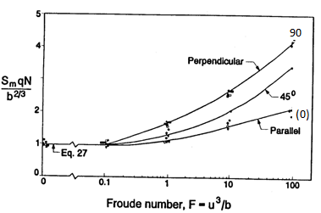
RSB….”range of experiment”
  Straight diffuser, uniformly spaced round ports on T-risers, horizontal ports in marine waters with plumes merging rapidly with length scale ratios:
S = port spacing;
lb = relates buoyancy per unit diffuser length to brunt Vaisala density frequency;
lm = relates momentum to density per unit length

Slide 31
CORMIX
CORMIX 1 single port positive/neutral buoyant discharges
CORMIX 2 multiport positive/neutral buoyant discharges
  Uses “equivalent slot diffuser”
  May need CORMIX1 if plume details near each port are desired
CORMIX 3 buoyant surface discharge

Slide 32
RIVPLUME (based on Fischer et al. 1979)
Single port, short diffuser, or bank discharge
Plume completely and rapidly vertically mixed within the acute zone. So a 2-D model
Uses mean cross-sectional velocity
It incorporates boundary effects of shoreline through superposition
Cannot model ambient density stratification, dense plumes or tidal buildup

Slide 33
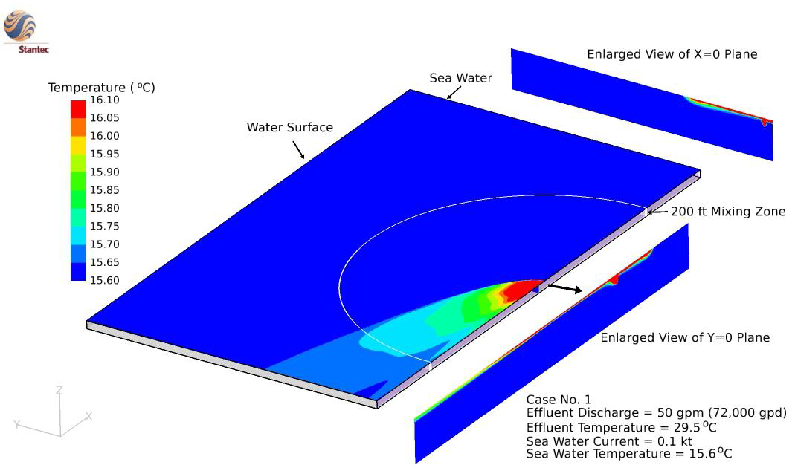
CFD (Computational Fluid Dynamics)
Mesh = 2.5 million grid cells (600 ft by 300 ft)
Courtesy: Dr. Lin Fangbiao, Stantec Corporation

