Slide 1

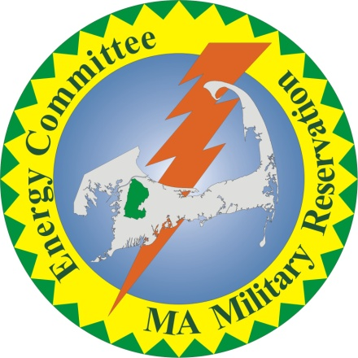
Energy Initiatives at Joint Base Cape Cod (JBCC)

Slide 2
The Massachusetts Military Reservation (MMR) was recently renamed as Joint Base Cape Cod (JBCC)
JBCC covers 22,000 acres on the Upper Cape and is approximately 10% of Cape Cod’s land mass
Main agencies include:
USCG Air Station Cape Cod
Otis ANG Base, 102nd IW
Camp Edwards Army National Guard
6th Space Warning Squadron, Cape Cod Air Force Station (PAVE PAWS radar)
Veterans Affairs National Cemetery

Slide 3
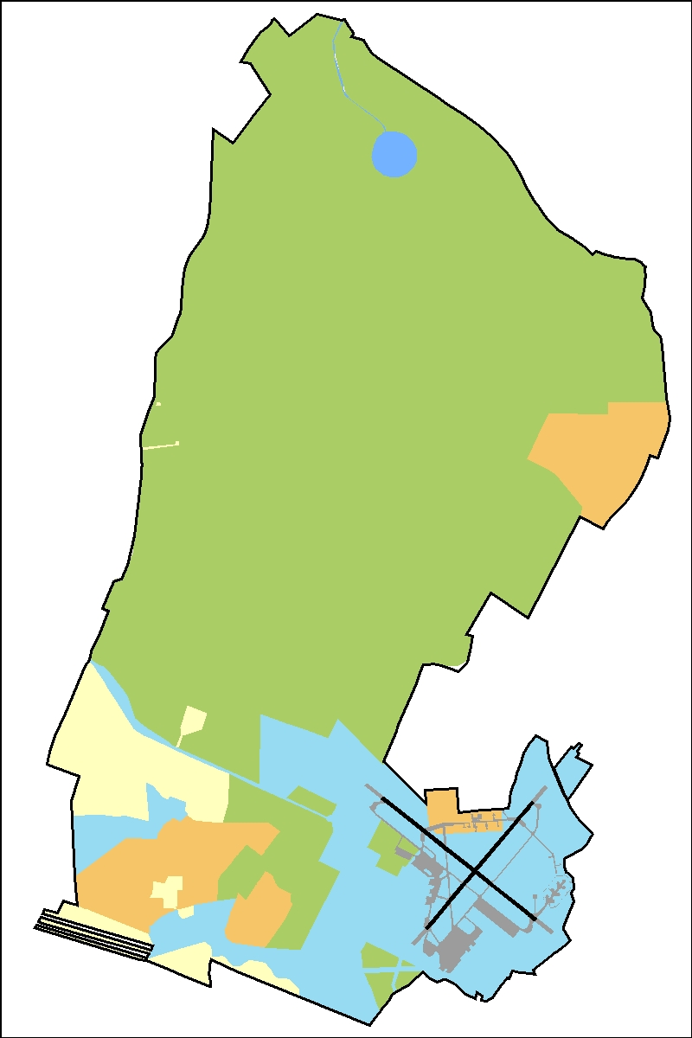
MULTI-USE FACILITY
Veterans Administration National Cemetery
Barnstable County Sheriff’s Office / Correctional Facility
6th Space Warning Squadron PAVE PAWS
U.S. Department of Agriculture
Massachusetts Environmental & Readiness Center
U.S. Army Environmental Center Impact Area Groundwater Study Program
Air Force Civil Engineer Center Installation Restoration Program
253rd Combat Communications Group
267th Combat Communications Squadron
U.S. Coast Guard Air Station Cape Cod
  Exchange/Commissary
  Golf Course
  MWR
  Family Housing
  Storage for ships in Boston
Massachusetts Army National Guard Army Aviation Support Facility #1
Massachusetts Army National Guard Regional Training Institute
Environmental Management Commission
Senior Environmental Corps
Massachusetts Disaster Preparedness Safe Haven Facility
US. Air Force Auxiliary (Civil Air Patrol)
Massachusetts Maritime Academy
Federal Aviation Administration, North Atlantic Region
Bourne School System
Coast Guard Communications Station, Boston
Coast Guard Electronic Systems Support Detachment
Coast Guard Marine Safety Field Office
Coast Guard Northeast Regional Fisheries Training Center
Coast Guard LANT Area Armory
Coast Guard Port Security Unit
Police Motorcycle & Canine Training Areas
Upper Cape Trash Transfer Station / Bay Colony Railroad
U.S. Geological Survey
Volpe Test Center
Buzzards Bay Project
FAA Cape Approach
Crane Wildlife Management Area

Slide 4
Energy Conservation
Energy Audits
Implementation
  occupancy sensors
  programmable thermostats
  high efficiency fluorescent lighting
  LED exit lights
  Variable frequency drives
  new windows/doors
  Insulation
  replacement of chillers
  electric vehicles
  etc

Slide 5
Demand Response Program
Enroll in curtailment programs; reduces impact to grid on high use days; prevents startup of peaker plants
Most benefit when no backup generation is involved
Air Force Civil Engineer Center earned $139,000 in curtailment program; used funds to replace old windows, doors, install VRV system (efficient heating and cooling).

Slide 6
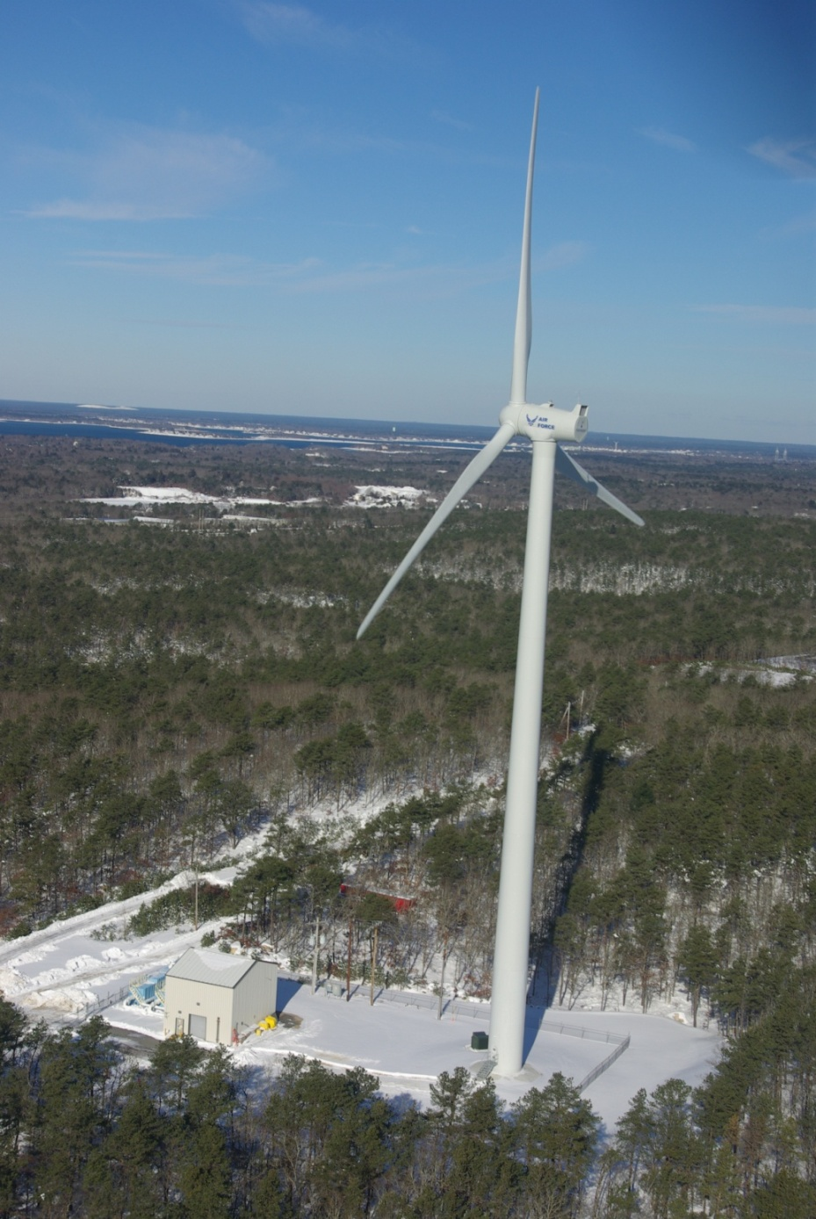
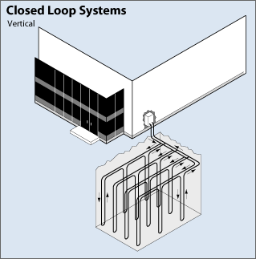
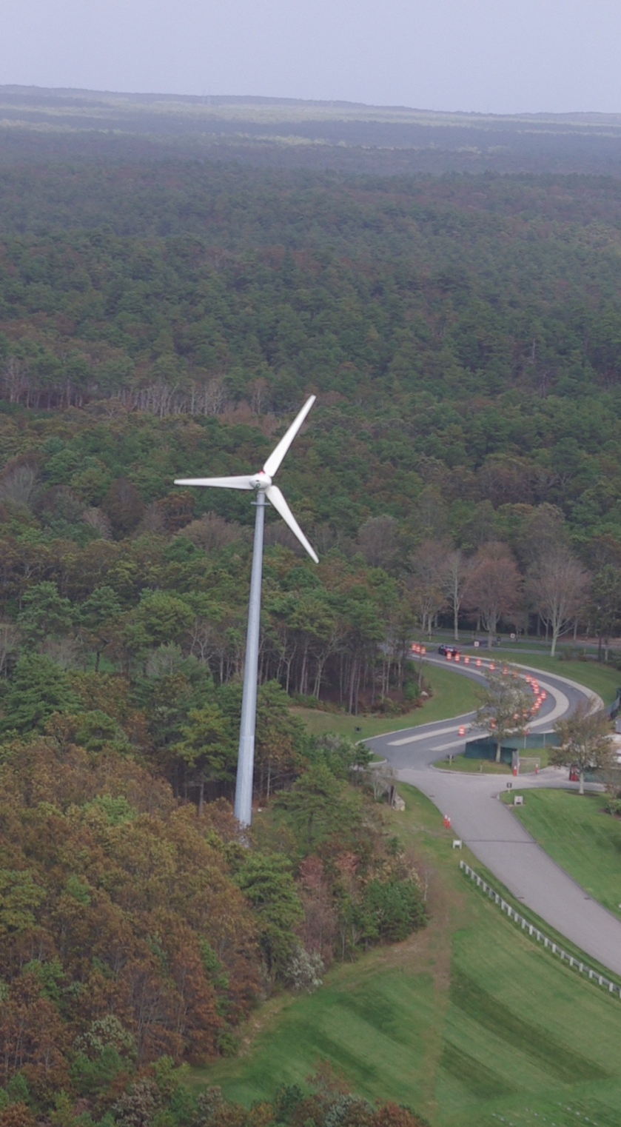
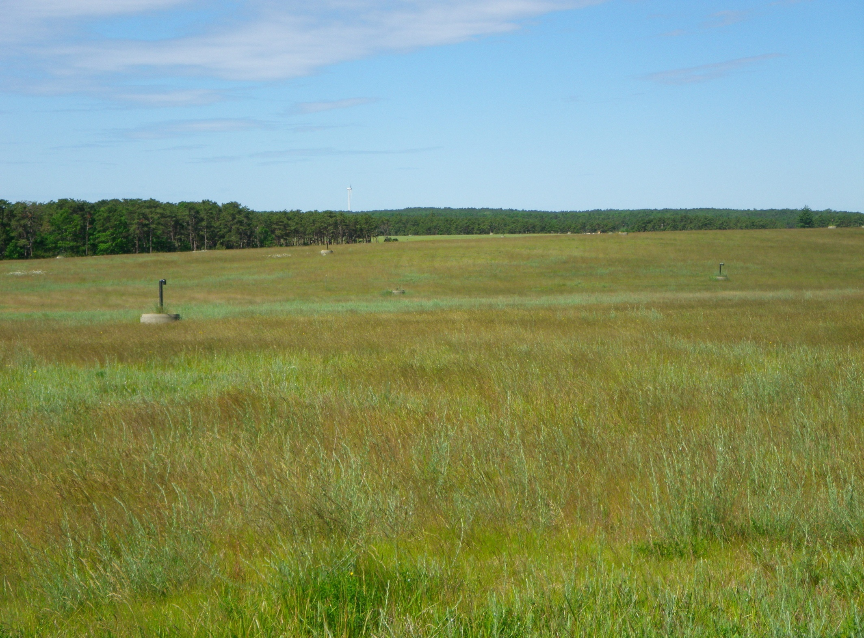
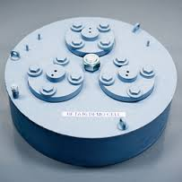
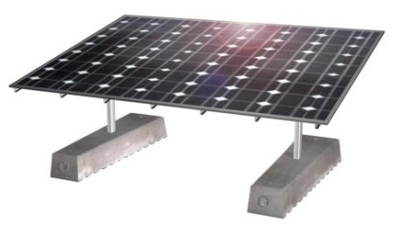
Renewable Energy Projects at JBCC
Wind turbines
Geothermal
Solar
Kocher’s
Ambri

Slide 7
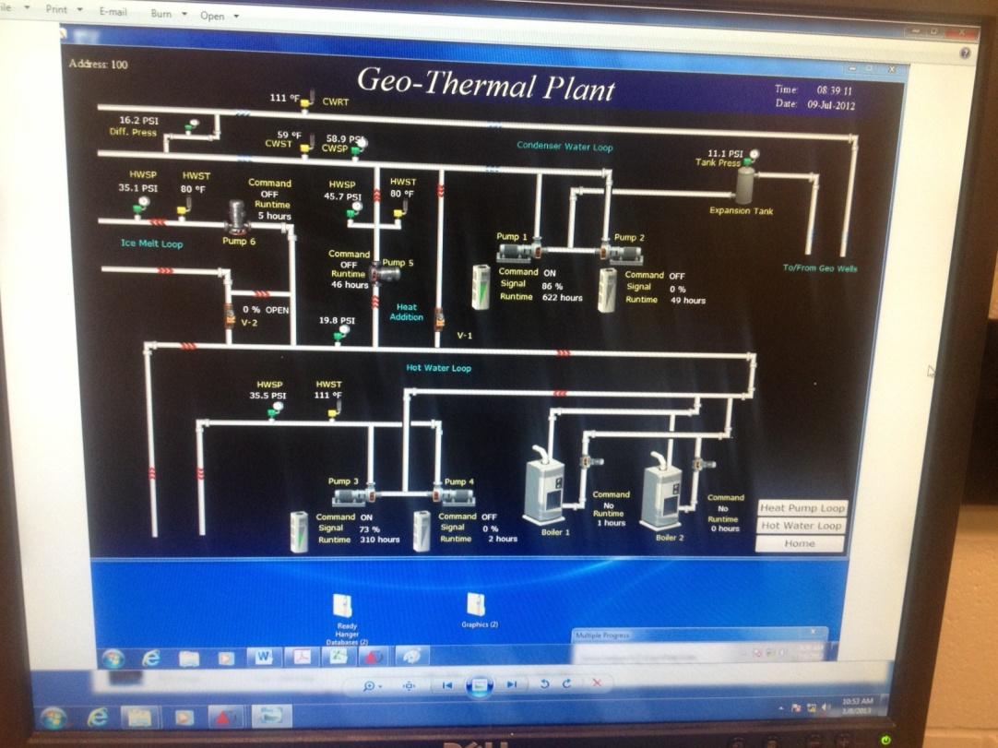
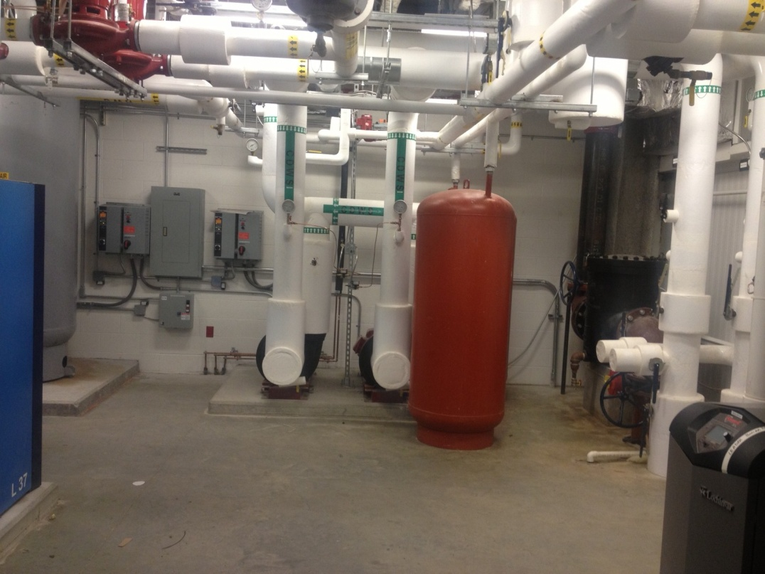
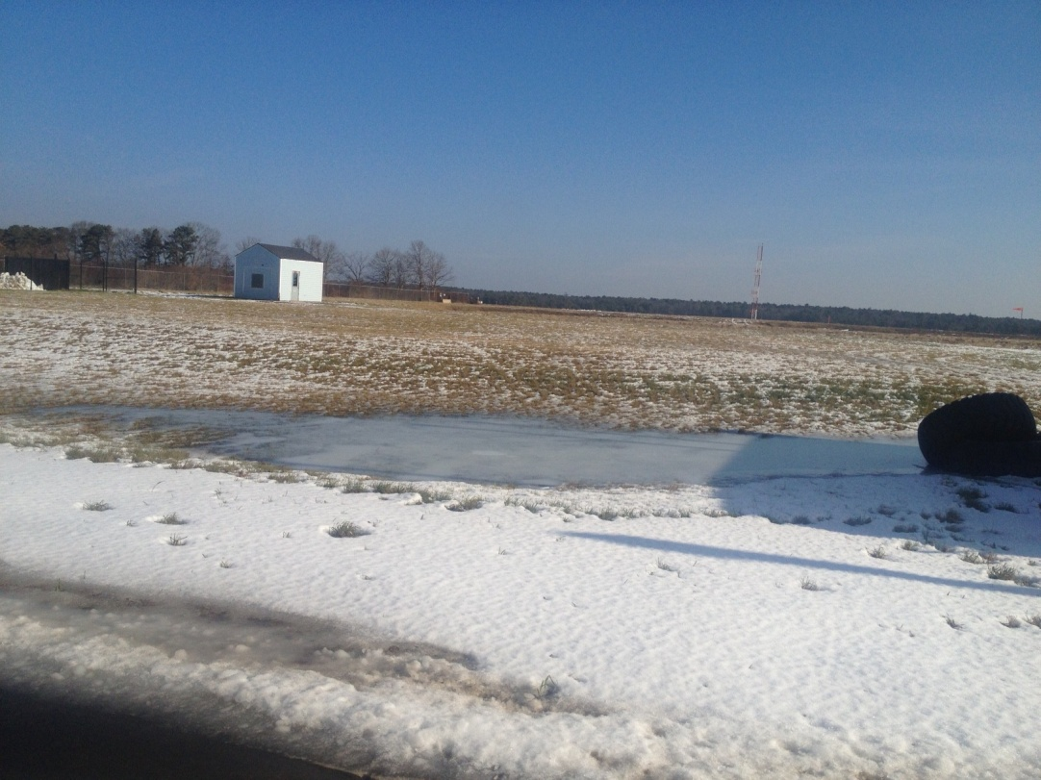
USCG Geothermal Systems
(two hangars)

Slide 8
VA Cemetery Wind Turbine – 50 kW Elecon

Slide 9
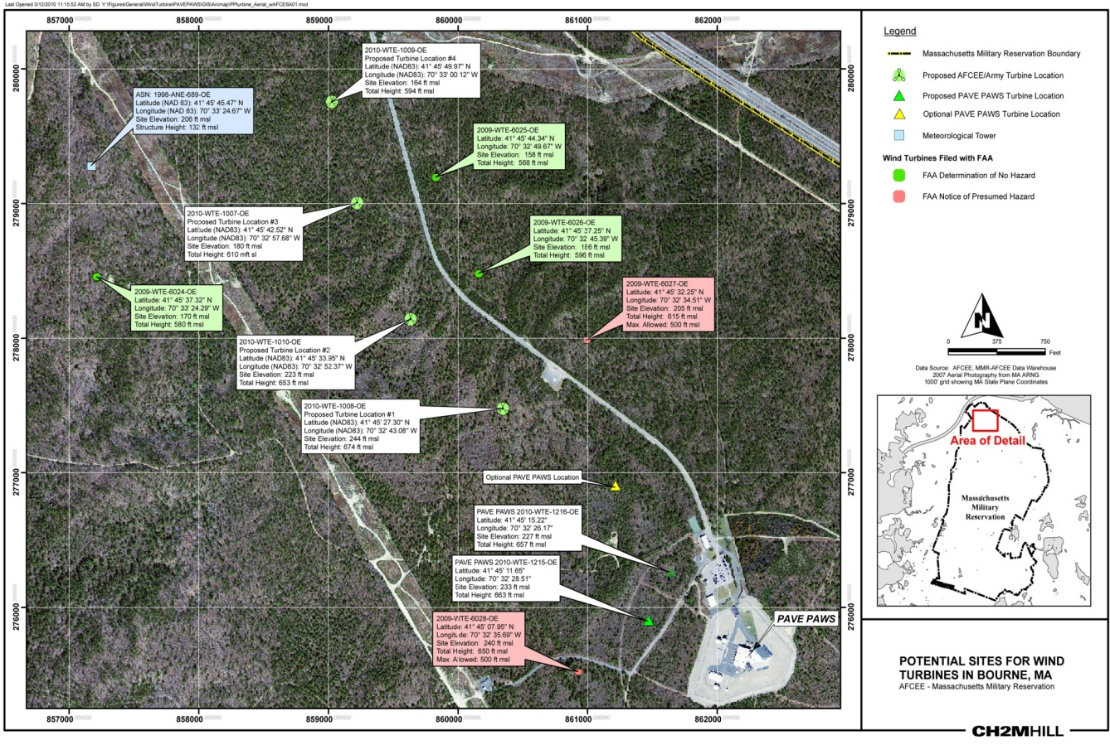
6 SWS PAVE PAWS Wind Turbines
Two 1.68 MW GE wind turbines
Under Construction
Expected to offset energy use by 50%-60%

Slide 10
AFCEC Landfill Cap – Site of Future 102nd Solar Array

Slide 11
Challenges: Energy Storage, Energy Security, Microgrid, and Net Zero

Slide 12


Slide 13
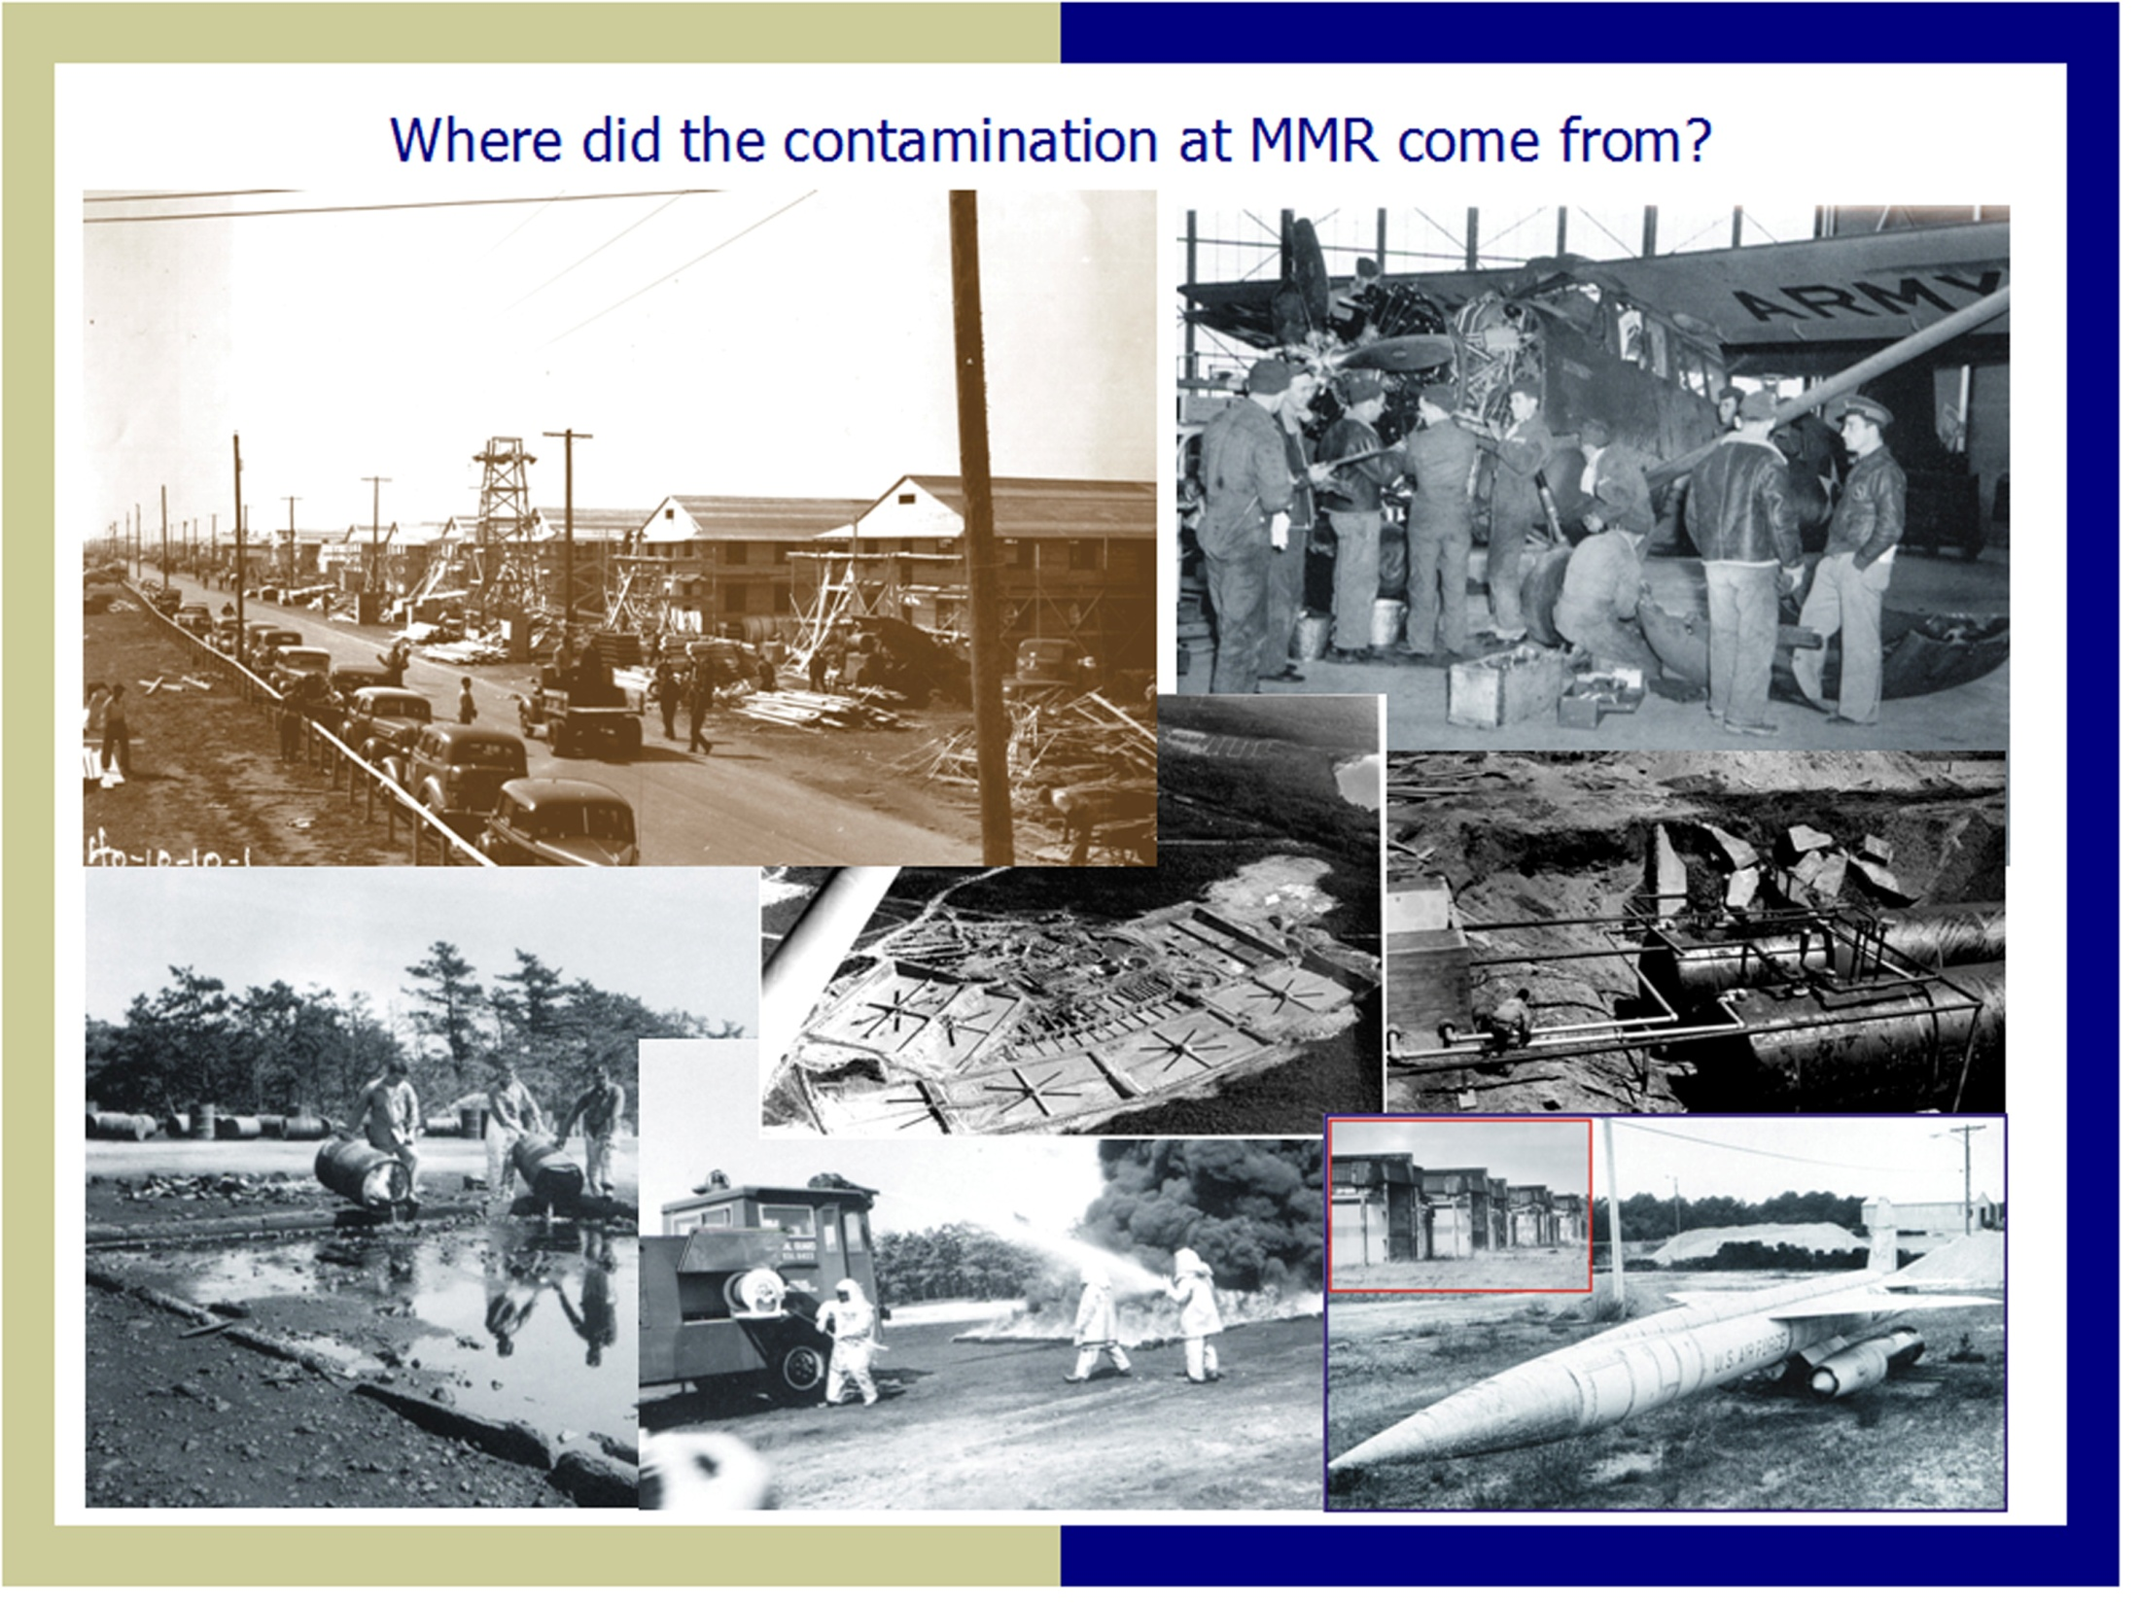

Slide 14
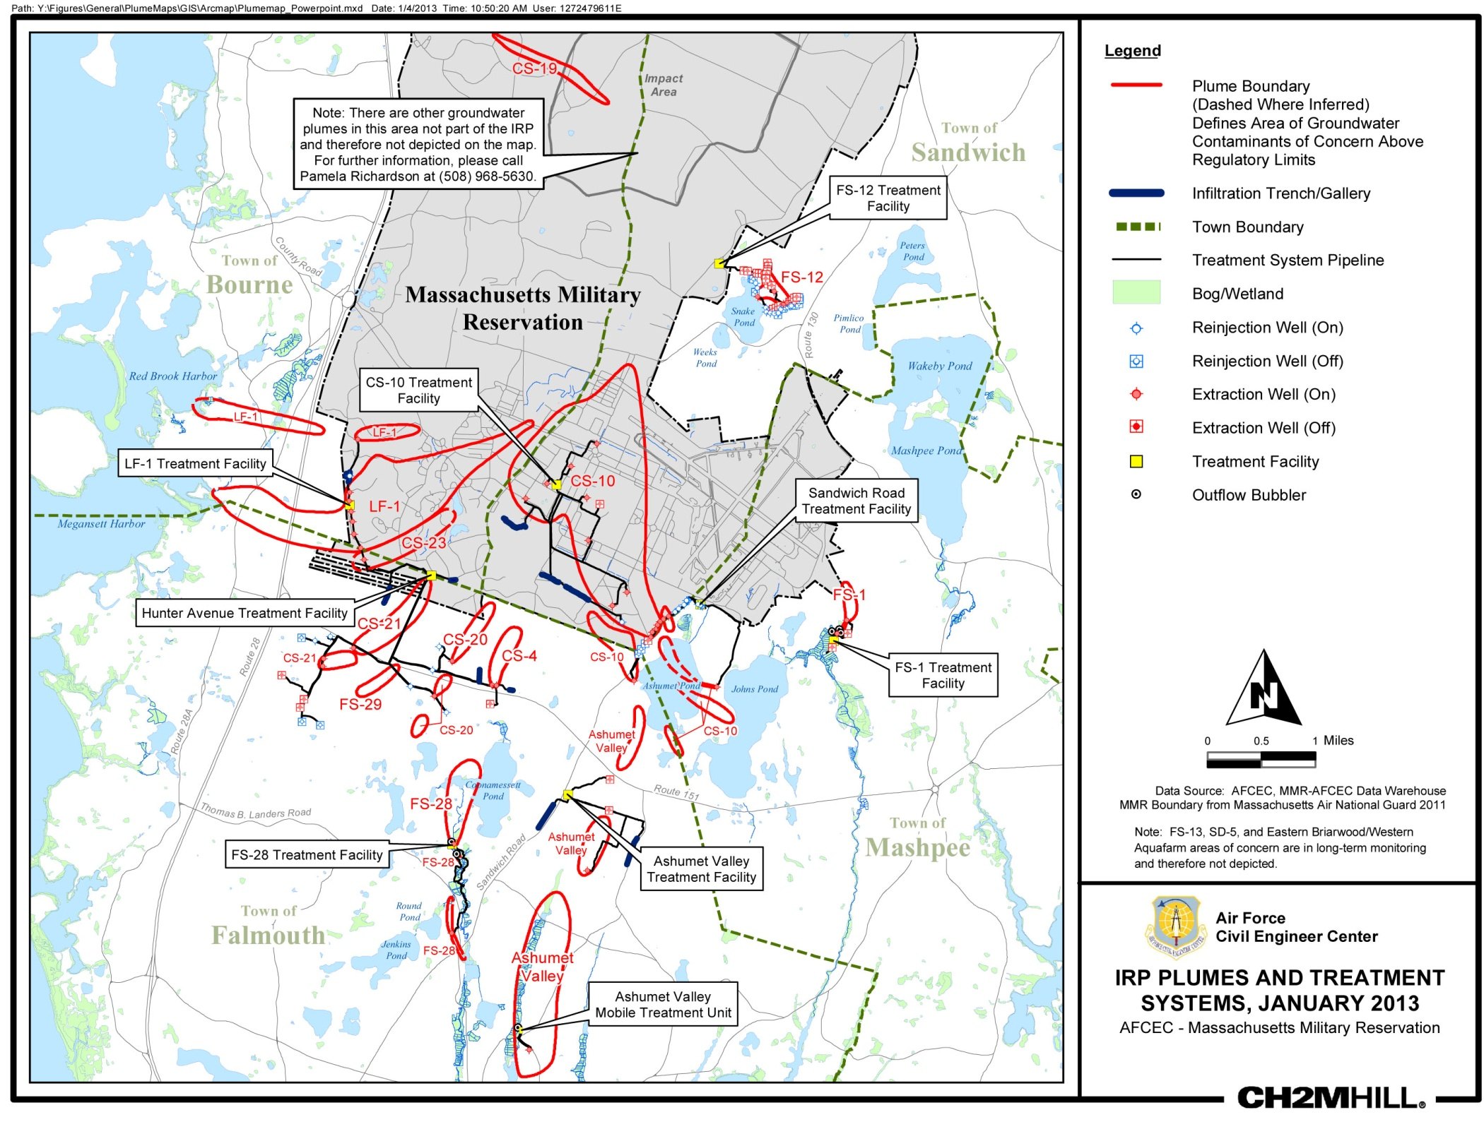
Insert latest plume map here

Slide 15
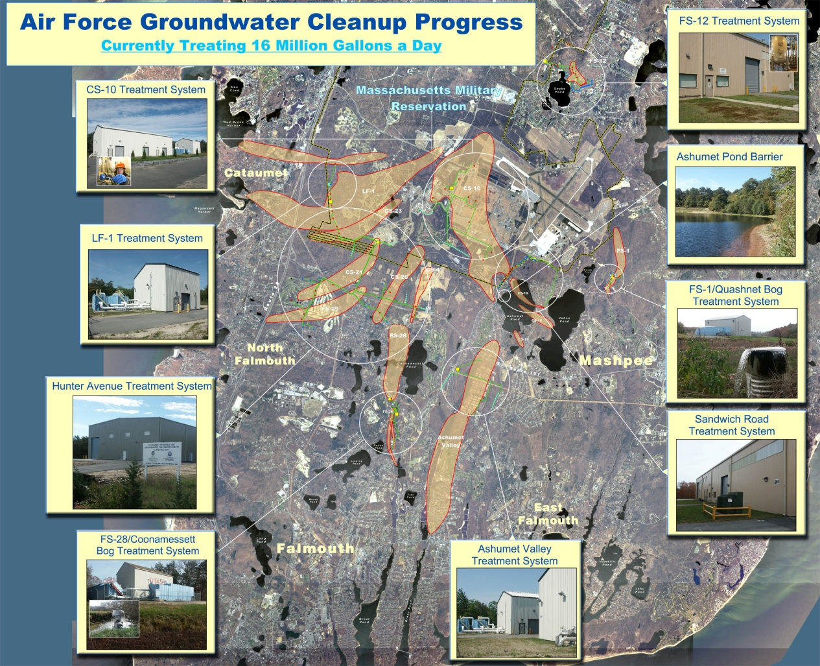

Slide 16
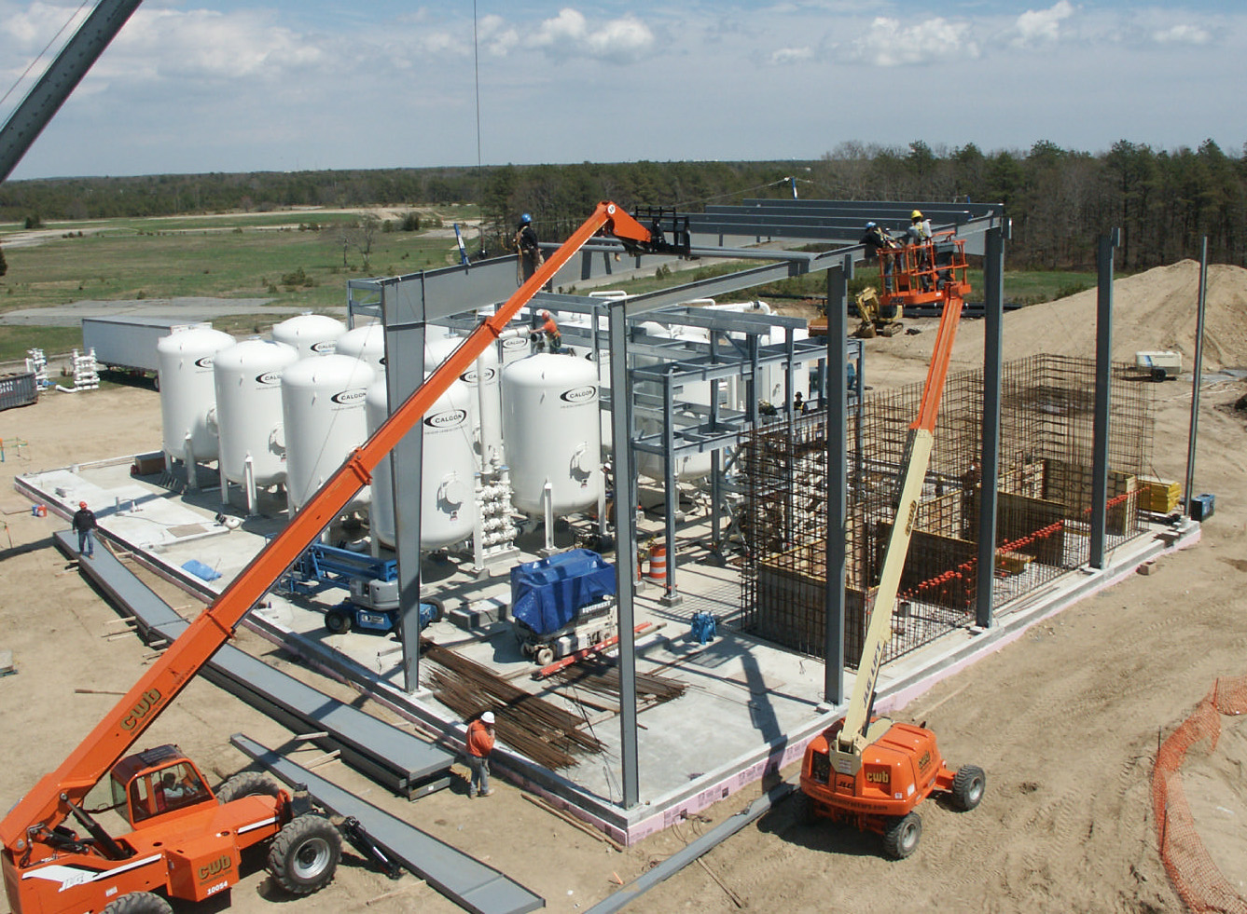

Slide 17
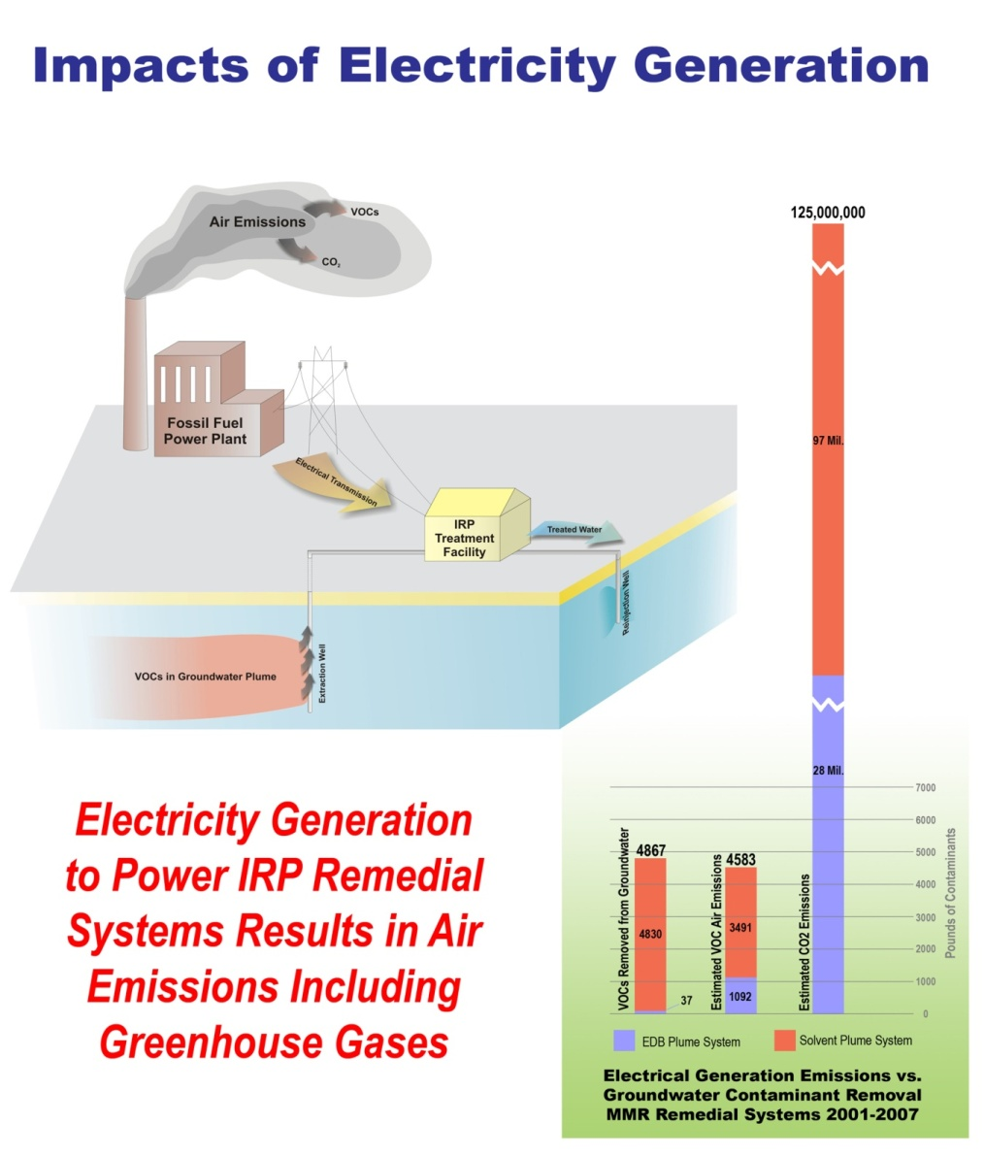
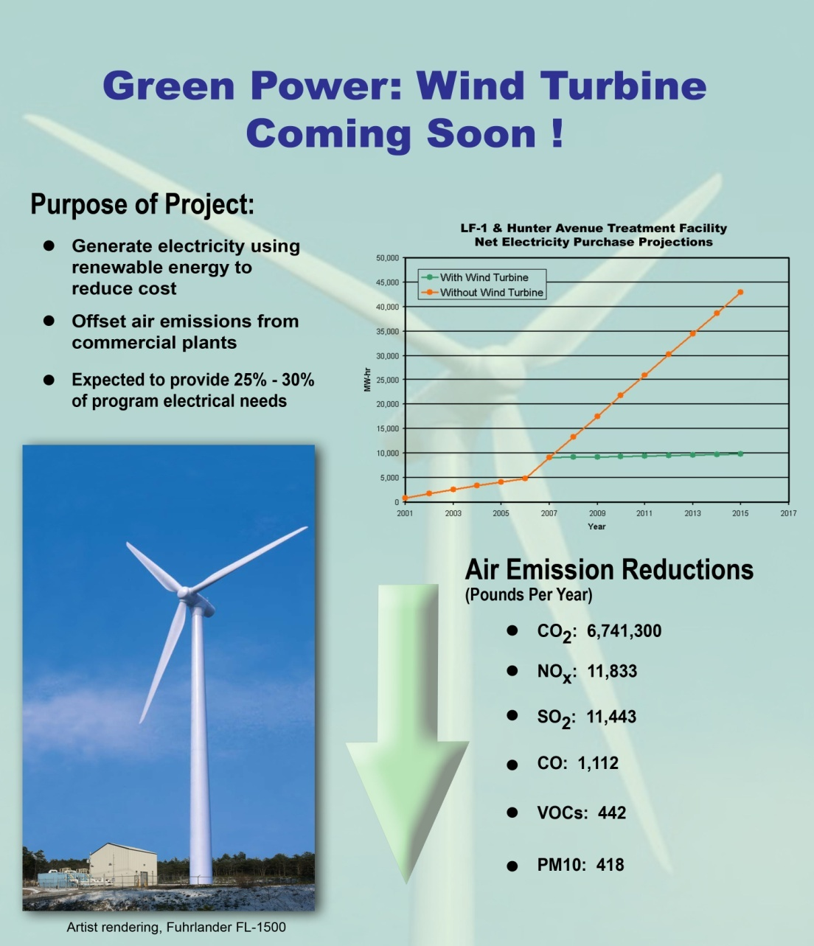
Sustainability Evaluation

Slide 18
Air Force Civil Engineer Center (AFCEC) Wind I and II

Slide 19
AFCECWind I
Fuhrlaender 1.5 MW, 80 m hub, 77 m rotor
Five year project; date of operation 2 Dec 09
$4.8M (included studies and two years O&M) – jointly funded by AF and Army
Earned $1.4M through May 2013
Owned and operated by AFCEC

Slide 20
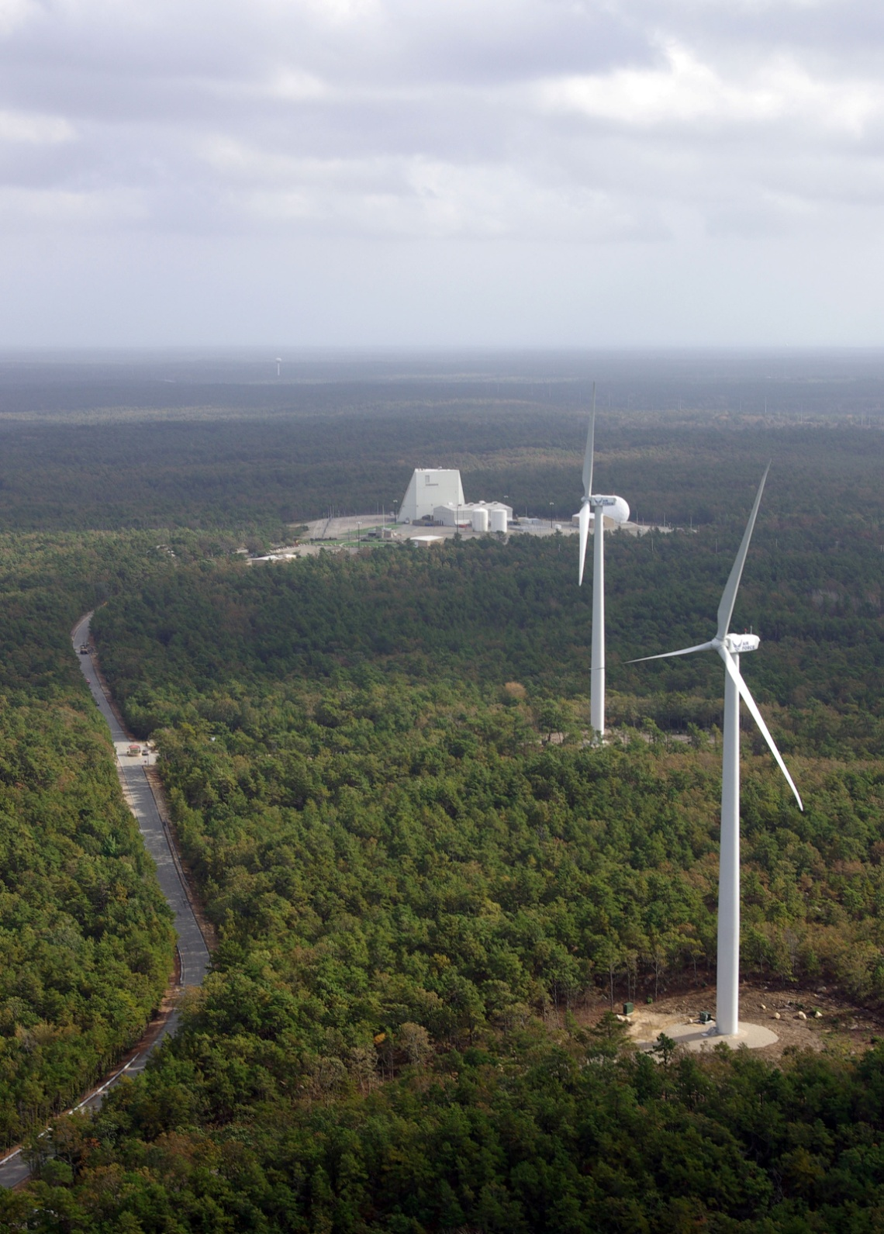
AFCEC
Wind II
Two GE 1.5 MW, 80 m hub, 77 m rotor
Two year project; date of operation 8 Nov 11
$9.4M for turbines and 7.5 MVA substation – jointly funded by AF and Army
Earned $1.7M through May 2013
Owned and operated by AFCEC
All three turbines combined produce enough power to offset AFCEC’s energy use and air emissions by 100%

Slide 21
