Slide 2
PANTEX ENERGY RENEWABLE PROJECT(PREP) John M. Herrera PREP Contracting Officer Representative & Project Manager john.herrera@npo.doe.gov 806.477.4689

Slide 3
Agenda
Pantex Plant Mission & Background
Federal Energy Goals
PREP Vision
Contract & Wind System Attributes
Project Management
R&D
PREP – Phase II

Slide 4
Pantex Plant Mission
The Pantex mission is Securing America as the NNSA'S production integrator and provider of the nuclear deterrent to the Department of Defense.

Slide 5
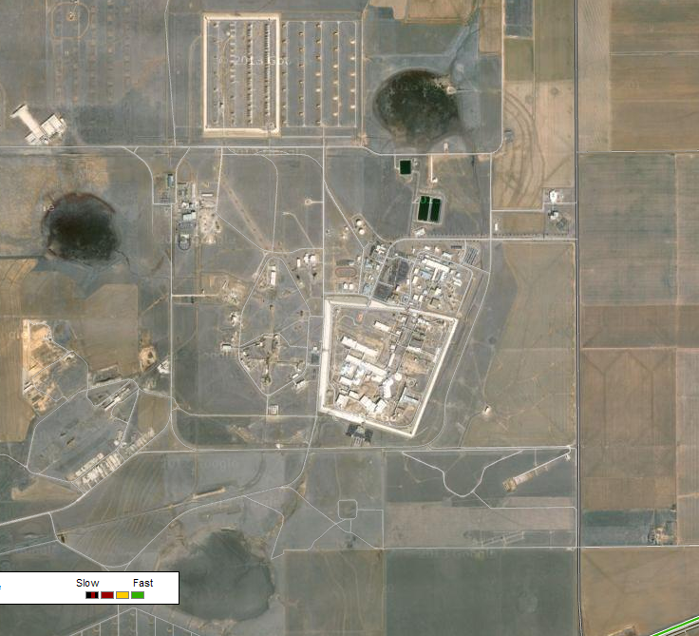
1,500 Acres – Aerial View

Slide 6
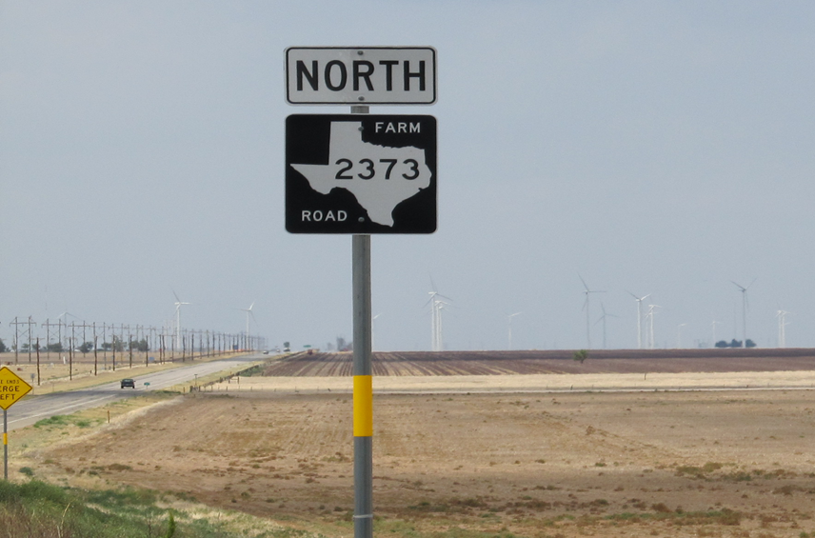
1,500 Acres -Ground Level View

Slide 7
Renewable Energy Requirements and Goals
Federal gov’t to consume 7.5% renewable electric energy beginning FY13. (Energy Policy Act of 2005). Increased to 20% by 2020.
Half of annual renewable energy must come from “new” energy sources and agencies must implement renewable energy generation on federal property. (EO 13423)
Each agency shall increase renewable energy use, implement projects on agency property, and reduce greenhouse gas emissions. (EO 13514)

Slide 8
PREP Vision
Vision: Install wind energy system up to 80 MW nameplate capacity with Texas Tech University Public-Private Partnership.

Slide 9
ESPC Contract Strategy
RFP: Design, install, operate 9.0 – 15 MW wind farm using FAA approved locations.
NNSA Firm Fixed Price ESPC Contract
Siemens Government Technologies, Inc. Contract signed May 10, 2013.
$50.5M Contract Value
18 year term

Slide 10
Wind System Features
Siemens Government Technologies, Inc.
11.5 MW system
Five (5) 2.3 MW Siemens w/ 101 meter blades
Five (5) yr full system warranty
Five (5) yr maintenance w/ five (5) option years
47,000 MWH/yr production
Pantex Plant uses ~72,000 MWH/yr
~65% of plant load
System life is 25 years

Slide 11
Energy “Savings”
Expected Savings
Yr(1): $1,768,907
25 Yrs: $84.4M
5% energy escalation
Cost Benefit: $84.4M – $50.5M = $33.9M

Slide 12
Surplus Renewable Energy Credits
94,000 RECs/yr
47,000 RECs/yr produced
Double counting eligible (EPACT 2005)
Pantex 7.5% Requirement = 5,400 RECs
Pantex 20% Requirement = 14,400 RECs
Surplus RECs spread to NNSA complex

Slide 13
Milestones
Milestone | Date
CD-0: Mission Need, Approved | April 2009
Qualifying Facility Designation | June 2009
CD-1: Approve Alternative Selection and Cost Range, Denied | April 2010
Energy Savings Performance Contract(ESPC) Acquisition Strategy Approved | June 2011
Federal Aviation Administration(FAA) Approved Five (5) 426 ft. Locations | April 2012
ESPC Request For Proposal Released | September 2012
Contract Award | May 2013
Operational | July 2014

Slide 14
Project Management

Slide 15
PREP Work Breakdown
PREP
Development
NEPA
FAA
Acquisition
Implementation
Interconnection
Physical
Utility Tariff
RFP Development
RFP Release
Selection
Investment Grade Data
Construction

Slide 16
Project Management Structure
OnePREP Team
Champion
Design Engineering
System Engineering
Contracting
Utility Management
Consultant
Agency Attorney
Contracting Officer
B&W Pantex
Idaho National Labs
NPO Production Office
NREL

Slide 17
Development
NEPA
Federal Aviation Administration Obstruction Evaluation
12 months of Investment Grade Data
60m Met Tower

Slide 18
Acquisition
Acquisition Strategy
RFP Development
Bidder Selection
PREP Evaluation Factors
Experience
System Capability
Understand Performance Modeling
Management Capability

Slide 19
Implementation
Construction
Physical Interconnection
Tariff Interconnection

Slide 20
Physical Interconnection
System Impact Study
Facility Study
Install System Upgrades
Power Backfeed

Slide 21
Tariff Interconnection
Xcel Energy Electric Tariff(s)
From: Large General Services
To:
Large General Services
Transmission Standby Service
Purchase of Non-Firm Energy From Qualifying Facilities

Slide 22
R&D Collaboration
Data Collection and Analysis – All raw data collected as part of the manufacture/developers data collection systems associated to the wind farm will be made available to the TTU.
Optimization Research - Perform various operational test and performance evaluations to investigate improving system production.
New Technology Development - Perform additional studies, equipment installation/testing, etc. to further the development of the wind farm and power generation.

Slide 23
PREP Phase II - Additional 35MW
Additional 35MW East of 2373
FAA VOR approach removal
Request For Information (FY13)
Regulatory Study (FY14)
Acquisition Strategy (FY14)
Acquire & Construct (FY16)

Slide 24
Questions?
John M. Herrera PREP Contracting Officer Representative & Project Manager john.herrera@npo.doe.gov 806.477.4689

