Slide 1
U.S. Coast Guard
Geothermal and Energy Efficiencies

Slide 2
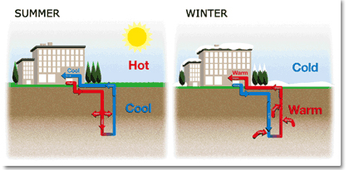
Geothermal (Ground Source) Heat Pump
Closed Loop System Overview

Slide 3
Benefits of GSHPs
Reduces energy consumption by 20 to 50%
Utilized for heating / cooling indoor air and hot water heating systems
Can be installed in most structures
Existing structures can be retrofitted with a GSHP
No exposed equipment outdoors
No open flame, flammable fuel or fuel storage tank
Minimizes ozone layer destruction
Conserves natural resources
Investments typically recouped in a few years.
Some utilities offer rebates or incentives to their customers who purchase GSHPs.
Many heat pump manufacturers, local utilities, and lending institutions have special financing for homeowners who are installing GSHPs

Slide 7
New Facility with GSHP
Facility
Well Field

Slide 8
6 MW Solar Array Concept
Other Solar Projects
USCG Solar Site

