Slide 1
Large-Scale Renewable Energy Guide
Boyan Kovacic and Anne Crawley

Slide 2
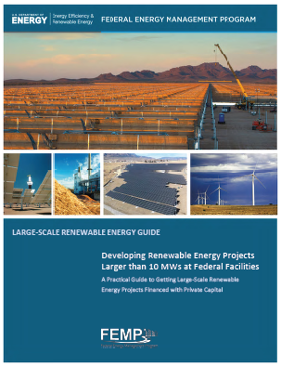
Large-scale RE Guide
Large-scale RE Guide: Developing Renewable Energy Projects Larger than 10 MWs at Federal Facilities
Introduction and Overview
For EPA RE-Powering America
August 8, 2013
Federal Energy Management Program
Office of Energy Efficiency
and Renewable Energy
U.S. Department of Energy

Slide 3

Federal Energy Management Program
FEMP works with key individuals to accomplish energy change within organizations by bringing expertise from all levels of project and policy implementation to enable Federal Agencies to meet energy related goals and to provide energy leadership to the country.

Slide 4
FEMP Renewable Energy
Works to increase the proportion of renewable energy in the Federal government’s energy mix.
The program does this by providing
  Web-based Knowledge and Tools
  Direct Project Technical Assistance
  Interagency Coordination
  Renewable Energy Guidance and Reporting Requirements
Technical Assistance supports
  Distributed-scale RE projects (smaller than 10 MWs)
  Large-scale RE projects (larger than 10 MWs)
  Renewables in green building construction or major renovations

Slide 5
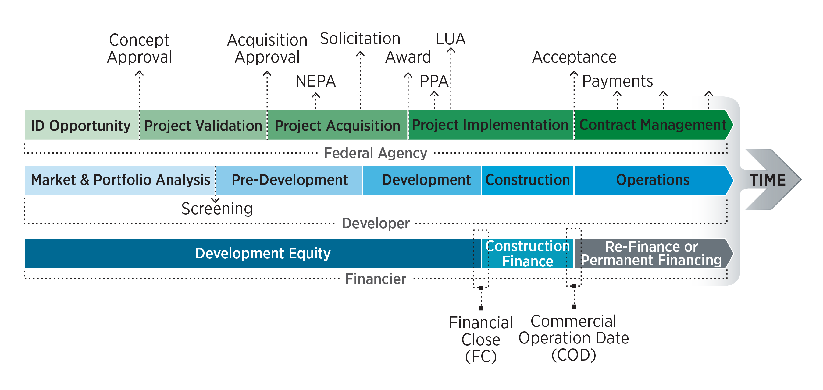
A Common Process
The Guide shows a common process for large RE projects, in spite of different terms, from three key perspectives: Developer, Federal agency, and Financier.

Slide 6






Federal Market for Large-Scale RE Projects
Federal goals:
  7.5% of total electricity must come from renewable electricity by 2013 and beyond
  20% consumption of renewable electricity by 2020
  28% reduction in greenhouse gas emissions by 2020
DOD goal: produce 3 GWs of renewables by 2025

Slide 7
Use of the Guide
DOE
  FEMP is applying the Guide in its implementation support to the DOE Pantex 11.5 MW ESPC wind farm
Army
  Energy Initiatives Task Force has adapted much of the process for Army specific practice. The Guide is a companion document to the EITF process and internal Army guidance.
  Committed to partnering with FEMP to meet 1 GW goal.
  EITF supporting Ft. Irwin (15 MW PV), Ft. Detrick (15 MW PV), Ft. Drum (28 MW Biomass), and Ft. Bliss (20 MW PV) projects
Navy
  Incorporated many elements of the Guide into its project development process
  Looking for FEMP assistance to fine tune its process

Slide 8
Key Strategic Issue: Competitive Projects
Attracting private investment to the Federal sector is essential to accomplish RE project goals.
Federal Project opportunities must compete within competitive capital markets for:
  (1) project development investment and
(2) project execution capital investment.

Slide 9
Introduction
The Guide provides a general resource that
develops Federal employee and private sector awareness and understanding of each other’s operating environment, goals, language, and process.
creates a methodology to:
  build strong business cases
  define and mitigate risks
  establish good project characteristics
so that the private sector will:
  respond to the Federal competitive process
  invest in and develop the projects.

Slide 10

A Common Goal
Federal agencies and private developers both want to deploy significant amounts of large-scale renewable energy projects on Federal lands using private financing.

Slide 11
A Common Process and Understanding
The Guide shows a similar process in spite of differences in language and terms from three key perspectives: Federal agency, Developer, and Financier.

Slide 12
A difference of perspective: Authorities
Being a government of prescribed powers, we can only do that which is authorized by law.
We can do anything that is not prohibited by law.
Government
Lawyer advising Federal agency
Private Lawyer advising Developer

Slide 13
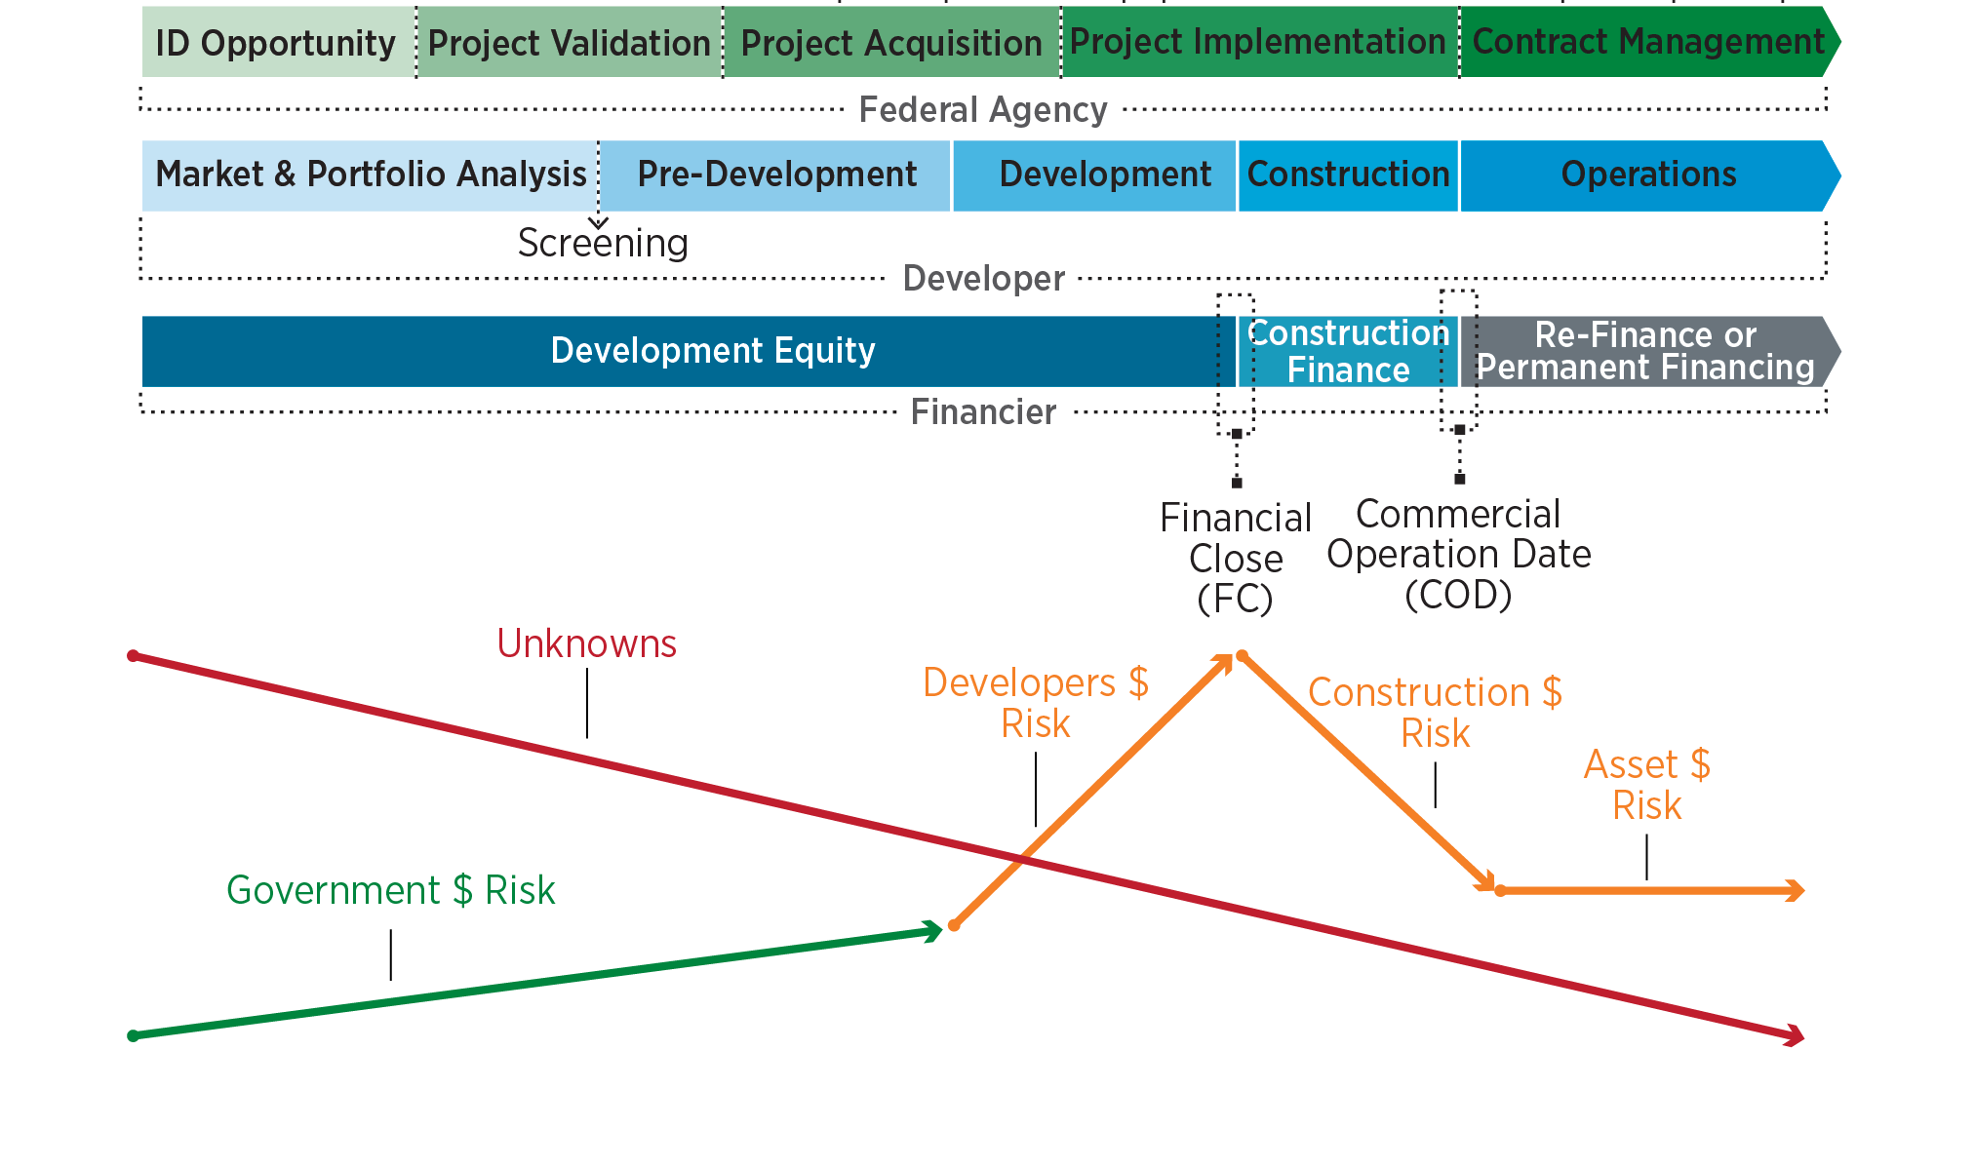
A Process that Acknowledges Risk
Risk is an important driver of project development.
The Guide acknowledges risk; a framework and process for managing projects in a risk environment is introduced.

Slide 14
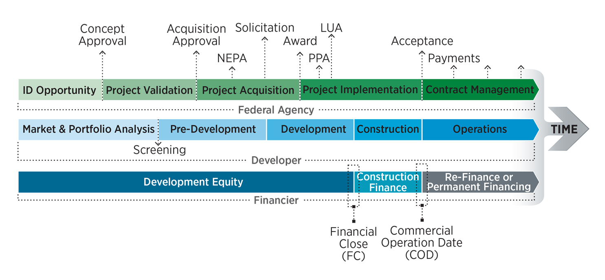
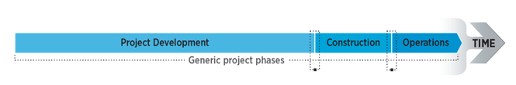


Project Development
Project Fundamentals
Project Development Framework

Slide 15
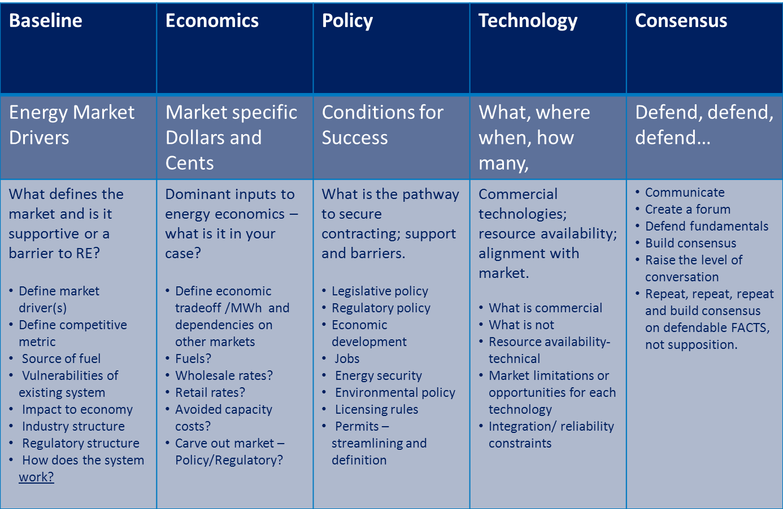
Project Fundamentals

Slide 16
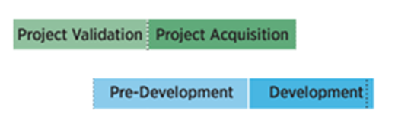
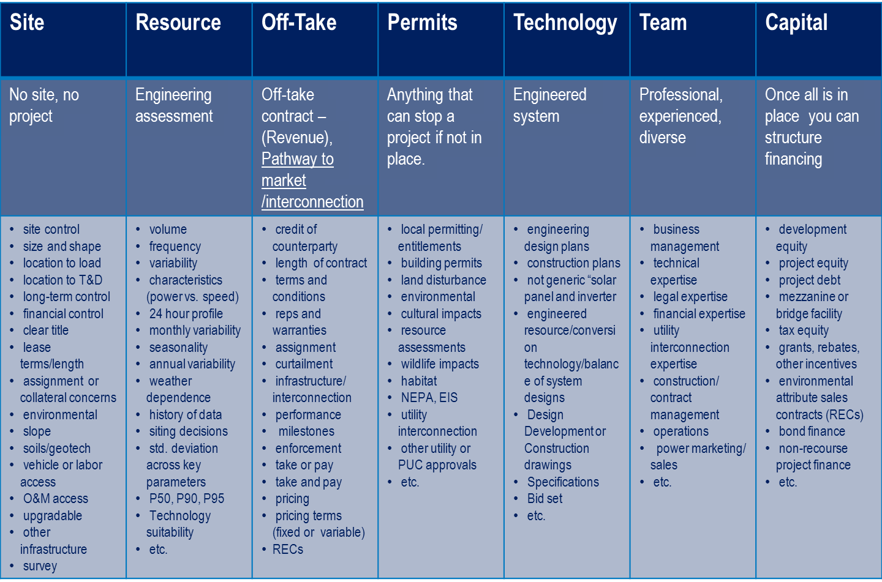
Project Development Framework

Slide 17
Project Development
Construction
Operations
Capital Investment
Cash Flows and Tax Benefits
Development Costs
Years
Cash Flows in Time - Illustration

Slide 18
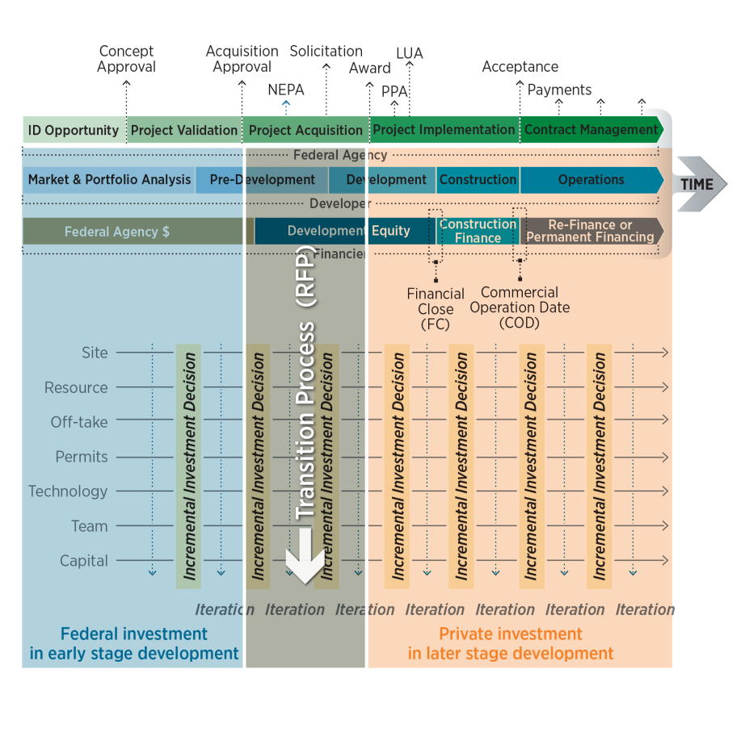
A common reliable, repeatable process
Identifiable stages
Consistency >> lower risk >> attractive projects
Iterative disciplined process for investing
Common understanding of important project characteristics
Government leads investment to ID good projects
Developer completes and operates project
Solicitation and developer selection

Slide 19
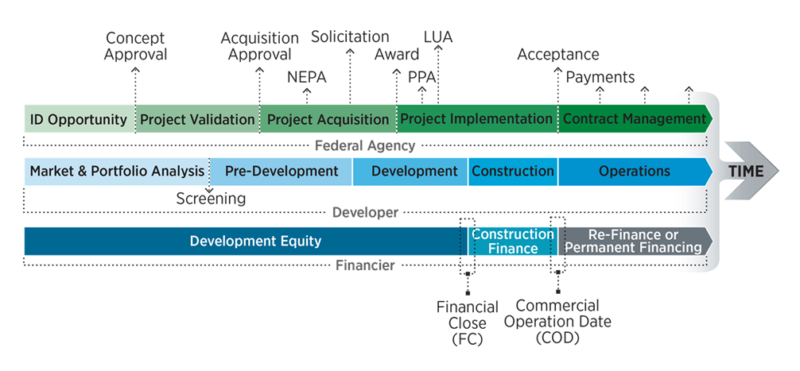
Guide Structure
Section I: Language and terms
Section II: A Reliable Repeatable Development Process
  The Commercial process
  Project Fundamentals
  Project Development Framework
Section III: Application of Project Development by a Federal Agency
  The Federal Process
Appendices

Slide 20
Detail in Appendices
Appendix A. Portfolio Approach
Appendix B. Project Development Framework Categories
Appendix C. Overview of Electricity Markets and Key Terms
Appendix D. Commercial Project Financing
Appendix E. 10-Step Project Development Framework Approach
Appendix F. Project Pro Forma Example
Appendix G. Energy Initiatives Task Force Project Assessment
Appendix H. Project Validation Workbook Draft
Appendix I. Responses to Comments

Slide 21

Federal Agency Key Points
Federal Agencies need private capital for large-scale renewables projects.
Risk is critical for capital.
Agencies can reduce project risk by using the process and frameworks in the Guide:
  Do early investment in market analysis, predevelopment
  Use a consistent approach.
The Guide helps Agencies understand the private sector process.

Slide 22

Private Developer Key Points
There is a large Federal market for large-scale renewable projects.
The Guide helps Agencies follow key methodical steps that:
  developers understand
  reduce project risk
  make projects attractive to private investors.
The Guide helps the Private Sector understand the Federal Agency process.

Slide 23
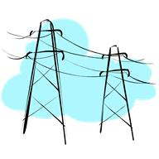
Utility Key Points
Federal agencies are committed to hosting large-scale renewable energy projects.
Utilities will play a key role as potential sole or partial off-takers and as transmission partners.
Agencies need good relationships with their utilities to facilitate interconnection and avoid curtailment.

Slide 24
Thank You and Feedback Welcomed
Boyan Kovacic
202-586-4272
boyan.kovacic@ee.doe.gov
Anne Crawley
202-586-1505
anne.crawley@ee.doe.gov
http://www1.eere.energy.gov/femp/technologies/large-scalereguide.html

