Slide 1
Energy Technology at Joint Base Cape Cod Solar Power Liquid Metal Battery Storage
Capt Shawn Doyle
102nd Civil Engineering Sqdn
Otis Air National Guard Base

Slide 2
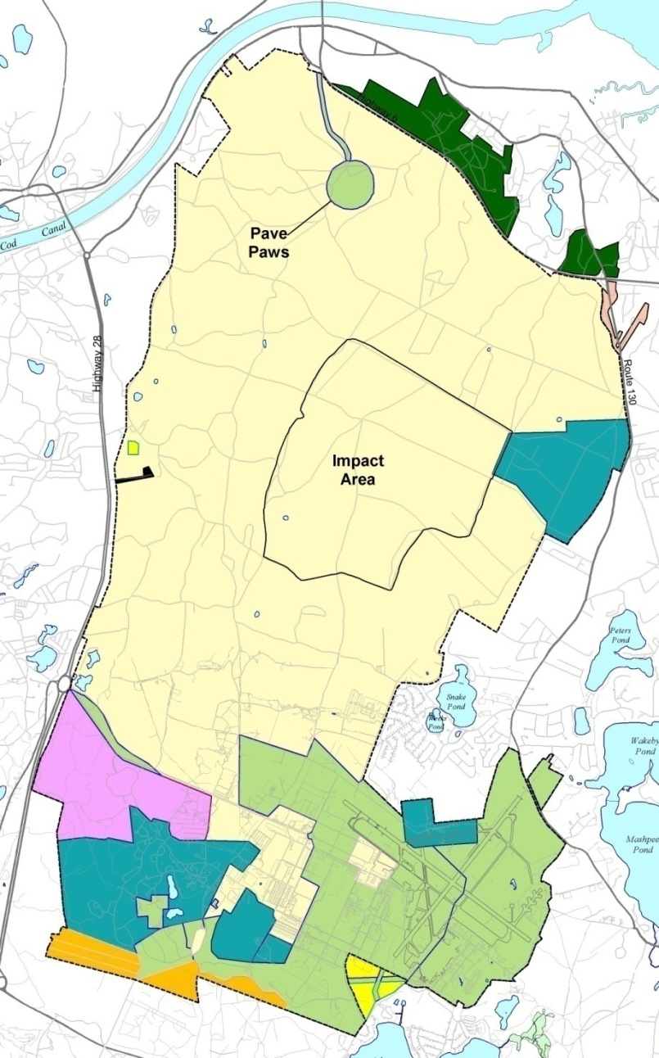
Joint Base Cape Cod
Total Area - 22,000 acres
Approx 10% of entire Cape Cod land mass
“Base Grid” covers southern 7,000 acres

Slide 3
JBCC Electrical Grid
Solar Array
Primary Feeder
Substation

Slide 4
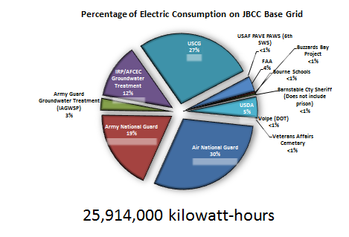
Power at JBCC

Slide 5
Power at JBCC*
Annual Usage - 25.9 MWhrs
Peak Load - 4.5 MW
Annual Cost - $ 3.9 Million ($.16/kWH)
Local Distribution by NStar
102nd IW owns power grid and substation
7 main feeders
Sub-meters tenant users
10+ facilities with stand-by diesel generators
* Data for base grid only; does not include connections to independent NSTAR feeders (Pave PAWS, IRP, some USCG)

Slide 7
Solar Installation
Closed Landfill, 37 Acres
~ 6 MW Capacity
20 year PPA
~ $9.2 M savings
On-line Q2 14

Slide 8
AMBRI
Analysis Group
MassDev

Slide 9
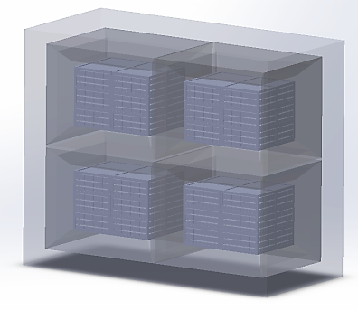
Ambri - From Cells to Systems
Cell
AMBRI CORETM
AMBRI Power Module (APMTM)
AMBRI Energy Storage System (AESSTM)
4”
34”
38”
34”
72”
65’
56 Wh (80 Ah)
Base repeat unit
6.25 kW / 25 kWh
432 cells
Thermal enclosure with BMS,
60 V
~ 5,000 lbs
25 kW / 100 kWh
1728 cells
Parallel COREs for redundancy
> 10 tons
Military Applications
Replace diesel generators (enviro, supply chain)
Power security in case of commercial grid failure
Renewables as primary power source
MMR Power Independent by 2018
500 kW / 2000 kWh
34,560 cells; 20 APMsTM
Distribution voltage e.g. 13.8 kV; Grid-scale system: SCADA, master controller, transformer, grid-tied inverter

Slide 10
Potential Military Applications
Energy Security
Energy Independence

Slide 11
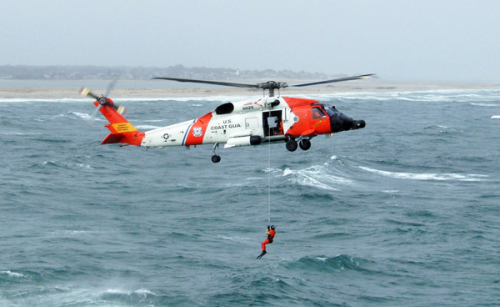
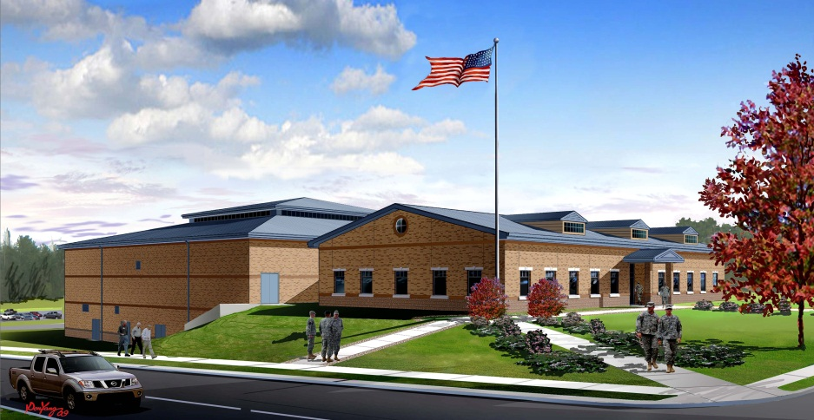
Energy Security
Single facility Uninterrupted Power Supply (UPS)
Guarantee continuous operation of critical missions
Replace power conditioning systems
Utility scale UPS for entire grid
Ensure Safe Haven for community
Large scale recovery support (Nemo & Nstar)

Slide 12
NStar Nemo Recovery
1200 Crew
600 Trucks
12 Acres
Dormitories
Dining Facility

Slide 13
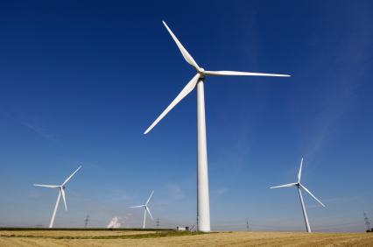
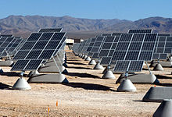
Energy Independence
Eliminate reliance on commercial power
NStar’s top priority for outage repair?
Peak load shedding & Demand Response
Reduce consumption of fossil fuels
Reduce carbon footprint – diesel exhaust & logistics
Renewables as primary power sources

Slide 14
Questions?

