Slide 1
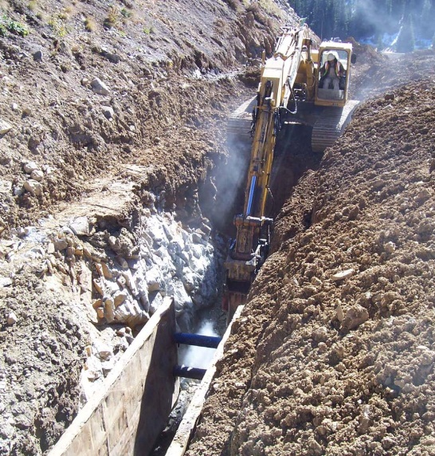
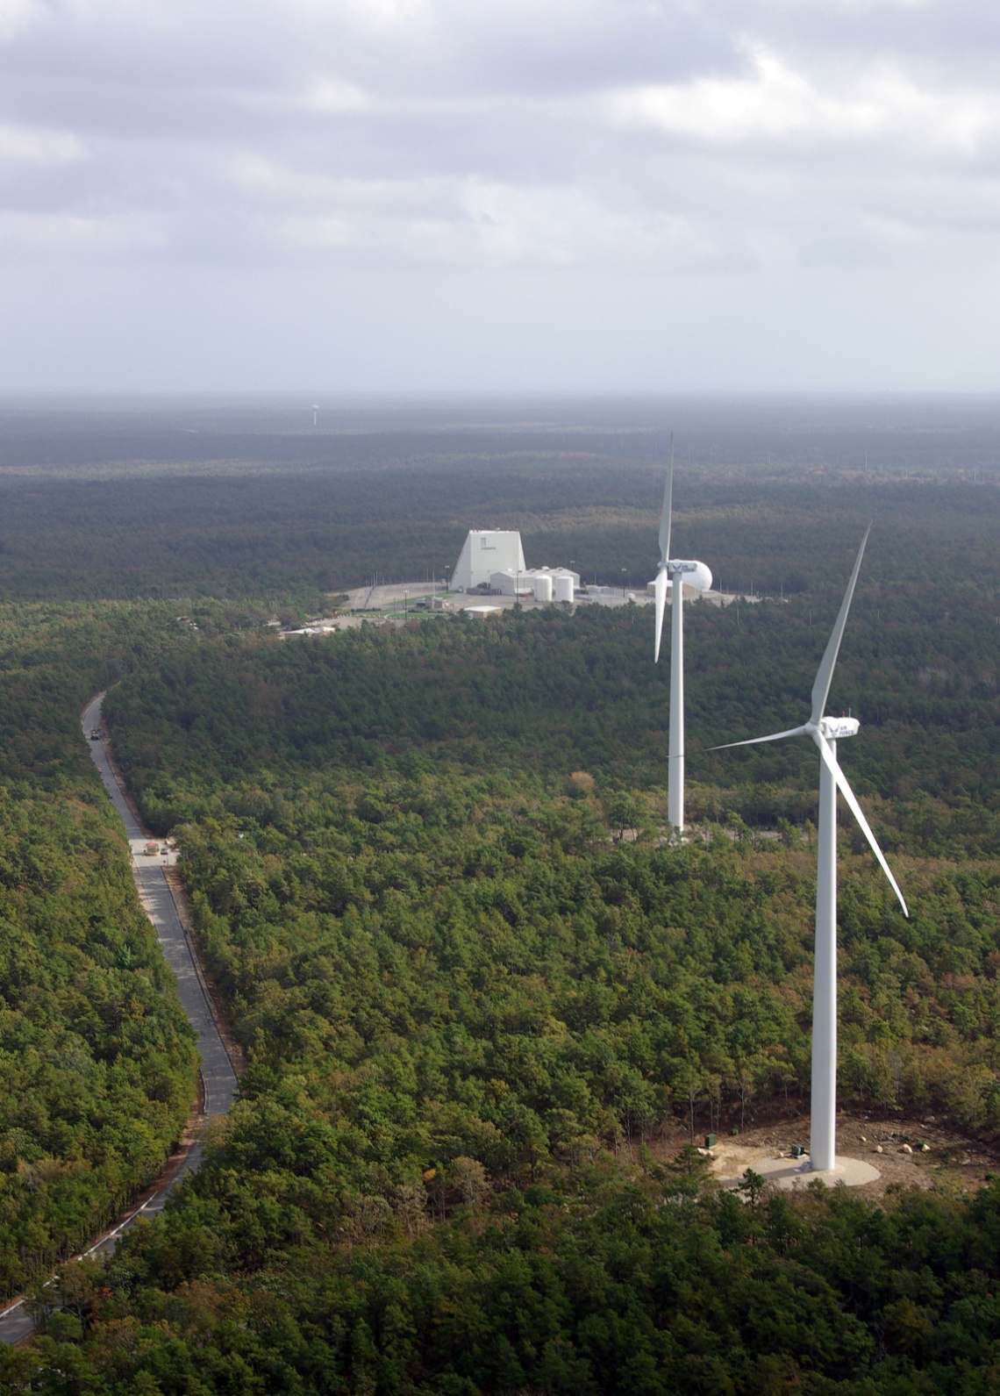
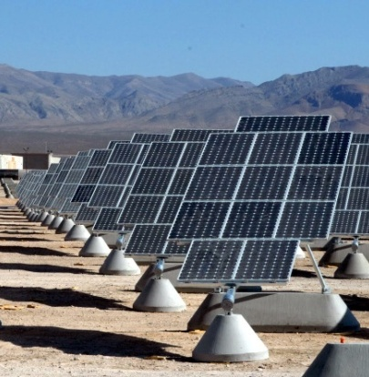
Renewable Energy Projects on Federal Lands: A Practical Guide and Examples
A Webinar Sponsored by EPA’s RE-Powering America’s Land Initiative
August 8, 2013

Slide 2
Renewable Energy Projects on Federal Lands: A Practical Guide and Examples
Developing Renewable Energy Projects Larger than 10 MWs at Federal Facilities
Mr. Boyan Kovacic, U.S. DOE, Federal Energy Management Program
Ms. Anne Crawley, U.S. DOE, Federal Energy Management Program
Massachusetts Military Reservation Ms. Rose Forbes, Air Force Civil Engineer Center Captain Shawn Doyle, 102nd Civil Engineer Squadron Mr. Steve Mellin, 6th Space Warning Squadron Ms. Elizabeth Kirkpatrick, U.S. Coast Guard, Air Station Cape Cod Pantex
Mr. John Herrera, U.S. DOE National Nuclear Security Administration

