Slide 1
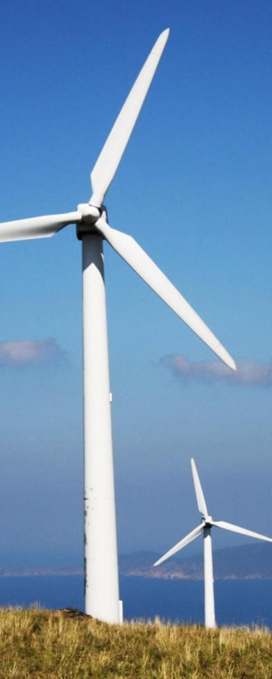
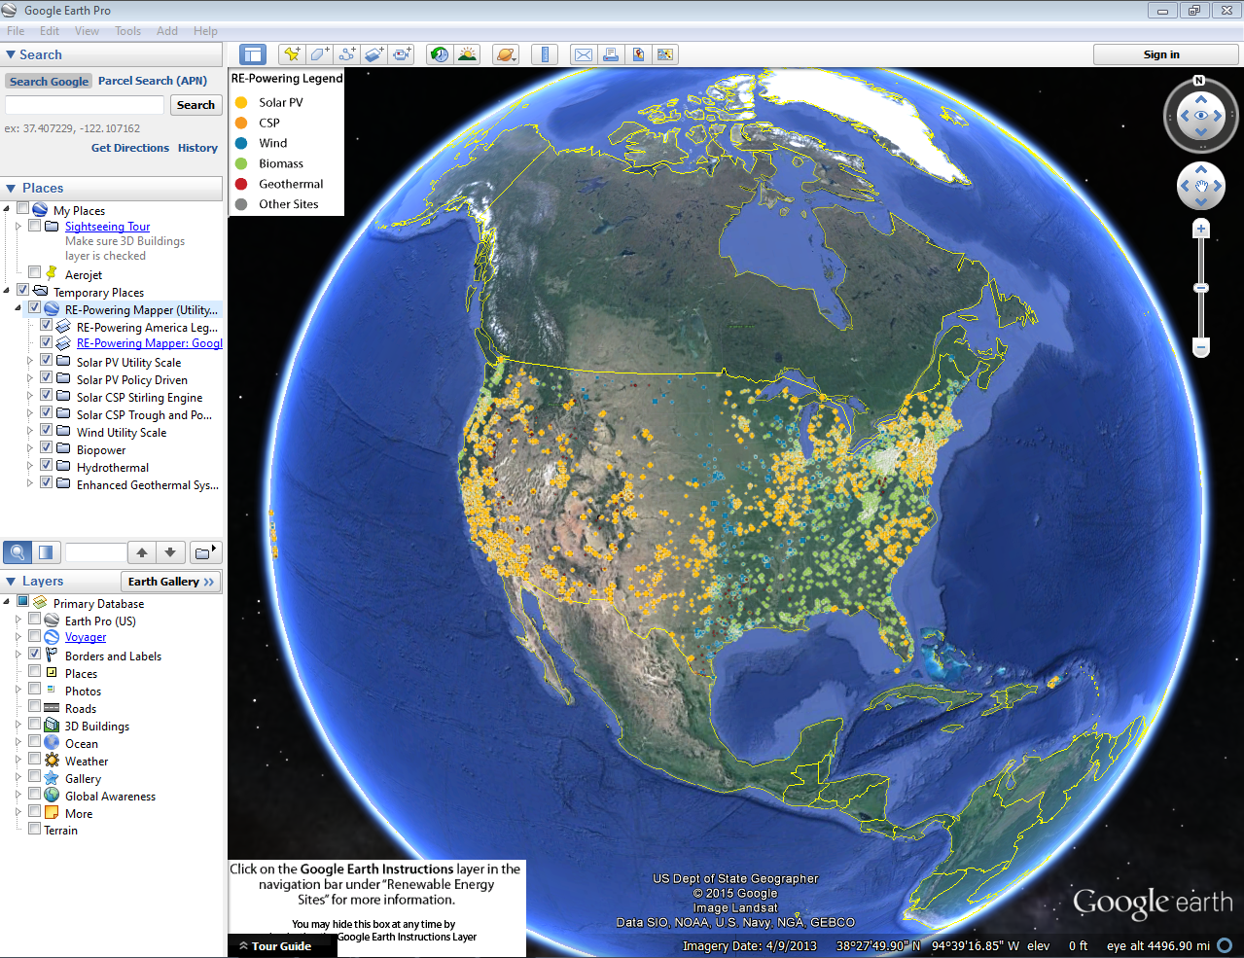
RE-Powering America’s Land:
Updated RE-Powering Mapper

Slide 2
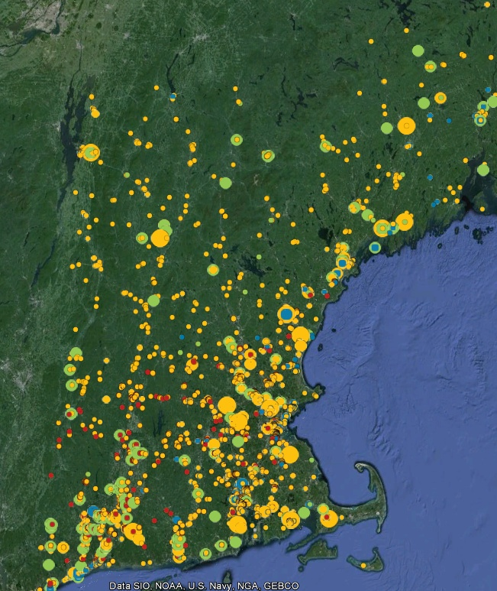
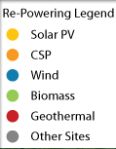
RE-Powering Mapper Google Earth Overlay
Mapped inventory of 80,000+ EPA and select state tracked sites (over 43 million acres of land)
Incorporates data from:
EPA Cleanup and Landfill Programs
National Renewable Energy Lab
Wind, Solar, and Biomass Resources
Southern Methodist University and USGS
Geothermal
Department of Homeland Security
U.S. Highways
Railroads
Transmission Lines
Substations
State Agencies from CA, HI, IL, MA, NJ, NY, OR, PA, TX, VA, and WV
2

Slide 3
Sites Screened by Program
and State
Program | # of Sites
Abandoned Mine Land | 466
Brownfield Program Sites | 26,030
Superfund | 2,009
Landfills - Landfill Methane Outreach Program | 2,062
RCRA Corrective Action Sites | 3,759
Sites Associated with Federal Programs | 34,326
State Identified Sites | # of Sites
California (7,622), Hawaii (1,180), Illinois (5,541), Massachusetts (1,495), New Jersey (10,362), New York (2,180), Oregon (4,743), Pennsylvania (5,543), Texas (1,150), Virginia (5,422), West Virginia (2,103) | 47,341
Federal and State Sites Screened | 81,667

Slide 4
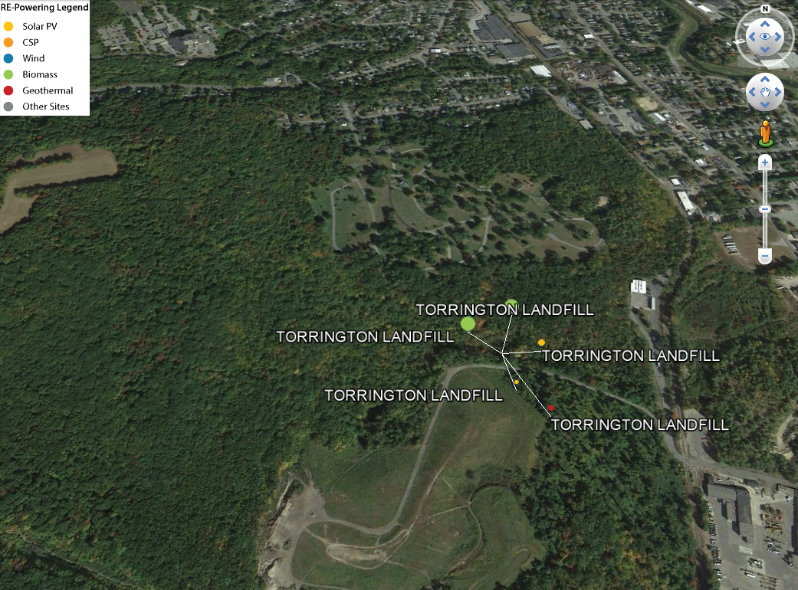
RE-Powering Mapper 1 Site, 5 Potential Opportunities
90 kW PV installed
Geothermal Heat Pump Potential
Biopower Potential

Slide 5
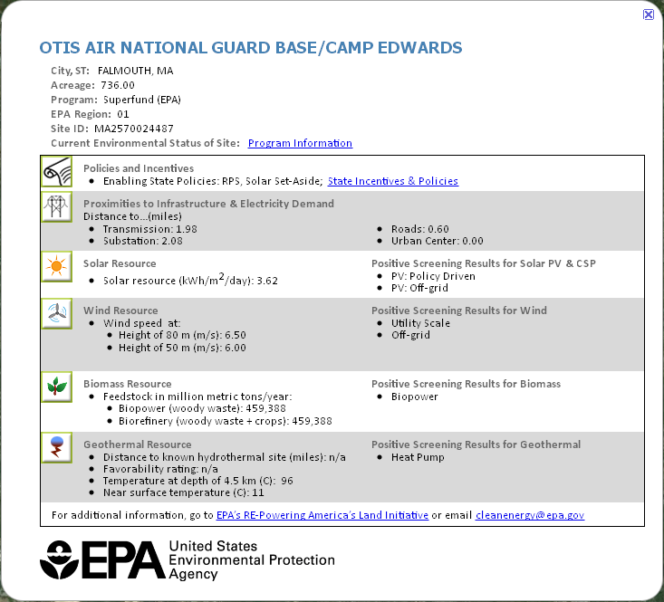
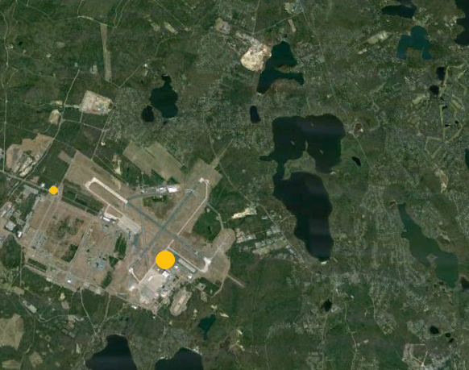
RE-Powering Mapper EPA Tracked Sites: Site-level information
5

Slide 6
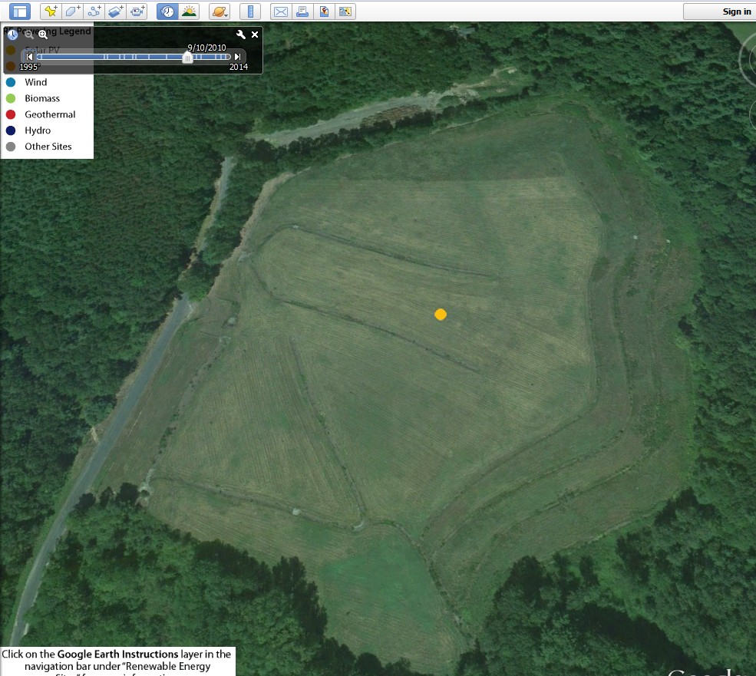
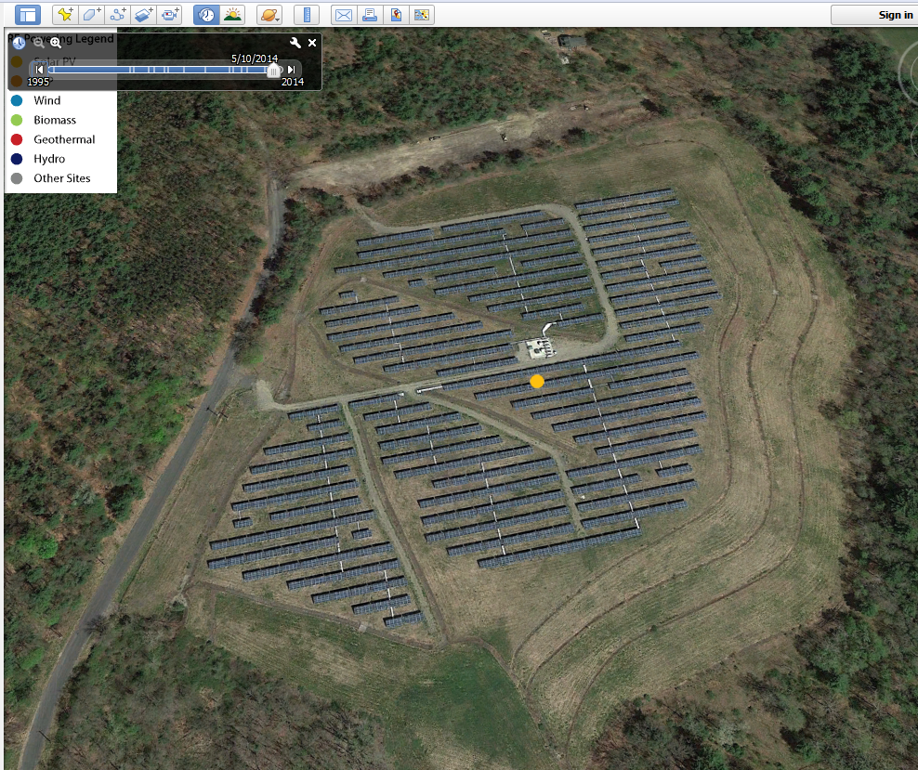
Google Earth Features

Slide 7
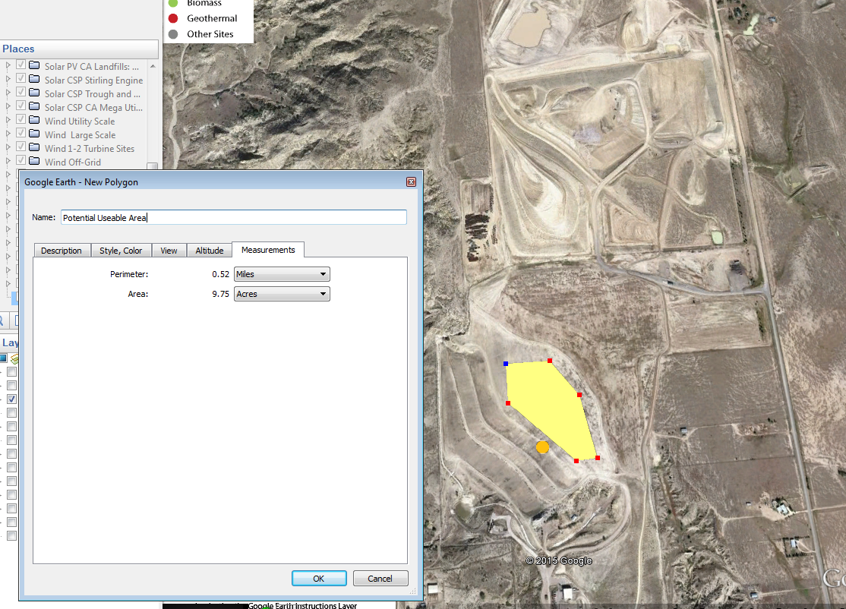
Google Earth Features

Slide 8
RE-Powering Screening Dataset
Contains detailed site information for all 80,000+ sites RE-Powering tracks
Example: Sites in Aurora, Colorado with Large Scale Solar PV Potential (over 300 kW capacity)

Slide 9
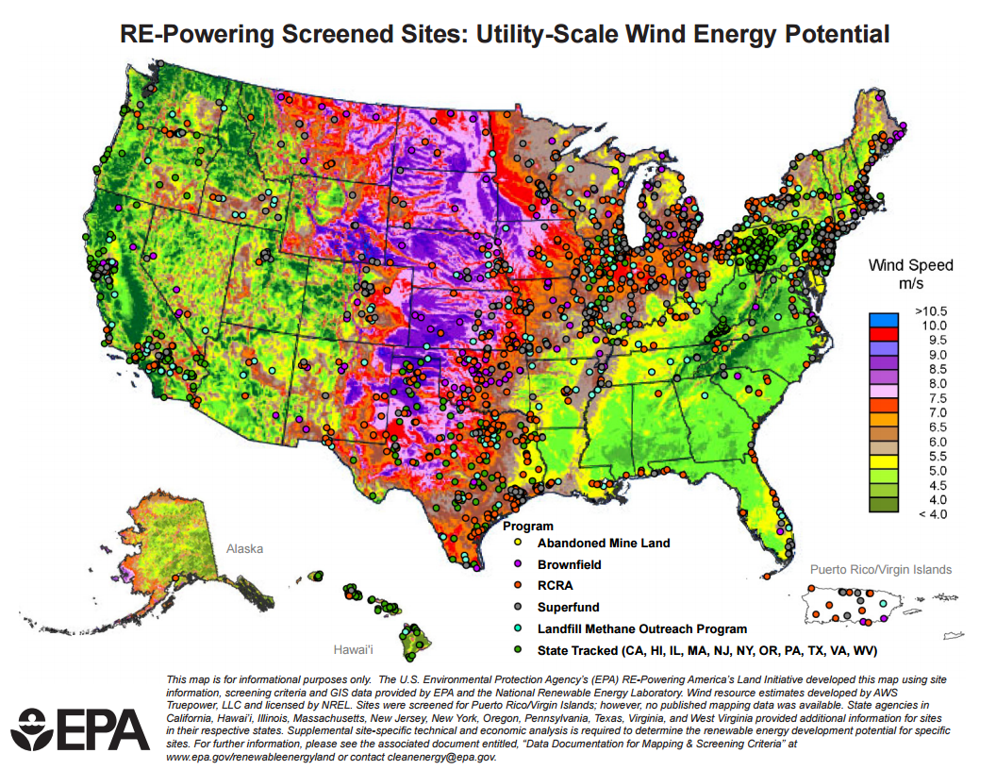
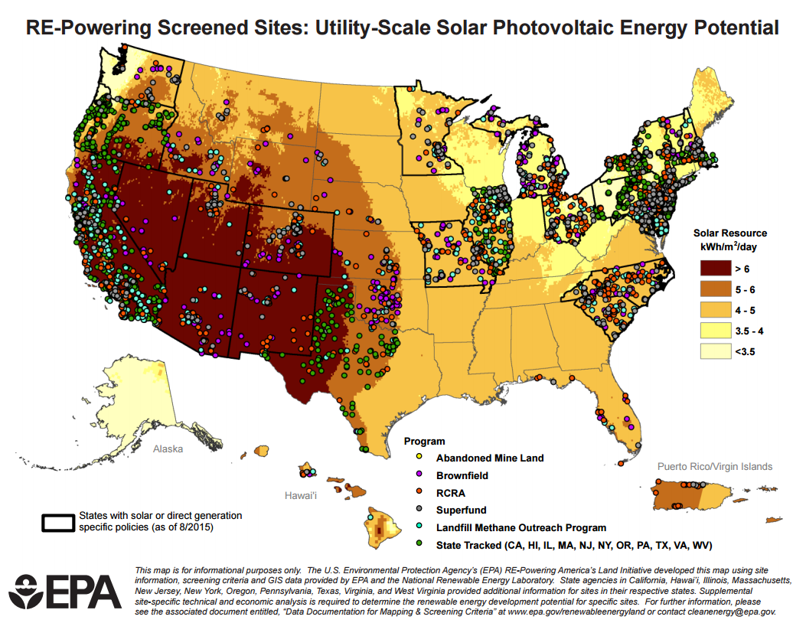
National Renewable Energy Maps

Slide 10
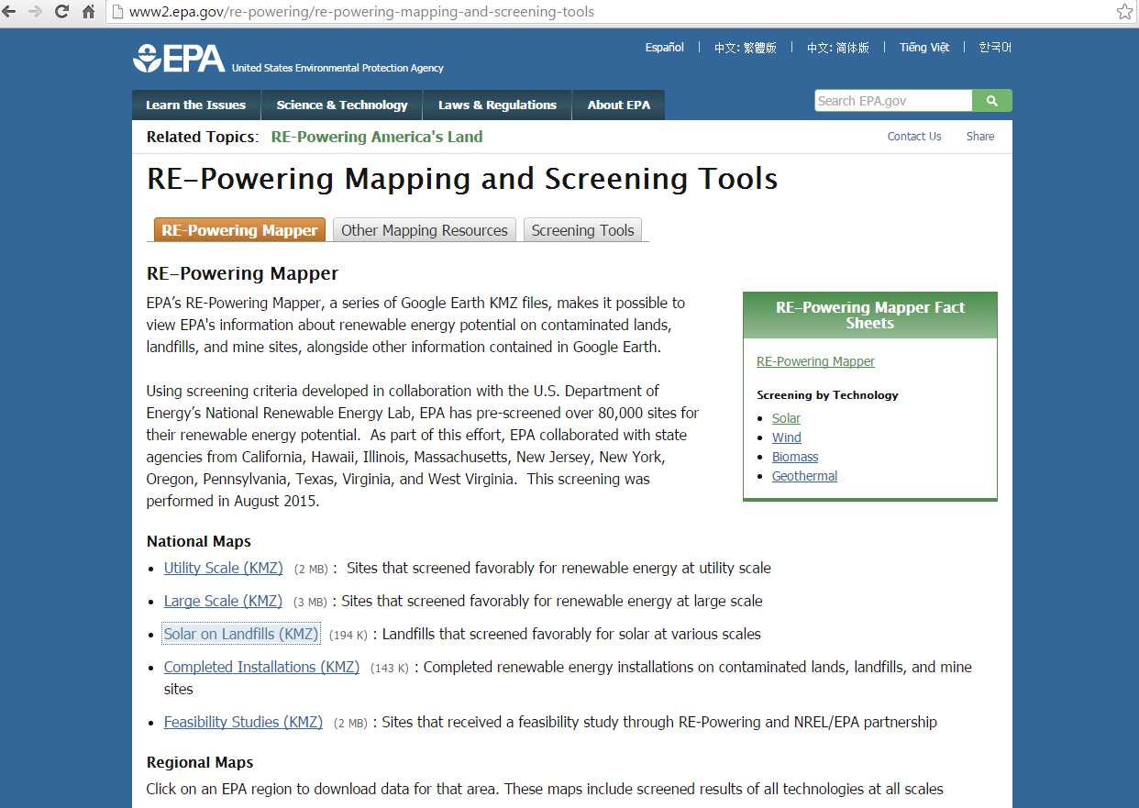
Questions?
Questions?

