Slide 1


Welcome to the CLU-IN Internet Seminar
US Small Business Funding Opportunities (SBIR/STTR) for Environmental Technologies at NIEHS SRP, EPA, and NSF
Sponsored by: NIEHS SRP, EPA, NSF
April 2, 2015, 1:00 PM – 3:00 PM, EDT (17:00-19:00 GMT)
Moderator:
  Kirsten Mease, NIEHS (kirsten.mease@nih.gov)
Instructors:
  Heather Henry, NIEHS SRP (henryh@niehs.nih.gov)
  April Richards, EPA (richards.april@epa.gov)
  Prakash Balan, NSF (pbalan@nsf.gov)
Visit the Clean Up Information Network online at www.cluin.org

Slide 2
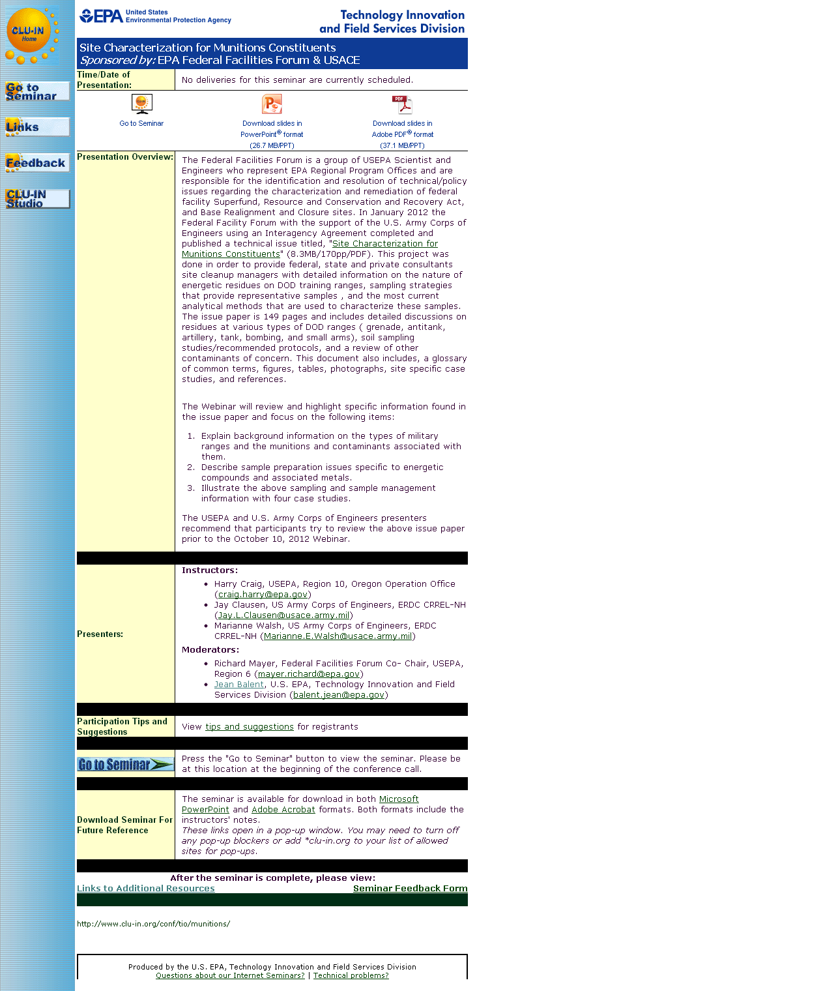
Seminar Homepage
Join the seminar online
Download Slides
Feedback

Slide 3

Housekeeping
Entire broadcast offered live via Adobe Connect
  participants can listen and watch as the presenters advance through materials live
  Some materials may be available to download in advance, you are recommended to participate live via the online broadcast
Audio is streamed online through by default
  Use the speaker icon to control online playback
  If on phones: all lines will be globally muted
  #6 to unmute, *6 to mute
  Closed Captioning will be available
Q&A – use the Q&A pod to privately submit comments, questions and report technical problems
This event is being recorded and shared via email shortly after live delivery
Archives accessed for free http://cluin.org/live/archive/

Slide 4
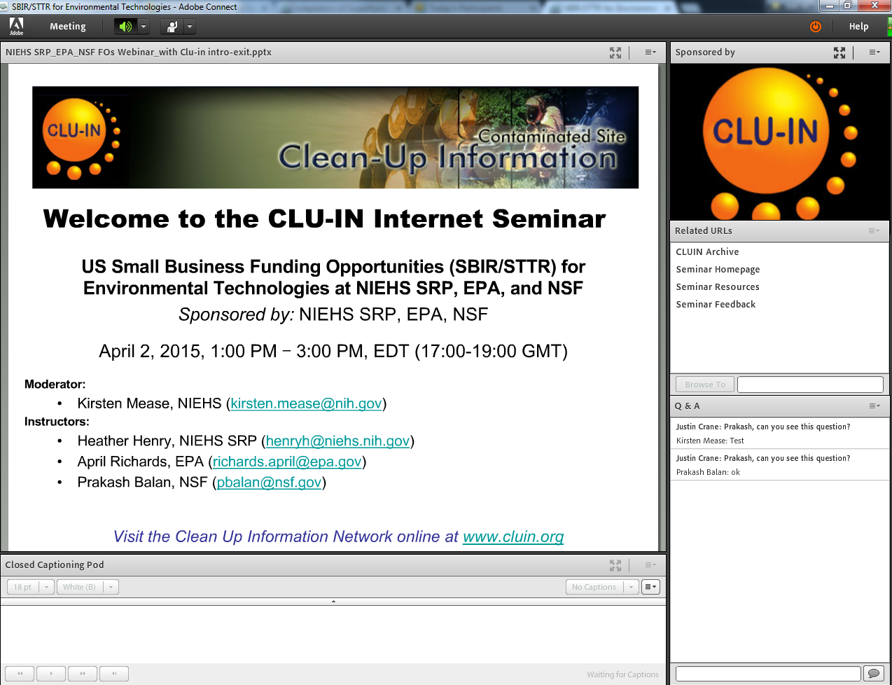

New online broadcast screenshot
Enlarge presentation
Control online audio
Information about Sponsors & Speakers
View presentation live online here
Related websites and files
Submit private questions, comments or report technical problems
Live closed captioning

Slide 5
US Small Business Funding Opportunities (SBIR/STTR) for Environmental Technologies at NIEHS SRP, EPA, and NSF
SBIR = Small Business Innovation Research
STTR = Small Business Technology Transfer
April 2, 2015
Presenters: Heather Henry - National Institute of Environmental Health Sciences
Superfund Research Program (NIEHS SRP)
April Richards - Environmental Protection Agency (EPA)
Prakash Balan - National Science Foundation
Chemical & Environmental Technologies (NSF CT)
Moderator: Kirsten Mease - National Institute of Environmental Health Sciences
http://www.clu-in.org/conf/tio/sbirsttr/

Slide 6
Overview
Purpose of the webinar
Introduction to SBIR and STTR grants
Agency Presentations
  National Institute of Environmental Health Sciences, Superfund Research Program (Heather Henry, NIEHS SRP)
  Environmental Protection Agency (April Richards, EPA)
  National Science Foundation, Chemical & Environmental Technologies (Prakash Balan, NSF CT)
Additional Resources
  Summary of Environmental Technology Funding Agencies & Institutes
  Top 10 Keys to Success
Q&A

Slide 7
Purpose
One-stop shopping for US owned and operated small business applicants with environmental technologies
Tailored to the CLU-IN audience
Overview of NIEHS SRP, EPA, NSF CT SBIR/STTR Programs
Direct access to SBIR/STTR Points of Contact to answer questions

Slide 8
Introduction
Phase I
Establish Technical merit, feasibility,
& commercial potential
Phase II
Continue R&D efforts initiated in Phase I
Phase III
Pursue commercialization objectives resulting from Phase I & II
SBIR – Small Business Innovation Research
  For profit
  <500 employees
  US owned and operated
STTR – Small Business Technology Transfer
  Small business (for profit) + Research Institution (nonprofit)
www.sbir.gov

Slide 9
SBIR Program – a brief history
In 1976
  Roland Tibbetts initiated an NSF program to support small businesses
  Provided early-stage financial support for high-risk technologies with commercial potential
In 1982
  Congress passed Small Business Innovation Development Act
Today
  11 Federal agencies support SBIR
  5 Federal agencies support STTR
  Over $2.5 billion awarded to small businesses in FY2011
  Produces an average of 7 patents/day
Required Allocations
FY | SBIR | STTR
2015 | 2.90% | 0.40%
2016 | 3.00% | 0.45%
2017 | 3.20% | 0.45%
Notes:
9

Slide 10


SBIR/STTR funds tech that is…
High risk, high payoff
Highly innovative
Disruptive, not iterative
Commercially viable
Impactful to society and/or environment

Slide 11
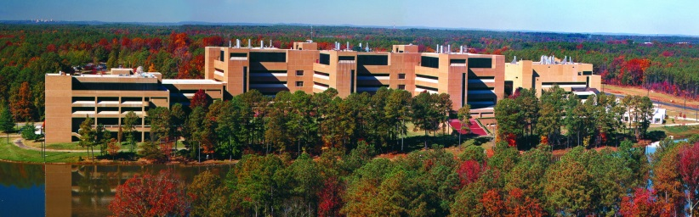
NIEHS SRP
Heather Henry
henryh@niehs.nih.gov
NIEHS, Research Triangle Park, NC
Please follow link to topics of interest: http://www.niehs.nih.gov/research/supported/dert/programs/srp/hwaerp/index.cfm
Current SBIR/STTR Grantees:
http://tools.niehs.nih.gov/srp/programs/index269.cfm

Slide 12


NIEHS Superfund Research Program Mission
Apply
Fundamental Knowledge
NIH Research Mission
…to Understand
Health Outcomes
NIEHS Research Mission
…from toxicology, epidemiology, genetics, -omics…
…related to environmental exposures
SRP Funded in 1986 under Superfund Amendments Reauthorization Act (SARA)
…including health,
risk assessment, remediation and
detection
SRP Research Mission
Research Triangle Park, NC
…with relevance
to Superfund
(EPA and ATSDR)
NIEHS SRP Hazardous Substances Detection and Remediation SBIR/STTR Grant Program
(R41, R42, R43, R44)

Slide 13
Topics of Interest:
NIEHS SRP SBIR/STTR Purpose
To foster commercialization of novel strategies to detect and remediate hazardous substances at contaminated sites.
Real-time, on-site monitoring: (soil, surface water, groundwater, subsurface, sediments, etc.).
Nanotechnology-based sensors and probes, biosensors, self-contained miniaturized toxicity-screening kits and miniaturized analytical probes and data analysis tools
Non-targeted or multi-analyte field sampling tools or kits; assays or devices to determine the extent to which a contaminant is bioavailable
Products that allow for rapid sample clean-up/preparation for analysis of environmental samples
Devices to detect and measure vapor intrusion or to detect non-aqueous phase liquids (NAPLs) and dense non-aqueous phase liquids (DNAPLs) in the subsurface; devices to detect contaminants in geological subsurface
Specific examples provided on SRP Webpage: http://www.niehs.nih.gov/research/supported/dert/programs/srp/hwaerp/index.cfm

Slide 14
Topics of Interest (continued):
NIEHS SBIR/STTR Topics
Complete List – www.niehs.nih.gov/sbir
Novel technologies for in situ remediation of contaminated sediments, soils, and groundwater.
Cost-effective devices to detect or remediate chemical mixtures in environmental media.
Computational, geographical information system-based, or modeling products for predicting fate and transport of contaminants, rates of remediation, or for identifying contamination sources.
Nano-enabled structures, electrochemical methods, photocatalytic processes, thermal treatments, or filtration-based methods of remediation.
Bioremediation and phytoremediation technologies
High throughput assays or toxicity screening products for use in ecological risk assessments.
Specific examples provided on SRP Webpage: http://www.niehs.nih.gov/research/supported/dert/programs/srp/hwaerp/index.cfm

Slide 15
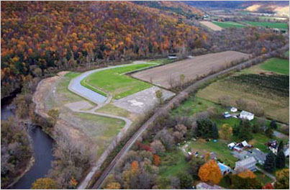
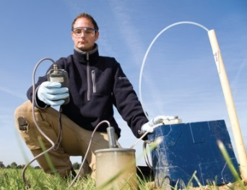

Superfund Relevance
Clearly state connection to Superfund
  Readily adaptable for Superfund site monitoring or mitigation
  Hazardous Substances: Priority List of contaminants found on Superfund Sites: http://www.atsdr.cdc.gov/SPL/index.html
  Value added over current Superfund Site Remedies: see Superfund Remedy Report: http://www.clu-in.org/asr/
Consistent with EPA/ATSDR Policies and Priorities:
  High Priority issues: http://www.clu-in.org/issues/
  Green & sustainable – improve energy efficiency and reduce waste generation.
Superfund Site Work
is not a requirement
Outside Scope NIEHS SBIR/STTR:
Pathogens in the environment
Petroleum (or hydrofracturing) remediation or detection technologies (per SARA, this is not a “hazardous substance”)

Slide 16
NIH Solicitations
Application Due Dates:
Apr 5, 2015
Sep 5, 2015
Jan 5, 2016
Apr 5, 2016 (ad infinitum)
Sep 5, 2016
Health and Human Services (HHS “Omnibus” Program Announcements): used by National Institutes of Health (NIH), Centers for Disease Control and Prevention (CDC), Food and Drug Administration (FDA).
  SBIR Omnibus - http://grants.nih.gov/grants/guide/pa-files/PA-14-071.html
  STTR Omnibus - http://grants.nih.gov/grants/guide/pa-files/PA-14-072.html
Full list of topics for all Institutes is provided in Program Announcement**
Required Registrations (takes 6-8 weeks)
  DUNS Number (Company)
  System for Award Management (SAM)
  Grants.gov (Company)
  eRA Commons (Company and all PD/PIs)
  SBA Company Registry at SBIR.gov
**Other NIEHS SBIR/STTR Topics:
Exposure assessment tools
Bio-monitoring technologies
Toxicity screening
Educational materials for Environmental Health
Advanced Training Tech for Emergency Responders
http://era.nih.gov/applicants/index.cfm

Slide 17

NIEHS SRP Budget & Awards
NIEHS Total SBIR/STTR budget
SBIR ~12.5M STTR ~2.0M
Award Budget ~ $1.8M (SRP SBIR/STTR)
Awards grants
  Phase I: Feasibility Study
    $150,000 direct costs
    6 months (SBIR), 1 year (STTR)
  Phase II: Full Research/R&D
      $1M direct costs
      2 years
  Fast Track – Phase I and Phase II application combined
    Time and award amounts are same as Ph I and Ph II, but consecutive
  Phase IIB: NIEHS SRP does not participate
  Phase III: Not funded through NIH SBIR/STTR budget

Slide 18
NIH Review Process
Applications Received
NIH External Peer Review
Awards
NIEHS Advisory Council Review
Determination of Relevance to Program Announcement
NIH Panel Review: includes detection, remediation, biomedical devices, biomedical
engineering applications.
NAEHS Council Review:
Concurrence of Peer Review
6-7 Months from time of submission

Slide 19
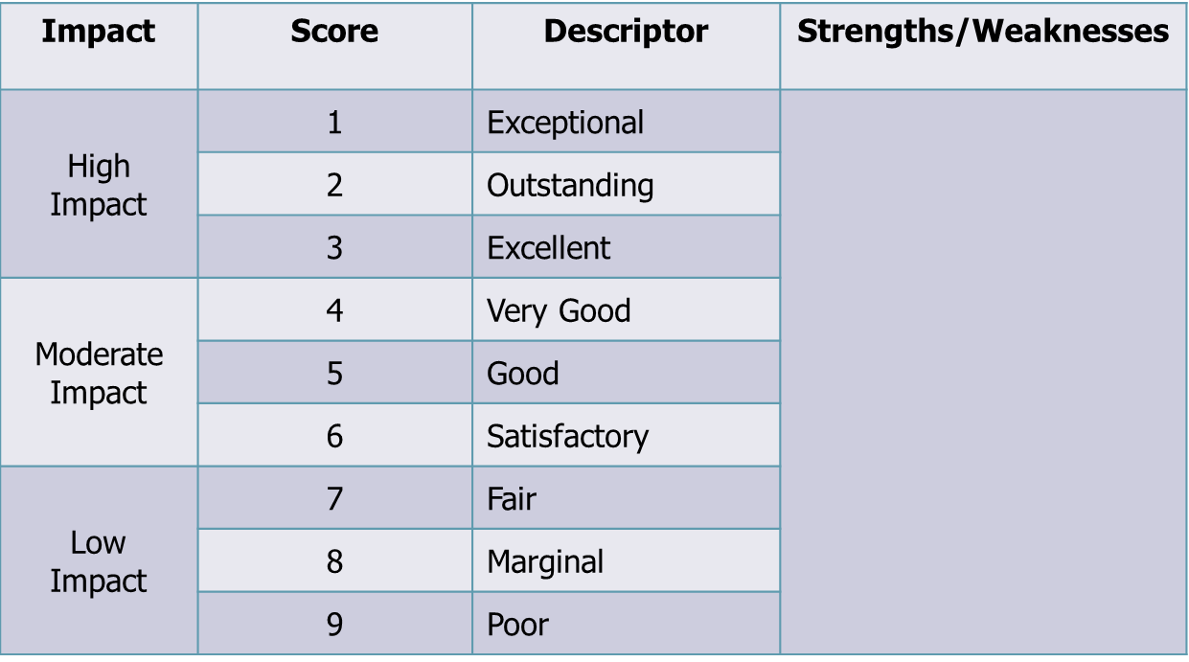

External Peer Review – Scoring
Scored Criteria:
Significance
(Real Problem/
Commercial Potential)
Investigators
(PI and team)
Innovation
(New or Improved?)
Approach
(Research Design, Feasible)
Environment (Facilities/Resources)
Also see “Additional Criteria” – i.e. plan for Biohazards
(chemical safety)
Strengths
Weaknesses
Initial Scoring 1-9, Final Score 10-90
Scores typically released within 3-4 days of review. Summary Statement posted within 2-3 weeks of review.

Slide 20
External Peer Review – Points to Know
Study Sections
3 reviewers per application
Wide scope expertise - majority are not environmental technologists
Expectations
Preliminary data
Fundamental science, novelty, innovation
Convince reviewers the market exists
(hint of commercialization capability, even for Phase I)
Review Study Section: http://public.csr.nih.gov/StudySections/IntegratedReviewGroups/
IMSTIRG/IMST12-13/Pages/default.aspx

Slide 21
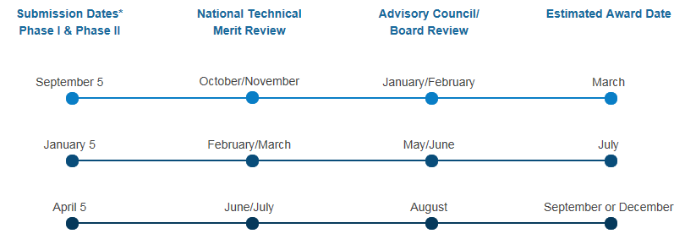
NIH Application to Award Timeline

Slide 22
EPA
April Richards
www.epa.gov/ncer/sbir
    richards.april@epa.gov

Slide 23

EPA-SBIR Mission
EPA: Protect human health and the environment
EPA SBIR: Support development and commercialization of innovative technologies to meet Agency’s mission

Slide 24
EPA SBIR Budget & Awards
Award Budget ~ $4M
Awards contracts
  Phase I: Proof of Concept
    $100,000
    6 months
  Phase II: Develop & Commercialize Technology
    $300,000 (+Commercialization Option of $100,000)
    2 years
EPA provides commercialization support to all Phase I and Phase II Companies

Slide 25

EPA Solicitation
One solicitation per year
Next solicitation scheduled for Spring 2015
Information at www.epa.gov/ncer/sbir
Who we fund? http://1.usa.gov/1Gtaxts

Slide 26


2014 Solicitation Topics
(for reference)
Air and Climate
  Industrial Process Pollution Reductions
  Lab-on-a-chip sensors
  Nano-Air Filters
Manufacturing
  Non-toxic electronics
Toxic Chemicals
  Non-fluorinated surfaces of coatings
  Polyurethane Coatings
  Flame Retardant Materials
Water
  Nutrient Recovery
  Small Drinking Water Systems
Building Materials
  Innovative Construction Materials
  Material Reuse and Recycling
Food Waste
  Resource Recovery
Homeland Security
  Pathogen Removal from Water Pipes

Slide 27

New Electronic Submission System
Now using FedConnect for electronic submissions
Please start early to register your company with FedConnect
Register at: www.fedconnect.net/FedConnect/

Slide 28
Required Registrations
Dun and Bradstreet Universal Numbering System (DUNS) – All registrations require that applicants be issued a DUNS number. After obtaining a DUNS number, applicants can begin both SAM, and SBA Company registry.
The same DUNS number must be used for all registrations, as well as on the proposal.
SBA Company Registry – New requirement. See solicitation for instructions on how to register and how to attach proof of registration to your proposal package. Applicants must have a DUNS number to complete this registration. SBA Company registration is NOT required before SAM.
System for Award Management (SAM) (formerly CCR) – Applicants must complete and maintain an active registration, which requires renewal at least annually. The renewal process may require as much time as the initial registration.
FedConnect – New process. Electronic applications system for EPA SBIR. FedConnect is a web portal that connects agencies and vendors to streamline the process of doing business with the federal government.

Slide 29
Proposal Evaluation and Selection
Applications Received
External Peer Review
Awards
EPA Internal Programmatic Review

Slide 30
EPA External Peer Review (Phase I)
Ratings:
  Excellent, Very Good, Good, Fair, Poor
Five Criteria:
  Disruptive Potential
  Management and Technical Capabilities
  Life Cycle (environmental) Impacts
  Technical Soundness
  Commercialization Potential

Slide 31
EPA Internal Relevancy Review
Review only proposals rated “Excellent” and “Very Good”
Three Criteria:
  EPA Needs and Program Priorities
  Significant Environmental Benefits (Sustainability)
  Broad Application and Impact

Slide 32
EPA Application to Award Timeline
Solicitation Opens for ~ 45 days | Peer Review | Relevancy Review | Awards
Spring 2015 | September 2015 | October 2015 | January 2016

Slide 33
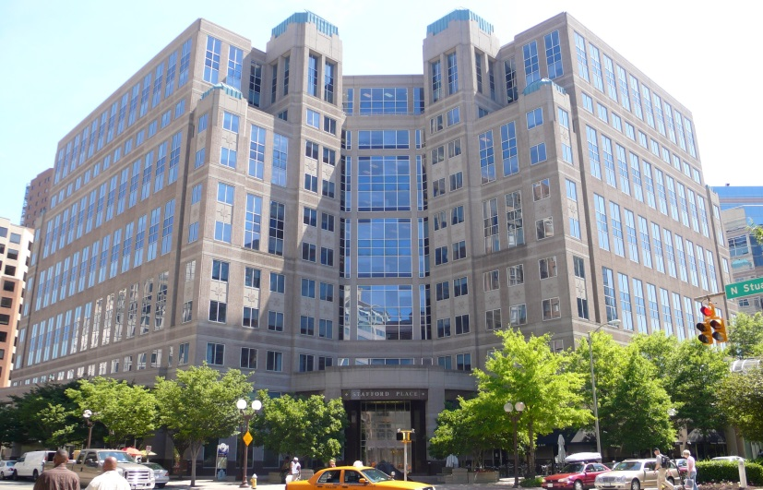
National Science Foundation (NSF)
Prakash Balan, Ph.D
pbalan@nsf.gov
Arlington, VA
NSF SBIR/STTR Home:
http://www.nsf.gov/eng/iip/sbir/index.jsp

Slide 34
National Science Foundation
NSF’s Vision – NSF’s vision is a nation that creates and exploits new concepts in science and engineering and provides global leadership in research and education
~$7.3B Budget, ~$177M for Small Business Program
320,900 researchers, postdoctoral fellows, trainees, teachers, and students supported
214 Nobel Laureates supported since 1950

Slide 35
NSF SBIR/STTR Budget & Phases
Award Budget ~ $177M NSF SBIR/STTR, NSF does not allocate budgets by topic. There is flexibility. Allocation depends on incoming proposal quality
Awards (grants)
  Phase I: Technology Proof of Concept
    $150,000 SBIR, $225,000 STTR
    6 months SBIR, 1 year STTR
  Additional R&D funds available supporting third party financial engagement (Investors, customers, state support)
  Phase II: Technology Development
    $750,000 SBIR and STTR
    2 years
  Additional funding available for Commercial, institutional, educational partnerships
  Phase III: No further NSF funding

Slide 36
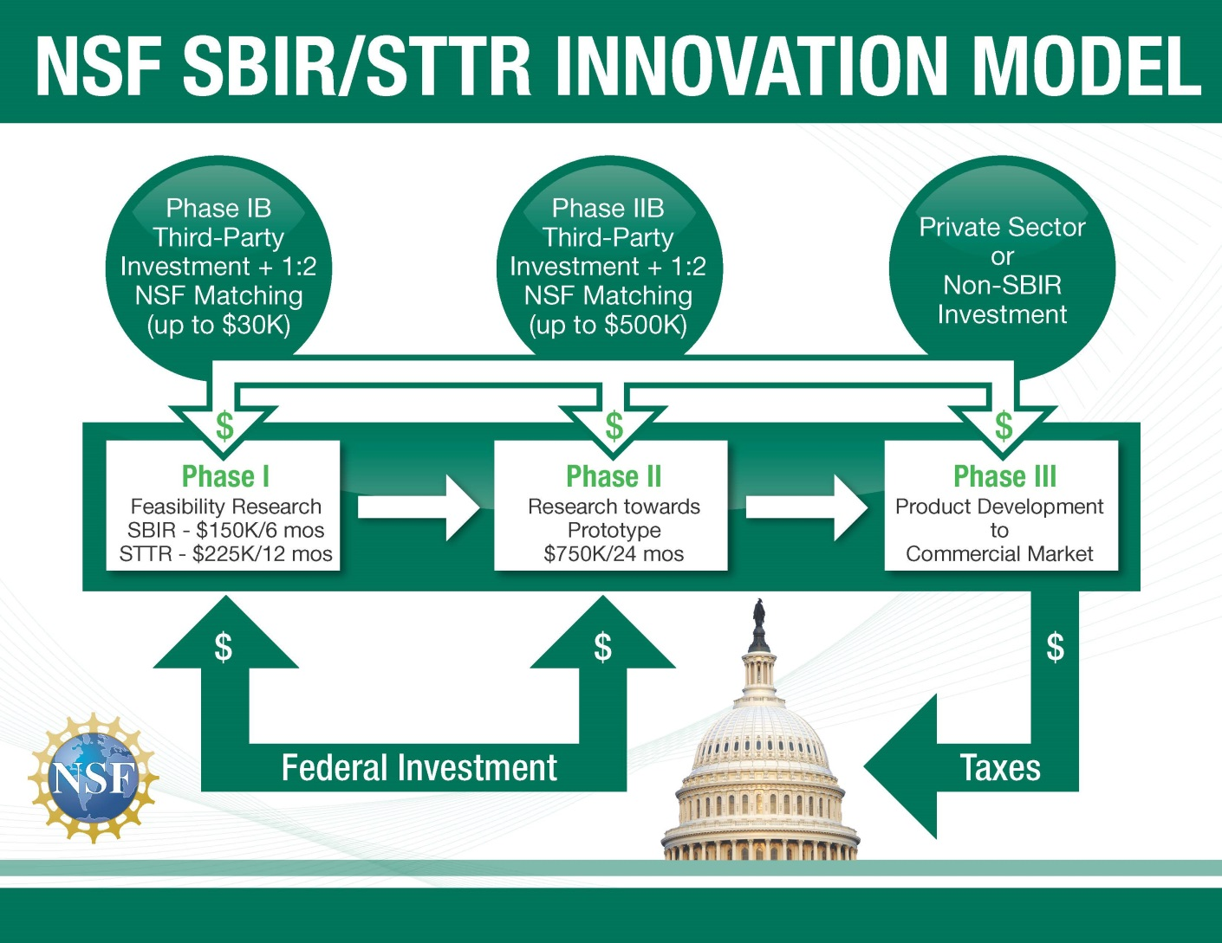

Slide 37
Very broad funding landscape!
Topic | Program Director
Educational Technologies and Applications (EA) | Glenn H. Larsen, glarsen@nsf.gov
Information and Communication Technologies (IC) | Peter Atherton, patherto@nsf.gov
Semiconductors (S) and Photonic (PH) Devices and Materials | Steven Konsek, skonsek@nsf.gov
Electronic Hardware, Robotics and Wireless Technologies (EW) | Muralidharan S. Nair, mnair@nsf.gov
Advanced Manufacturing and Nanotechnology (MN) | Rajesh Mehta, rmehta@nsf.gov
Advanced Materials and Instrumentation (MI) | Benaiah Schrag, bschrag@nsf.gov
Chemical and Environmental Technologies (CT) | Prakash Balan, pbalan@nsf.gov
Biological Technologies (BT) | Ruth M. Shuman, rshuman@nsf.gov
Smart Health (SH) and Biomedical (BM) Technologies | Jesus V. Soriano, jsoriano@nsf.gov
  Nearly any innovation with commercial potential fits somewhere!

Slide 38

Chemical and Environmental Technologies (CT)
Chemicals and sustainability, green chemistry…
Energy efficiency, capture, storage, use…
Water, wastewater treatment, reuse, waste recycling…
Environmental sensors, Pollution control & mitigation…
Biofuels, bioenergy…
Renewable chemicals, materials…
Technologies for agricultural innovations. …
Food, Pharmaceutical and industrial biotechnology
…..and more!

Slide 39
Looking to fund a new/novel innovation?
Discuss it with a Program Director!
Email a 2 page executive summary discussing the following aspects of the project: pbalan@nsf.gov
  Company and team
  Market opportunity, value proposition, and customers
  Technology/innovation
  The competition
  Research outline

Slide 40
How To Apply
How to Apply – http://www.nsf.gov/eng/iip/sbir/phase_I.jsp
Two solicitations per year typically (June and December deadlines)
  Solicitations are published 3 months ahead of submission deadline
  Current Open Solicitation
    Jun 16, 2015 (SBIR) http://www.nsf.gov/pubs/2015/nsf15546/nsf15546.htm
    Jun 18, 2015 (STTR) http://www.nsf.gov/pubs/2015/nsf15545/nsf15545.htm
Funding Topics Website- http://www.nsf.gov/eng/iip/sbir/topicshome.jsp

Slide 41
Required Registrations
Dun and Bradstreet Universal Numbering System (DUNS) – All registrations require that applicants be issued a DUNS number. After obtaining a DUNS number, applicants can begin both SAM, and SBA Company registry.
The same DUNS number must be used for all registrations, as well as on the proposal.
SBA Company Registry – New requirement. See solicitation for instructions on how to register and how to attach proof of registration to your proposal package. Applicants must have a DUNS number to complete this registration. SBA Company registration is NOT required before SAM.
System for Award Management (SAM) (formerly CCR) – Applicants must complete and maintain an active registration, which requires renewal at least annually. The renewal process may require as much time as the initial registration.
FastLane– Register the Principal Investigator AND company in NSF's electronic submission system.

Slide 42
Proposal Evaluation and Selection
Applications
External Peer Merit Review
Awards/Decline
Due diligence

Slide 43
Intensely competitive process
~ 1500-2000 Phase I Proposals typically received (annually)
Roughly 15% of the Phase I proposals may be funded
Roughly 40% of Phase I companies may make it all the way to Phase II funding
Proposals reviewed on both technical and commercial merits

Slide 44
Merit Review
Invited subject matter experts from Academia and Industry in Panel reviews
Focus on disruptive and discontinuous technology developments with broad impact
  New markets, novel products, enabling platform technologies and applications
  Must show a strong commercialization focus and well thought out vision to profitability and growth
NOT funded
  Evolutionary optimization of existing products and processes or modifications to broaden the scope of an existing product, process or application,
  Analytical or “market” studies of technologies, market research
  Routine engineering design & system integration

Slide 45
Proposal Review: Technical Aspects
A sound approach to establish technical
& commercial feasibility
Qualified technical team
Sufficient access to resources
Reflects “state-of-the-art”

Slide 46
Proposal Review: Commercial Aspects
The commercial and societal benefits?
Business team with relevant skills?
Any past commercialization track record?
Competitive advantage in the marketplace?
Enabling technologies/platforms (instrumentation, software, etc.) for further innovation?
Ability to attract further funding from non-SBIR sources once the SBIR project ends?

Slide 47
NSF Application to Award Timeline
4-5 months
Submission Date | Merit Review | Award Decisions | Awards
June 2015 | July - September 2015 | October - November 2015 | January 2016
December 2015 | January – March 2016 | April – May 2016 | July 2016
Applicants receive detailed feedback.
Reviewer and panel comments to NSF are shared with applicants verbatim

Slide 48

Other SBIR/STTR Agencies and Institutes that Fund Environmental Technologies
AGENCIES
Department of Defense (DoD) - Tracy Frost administrator.dodsbir@osd.mil
Department of Energy (DoE) - Manny Oliver manny.oliver@science.doe.gov
United States Department of Agriculture (USDA) - Charles F. Cleland ccleland@nifa.usda.gov
National Oceanic and Atmospheric Administration (NOAA) - Joan Clarkson joan.e.clarkston@noaa.gov
NIH INSTITUTES
National Institute of General Medical Sciences (NIGMS) - Scott Somers somerss@nigms.nih.gov
National Center for Advancing Translational Sciences (NCATS) - Lili M. Portilla Portilll@mail.nih.gov
National Heart, Lung, and Blood Institute (NHLBI) - Jennifer Shieh jennifer.shieh@nih.gov
National Institute of Biomedical Imaging and Bioengineering (NIBIB) - Todd Merchak merchakt@mail.nih.gov
Eunice Kennedy Shriver National Institute of Child Health and
Human Development (NICHD) - Louis A. Quatrano Email: Quatranol@mail.nih.gov

Slide 49

TOP 10 Keys to Success
Contact the Program Official before applying
Begin the registration process 6 -8 weeks in advance
Submit your application 3-5 days before the due date
Read the solicitation/funding announcement carefully
Need an effective team (technical and business expertise)
Demonstrate real market interest and need for proposed innovation
Anticipate questions and doubts about the proposal
If resubmitting, address all previous review comments
Use the cover letter to direct your application to the correct review group
Remember NIEHS SRP, EPA, and NSF are “investors” not “customers”

Slide 50

Q&A
Online Participants
  Enter your question into the Q&A box on the bottom right hand side of your screen
Phone Participants
  Dial *6 to mute and unmute phone

Slide 51
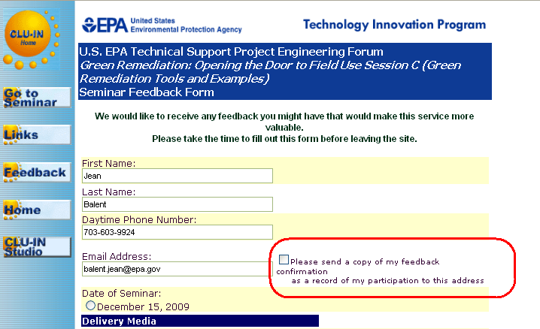
Resources & Feedback
To view a complete list of resources for this seminar, please visit the Additional Resources
Please complete the Feedback Form to help ensure events like this are offered in the future
Need confirmation of your participation today?
Fill out the feedback form and check box for confirmation email.

Slide 52



New Ways to stay connected!
Contaminated Site Clean-Up Information: www.cluin.org
  https://www.facebook.com/EPACleanUpTech
  https://twitter.com/#!/EPACleanUpTech
    http://www.linkedin.com/groups/Clean-Up-Information-Network-CLUIN-4405740

Slide 53
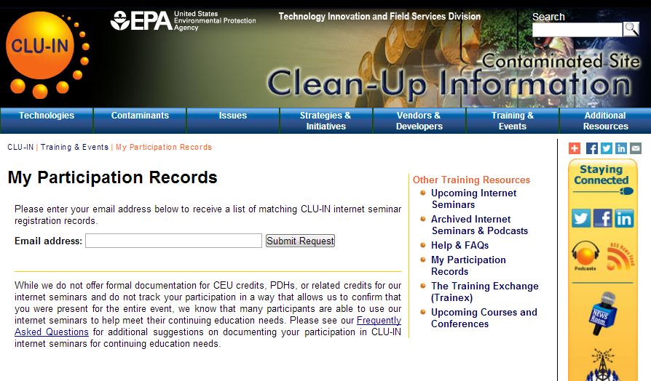
CLUIN Participation Records
http://www.clu-in.org/training/records/

