Slide 1
US Small Business Funding Opportunities (SBIR/STTR) for Environmental Technologies at NIEHS SRP, EPA, NSF, USDA
SBIR = Small Business Innovation Research
STTR = Small Business Technology Transfer
October 3, 2016
Presenters:
Heather Henry , National Institute of Environmental Health Sciences Superfund Research Program
(NIEHS SRP)
April Richards , US Environmental Protection Agency (EPA)
Charles Cleland, United States Department of Agriculture (USDA)
Prakash Balan , National Science Foundation Chemical & Environmental Technologies (NSF CT)
Moderator:
Michael Adam and Jean Balent, US EPA, Office of Superfund Remediation and Technology Innovation
http://www.clu-in.org/conf/tio/sbirsttr/
Notes:
Moderator: Welcome , we will begin the preliminary audio broadcast shortly before 1pm eastern. If you have any questions, comments or technical issues, please use the Q&A window to privately submit them.

Slide 2
Overview
Purpose of the webinar
Introduction to SBIR and STTR grants
Agency Presentations
  National Institute of Environmental Health Sciences, Superfund Research Program (Heather Henry, NIEHS SRP)
  Environmental Protection Agency (April Richards, EPA)
  United States Department of Agriculture (Charles Cleland, USDA)
  National Science Foundation, Chemical & Environmental Technologies (Prakash Balan, NSF CT)
Additional Resources
  Summary of Environmental Technology Funding Agencies & Institutes
  Top 10 Keys to Success
  Small Business Administration Resources
Q&A

Slide 3
Purpose
One-stop shopping for US owned and operated small business applicants with environmental technologies
Tailored to the CLU-IN audience
Overview of NIEHS SRP, EPA, USDA, and NSF CT SBIR/STTR Programs
Direct access to SBIR/STTR Points of Contact to answer questions

Slide 4

Introduction
Phase I
Establish Technical merit, feasibility,
& commercial potential
Phase II
Continue R&D efforts initiated in Phase I
Phase III
Pursue commercialization objectives resulting from Phase I & II
SBIR – Small Business Innovation Research
  For profit
  <500 employees
  US owned and operated
STTR – Small Business Technology Transfer
  Small business (for profit) + Research Institution (nonprofit)
Required Allocations
FY | SBIR | STTR
2015 | 2.90% | 0.40%
2016 | 3.00% | 0.45%
2017 | 3.20% | 0.45%
www.sbir.gov
Notes:
Congressional History
The SBIR program was established under the Small Business Innovation Development Act of 1982 (P.L. 97-219) with the purpose of strengthening the role of innovative small business concerns in Federally-funded research and development (R&D). Through FY2009, over 112,500 awards have been made totaling more than $26.9 billion.
In December 2000, Congress passed the Small Business Research and Development Enhancement Act (P.L. 102-564) The program was reauthorized until September 30, 2008 by the Small Business Reauthorization Act of 2000 (P.L. 106-554). Subsequently, Congress passed numerous extensions, the most recent of which extends the SBIR program through 2017.
SBIR Agencies
Department of Agriculture
Department of Commerce - National Institute of Standards and Technology
Department of Commerce - National Oceanic and Atmospheric Administration
Department of Defense
Department of Education
Department of Energy
Department of Health and Human Services
Department of Homeland Security
Department of Transportation
Environmental Protection Agency
National Aeronautics and Space Administration
National Science Foundation
STTR Agencies
Department of Defense
Department of Energy
Department of Health and Human Services
National Aeronautics and Space Administration
National Science Foundation

Slide 5
SBIR Program – a brief history
In 1976
  Roland Tibbetts initiated an NSF program to support small businesses
  Provided early-stage financial support for high-risk technologies with commercial potential
In 1982
  Congress passed Small Business Innovation Development Act
Today
  11 Federal agencies support SBIR
  5 Federal agencies support STTR
  Over $2.2 billion awarded to small businesses
  Produces an average of 10 patents/day
Notes:
5
Note: 7 patents/day is more than all U.S. universities combined.
Federal Agencies with extramural R&D budgets >$100M
Federal Agencies with extramural R&D budgets >$1B
Last two statistics: SBA is the source from 2015:
https://www.sbir.gov/sites/default/files/SBA_OII_SBIR_STTR_Presentation_for_General_Public_3-20-15.pdf

Slide 6


SBIR/STTR funds tech that is…
High risk, high payoff
Highly innovative
Disruptive, not iterative
Commercially viable
Impactful to society and/or environment
Notes:
This is a weed out

Slide 7
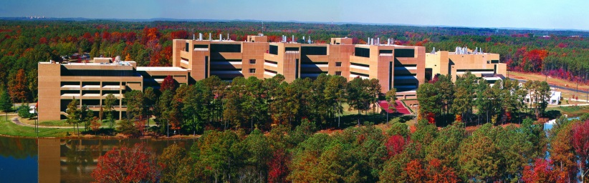
NIEHS SRP
Heather Henry
henryh@niehs.nih.gov
NIEHS, Research Triangle Park, NC
Please follow link to topics of interest: http://www.niehs.nih.gov/research/supported/centers/srp/hwaerp/index.cfm
Current SBIR/STTR Grantees:
http://tools.niehs.nih.gov/srp/programs/index269.cfm
Notes:
These links were updated 9.22.16

Slide 8


NIEHS Superfund Research Program Mission
Apply
Fundamental Knowledge
NIH Research Mission
…to Understand
Health Outcomes
NIEHS Research Mission
…from toxicology, epidemiology, genetics, -omics…
…related to environmental exposures
SRP Funded in 1986 under Superfund Amendments Reauthorization Act (SARA)
…including health,
risk assessment, remediation and
detection
SRP Research Mission
Research Triangle Park, NC
…with relevance
to Superfund
(EPA and ATSDR)
NIEHS SRP Hazardous Substances Detection and Remediation SBIR/STTR Grant Program
(R41, R42, R43, R44)
Notes:
NIH 27 institutes
NIEHS established in 1960s
University-based basic research program established in 1986 under Superfund Amendments Reauthorization Act (SARA)
The National Institute of Environmental Health Sciences (NIEHS) Superfund Research Program (SRP) supports cutting edge research to investigate toxicity, exposure, and remediation of hazardous substances found at Superfund Sites and to address a wide array of scientific problems facing the national Superfund program. SRP funds a multi-project center grant program consisting of integrated biomedical and environmental science and engineering research teams. SRP also awards grants to small businesses, individual investigator teams, and training coordinators.
FY 2014
Appropriation
NIH $29,926,104,000
NIEHS $665,439,000
Superfund Programs $77,349,000
Superfund Research Program $45M
Phase I: Feasibility Study $150,000 for 6 months
Budget Guide: $150K (SBIR); $150K (STTR) Total Costs
Project Period: 6 months (SBIR); 1 year (STTR)
\Phase II: Full Research/R&D
$1M (STTR), $1M (SBIR) over two years
2 years
NIEHS - discover how the environment affects people in order to promote healthier lives.
NIEHS SBIR/STTR - help small businesses develop innovative applications to translate and communicate environmental health research to improve public health
NIEHS
SBIR Totals$12.5M
STTR Totals$2.0M
Superfund Research Program
SBIR/STTR : $1.8M
-
Worker Training Program
$0.7M

Slide 9
Topics of Interest:
NIEHS SRP SBIR/STTR Purpose
To foster commercialization of novel strategies to detect and remediate hazardous substances at contaminated sites.
Monitoring, Detection, and Site Characterization
Remediation
Information Technology to Support Monitoring and Remediation
Green / sustainable detection technologies and remediation approaches
Improved energy efficiency and reduced waste generation.
Proposals must demonstrate that the proposed detection and remediation technologies are relevant to Superfund.
Topics will be updated June 2017
Specific examples provided on SRP Webpage: http://www.niehs.nih.gov/research/supported/centers/srp/hwaerp/index.cfm
Notes:
Update topics – link is already updated
Monitoring, Detection, and Site Characterization Real-time, on-site monitoring: soil, surface water, groundwater, subsurface, sediments, air (such as volatile releases from sites), etc.
Nanotechnology-based sensors and probes, biosensors, and miniaturized analytical probes
Non-targeted or multi-analyte field sampling tools or kits
Products that allow for rapid sample clean-up/preparation for analysis of environmental samples
Devices to detect chemical mixtures in environmental media
Self-contained miniaturized toxicity-screening kits for detecting contamination hotspots
Assays or devices to determine the extent to which a contaminant is bioavailable
High throughput assays or toxicity screening products for use in ecological risk assessments
Examples of specific environmental monitoring, detection, and site characterization needs: Devices to detect and measure vapor intrusion or to detect non-aqueous phase liquids (NAPLs) and dense non-aqueous phase liquids (DNAPLs) in the subsurface
Site characterization techniques and strategies for complex geology (fractured, karst and heterogeneous layered deposits)
Short-duration tests or methods to improve identification of reasonable worst case vapor intrusion condition in a building
Technologies for rapid extraction or processing of soil for incremental sampling methodologies (ISM)
Technologies for automated fiber counting for asbestos samples
Remediation Novel technologies for in situ remediation of contaminated sediments, soils, and groundwater
Technologies to remediate chemical mixtures in environmental media
Portable adsorption systems for removing chlorinated VOCs from indoor air to achieve risk-based indoor air standards
Nano-enabled structures, electrochemical methods, photocatalytic processes, thermal treatments, or filtration-based methods of remediation.
Bioremediation and phytoremediation technologies including development and culturing/propagation of plants, bacterial strains, or fungal species optimized for bioremediation.
New strategies for delivery of reagents for groundwater remediation: in situ chemical oxidation ISCO), zero valent iron (ZVI), and hydraulic fracturing (note: this excludes gas exploration)
New strategies for delivery of reagents for recovery/extraction of contaminants in groundwater
Information Technology to Support Monitoring and Remediation Computational, geographical information system-based, or modeling products for predicting fate and transport of contaminants, rates of remediation, or for identifying contamination sources
Miniaturized data analysis tools
SRP encourages applicants to develop green / sustainable detection technologies and remediation approaches that improve energy efficiency and reduce waste generation. Proposals must demonstrate that the proposed detection and remediation technologies are relevant to Superfund.

Slide 10
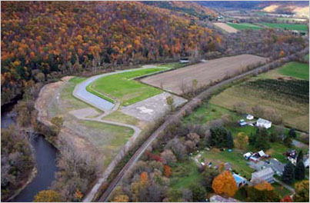
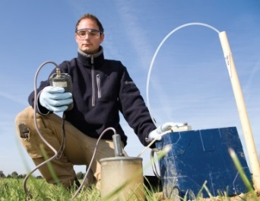

Superfund Relevance
Clearly state connection to Superfund
  Readily adaptable for Superfund site monitoring or mitigation
  Hazardous Substances: Priority List of contaminants found on Superfund Sites: http://www.atsdr.cdc.gov/SPL/index.html
  Value added over current Superfund Site Remedies: see Superfund Remedy Report: http://www.clu-in.org/asr/
Consistent with EPA/ATSDR Policies and Priorities:
  High Priority issues: http://www.clu-in.org/issues/
  Green & sustainable – improve energy efficiency and reduce waste generation.
Superfund Site Work
is not a requirement
Outside Scope NIEHS SBIR/STTR:
Pathogens in the environment
Petroleum (or hydrofracturing) remediation or detection technologies (per SARA, this is not a “hazardous substance”)
Notes:
In your application you should demonstrate your relevance to Superfund.
High Priority for remediation and detection technologies with a clear connection to Superfund; nonpoint-source air pollution and drinking water
Priority Hazardous Substances - CERCLA Priority List of Hazardous Substances (ATSDR)
his is a list of Comprehensive Environmental Response, Compensation, and Liability Act (CERCLA) priority hazardous substances, i.e. a list, in order of priority, of substances that are most commonly found at facilities on the National Priorities List (NPL) and which are determined to pose the most significant potential threat to human health due to their known or suspected toxicity and potential for human exposure at these NPL sites.
http://www.atsdr.cdc.gov/SPL/index.html
Superfund Remedy Report http://www.clu-in.org/asr/
(formerly called “Annual Status Report”): The SRR follows trends in remedy selection using past data going back as far as 1982. The SRR analyzes remedies selected or modified in 594 decision documents; includes brief project highlights related to green remediation, in situ bioremediation, and high resolution site characterization; and includes downloadable appendices with data for several key tables and figures in the report and new appendices that summarize all the remedy components.
EPA Clean-Up Information (Clu-In) Issue Areas CLU-IN Issue Areas draw upon existing resources from the EPA CLU-IN Web site, other sources of information, and updates from federal cleanup programs, state sources, universities, nonprofit organizations, peer-reviewed publications, and public-private partnerships.
http://www.clu-in.org/issues/

Slide 11
NIH Solicitations
Application Due Dates:
Jan 5, 2017
Apr 5, 2017
Sep 5, 2017
Health and Human Services (HHS “Omnibus” Program Announcements): used by National Institutes of Health (NIH), Centers for Disease Control and Prevention (CDC), Food and Drug Administration (FDA).
  SBIR 2016-02 Omnibus – http://grants.nih.gov/grants/guide/pa-files/PA-16-302.html
  STTR 2016-02 Omnibus- http://grants.nih.gov/grants/guide/pa-files/PA-16-303.html
Full list of topics for all Institutes is provided in Program Announcement**
**Other NIEHS SBIR/STTR Topics:
Exposure assessment tools
Bio-monitoring technologies
Toxicity screening
Educational materials for Environmental Health
Advanced Training Tech for Emergency Responders
https://sbir.nih.gov/niehs/index
Notes:
Need to update pa links

Slide 12
Required Registrations (takes 6-8 weeks)
Required Registrations
Dun and Bradstreet Universal Numbering System (DUNS) - All registrations require that applicants be issued a DUNS number. After obtaining a DUNS number, applicants can begin both SAM, SBA Company registry, and eRA Commons registrations. The same DUNS number must be used for all registrations, as well as on the grant application.
System for Award Management (SAM) (formerly CCR) – Applicants must complete and maintain an active registration, which requires renewal at least annually. The renewal process may require as much time as the initial registration. SAM registration includes the assignment of a Commercial and Government Entity (CAGE) Code for domestic organizations which have not already been assigned a CAGE Code.
SBA Company Registry – New requirement. Applicants must have a DUNS number to complete this registration. SBA Company registration is NOT required before SAM, Grants.gov or eRA Commons registration registration.
eRA Commons - Applicants must have an active DUNS number and SAM registration in order to complete the eRA Commons registration. Organizations can register with the eRA Commons as they are working through their SAM or Grants.gov registration. eRA Commons requires organizations to identify at least one Signing Official (SO) and at least one Program Director/Principal Investigator (PD/PI) account in order to submit an application.
Grants.gov – Applicants must have an active DUNS number and SAM registration in order to complete the Grants.gov registration.
Notes:
Need to update ## and awards (Iib) – maybe add other transition programs…CAP, etc.
Are these direct costs? $150,000 direct = $225,000 total and this is the hard cap
I made mine more similar to Aprils.
NIEHS
SBIR Totals$12.5M
STTR Totals$2.0M
Superfund Research Program
SBIR/STTR : $1.8M
-
Worker Training Program
$0.7M
Add Hard caps $225,000 for Phase I and $1.5M for phase II, $3.0M Phase Iib
Phase IIb - NIEHS has not yet participated.
ICs with a waiver (waiver is from SBA) can exceed hard caps, NIEHS does not currently have a waiver.
PHASE III Commercialization Stage
NIH, generally, not the “customer”
Consider partnering and exit strategy early

Slide 13

NIEHS SRP Budget & Awards
NIEHS Total SBIR/STTR budget
SBIR ~12.5M STTR ~2.0M
Award Budget ~ $1.8M (SRP SBIR/STTR)
Awards grants
  Phase I: Feasibility Study
    $150,000 direct costs
    6 months (SBIR), 1 year (STTR)
  Phase II: Full Research/R&D
      $1M direct costs
      2 years
  Fast Track – Phase I and Phase II application combined
    Time and award amounts are same as Ph I and Ph II, but consecutive
  Phase IIB: NIEHS SRP does not participate
  Phase III: Not funded through NIH SBIR/STTR budget
Notes:
NIEHS SBIR Phase IIB Awards for Validation and Commercialization of Approaches to Reduce Animal Use in Toxicology Testing (U44) http://grants.nih.gov/grants/guide/rfa-files/RFA-ES-15-016.html
Are these direct costs? $150,000 direct = $225,000 total and this is the hard cap
I made mine more similar to Aprils.
NIEHS
SBIR Totals$12.5M
STTR Totals$2.0M
Superfund Research Program
SBIR/STTR : $1.8M
-
Worker Training Program
$0.7M
Add Hard caps $225,000 for Phase I and $1.5M for phase II, $3.0M Phase Iib
Phase IIb - NIEHS has not yet participated.
ICs with a waiver (waiver is from SBA) can exceed hard caps, NIEHS does not currently have a waiver.
PHASE III Commercialization Stage
NIH, generally, not the “customer”
Consider partnering and exit strategy early

Slide 14
NIH Review Process
Applications Received
NIH External Peer Review
Awards
NAEHS Advisory Council Review
Determination of Relevance to Program Announcement
NIH Panel Review: includes detection, remediation, biomedical devices, biomedical
engineering applications.
NAEHS Council Review:
Concurrence of Peer Review
6-7 Months from time of submission
Notes:
May raise up an application of interest
May raise the pay line

Slide 15
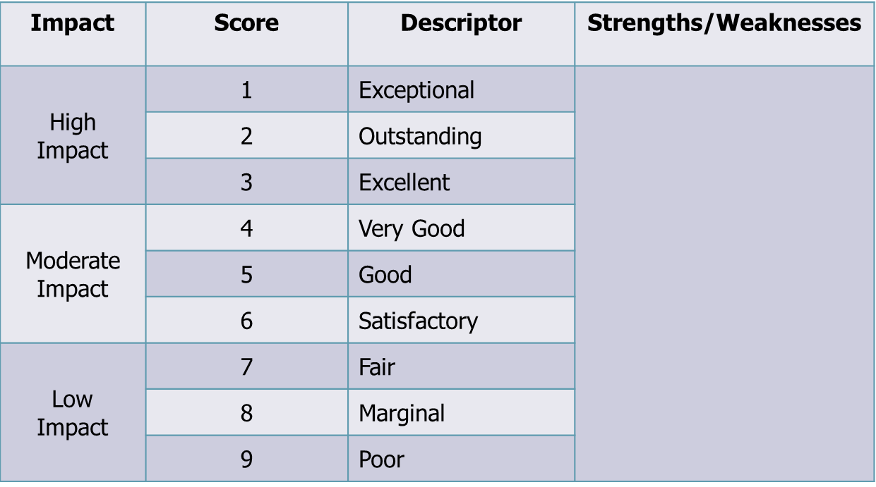

External Peer Review – Scoring
Scored Criteria:
Significance
(Real Problem/
Commercial Potential)
Investigators
(PI and team)
Innovation
(New or Improved?)
Approach
(Research Design, Feasible)
Environment (Facilities/Resources)
Also see “Additional Criteria” – i.e. plan for Biohazards
(chemical safety)
Strengths
Weaknesses
Initial Scoring 1-9, Final Score 10-90
Scores typically released within 3-4 days of review. Summary Statement posted within 2-3 weeks of review.

Slide 16
External Peer Review – Points to Know
Study Sections
3 reviewers per application
Wide scope expertise - majority are not environmental technologists
Expectations
Preliminary data
Fundamental science, novelty, innovation
Convince reviewers the market exists
(hint of commercialization capability, even for Phase I)
Peer Review Study Section Roster Index: http://public.csr.nih.gov/StudySections/SmallBusinessTechnologyTransfer/Pages/default.aspx
IMST (10), IMST (12), IMST (14), IDM (12)
Notes:
Small Business: Instrumentation, Environmental, and Occupational Safety [IMST (12)]
This special emphasis panel reviews small business applications in the general area of instrumentation and systems development, molecular imaging, environmental monitoring and remediation, and occupational safety.
Rosters
IMST (12) Meeting Roster
Topics
Photonic, electronic, and chemical technologies for bioinstrumentation and portable point-of-care devices
Optical, spectroscopic, and microscopic devices for identifying biomolecular and cellular structures
Instrumentation and devices for occupational safety applications
Chemical, physical, and biological assays or instrumentation for environmental monitoring and remediation
http://public.csr.nih.gov/StudySections/IntegratedReviewGroups/IMSTIRG/IMST12/Pages/default.aspx
Small Business: Bioanalytical Chemistry, Biophysics, and Assay Development [IMST (10)]
This special emphasis panel reviews small business applications in the general area of biological chemistry, chemistry, biophysics, and assay development.
Rosters
IMST (10) Meeting Roster
Topics
Advancements in instrumentation and methods for bioanalytical and biophysical measurements (e.g. mass spectrometry, magnetic resonance, crystallography, spectroscopy)
Development of instrumentation and systems for proteomics and protein analysis
Technological advancements in purification, separations, and large-scale synthesis
Technologies and methods for high-throughput and high-content applications (not cell-based)
Immunological, enzymatic, or oligonucleotide sensors and reporters for bioassays and diagnostics
New technologies for molecular separations and screens, immunoassays, chemical reactions, and molecular detection
Polymers, membranes, surfaces, or microfluidics for biological separations and assays
Novel materials, labels and reagents, molecular probes, reporter systems, and surface chemistries
http://public.csr.nih.gov/StudySections/IntegratedReviewGroups/IMSTIRG/IMST10/Pages/default.aspx
Small Business: Computational, Modeling, and Biodata Management [IMST (14)]
This special emphasis panel reviews small business applications in the general area of computation, modeling, and biodata management, with a dominant focus in computational and mathematical sciences.
Rosters
IMST (14) Meeting Roster
Topics
Bioinformatics, computational, and systems biology, metabolic and network modeling
Software and system engineering
Ontologies, text mining, neural networks, pattern recognition, and expert systems
Technologies and methods for imaging processing, data analysis, data management, data modeling, and data mining
Big-data
http://public.csr.nih.gov/StudySections/IntegratedReviewGroups/IMSTIRG/IMST14/Pages/default.aspx
Small Business: Non-HIV Infectious Agent Detection/Diagnostics, Food Safety, Sterilization/Disinfection and Bioremediation Special Emphasis Panel [IDM (12)]
​The Non-HIV Infectious Agent Detection/Diagnostics, Food Safety, Sterilization/Disinfection and Bioremediation Special Emphasis Panel [ZRG1 IDM-V12] considers Small Business Innovation Research [SBIR] and Small Business Technology Transfer Research [STTR] grant applications that deal with detection and diagnostics of bacteria, non-HIV viruses, fungi, parasites and prions. Grant applications focused on non-HIV infectious agents and toxins that are contaminating food are also considered; emphasis may include technologies to protect food and water from infectious contamination, as well as sterilization and bioremediation technologies.
Rosters
IDM (12) Meeting Roster
Topics
Innovations in methods or technologies for the detection or quantitation of bacteria, non-HIV viruses, eukaryotic pathogens, and prions
Study of bacterial biofilms as related to human disease; development of agents or methods to combat biofilms in vivo and on medical devices
Detection and Inactivation of pathogens and toxins in food or drinking water
Advances in sterilization, decontamination or disinfection technologies
Development of novel applications for bioremediation
http://public.csr.nih.gov/StudySections/IntegratedReviewGroups/IDMIRG/IDM12/Pages/default.aspx

Slide 17
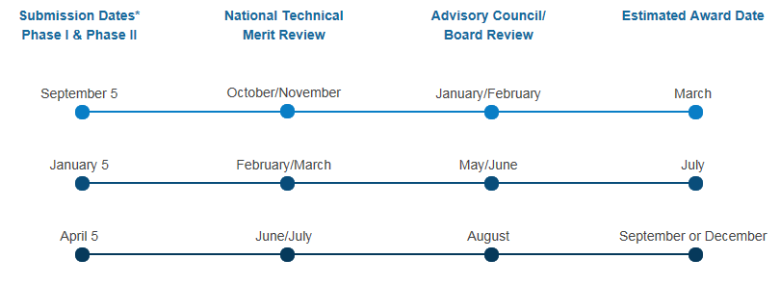
NIH Application to Award Timeline

Slide 18
EPA
April Richards
www.epa.gov/sbir
    richards.april@epa.gov
Current EPA SBIR awards: https://cfpub.epa.gov/ncer_abstracts/index.cfm/fuseaction/outlinks.sbir/

Slide 19

EPA-SBIR Mission
EPA: Protect human health and the environment
EPA SBIR: Support development and commercialization of innovative technologies to meet Agency’s mission

Slide 20
EPA SBIR Budget & Awards
Award Budget ~ $4.5M
Awards contracts
  Phase I: Proof of Concept
    $100,000
    6 months
  Phase II: Develop & Commercialize Technology
    $300,000 (+Commercialization Option of $100,000)
    2 years
EPA provides commercialization support to all Phase I and Phase II Companies

Slide 21

EPA Solicitation
2016-17 Solicitation is NOW OPEN
https://www.epa.gov/sbir/sbir-funding-opportunities
Closes October 20th
Must submit through FedConnect: www.fedconnect.net/FedConnect/

Slide 22

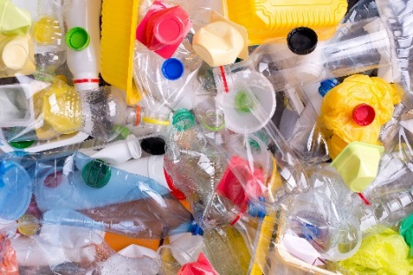

2016-17 Solicitation Topics
Air and Climate
  Inexpensive Indoor Formaldehyde Sensor
  Low-Cost Sensor for Fugitive Methane Emissions
Manufacturing
  Greener manufacturing of plastics
  Greener Plastic Materials and Products
Toxic Chemicals
  Cleaner Manufacturing Processes for Dyes, Paints & Pigments
  Technologies to Help Consumers Understand the Chemical Composition of Products
Water
  Non-Reverse Osmosis Desalination Units for Small Communities
  Non-toxic Coating for Water Pipes that Prevent Biofilms, Corrosion, Scaling and Leaching of Lead
  Simple Lead Test for Tap Water
Water and Homeland Security
  Water Pipes that Prevent Biofilms, Corrosion and Scaling
Greener Buildings
  Nontoxic Interior Construction Materials
  Greener Exterior Construction Materials

Slide 23
Selecting a Topic
It is the responsibility of the company to select the most appropriate topic
The topic you select will determine which peer review panel reviews your proposal
EPA budget is modest so program is very competitive
  Proposals must be responsive to specific topics
Program managers can provide general advice on your proposed technology

Slide 24
Required Registrations
Dun and Bradstreet Universal Numbering System (DUNS) – All registrations require that applicants be issued a DUNS number. After obtaining a DUNS number, applicants can begin both SAM, and SBA Company registry.
The same DUNS number must be used for all registrations, as well as on the proposal.
SBA Company Registry – See solicitation for instructions on how to register and how to attach proof of registration to your proposal package. Applicants must have a DUNS number to complete this registration. SBA Company registration is NOT required before SAM.
System for Award Management (SAM) (formerly CCR) – Applicants must complete and maintain an active registration, which requires renewal at least annually. The renewal process may require as much time as the initial registration.
FedConnect – Electronic applications system for EPA SBIR. FedConnect is a web portal that connects agencies and vendors to streamline the process of doing business with the federal government.

Slide 25
Proposal Evaluation and Selection
Applications Received
External Peer Review
Awards
EPA Internal Programmatic Review

Slide 26
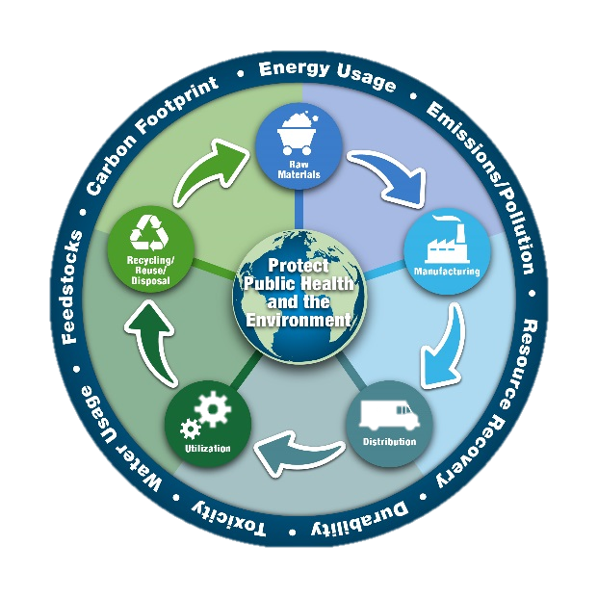
EPA External Peer Review (Phase I)
Ratings:
  Excellent, Very Good, Good, Fair, Poor
Phase II Commercialization Criteria
  Commercialization Plan
  Company/Team
  Partners/Investors
Phase II Technical Criteria
  Technical Soundness
  Demonstrations and Performance Evaluation Criteria
  Life Cycle Impacts and Quality Assurance Plan

Slide 27
EPA Internal Relevancy Review
Review only proposals rated “Excellent” and “Very Good”
Three Criteria:
  EPA Needs and Program Priorities
  Significant Environmental Benefits (Sustainability)
  Broad Application and Impact

Slide 28
EPA Application to Award Timeline
Solicitation Opens for ~ 45 days | Peer Review | Relevancy Review | Awards
Fall 2016 | January/February 2017 | March 2017 | June 2017

Slide 29







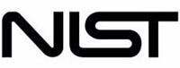

SBIR Sensors Research Microsite
The Federal government is a significant driver of sensor innovation: investing in low cost, portable, easy-to-use technologies to facilitate the collection of real time, reliable measurement information.
Coordinated by EPA, the new SBIR Sensors Research Microsite:
is a central web location to promote collaboration across SBIR agencies in the area of sensor technology.
makes it easier for sensor developers to locate relevant SBIR and/or STTR funding opportunities across federal agencies.
Participating agencies:
Visit the site! https://www.sbir.gov/Sensor-technology-for-the-21st-century
Notes:
How does this site help small businesses?
Communicates needs and interest across the federal government related to sensors
Provides a central location for agency sensor-related SBIR and/or STTR solicitations (listed by topic, where possible)
Highlights success stories
How does this site help federal agencies?
EPA, NSF, DOE, NOAA, DOD, USDA, NIH/NIEHS, NIST, NIOSH (NASA and DOT in the works)
Promotes interagency collaboration on topic of common interest
Helps to avoid duplicative investments
Provides the ability to identify federal sensor investments to date and track over time
Encourages cross-Agency adoption of projects as they move through funding phases

Slide 30

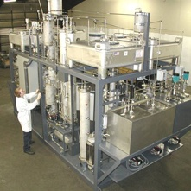
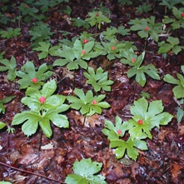
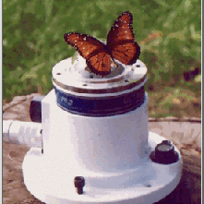

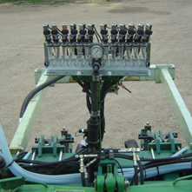
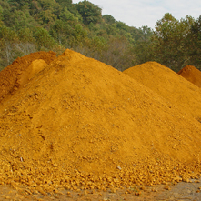
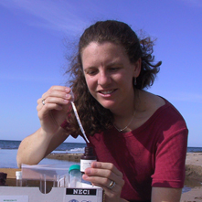
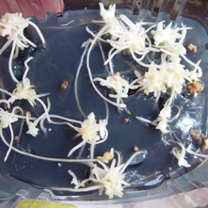
Charles Cleland, Ph.D
ccleland@nifa.usda.gov
http://nifa.usda.gov/fo/sbir
National Institute
of Food
And Agriculture

Slide 31
United States Department of Agriculture
National Institute of Food and Agriculture (NIFA)
Invest in and Advance Agricultural Research, Education, and Extension to Solve Societal Challenges
Small Business Innovation Research (SBIR) Program
The purpose of the SBIR program is to provide an opportunity for US-owned, for-profit small business firms to submit innovative, applied, research and development projects that address important problems facing American agriculture or rural America and have the potential to lead to significant public benefit

Slide 32
Features of USDA SBIR Program
Award Grants Only - Ideas are Investigator-Initiated
Phase I Grants = 8 Months/$100,000
Phase II Grants = 2 Years/$600,000
All Applicants Receive Verbatim Copies of Reviews
12 Month No-Cost Extensions Available
Commercialization Assistance Program in Both Phase I & Phase II
Subcontracting to Universities and USDA Labs Permitted and Encouraged
Contact with SBIR Program Staff Available at any Time

Slide 33
Topic Areas
Forests & Related Resources
Plant Production & Protection – Biology
Plant Production & Protection - Engineering
Animal Production & Protection
Air, Water & Soils
Food Science & Nutrition
Rural Development
Aquaculture
Biofuels and Biobased Products
Small & Mid-Size Farms

Slide 34
Air, Water and Soils
Research Priority Areas
Water Quality and Conservation
Improved Irrigation Technology
Monitoring and Prevention of Soil Erosion
Measurement of Soil Properties
Monitoring and Improvement in Air Quality

Slide 35
Application Submission
Application Submission Requires Many Steps to Complete the Process
Download the USDA SBIR Solicitation at https://nifa.usda.gov/funding-opportunity/small-business-innovation-research-program-phase-i
Electronic Submission is Mandatory via Grants.gov
Obtain Data Universal Number System (DUNS) Number
Register with System for Award Management (SAM)
Register your Business with Grants.gov
  http://www.grants.gov/web/applicants/organization-registration.html
Register your company with the Small Business Administration (SBA)
    https://www.sbir.gov/registration

Slide 36
Proposal Evaluation and Selection
Applications Received
External Peer Review
Awards
UDSA Administrative Review

Slide 37
USDA Application to Award Timeline
Solicitation Opens | Submission Date | Merit Review | Award Date
June-July 2016 | Early October 2016 | Jan-Feb 2017 | June 2017

Slide 38
USDA SBIR REVIEW PROCESS
Proposals are Evaluated by a Confidential Peer Panel Review Process Using Outside Technical Experts from Non-Profit Organizations for Phase I. For Phase II both Technical and Commercialization Experts are Utilized.
Selection Criteria Include Scientific/technical Merit, Commercial Potential, Investigator and Resource Qualifications, Budget, and Duplication. In Addition, for Phase II the Degree to which Phase I Feasibility has been Demonstrated is also a Critical Factor.

Slide 39
History of USDA SBIR Funding

Slide 40
Geographical Distribution Of USDA SBIR Winners
FY83- FY15

Slide 41
U.S. Department of Agriculture
Small Business Innovation Research Program
Dr. Toby Ahrens
Biofuels and Biobased Products
Dr. Jodi Williams
Food Science and Nutrition
Dr. Robert Nowierski
Plant Production and Protection –
Biology
Dr. Denis Ebodaghe
Small and Mid-Size Farms
Scott Dockum
Program Coordinator, SBIR
Elden Hawkes
Program Specialist, SBIR
Dr. Charles Cleland
Forests and Related Resources
Dr. Gene Kim
Aquaculture
Dr. Brent Elrod
Rural and Community Development
Dr. Robert Smith
Animal Production and Protection
Dr. Karelyn Cruz
Air, Water and Soils
Dr. Rachel Melnick
Plant Production and Protection - Engineering

Slide 42
U.S. Department of Agriculture
Small Business Innovation Research Program
Waterfront Centre
800 9th Street, SW, Suite 3252
Washington, DC 20024
Phone: (202) 401-4002 • Fax: (202) 401-6070
E-mail: sbir@nifa.usda.gov
Web Site: www.nifa.usda.gov/fo/sbir

Slide 43
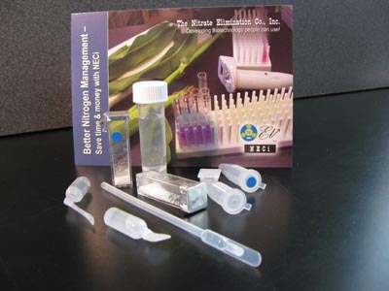
Nitrate Elimination Company, Inc.
Technology Developed
Developed nitrate test kits based on the use of nitrate reductase instead of cadmium chemistry to help farmers manage nitrate concentrations, reduce costly nitrogen fertilizer applications, and protect the environment from pollution.
SBIR History
Phase I – 2006 ($80K)
Phase II – 2007 ($364K)
8.4 Air, Water and Soils
Commercialization Success
Nitrate test has ATP standard method status under US EPA Clean Water and Safe Drinking Water Acts.
Reagents are the standard method for nitrate in all USGS laboratories.
Nitrate test kits are sold in Environmental Express and Gempler’s catalogs

Slide 44

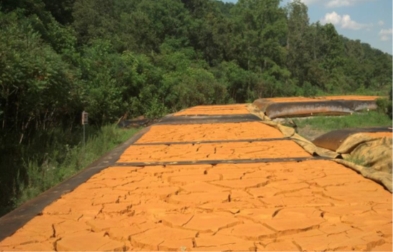
Hedin Environmental
Technology Developed
Developed system to treat coal mine drainage water through the use of ponds and constructed wetlands to remove iron by precipitating iron oxides that are then collected and sold as pigments and reactive media.
SBIR History
Phase I – 1995 ($53K)
Phase II – 1996 ($200K)
8.4 Air, Water and Soils
Commercialization Success
Over 4,600 tons of iron oxide have been sold for $1.4M and used primarily as a pigment.
Received additional support of $476K from USDA-NRCS and the PA Dept. of Environmental Protection

Slide 45
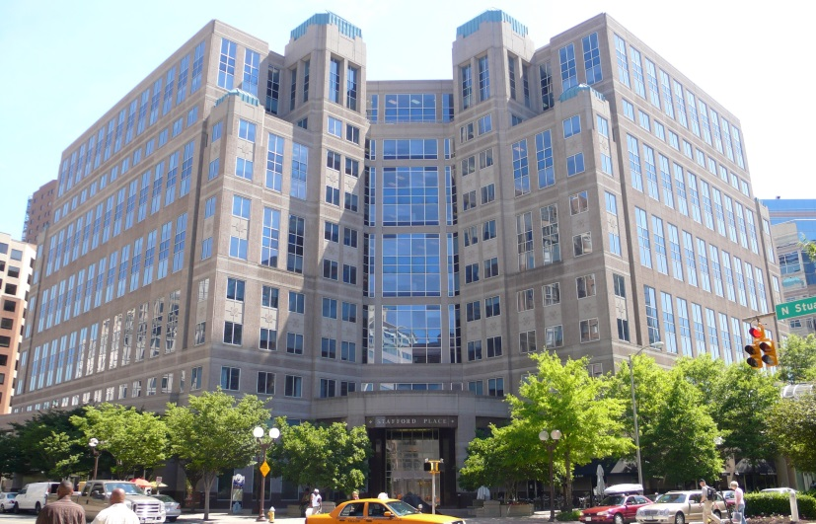
National Science Foundation (NSF)
Prakash Balan, Ph.D
pbalan@nsf.gov
Arlington, VA
NSF SBIR/STTR Home:
http://www.nsf.gov/sbir

Slide 46

Who we are
NSF’s Vision - NSF’s vision is a nation that creates and exploits new concepts in science and engineering and provides global leadership in research and education
~$7.3B Budget, $177M for SBIR/STTR
    217 Nobel Laureates supported
    Overall: 350,000 researchers, postdoctoral fellows, trainees, teachers, and students supported
    ~400 startups/small businesses funded each year
Video: A Foundation for Innovation

Slide 47
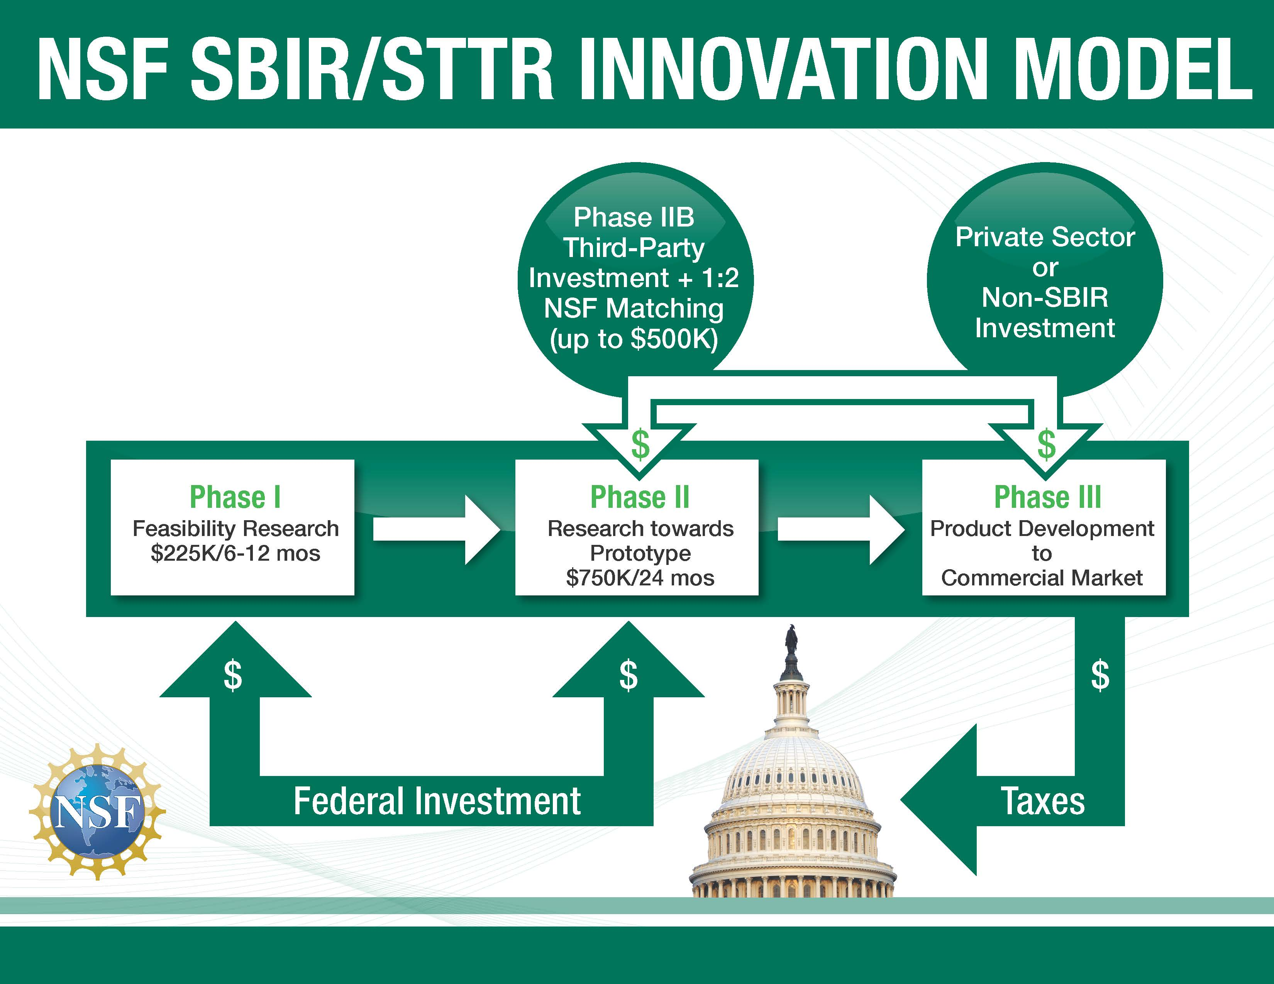

Slide 48
NSF SBIR/STTR Budget, Funding Phases and Supplements
Award Budget ~ 177M NSF Total, ~ $20M NSF CT
Awards (grants)
  Phase I: Proof of concept, technical feasibility
    $225,000 Grant for SBIR or STTR
    6-12 month grant
  Phase II: Product/technology development, scale-up
    $750,000 Grant for SBIR or STTR
    2 year grant
    Phase II Supplemental funding support
      Commercial partnerships (TECP, Phase IIB)
      Research Internships for undergraduates, high school students
      Institutional research collaborations

Slide 49

Very broad funding landscape!
Topic
Educational Technologies and Applications
Information and Communication Technologies
Semiconductors and Photonic Devices and Materials Internet of Things
Electronic Hardware, Robotics and Wireless Technologies
Advanced Manufacturing and Nanotechnology
Advanced Materials and Instrumentation
Chemical and Environmental Technologies
Biological Technologies
Smart Health and Biomedical Technologies
  Nearly any innovation with commercial potential fits somewhere, and if not, we will still review it!

Slide 50
Chemical and Environmental Technologies (CT)
Water, wastewater treatment, reuse, waste recycling…
Pollution control & mitigation…
Chemicals and sustainability, Green Chemistry…
Energy efficiency, capture, storage, use…
Environmental sensors…
Biofuels, bioenergy…
Renewable chemicals, materials…
Technologies for Agricultural innovations…
Food, Pharmaceutical and industrial biotechnology
…..and more!

Slide 51
Looking to fund a new/novel innovation?
Email a 2 page executive summary discussing the following aspects of the project (pbalan@nsf.gov) :
  Company and team
  Market opportunity, value proposition, and customers
  Technology/innovation concept
  The technical challenge to overcome
  The competition
  Research outline
Funding Topics Website- http://www.nsf.gov/eng/iip/sbir/topics.jsp

Slide 52
How To Apply
How to Apply: http://www.nsf.gov/eng/iip/sbir/howtoapply.jsp
Two solicitations per year typically (June and December deadlines)
  Solicitations are published 3 months ahead of submission deadline
  Current Open Solicitations (Dec 6th submission deadline)
    SBIR: http://www.nsf.gov/pubs/2016/nsf16599/nsf16599.htm
    STTR http://www.nsf.gov/pubs/2016/nsf16600/nsf16600.htm
  Funding Topics Website- http://www.nsf.gov/eng/iip/sbir/topics.jsp

Slide 53
Required Registrations
http://www.nsf.gov/eng/iip/sbir/registration.jsp
Dun and Bradstreet Universal Numbering System (DUNS) – All registrations require that applicants be issued a DUNS number. After obtaining a DUNS number, applicants can begin both SAM, and SBA Company registry.
The same DUNS number must be used for all registrations, as well as on the proposal.
SBA Company Registry – See solicitation for instructions on how to register and how to attach proof of registration to your proposal package. Applicants must have a DUNS number to complete this registration. SBA Company registration is NOT required before SAM.
System for Award Management (SAM) – Applicants must complete and maintain an active registration, which requires renewal at least annually. The renewal process may require as much time as the initial registration.
FastLane– Register the Principal Investigator AND company in NSF's electronic submission system.

Slide 54
Proposal Evaluation and Selection
Applications
External Peer Merit Review
Awards
Due Diligence
Review

Slide 55
Intensely competitive process
~ 2000 Phase I Proposals typically received (annually)
Roughly 10-20% of the Phase I proposals may be funded
Roughly 40% of Phase I companies may make it all the way to Phase II funding
Proposals reviewed on both technical and commercial merits

Slide 56
Merit Review
Invited subject matter experts from Academia and Industry in Panel reviews
Focus on disruptive and discontinuous technology developments with broad impact
  New markets, novel products, enabling platform technologies and applications
  Must show a strong commercialization focus and well thought out vision to profitability and growth
NOT funded
  Evolutionary optimization of existing products and processes or modifications to broaden the scope of an existing product, process or application,
  Analytical or “market” studies of technologies, market research
  Routine engineering design & system integration

Slide 57
Proposal Review: Technical Aspects
A sound approach to establish technical
& commercial feasibility
Qualified technical team
Sufficient access to resources
Reflects “state-of-the-art”

Slide 58
Proposal Review: Commercial Aspects
The commercial and societal benefits?
Business team with relevant skills?
Any past commercialization track record?
Competitive advantage in the marketplace?
Potential early partnerships? Intellectual property status?
Enabling technologies/platforms (instrumentation, software, materials etc.) for further innovation?
Ability to attract further funding from non-SBIR sources to get to product/technology commercialization?

Slide 59
NSF Application to Award Timeline
4-6 months
Submission Date | Panel Review | Pre-award diligence | Award start
June 2016 | July - September 2016 | October - November 2016 | Jan 2017
December 2016 | January – March 2017 | April – May 2017 | July 2017
Applicants receive detailed feedback. Reviewer and panel comments to NSF are shared with applicants verbatim

Slide 60

TOP 10 Keys to Success
Contact the Program Officer before applying
Assemble an effective team (technical and business expertise)
Clearly present the business case that drives your technology development
Demonstrate real market interest and need for your proposed innovation
Present clearly the critical technical challenges you need to overcome
If resubmitting, address all previous review comments
Start Early…begin the registration process 6 -8 weeks in advance
Read the solicitation/funding announcement carefully
Submit Early (days ahead of the deadline)!
Remember NIEHS SRP, EPA, USDA, and NSF are “investors” not “customers”

Slide 61
iCorps Program: Leveraging Lean Startup Approaches to build a business model….
SBIR Project from an NSF research award in the last 5 years?
Explore the NSF national I-Corps program
  need three (3) team members and a need to search for a market to your idea, technology or research
  NSF I-Corps Teams award - $50,000 for 12 months – Funding to be spent on customer discovery - 15 hours per week for 7 weeks
No prior NSF Research Funding?
Explore the NSF regional I-Corps programs
  more flexible I-Corps programs in team composition, time, and stage of startup development – able to provide eligibility for teams to the NSF I-Corps program above - typically not funded, or limited funding by regional institutions for customer discovery and prototyping
For more information: Contact Dr. Lydia McLure ( lmcclure@nsf.gov), Program Director, iCorps
61

Slide 62
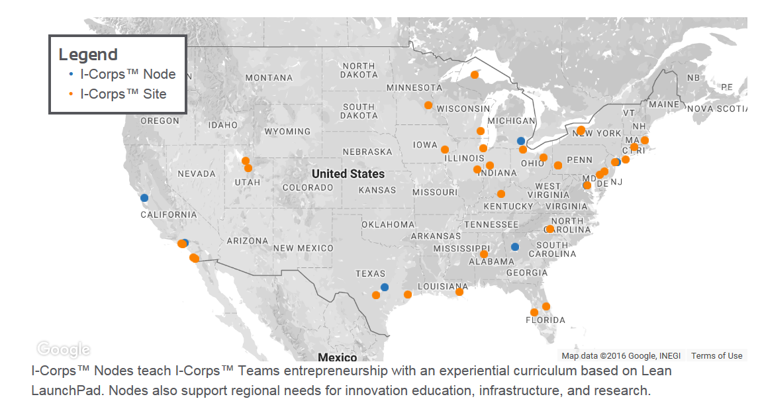
iCorps Program: Nodes and Sites
62

Slide 63

Other SBIR/STTR Agencies and Institutes that Fund Environmental Technologies
AGENCIES
Department of Defense (DoD) - Tracy Frost administrator.dodsbir@osd.mil
Department of Energy (DoE) - Manny Oliver manny.oliver@science.doe.gov
National Oceanic and Atmospheric Administration (NOAA) - Joan Clarkson joan.e.clarkston@noaa.gov
NIH INSTITUTES
National Institute of General Medical Sciences (NIGMS) - Scott Somers somerss@nigms.nih.gov
National Center for Advancing Translational Sciences (NCATS) - Lili M. Portilla Portilll@mail.nih.gov
National Heart, Lung, and Blood Institute (NHLBI) - Jennifer Shieh jennifer.shieh@nih.gov
National Institute of Biomedical Imaging and Bioengineering (NIBIB) - Todd Merchak merchakt@mail.nih.gov
Eunice Kennedy Shriver National Institute of Child Health and
Human Development (NICHD) - Louis A. Quatrano Email: Quatranol@mail.nih.gov

Slide 64

Small Business Administration www.SBA.gov
Small Business Administration Website:
  Advice on how to get started:
    From university lab to business
    How to start your own business
    How find a small business partner
    University Tech Transfer office
  Contacts:
    Your state SBA Office
    Federal SBIR/STTR Offices
  Eligibility Details
  Upcoming Meetings
  Email notification listserv

Slide 65

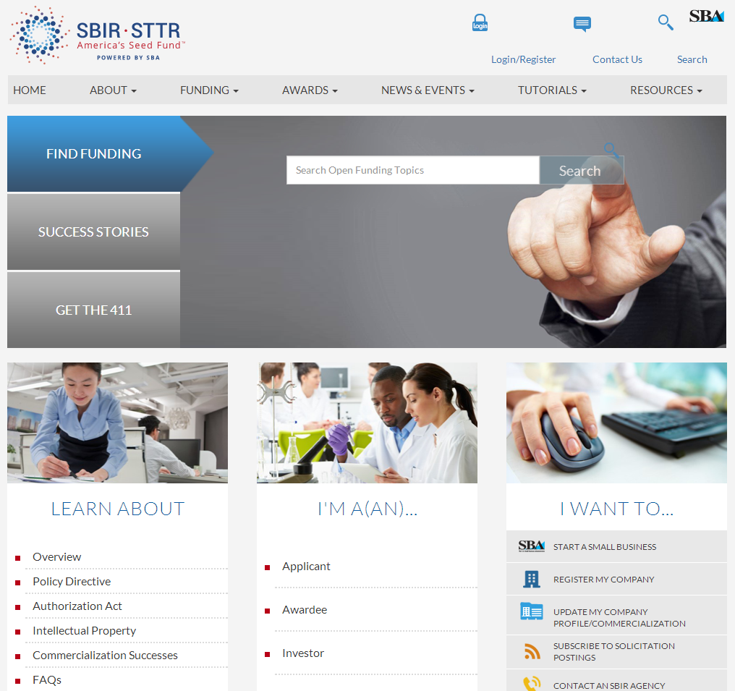
www.SBIR.gov
The SBIR/STTR website:
  Provides information about current, past, and future funding opportunities
  Describes program goals, policy directives, the history of the program, and participating agencies
  Provides a listing of SBIR and STTR awards and highlights success stories

Slide 66

Q&A
Online Participants
  Enter your question into the Q&A box on the bottom right hand side of your screen
Phone Participants
  Dial #6 to unmute phone
  Dial *6 to mute phone
Notes:
Canned questions for panel if no questions are asked
PI eligibility - how is primary employment defined?
NSF and NIH - 51% of a 40 hour work-week. NSF considers employment elsewhere of greater than 19.6 hours/week to be in conflict with this requirement
PI time commitment per SBIR and STTR? The PI must spend a minimum of one (1) calendar month on a SBIR Phase I project, or two (2) calendar months on a STTR Phase I project.
SBIR - research commitment by SBC?
Ph I 67% effort
Ph II 50% effort
STTR - research commitment by SBC and research institution?
Ph I and Ph II - 40% SBC + 30% Research Institution + 30% any combination there of or another third party
What about virtual companies?
NIH - SBC must have a research facility where research is conducted by the SBC according to effort requirements, thus technically we do not fund virtual businesses. Data analysis, protocol development, management of research activities, animal purchases all constitute research activities.
How do we define “employee”?
13 CFR 121 (121.06 define employee, 121.701-705 is specific to SBIR and STTR)
First step in identifying an agency?
Federal RePORTER
How do I know if an agency would be interested in funding my specific technology?
Is there a way to meet face-to-face with SBIR Program Managers?
Could I serve as a peer reviewer for SBIR/STTR?

