Slide 1
How to Bring about Ecological Revitalization on Contaminated Lands
Tuesday April 21, 2015

Slide 2
Webinar Overview
Introduction to Reuse and SRI
  Michele Mahoney, EPA Technology Innovation and Field Services Division
Introduction to Ecological Revitalization
  Michele Mahoney, EPA Technology Innovation and Field Services Division
Bunker Hill Case Study
  Ed Moreen, EPA Region 10
Considering Native Plants and Pollinator Habitats
  Bruce Pluta, EPA Region 3
Chemical Commodities, Inc. Site Case Study
  Jeff Field, EPA Region 7
Pollinator Partnership
  Mary Byrne, Pollinator Partnership
EPA Region 7 Pollinator Work Group
  Damon Frizzell, EPA Region 7

Slide 3
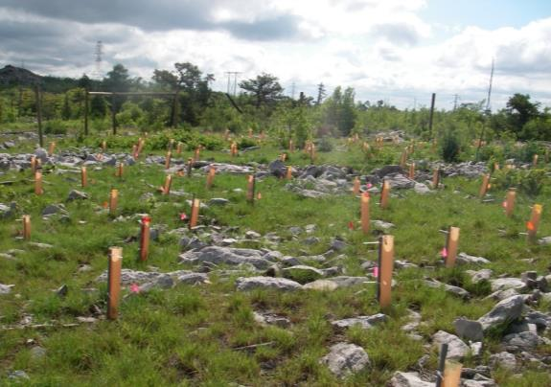
SRI: The Superfund Redevelopment Initiative
Working with communities and other partners in considering future use opportunities and integrating appropriate reuse options into the cleanup process

Slide 4
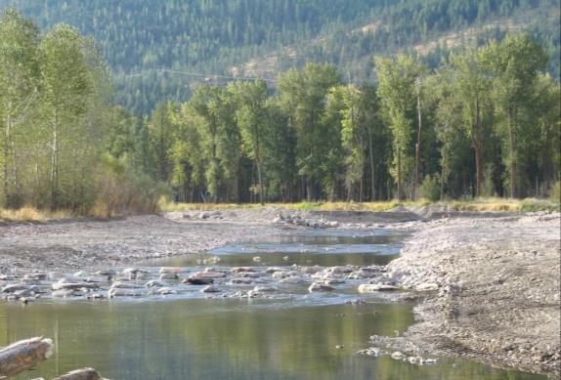
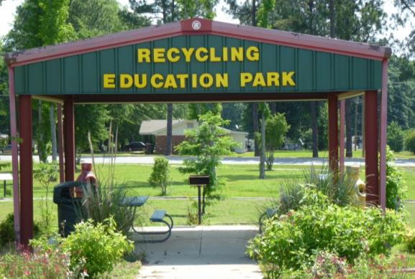

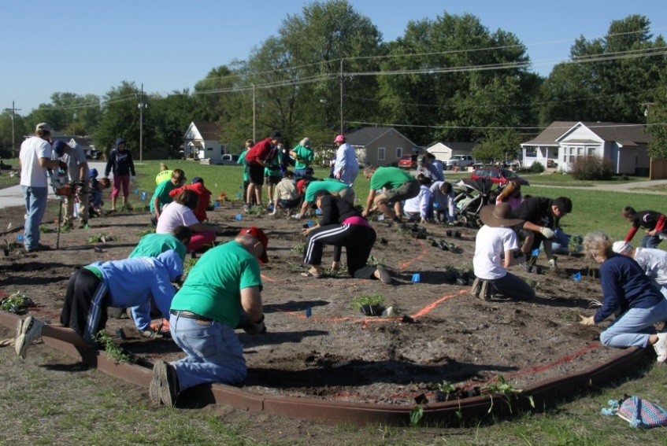
Reuse as a Priority

Slide 5
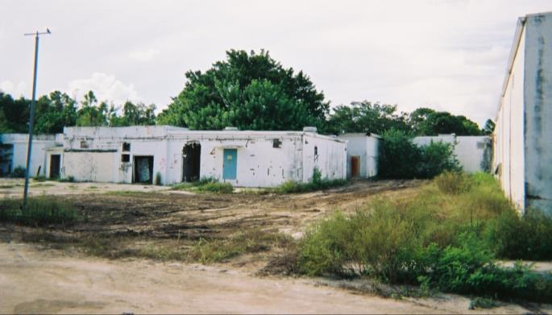
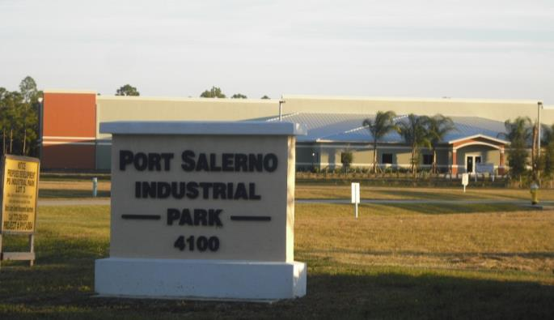
Benefits of Reuse
Economic
Environmental
Social
Protection of human health

Slide 6
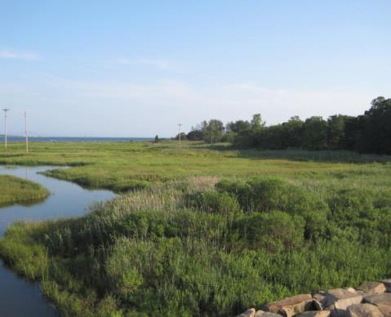
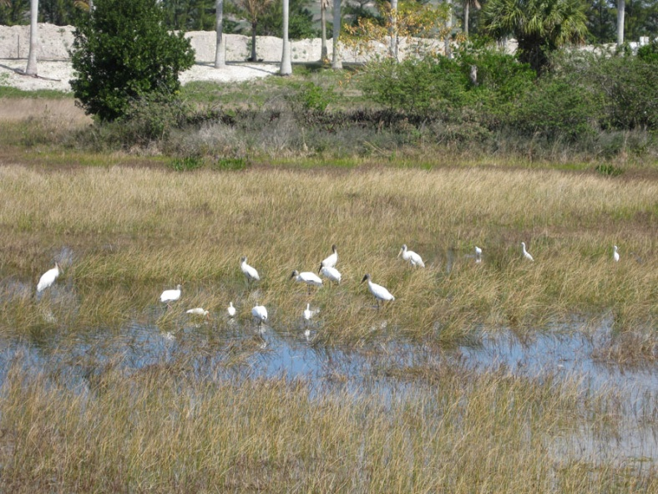
Ecological Revitalization and
Ecological Reuse

