Slide 1
Bunker Hill Case Study
Providing Safe Waterfowl Feeding Habitat in Toxic Floodplains

Slide 2
Bunker Hill Superfund Site Case Study
Site Orientation and Brief Site History

Slide 3
Bunker Hill Mining and Metallurgical Complex Superfund Site (Bunker Hill)
Site listed on NPL in 1983
Record of Decision Documents:
  OU1 – Box Pop. Areas/ROD - 1991
  ➔ OU2 – Box Non-Pop. Areas/ROD – 1992
  ➔ OU 3 – CDA Basin/ROD – 2002 (waterfowl feeding areas)
  Upper Basin ROD Amendment - Aug 2012

Slide 4
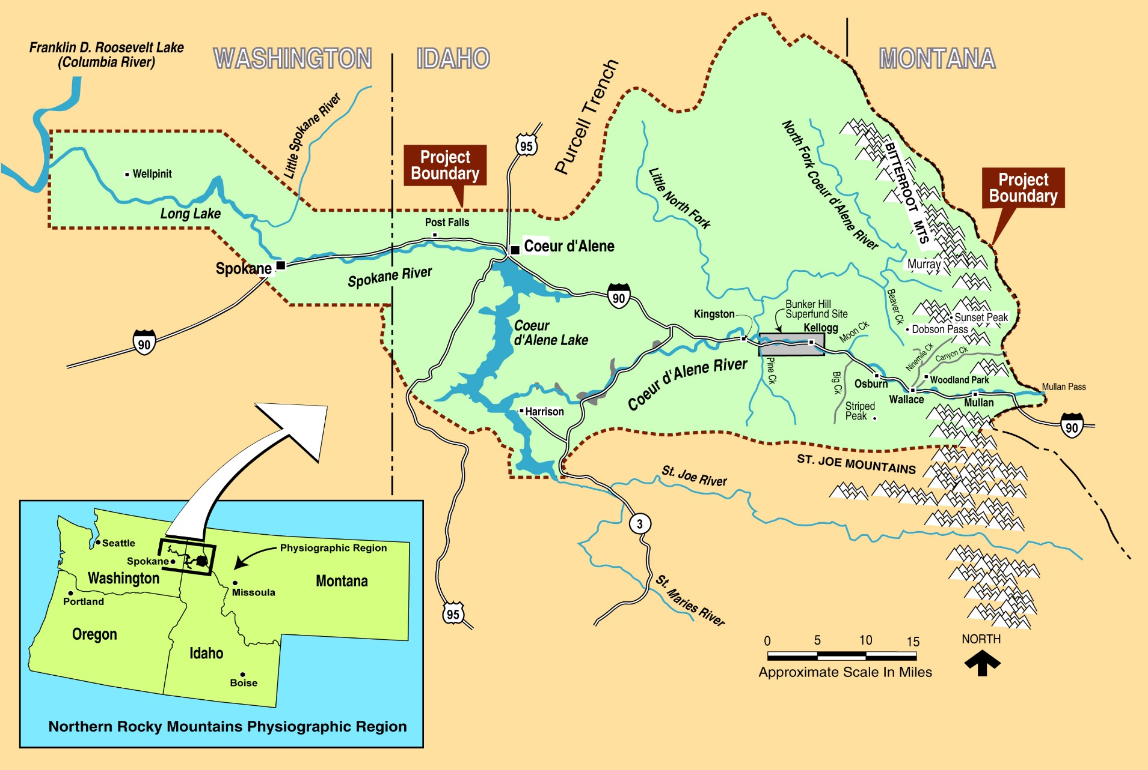
Basin Geography

Slide 5
Mining History Waste Disposal Practices
Mining and milling began in the 1880s
Until 1968, mine waste discharged directly to creeks and rivers at many mine & mills
Most tailings piles located adjacent to streams
Estimated over 100 million tons discharged
  - 2.4 billion pounds of lead
  - Dispersed over 10,000’s Ac

Slide 6
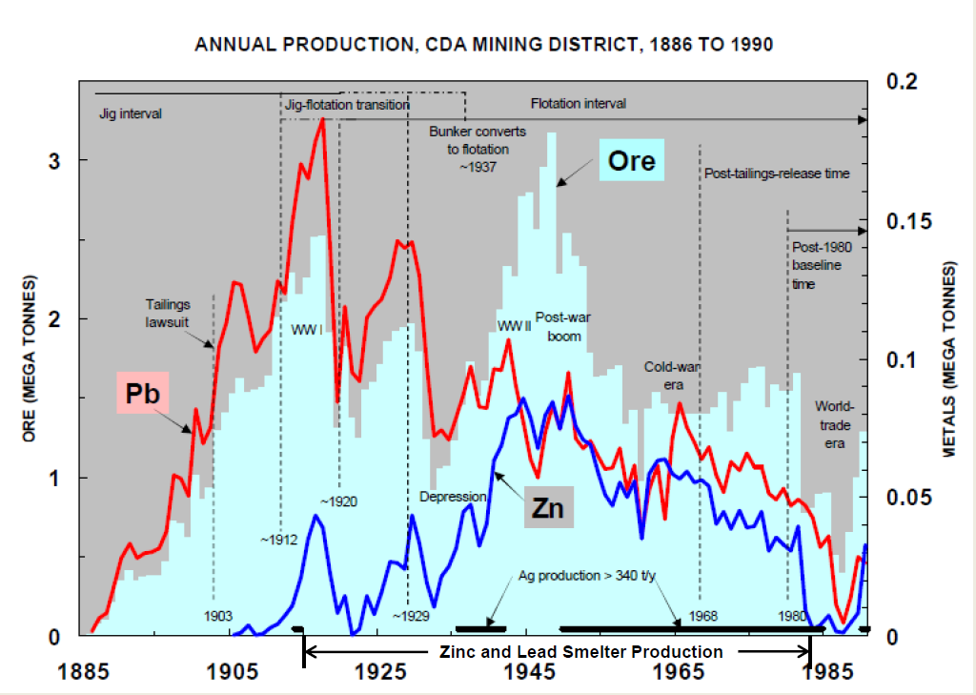
Coeur d’Alene Mining District Production
USGS modified Bookstrom, etal

Slide 7
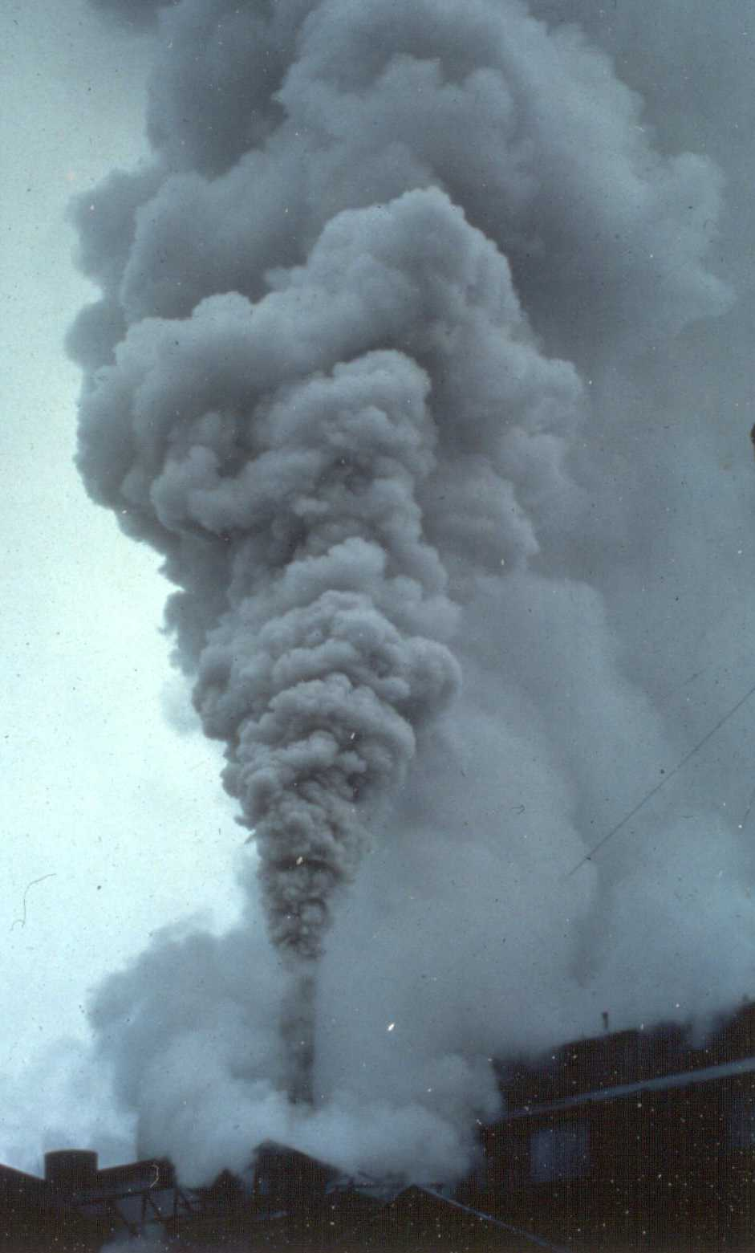
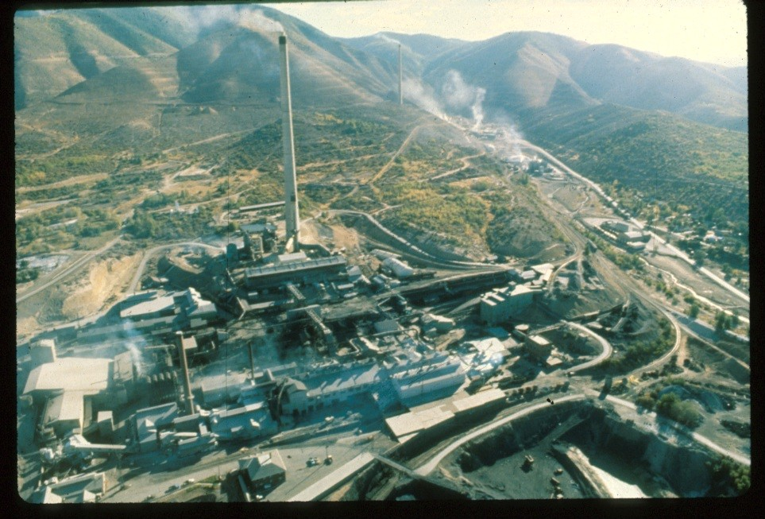
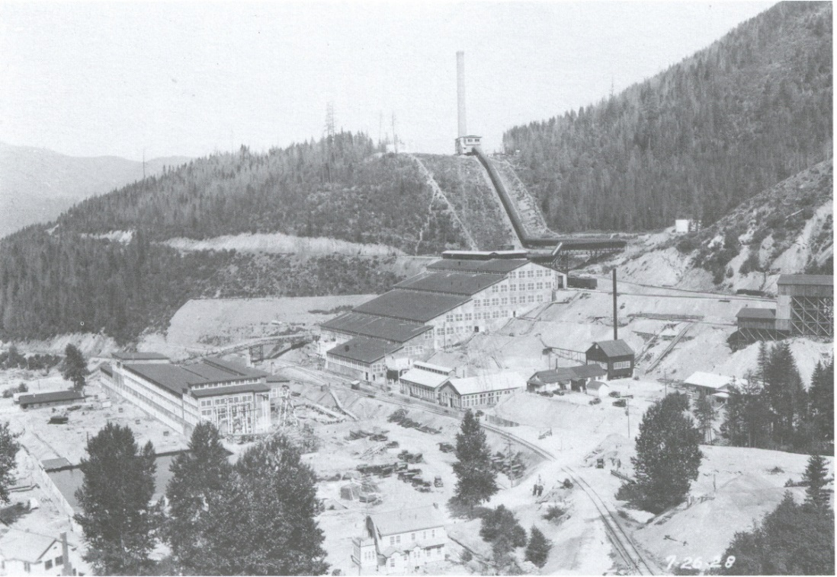
Bunker Hill Box
Major Industrial Complex (mining, milling, smelting)
Contaminants in Air, soil and water pathways
Some of Highest Blood Leads Measured in the World
Hillsides Denuded as Result of …
Lead Smelter
Zinc Plant

Slide 8
Lower Basin = Complex of Lakes/Wetlands

Slide 9
Flooding is Common in Lower Basin
Main Stem Coeur d’Alene River
May, 22, 2008

Slide 10
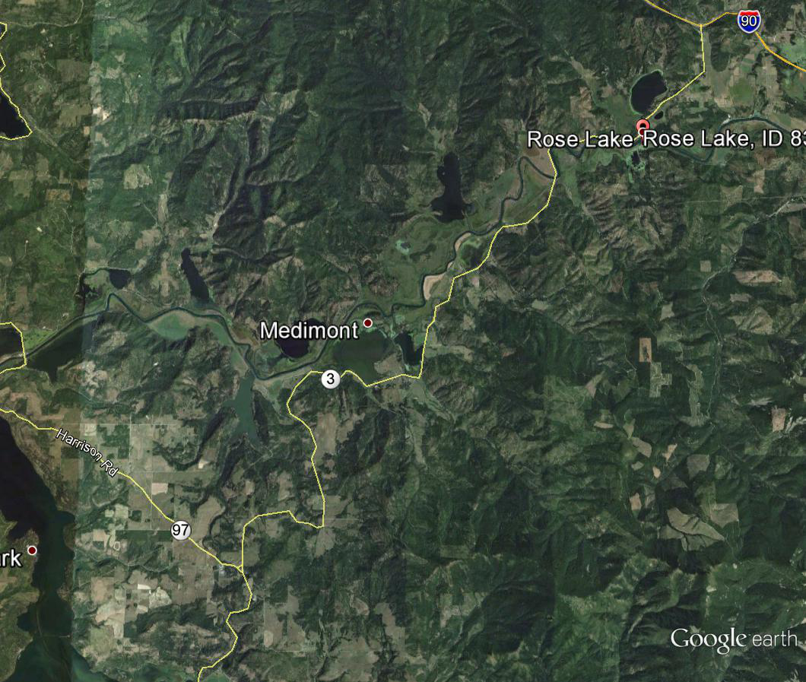
Lower Basin Aerial View
AG to Wetland

Slide 11
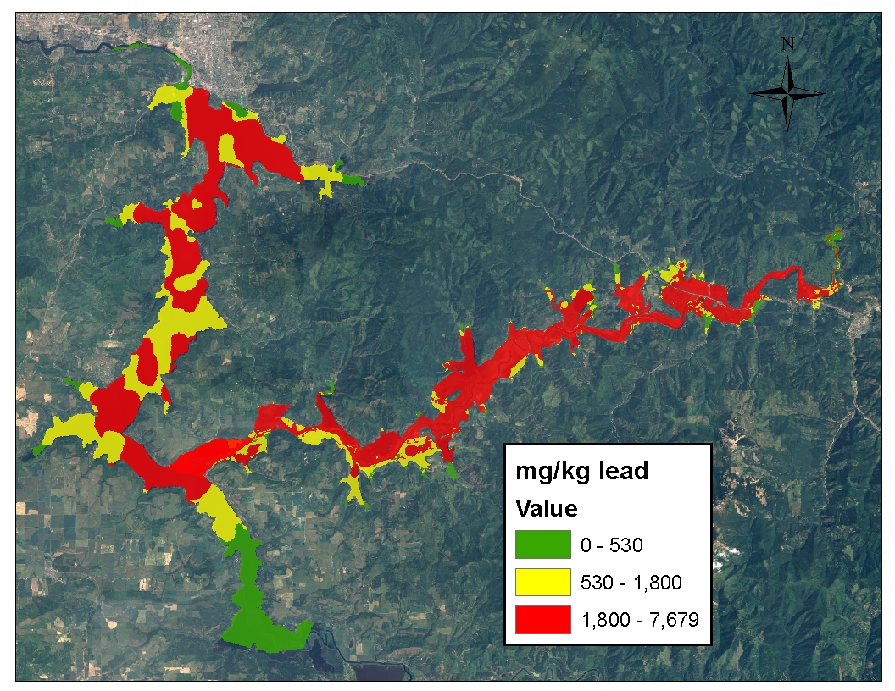

Slide 12
Bunker Hill Superfund Site
Wetlands Remediation/Revitalization

Slide 13
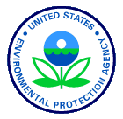
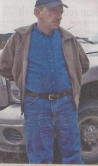

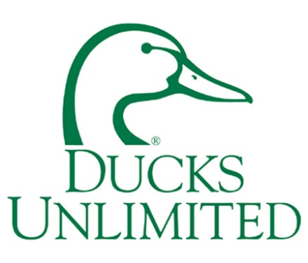
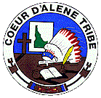
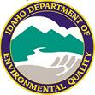



Wetland Project Partnership
Environmental Contaminants
Willing Private Property Owner
U.S. Forest Service

Slide 14
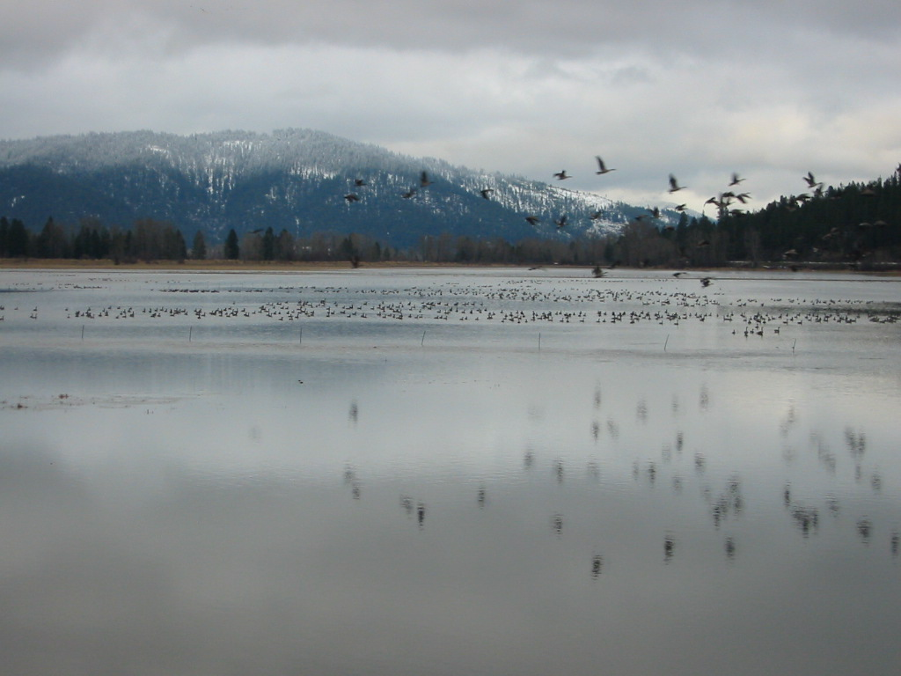
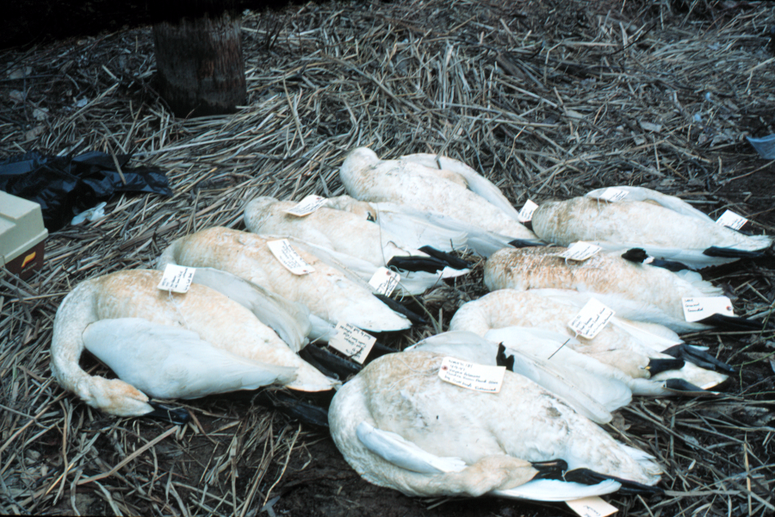
Pilot Project Objective:
Create clean feeding habitat for waterfowl
→

Slide 15
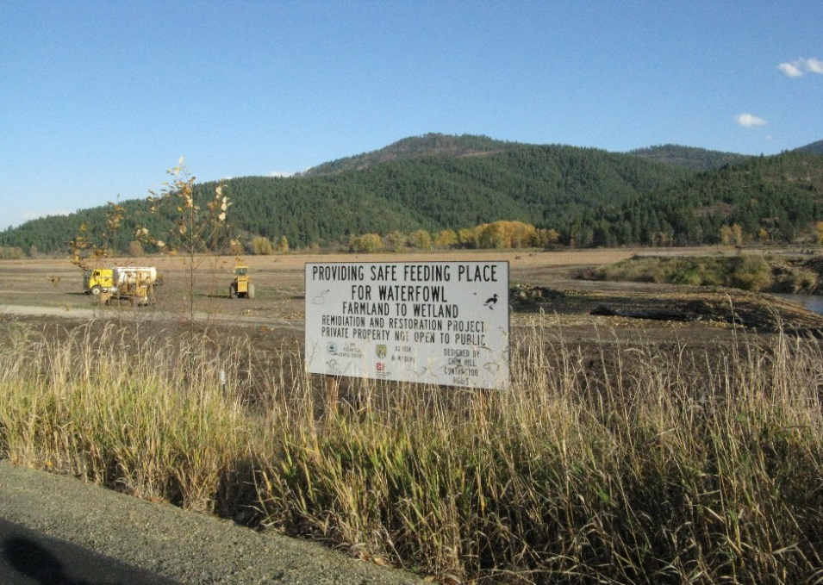
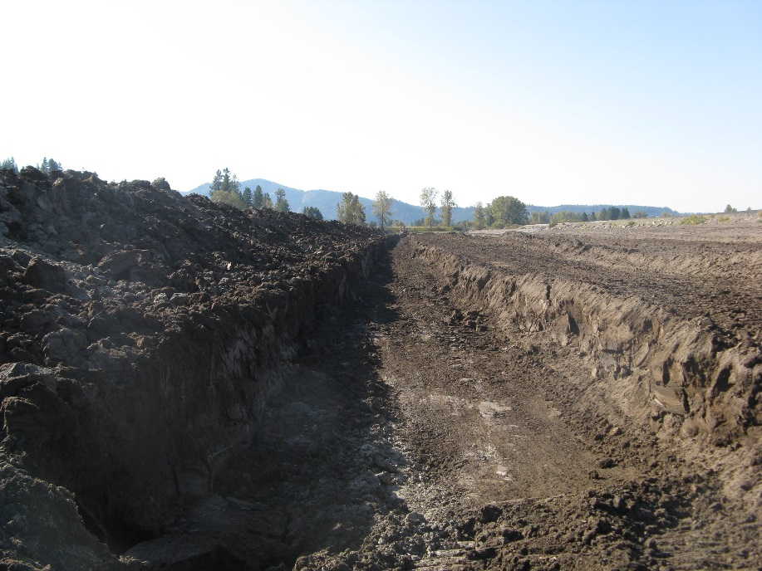
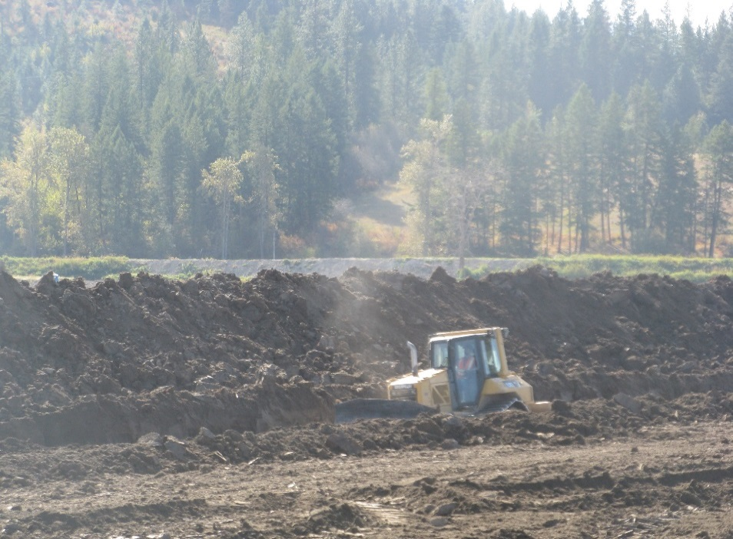
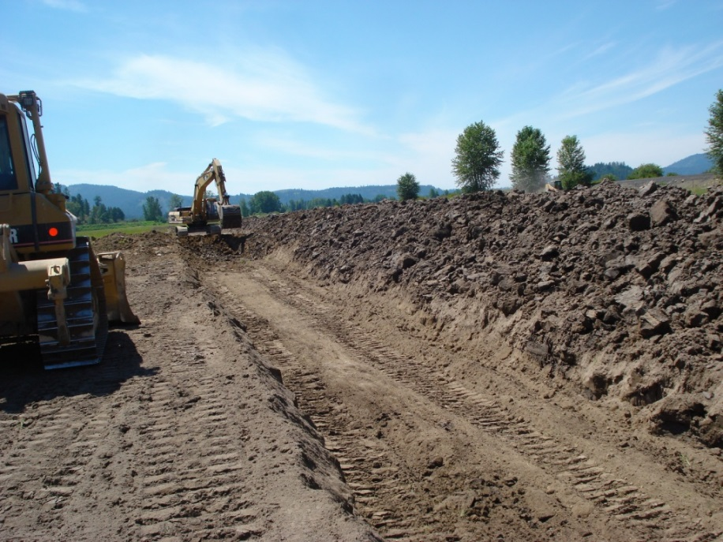
2007 – 2011 Construction

Slide 16
Bunker Hill Superfund Site
State of the Site

Slide 17
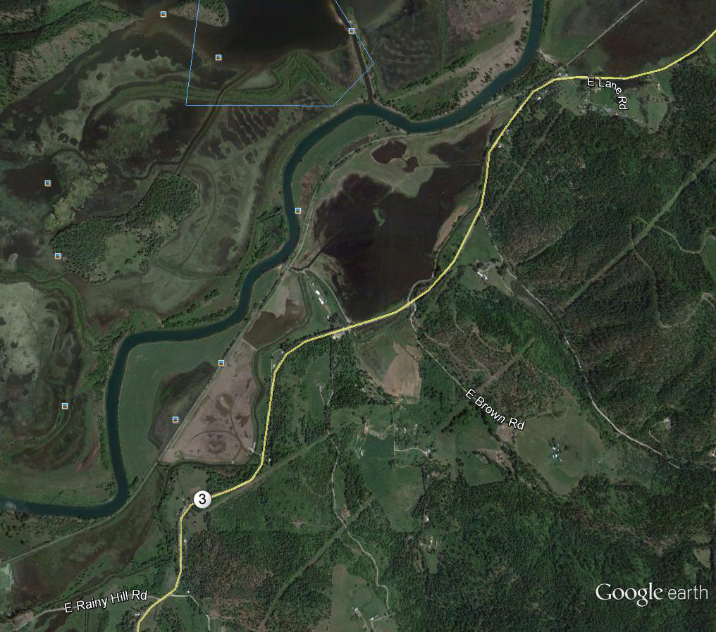
2015 Aerial View of Ag/Wetland
Campbell Marsh
East Field
West Field
Trail of the CDAs
CDA River

Slide 18
Wetland Waterfowl Usage Data

Slide 19
Wetland Waterfowl Usage Data

Slide 20
Wetland Findings
Annual Ave. Tundra Swan mortality ~ 73 in CDA Basin
Usage is variable and is a fn of multiple factors
1st order control on Tundra Swan usage appears to be water level in Lower Basin (see 2014, 2015 data)
2014 Tundra Swan mortality recorded by USFWS ~ 1 obs.
2015 Tundra Swan Mortality Preliminary ~ 30 observed

Slide 21
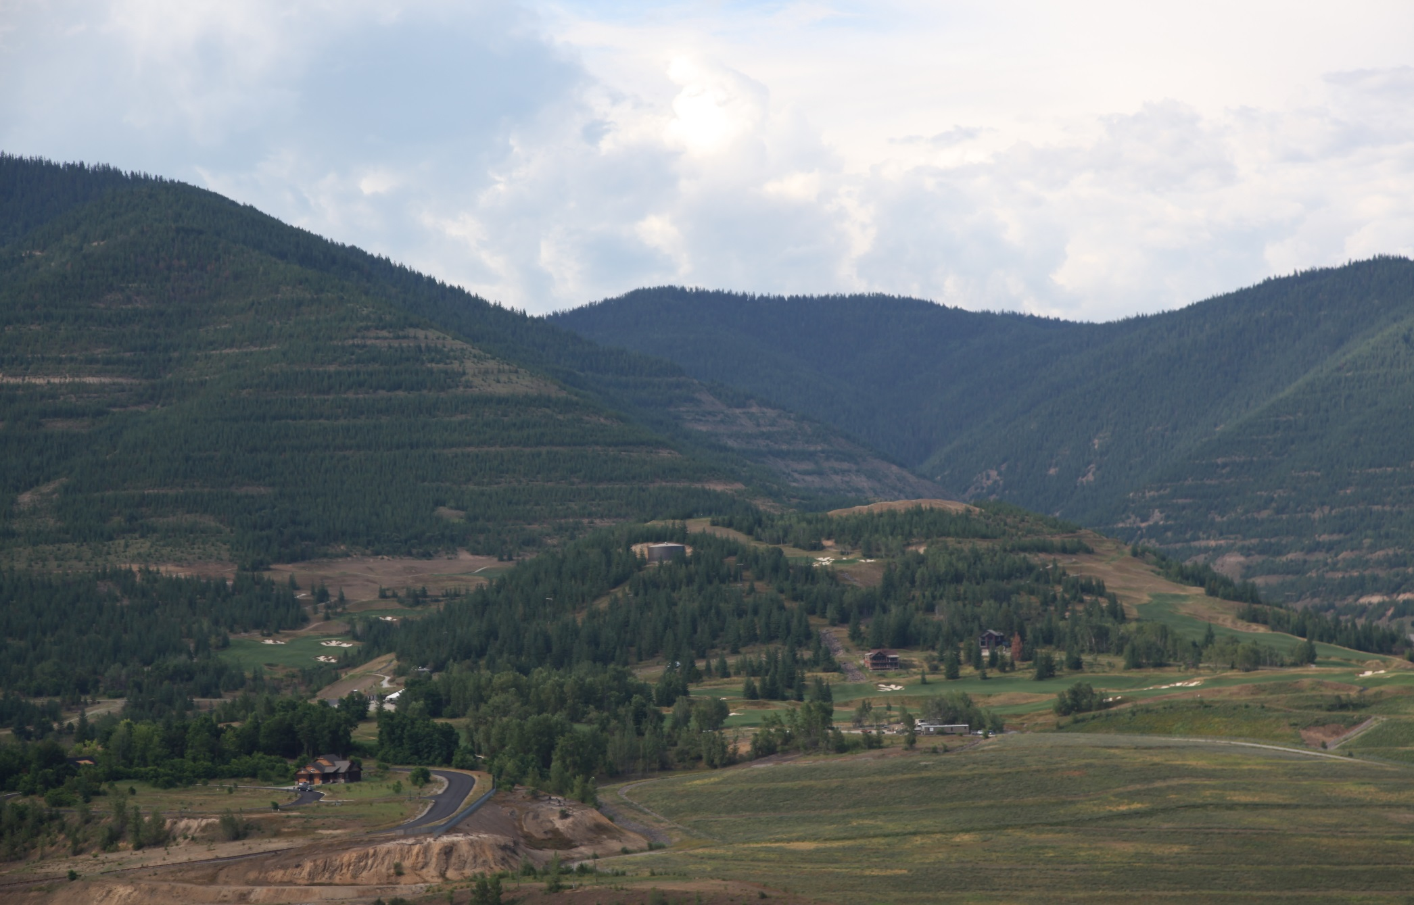
Bunker Hill Superfund Site
Lessons Learned

Slide 22
Ag to Wetland Lessons

Slide 23
Lessons Learned: Ag to Wetland
Having all parties at the “technical table” helps ensure smooth transition from remediation to restoration.
Working in wetland soils is tricky – dewatering/drying can take much longer than expected.
River levels controlled by downstream dam – so needed infrastructure to control water levels - with infrastructure comes O&M and associated ongoing expense.
Armored overflow areas are a cost-effective tool to prevent recontamination of clean remediated wetland.
Project highlighted problems with nearby highway culverts - recently resolved.

Slide 24
Lessons Learned: Ag to Wetland (cont.)
Things that we can’t control take longer than expected
  Shifted to a portable electric pump to control water level in west field resulting in need to contract with power company - long lead time item that was not anticipated.
Complete all agreements in advance - we had an agreement with a party that would hold the easement but that failed after the economy imploded in 2008.
Since we can optimize water levels for waterfowl – the site has had extraordinary use when flooding impacts other areas.
While waterfowl usage is very impressive, we want to increase use by tundra swans. USFWS plans to transplant Wapato - a favorite food source of tundra swans.
Early vegetation success was poor following remediation of W. Field. Soil chemistry data could have been useful during remediation so decision could be made whether to address during construction.
➔Looking for additional areas to create more clean feeding areas in the Lower Basin.

Slide 25

QUESTIONS?
Ed Moreen
U.S. EPA Region 10
Moreen.ed@epa.gov
(208) 664-4588
Anne Dailey
U.S. EPA
dailey.anne@epa.gov
(703) 347-0373
Photo courtesy Toni Davidson, USFWS

