Slide 1
Considering Native Plants and Pollinator Habitats
Bruce Pluta, EPA

Slide 2
Why Pollinator Habitats?

Slide 3
Presidential Memorandum - Creating a Federal Strategy to Promote the Health of Honey Bees and Other Pollinators
Benefits to the Community
  Visual appeal
  Increased ecological services
  Enhanced recreational opportunities
  Benefits to agriculture
Benefits to Site Owners / PRPs / Contractors
  “WOW” factor
  Good Land Steward
  Reduced costs over the long term
  Reap the same benefits as the Community

Slide 4
Pollinator Meadows
DuPont Newport Site
Newport, Delaware

Slide 5
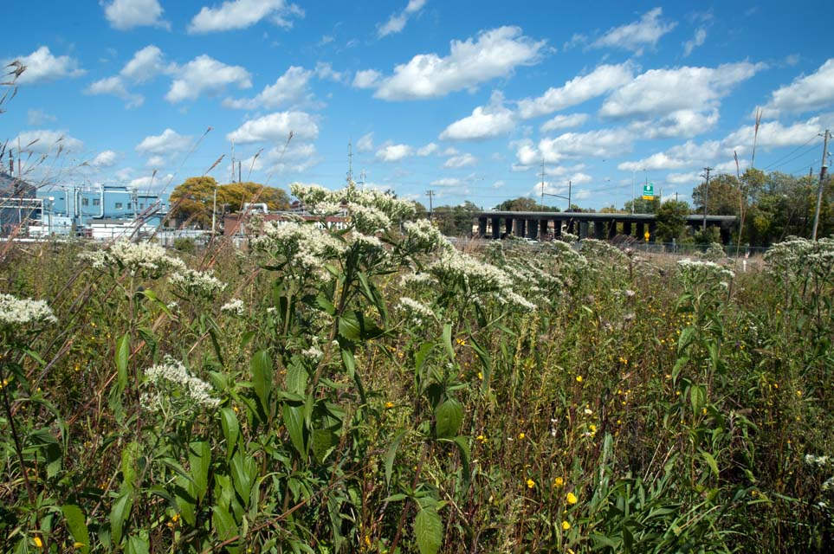
Setting the Stage
Put corporate lands to better use
Appropriate and sensible reuse for the parcel
Integrate with other uses
Dupont and the Wildlife Habitat Council

Slide 6
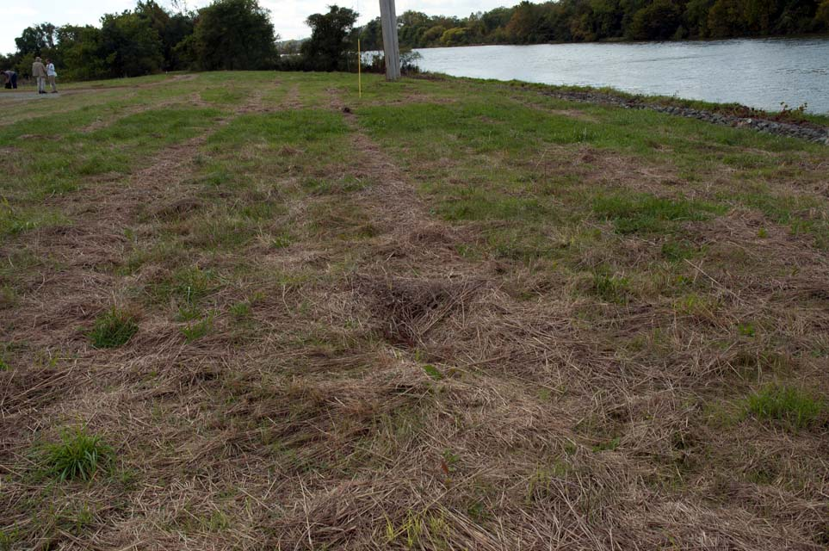
Pollinator Meadows
Objective: Increase pollinator diversity
Three meadows totaling approximately 0.5 acres
Meadows occupy different positions in the existing landscape
The blank slate: existing landfill cover grasses

Slide 7
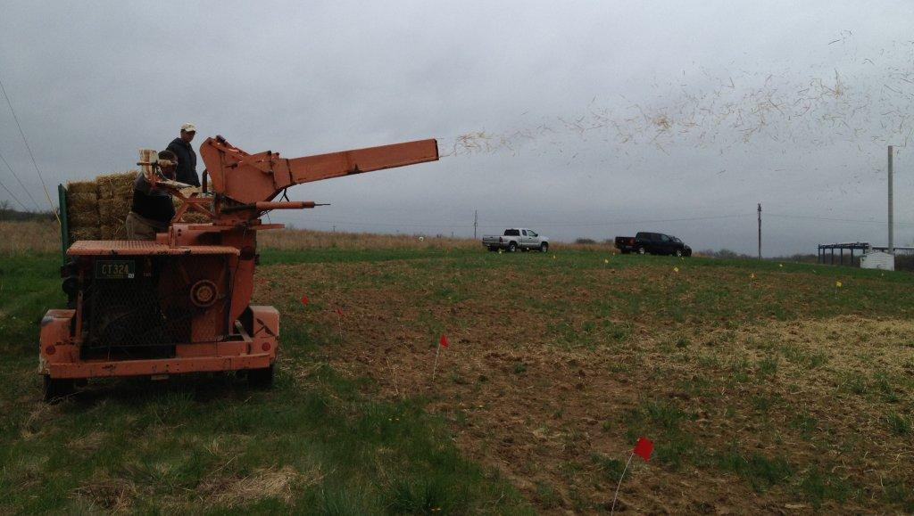
Planning and Implementing
Location – subtleties and habitat
Evaluate site conditions
Determine planting strategy
Site preparation and planting

Slide 8
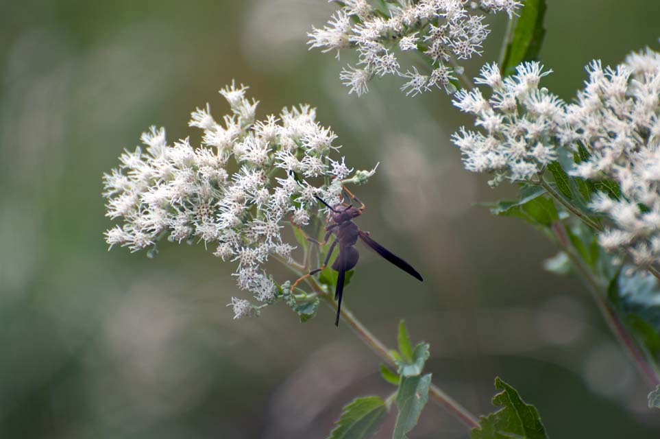
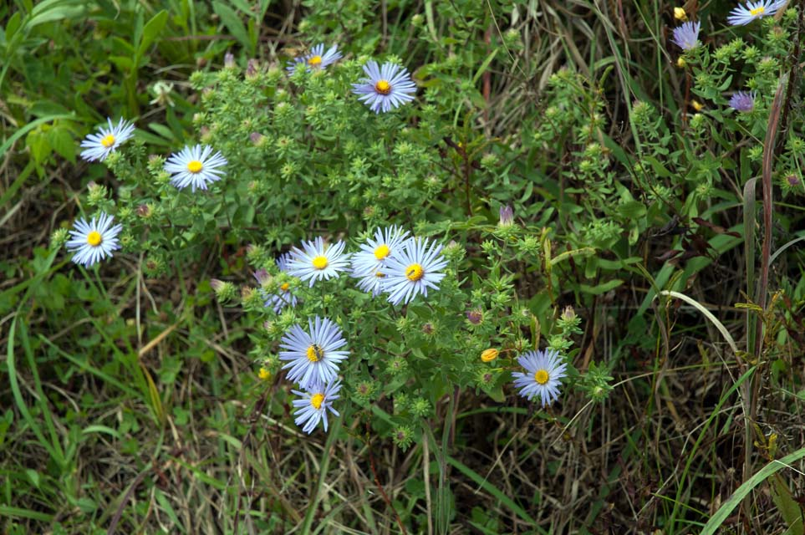
Maintenance and Monitoring
Watering during establishment
Invasives Control
Monitored plant success and pollinator
Seed Collection

Slide 9
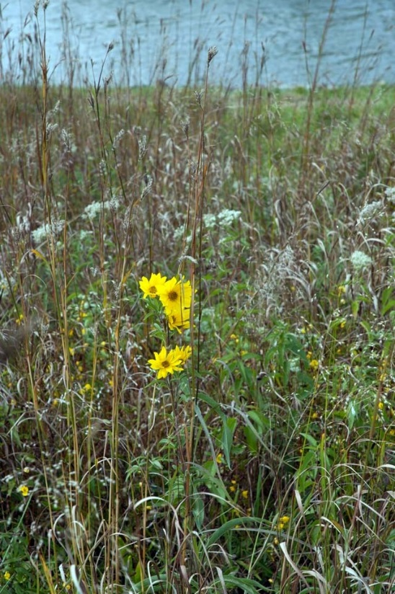
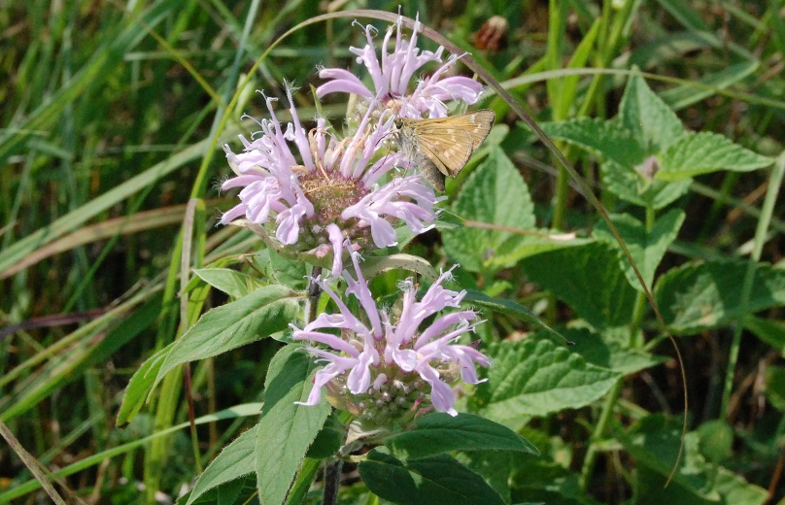
Education Opportunities
and Public Involvement
Earth Day Lunch and Learn
Volunteer Planting Days
Monarch Watch Meadow Walk
Thank you cards with meadow photo
and seed packet for volunteers
“Seed Collection” Field Day

Slide 10
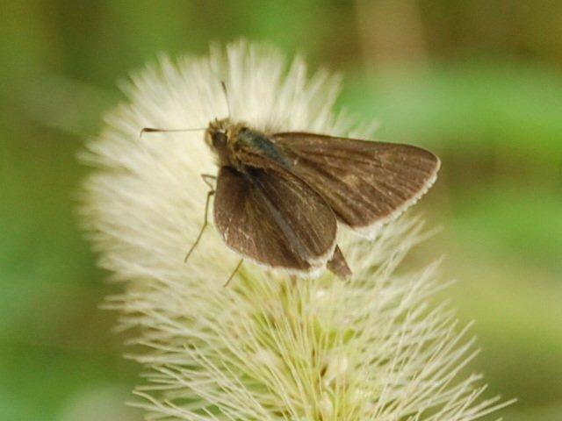
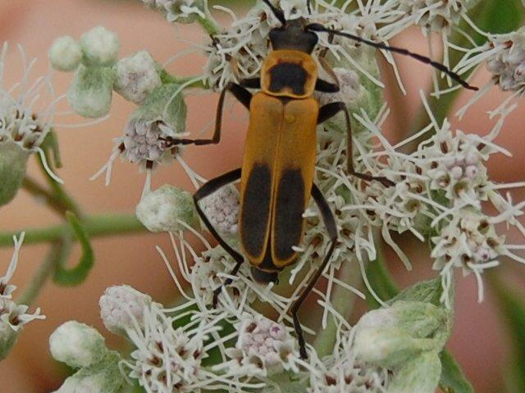
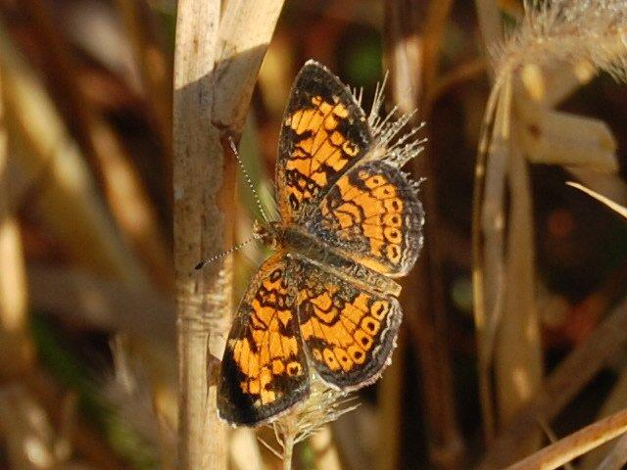
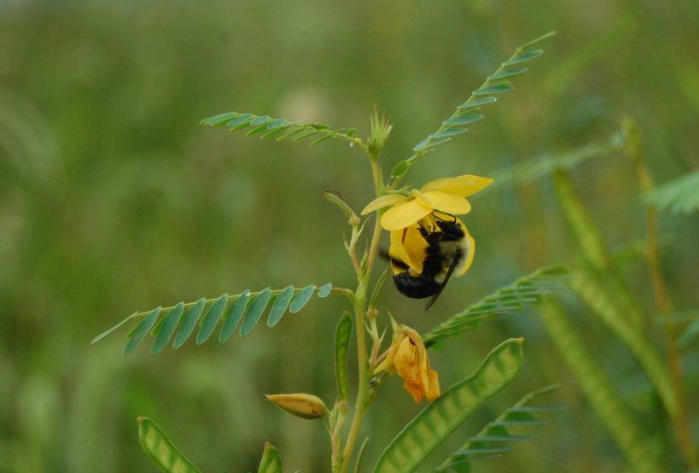

Slide 11
BoRit Asbestos
Removal Action
Ambler, Pennsylvania

Slide 12
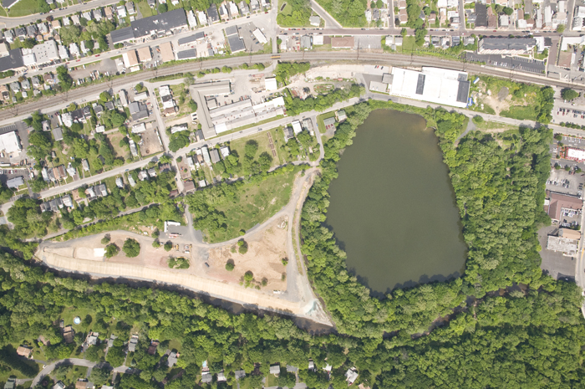
Setting the Stage

Slide 13
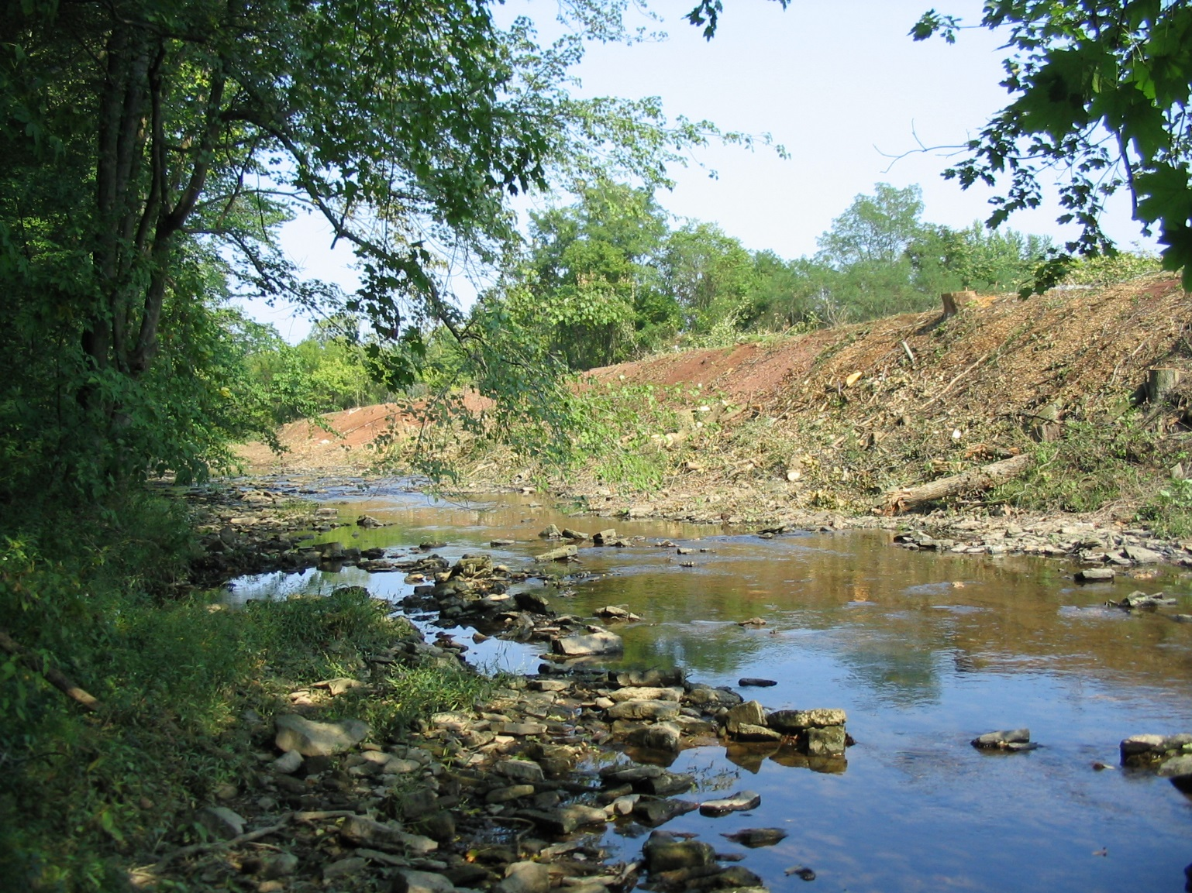

Slide 14
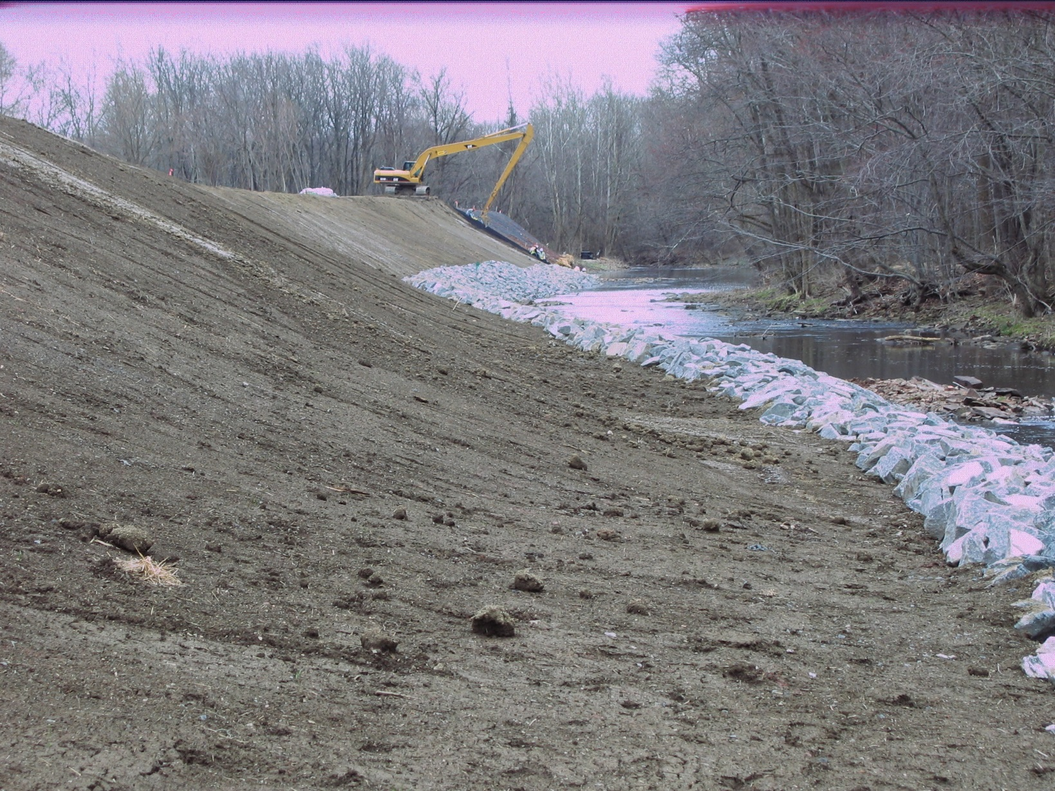

Slide 15
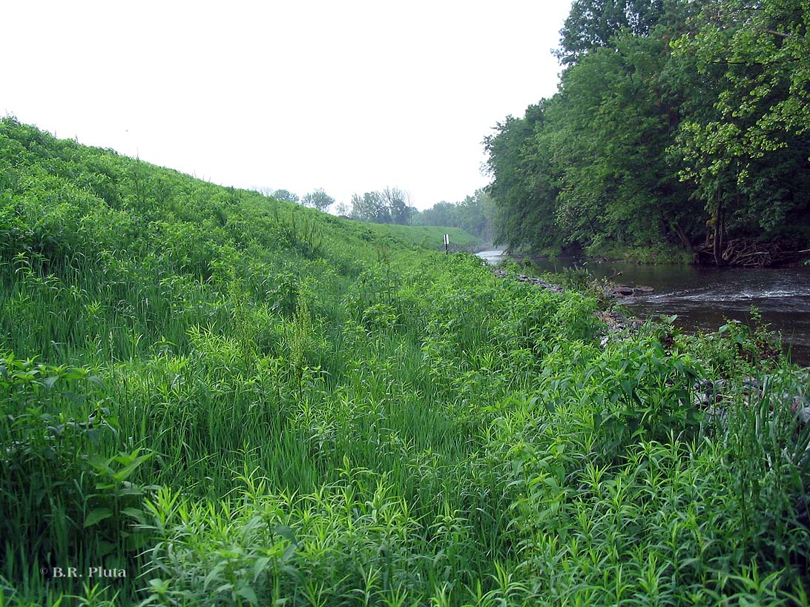

Slide 16
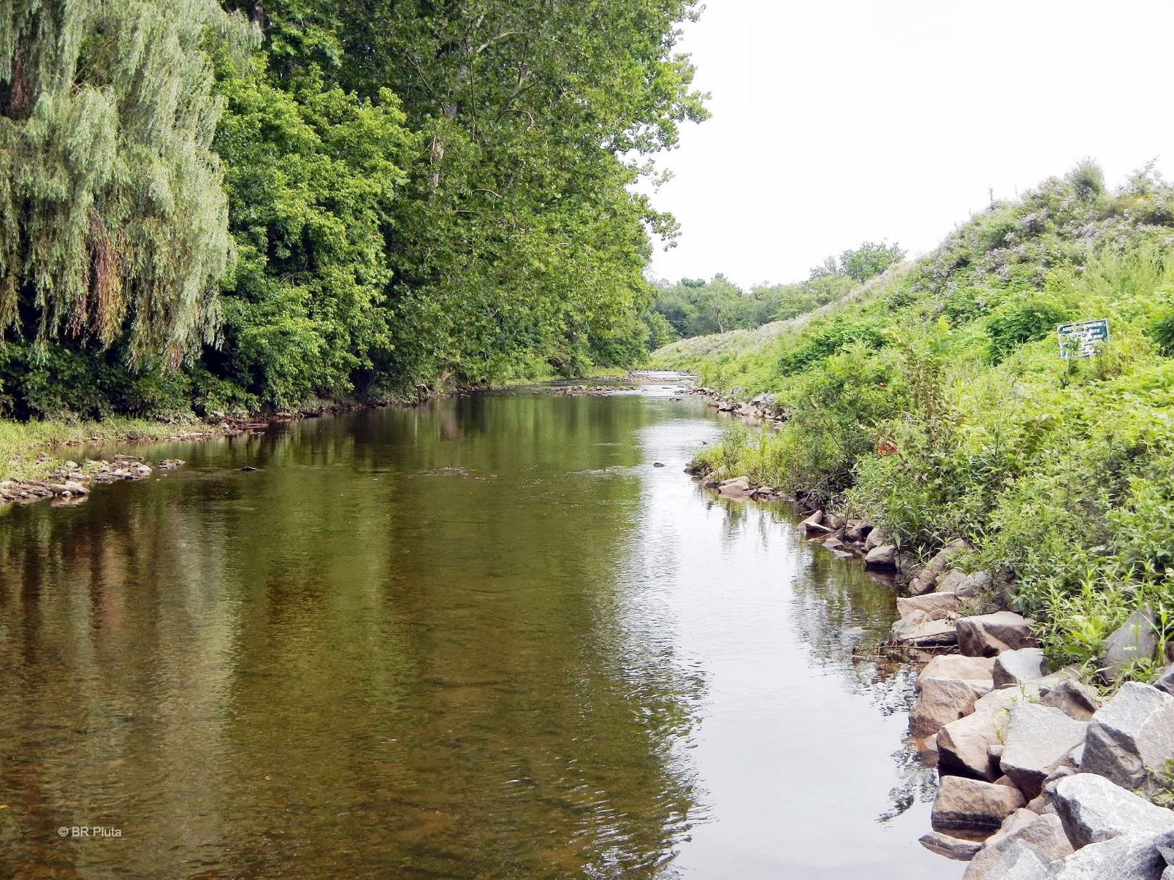

Slide 17
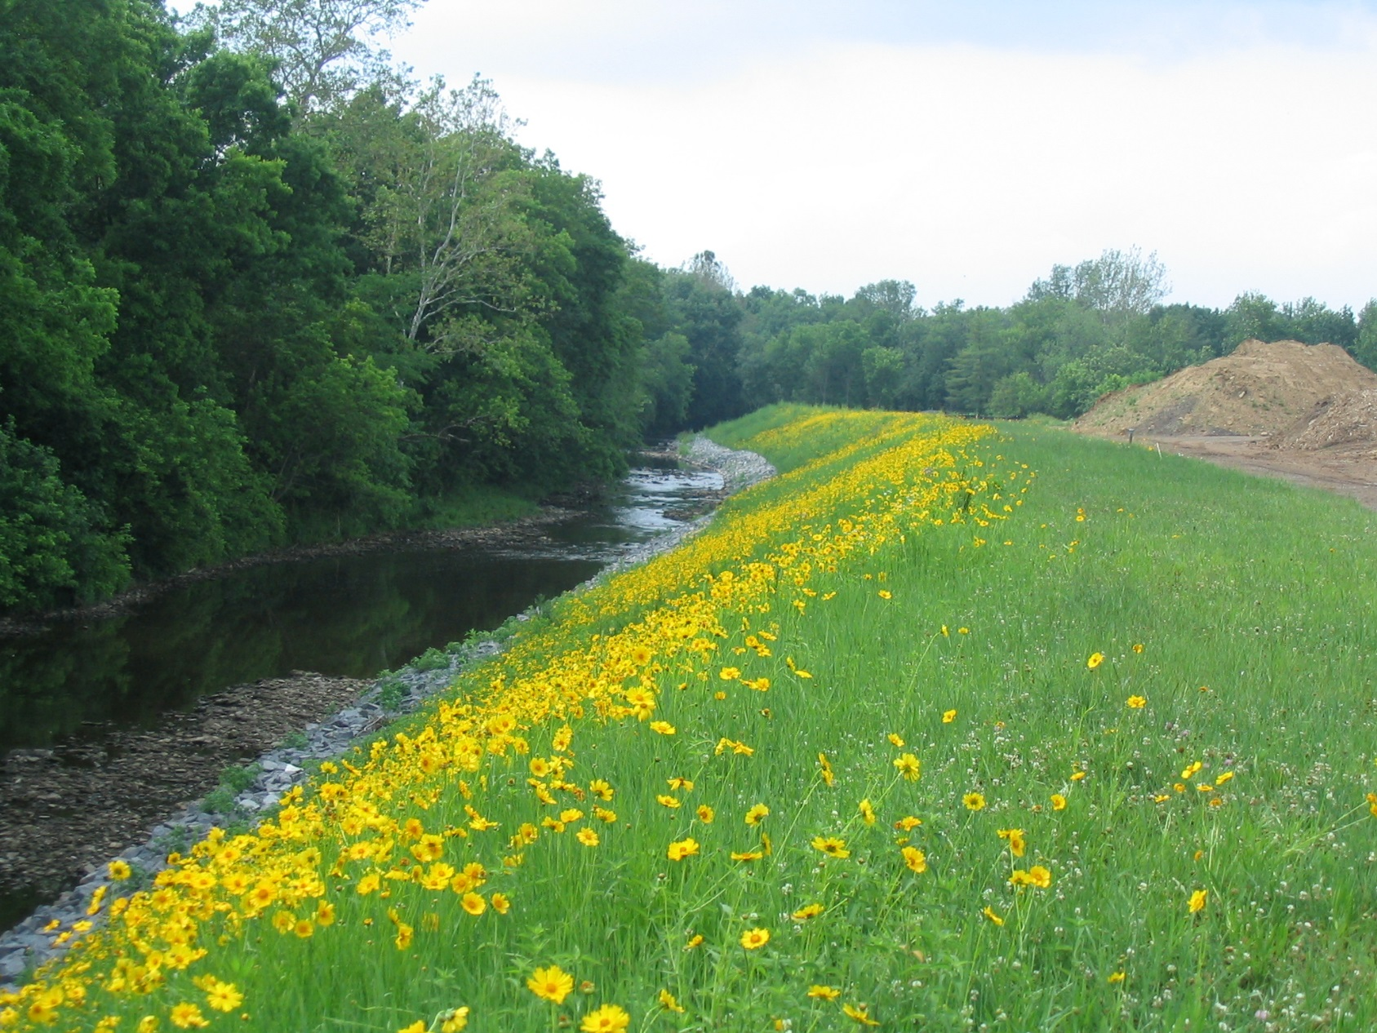

Slide 18
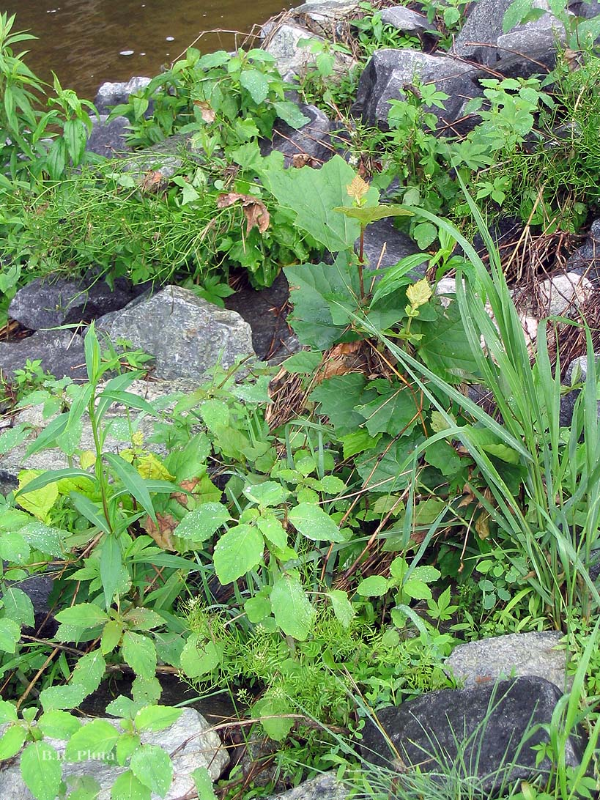
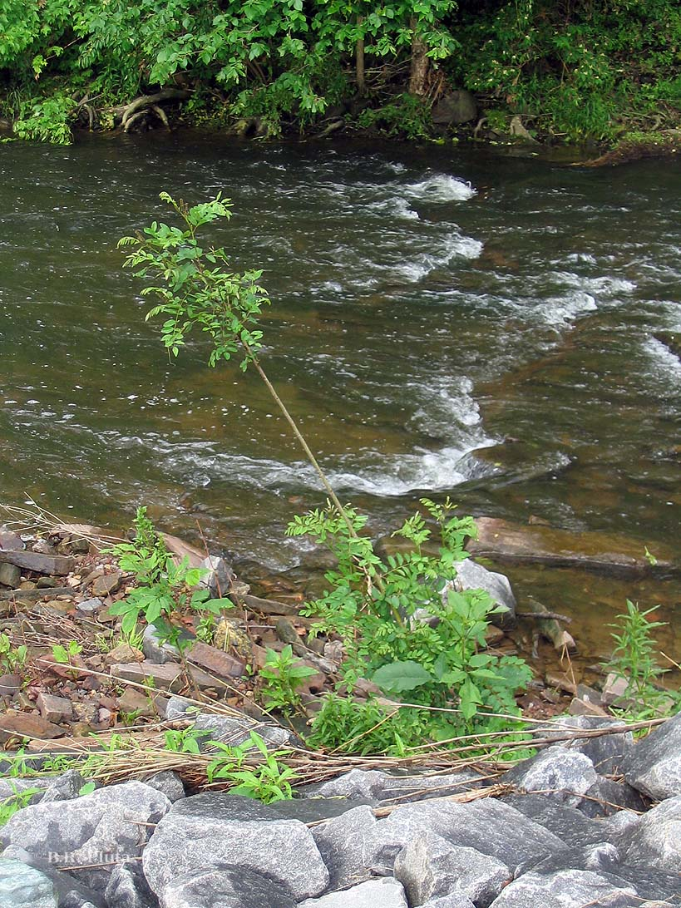

Slide 19
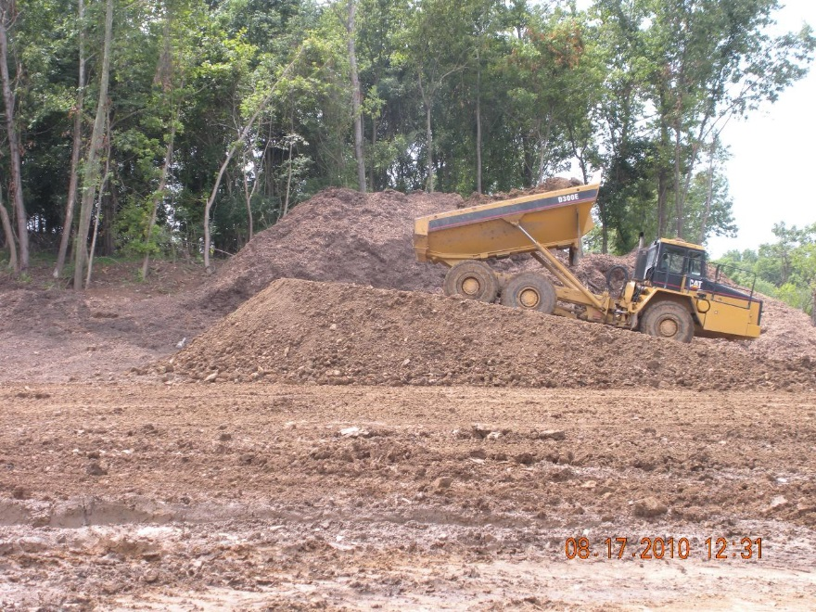
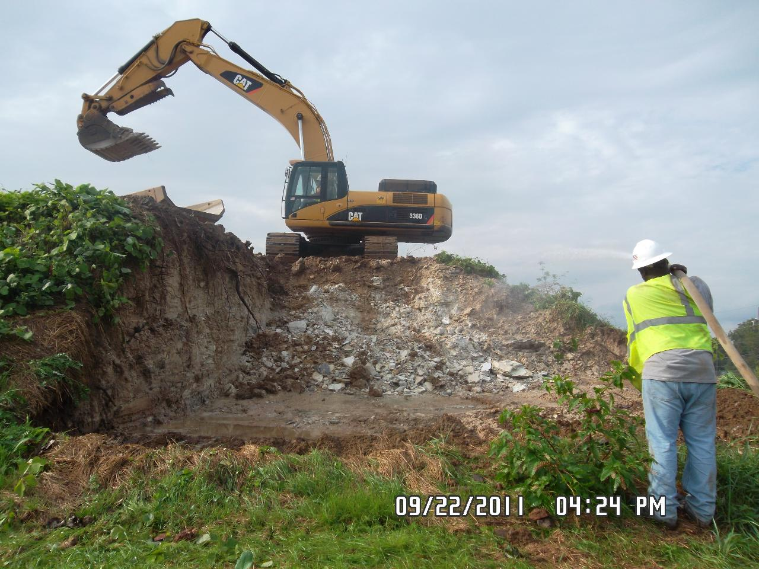

Slide 20
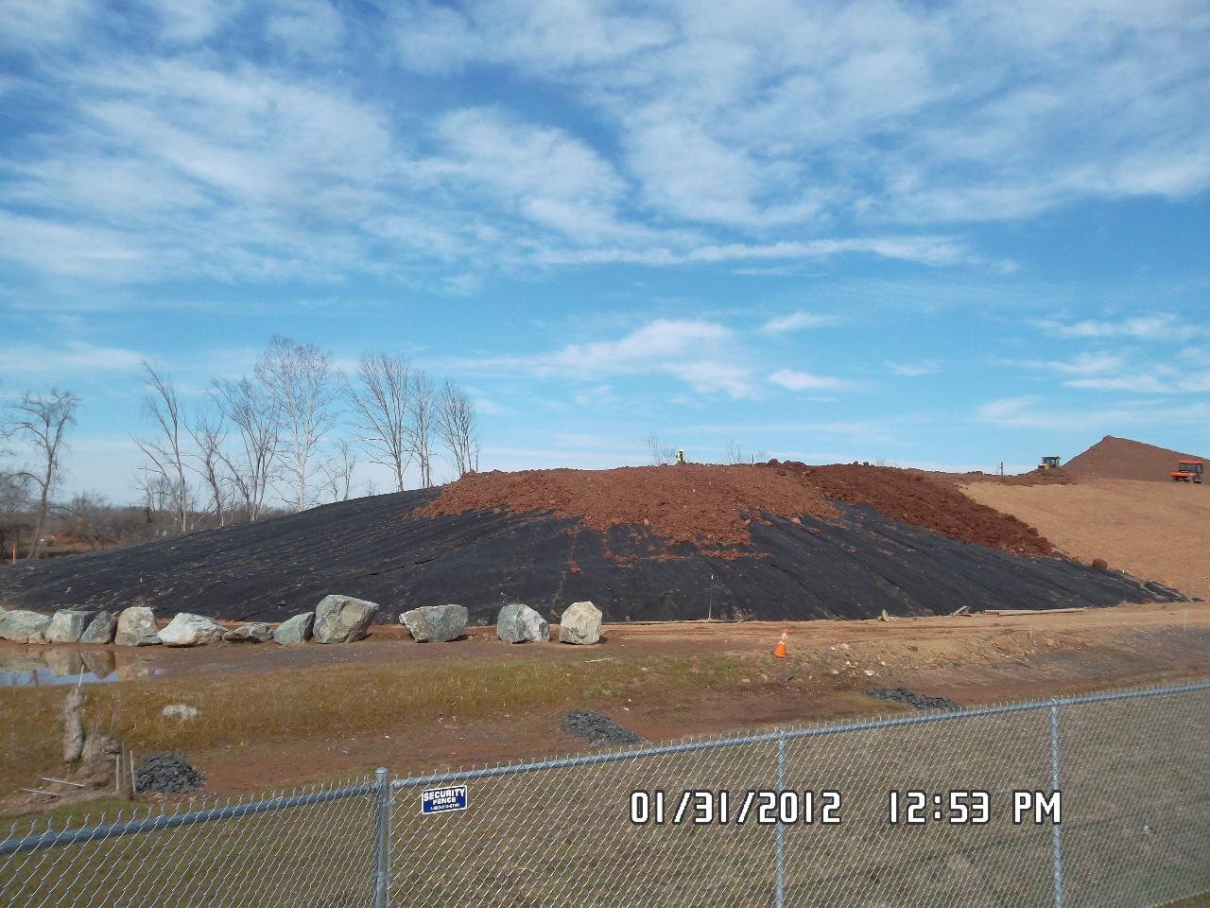
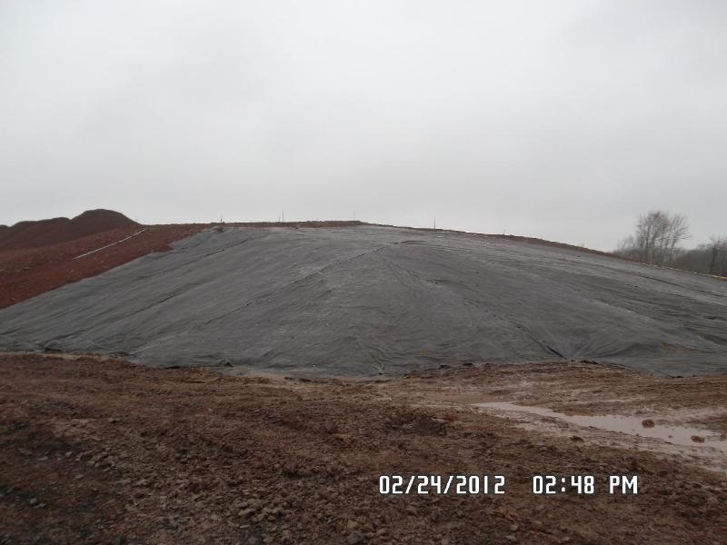

Slide 21
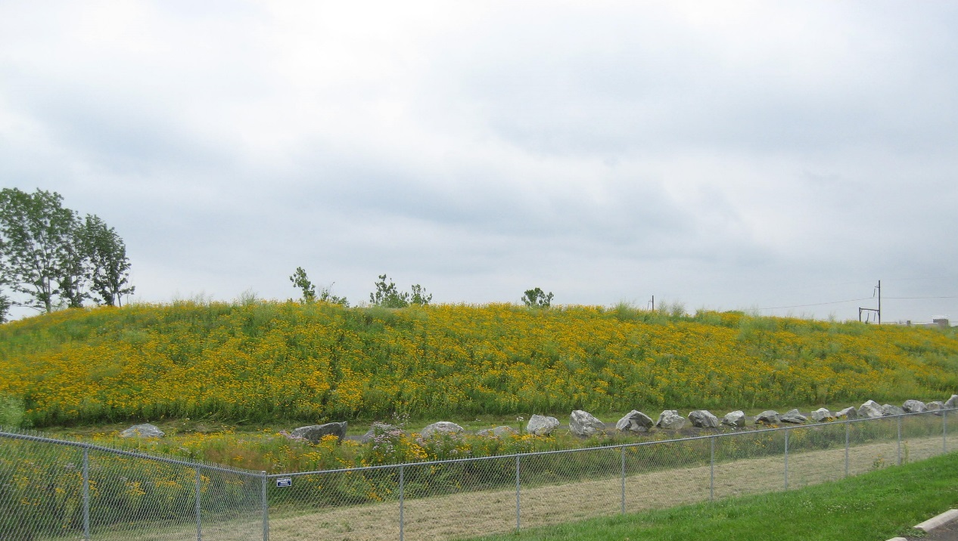
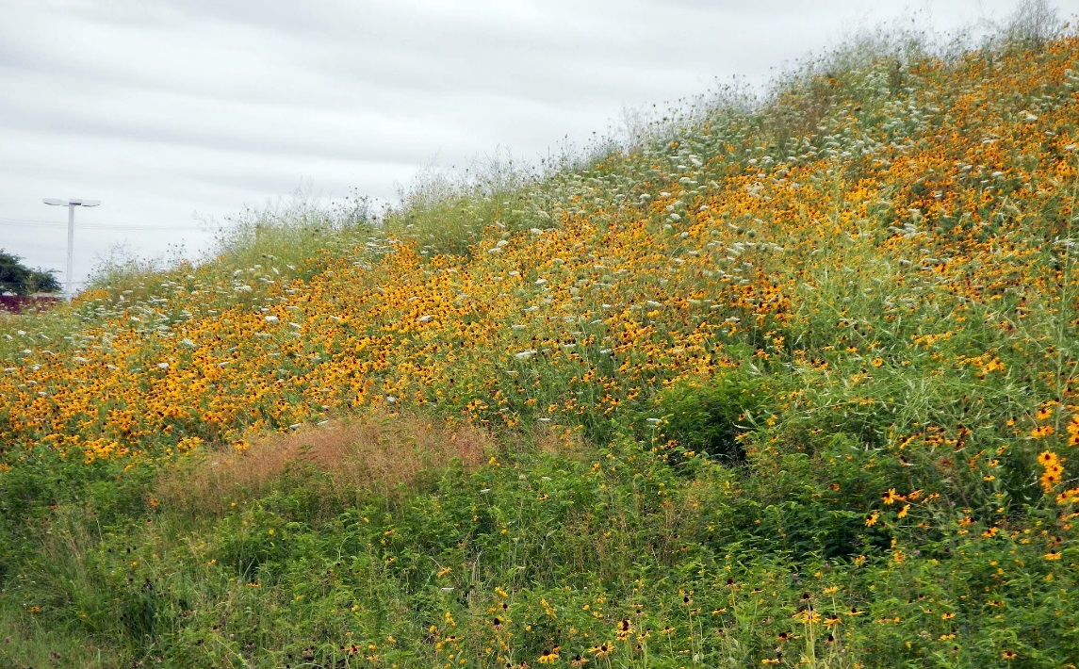

Slide 22
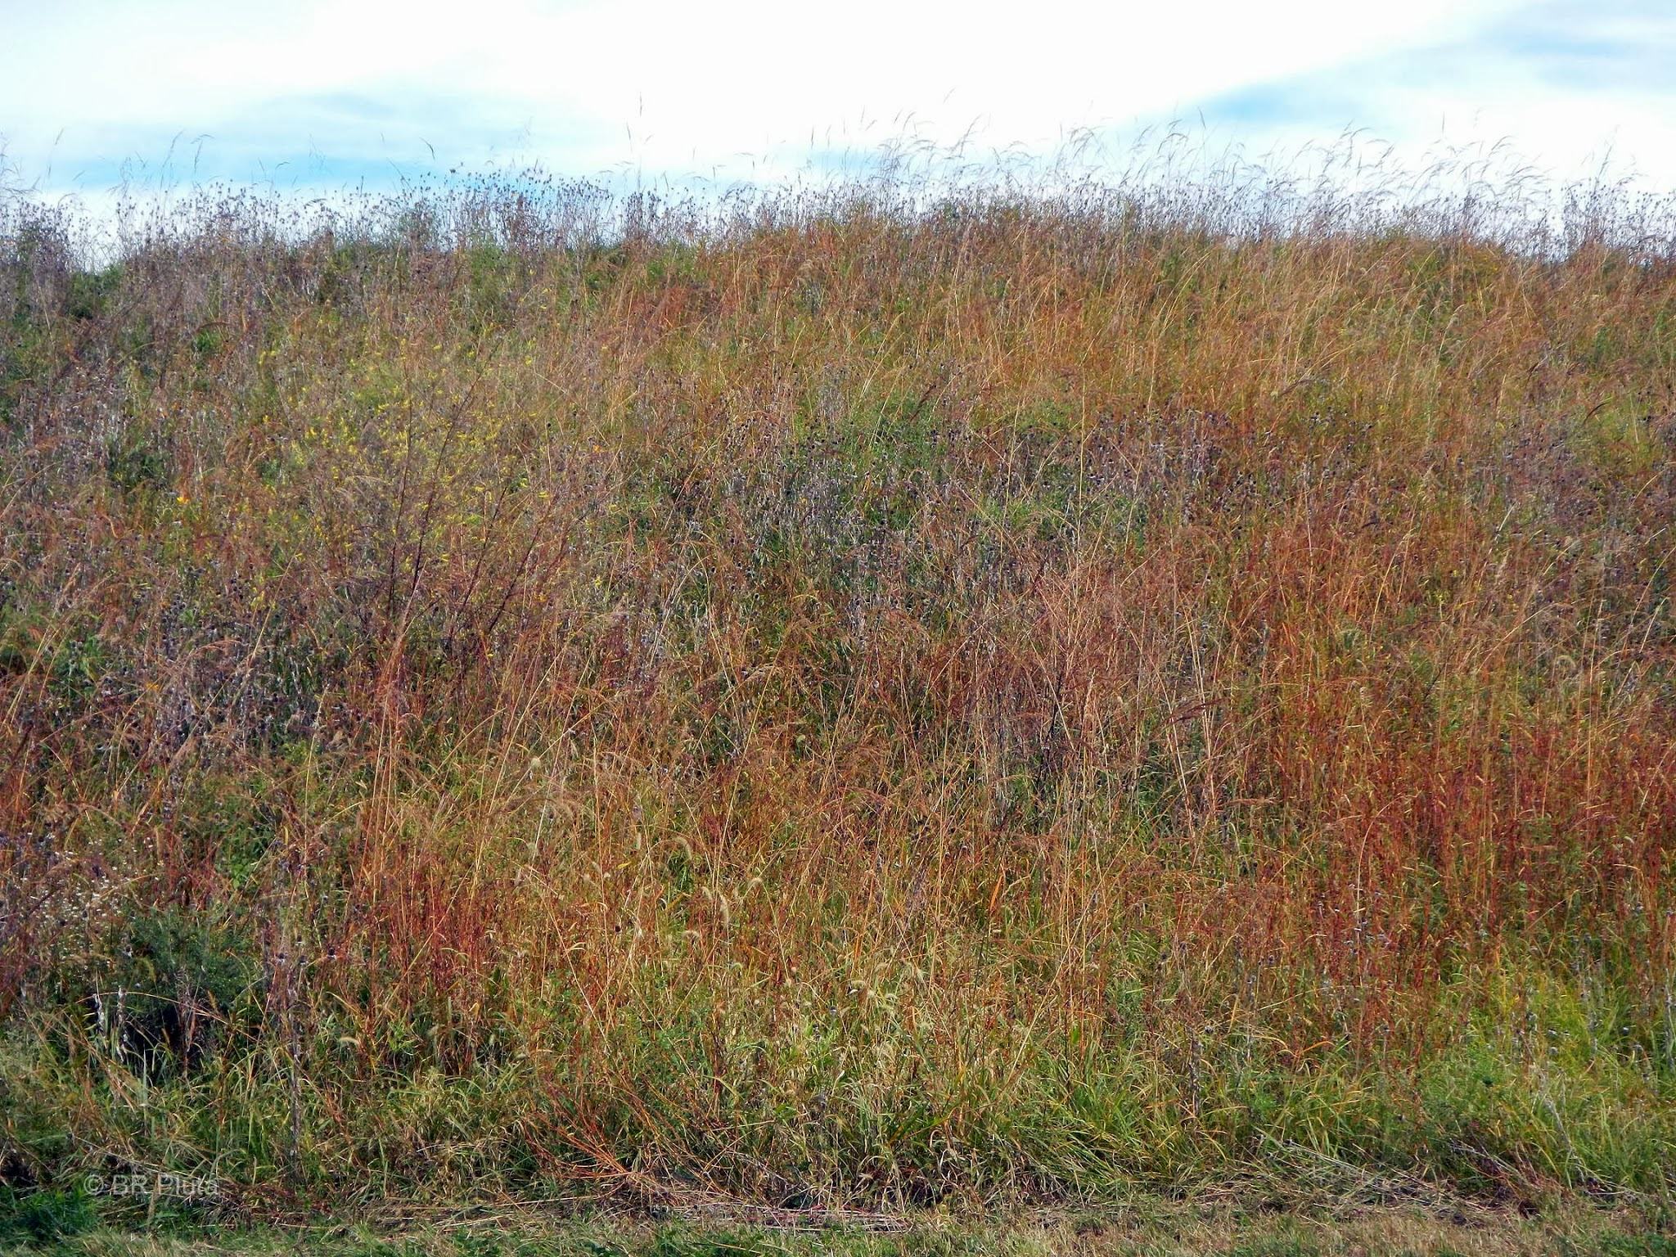

Slide 23
Top Eight Challenges
They’re weeds! (Need public education)
Where are they? (Manage expectations)
Dirt is dirt, right? (Determine agronomic properties, make sure clean soil is clean, watch for compaction)
Why isn’t everything growing? (Match species with the habitat conditions)
Invasives!
Timing (rainfall), Timing (temperature), Timing (availability)
Local supplies
Maintenance: specify, educate, if necessary require

Slide 24
QUESTIONS?
Bruce Pluta
EPA Region 3
pluta.bruce@epa.gov
(215) 814-2380
Special thanks to Maryann J. Nicholson, Principal Technical Consultant, Chemours Corporate Remediation Group for her generous provision of photographs, information, and time.

