Slide 1
CHEMICAL COMMODITIES INC.
The History, Cleanup and Ecological Reuse of a Superfund Site

Slide 2
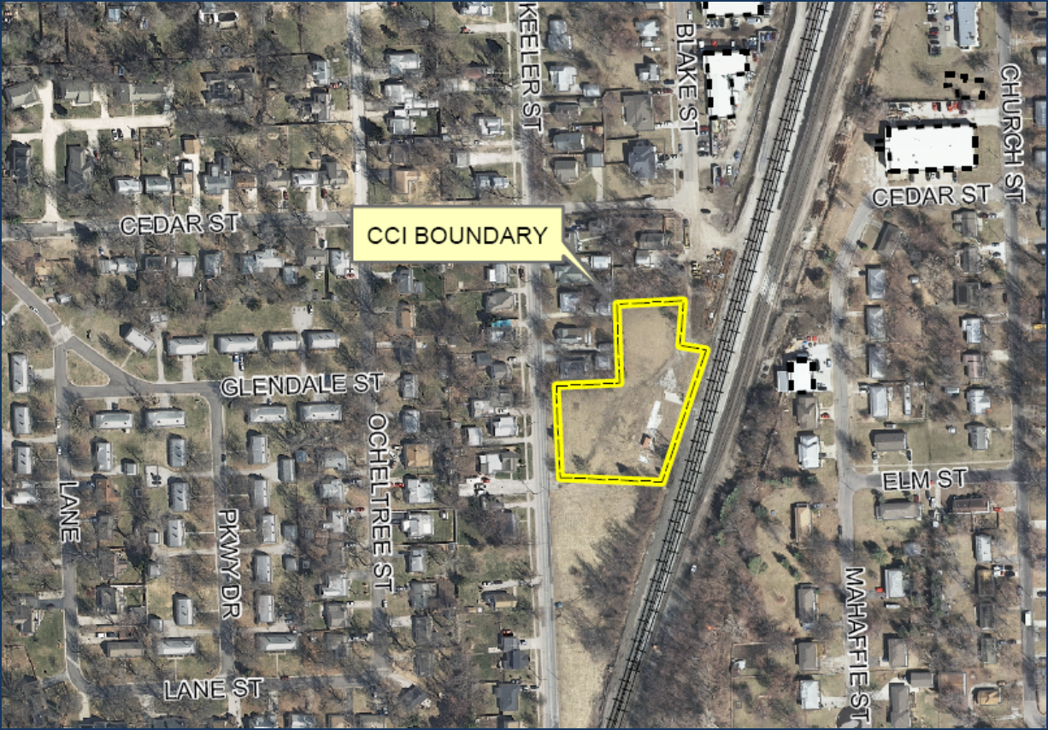
Chemical Commodities, Inc

Slide 3
Chemical Commodities, Inc.
Site History

Slide 4
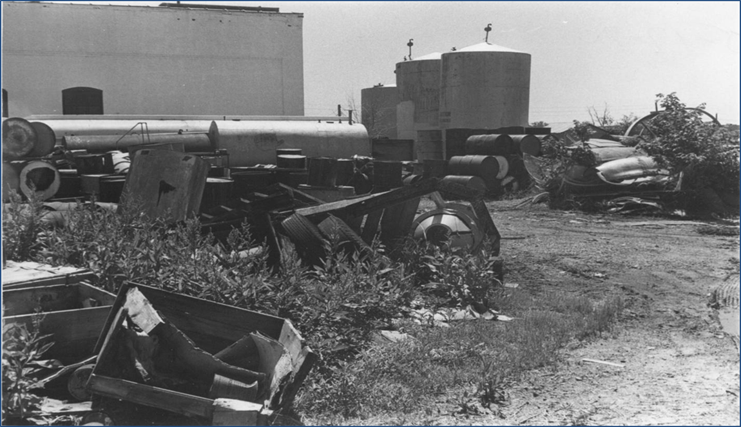

Slide 6
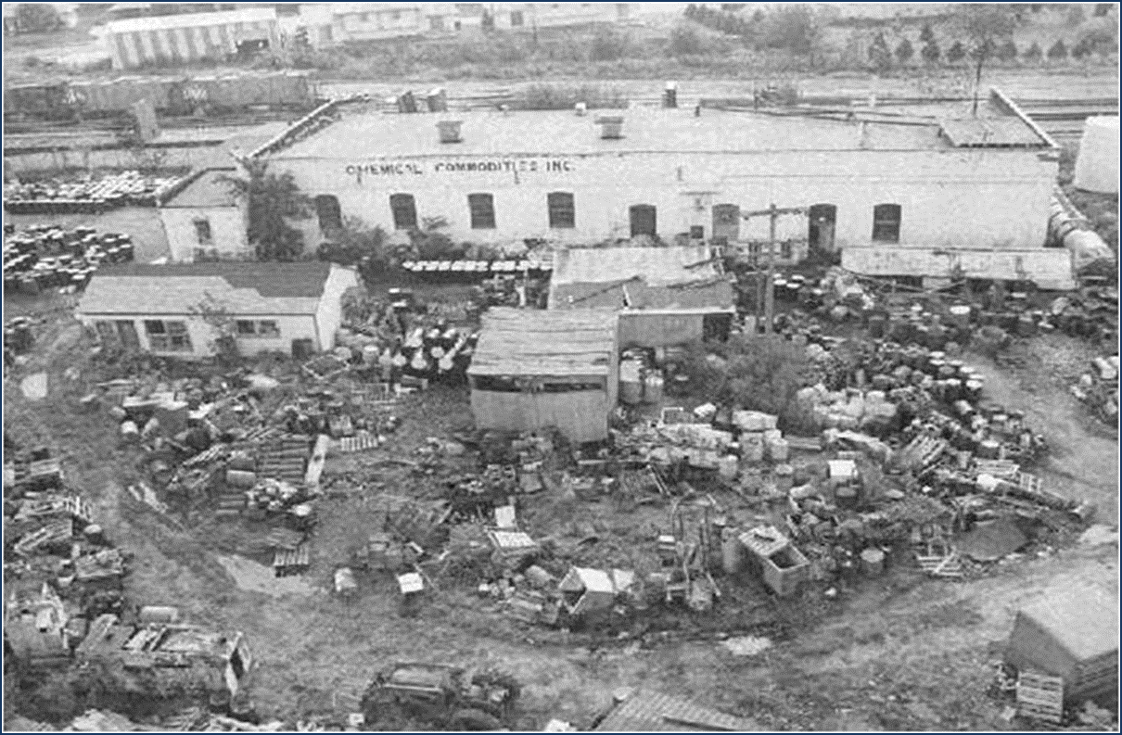

Slide 7
Soil:
Alternative S3D – Excavation and Off-Site Disposal
Excavation and off-site disposal of soils from certain areas containing high VOC concentrations and metals
Construction of a soil cap
Institutional controls to restrict land use
Ground water:
Alternative G2 – In-situ Chemical Oxidation
Treatment of on-site and off-site ground water using chemical oxidation
Monitored Natural Attenuation
Ground water Monitoring
Institutional controls to restrict private well installation and use;
Engineering controls (indoor air ventilation units)
Alternative S3D PLUS:
Retains the remedial components of Alternative S3D with additional excavation and treatment components added to further enhance on-site source area treatment.

Slide 8
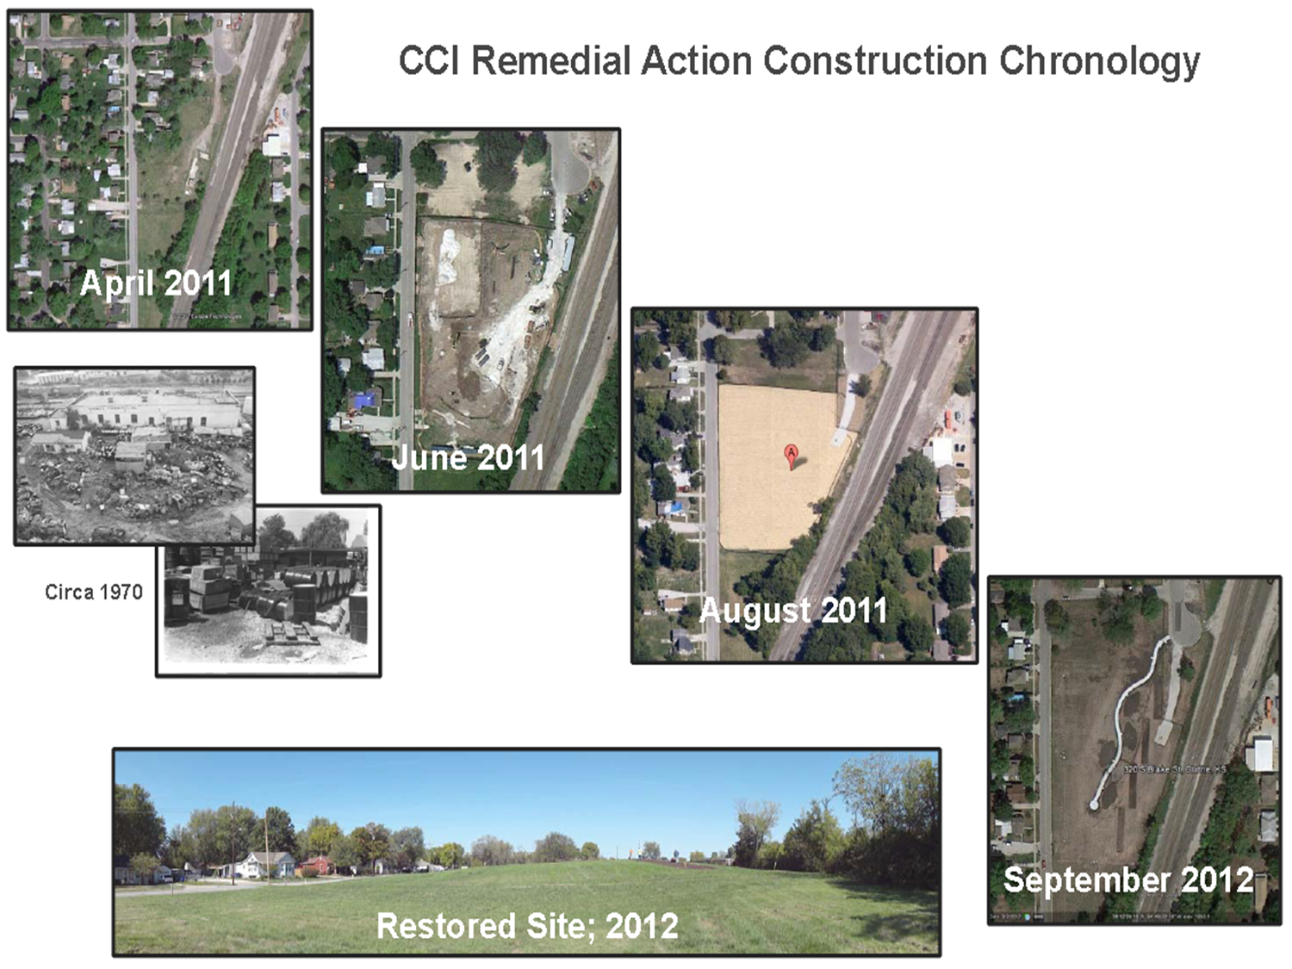

Slide 9
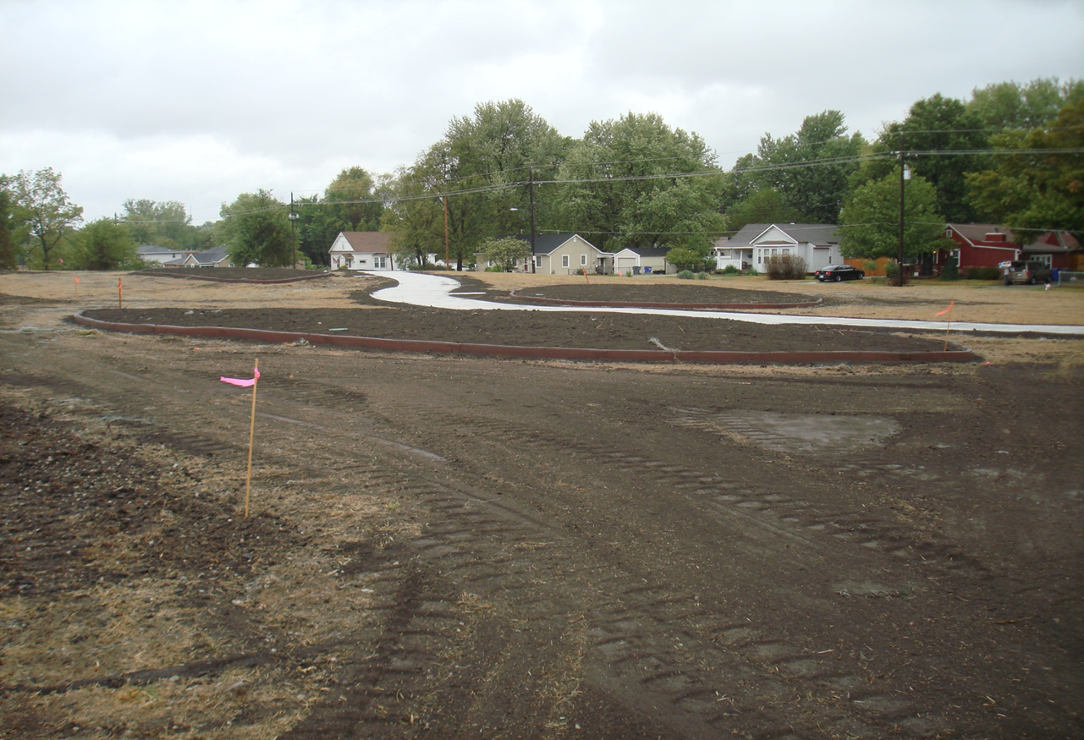
September 2012

Slide 10
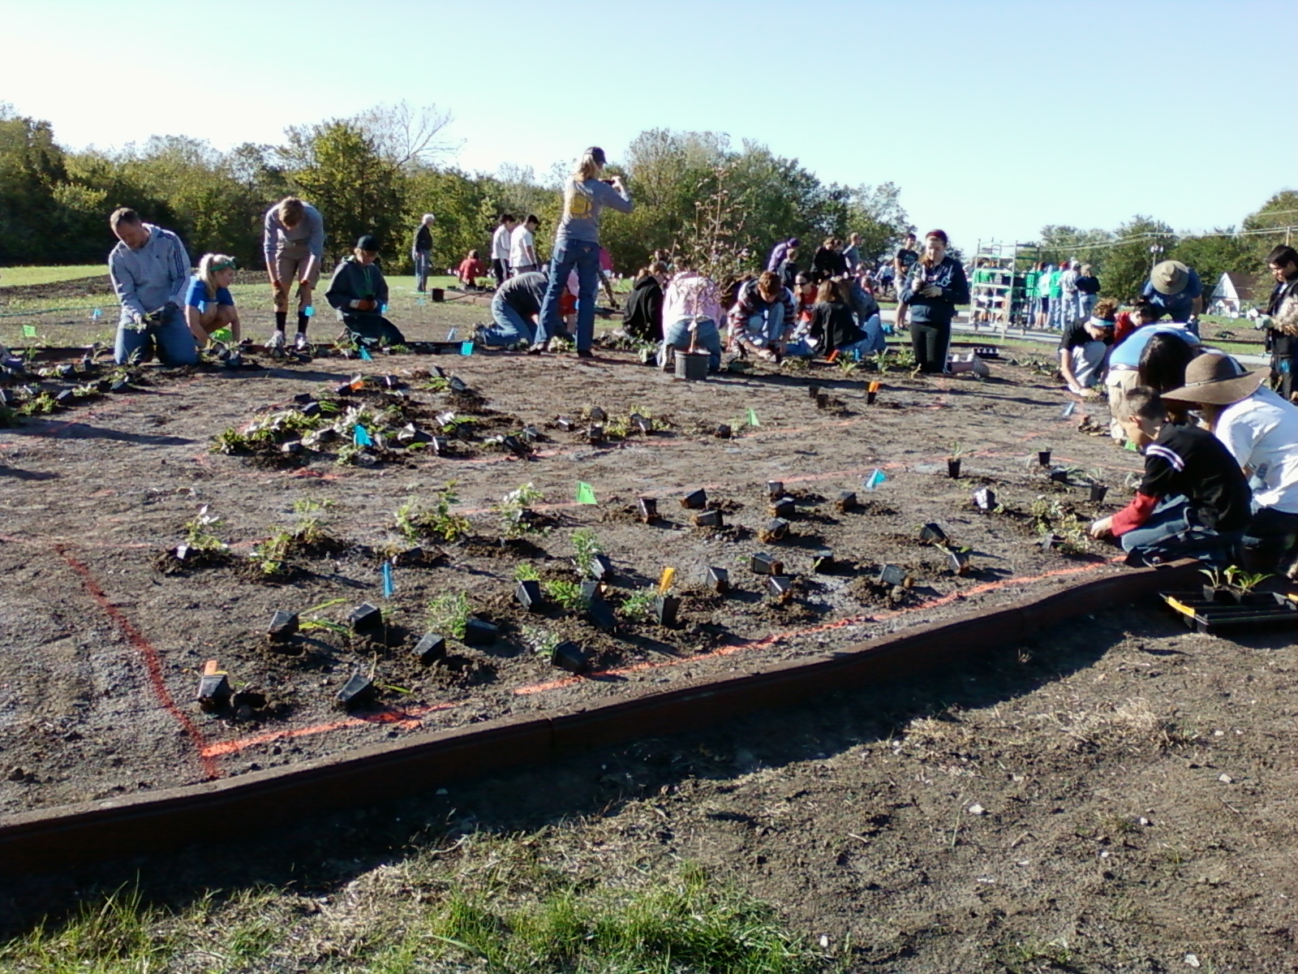
May 2013

Slide 11
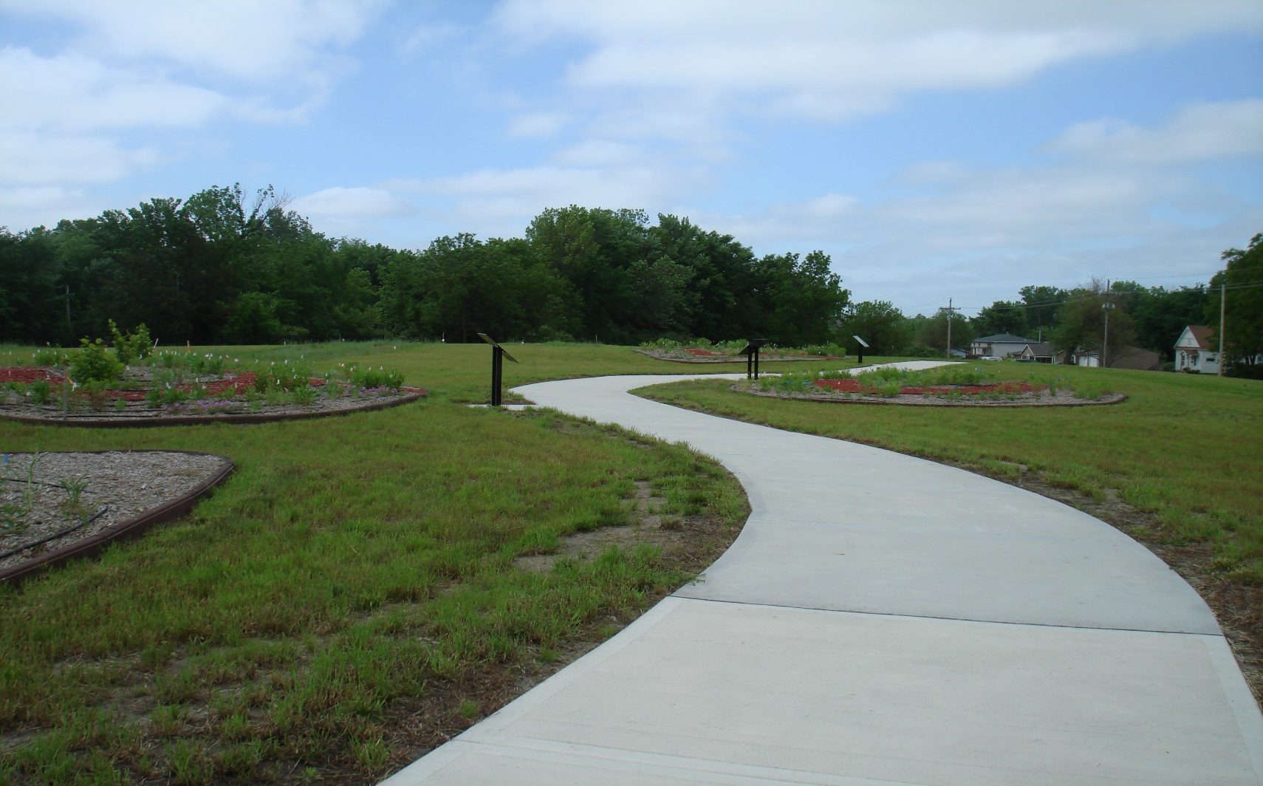
Late June 2013

Slide 12
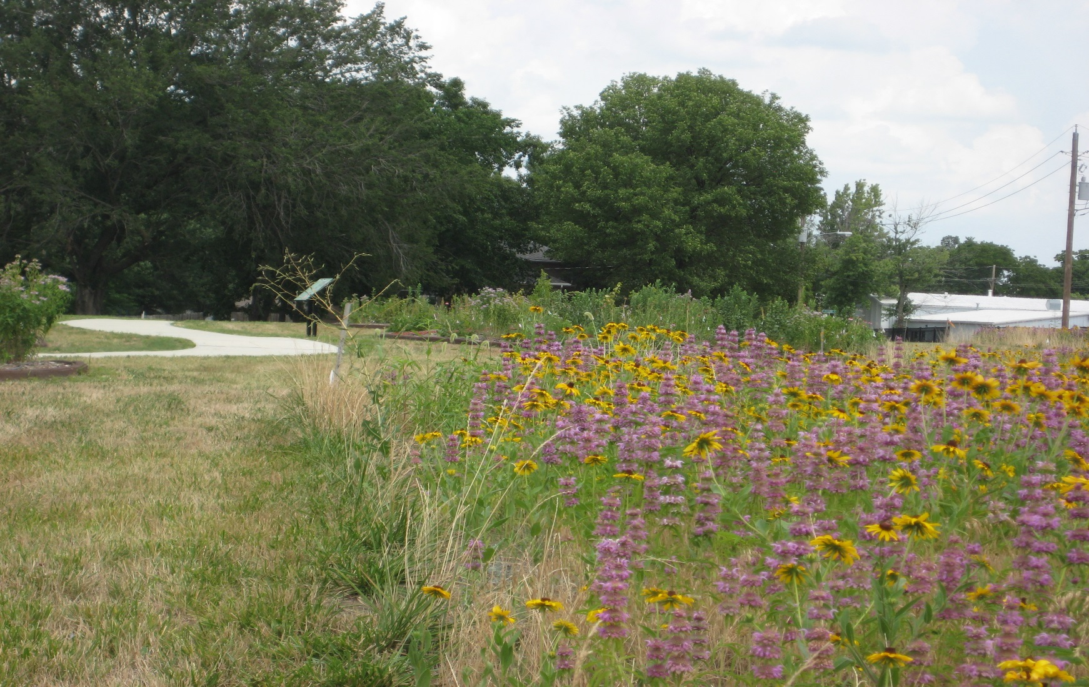
July 2014

Slide 13
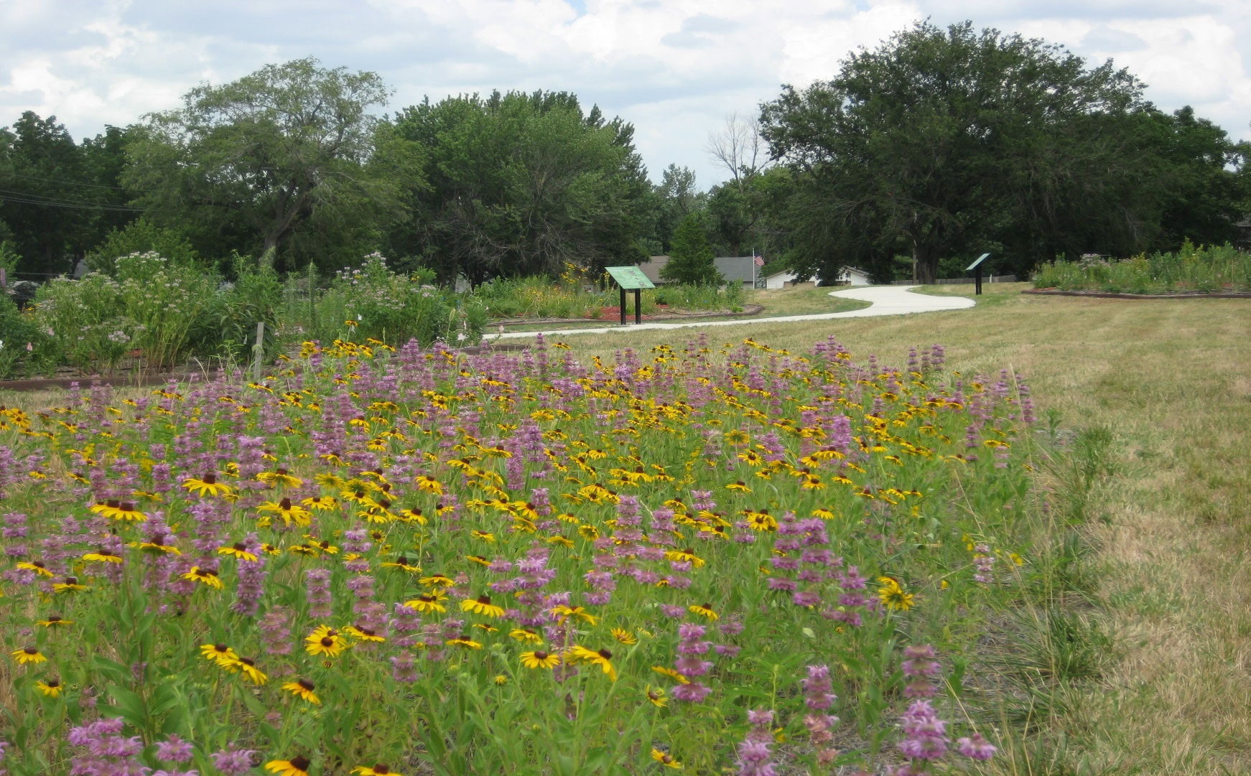
July 2014

Slide 14
QUESTIONS?
Jeff Field
EPA Region 7
field.jeff@epa.gov
(913) 551-7548
Special thanks to The Boeing Company, Monarch Watch, Monarch Joint Venture, the Pollinator Partnership, and the Wildlife Habitat Council.

