Slide 1

Pollinator Partnership
Mary Byrne
Plant Ecologist, P2

Slide 2
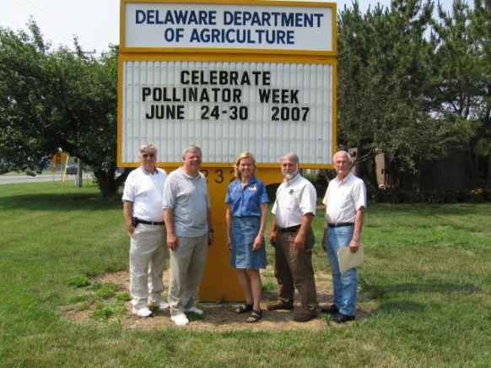
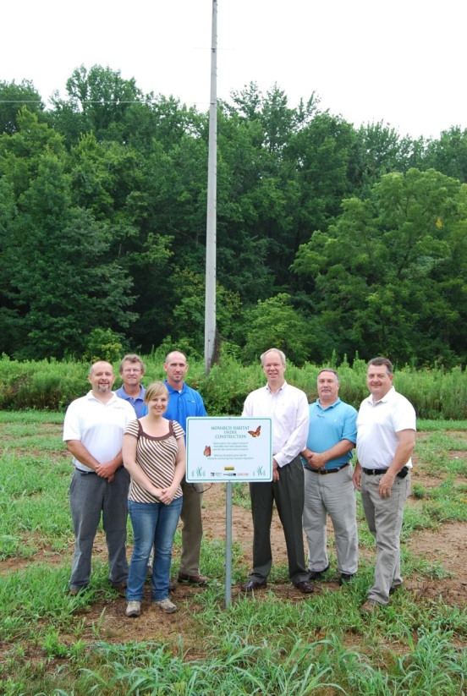

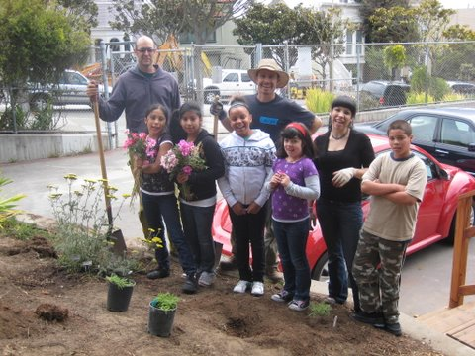
Pollinator Partnership
April 2011
Mission: The Pollinator Partnership’s mission is to promote the health of pollinators, critical to food and ecosystems, through conservation, education, and research.

Slide 3
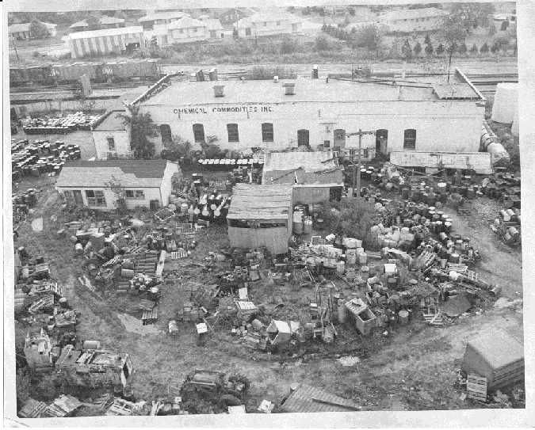
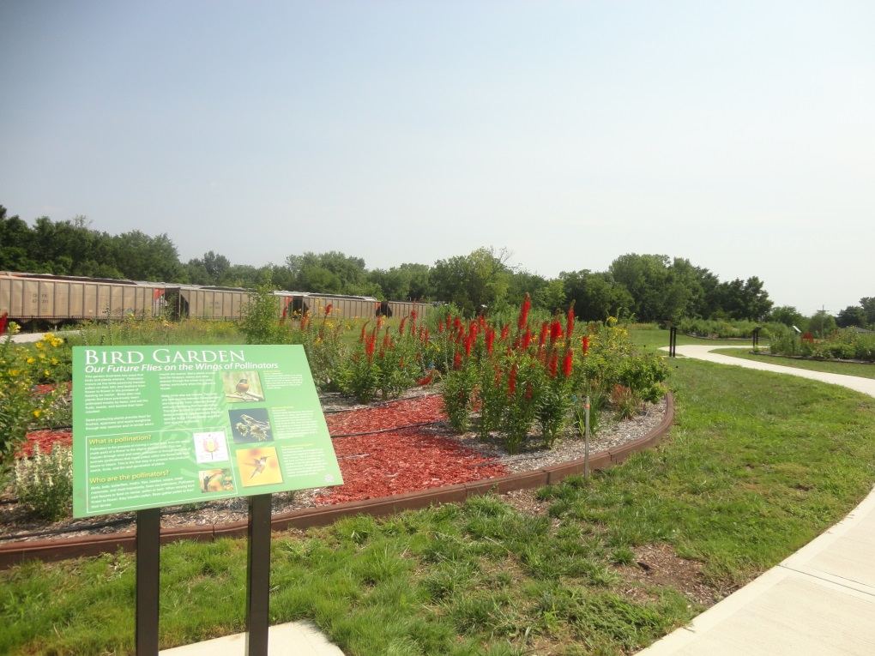


Pollinator Prairie
Superfund to Habitat

Slide 4
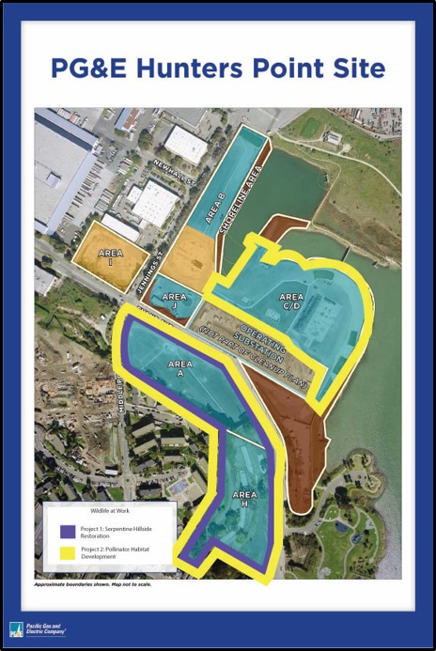
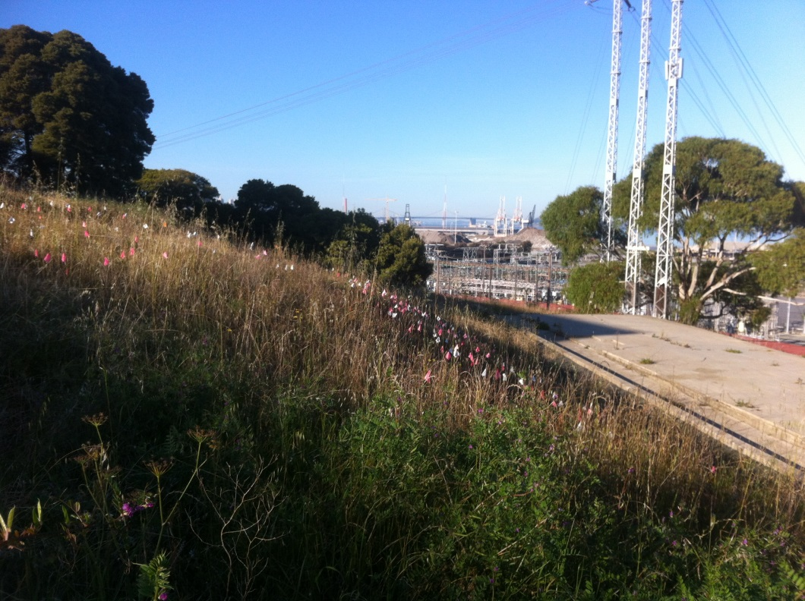
Hunters Point
Former Coal Power Plant

Slide 5
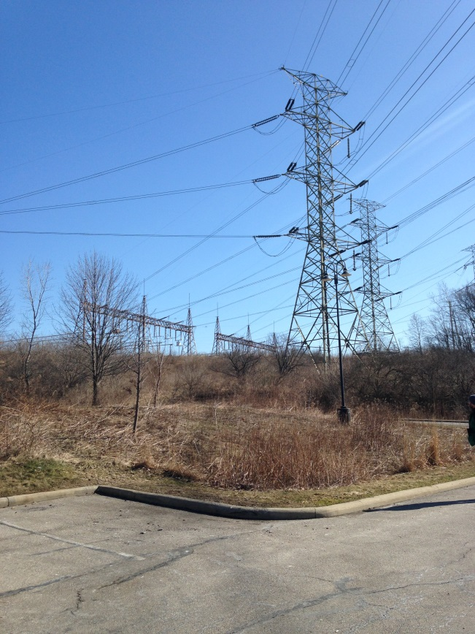
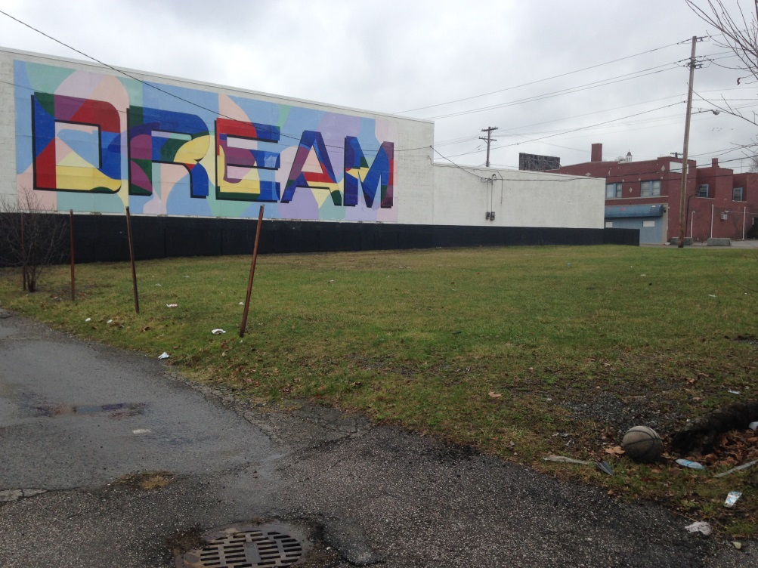
Monarch Wings Across Ohio
Ohio & Erie Reservation
Cleveland Metroparks and FirstEnergy
Cleveland, Ohio
New Vista Enterprises
Cleveland, Ohio
Goal: Habitat development guides for corporations gardens, farmers and urban land managers with Ohio-specific planting lists.

Slide 6

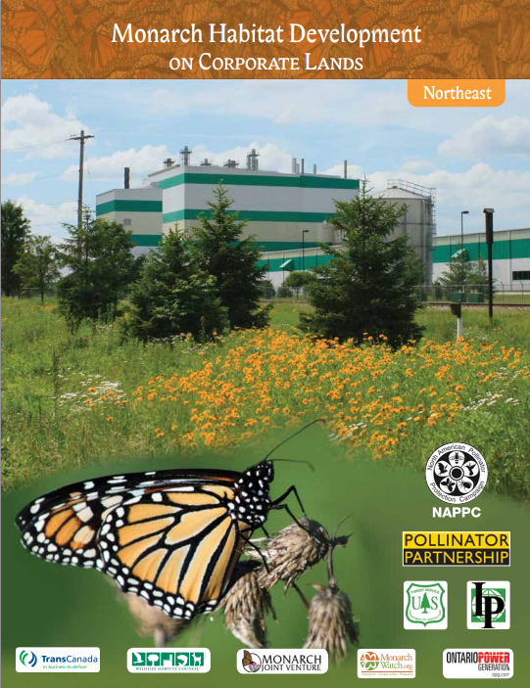
Monarch Habitat Development Guides

Slide 7
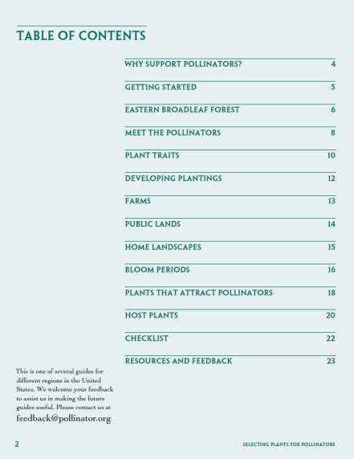
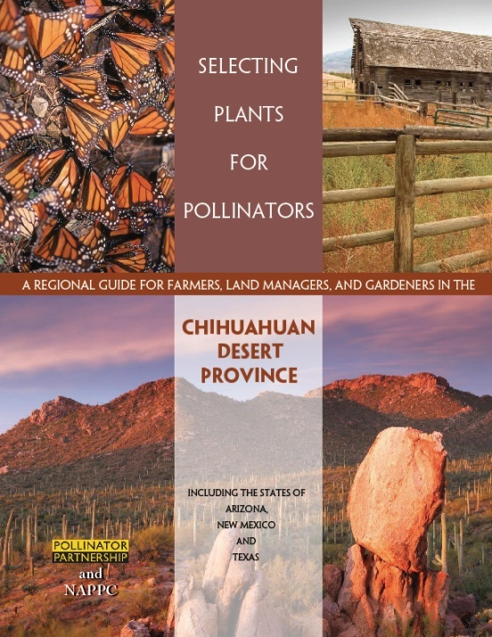
Ecoregional Planting Guides

Slide 8

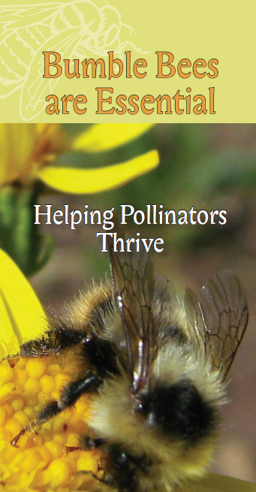

Brochures

Slide 9

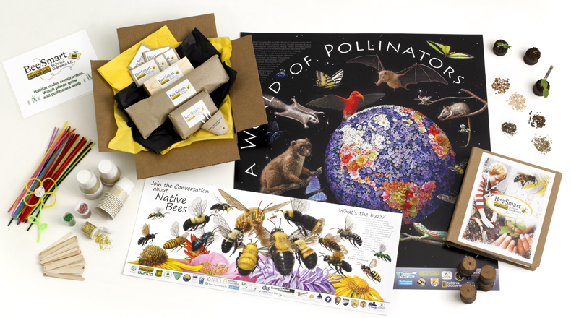
BeeSmart School Garden Kit

Slide 10
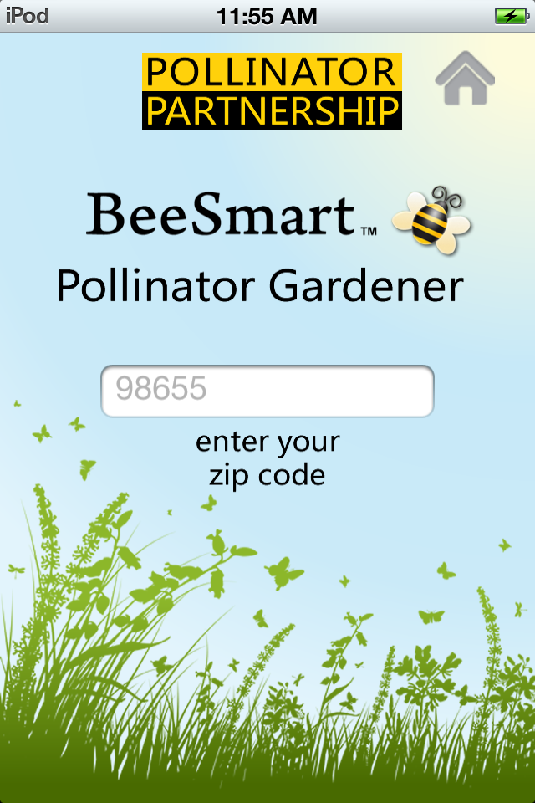
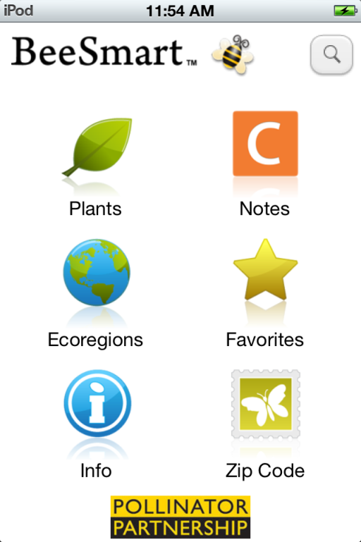
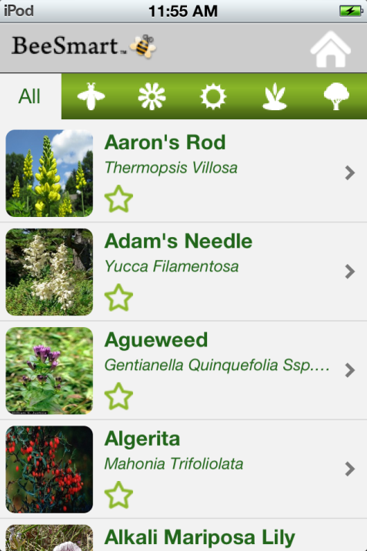
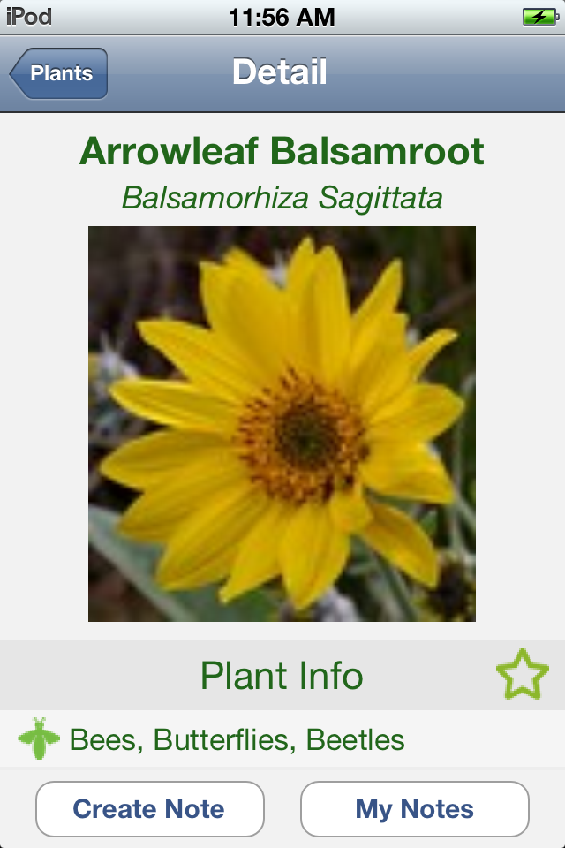
BeeSmart App

Slide 11


Simply Having Areas Reserved for the Environment
Goal: 1 Million Acres
Who: Gardeners, Farmers, Ranchers, Schools, Beekeepers, Corporate Land Managers, Utilities, Roadscapes, anyone with land to influence
YOU!

Slide 12
QUESTIONS?
Mary Byrne
Pollinator Partnership
MB@Pollinator.org
(415) 362-1137

