Slide 1
Questions and survey
Michele Mahoney

Slide 2

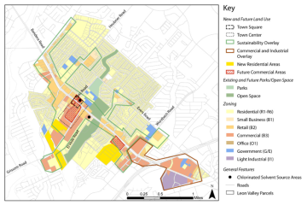
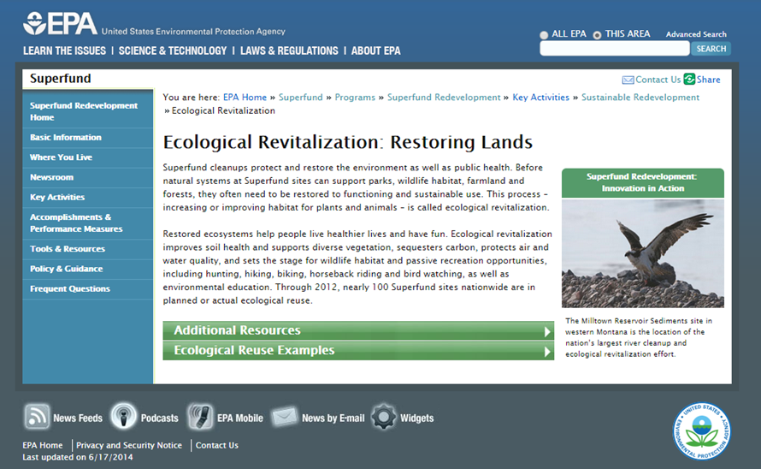
Tools and Resources

Slide 3
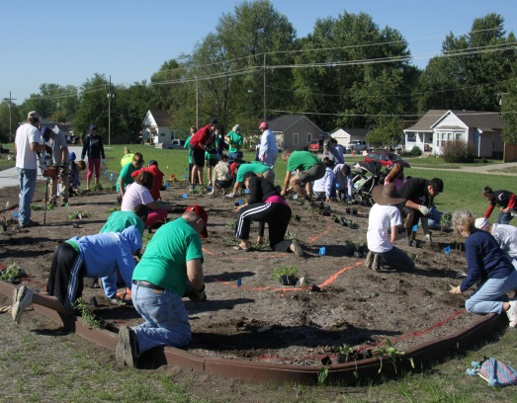
Partnerships
Laurie Davies Adams
(415) 362-1137
LDA@pollinator.org
http://www.epa.gov/superfund/programs/recycle/activities/pollinatorpartnership.html

Slide 4
SRI Coordinators by Region
Region | Name | Phone | Email
1 | Mike Jasinski | 617-918-1352 | Jasinski.miken@epa.gov
2 | Gloria Sosa | 212-637-4283 | sosa.gloria@epa.gov
3 | Chris Thomas | 215-814-5555 | thomas.christopher@epa.gov
4 | Bill Denman | 404-562-8939 | denman.bill@epa.gov
5 | Thomas Bloom | 312-886-1967 | bloom.thomas@epa.gov
6 | Casey Luckett-Snyder | 214-665-7393 | luckett.casey@epa.gov
7 | Tonya Howell | 913-551-7589 | howell.tonya@epa.gov
8 | Fran Costanzi | 303-312-6571 | costanzi.frances@epa.gov
9 | Gary Riley | 415-972-3003 | riley.gary@epa.gov
10 | Kira Lynch | 206-553-2144 | lynch.kira@epa.gov

Slide 5
For More Information, Contact:
Melissa Friedland
Superfund Program Manager for Redevelopment
friedland.melissa@epa.gov
(703) 603-8864
Frank Avvisato
Superfund Redevelopment Initiative Project Officer
avvisato.frank@epa.gov
(703) 603-8949
Michele Mahoney
Technology Innovation and Field Services Division
mahoney.michele@epa.gov
(703) 603-9057
http://www.epa.gov/superfund/programs/recycle/

