Slide 1
Green Infrastructure Considerations and Opportunities in Superfund Reuse Projects
Michele Mahoney

Slide 2
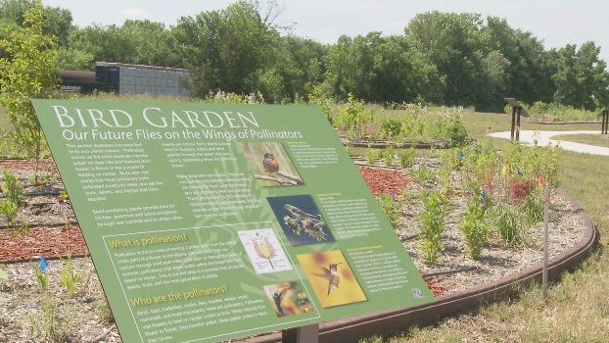
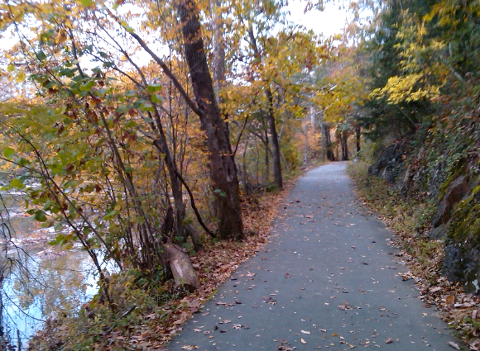
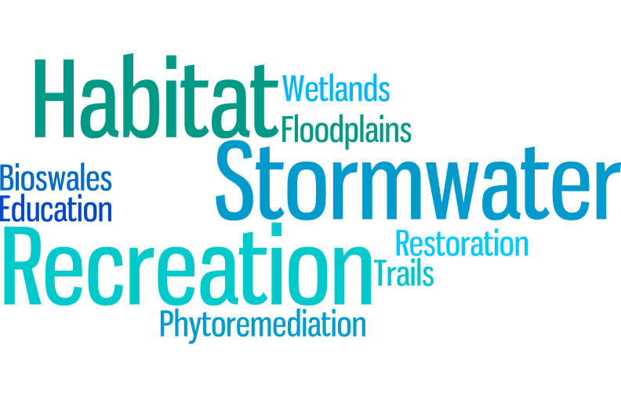
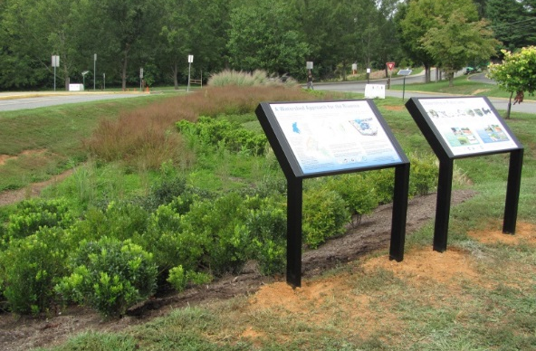
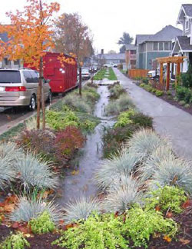
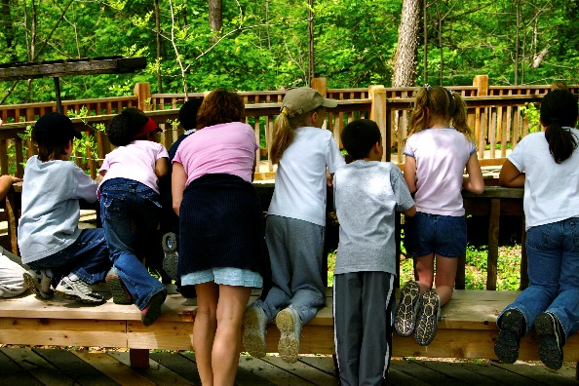
Green Infrastructure Definition

Slide 3
Green Infrastructure can…
meet a range of the EPA program goals including promoting sustainable communities, environmental justice, and clean urban waters
provide a viable reuse option at sites where the remedy may limit other forms of development
provide an interim use for a portion of the site during long-term cleanup
offer a sustainable means of managing drainage from caps
bring long-term stewardship partners and funding sources to the table
provide an educational opportunity for schools and residents
re-green and revitalize a community with sustainable reinvestment to offset site stigma

Slide 4
Common Green Infrastructure Goals
A. Revitalize Site Ecology
C. Increase Recreational Activities
B. Improve Stormwater

Slide 5
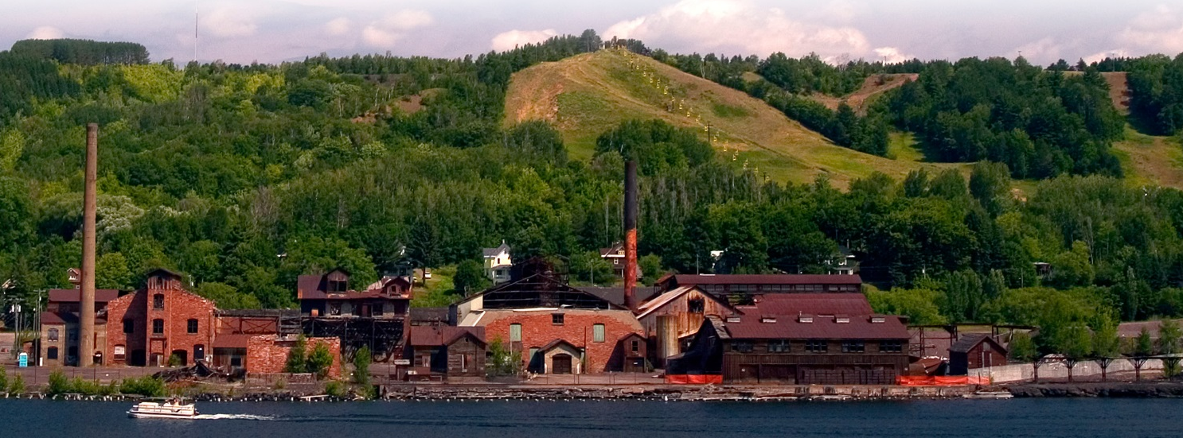
Goal A: Revitalize Site Ecology
Strategies
Ecological Revitalization
Phytoremediation
Environmental Education
Greening Economies
Environmental Education Example:
Quincy Smelter Site, Torch Lake Superfund Site, Houghton County, Michigan
The Quincy smelter will offer opportunities to learn about historic industrial technologies and how the environmental impacts of mining can be addressed as well as restore the community’s connection to the waterfront.

Slide 6
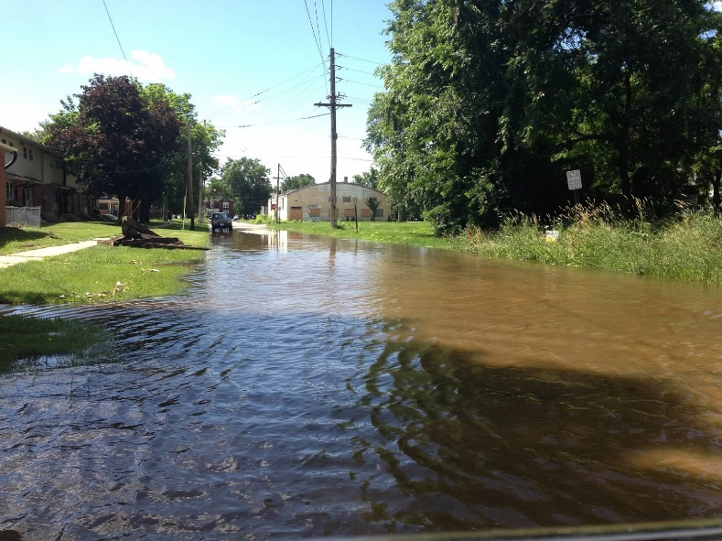
Goal B: Improve Stormwater
Strategies
Constructed Wetlands
Natural Drainage Bioswales
Floodplains
Natural Drainage Bioswales Example:
East Side Revitalization, Freeport IL
Prioritizing vacant sites for rain gardens to reduce chronic residential flooding

Slide 7
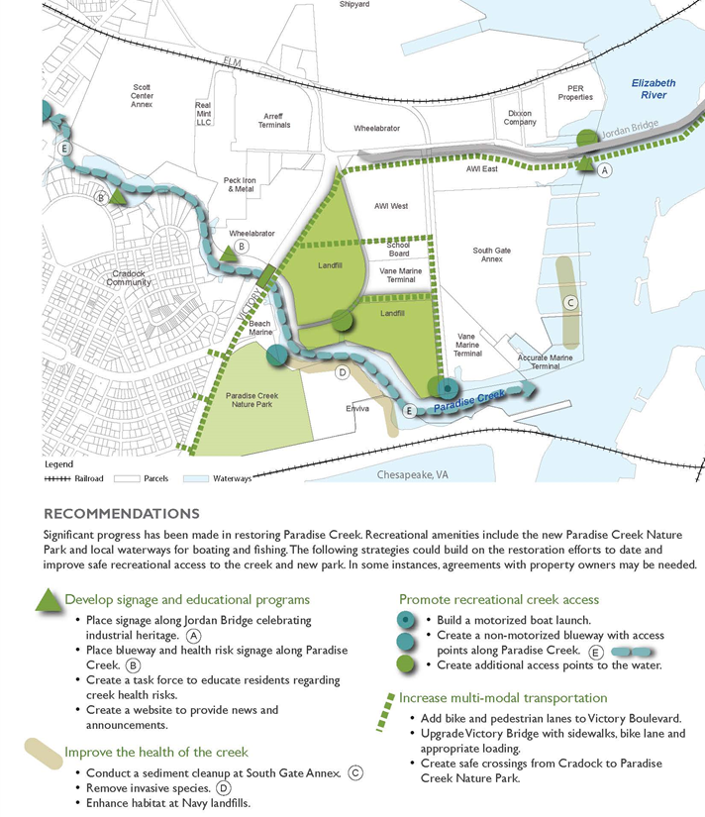
Goal C: Increase Recreational Amenities
Strategies
Trails
Green Streets
Programmed Spaces
Green Links to Urban Waters
Green Links to Urban Waters Example:
Paradise Creek Industrial Corridor
Future Use Plan, Portsmouth, Virginia
This project aims to restore the community’s connection to urban waters through strategies such as promoting recreational creek access.

Slide 8
Integrating Green Infrastructure into the Reuse Process
1.
Gather community goals
2.
Determine site suitability
3.
Evaluate land use context
4.
Develop recommendations

Slide 9
Connecting the Dots
Butterworth Landfill
Grand Rapids, Michigan
C. Increase Recreational Amenities
Landia Chemical Company
Lakeland, Florida
A. Revitalize Site Ecology
Pemaco Maywood
Maywood, California
B. Improve Stormwater

