Slide 1

Green Infrastructure at Butterworth Landfill
Tom Bloom, EPA Region 5 and Jay Steffen, Grand Rapids, MI

Slide 2
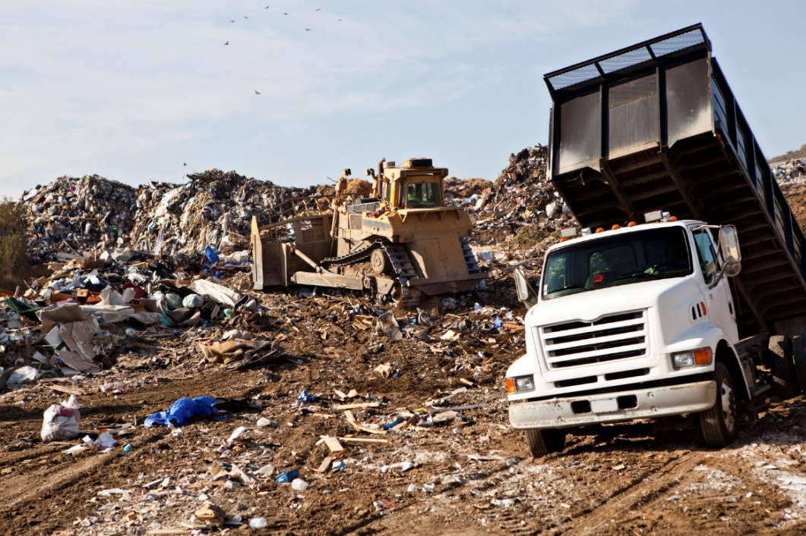
The Site
Butterworth #2 Landfill Superfund site
190 acres, located in Grand Rapids, Michigan
Portions of the site are within the hundred-year flood plain of the Grand River
The City of Grand Rapids owned and operated the landfill as an open dump from 1950 to 1967.
The property then operated as a sanitary landfill from 1967 to 1973.
2

Slide 3
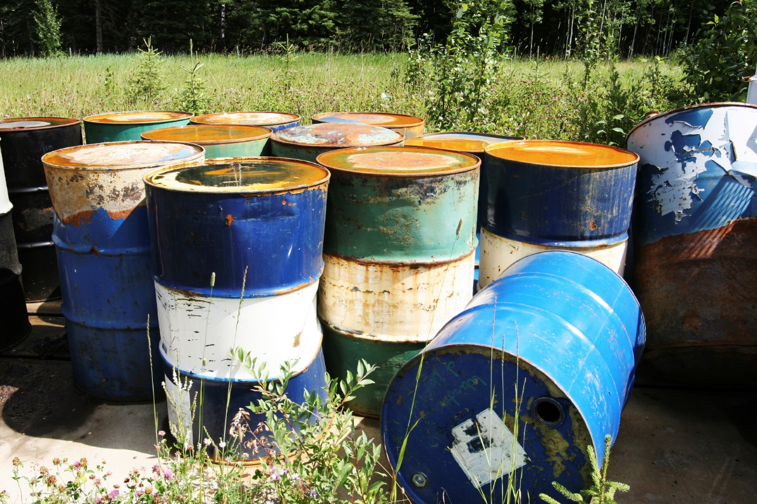
Site Remediation
Drum and soil removal in 1990
EPA selected a remedy in 1992, including a landfill cover and groundwater monitoring.
Remedial construction is complete and groundwater monitoring continues.

Slide 4
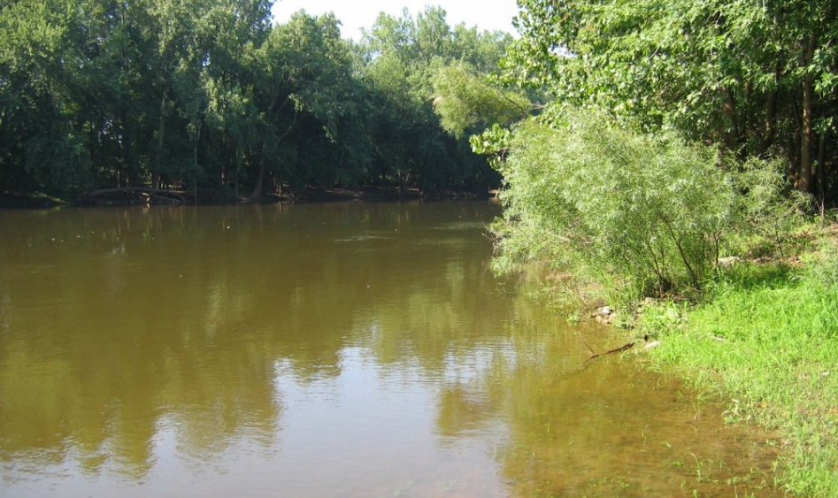
Site Drainage, Using Natural Resources
Using natural resources to assist with stormwater drainage makes sense given the site’s location.
Vegetated stormwater drainage canal runs through a portion of the site into the Grand River.
Wetlands at the site serve dual purposes; they help regulate stormwater runoff by acting as collection areas and they also serve as wildlife habitat.

Slide 5
Initial Reuse Considerations
The site had several qualities that made it a prime reuse candidate:
  Located in an easily accessible urban area
  Near the Grand River
  Level surface
  Large area
Community hoped for new recreational amenities
EPA and the City of Grand Rapids needed to make sure the remedy would be protected during reuse.

