Slide 1
Green Infrastructure at Pemaco Maywood
Rose Marie Caraway, EPA Region 9

Slide 2
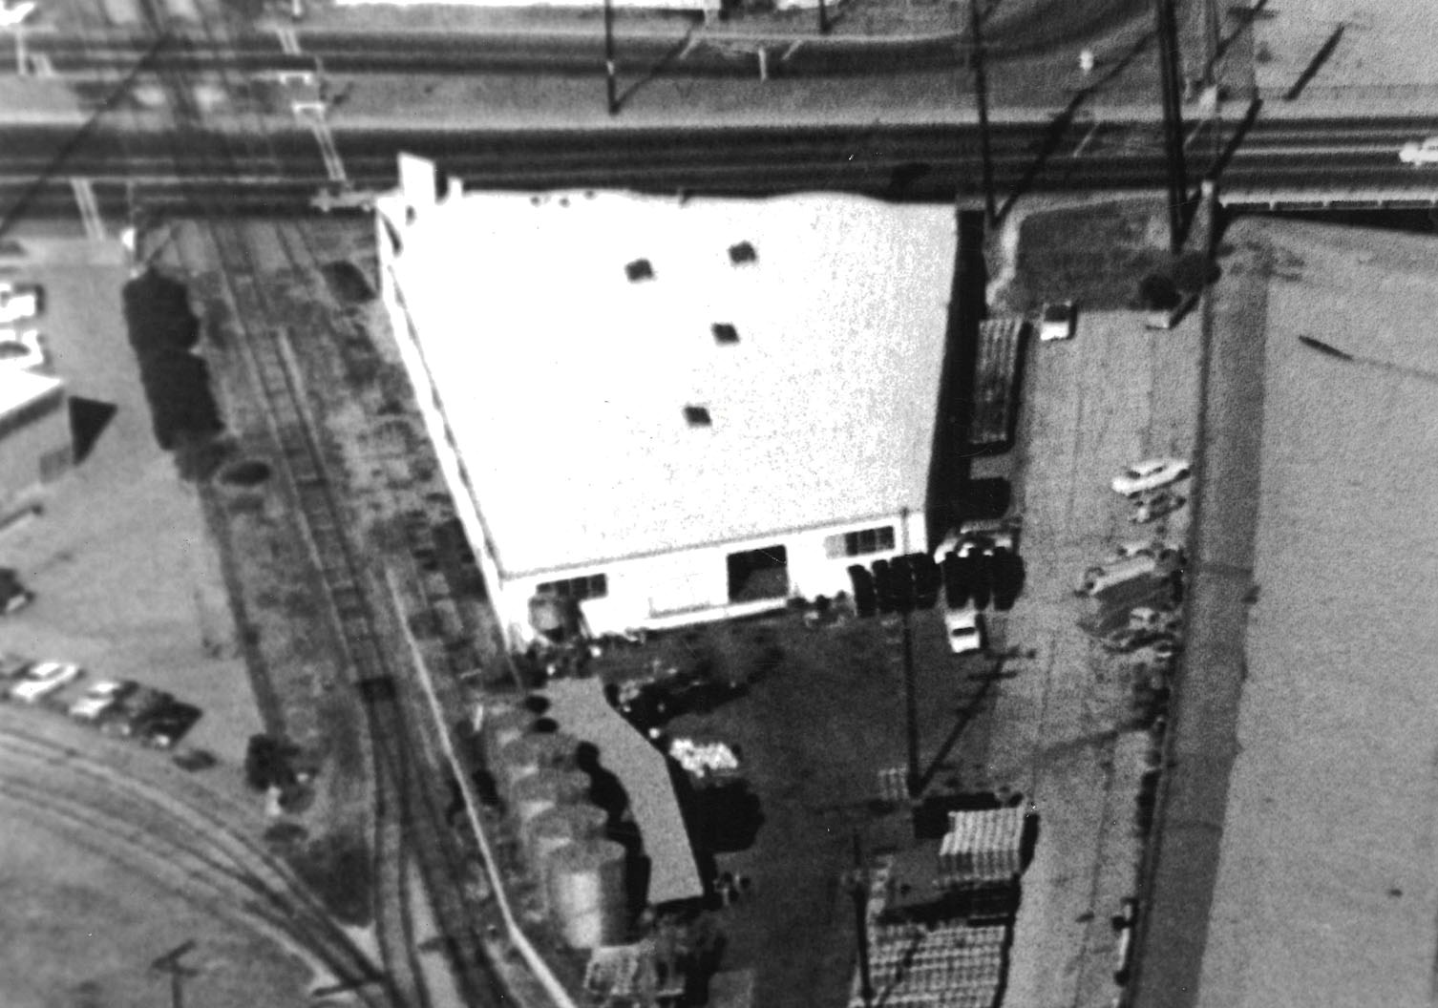
The Site
Pemaco Maywood Superfund site
Located in Maywood, California
4-acre tract of land along the Los Angeles River

Slide 3
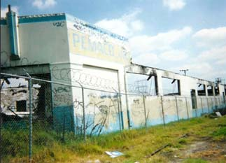
Site History
Custom chemical blending facility
Operated from 1940s until 1991
Fire destroyed warehouse in 1993
Chemicals remained on site in
31 USTs
6 ASTs
Over 400 drums

Slide 4
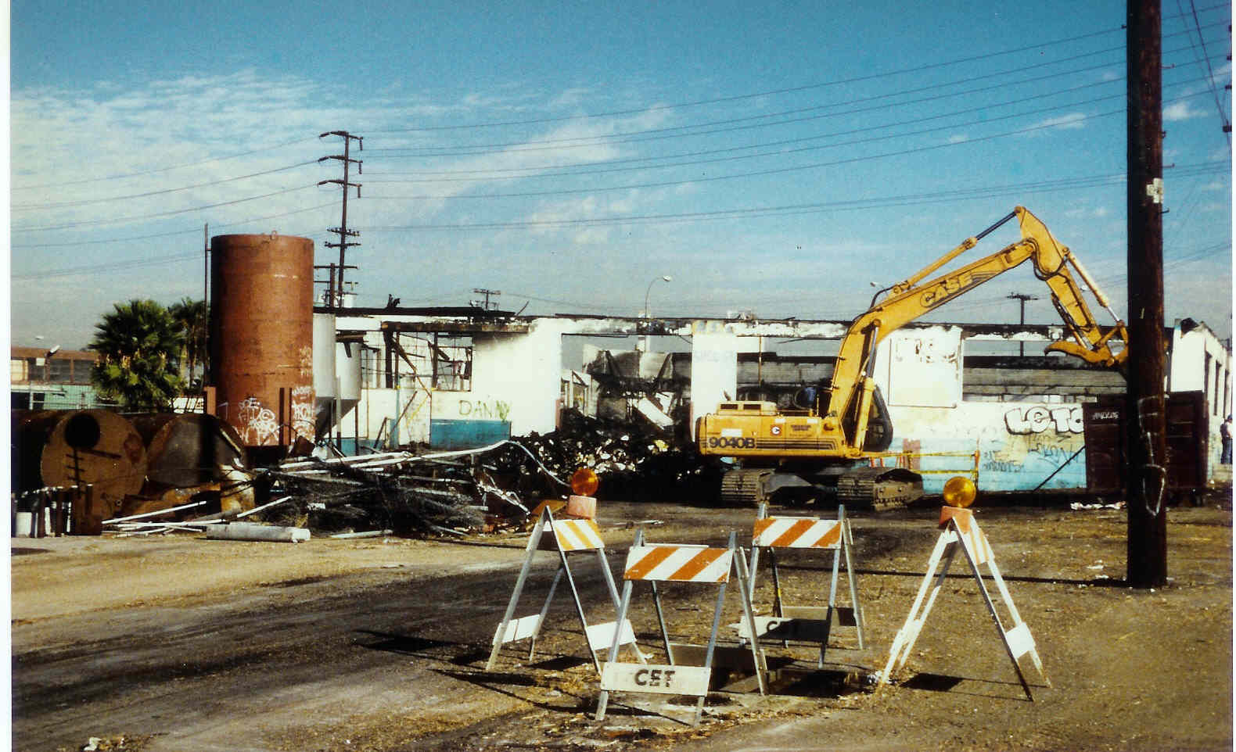
1997 Removal Actions

Slide 5
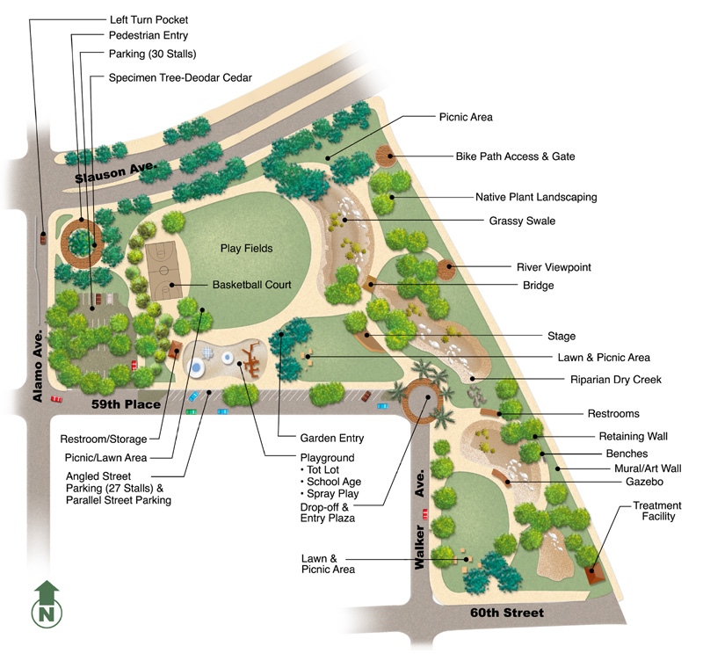
Maywood Riverfront Park Conceptual Design
5

Slide 6
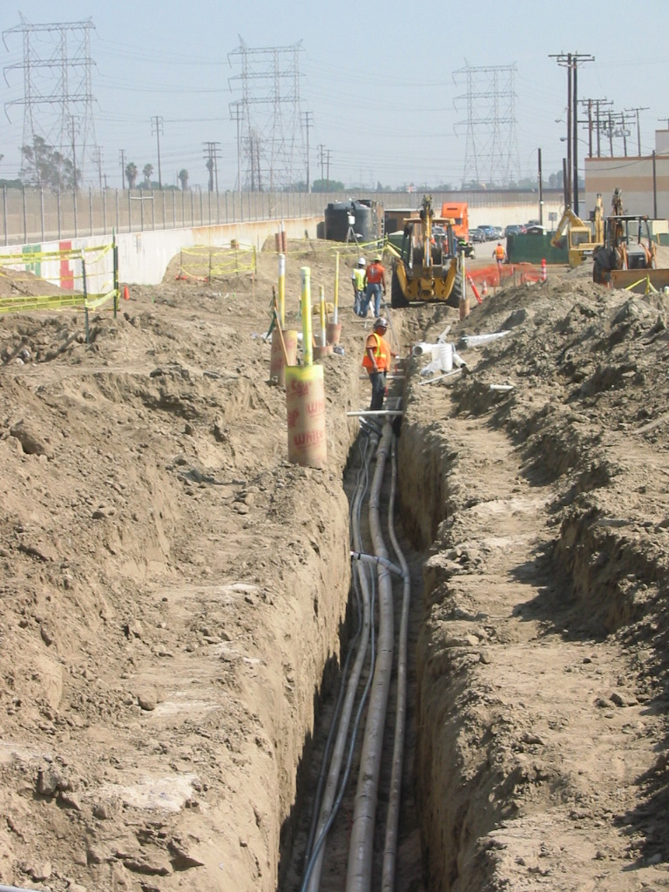
Remedy Construction

Slide 7
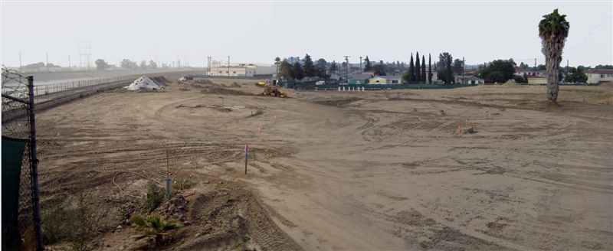
Soil Cover with Liner

Slide 8
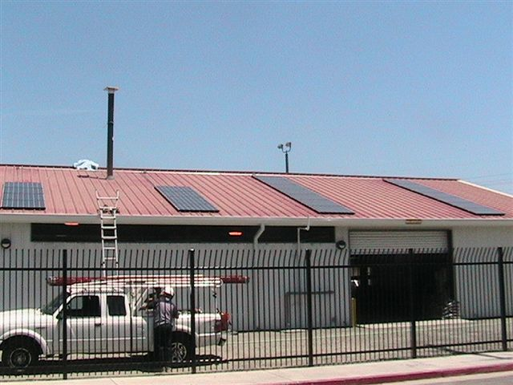
Treatment Plant
Completed in December 2006
Vapor and groundwater treatment
3.4 kW solar power system installed in July 2007
Produces 5,600 kWh/yr.
Offsets ~3.3 tons of CO2 per year (roughly equal to saving 2.5 acres of forest and 7,600 vehicle miles)

Slide 9
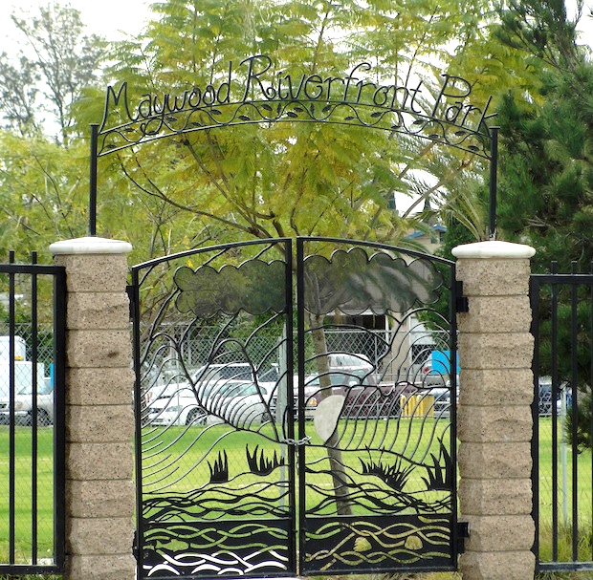
Maywood Riverfront Park

Slide 10
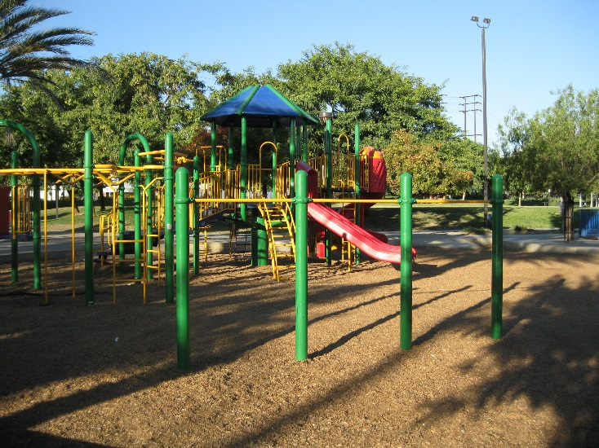
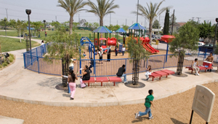
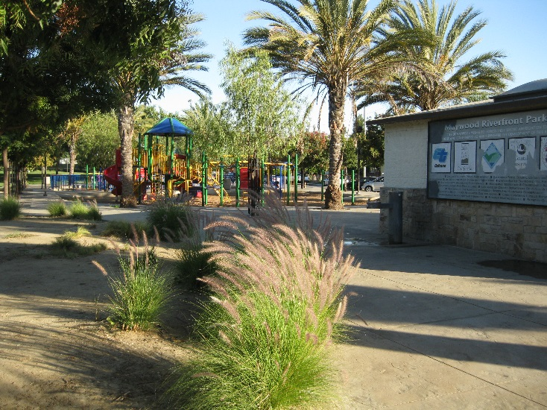
Playgrounds

Slide 11
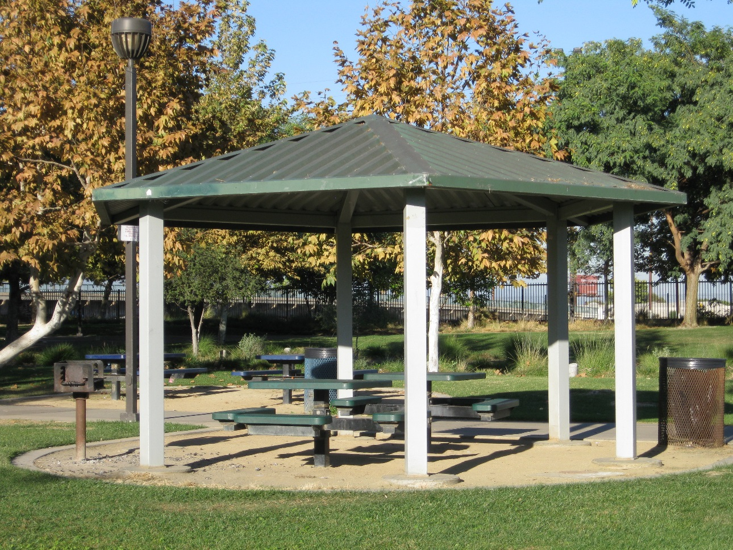
Picnic Pavilions and Walking Paths
11

Slide 12
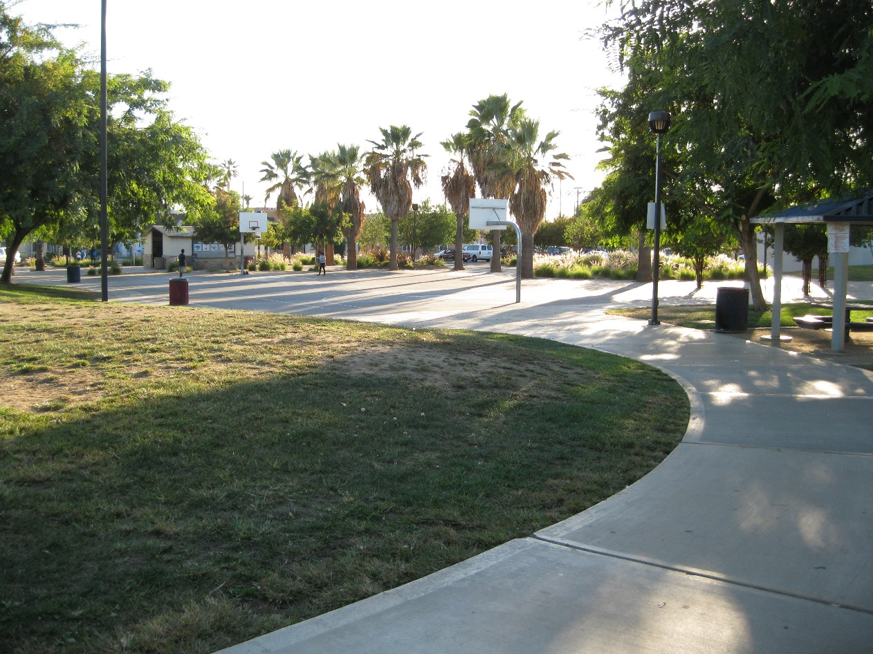
Basketball Courts
12

Slide 13
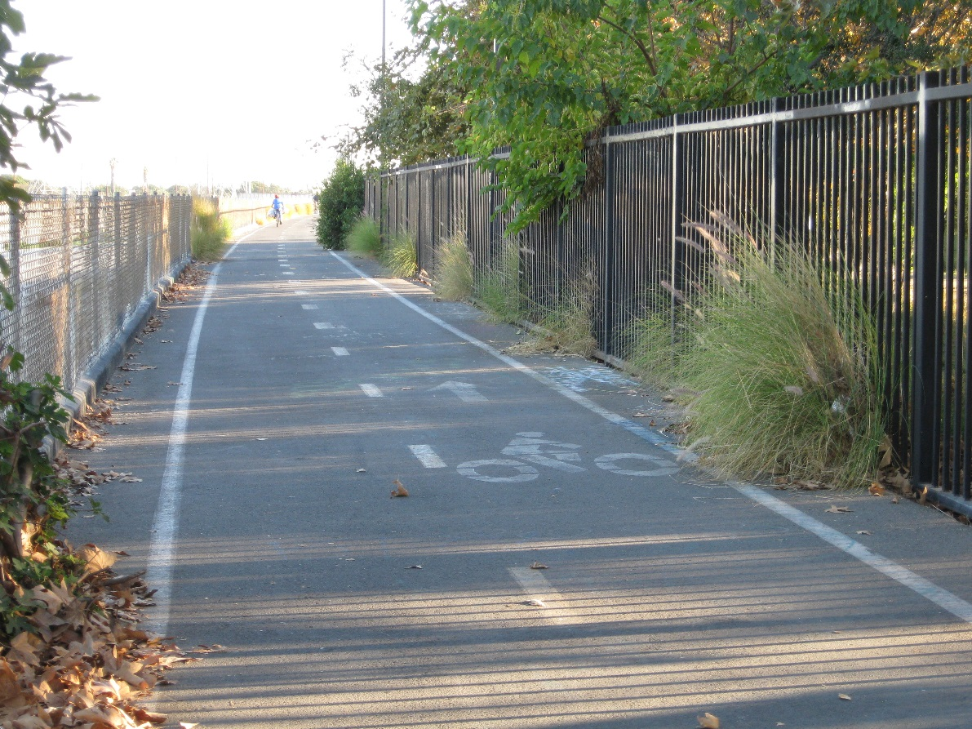
Los Angeles River Bike Path Access
13

Slide 14
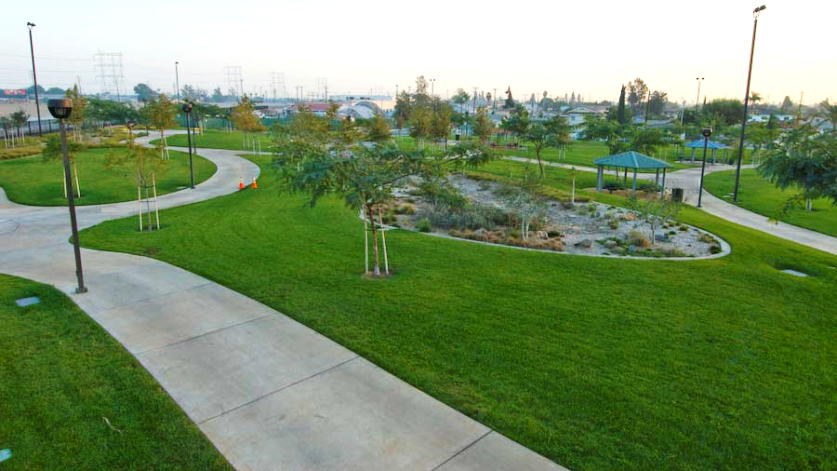
Stormwater Retention Basins

Slide 15
Landscaped Berms

Slide 16
Bioswales

Slide 17
Green Infrastructure Summary
Improve Stormwater
Stormwater retention basins
Landscaped berms
Bioswales
Increase Recreational Amenities
Trails and greenways encouraging outdoor recreation
Programmed spaces including athletic facilities/fields
Restoring a community’s connection to their urban waters

Slide 18
For More Information, Contact
Gary Riley
EPA Region 9 Reuse Coordinator
riley.gary@epa.gov
Rose Marie Caraway
EPA Region 9, Site RPM
caraway.rosemarie@epa.gov
Rusty Harris-Bishop
EPA Region 9
harris-bishop.rusty@epa.gov

