Slide 1
Midvale Slag
Kevin R. Murray Holland & Hart LLP

Slide 2
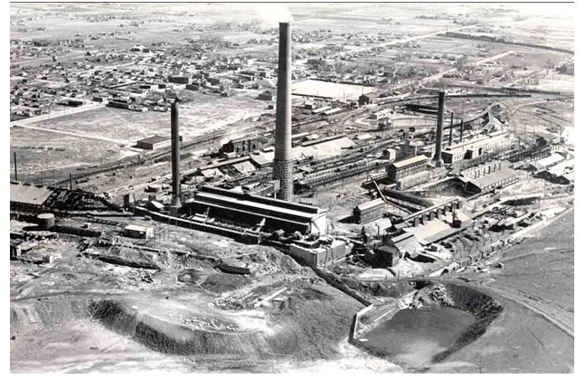
Midvale Slag Site, circa 1940

Slide 3
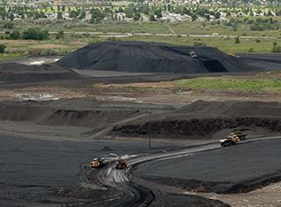
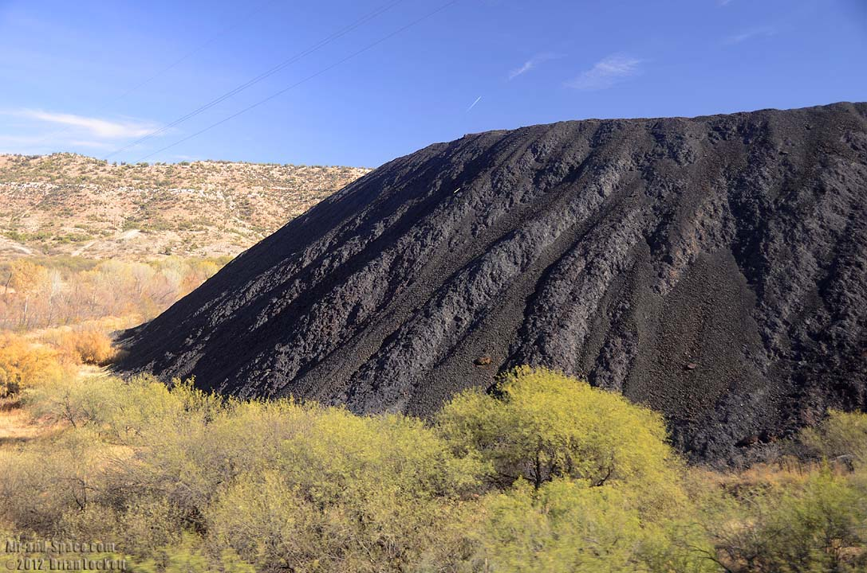
446 acres in Midvale, Utah
OU1 226 acres, OU2 180 Acres
From 1871 to 1958 five smelters processed lead and copper ore
Including arsenic trioxide for WWII
The site was covered with blast furnaces, baghouses, smokestacks storage areas and rail lines

Slide 4
Elements of Success
A collaborative goal of Reuse
A unique “cooperative funding alternative”
Protections made available in the RD/RA Consent Decree
Protections made available from the State of Utah
Covenant Not To Sue
Institutional Controls – easy to understand and implement
Procedure for unrestricted use
Ready for Reuse Determination

Slide 5
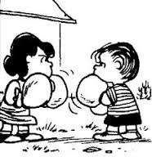
1997 relations strained and project is stalled
Work to bring Landowner, EPA, UDEQ and Midvale together
Landowner and EPA work to understand reuse
Bingham Junction Reuse Assessment published
Funding now the biggest obstacle
Ultimately not used, but brought the group together

Slide 6
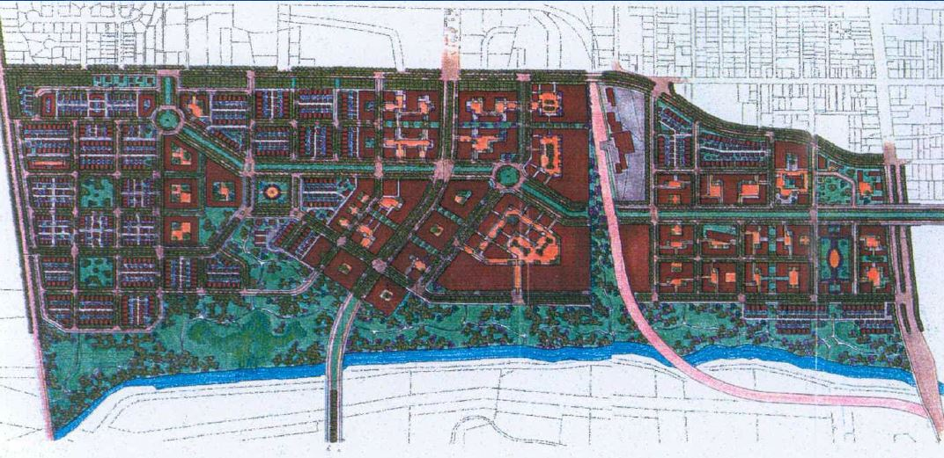
Bingham Junction Master Plan 2000

Slide 7
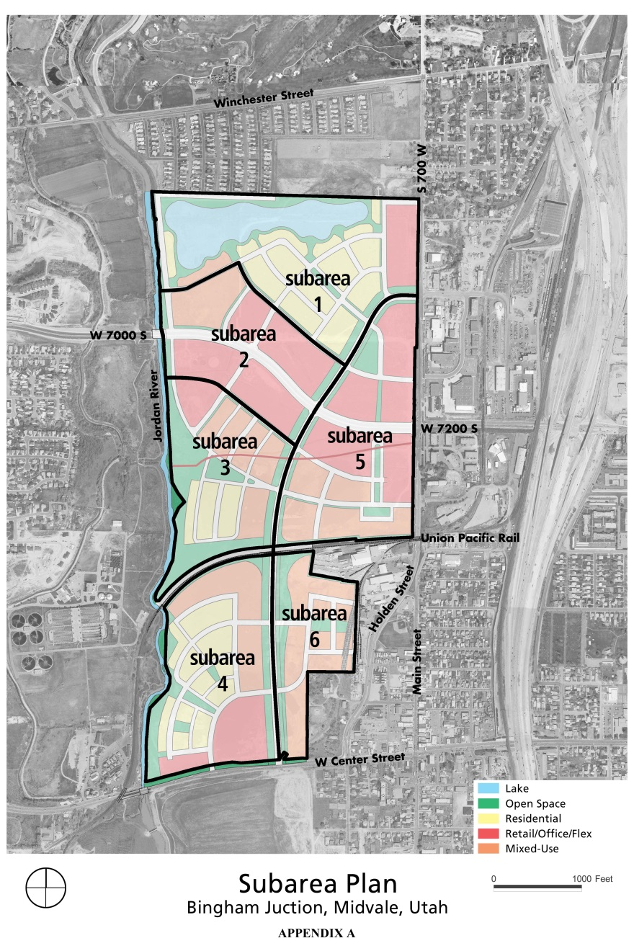

Slide 8
Collaboration/Cooperation Continues
Status of the settlement fund
Landowner estimates $16 million
EPA estimates $35 million
Either way $ is an issue
Proposed use of the fund as payment during private party lead
Fixed fee contract with remedial contractor
EPA engages expert
Insurance is written to cover the delta
The logjam is seemingly broken

Slide 9
Developers Hate Uncertainty
Paragraph 89 of the RD/RA CD
“a purchaser that acquires an ownership or other interest in any real property located within the Site after certification of construction completion . . . Shall be considered a Bona Fide Purchaser meeting the statutory definition of ‘bona fide prospective purchaser’ set forth in . . . Of CERCLA”

Slide 10
Eliminating Uncertainty
Grant of Access to UDEQ, and Covenant Not to Sue
UDEQ’s covenant not to sue extends to persons acquiring a legal interest in any portion of the site so long as
Not directly responsible
Notice is given
Purchaser assumes certain obligations
Purchaser complies with RD/RA CD

Slide 11
And Next . . .
Institutional Controls
Article IX of the RD/RA CD grants Midvale City the right to enforce ICs
Institutional Controls Ordinance
Developers are used to dealing with the municipal building department – and moving dirt
Very Clear
Well prohibition
Material segregation (effort to return material to original excavation
Maintenance of covers
Site Plan Approval

Slide 12
More Suspenders
Ready For Reuse Determination
The RfR states that EPA has determined that the Midvale Slag Site is ready for commercial and residential reuse
It is an EPA technical determination
The site is protective of human health and the environment
RfR provides potential uses of a site with clear information about the environmental status of the property and the actions needed to maintain the integrity of the remedy

Slide 13
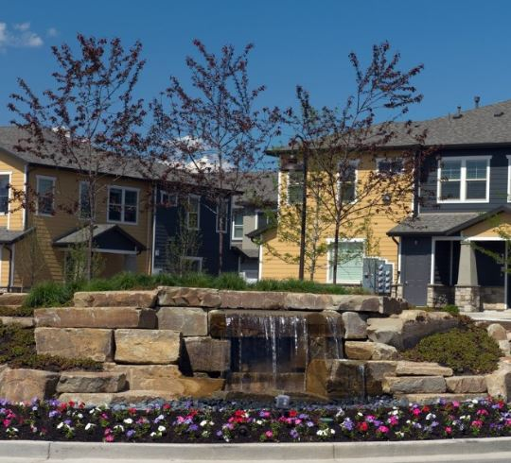
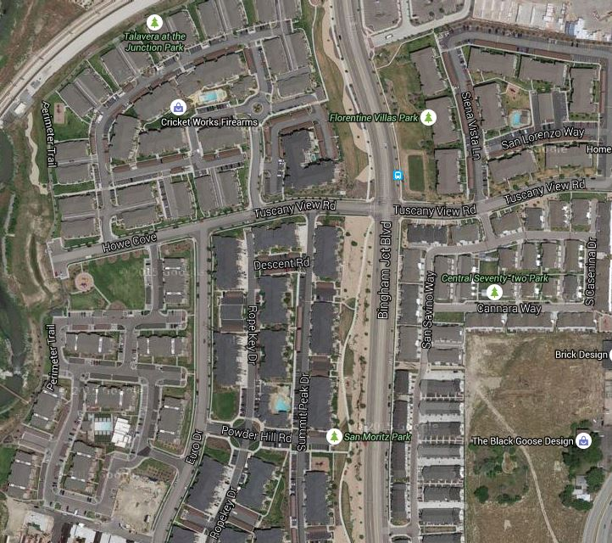
2000 plus jobs
Taxable value went from approximately $3 Million to $309 Million
The program has worked seamlessly

Slide 14
For More Information, Contact:
Kevin R. Murray Holland & Hart LLP
krmurray@hollandhart.com
(801) 799-5919

