Slide 1
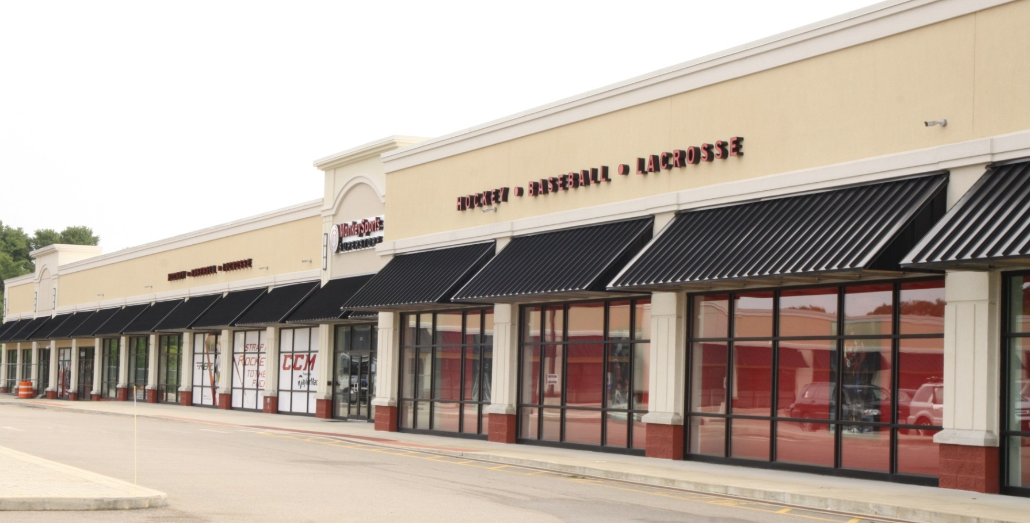
NORWOOD PCBS SITE
Daniel Keefe, Region 1 Remedial Project Manager

Slide 2
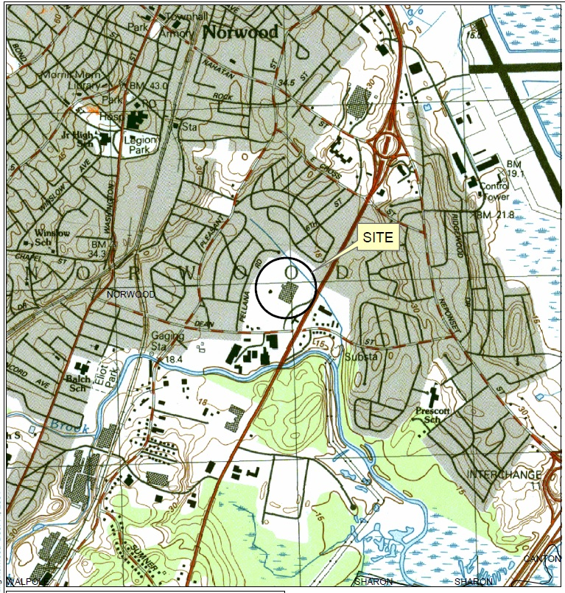
Site Location
Norwood, MA
~10 acres
Proximity to a major roadway (“Auto Mile”)
Proposed to the NPL in 1984 (added to Final List in 1986)
Deletion Date: 2011

Slide 3
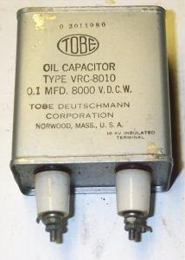
Norwood PCBs Operational History
Used for decades, since 1940s, to produce various electrical components (e.g. transformers)
Multiple owners and operators (7 CDs)
Primary contaminant: PCBs (some VOCs, PAHs)
  Up to 24,000 parts per million PCBs in soil
Media contaminated:
  Soil, sediment
  Ground water

Slide 4
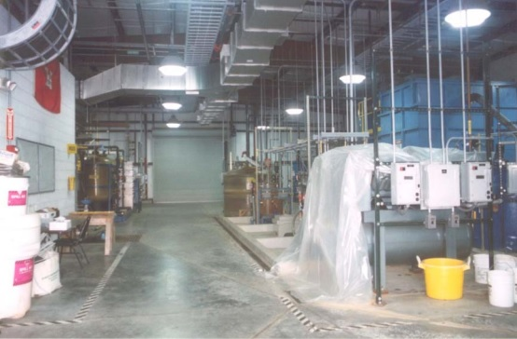
Norwood PCBs Remedial History
1989 Record of Decision (ROD) signed
1996 ROD Amendment
  Soil remedy changed from “solvent extraction” to “capping in place”
  PRP-lead component (contaminated soil/sediment)
  Fund-lead component (contaminated ground water)

Slide 5
Norwood PCBs Remedial History
1996 GWTP constructed (Fund-lead)
1997 – 1998 Cap Constructed (PRP-lead)
1996 – 2000 GWTP operated
2001 - State submits “Low” GW Use and Value
2005 - ESD results in revised GW CUGs

Slide 6
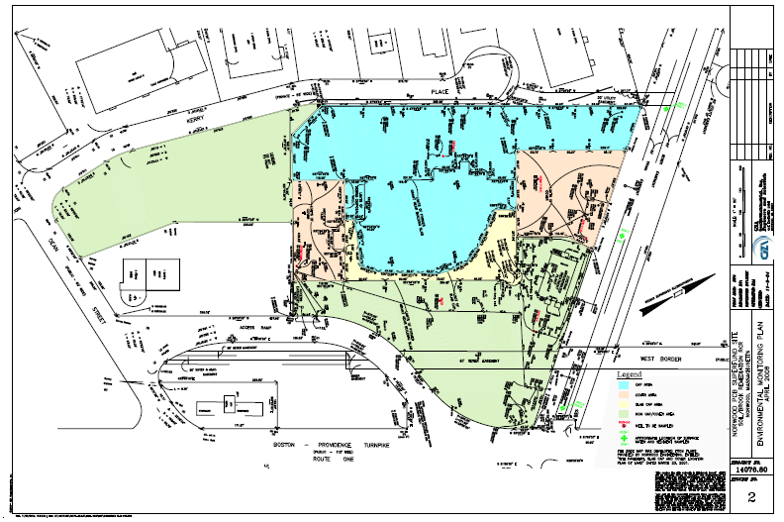
Site Diagram Post Capping/Pre-development
Area C
Area B
Area A
Area D →
GWTP
Area A

Slide 7
Restricted Uses Based on Area
Area A (Non-cap/Non-cover Area)
Area B (Cover Area)
Area C (Slab Cap Area)
Area D (Cap area)
Area E (Debris Vault)
Increasingly
More
Restrictive

Slide 8

Reuse Opportunities
Q: What’s often needed to realize redevelopment of a (Superfund) site?
A: An interested Third Party!
1999 – Local Businessman purchased the property and obtained a PPA from EPA.
PPA requires (among other things):
  Providing town with electric vehicle
  His reuse (or demolition) of the GWTP structure
  Record Land Use Controls (ICs)

Slide 9
Reuse Challenges
Owner leases property to Developer A
  Developer A wanted a “Big Box” store which required intrusive activities through Cap
  Developer A denied local permit
Developer B acquires Developer A (including lease obligations)
Revised “concept” for redevelopment approved by Town – no intrusive activities through Cap.
Developer B “forced” to work around the “cap”

Slide 10
Reuse Challenges
2007 - EPA and MassDEP re-drafting Final Grant of Environmental Restriction and Easement
Developer satisfied the Owner’s obligations to
  Update title
  Prepare property surveys
  Identify and subordinate 15 encumbrances
  Provide title insurance
With forgoing knowledge of redevelopment, EPA/DEP make modifications to allow certain activities, in certain areas, so as to not inhibit redevelopment (e.g., Pre-approved Work Plan)

Slide 11
Government/Developer Coordination
March 27, 2008 – Grant was recorded
March 27, 2008 (consistent with Grant requirements) the Redevelopment Work Plan (RWP) was received and approved (same day)

Slide 12
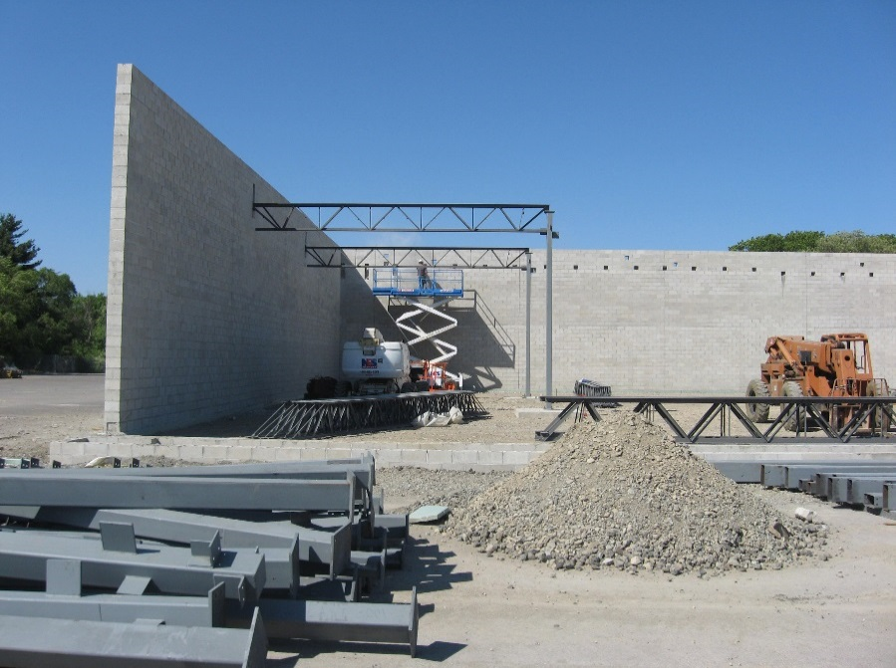
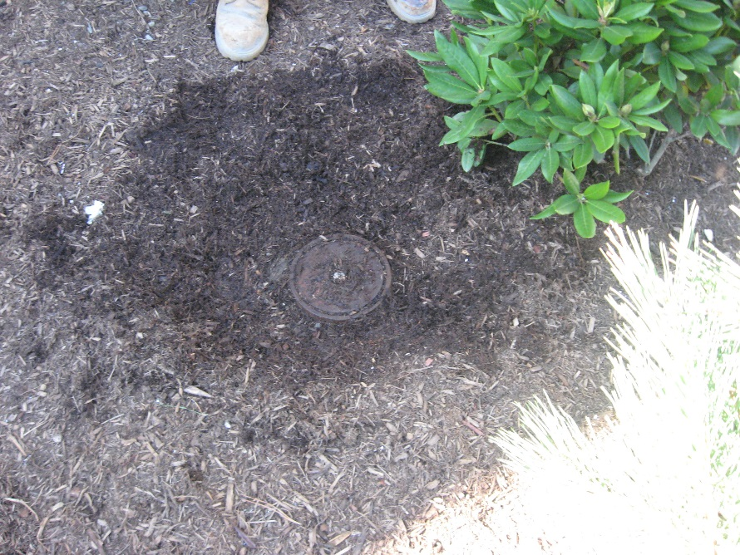
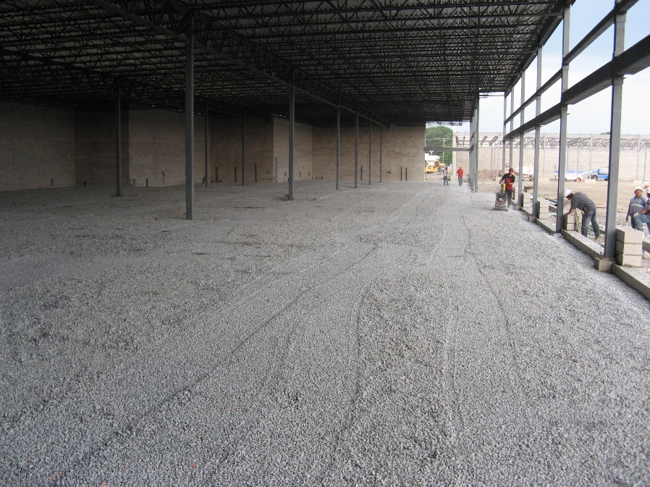
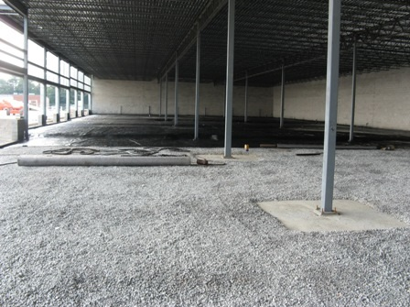
Construction

Slide 13
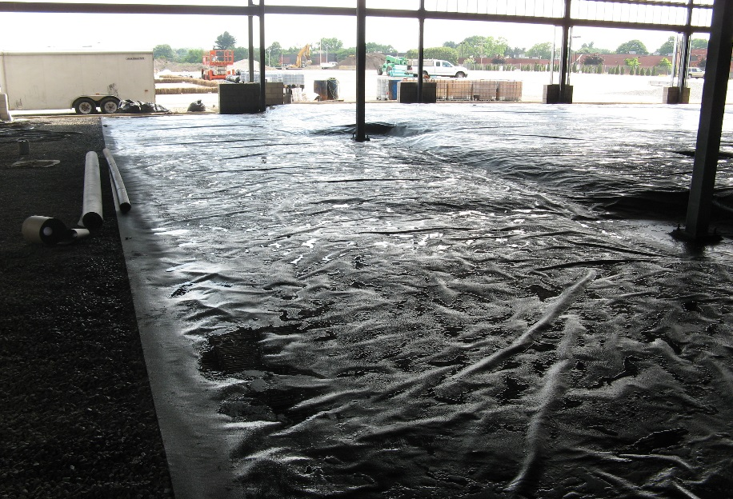
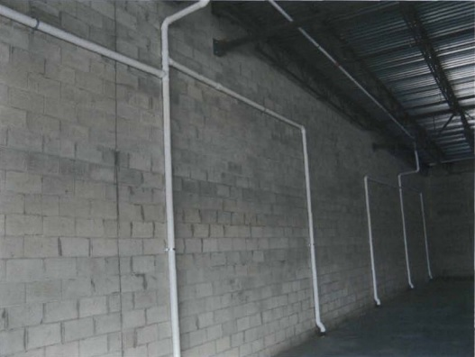
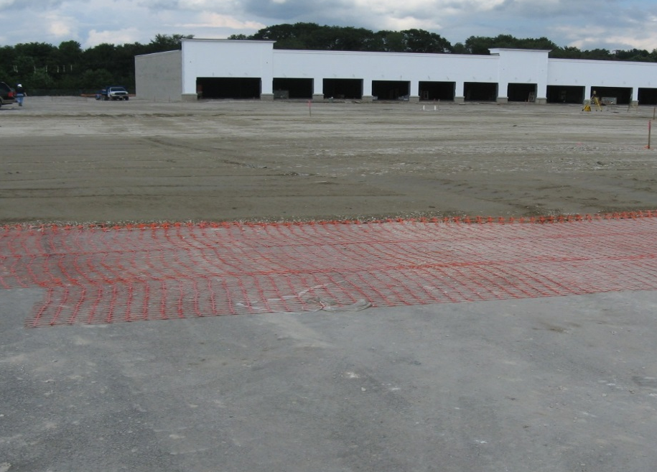
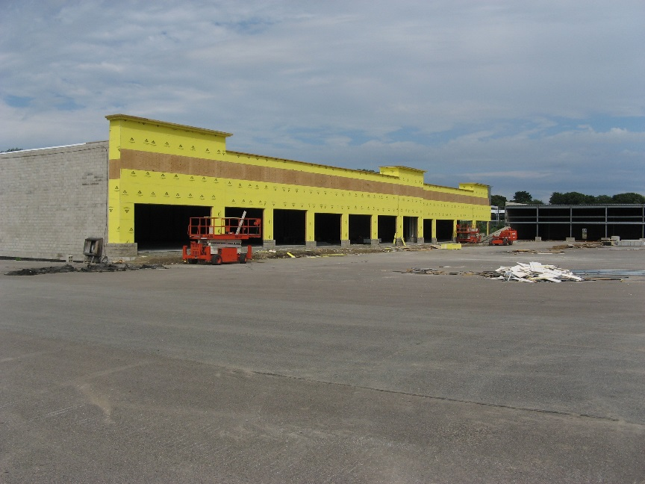
Construction

Slide 14
Post - Construction
Developer B breaks lease after year long attempt to lease building (during recession)
Owner benefits by acquiring (estimated) 2M spent on redevelopment (buildings, infrastructure, etc…)
Owner markets property himself (~2010)
  Economy rebounds
  Identifies interested party for purchase
Subdivided property and sells land/building to sports retailer (May 2011)

Slide 15
Site Diagram Post Construction

Slide 16
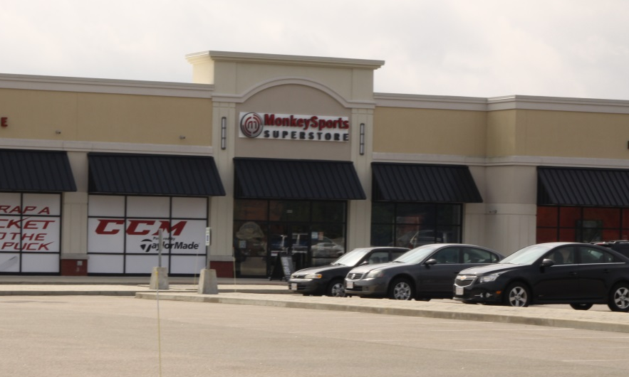
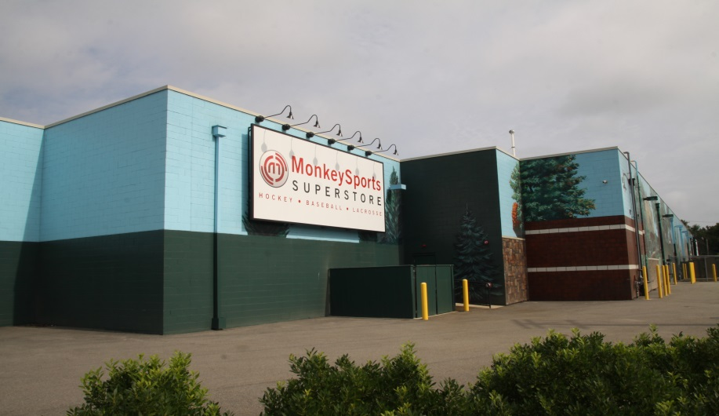
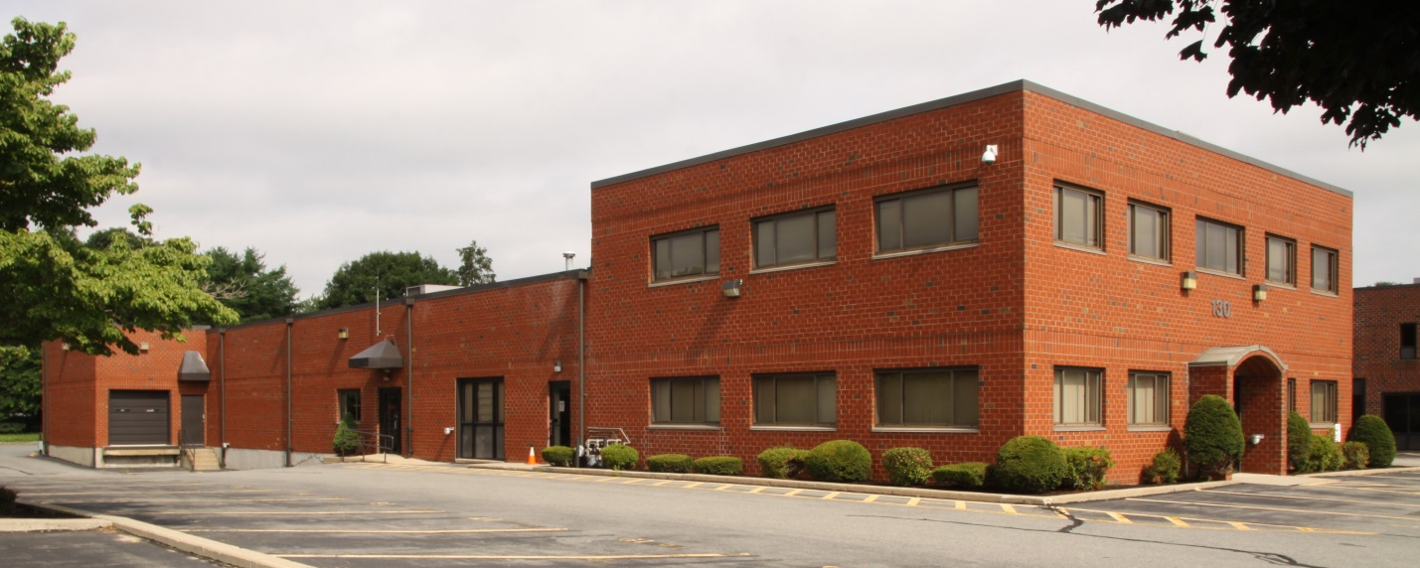
Site Today
Front of Building A.
Offices and commercial buildings in continued use at the site.

Slide 17
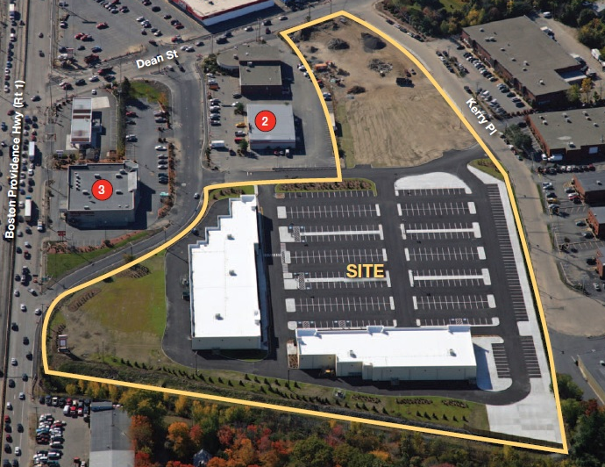
Key Lessons
ICs can be very onerous and costly to obtain.
IC can be written to anticipate certain redevelopment (if known) and include provisions for “pre-approved work plan” preserving some flexibility for owner/developers
Developer provided the catalyst (funding) and motivation for owner to cooperate.
Keeping harmony between PRPs (responsible for remedy) and owner/site operator (responsible for redevelopment features) can be (and likely will) be difficult!
The completed retail buildings.

Slide 18

Contact Information
Daniel Keefe
EPA Region 1
Keefe.daniel@epa.gov
(617) 918-1327

