Slide 1
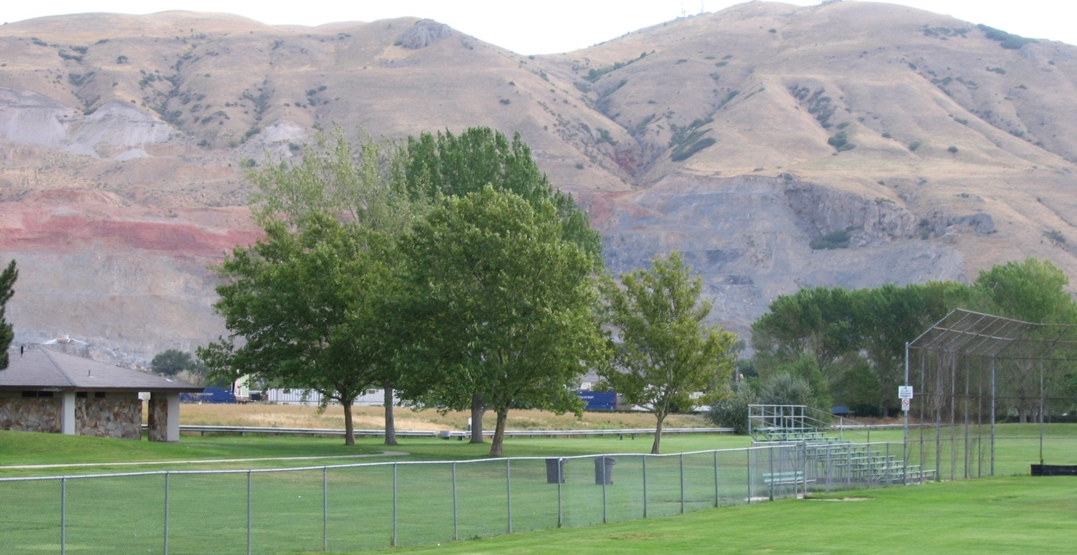
ROSE PARK SLUDGE PIT SUPERFUND SITE
Fran Costanzi, Region 8 SRI Coordinator

Slide 2
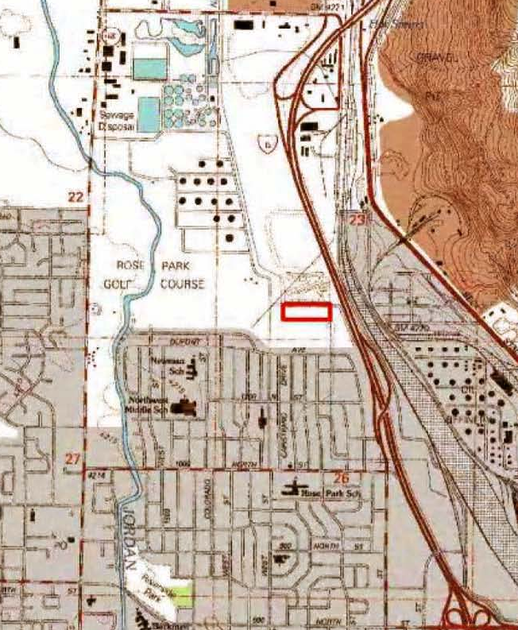
Site Background
Salt Lake City, Utah (Rose Park Community)
5 acres
Surrounded by undeveloped land and recreational space (Rosewood Park)
Final NPL listing on September 8, 1983

Slide 3

Site Remediation and Deletion
Intergovernmental/Corporate Cooperation Agreement (ICCA)
Cleanup designed to prevent exposure
Bentonite slurry wall, capping waste, monitoring ground water, institutional controls

Slide 4
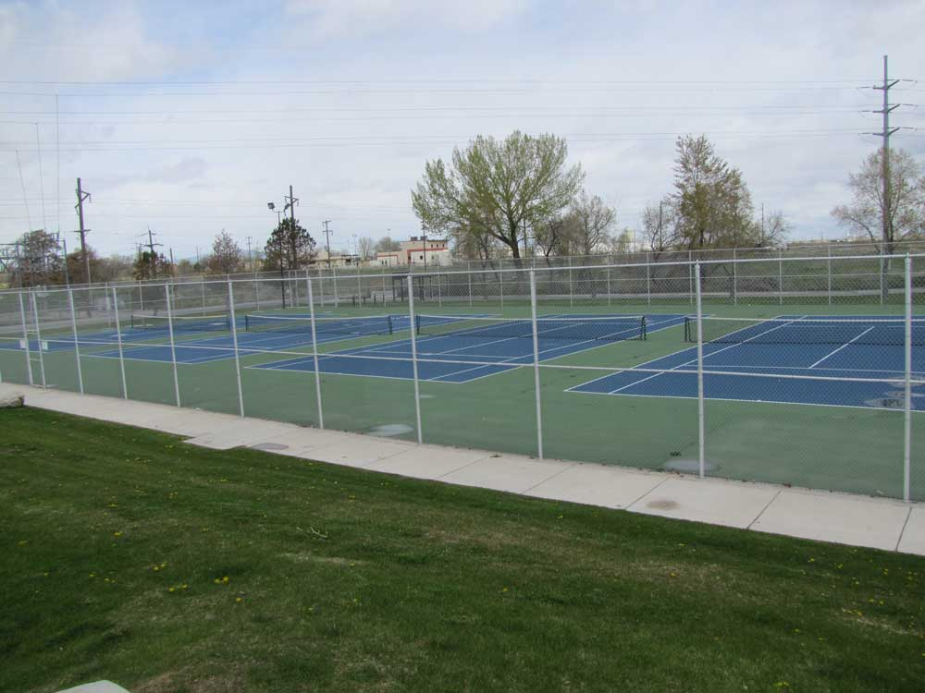
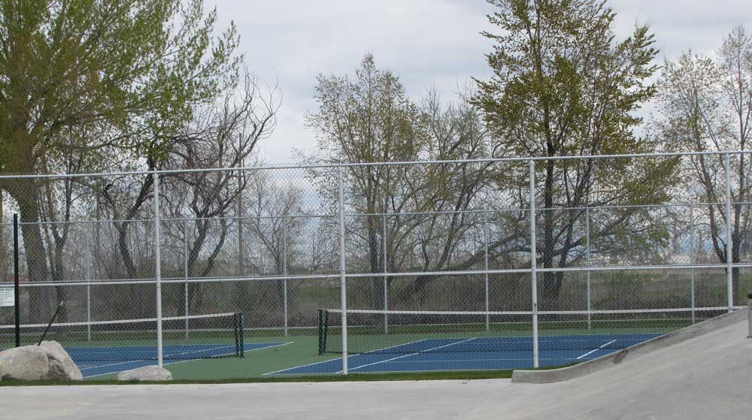
Reuse Considerations
Existing tennis courts near the Rose Park Sludge Pit site . (Source: http://www.slcgov.com/cityparks/parks-rosewood-park)

Slide 5
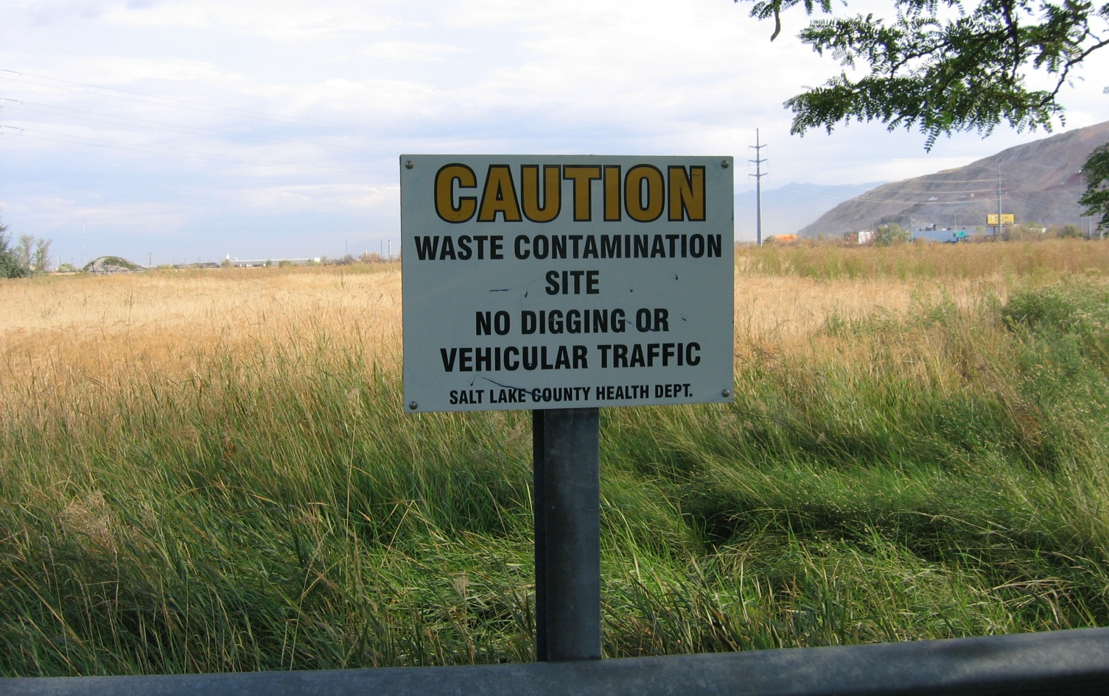
Unused Site Property
Warning signs

Slide 6
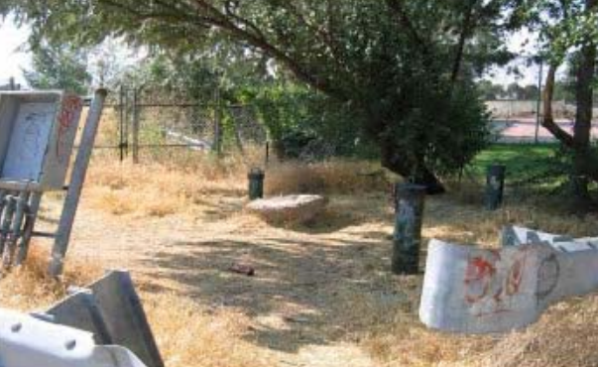
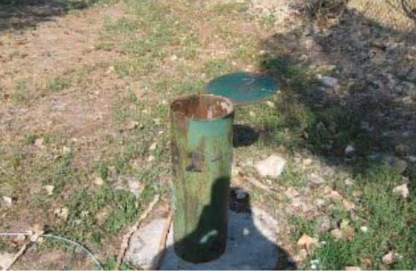
Unused Site Property
Vandalism noted during the 2007 Five-Year Review.

Slide 7
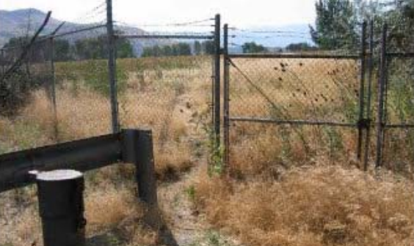
Keeping it Safe, Making Reuse Work
Unnecessarily strict institutional and engineering controls

Slide 8
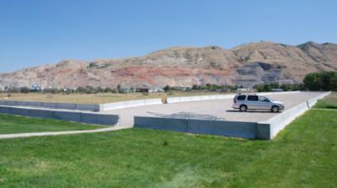
Parking Lot

Slide 9
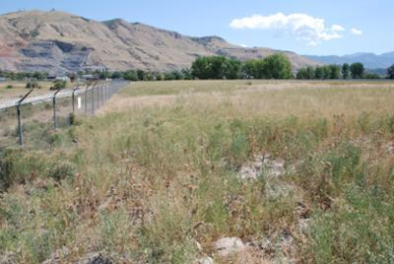
Future Dog Park
Vegetated cap and view of the future dog park area.

Slide 10

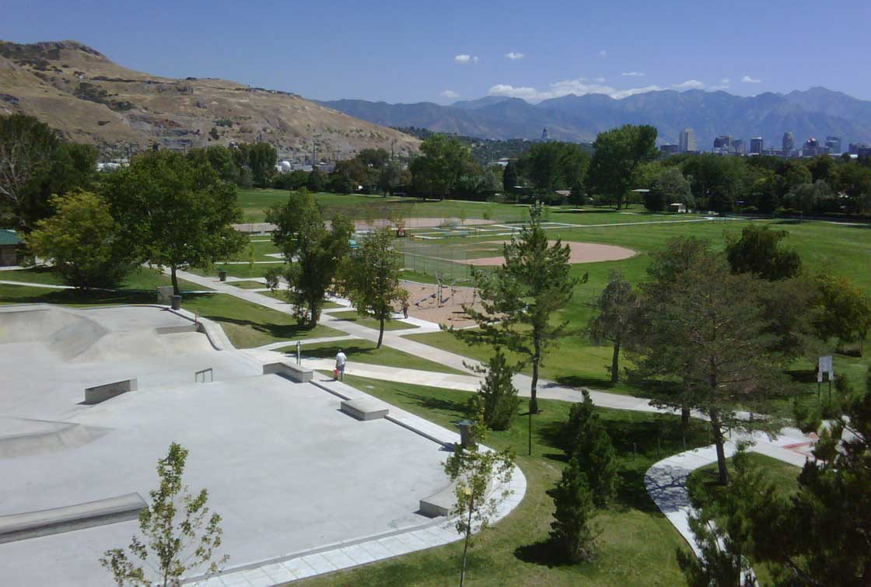
The Site Today
Source: http://www.slcgov.com/cityparks/parks-rosewood-park

Slide 11
Key Lessons
Outdated or unnecessarily strict institutional and engineering controls can be adjusted even after NPL deletion when appropriate to support safe reuse
Interagency and local government collaboration is essential
Reuse can promote long-term stewardship

Slide 12

Contact Information
Fran Costanzi
EPA Region 8
costanzi.frances@epa.gov
(303) 312-6571

