Slide 1
Protecting Pollinators through Sustainable Superfund Reuse

Slide 2
Webinar Overview
Introduction to Reuse and SRI
Melissa Friedland, EPA SRI
Pollinator Protection and National Policy
Dr. Larry Zaragoza, EPA OSRTI
Role of Pollinators
Mary Galea, Pollinator Partnership
Ecological Revitalization –
Tools to Promote Pollinator Protection
Michele Mahoney, EPA TIFSD
Pollinator Protection in Region 7
Catherine Wooster-Brown, EPA Region 7
Pollinator Protection in Region 4
Candice Teichert, EPA Region 4
Resources, Contacts and Questions
Melissa Friedland, EPA SRI

Slide 3
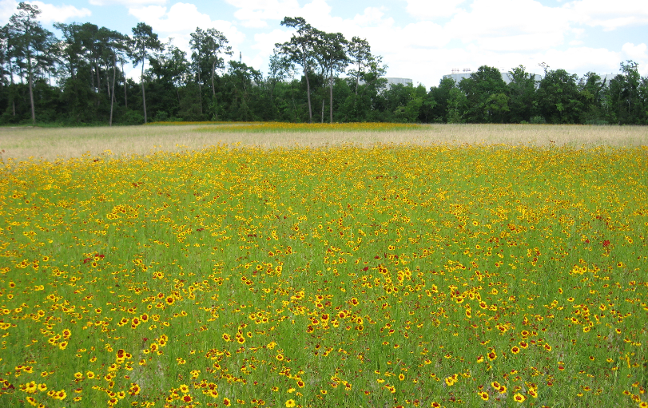
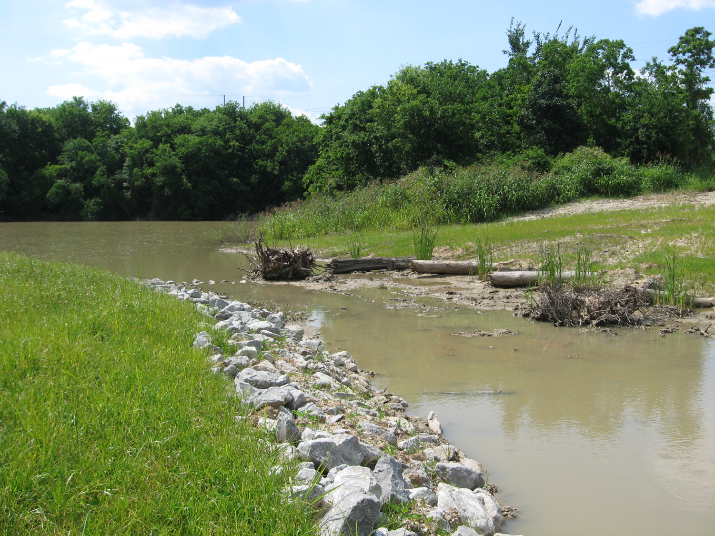
SRI: Superfund Redevelopment Initiative
Working with communities and other partners in considering
future use opportunities and integrating appropriate reuse
options into the cleanup process
https://www.epa.gov/superfund-redevelopment-initiative

Slide 4
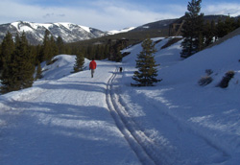
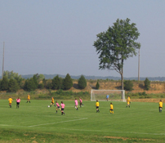
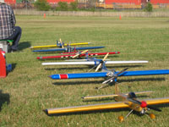
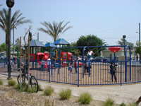
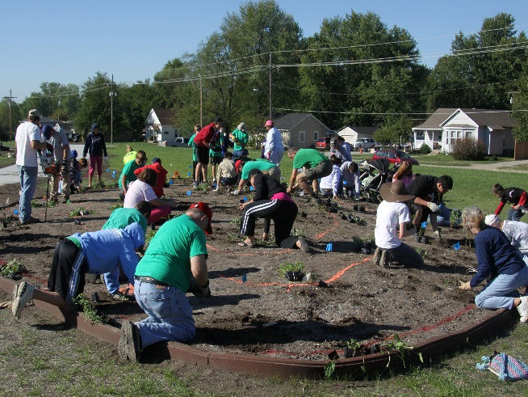
Redevelopment Partnerships
Rails-to-Trails Conservancy support at California Gulch Superfund site, Colorado
U.S. Soccer Foundation support at Avtex Fibers Superfund site, Virginia
Academy of Model Aeronautics support at Auburn Road Landfill Superfund site, New Hampshire
https://www.epa.gov/superfund-redevelopment-initiative/redevelopment-partnerships
The Trust for Public Land support at Pemaco Maywood Superfund site, California
Pollinator Partnership (P2) at Chemical Commodities Inc. Superfund site, Kansas

