Slide 1
Pollinator Protection in Region 4
Candice Teichert
Pollinator Habitat Coordinator

Slide 2
Education and Training
Pollinator protection and reuse training for Superfund and RCRA site managers and Brownfields Coordinators
National Strategy and Objectives
Importance and Examples
Resources and Opportunities

Slide 3
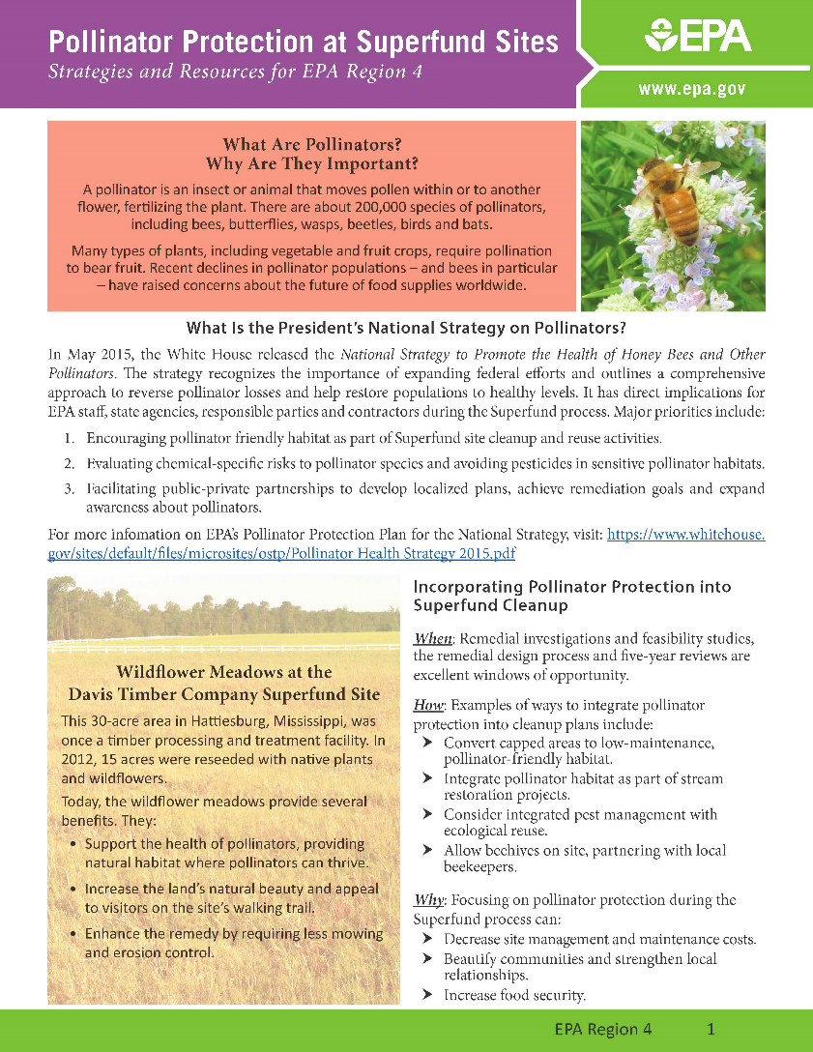
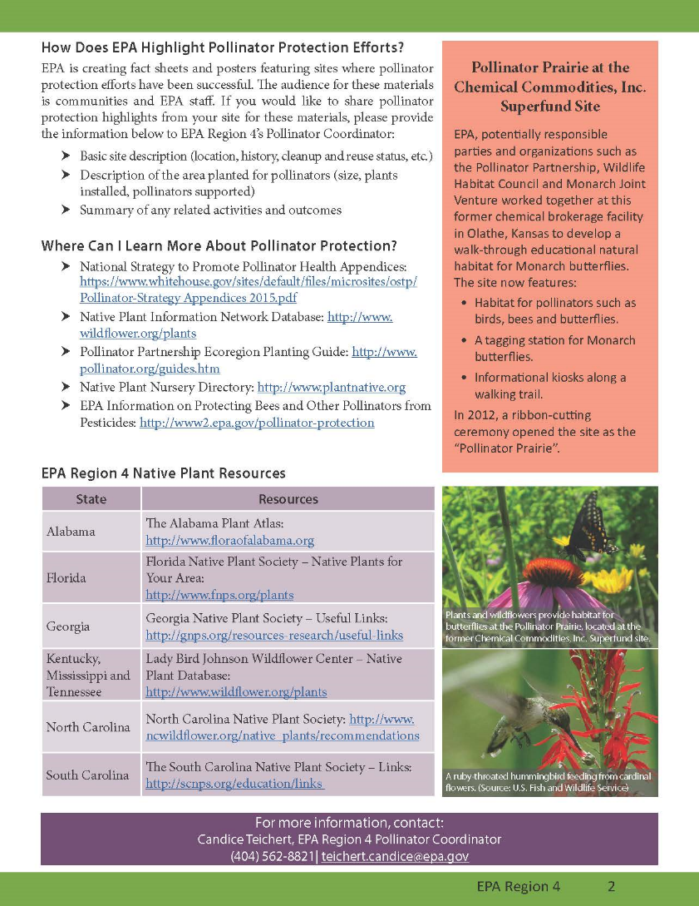

Slide 4
Helpful Resources
Lady Bird Johnson Wildflower Center
http://www.wildflower.org/plants/
Pollinator Partnership Ecoregional Planting Guide
http://pollinator.org/guides.htm
Florida Native Plant Society
http://www.fnps.org/plants

Slide 5
Lady Bird Johnson Wildflower Center
Native Plant Information Network (NPIN)
Native Plants Database
http://www.wildflower.org/plants/

Slide 6
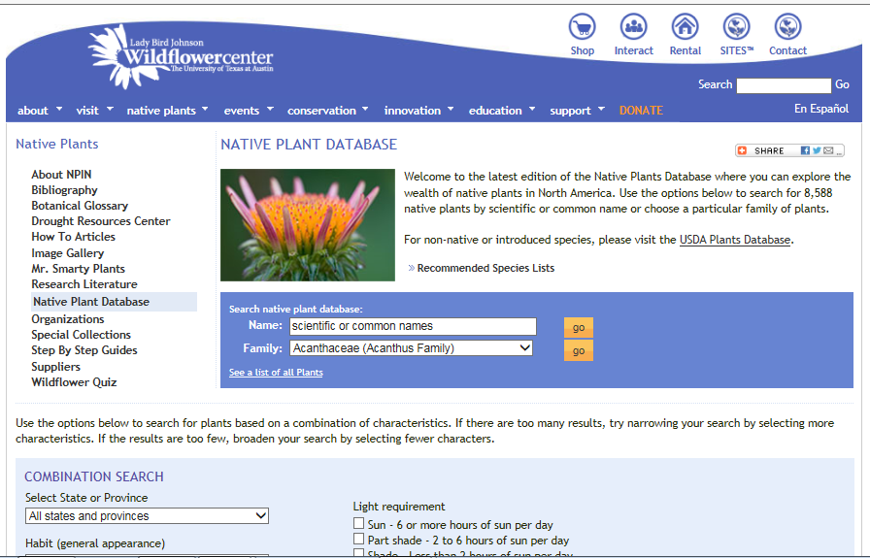

Slide 7
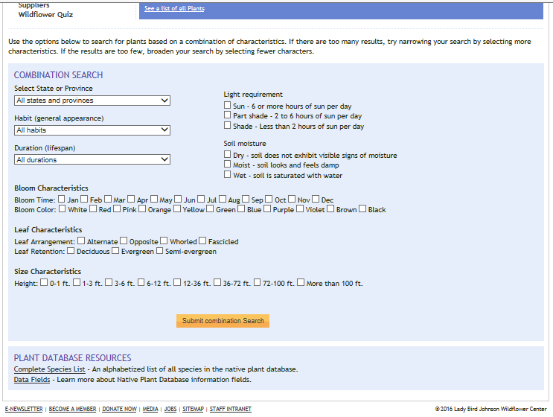

Slide 8
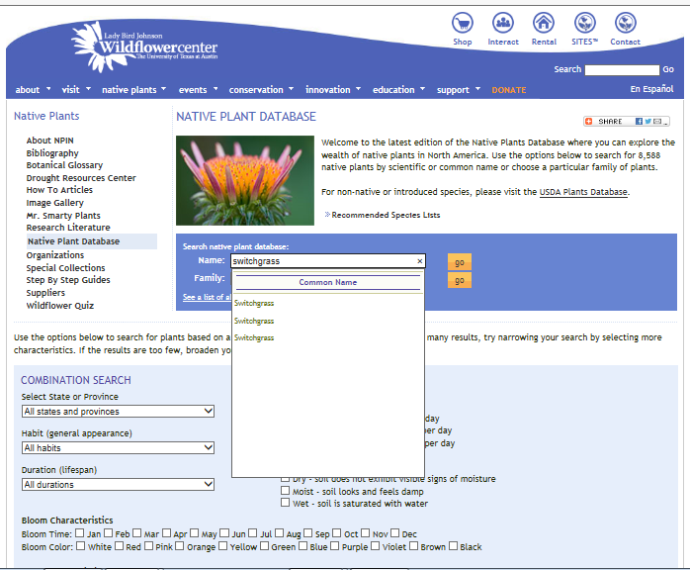

Slide 9
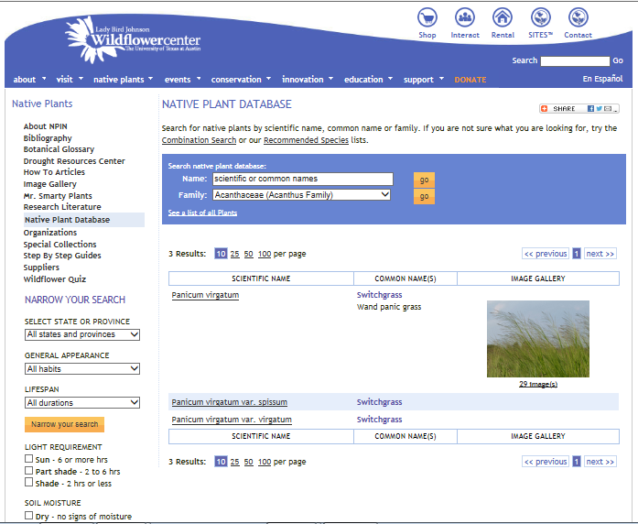

Slide 10
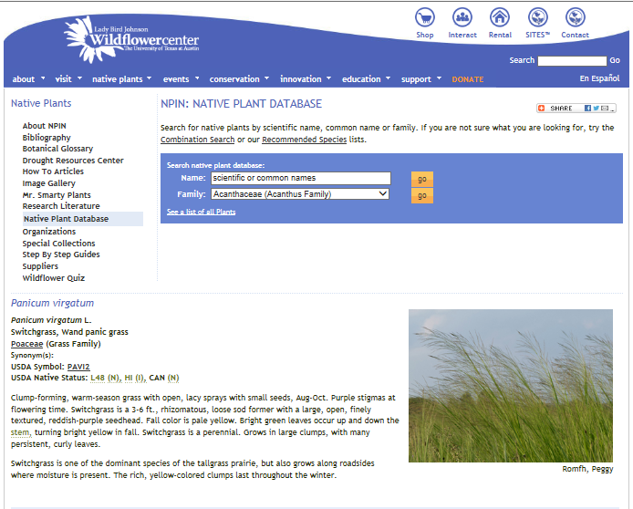

Slide 11
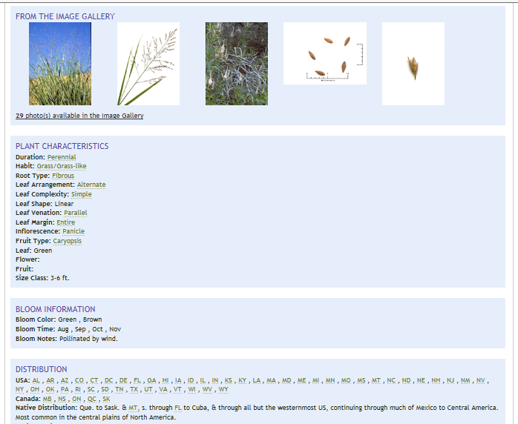

Slide 12
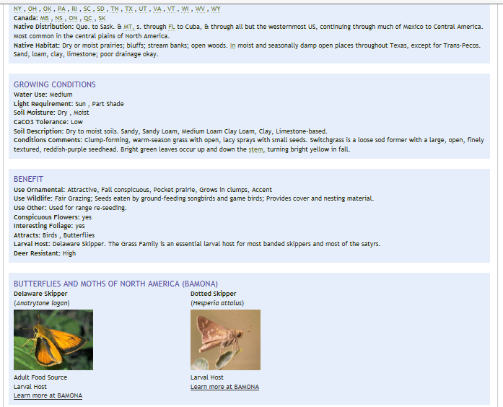

Slide 13
Superfund Metric Objective and Strategy
Metric: Acres of pollinator friendly habitat at Superfund remedial sites
Identify pollinator habitat at existing sites
New opportunities
Feasibility Study, Record Of Decision, Remedial Design, Remedial Action
Five Year Review

Slide 14
Highlighting our Efforts through Case Studies and Fact Sheets
Davis Timber Co. (15 acres)
TVA Kingston Coal Ash (76 acres)
Copper Basin (400 acres)
Agrico Chemical Co. (12 acres)
Raleigh Street Dump (4 acres)
Landia Chemical (6 acres)
Armstrong World Industries (4 acres)

Slide 15
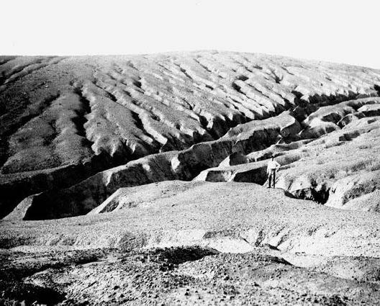
Existing Pollinator Habitat
Site - Copper Basin Mining District
Location – southeast TN and northern GA
History – Mining and chemical processing between the late 1880s to the 1980s left over 30 square miles of land barren of vegetation.
Barren landscape and soil erosion prior to restoration activities (1912).

Slide 16
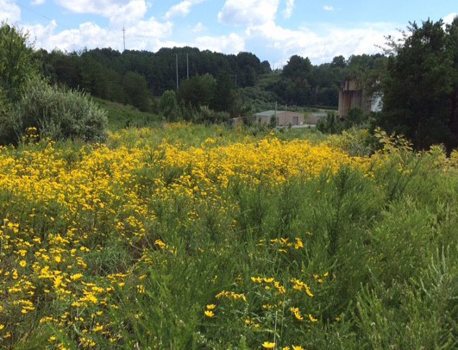
Existing Pollinator Habitat
Revegetation – Since 2002, 385 acres in the North Potato Creek watershed have been revegetated with native species and over 400,000 trees. In addition, over 17 acres in the Davis Mill Creek watershed and several other areas have been revegetated.
Native Plants - Seed mixes included over 20 varieties of native plants and wildflowers.
Grasses - annual rye, orchard, Indian, switch and weeping love grasses.
Flowers – sunflowers, goldenrod, and red, ladino and yellow sweet clover.
Trees and Shrubs - river birch, silky dogwood and tulip poplar.
North Potato Creek Water Treatment Plant (2015).

Slide 17
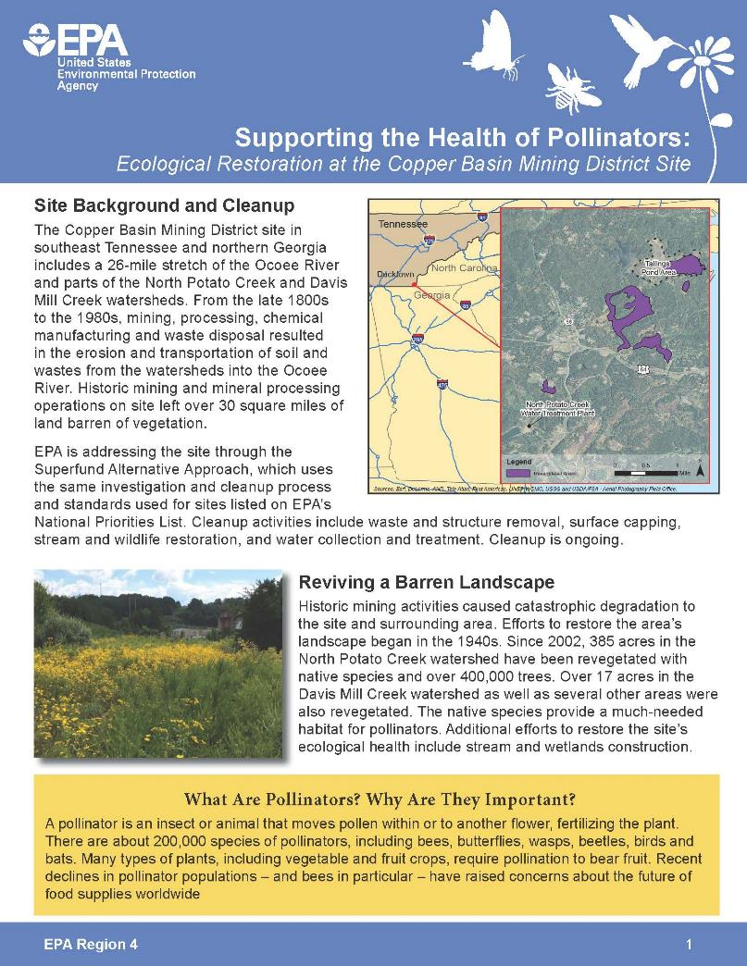
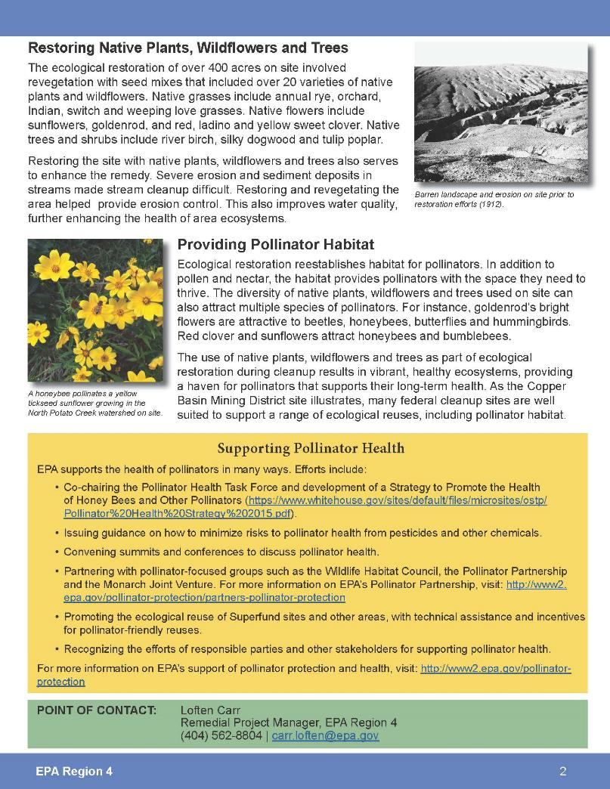

Slide 18
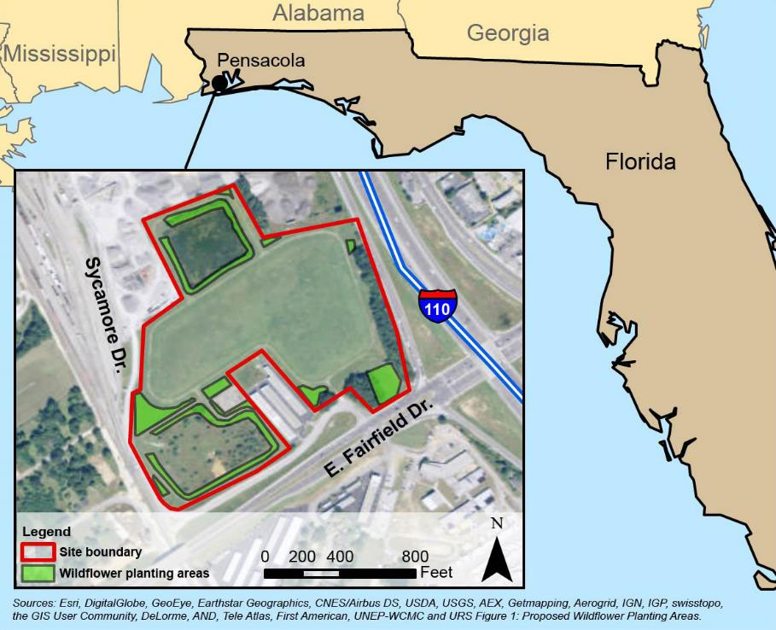
Newly Created Pollinator Habitat
Site - Agrico Chemical Company
Location – Pensacola, Florida
History – Agrichemical production between 1889 to 1975 occurred at the site. Contaminated groundwater, sludge and soil resulting from facility operations was identified and the site was placed on the National Priorities List in 1989. Cleanup actions included soil removal, solidification, stabilization and capping.

Slide 19
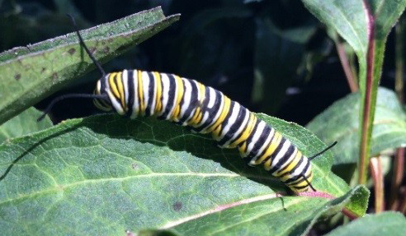
Newly Created Pollinator Habitat
Monarch Way Station – In early 2015, the PRP began researching ecological reuse options and discovered that several conditions made the site an ideal location for butterfly habitat. As Monarch butterflies migrate, they pass through the Pensacola area each year in early October. A total of 12 acres was identified and planted with a focus on establishing a food source way station for Monarchs.
More than 1,700 plants including:
230 asters and 200 each of abelia, coneflower, liatris, cassia and rudbeckia.
200 buddleia (butterfly bush)
300 milkweed
Monarch larva on site (2015).

Slide 20
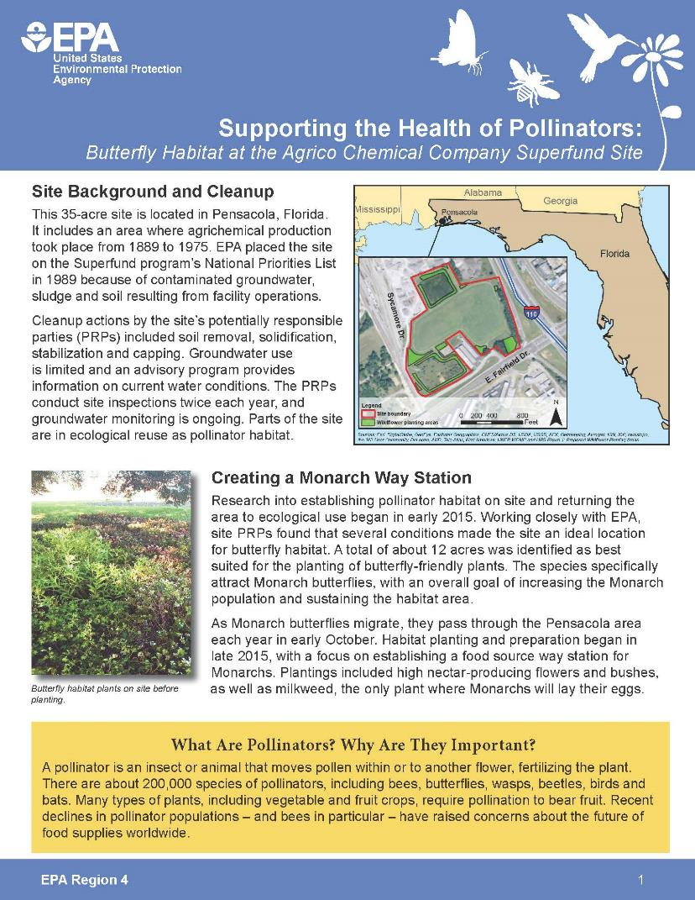
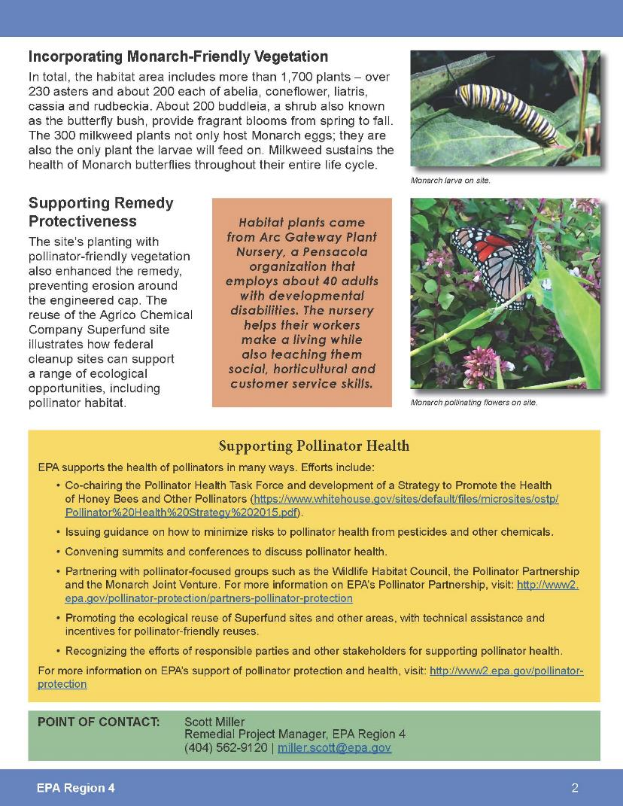

Slide 21
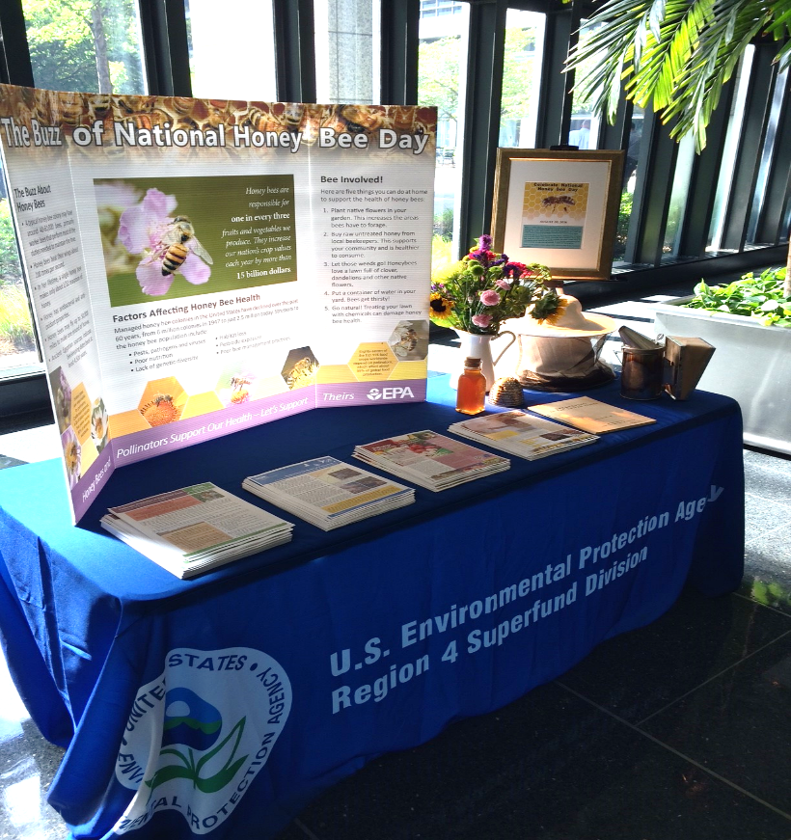
Additional Activities and Outreach
National Pollinator Week and National Honey Bee Day
2016 National Association of Remedial Project Managers (NARPM) in Pittsburgh, PA
Georgia Environmental Conference in Jekyll Island, GA
Wildlife Habitat Council’s Conservation Conference in Baltimore, MD

Slide 22
Youth Activities and Outreach
North Birmingham Summer Camp
International Environmental Youth Symposium
Science Saturday event hosted by Georgia Pacific

Slide 23
For More Information, Contact
Candice Teichert Pollinator Habitat Coordinator Region 4 EPA 404-562-8821 teichert.candice@epa.gov

