Slide 1
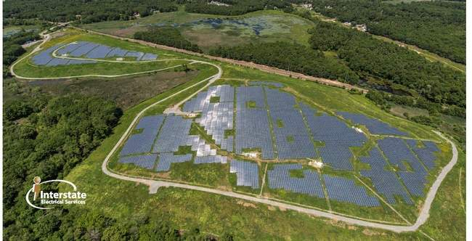
Iron Horse Park (Shaffer Landfill)
Source: http://billerica.wickedlocal.com/
Don McElroy, EPA Region 1, Remedial Project Manager

Slide 2
Site Location

Slide 3
Shaffer Landfill Remedy
The capping of Shaffer Landfill involved:
Placement of subgrade soils over regarded waste providing:
5% grade on top deck
Smooth subgrade surface on side slopes
Installing textured membrane liner over entire landfill
Installing synthetic drainage layer (drain net) over entire landfill
Installing filter fabric over drainage layer
Installing 18” of soil as top layer (to be seeded)
Construction included:
Stormwater conveyance systems and detention basins
Combined landfill gas and leachate collection wells
Landfill gas flare
Perimeter fence.

Slide 4
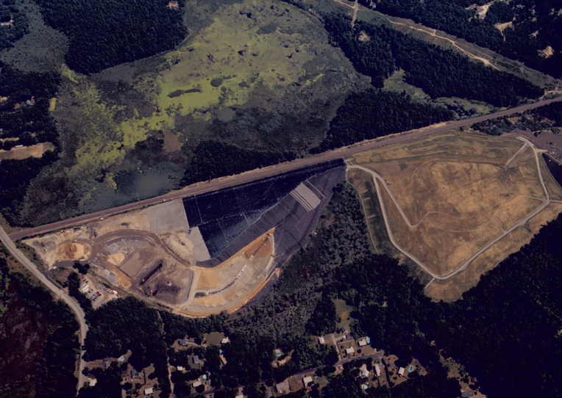
Construction

Slide 5
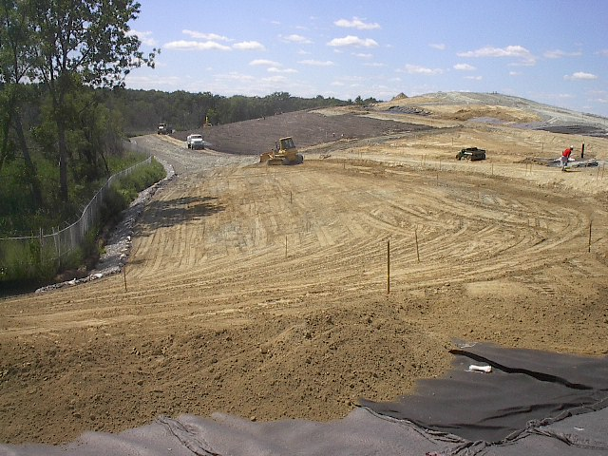
Shaffer Landfill Cleanup

Slide 6
Contact Information
Don McElroy
EPA Region 1
mcelroy.don@epa.gov
(617) 918-1326

