Slide 1
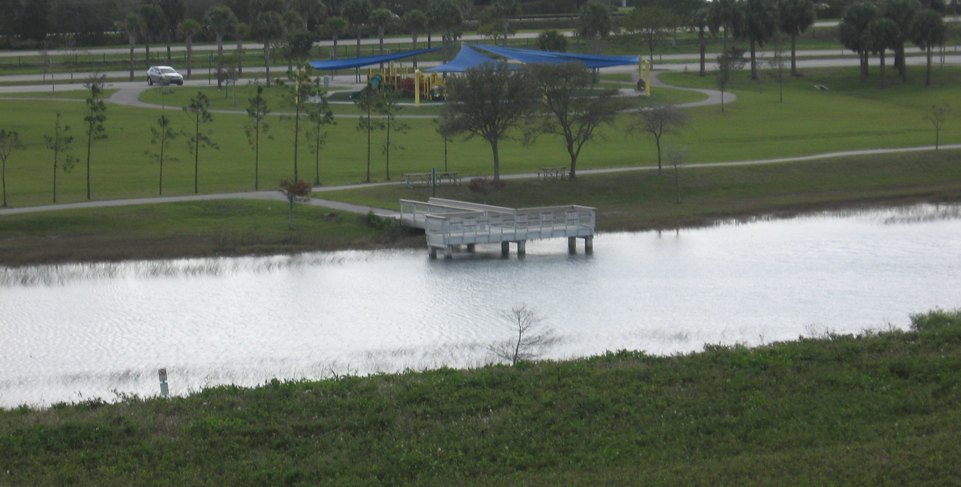
Davie Landfill Case study
Bill Denman, EPA Region 4 Superfund Division, Section Chief

Slide 2
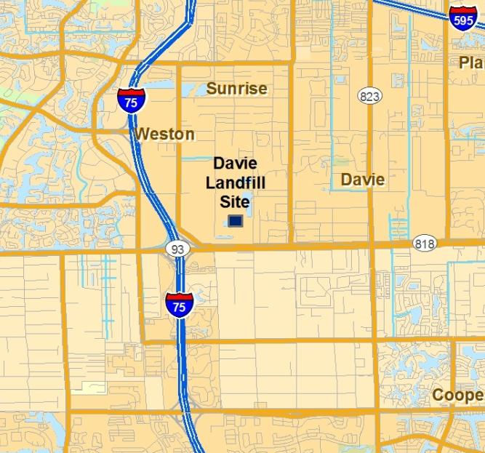
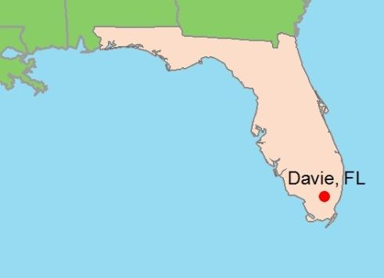
Site Location
Davie, Broward County, Florida

Slide 3
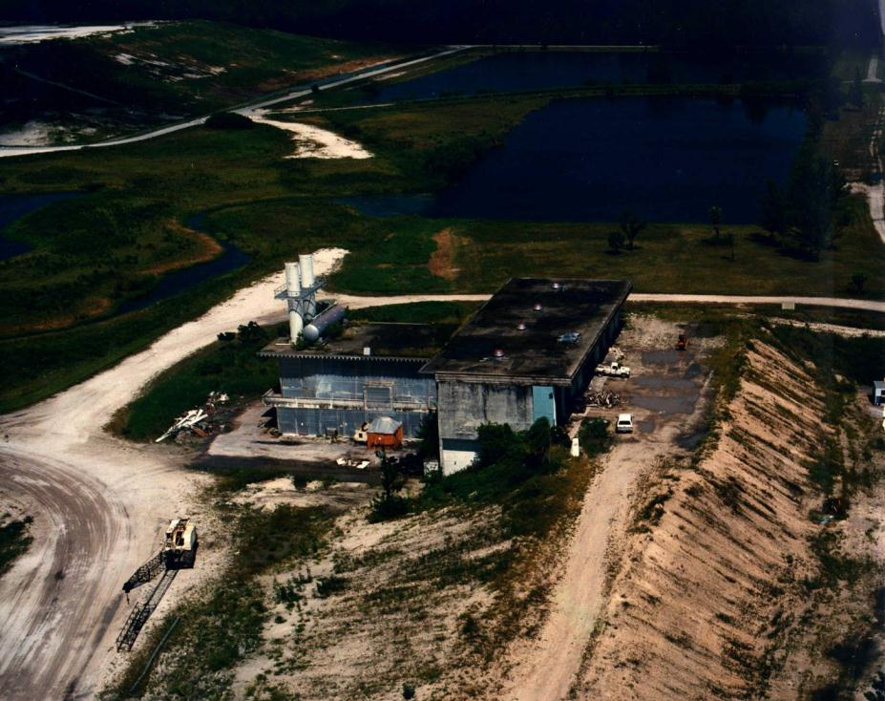
Site History

Slide 4
Proactive Reuse Considerations

Slide 5
Contact Information
Bill Denman
EPA Region 4
denman.bill@epa.gov
(404) 562-8939

