Slide 1
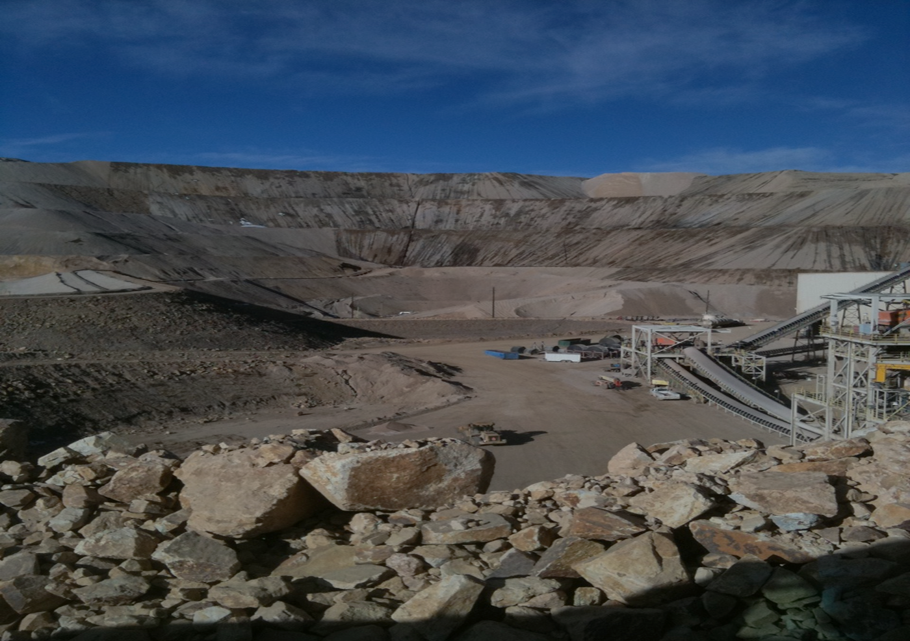
Can Environmental Stewardship be Profitable?
Advancing Solutions for a New Legacy
EPA Hard Rock Mining Conference
April 3 – 5, 2012
Denver, CO

Slide 2
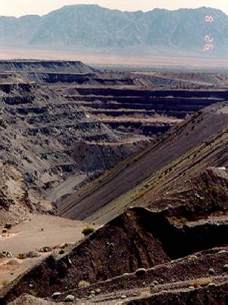
What You Will Hear
The legacy of the past
  Sustaina-what?
Why Change?
  Regulatory Drivers
  Corporate Responsibility
The new legacy
  Design for Closure
  Life-Cycle-Profitability
How it works
Notes:
This discussion focuses on encouraging the mining industry to think differently regarding the role of environmental controls in the life cycle profitability of a hard rock mine.
Case history has shown that by financing and implementing robust environmental controls at the initial stages of mine development, significant reductions in closure cost and toxic tort liability can be realized
This results in increased life cycle profits.

Slide 3
Legacy of the Past

Slide 4
The Legacy of the Past
Narrow profit margins dictated corporate environmental policy
Low front end costs
High closure liability
Minimal Environmental controls
$$
Gross Contamination & Law Suits
$$$$
Closure, Maintenance & Monitoring
$$$$$$
Notes:
As a result of low mineral prices, profit margins have historically been low.
This narrow margin has influenced corporate policy

Slide 5
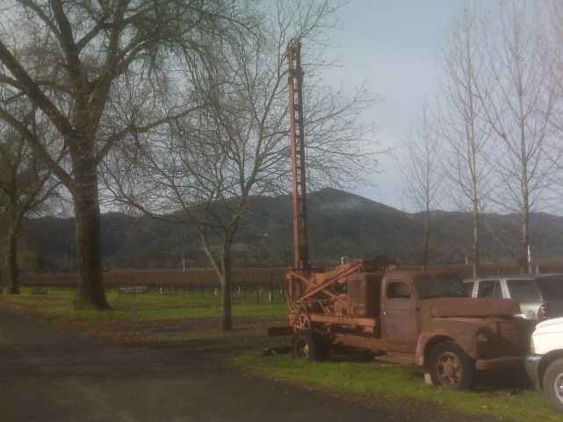
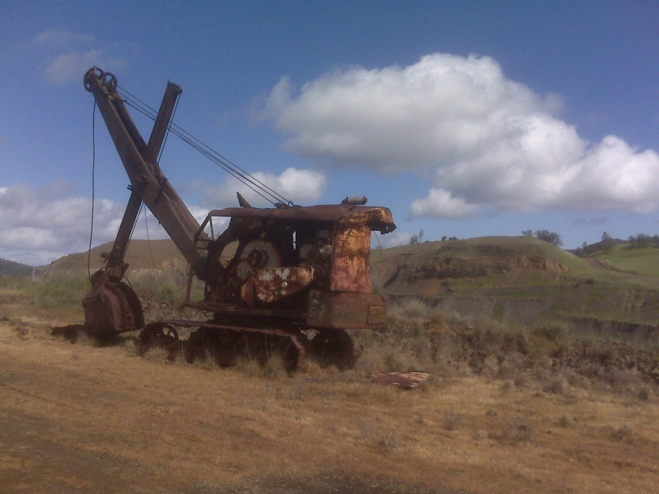
The Legacy of the Past
Philosophy of “perpetual care” (containment) vs. real “closure”
Environmental resource inventory not considered
The value of natural resources not considered into life-cycle profit analysis
Plant decommissioning fails to consider value of equipment to support closure activities
Notes:
As a result, mine closure managers were constantly being dealt a loosing hand of cards.
Profits initially realized from mineral production would slowly bleed out the back door
Economic value – permitting $-const/operation$ - (closure cost) = Profit

Slide 6
Why Change?

Slide 7
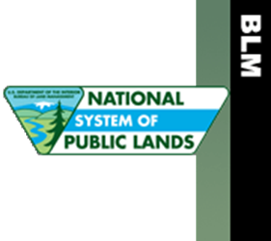
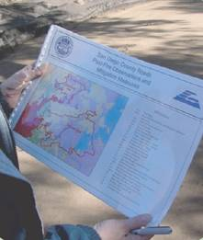
Why Change?
Regulatory Trends
Permitting requirements trending toward stricter environmental controls
Closure/Remediation focus on “Source control and Removal”
Long-term “management” not accepted
CERCLA Bonding requirements
  Requiring “Worst Case” scenarios
  Requiring care in perpetuity
Notes:
The old paradigm has seemed to work until now…so…

Slide 8
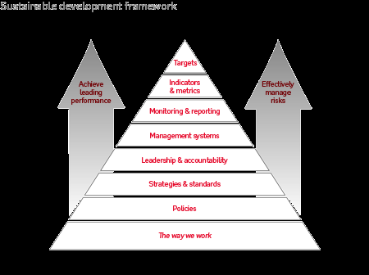
Why Change?
SEC Regulation Trends
Environmental liability estimating requirements
Liability reporting requirements
Mining Industry Trends
Focus toward “responsible mining”
Positive public perception
Balancing performance with risk
Investor pressure to maximize profits
Notes:
Responsible Mining stated by Chuck Keannes of Goldcorp in keynote address yesterday
Positive public perception promoted by NWMA website

Slide 9
The New Legacy
Environmental Stewardship

Slide 10
The New Legacy – Think Different
The New
The Old
Philosophy of Life-Cycle accountability
Mine “conversion” vs. “closure”
View environmental resources as ASSETS not liabilities
Integrate effective links between exploration, production, closure, and conversion
All processes centered around Environmental Stewardship
Philosophy of “perpetual care” (containment)
Environmental resource inventory not considered
The value of natural resources not considered into life-cycle profit analysis
Plant decommissioning fails to consider value of equipment to support closure activities

Slide 11
What is Environmental Stewardship?
“Respect for the environment is central to our approach to sustainable development. Wherever possible we prevent, or otherwise minimise, mitigate and remediate, harmful effects of the Group's operations on the environment.” (http://www.riotinto.com/ourapproach/17194_environmental_stewardship)
“…our goal is to minimize our environmental footprint and safeguard the environment, now and for future generations. Responsible environmental management is central to our success as a leading gold mining company and we seek to continually improve our performance.” (http://www.barrick.com/CorporateResponsibility/Environment/default.aspx)
“Our employees are committed to responsible mining practices that protect and enhance air and water quality and biodiversity. Hecla will continue to be a leader in environmental practices by implementing appropriate energy conservation and waste reduction programs.” (http://www.hecla-mining.com/responsibility/responsibility_stewardship.php)

Slide 12
Stewardship Elements –
A wide range of approaches
Respect for the Environment
Minimize Environmental Footprint
Take inventory
  Air, water, land, ecology
Assess impacts
  Resource consumption
  Resource modifications
Operations response
  Reduce, reuse, recycle, reclaim
Closure restoration
  Leave no footprint behind
Quantify inventory
  Develop metrics
Calculate impacts
  Establish performance goals
Value engineering
  Balance performance/risk
Design operations
  Build-operate environmental controls
Monitor performance
Reclaim and restore

Slide 13
The Opportunities for the Future
Better planning => increased project life-cycle profits
Increased planning, capital, and compliance costs
$$$$
Reduced environmental impact (liability)
$$$
Reduced Environmental Footptrint
$$
(retained PROFIT)
Notes:
More robust environmental controls + better planning = less environmental impacts = lower closure costs AND lower toxic tort liability
Translates to preservation of profit margins

Slide 14
How It Works
Environmental Stewardship

Slide 15
The Old Legacy
Key to success is taking a Life-Cycle Perspective of all elements of environmental stewardship.
Traditional Approach:
Exploration
Pre-Feasibility Exploration
Feasibility Studies
Mining
Design
Permit
Closure
Decommissioning/Demolition
Closure
Operate
Restoration
Conceptual Planning

Slide 16
The New Legacy - Think Different
State of the practice Approach:
Environmental Stewardship
Exploration
Mining Operations
Closure
Conversion

Slide 17
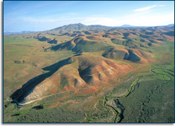
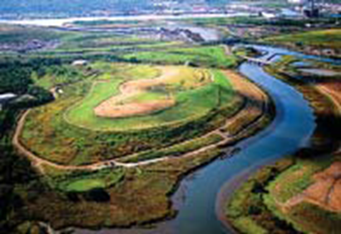
Step 1: Develop a Vision
How it Works
  Environmental resource assessment
  Mining vision
  Closure, restoration, “End-State Vision”

Slide 18
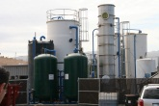
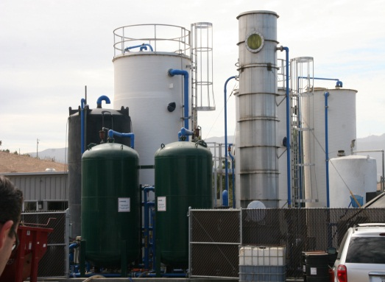
Step 2: Identify critical mining operation facilities
How it Works
Waste rock dump
Tailings pond
Heap leach pad
Process water treatment system
Process water disposal pond
Storm water runoff management pond
Ore conveyance system
Notes:
Step 1: become land use planners
Step 2: what do the look like at operation? Closure?

Slide 19

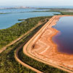
Step 3: Identify/Quantify environmental impacts
How it Works
Greenhouse gas emissions
Wastewater discharges
Sensitive species
Stormwater runoff
Groundwater resources

Slide 20
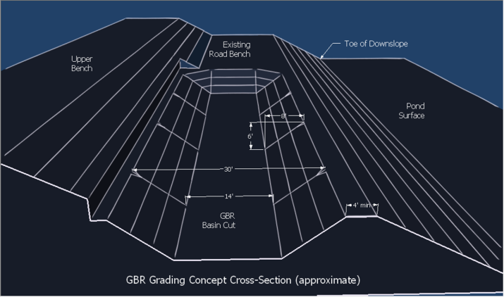
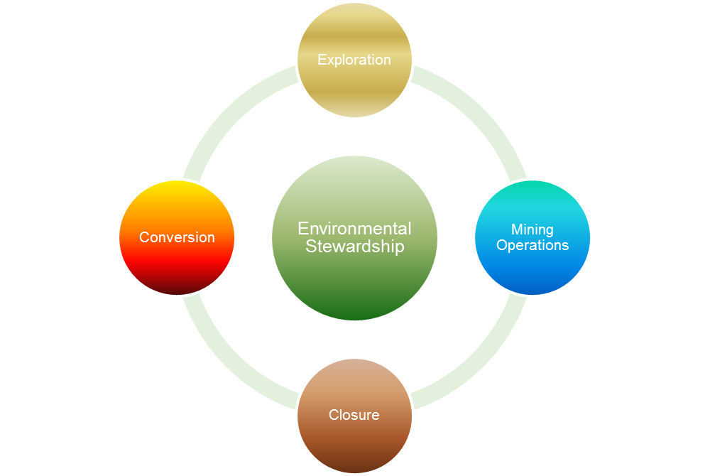
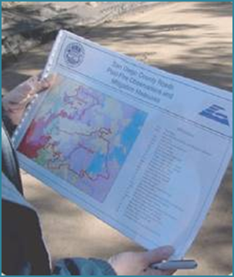
Step 4a: Operations “Design for Closure”
How it Works
Integrate environmental controls
Compliance with permit conditions
Minimize releases to environment
Minimize waste generation
Maximize reuse and recycling
Notes:
Step 4: most critical step
Ask yourself: what can I do now that will same me time and money later?

Slide 21

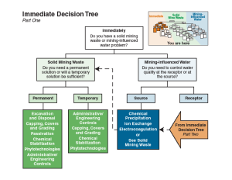
Step 4b: Value engineering
How it Works
Reduce overall environmental resource damage, closure cost, and toxic tort liability
Maximize resource reuse/recycling
Water recycling-reduce reliance on groundwater
Recycle-reuse waste rock overburden
Minimize generation of hazardous waste
Material management
Protect groundwater resources
Coordinate transition from operation to conversion
Maximize value of deployed assets

Slide 22
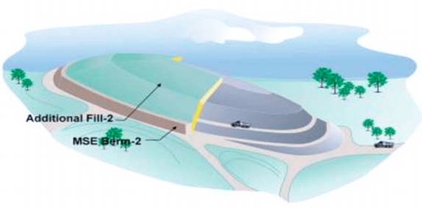
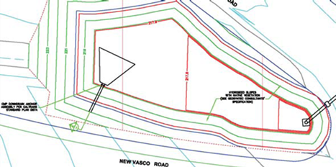
Step 5: Develop Closure Plan and Cost Estimate
How it Works
Realistic Case scenario vs. worst case scenario
Integrate operational controls with closure elements
More robust environmental program results in lower closure cost; reduced toxic tort liability
Compatible with long term benefits
Notes:
From Steps 1 -4 you will have the basis to complete Step 5
This results in realistic closure cost estimating, which reduces closure cost financial assurance, which results in reduced bonding
Includes the added benefit of lower likelihood of toxic tort liability

Slide 23
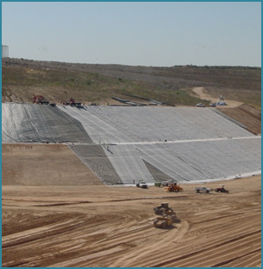
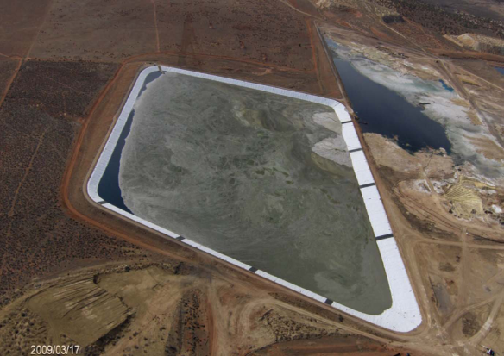
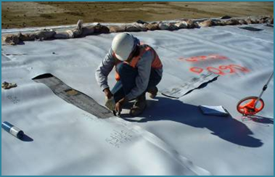
Resources and Tools
Properly designed impoundments
Reduces releases to the environment
  Groundwater remediation cost lower
  Less loss of product
Reduces operational costs
  Fewer emergency responses
Facilitates closure
  Integrated design

Slide 24
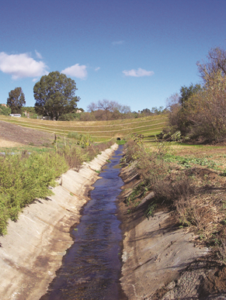
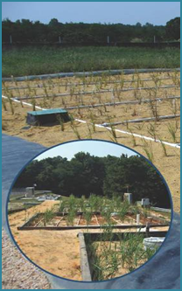
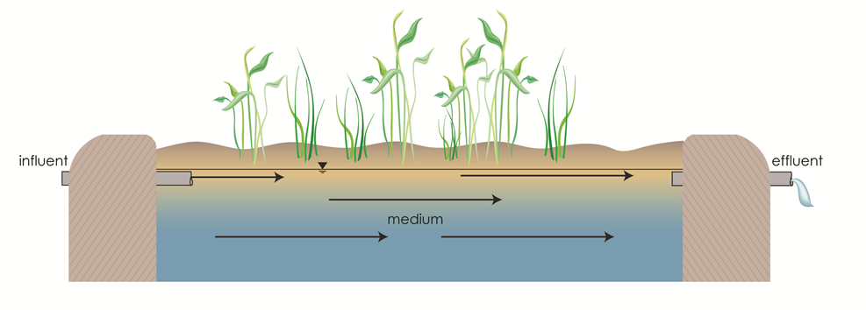
Resources and Tools
Surface Water Management
Emphasize in-situ and natural processes
  Constructed wetlands
  Flow through gravel bed reactors
Treat at source not property line
  Reduces impact zone
Capture, recycle, reuse

Slide 25
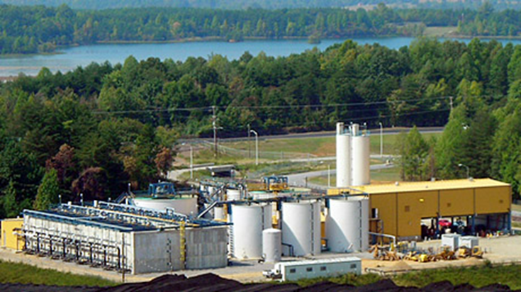
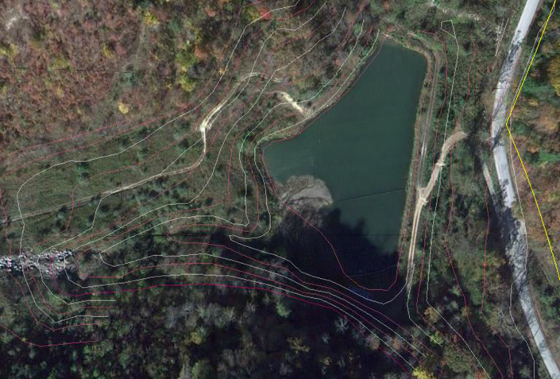
Resources and Tools
Water treatment and recycling
Develop water management plan
  Identify needs and resources
  Groundwater supply
  Surface water supply
  Waste water recycling
Water treatment technologies
  State of the art treatment technologies
  Minimize operational requirements
  Minimize waste by products

Slide 26
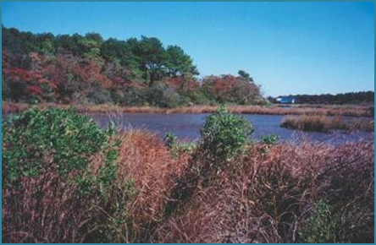
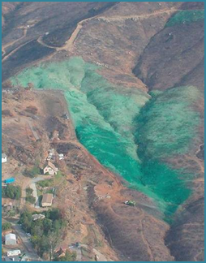
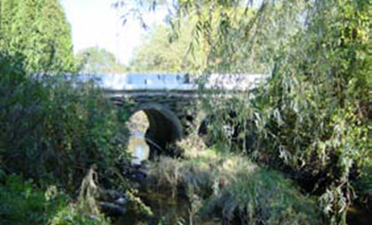
Conclusions
Reduced closure cost and bonding
Reduced toxic tort exposure
Better governmental and public relations
INCREASED PROFITS
Environmental Stewardship

Slide 27
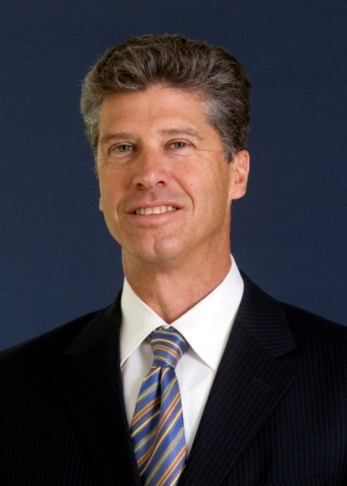
Contact Information
Randy Brandt, P.G.
Principal
1111 Broadway 6th Floor
Oakland, California 94607
Phone: 510-285-2736
Mobile: 510-610-1500
rbrandt@geoynstec.com
www.geosyntec.com

