Slide 1
A Proposed Semi-Passive Treatment System At Remote AML Sites
by
Robert H. Lambeth, PE, PG, LHG & Gene Andrews, PE
Millennium Science & Engineering, Inc.
Spokane, Washington
EPA HARDROCK MINING CONFERENCE 2012
Denver, Colorado
April 3, 2012

Slide 2
Problem: ARD discharging into a popular Wild & Scenic River floodplain Question: Can you build a minimal cost, walk-away treatment system that has no footprint, odor, maintenance, or power needs? Answer: It would be difficult! Or more precisely – NO!

Slide 3
History & Description
Volcanogenic Massive Sulfide deposit
Active 1898-1942
Most production 1908-1916
13 Adits
2 Shafts
4 Levels below River
10,000 feet of workings

Slide 4
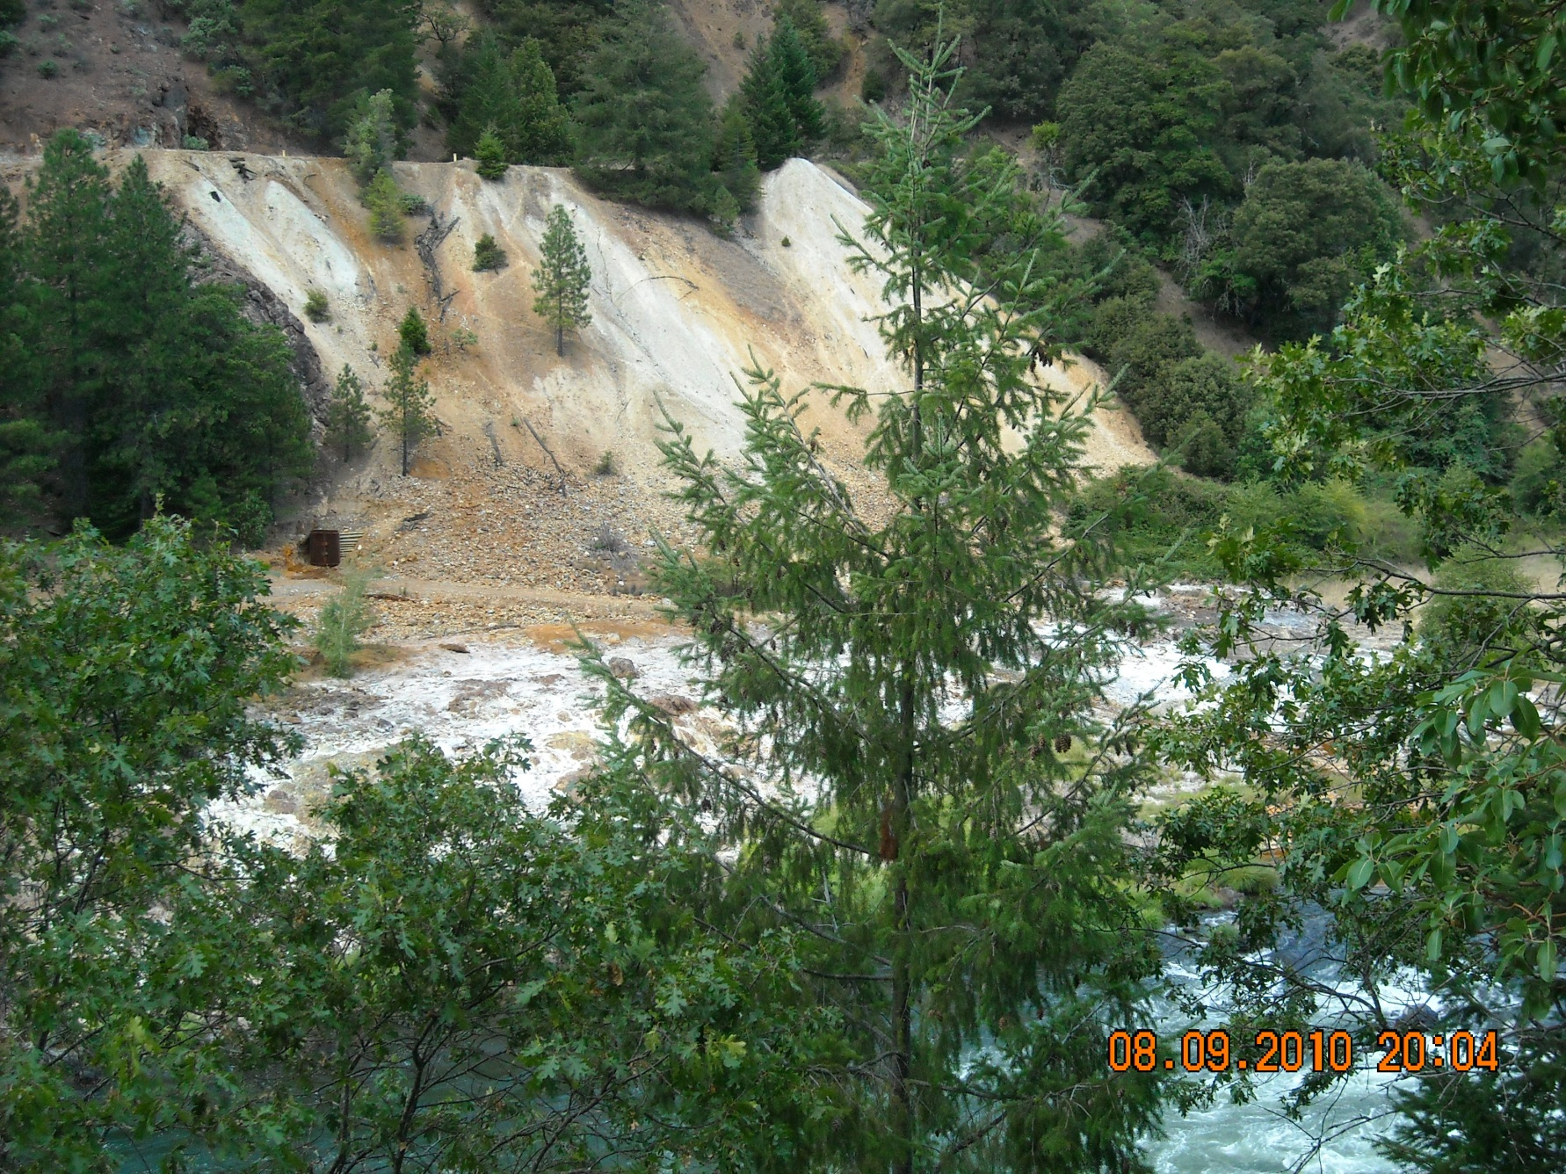
Ground Level View of Site

Slide 5
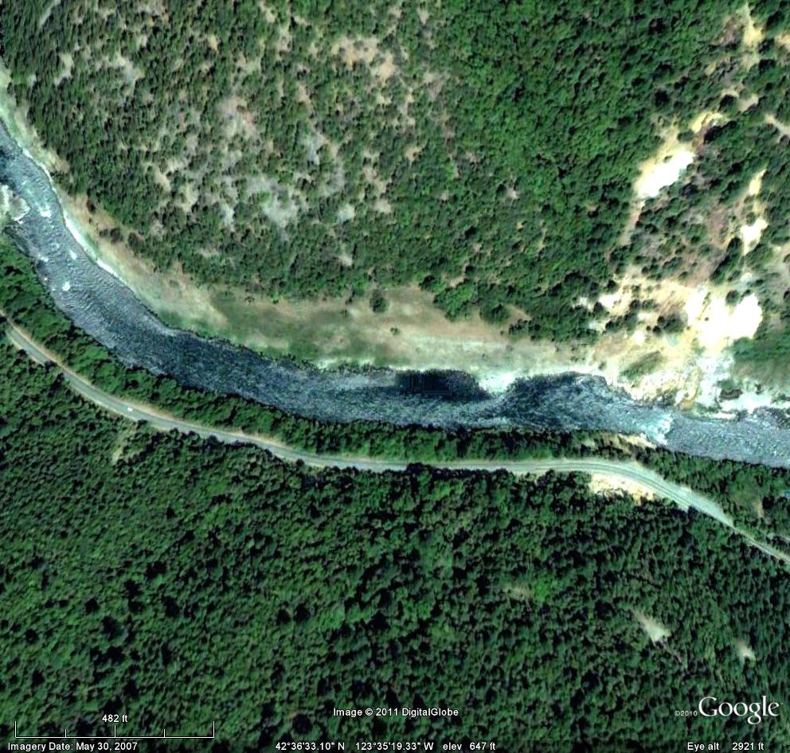
Aerial View of Site
100 Yr. Flood Plain
Y
River Level Adit

Slide 6
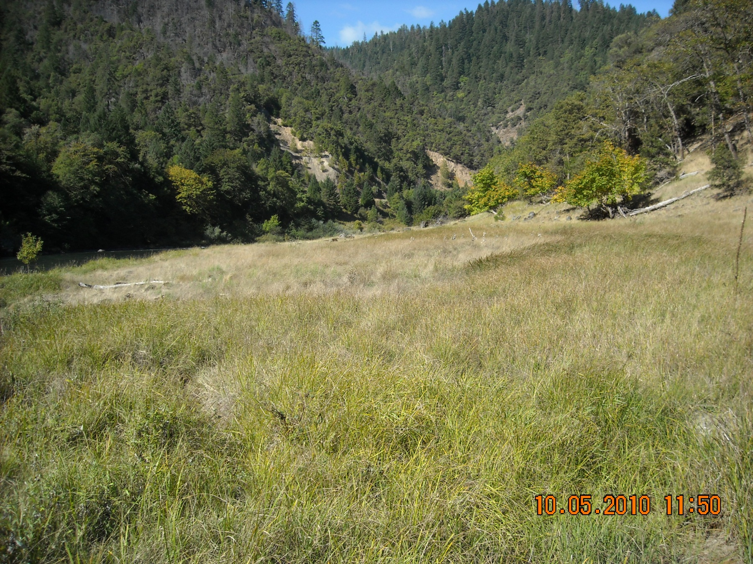
Floodplain Looking West

Slide 7
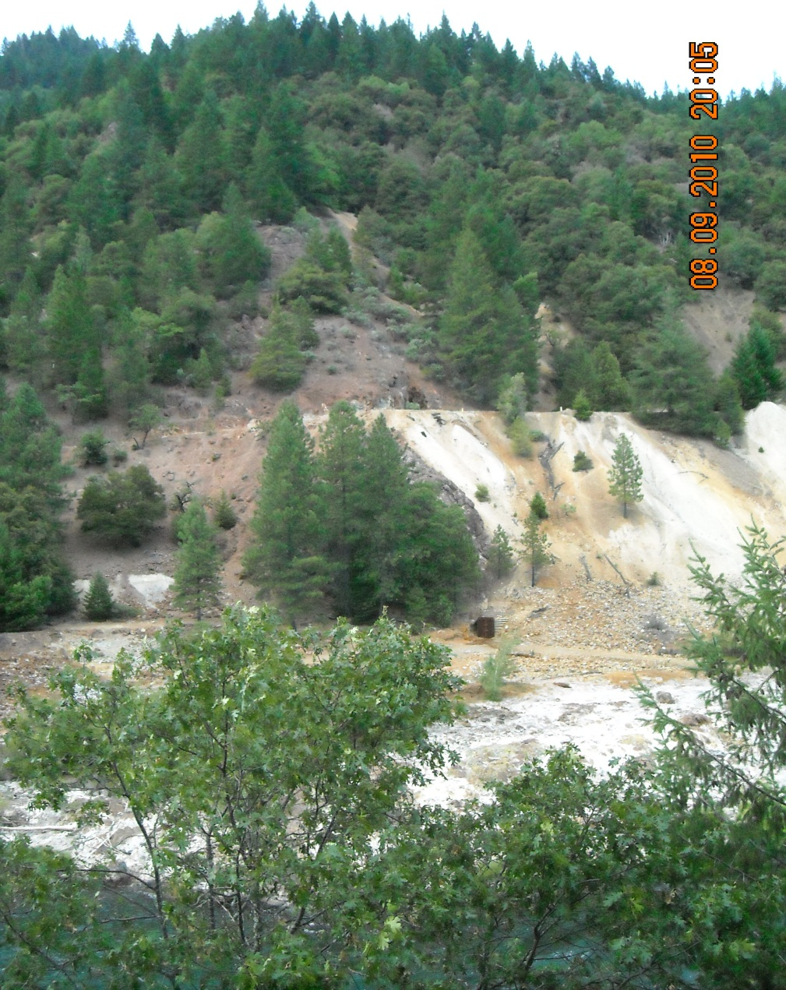
All Adits

Slide 8
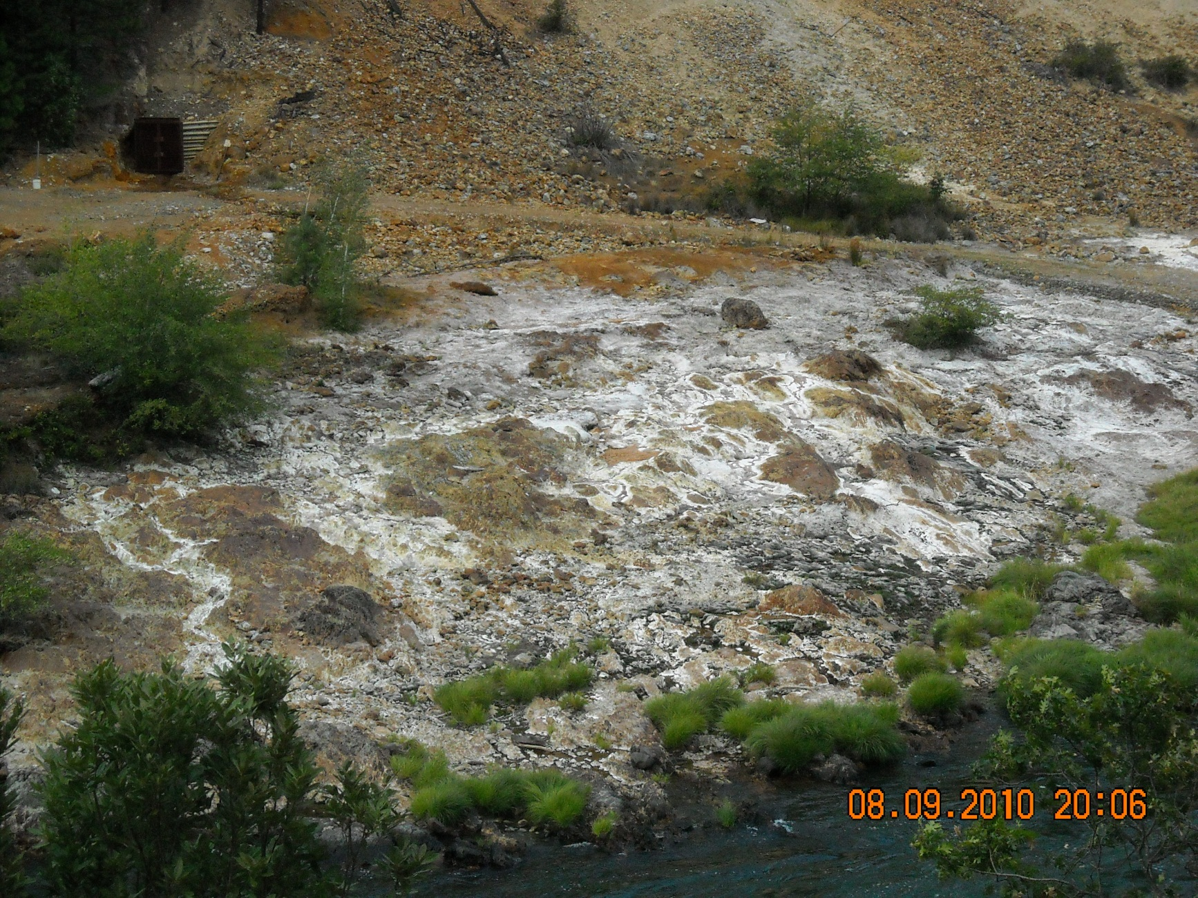
Adit Discharge

Slide 9
Discharge Quality
Flow = 10 gpm
pH = 2.9 su
Al = 19 mg/L
As = 0.016 mg/L
Cu = 3.5 mg/L
Fe = 93 mg/L
Pb = 0.21 mg/L
Se = 0.03 mg/L
Zn = 18 mg/L

Slide 10
Treatment Design Considerations
Limited access
No power
Adit frequently flooded
Entire valley is a floodplain
Visibility
Vandalism
No water availability

Slide 11
Basic Treatment Options
Neutralization (mandatory)
Within wetlands?
Caustic?
Lime?
Sludge handling
Direct discharge?
Settlement basin w/removal?
Filtration w/removal

Slide 12
Neutralization Discussion
Lime addition
Denser sludge
Lower cost
Doesn’t freeze, but
More maintenance
Greater power requirements
Caustic addition (Preferred)
Much easier and simpler to use
Less power needs
Lower maintenance

Slide 13
Bench & Field Tests
Performed by Ionic Water Technologies, Inc., Reno, NV
8 gpd of 30% NaOH solution to pH 9
All metals but Al declined to criteria in effluent
Sludge passed TCLP, but leachate still exceeded some criteria
Paint filter test was not performed
This Should Work!

Slide 14
Settlement Option Issues
Wetlands
Would have to be in the floodplain
Will 10 gpm sustain an adequate size system for the pH?
Visible and subject to vandalism
Settlement basins
Would have to be in the floodplain
Visible and subject to vandalism
>> Sludge removal for both awkward and the disturbed sludge may not pass the Paint Filter Test<<

Slide 15
Potential Locations
100 Yr. Flood Plain
?
?
??
?
?
Y
??
River Level Adit
?
?? = Treatment plant
? = Basins
? = Pipeline

Slide 16
Alternative Proposal!
Concrete plug in adit
Can create head!
Stops inundation!
Treatment system underground
Hides it!
Protects it!
Treated effluent to fabric filters
Contains sludge!
Protects sludge from flooding!
Discharge to drainfield for polish and concealment!

Slide 17
Sludge Disposal ?!?
Use multiple fabric filter tubes in series!
Containerize filter tubes in large garbage dumpsters!
Change out full filter tubes quickly!
Dispose in local landfill!
The sludge passes TCLP!
The sludge should pass the Paint Filter Test!
>>The landfill can still reject it!!<<

Slide 18
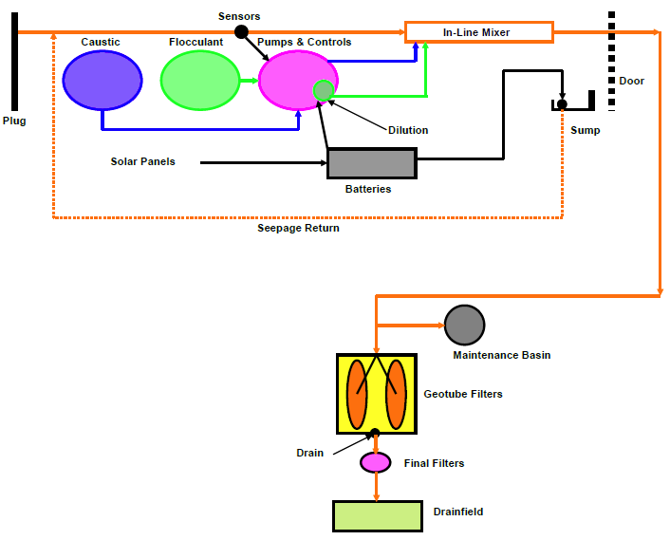
Flowsheet

Slide 19
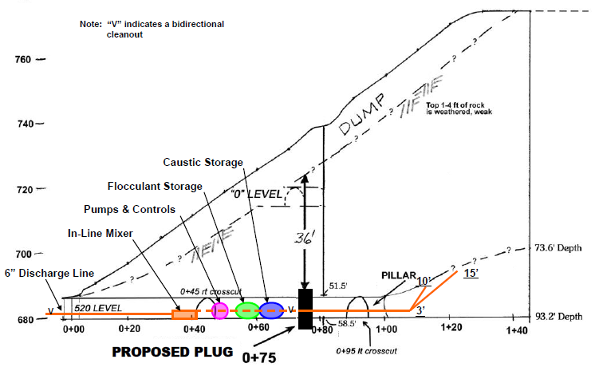
In-Adit Design

Slide 20
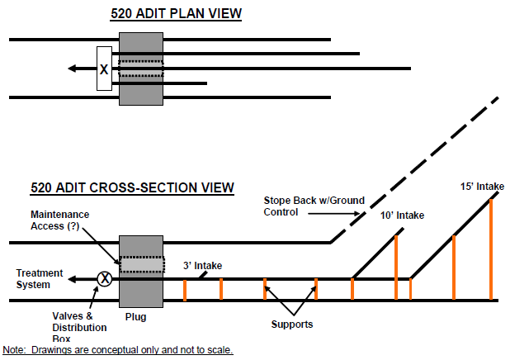
Pipe Detail

Slide 21
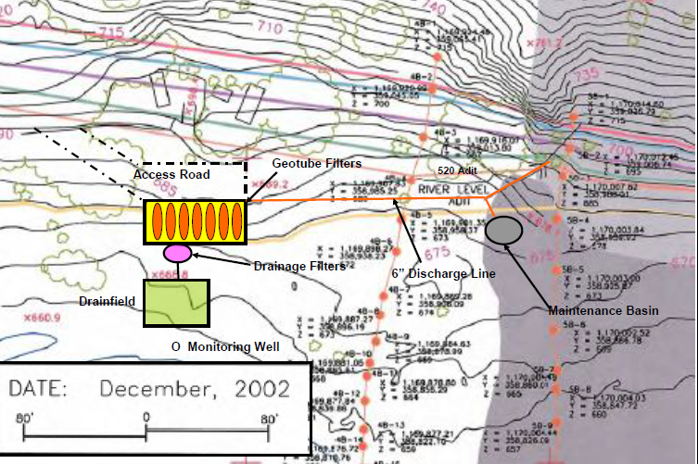
Surface Plan View

Slide 22
COSTS
Capital Cost = $1,900,000
Five Year Capital & Operating Cost = $2,828,000

Slide 23
Closing
More treatment/pilot tests are needed!
This can be phased in!
This is just one more wrench in the ARD remedial toolbox!

Slide 24
Comments? Questions? Sticker Shock?

