Slide 1

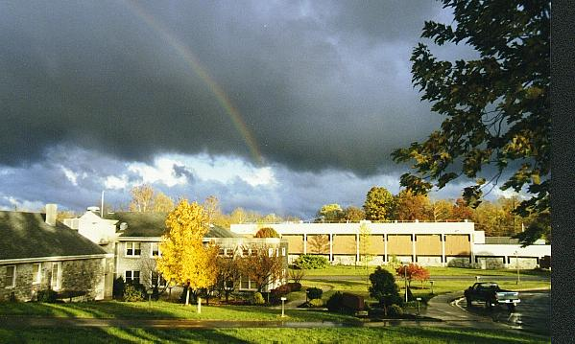
Using Acid Mine Drainage Sludge to Remove Phosphorus and Other Metal Oxyanions from Waste Water
P. L. Sibrell
USGS Leetown Science Center, Kearneysville, WV 25430
U.S. Department of the Interior
U.S. Geological Survey

Slide 2
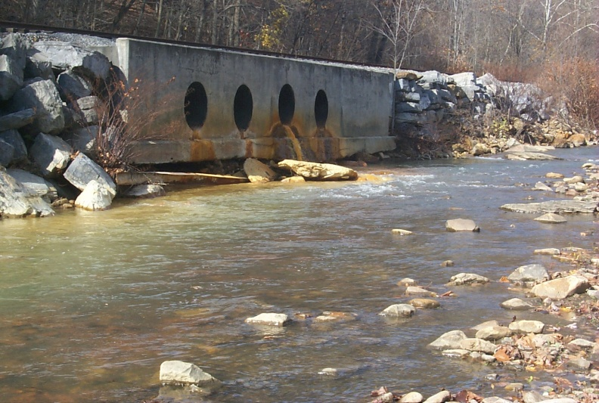
Problem #1 – Acid Mine Drainage
Pyrite + Air + Water →AMD
FeS₂ + 7/2O₂ + H₂O → Fe²⁺ + 2SO₄²⁻ + 2H⁺
Fe²⁺ + 1/4O₂ + H⁺ → Fe³⁺ + ½H₂O
Fe³⁺ + 3H₂O → Fe(OH)₃ + 3H⁺
FeS₂ + 14Fe³⁺ + 8H₂O → 15Fe²⁺ + 2SO₄²⁻ + 16H⁺
St Georges River,
Western Maryland

Slide 3

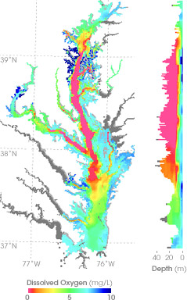
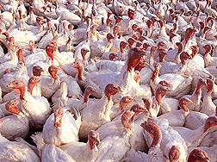
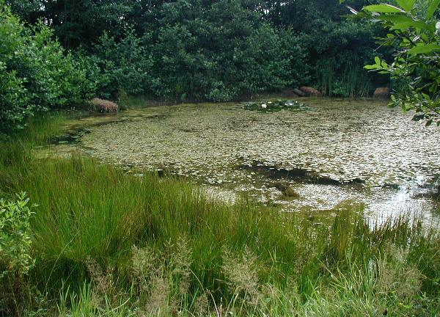
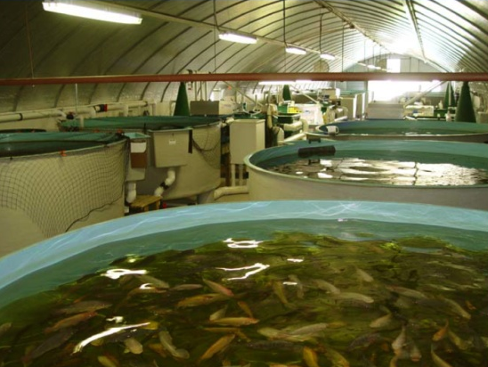
Problem #2 – Excess Nutrients
Animal feeding
operations
Anoxic dead
zones
Eutrophication

Slide 4
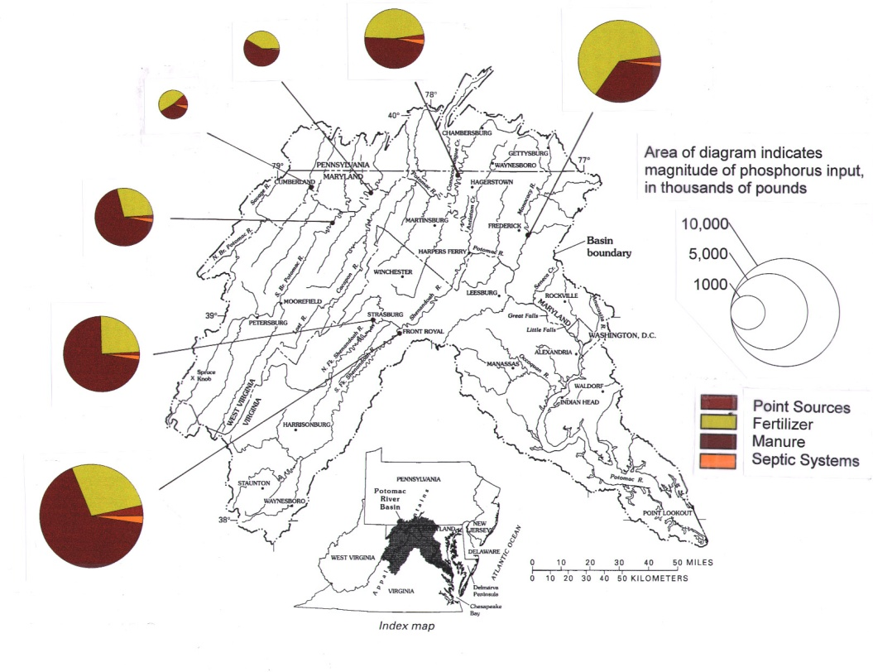
AMD and P Sources Overlap Geographically
Over 1000 tons of P input
to Chesapeake per year
from Potomac watershed
(From Water-Quality Assessment of the
Potomac River Basin. 1996. USGS Water
Resources Investigations Report 95-4221.)
Over 5000 stream miles
Impacted by AMD in the
Appalachian region alone
(From AMD: A Citizen’s Introduction. 1995.
U.S. EPA and the Pennsylvania Organization
for Watersheds and Rivers.)

Slide 5
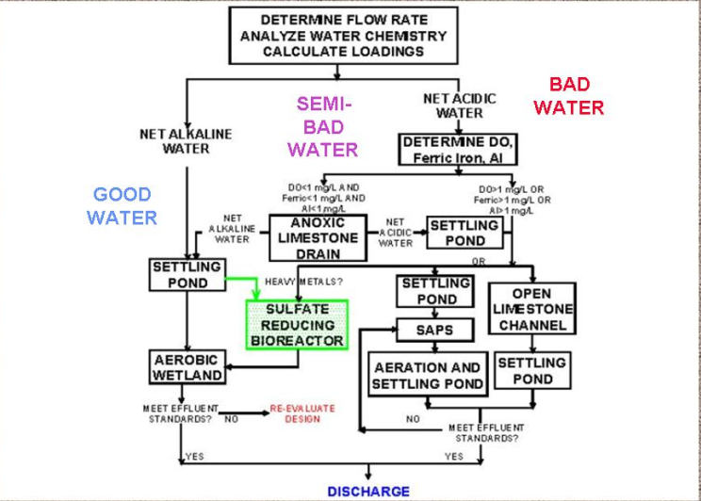
Treating AMD:
You Always Get Sludge…
AMD treatment flowsheet from Hedin, as modified by Gusek

Slide 6
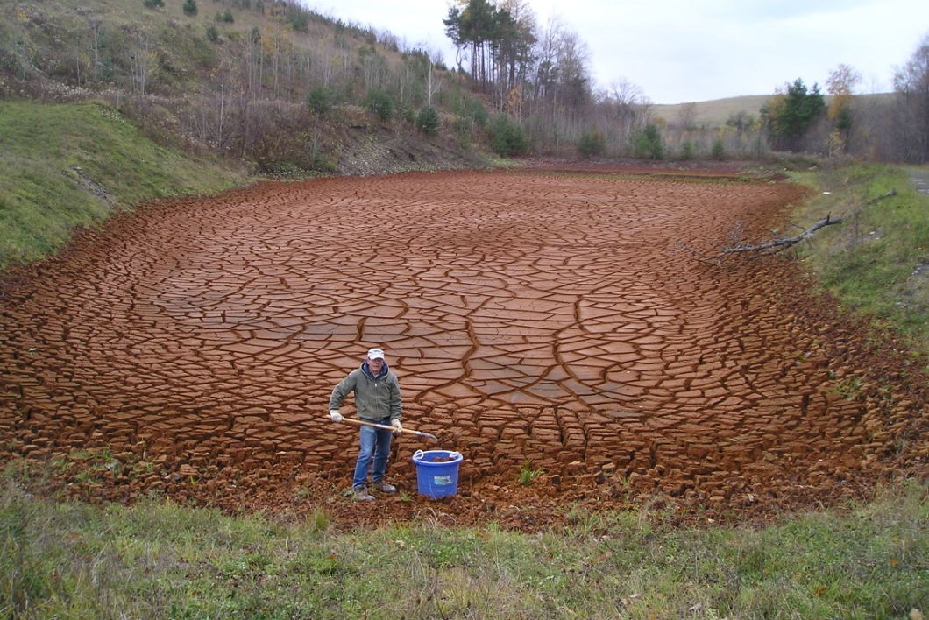
… And There’s Lots of it Out There

Slide 7
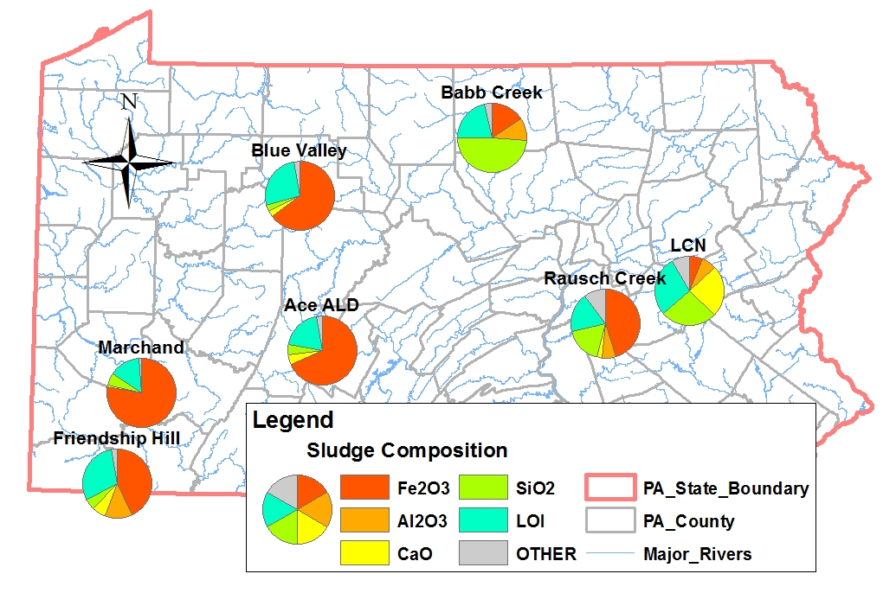
What’s in the sludge?

Slide 8
Sludge Trace Elements

Slide 9
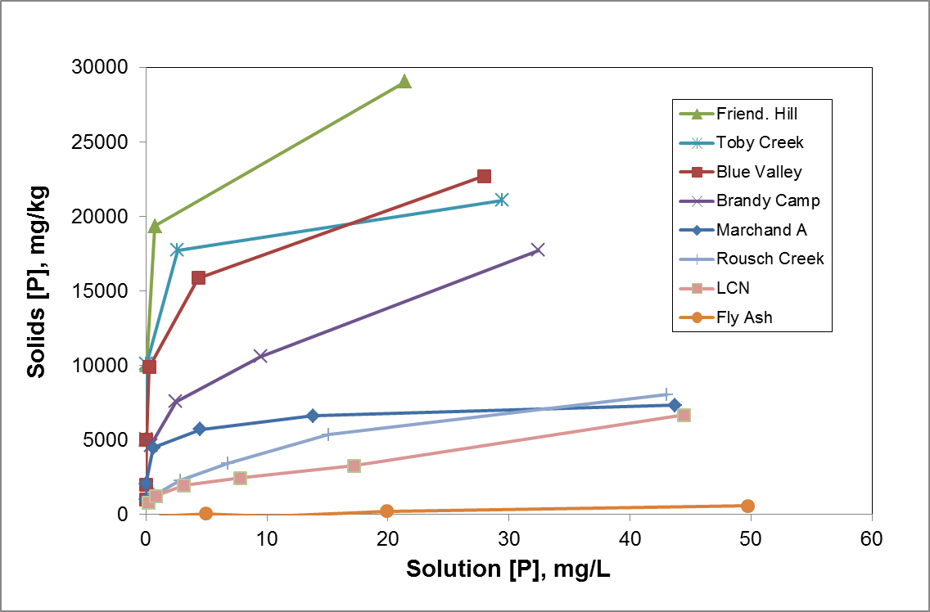
AMD Sludges Adsorb P to Varying Degrees

Slide 10
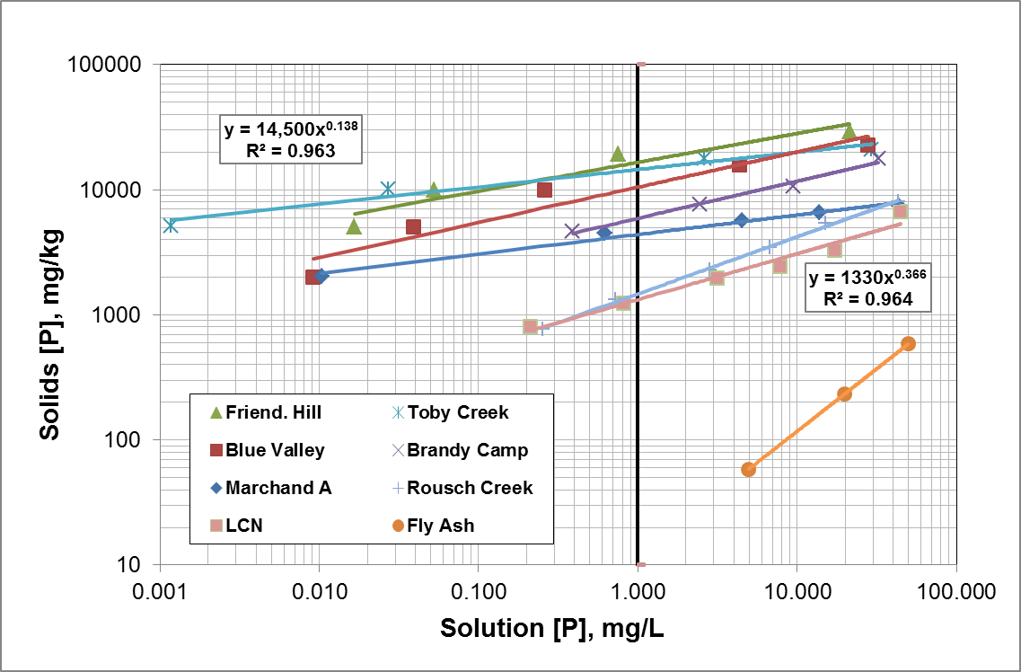
Sorption Isotherms – Log Scale

Slide 11
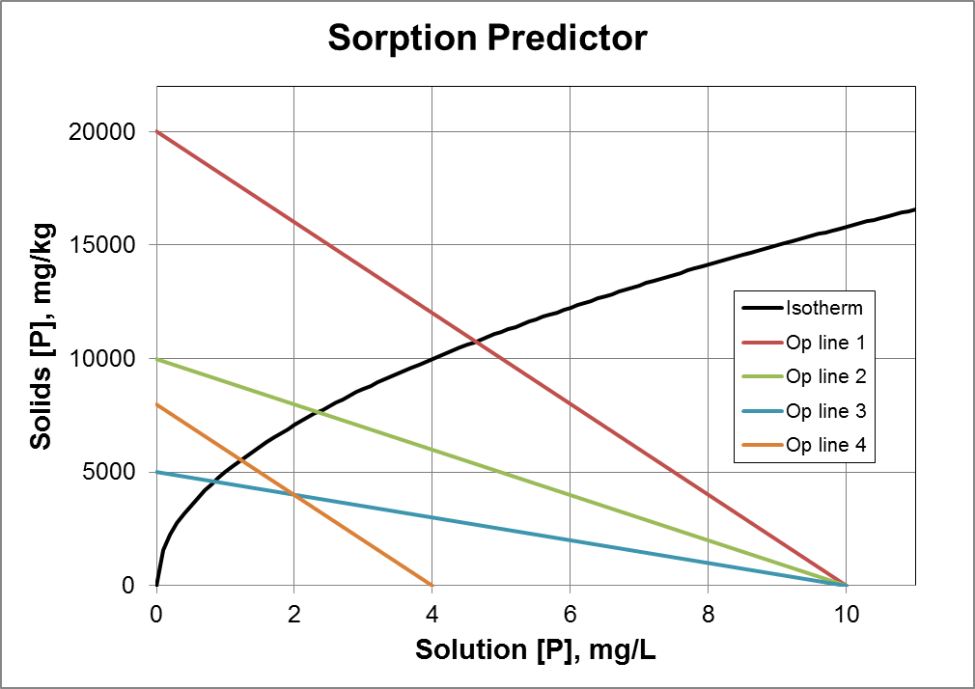
How is the Isotherm Useful?

Slide 12
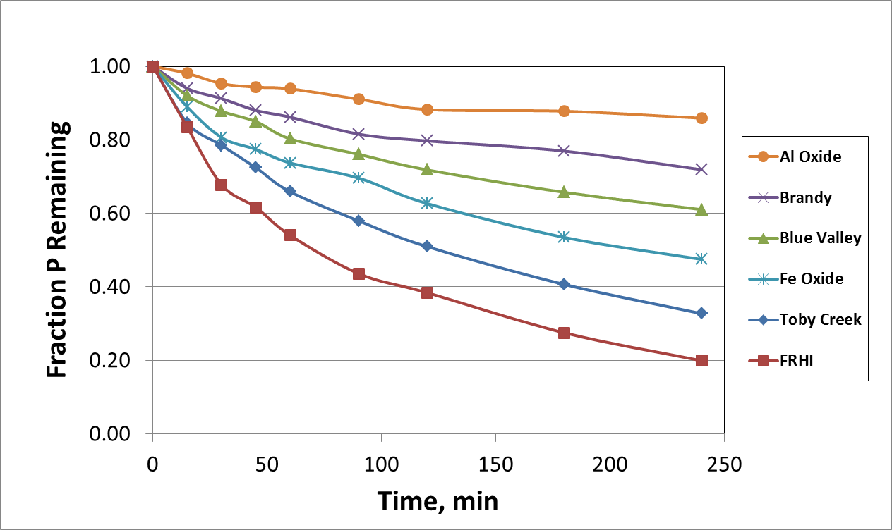
The Rate of P Removal from Water is Important, too.

Slide 13
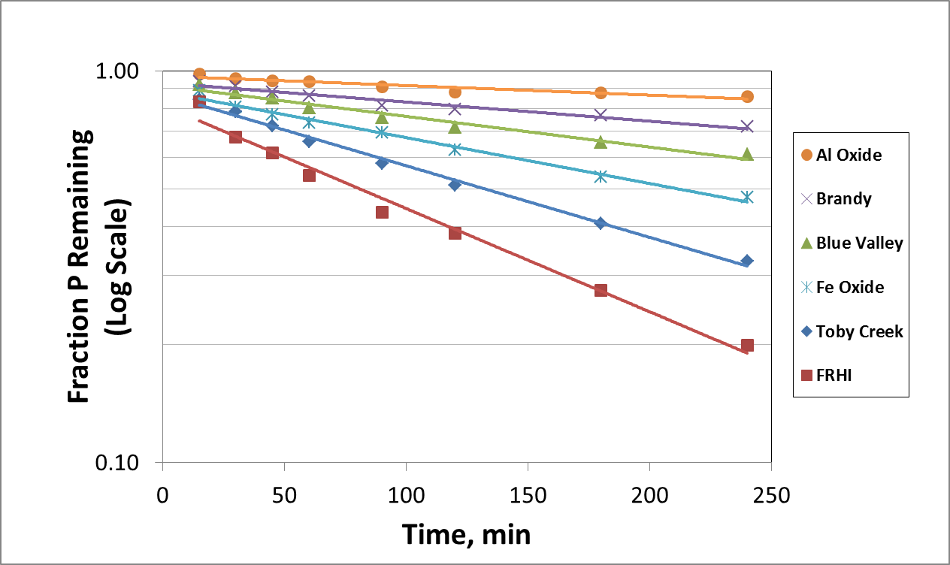
First Order Kinetics Plots

Slide 14
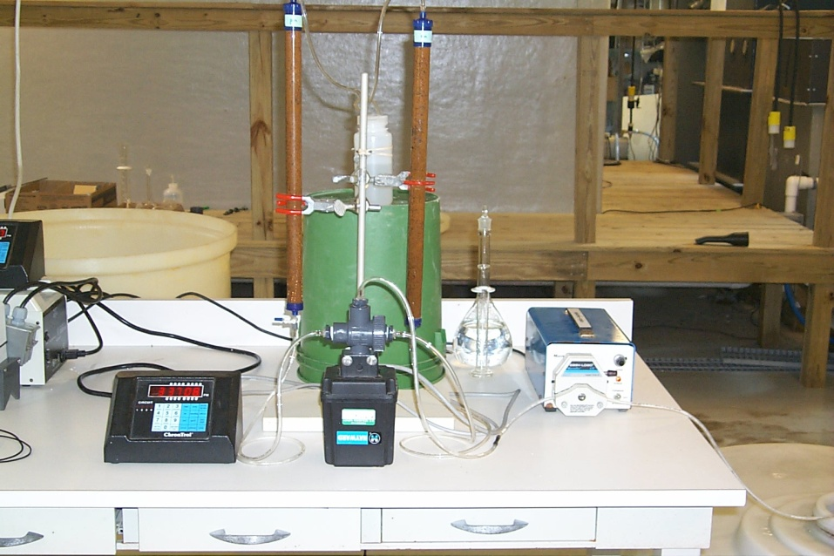
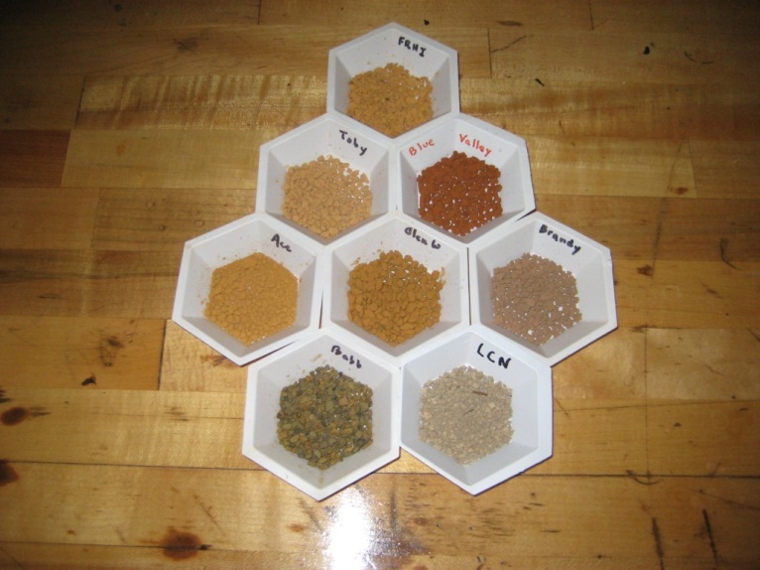
Water Treatment Method-
Fixed Bed Sorption of P

Slide 15
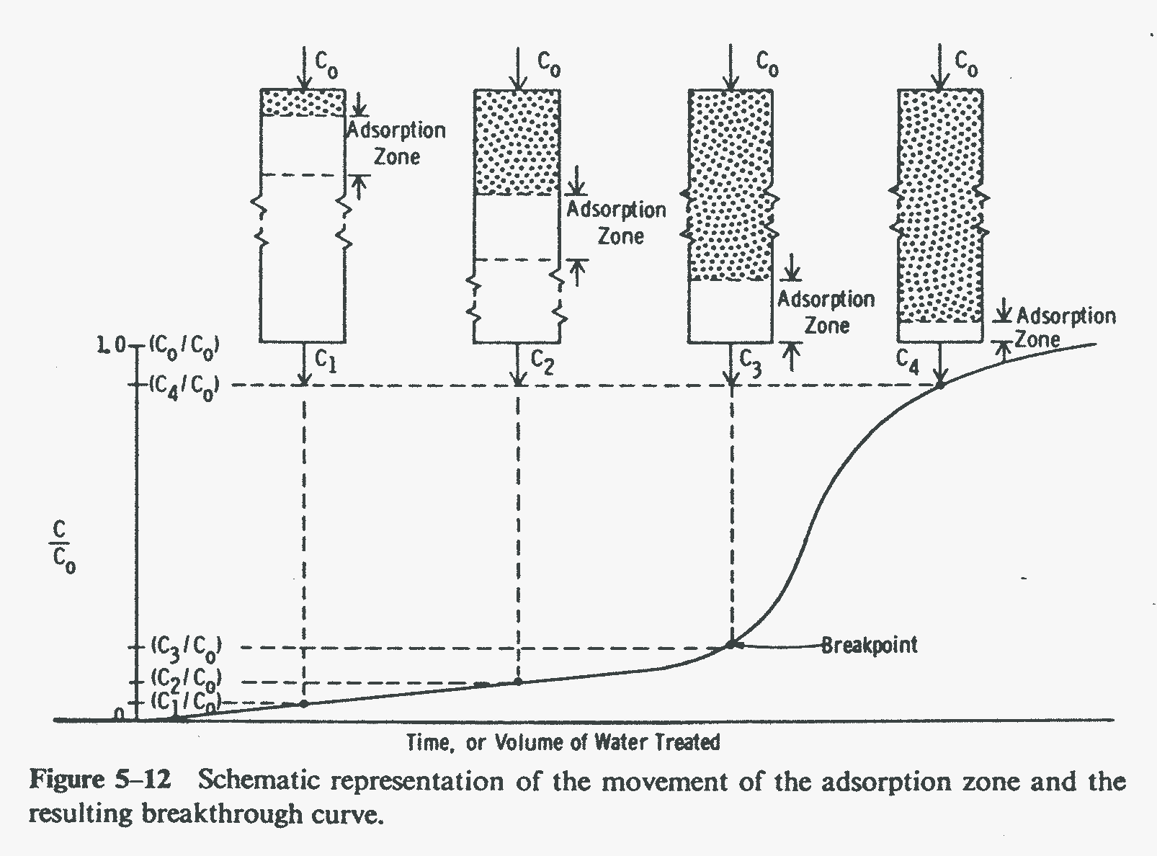
Understanding the Break- through Curve
Weber, W. J., Jr., 1972, Physicochemical Processes for Water Quality
Control, Wiley Interscience, New York, NY, p. 244.

Slide 16
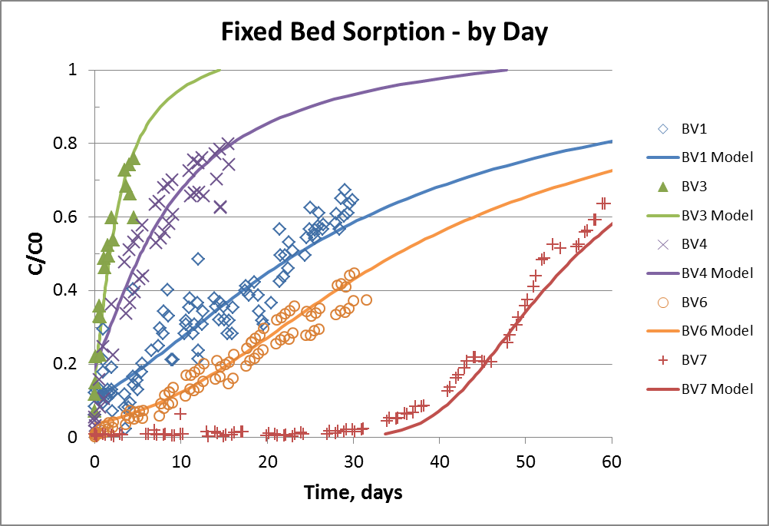
Modeling the Break-through Curve

Slide 17
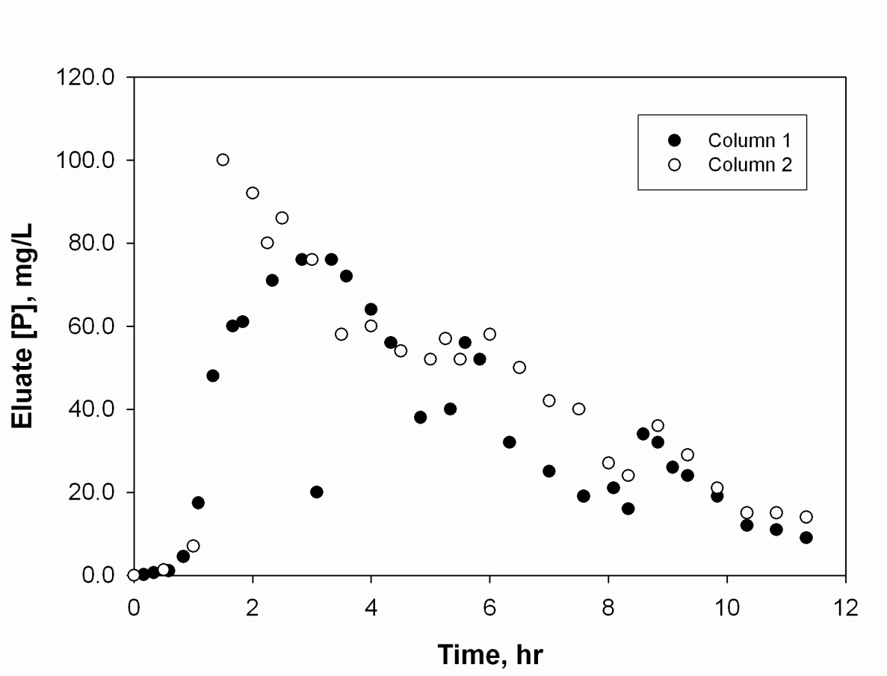
The Media Can Be Stripped and Reused…
Strip solution removed 76% of P, and concentrated it
up to 1000-fold

Slide 18
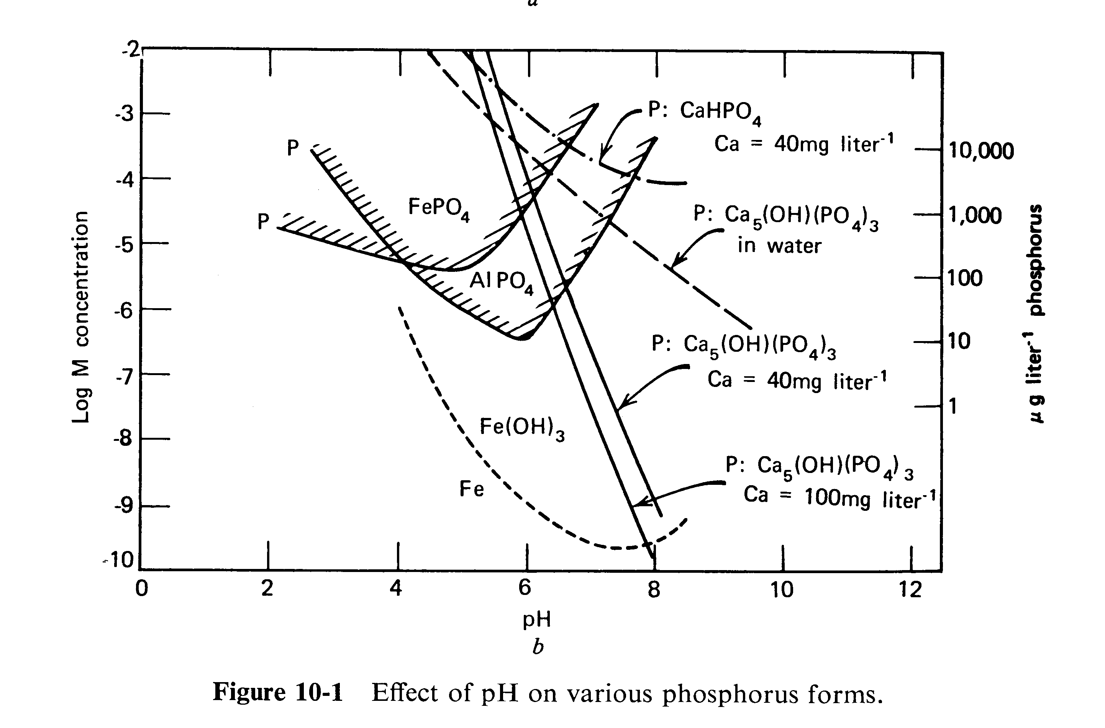
…P can be Precipitated…
Stumm and Morgan, Aquatic Chemistry, 3rd. Ed, 1996.

Slide 19
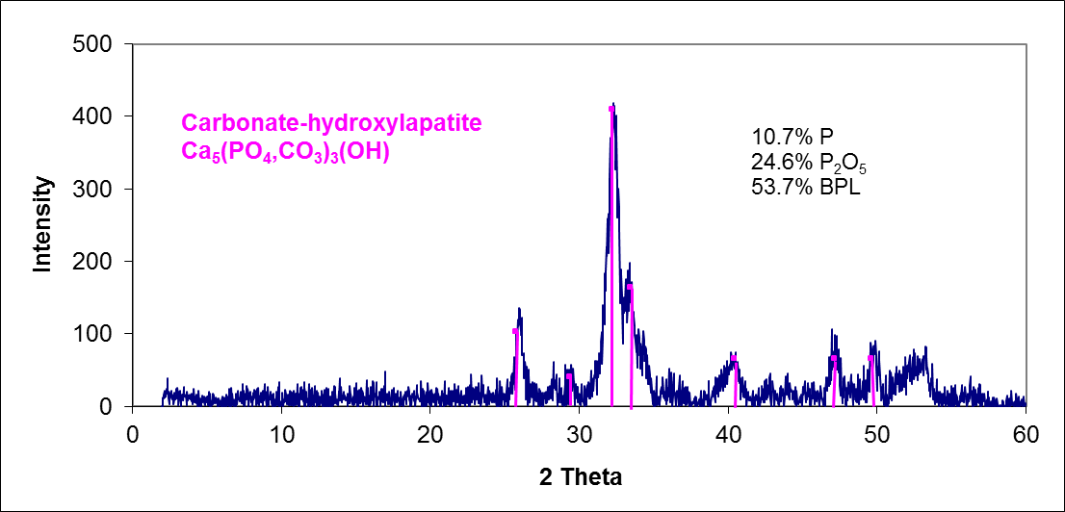
…and the P Recycle Loop can be Closed
10.7 %P
24.6 %P2O5
53.7 % BPL

Slide 20
What About Water Contamination?

Slide 21
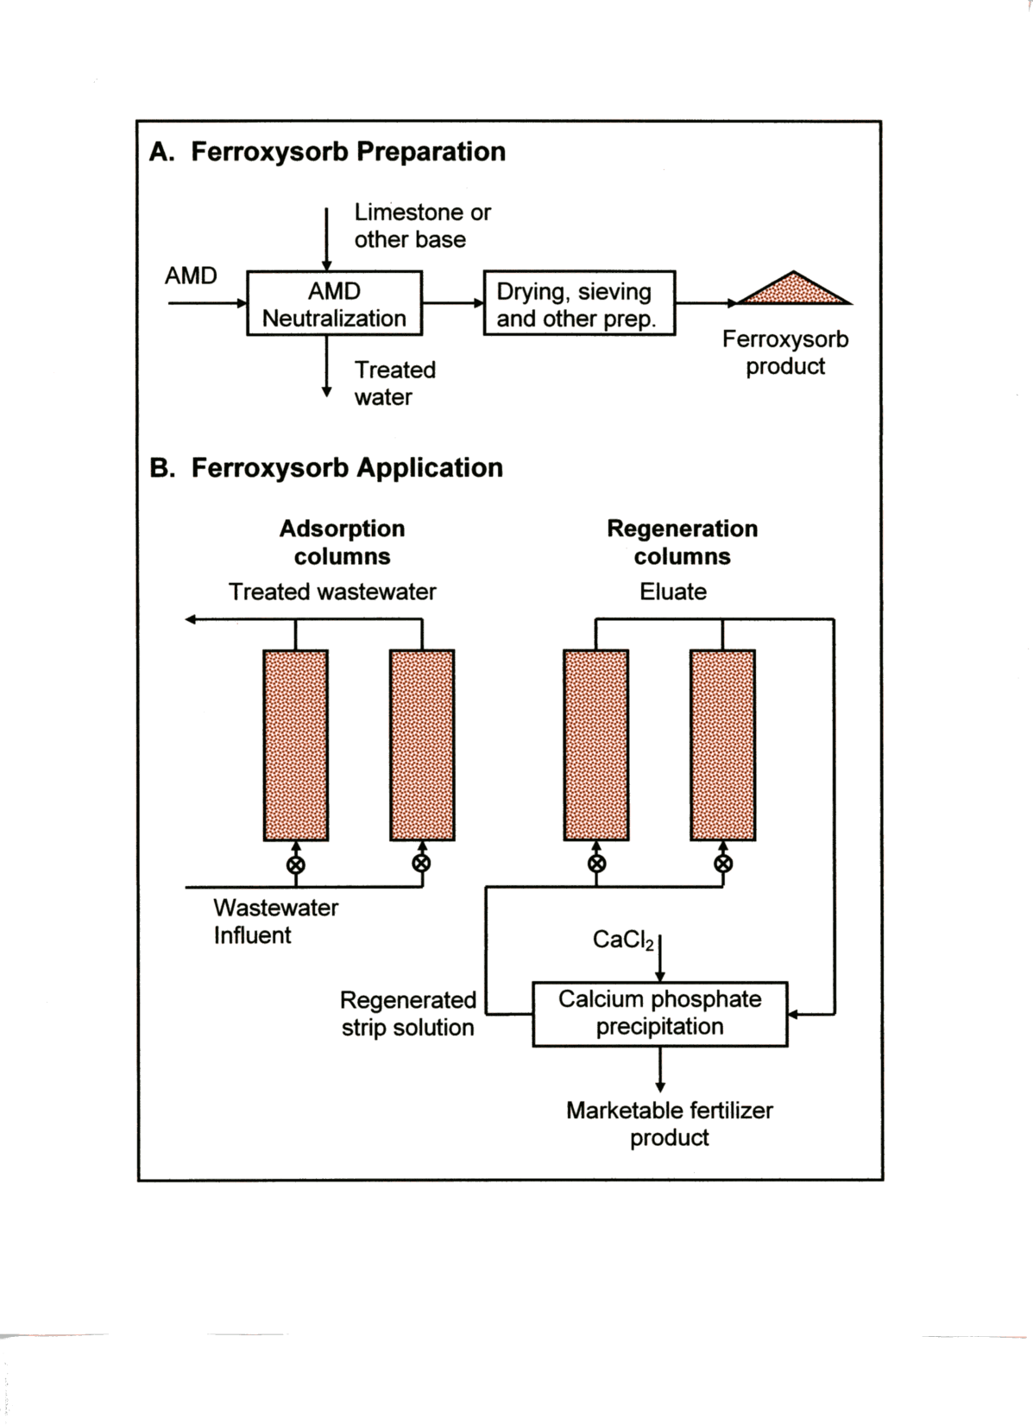
Schematic Flowsheet for the Production and Use of Ferroxysorb
P Sorption Media

Slide 22
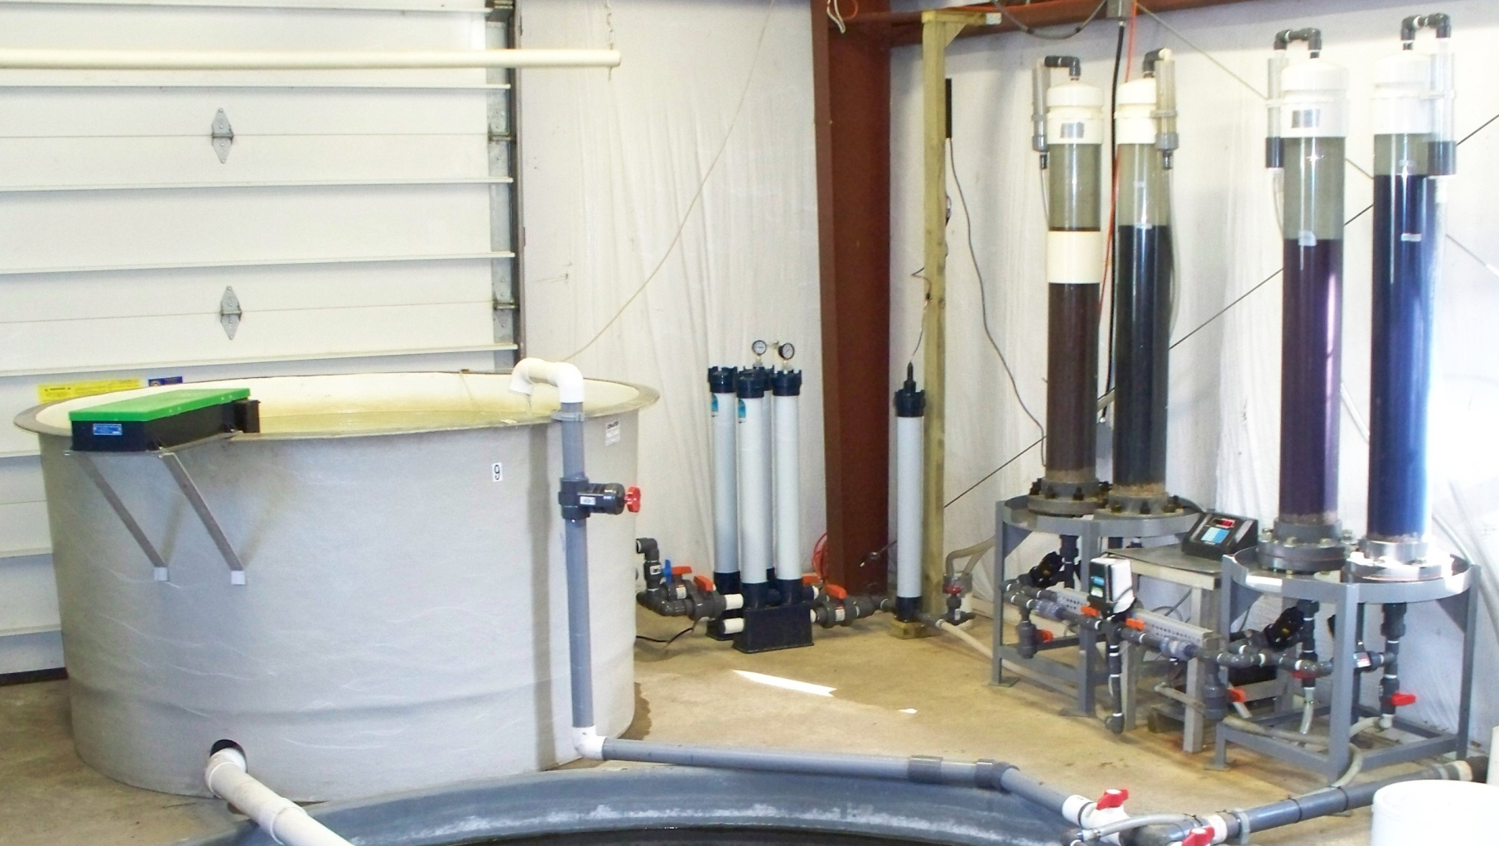
Field Trial at USFWS Northeast Fishery Center, Lamar, PA

Slide 23
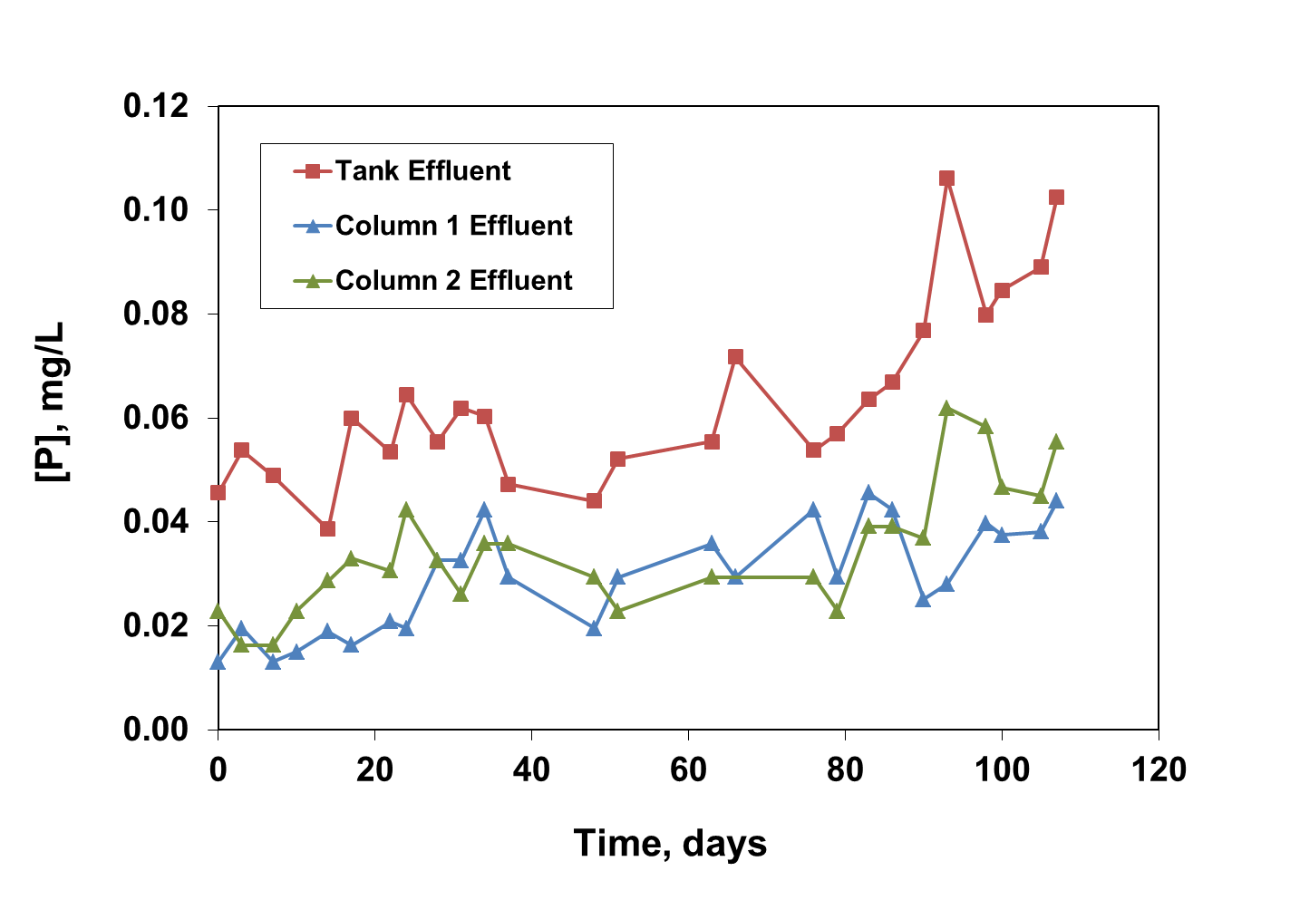
Field Trial, Phase I

Slide 24
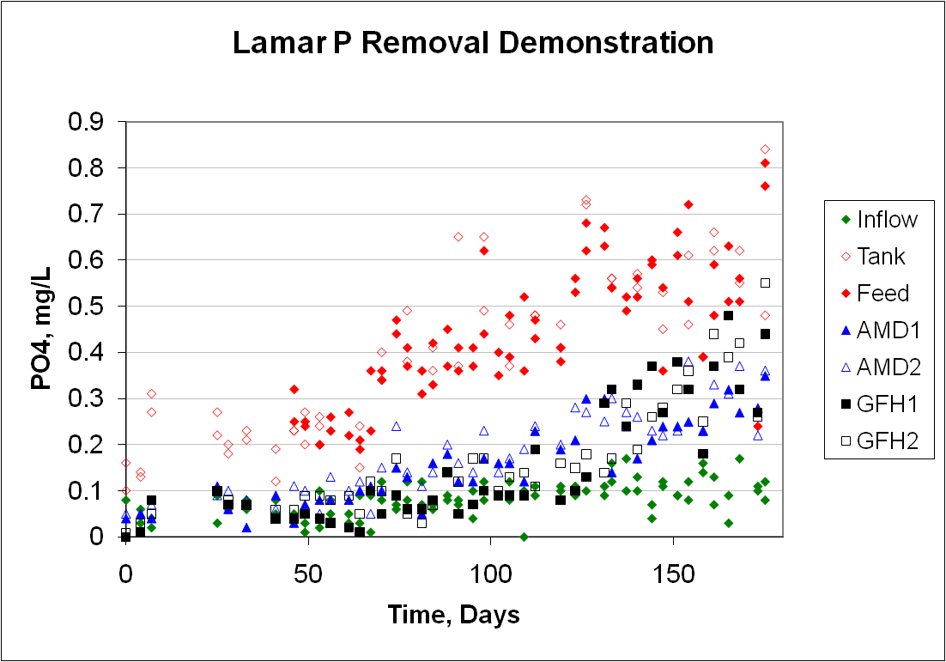
Field Trial, Phase II

Slide 25
What About Other Species
Besides P?
Data generated in cooperation with L. Twidwell, Montana Tech

Slide 26
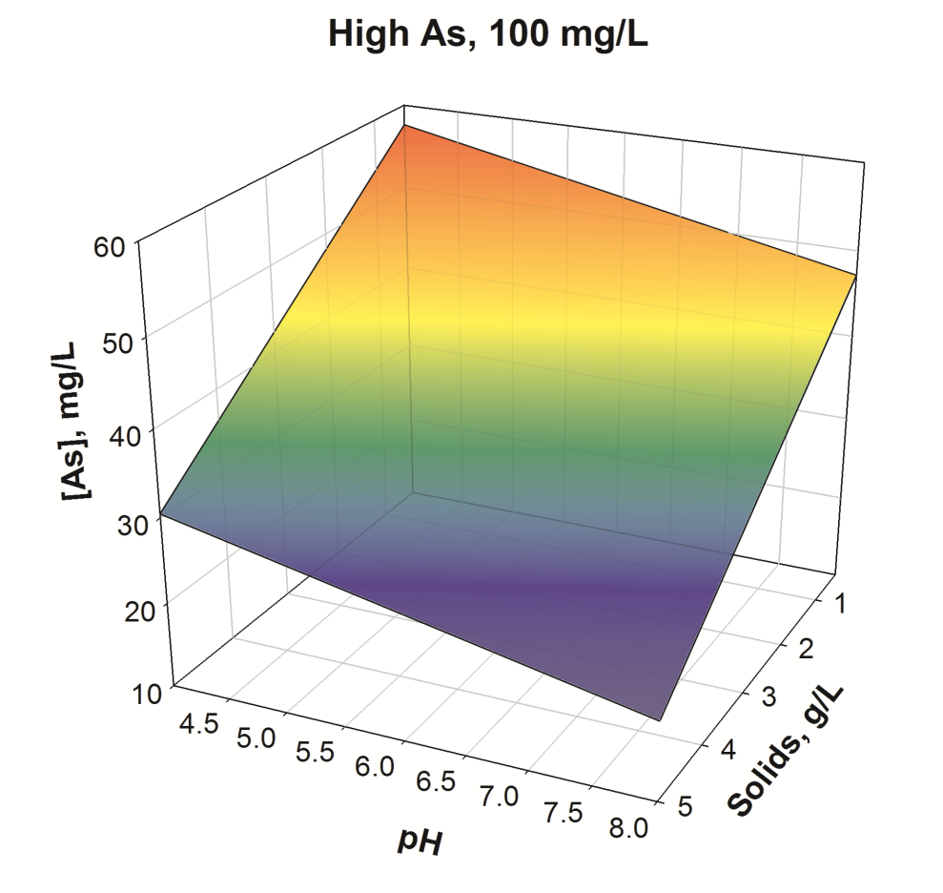
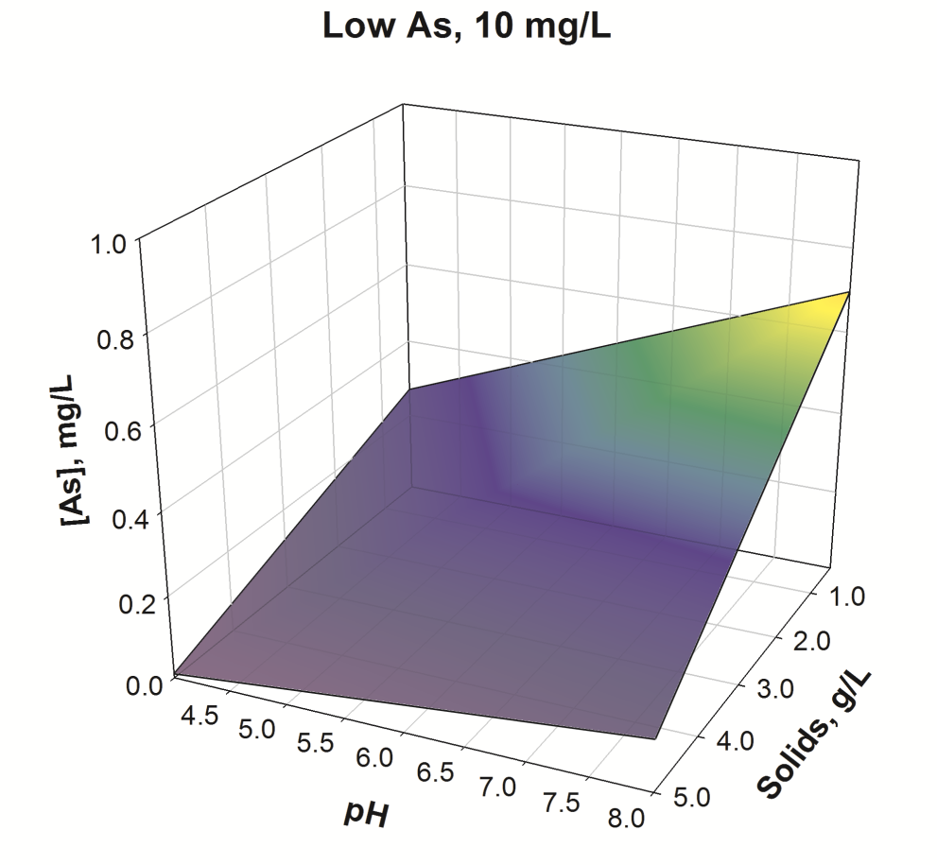
Visualizing As Sorption

Slide 27

Bottom Line
Laboratory and field test results have demonstrated that solid Fe/Al oxide media prepared from mine drainage residuals can be used as an effective and economical sorbent for the removal of P and As from wastewaters.

