Slide 1




Soil Treatment at the California Gulch NPL Site for Vegetation Reestablishment and Mitigation of Metal Mobility
Stuart Jennings, RRG, Jan Christner, URS
Mike Holmes, EPA and John DeAngelis, PWT

Slide 2
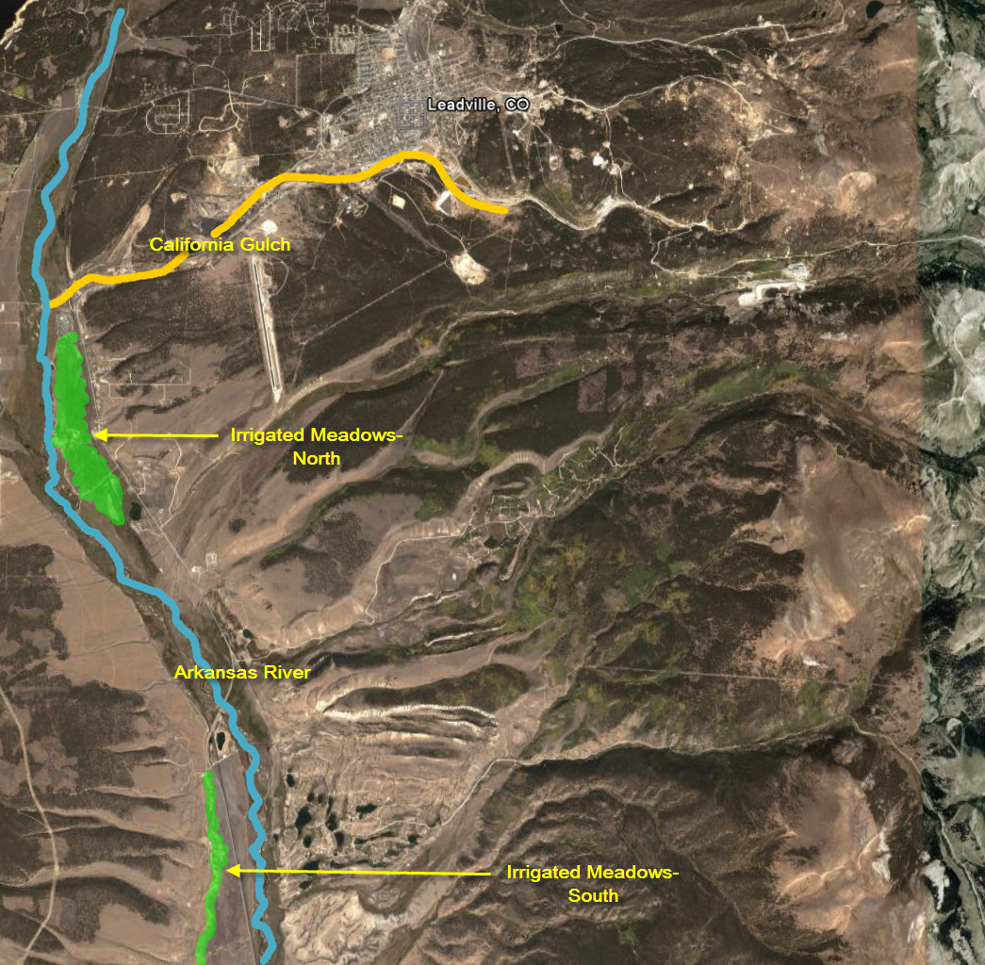
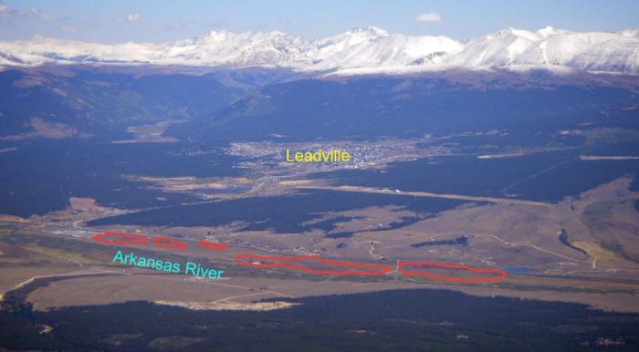
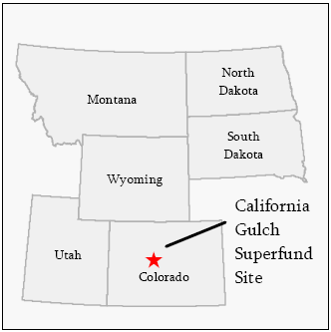
Operable Unit 11 of the California Gulch Superfund Site near Leadville, CO

Slide 3
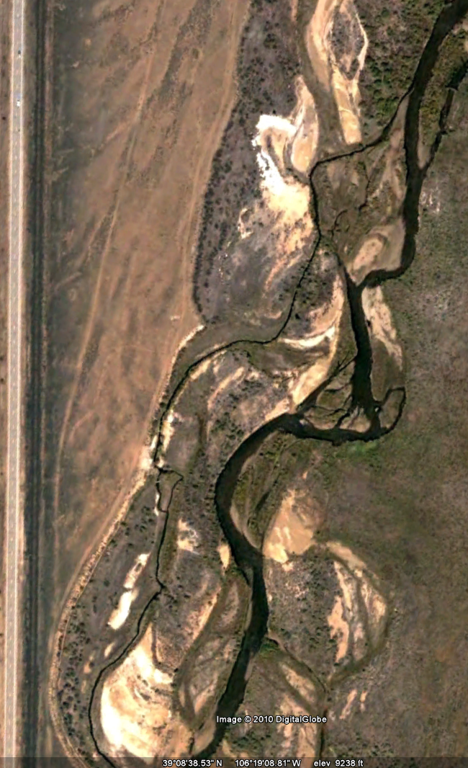
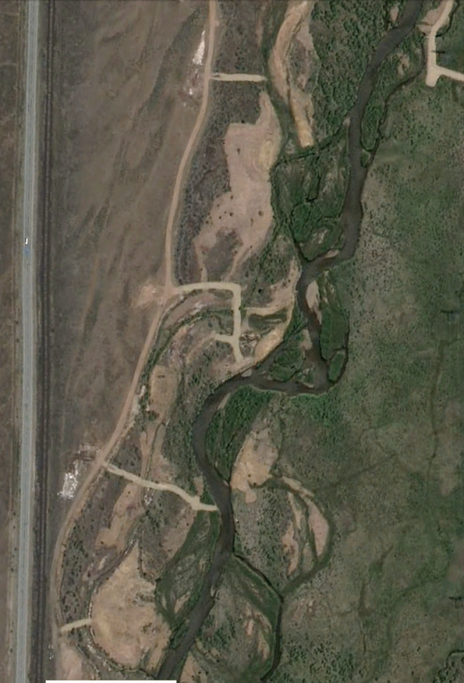
Pre-Treatment (~2008)
Post Treatment (~2010)

Slide 4
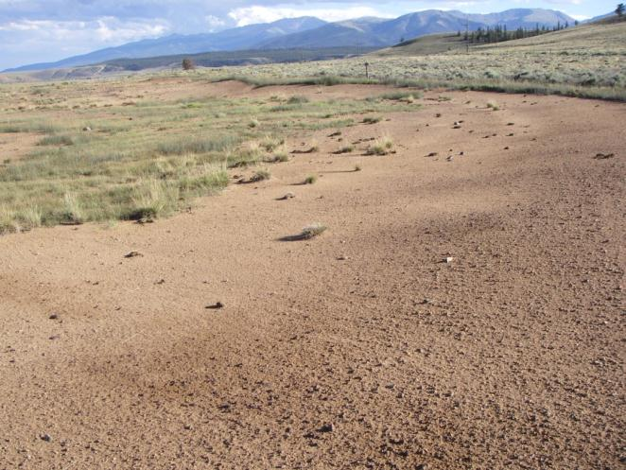
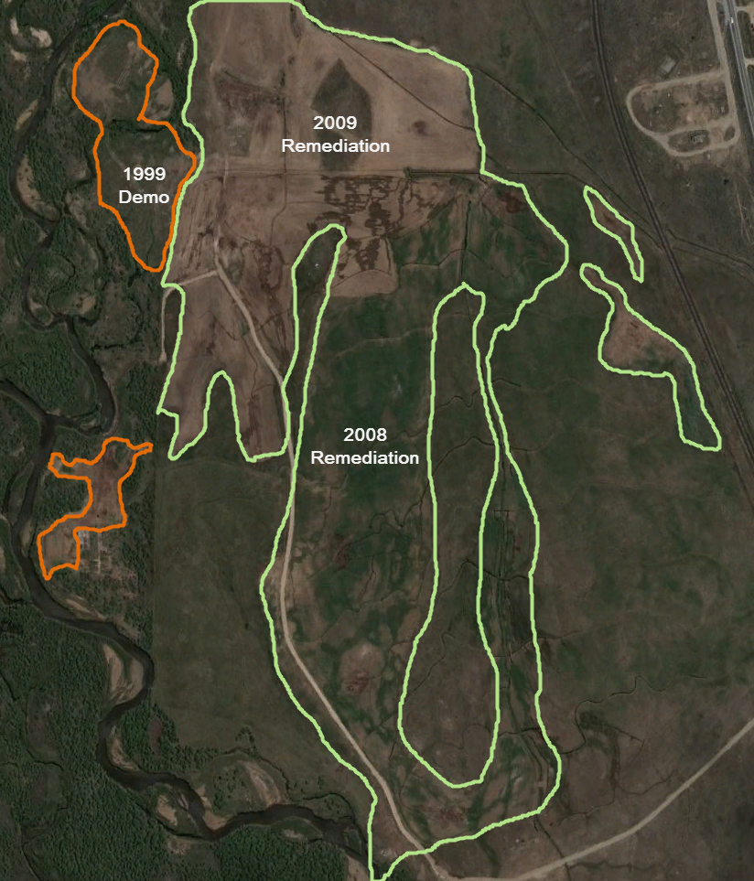
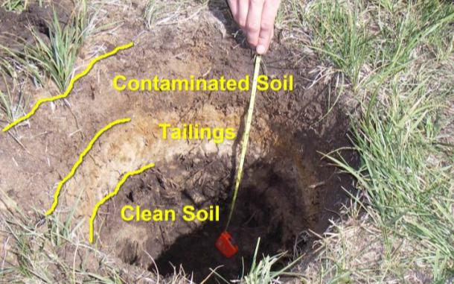
Irrigated Meadows
Before remediation
After remediation
Notes:
Arrow is provided for reference—the same spot in both photos

Slide 5
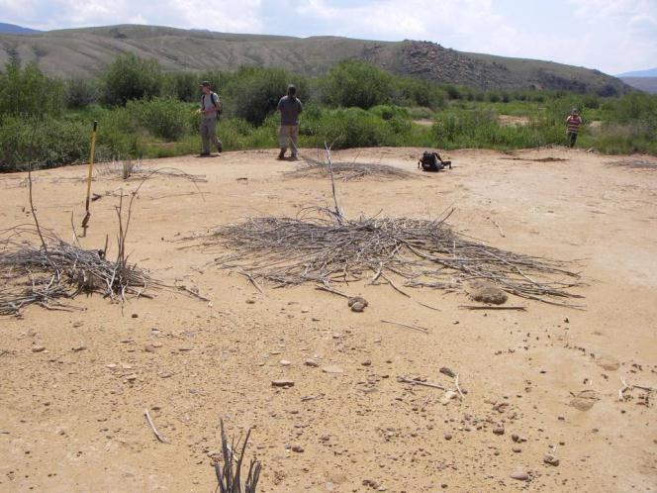
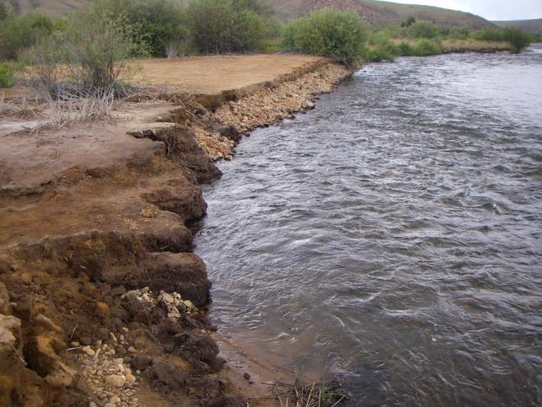
Arkansas River Fluvial Tailing Areas
Fluvial Tailing Deposits
Unstable Streambanks

Slide 6
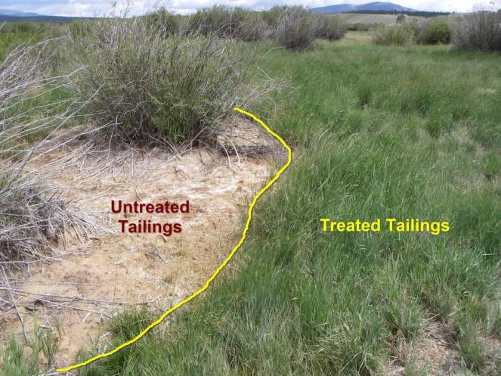
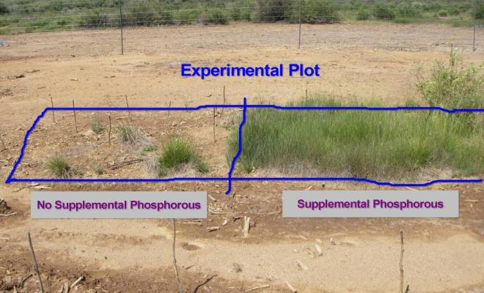
Prior Research and Demonstration Work
1999 EPA Demonstration
University Research
CSU Revegetation Research
Kevin Fisher, MS 1999
Joe Brummer, principal investigator
Harry Compton (EPA), Mark Sprenger, (EPA), Sally Brown (USDA/UW), Mike Zimmerman (EPA), Jan Christner (URS)
Notes:
Lime and no-lime differences shown in left photo, Low and High phosphorous amendment shown in right photo

Slide 7
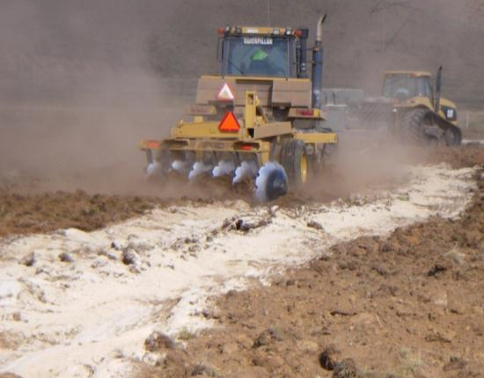
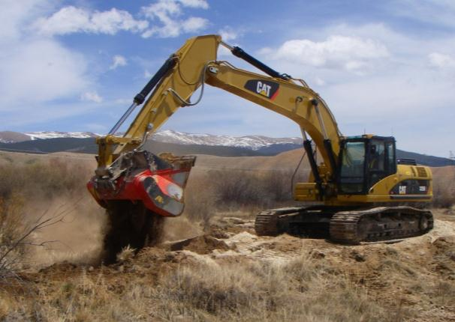
Two Treatment Strategies
Irrigated Meadow Contamination
Fluvial Tailing Deposits
153 acres treated to either 6 or 12 inch depth using a tractor-pulled plow
Thin deposits of relatively uniform depth
18 acres treated with an excavator-mounted soil mixer
Thick deposits of varying depths within the floodplain
Notes:
The amendment rates will vary by type and probably within each type. While the overall approach is similar—using soil amendments mixed into the contaminated media—each approach will be unique and adapted to the specific site reflecting soil rock content, depth to groundwater, soil pH, lime requirement, proximity to streambanks, presence or absence of existing woody vegetation, post-treatment land use, etc.

Slide 8
Remedial Action Objectives
Minimize future human exposures
Minimize erosion
Control leaching and migration of metals
Reduce toxins in plants
Reduce metal exposures of wildlife and livestock
Remedial Timeline
1990’s-2006—Data Collection, Research, Demonstration
2007—Work plan
2008-2009—Construction
2010-present—Monitoring and maintenance

Slide 9
Soil Treatment
Approach
Expected Outcome
Add lime to control current and future acidity
Add organic amendment to serve as basis for long-term soil fertility/nutrient cycling
Add supplemental phosphorous
Treat entire contamination thickness
Seed
Monitor and maintain
Soil pH will remain between 7-8 and control soluble metals
Nutrient cycling will be perpetuated by soil organisms
Vegetation will not translocate harmful concentrations of contaminants into shoots
Water balance will be improved
  Reduced metal flux to groundwater
  Reduced runoff/reduced erosion
  Increased evapotranspiration
Conventional land uses will be restored (grazing and recreation)
Meet RAO’s and Performance Standards
Notes:
Mention companion poster related to performance standards

Slide 10
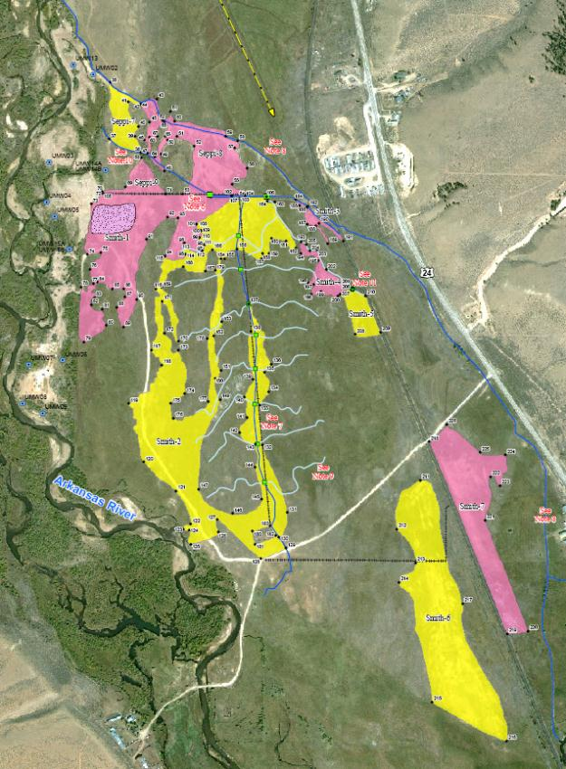
Soil Treatment Polygons—
Irrigated Meadows North
12-inch tillage --Pink coded polygons
6-inch tillage – Yellow coded polygons

Slide 11
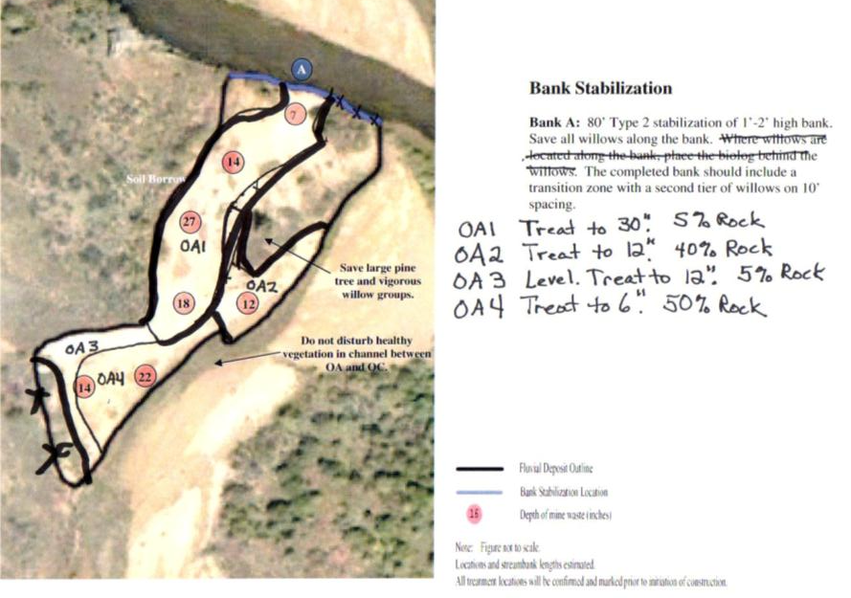
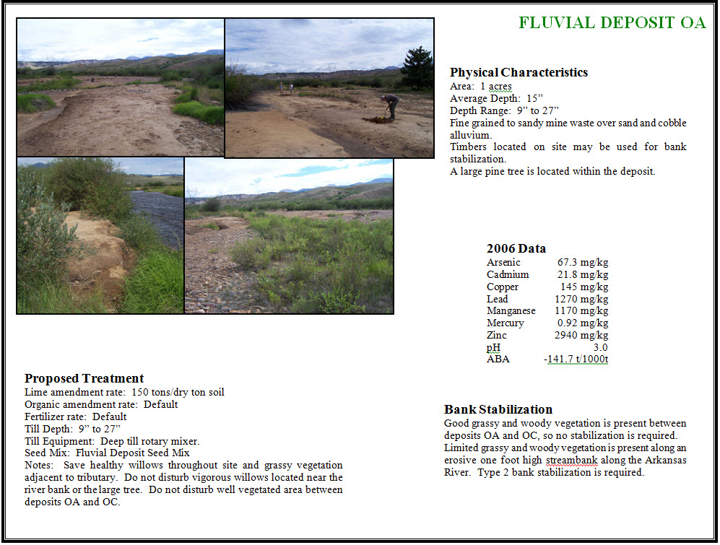

Slide 12
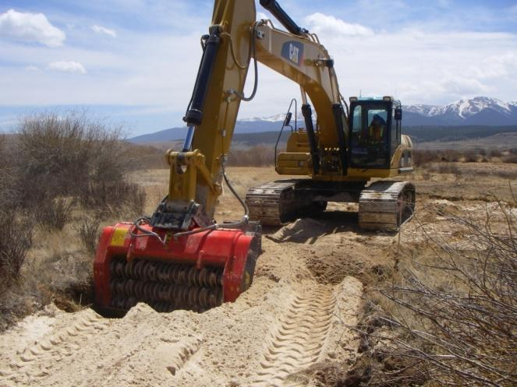
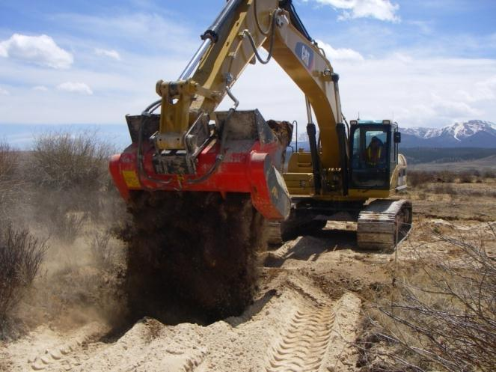
Lime Amendment Mixing into
Fluvial Tailing Deposits
Notes:
Poster Presentation on Project Construction

Slide 13
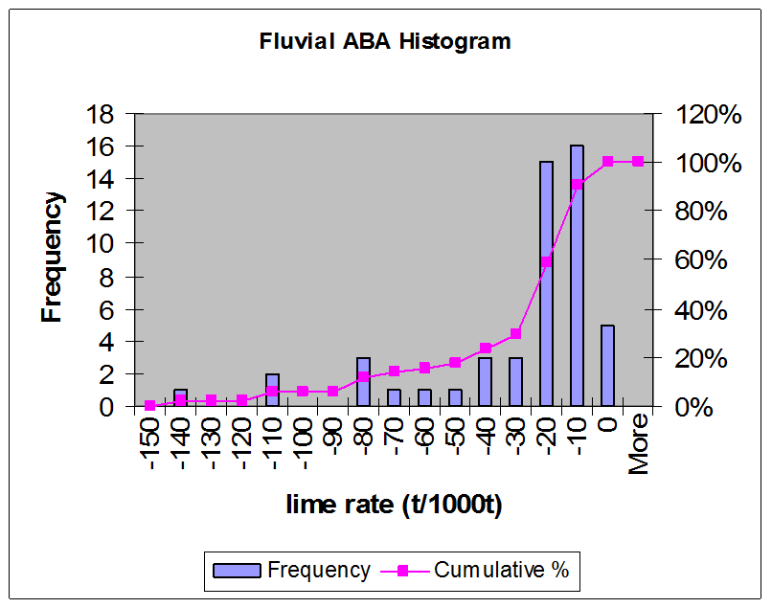
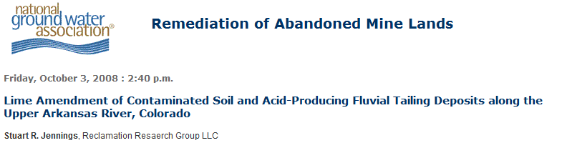
Lime Requirement for Soil Treatment

Slide 14
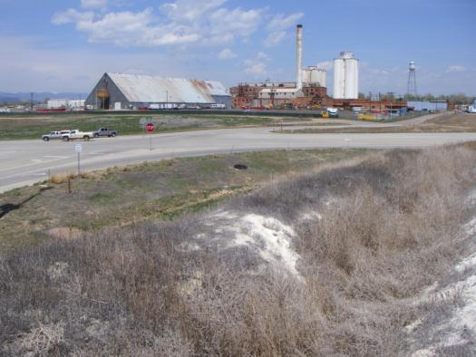
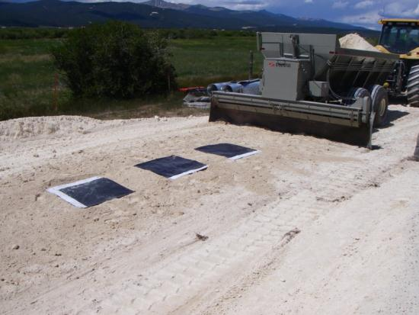
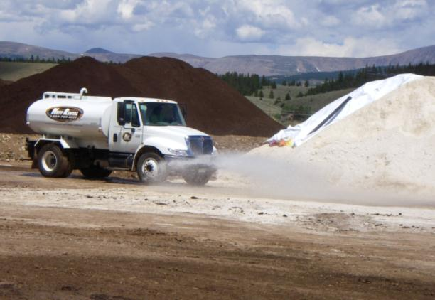
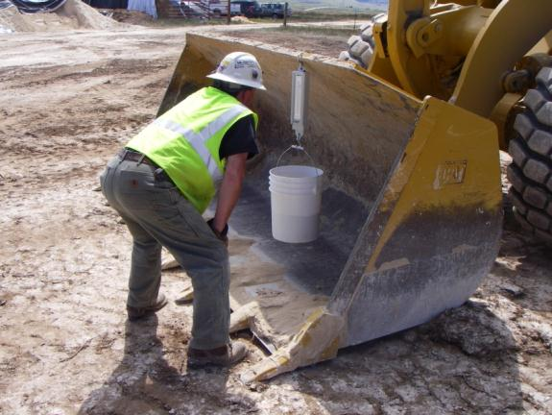
Sugar Beet Lime
13,000 tons used for project

Slide 15
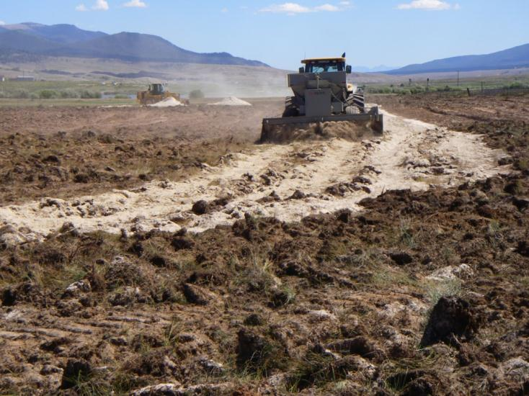
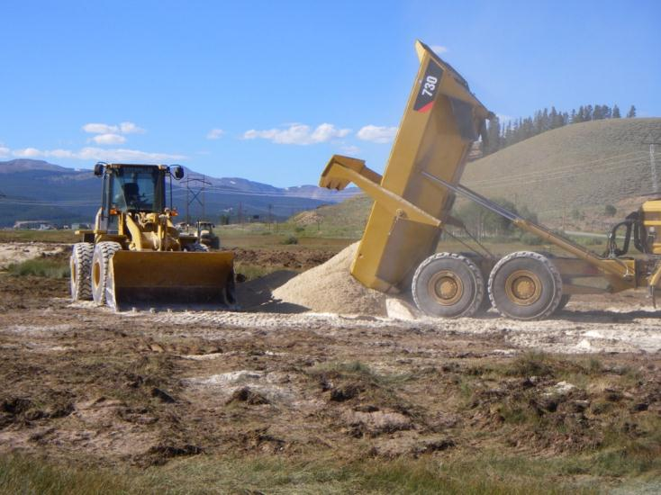
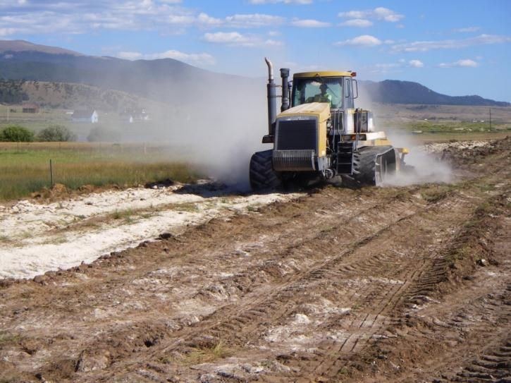
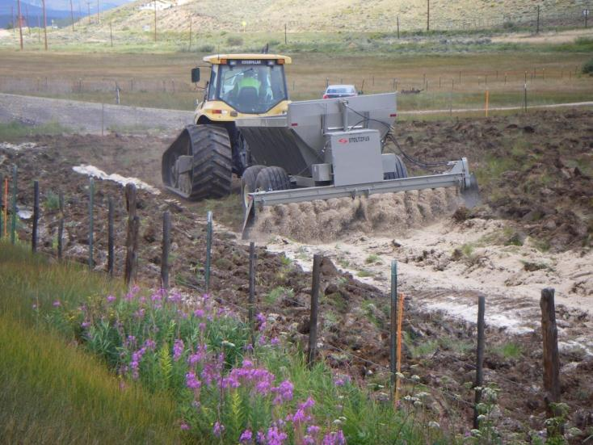

Slide 16
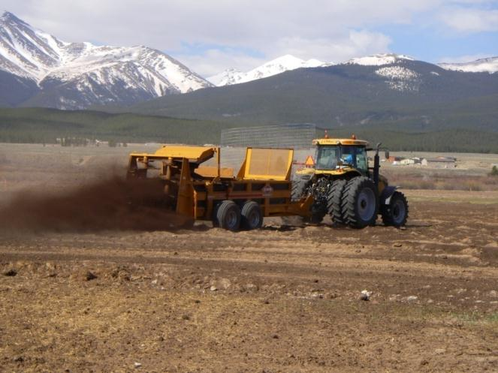
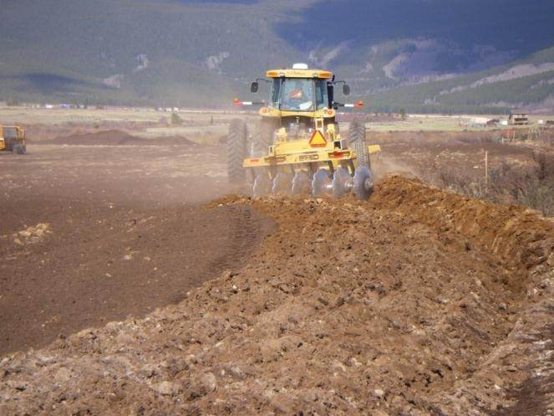
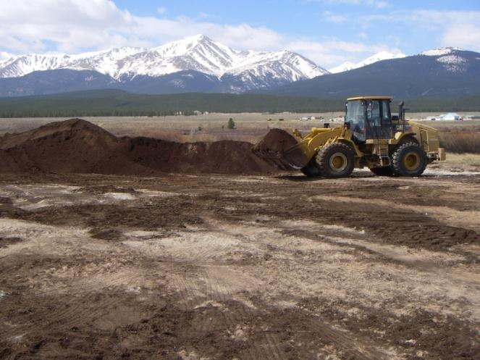
Compost Amendment
28,000 tons used for project (45,000 cy)

Slide 17
Soil Total Metal Levels (2011)
Post-Treatment
RESULTS
Elevate metal levels and essentially
unchanged from pre-treatment

Slide 18
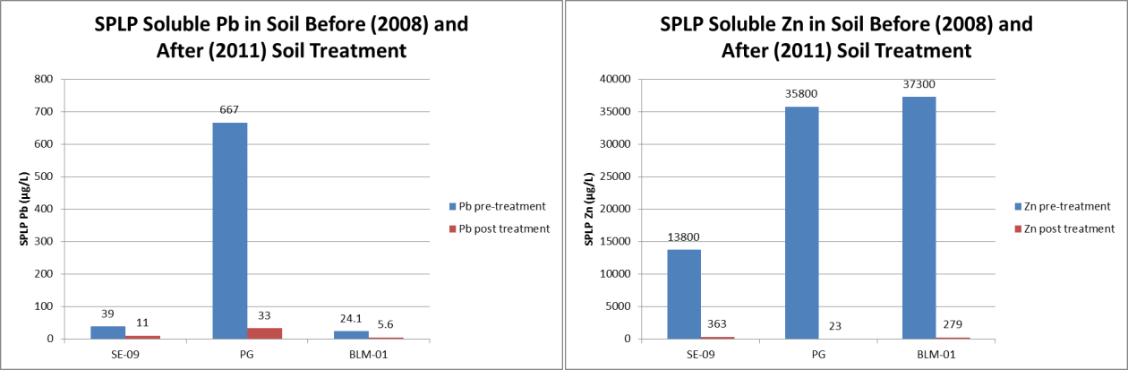
Changes in SPLP Soluble Metal Levels
Before and After Treatment
Post-Treatment Comparisons between Totals and Water Soluble levels | Pb | Zn
Water soluble as a percent of total | 0.022% | 0.065%
Total as a factor of soluble | 4588X | 1543X
Notes:
SPLP - Synthetic Precipitation Leaching Procedure
A prominent reduction in metal mobility after treatment

Slide 19
Soil Conditions
Soil pH and Electrical Conductivity
Soil Organic Matter
and Fertility
Acidic prior to treatment
Neutral to slightly alkaline following lime addition (7-8)
Soil solution dominated by metals prior to treatment
Soil solution dominated by alkaline cations and nutrients following treatment
Prior to treatment organic matter varied widely from near zero (bare areas) to adequate (sparse areas)
Prior to treatment plant macronutrients N/P/K were deficient in nearly all barren/sparsely vegetated areas
Following treatment adequate to abundant fertility levels were observed

Slide 20
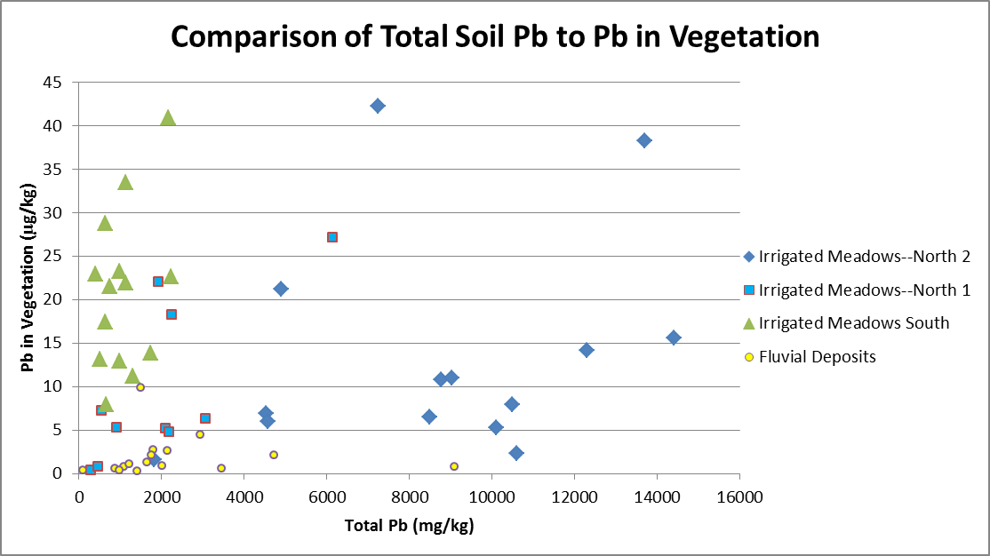
Lead levels in Vegetation
The amount of Pb in vegetation appears unrelated to total Pb in soil. Differences are apparent by site.

Slide 21
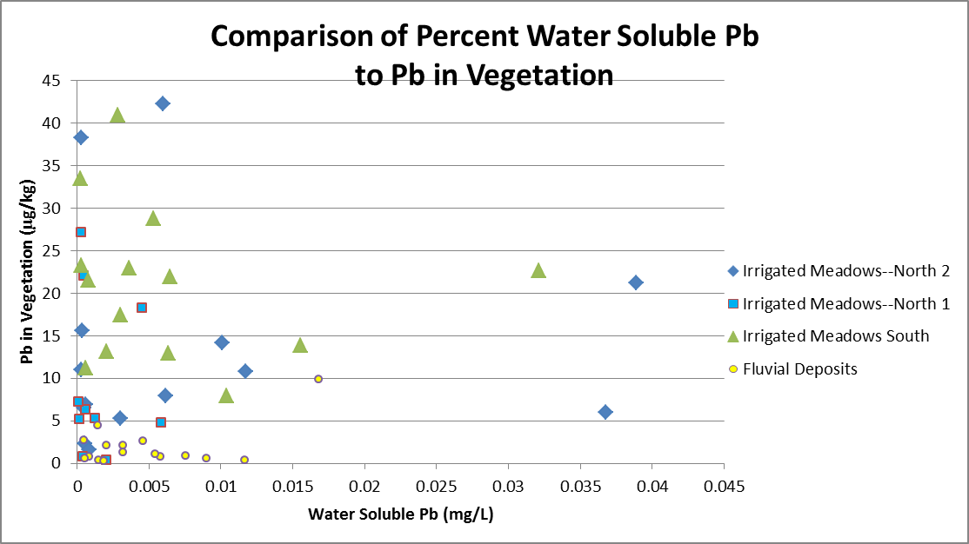
Lead levels in Vegetation
Water soluble Pb also appears to be a poor predictor of Pb in vegetation.

Slide 22
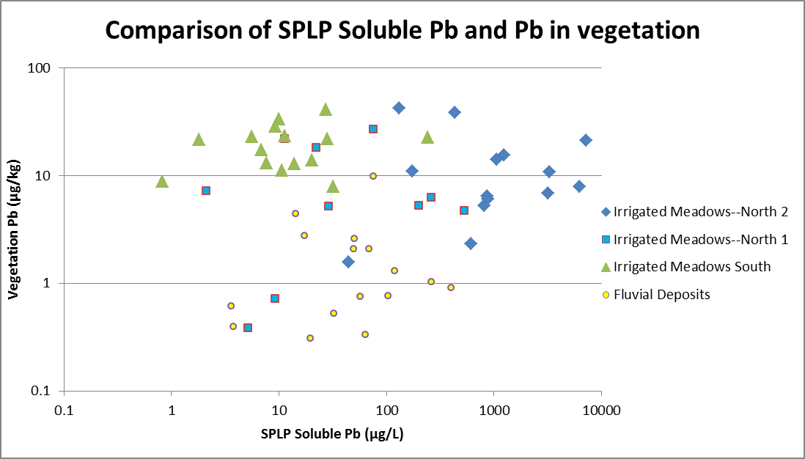
Lead levels in Vegetation
SPLP soluble Pb appears to provide good discrimination of Pb in vegetation by site location

Slide 23
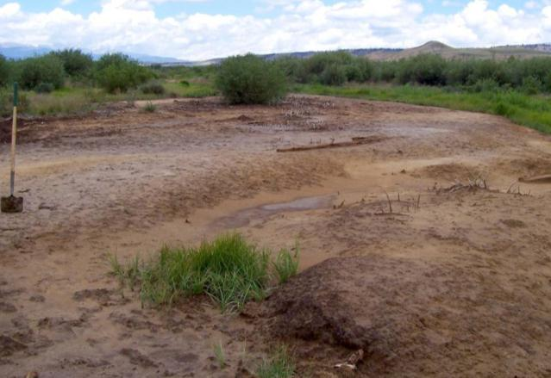
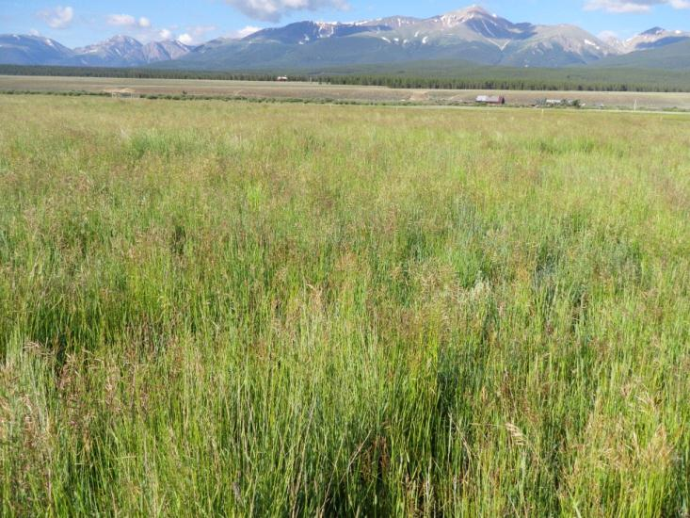
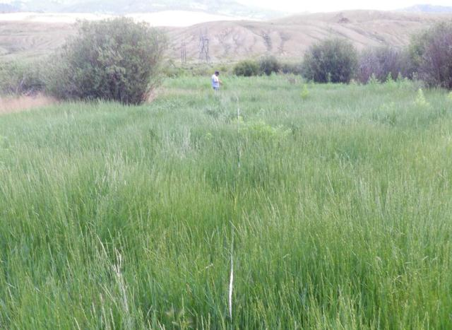
2011 Vegetation Monitoring
Fluvial Deposit QF
Irrigated Meadow SM-06
Total Metal Levels (mg/kg)
 | Pb | Zn
QF | 988 | 1310
SM-06 | 4900 | 5060
Notes:
Red arrow points to the same willow

Slide 24
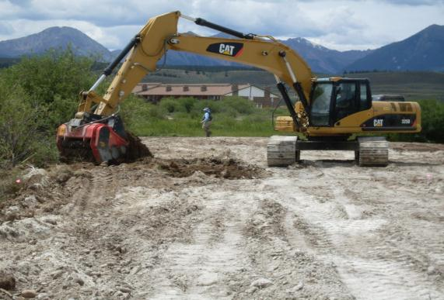
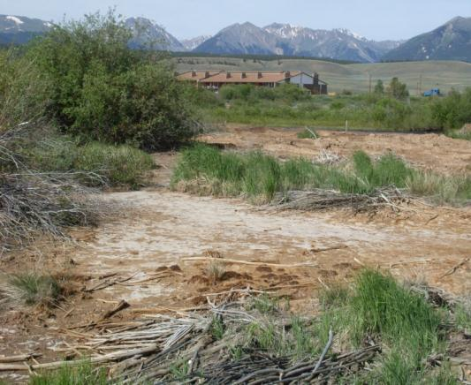
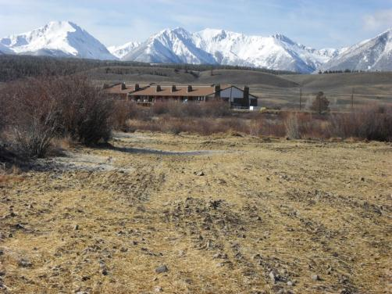
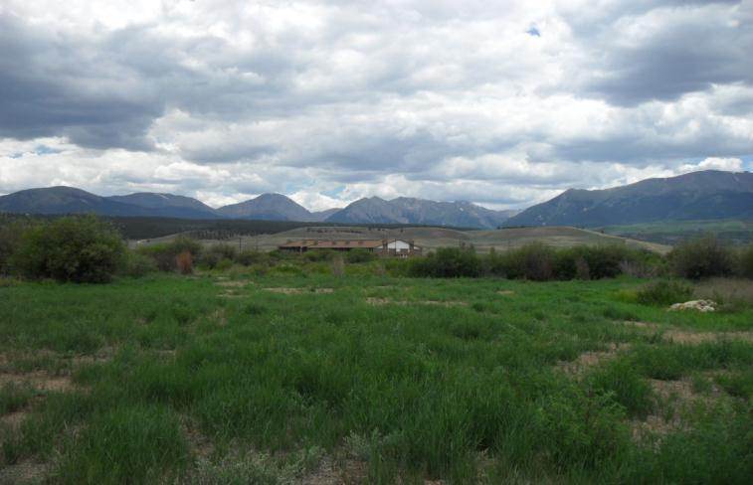
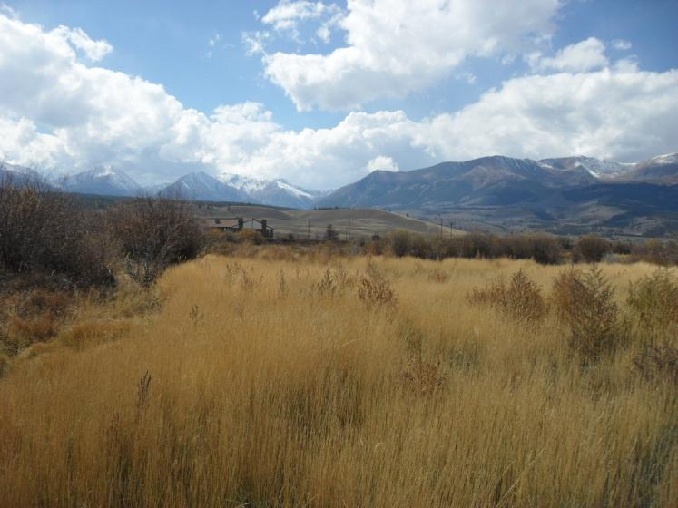
June 2009
July 2009
Fluvial Deposit QF
November 2009
July 2010
July 2010
October 2010

Slide 25
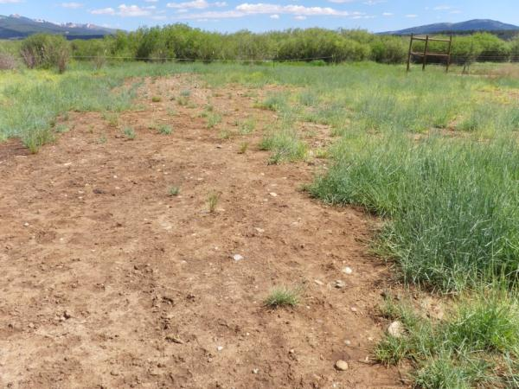
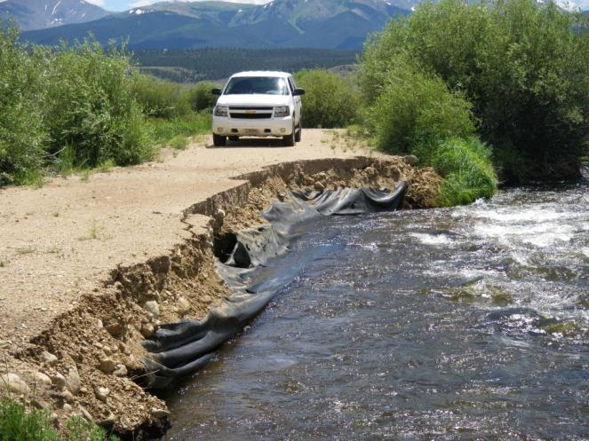
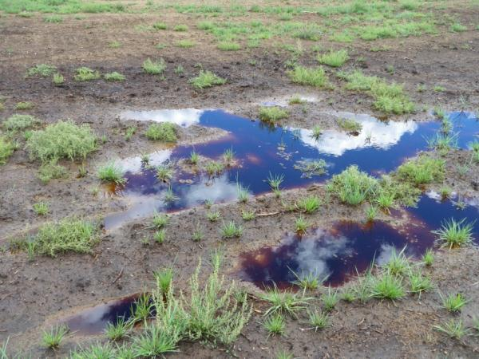
On-going Maintenance
Reseeding Bare Spots caused by Excess Salinity
Streambank Repairs due to High Flow in 2011

Slide 26
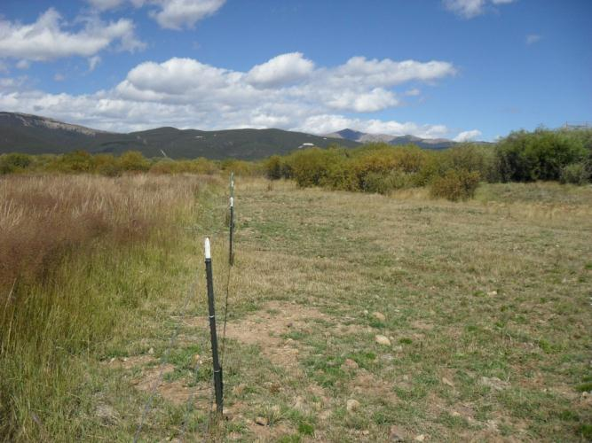
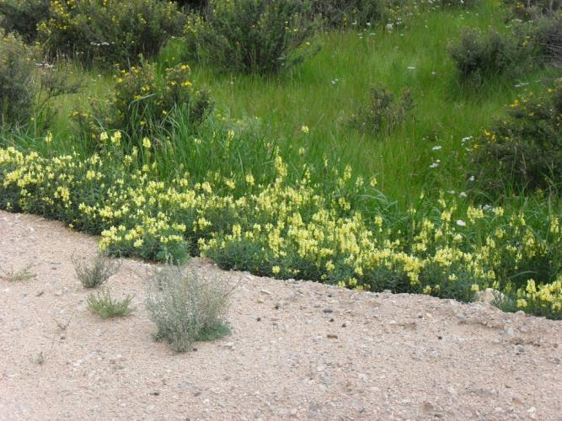
On-going Management
Grazing Intensity
Weed Control

Slide 27
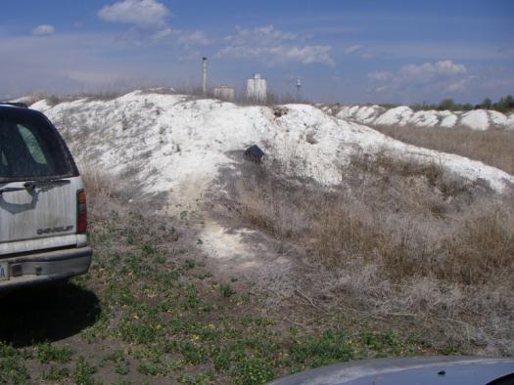


Remediation and Stabilization
Using Natural Materials
Lime
Local Borrow Soil and Rock
Compost

Slide 28





Remediation and Stabilization
Using Natural Materials
Carex
Willows

Slide 29

Soil Treatment and Vegetation Trends—
Arkansas River OU 11
Soil Characteristic | Pre-Treatment | Post-Treatment
Total Metals | Elevated | Elevated
Soluble Metals | Elevated | Reduced
Soil pH | Acidic | Neutral/alkaline
Soil Fertility | Low | High
Soil Organic Matter | Low | High
Biological Function | Low | High
Erosion | High | Low

Slide 30




10 year old treated tailings
Livestock grazing remediated land
Notes:
The revegetation results of the 1998-1999 demonstration areas show the robust potential of in-situ treatment of contaminated soil and tailings without topsoil. The willows in the background were untreated and were avoided during soil treatment. This same type of approach will be used during the remedial action: preservation of existing woody vegetation wherever possible coupled with careful soil treatment with amendments for fluvial deposits.

Slide 31





Questions/Discussion
Contact Information:
Stuart Jennings
sjennings@reclamationresearch.net

