Slide 1

Mine Water Treatment Strategies at
Resolution Copper Mining and the Eagle Project
Casey McKeon, Resolution Copper Mining, LLC
Kristin Mariuzza, Eagle Development Project
Kennecott’s Eagle Development Project
Project Development and Implementation

Slide 2
OVERVIEW
Project Introductions
Regulations that govern project design
Water Treatment Design
Water Management

Slide 3
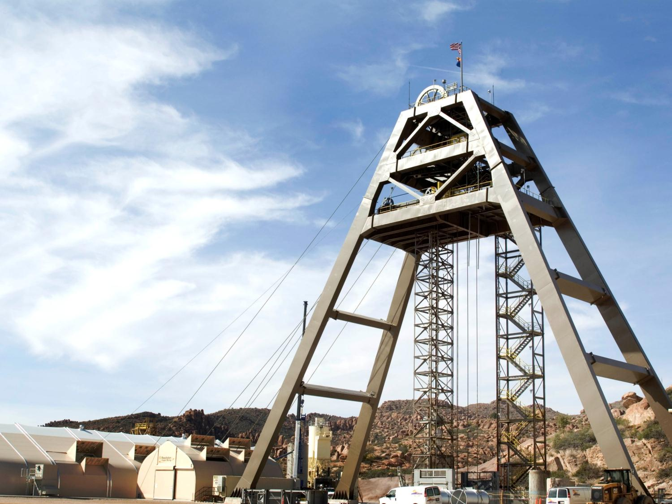
Resolution Copper Project Overview
Near Superior, Arizona
Adjacent to the Magma Mine (1911-1996)
Rio Tinto and BHP partnership
3rd largest undeveloped Cu resource in world
1.62 billion tonnes @ 1.47% Cu
>$5 billion investment
40-year mine life
Located in the Historic Pioneer Mining District
3 Confidential; © Copyright Protected
Notes:
3

Slide 4
Resolution Copper Water Treatment
Required for dewatering old Magma Mine workings adjacent to new work areas
  Safety of shaft sinking-exploration activities
Historic Treatment (pre -1996)
  Onsite ponds
  AZPDES requirement only
Present Day
  Over 2.5 billion gallons to dewater (2008)
  New HDS treatment process: Lime (pH) and Soda Ash (prevent scaling)
  AZPDES and Aquifer Protection Permits (APP) for discharges and solids storage ponds
  Treats to Aquifer Quality Limits and surface water standards
  Reverse Osmosis required for gypsum removal if discharging to nearby creek
  Looked for alternative, beneficial use of water

Slide 5
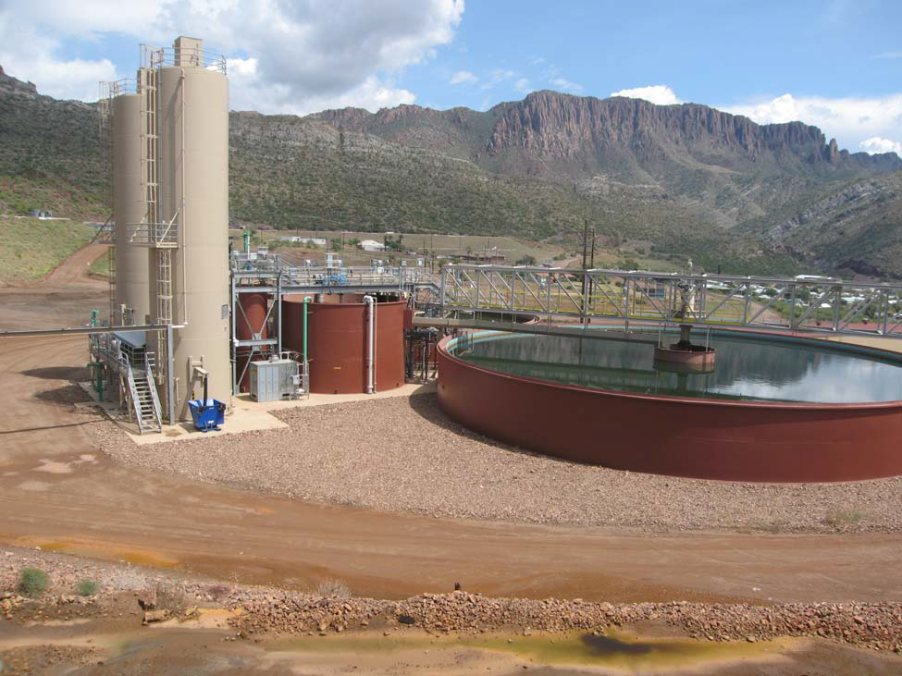
Water Treatment Objectives
Dewater existing underground copper mine
Beneficially use the treated water in a cooperative effort

Slide 6
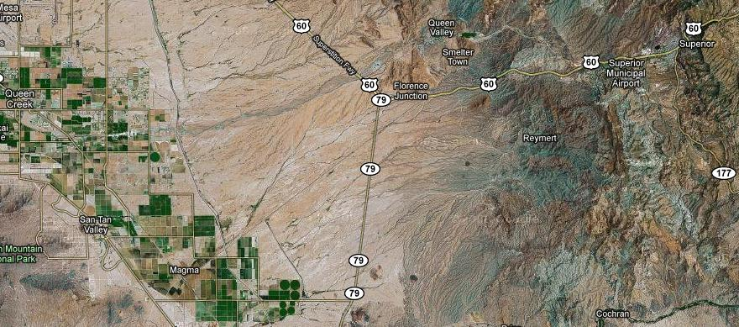
Goal: remove water from existing copper mine (2009)
Beneficial Reuse Area
RCM Copper Mine
RCM Pipeline

Slide 7

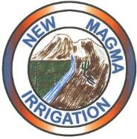


Project Cooperators
Resolution Copper Mining, LLC (RCM)
  Supply water and support sampling efforts
New Magma Irrigation and Drainage District (NMID)
  Facilitate land access and communicate with RCM
  6 cooperating growers
University of Arizona (UA)
  Provide laboratory services and quality control of data
NewFields Agricultural & Environmental Resources
  Coordinate and conduct sampling and reporting efforts and facilitate grower communication

Slide 8
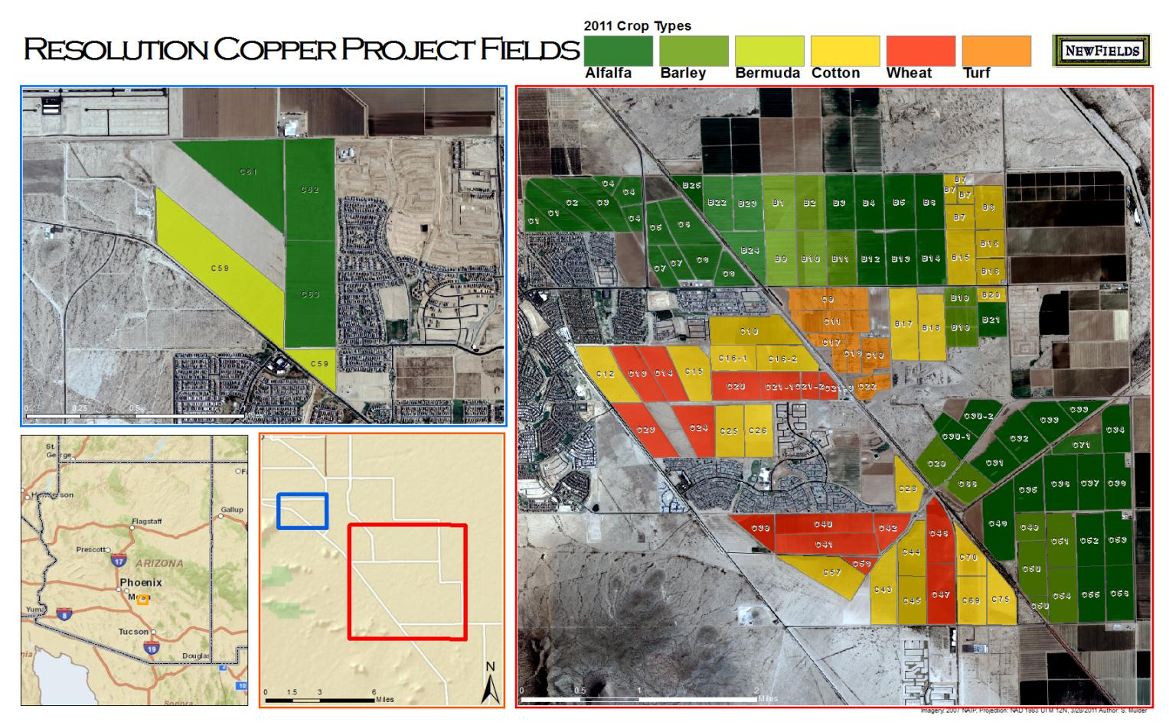
5,200 acres; 68+ fields

Slide 9
Monitoring Approach
Sample Type |  | Sampling Frequency
 |  | Continuous | Monthly | Quarterly
Water | Grab |  | X | X
 | In Situ Probe | X
Soil | 0-12” & 12-24” sample depths |  |  | X*
Plant | Tissue |  |  | X*
Water probes measure pH, specific conductance and temperature
Water grab samples measure salinity and nutrient related constituents monthly.
Soil samples measure salinity and nutrient levels quarterly and metals annually.
Plant tissue samples measure salinity and nutrient levels quarterly, depending on crop growth cycles, and metals annually.

Slide 10
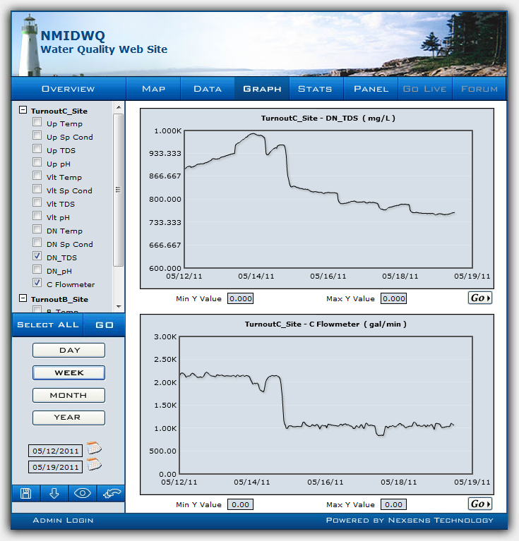
Water Quality Website

Slide 11
Web Mapping Application
Allows stakeholders to view Project data related to soil salinity
  View Project infrastructure
  View field information
  Access Project documents
  Chart trends for soil constituent
Facilitates rapid, visual representation of key constituents to ensure project goals concerning agricultural production are being met
Used frequently during grower meetings to spatially and temporally compare each growers data
  Intended to be made available to each grower once login information is established

Slide 12
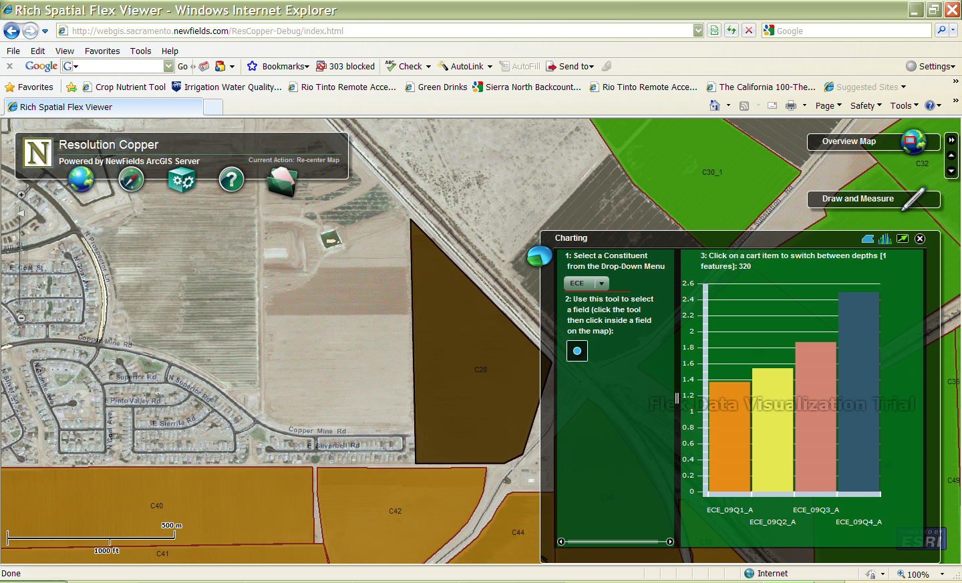
Web Mapping Application

Slide 13
Results: Soil Salinity 0-12”
Crop productivity has not been impacted

Slide 14
Results: Dewatering, over 2B gallons to date

Slide 15
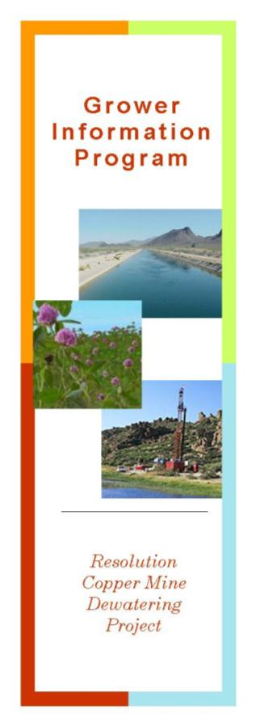
Communication with Growers
Semi-Annual meetings with growers prior to
each sampling event
  Discuss field conditions and recent field
  operations
  Ensure all farm staff are aware of our activities
  Share data

Slide 16
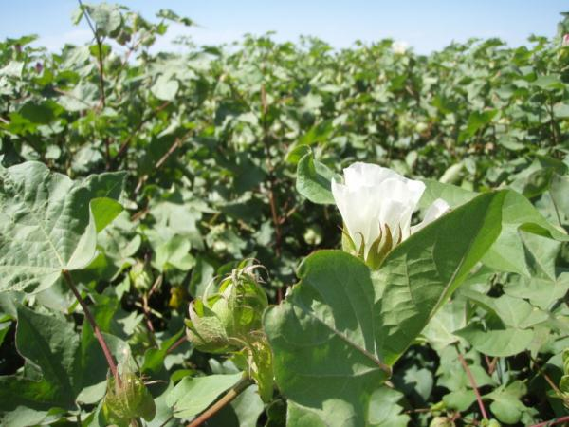
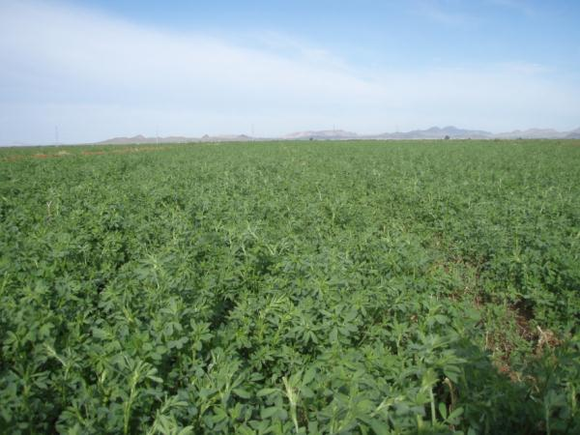
Results
Nutrient and metal levels for the water, soil and plant tissue samples have all fallen within acceptable, expected ranges.
Environmental health and agricultural productivity have remained unaffected.
Soil salinities (gypsum) have increased slightly, as expected, but have not affected crop yield.

Slide 17
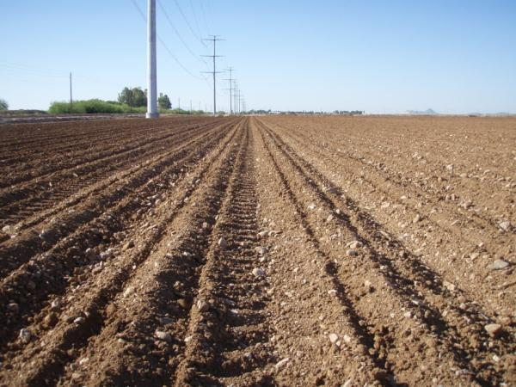
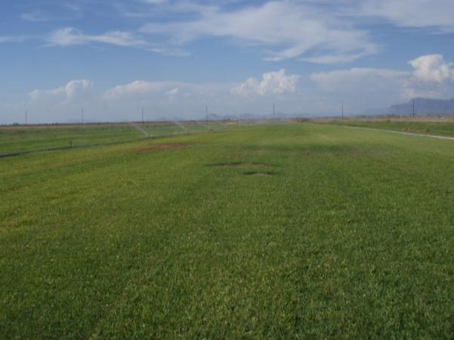
Lessons Learned
Daily communication is critical among all project stakeholders
Conservative sampling and irrigation efforts throughout the project have been helpful for tracking salinity trends
Consistency in the water treatment and regular communications have led to continued project success.

Slide 18
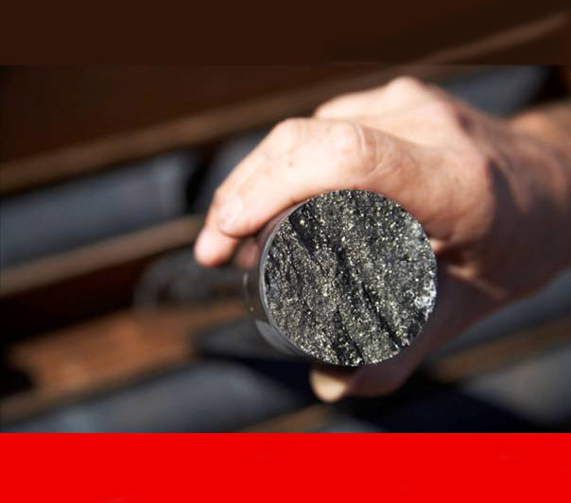
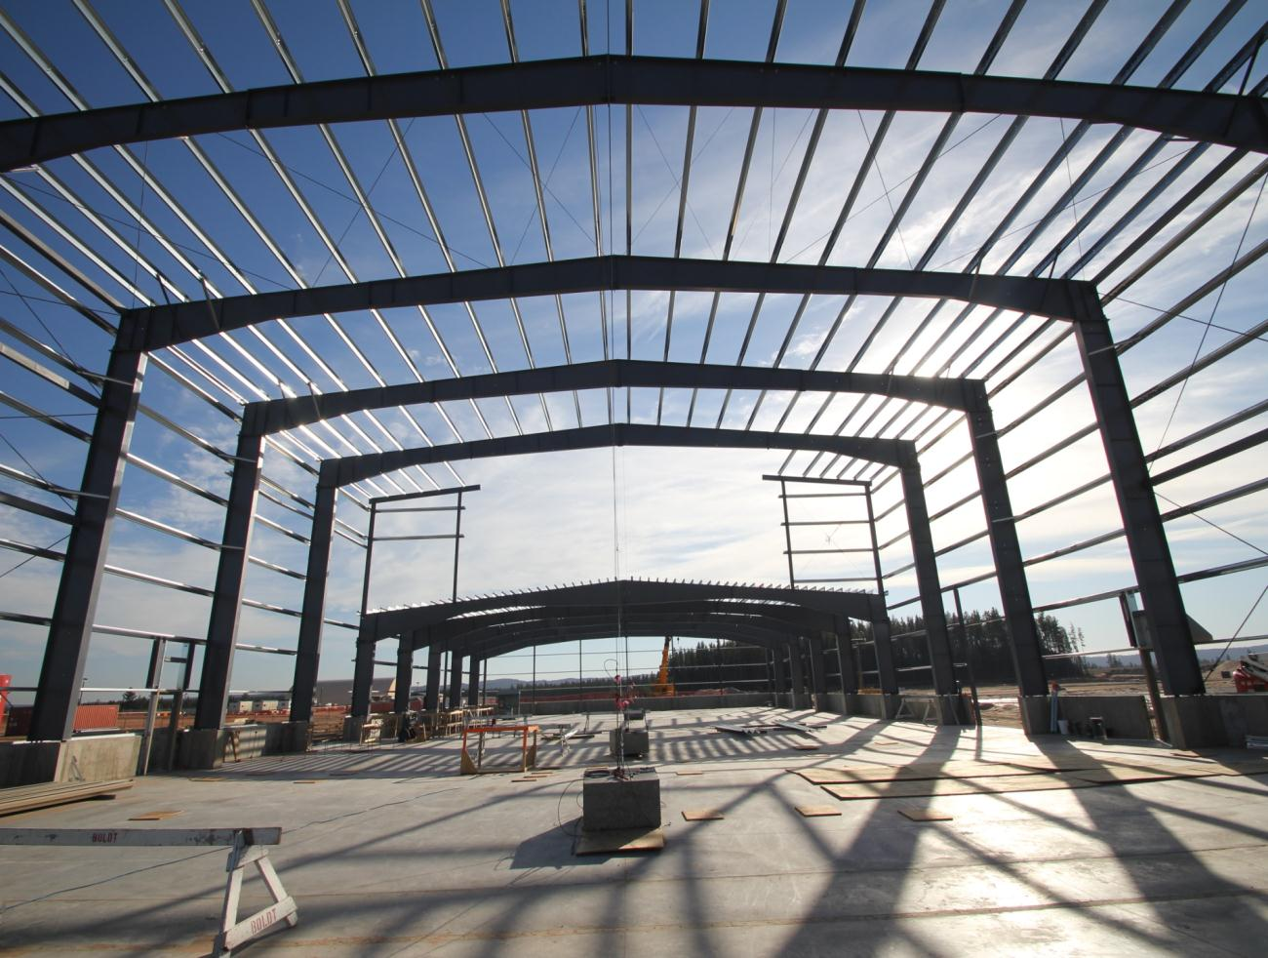
Kennecott’s Eagle Development Project
Project Development and Implementation

Slide 19
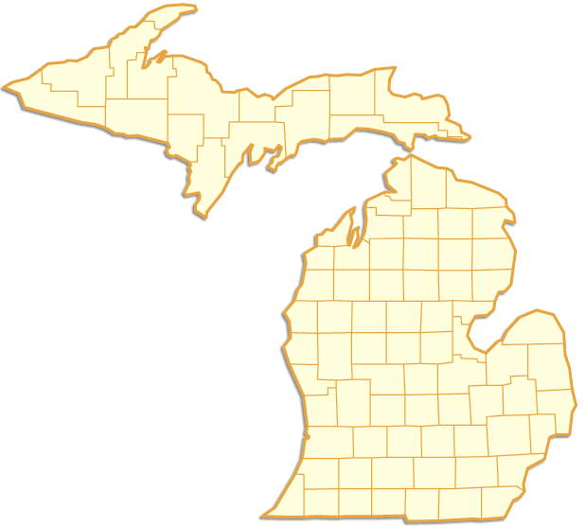
Located in the Upper Peninsula of Michigan
Marquette County
Eagle
Michigan, USA

Slide 20
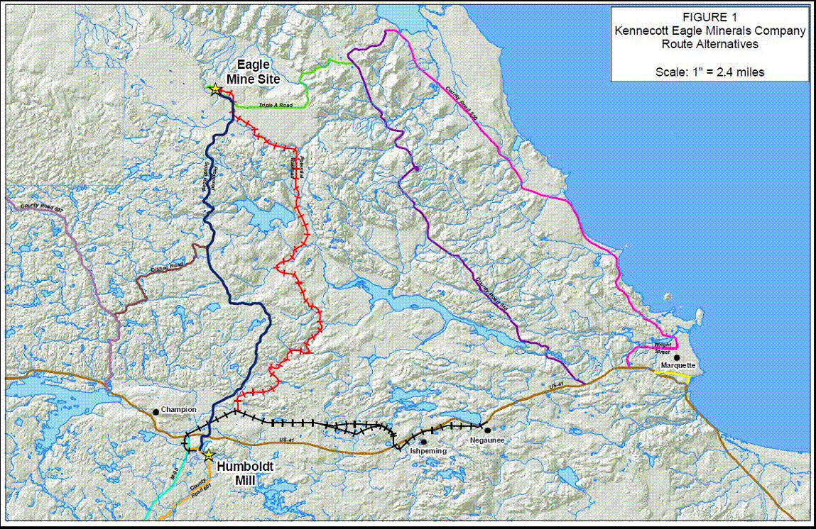
3 April 2012
Presentation Title
20

Slide 21
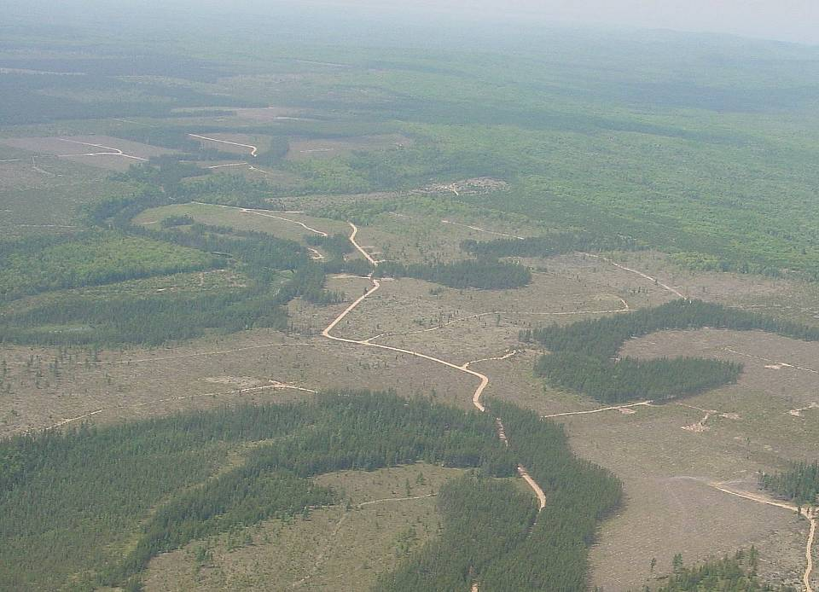
Source: Kennecott Eagle

Slide 22
Mine Site Layout
North
underground ore body (6 acres)
underground decline to ore body
Salmon-Trout River
surface facilities
surface road from portal to storage pad
ventilation raise and aggregate backfill site
mine portal
site access road
Source: Kennecott Eagle

Slide 23
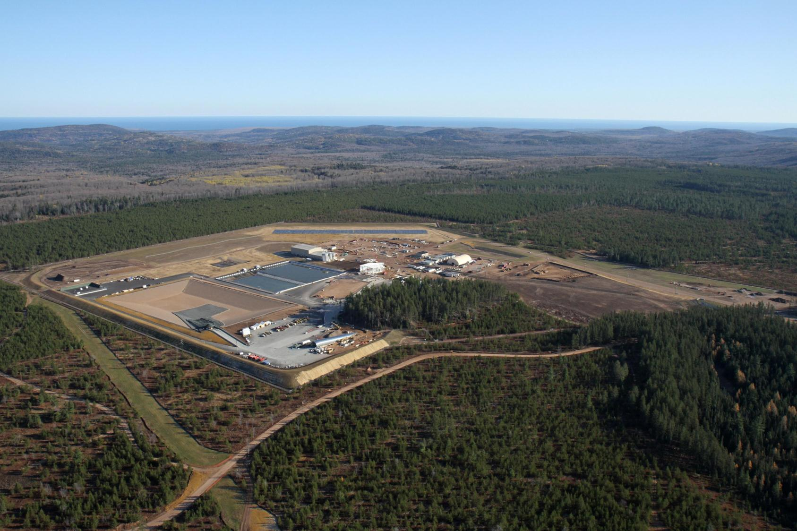

Slide 24
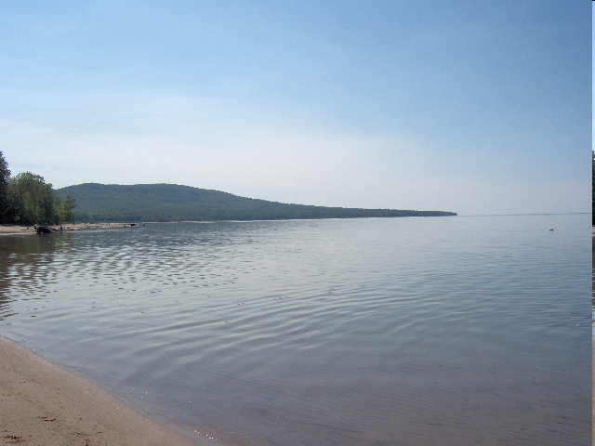
Michigan’s Environmental Regulations
Part 632, Nonferrous Metallic Mining Regulations, of PA 451, Natural Resources and Environmental Protection Act, of 1994.
  Covers all aspects of mining and includes EIA
Part 31, Water Resources Protection, of PA 451, Natural Resources and Environmental Protection Act, of 1994.
        Part 22 Rules, Groundwater Quality
        Part 4 Rules, Water Quality Standards
        Part 8 Rules, Water Quality Based Effluent Limit Development
3 April 2012
Regulatory Drivers

Slide 25
Michigan’s Environmental Regulations
Part 632, Nonferrous Metallic Mining Regulations, of PA 451, Natural Resources and Environmental Protection Act, of 1994.
Managing Water On Site
Waters that Receive Treatment at WTF
- Underground Dewatering
- Storm Water Runoff from Operations Area
- Temporary Development Rock Storage Area
  Industrial Landfill Equivalency
  Leachate Collection
  Geomembrane Cover
Not Treated at WTF
- Sanitary Wastewater
- Non-Contact Storm Water
3 April 2012
Regulatory Drivers

Slide 26
Michigan’s Environmental Regulations
Part 31, Water Resources Protection, of PA 451, Natural Resources and Environmental Protection Act, of 1994.
Water On Site Governed by:
- Part 22 Rules - Groundwater Quality
  Contact Water Basin Liner Design
  Basis of Design for Facility and Infiltration Gallery
  Water Discharge Application Requirements
- Part 4 Rules - Water Quality Standards
  Antidegradation - Best Technology in Process in Treatment for BCC Mercury
- Part 8 Rules - Water Quality Based Effluent Limits
  Low Level Metals – Designated Use Protection
Due to groundwater venting, the state agency applied surface water discharge requirements to the venting location (groundwater seeps).
3 April 2012
Regulatory Drivers

Slide 27
Final Agency Decisions
Ultimately, the State of Michigan issued a water discharge permit that included limits protective of both surface and ground water.
Comparison of select Permit Limits and Drinking Water Standards
Parameter | Eagle Permit Limit Monthly Average (ug/l) | Michigan Drinking Water Standard (ug/l)
Selenium | 5 | 50
Mercury | 0.0021 | 2
Copper | 10 | 1300
Compliance points are both groundwater and WTF effluent.
3 April 2012
Regulatory Drivers

Slide 28
Water Treatment Facility Schematic
Facility rain/snow
Filtration
Double Pass Reverse Osmosis
Metals Precipitation Process
Mine Inflow
Recycle for Mine
Groundwater Infiltration System
350 gpm
permitted

Slide 29
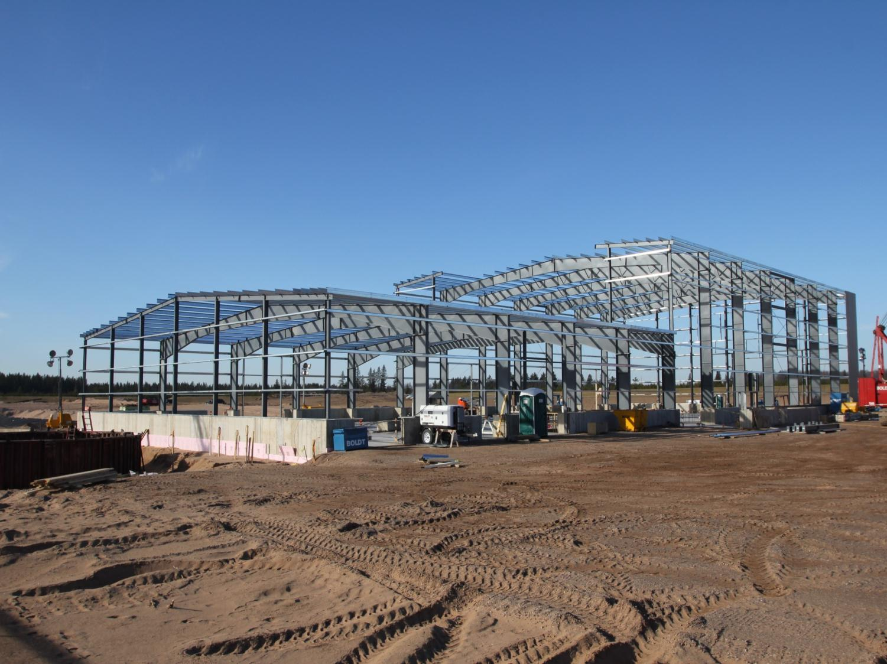

Slide 30
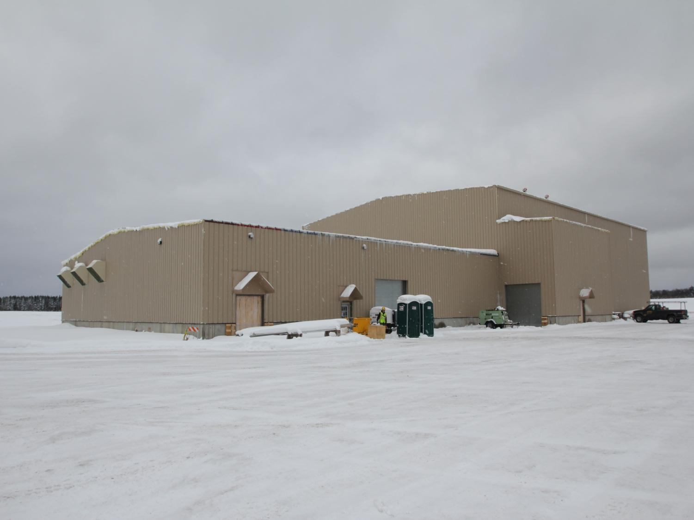

Slide 31
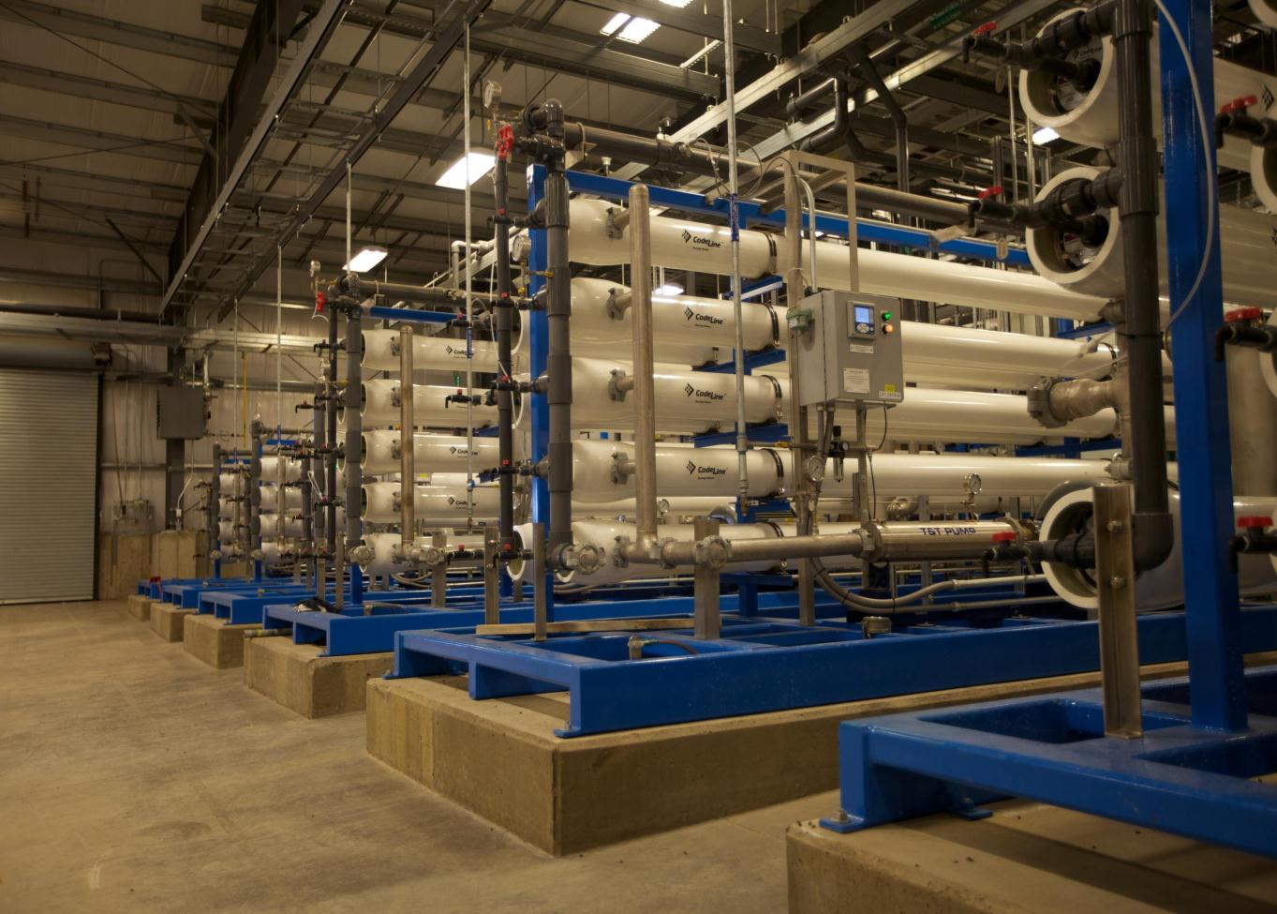
Questions are Welcome.
Thank You.

