Slide 1
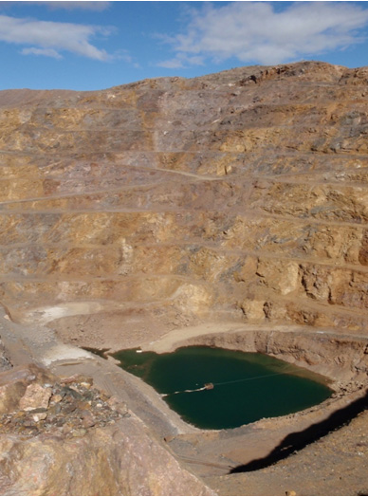
Bob Seal rseal@usgs.gov Phil Verplanck plv@usgs.gov Brad Van Gosen bvangose@usgs.gov Andrew Grosz agrosz@usgs.gov April 4, 2012
Geologic and Environmental Characteristics of Rare Earth Element Deposit Types Found in the United States

Slide 2
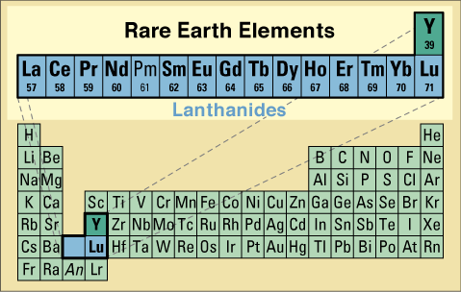
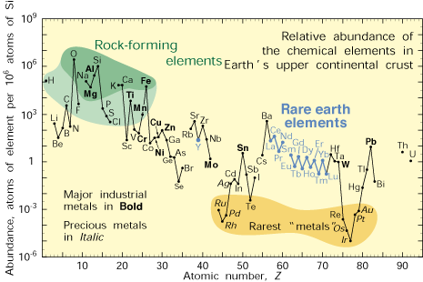
Rare Earth Elements
Less abundant than common rock-forming elements
More abundant than precious metals
More or less abundant than base metals and metalloids.

Slide 3
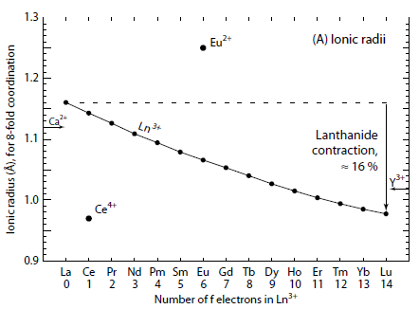
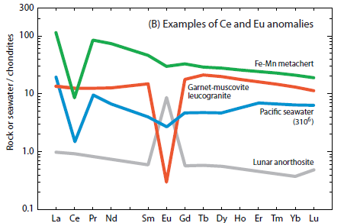
Geochemical Controls in Nature
Lanthanide Contraction
Ionic radius decreases with increasing number
Oxidation State
All REEs occur in 3+ state
Eu also occurs in 2+ state
Substitutes for 2+ cations like Ca²⁺
Ce also occurs in 4+ state
Even more insoluble
From: Haxel (2005)

Slide 4
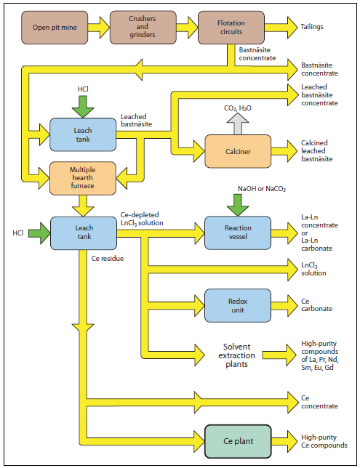
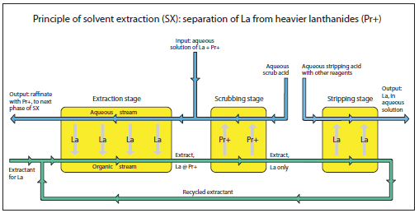
Rare Earth Element Ore Processing
Recovery of individual REEs is complicated by:
Similar geochemical behavior of REEs as a group
Wide variety of REE host minerals
From: Haxel (2005)

Slide 5
Primary and Byproduct REE Deposit Types
Carbonatites
Bayan Obo, China
Mountain Pass, CA
Alkaline Intrusion-Related Deposits
Bokan Mountain, AK
Thor Lake (Nechalacho), NWT, Canada
Magmatic Magnetite-Hematite bodies
Pea Ridge Mine, Missouri
Olympic Dam, Australia?
Kiruna, Sweden?
Notes:
There are four basic types of rare earth elements deposits in the U.S. At a broadest level these are……………
I won’t be discussing the magmatic iron deposits and the placer deposits today, because of limited time and because they seem unlikely to be significant contributors to our domestic rare earth supply in the near future.

Slide 6
Potential Byproduct REE Sources
Monazite-bearing Placer Deposits
Central Idaho stream placers
North and South Carolina stream placers
Virginia, Georgia, and Florida beach deposits
Phosphorite Deposits
Florida, North Carolina
Phosphoria Formation, ID, MT
Notes:
There are four basic types of rare earth elements deposits in the U.S. At a broadest level these are……………
I won’t be discussing the magmatic iron deposits and the placer deposits today, because of limited time and because they seem unlikely to be significant contributors to our domestic rare earth supply in the near future.

Slide 7
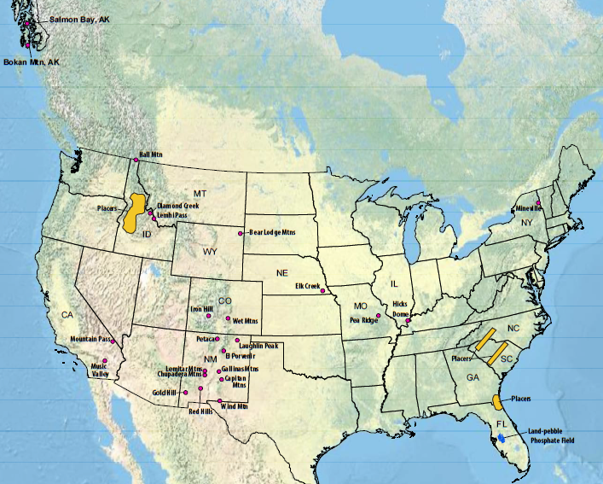
Rare Earth Element Deposits of the United States

Slide 8
Rare Earth Element Minerals & Deposit Types
Group-Mineral | Formula | Carbonatite | Alkaline Intrusion-Related | Placer | Phosphorite
Oxides
Aeschynite | (Ln,Ca,Fe)(Ti,Nb)₂(O,OH)₆ |  | X
Euxenite | (Y,Ln,Ca)(Nb,Ta,Ti)₂(O,OH)₆ |  | X | X
Fergusonite | YNbO₄ |  | X
Carbonates
Bastnäsite | (Ln,Y)CO₃F | X | X
Parisite | Ca(Ln)₂(CO₃)₃F₂ | X | X
Synchisite | Ca(Ln,Y)(CO₃)₂F | X | X
Tengerite | Y₂(CO₃)₃•n(H₂O) |  | X
Phosphates
Apatite | (Ca,Ln)₅(PO₄)₃(OH,F,Cl) | X | X |  | X
Monazite | (Ln,Th)PO₄ | X | X | X
Xenotime | YPO₄ |  | X | X
Silicates
Allanite | (Ln,Y,Ca)₂(Al,Fe³⁺)₂(SiO₄)₃(OH) |  | X
Eudialyte | Na₄(Ca,Ce)₂(Fe²⁺,Mn²⁺,Y)ZrSi₈O₂₂(OH,Cl)₂ |  | X
Thalenite | Y₂Si₂O₇ |  | X
Zircon | (Zr,Ln)SiO₄ |  | X | X
Ln: Lanthanide (a.k.a. REE)

Slide 9
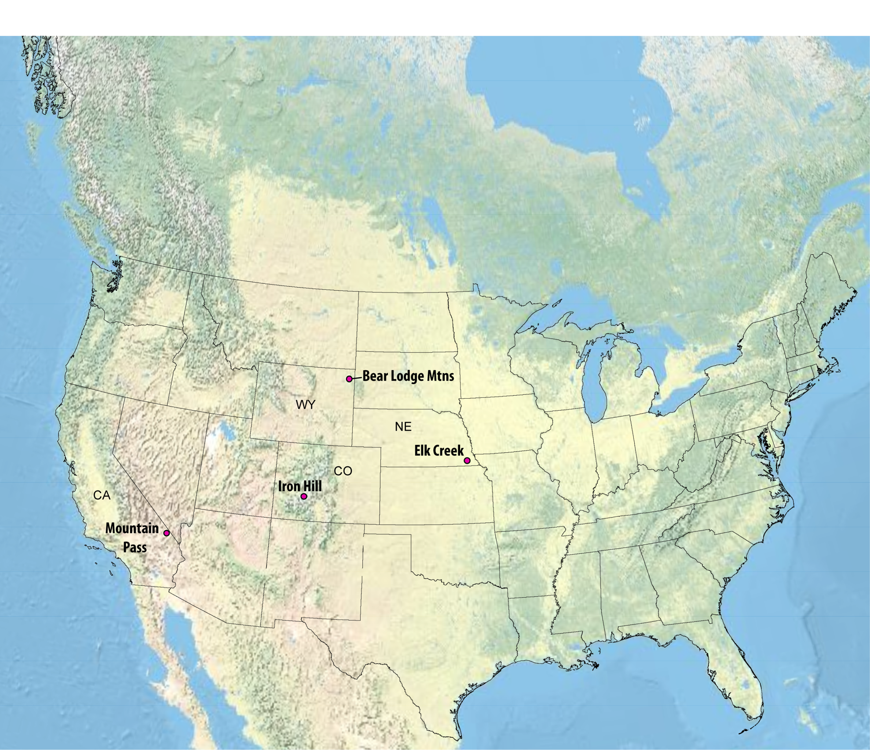
Carbonatite Deposits
Carbonatites
Notes:
There are 4 very large carbonatite masses known in the U.S.
Carbonatites, by definition, are igneous rock composed of at least 50% carbonate minerals that crystallized formed directly from a magma. A carbonate igneous rock.
The large carbonatites are…..

Slide 10
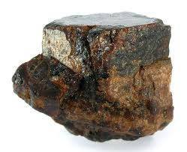
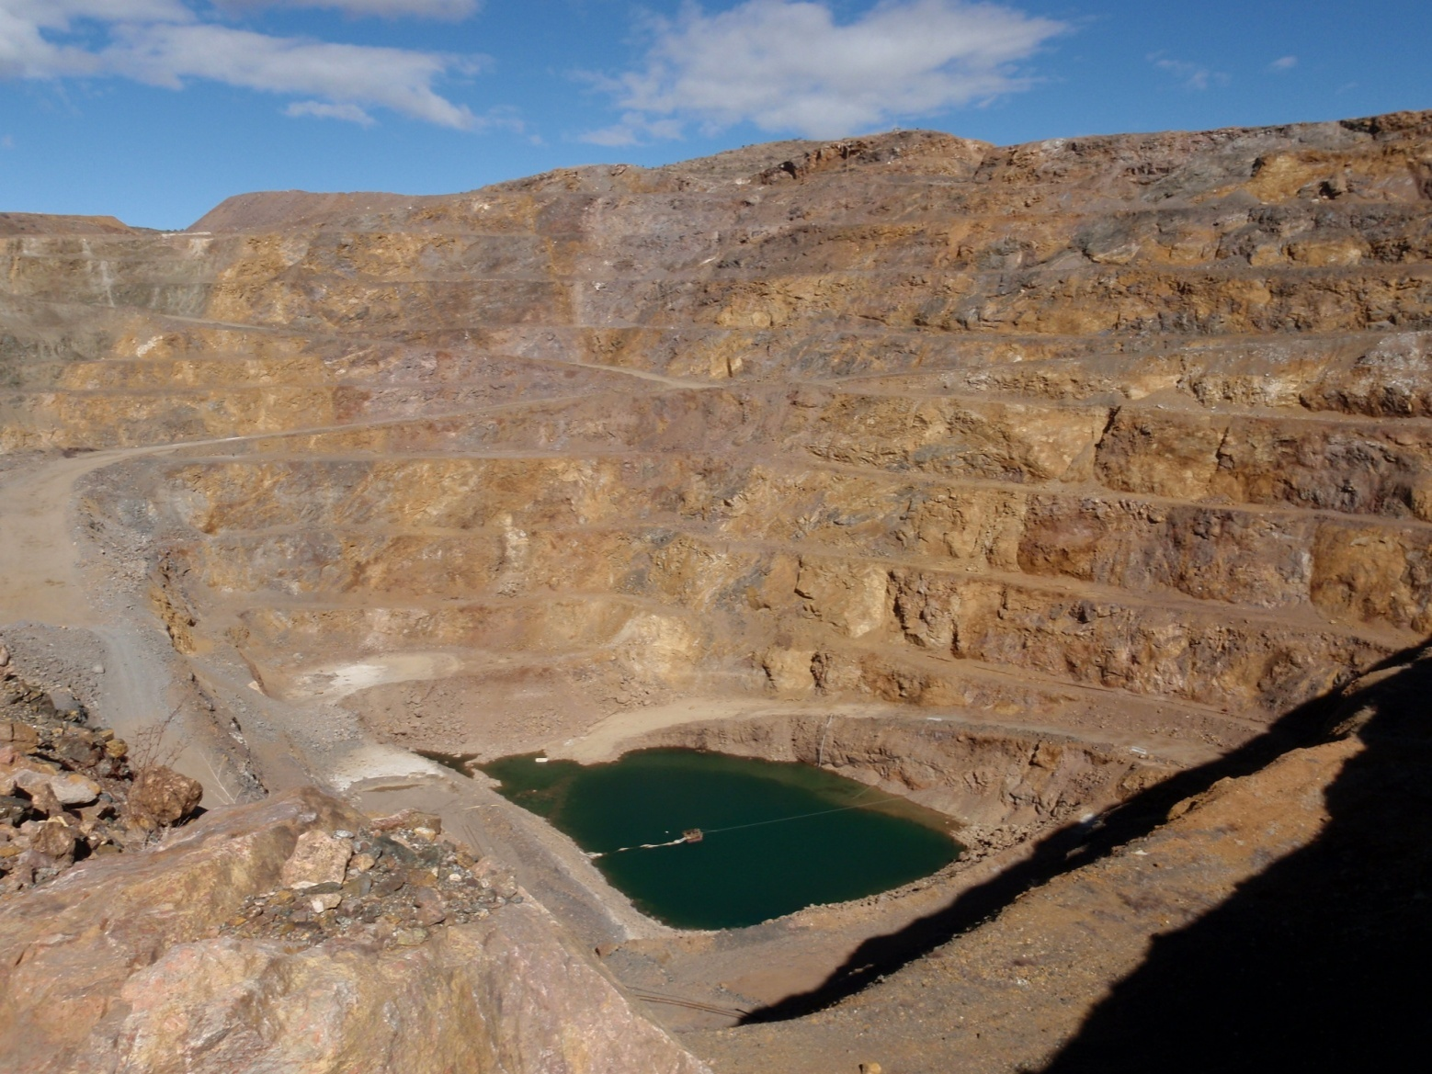
Carbonatite Deposits
Bastnäsite
(REE)CO₃F
Carbonatite – an igneous rock with greater than 50 % carbonate minerals (calcite, dolomite, ankerite)
Less than 550 carbonatites known in world.
Commonly associated with alkaline or peralkaline igneous rocks.
The REE are “incompatible elements”, such as Th, Nb, and Zr, that do not tend to participate in the earlier mineral-forming events.
Important sources of Nb, Ta, and REEs.
Mountain Pass, California
Notes:
The mine closed in 2002, due to competition with China and environmental issues related to wastewater spills, but the mine re-opened officially the week of Christmas last December.
MolyCorp suggests they will reach full production mode again sometime later next year, along with the completion of a new state-of-the-art ore processing facility
The primary ore mineral is bastnaesite, a rare earth-carbonate-fluorine mineral.

Slide 11
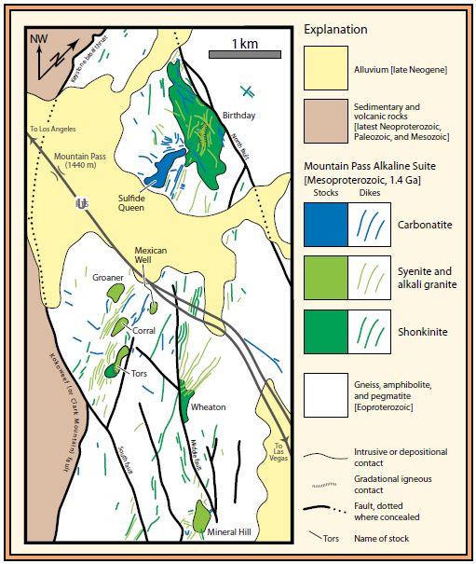
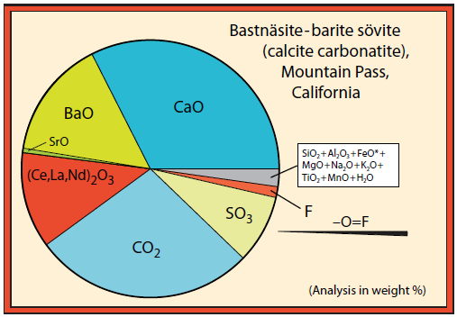
Mountain Pass, California
Located in Mojave Desert
Discovered in 1949 by uranium prospector.
1.4 Ga carbonatite complex
Stopped mining in 2002
Reopened 2010
From: Haxel (2005)

Slide 12
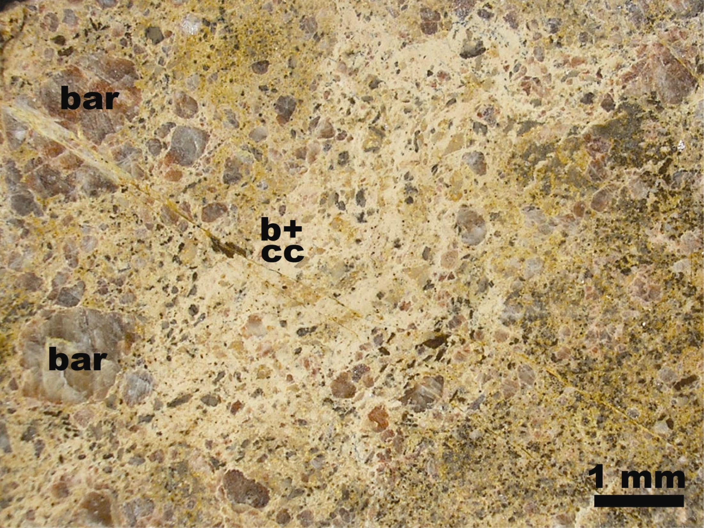
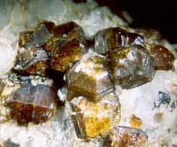
Sulphide Queen carbonatite
Probable reserves
13.1 million tons of ore
grading 8.2 % REE oxides,
using cut-off grade of 5 %
Bastnäsite
calcite
Bastnäsite
(REE)CO₃F
barite
dolomite
1 mm
Notes:
The carbonatite is a large tabular intrusion called the Sulphide Queen carbonatite.
MolyCorp reports probably reserves of……
This is an example of the Sulphide Queen ore, a calcite-dolomite carbonatite.
It consists of barite (bar) phenocrysts, brown to yellow dolomite, and fine-grained bastnaesite—the primary ore mineral—mixed with calcite (b+cc). The carbonatite varies from dolomite rich to calcite rich to nearly equal amounts of each.

Slide 13
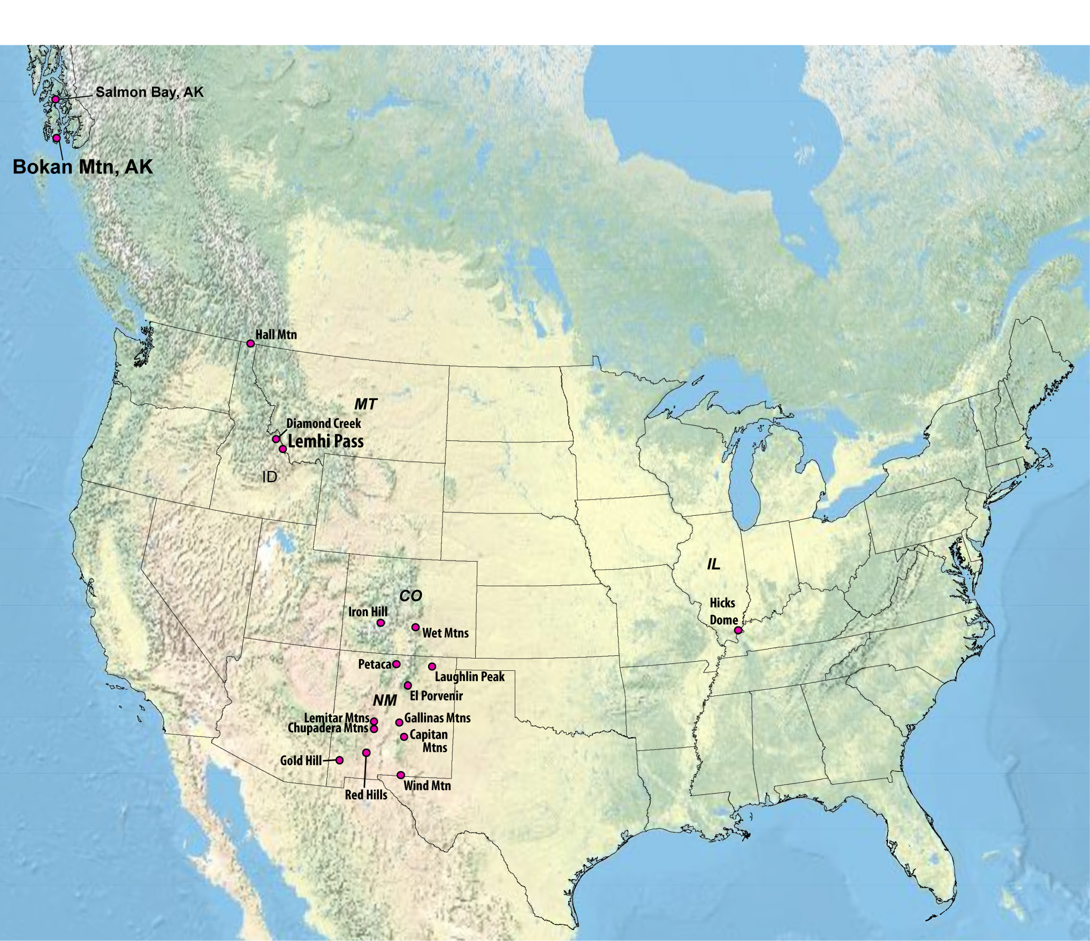
Alkaline Intrusion-Related Deposits
Vein and dike REE districts
Notes:
There are many rare earth vein districts in the U.S.—the red dots on this map. Some of these districts may in fact represent veins exposed in the upper portions of buried carbonatite systems rather than peralkaline intrusive complexes. For the sake of time, I’ll describe two districts with the most advanced exploration activity.
These are:
the Lemhi Pass district along the Montana-Idaho border;
And dikes with vein-like deposits in the Bokan Mountain district of southernmost Alaska.
First, the Lemhi Pass district…

Slide 14
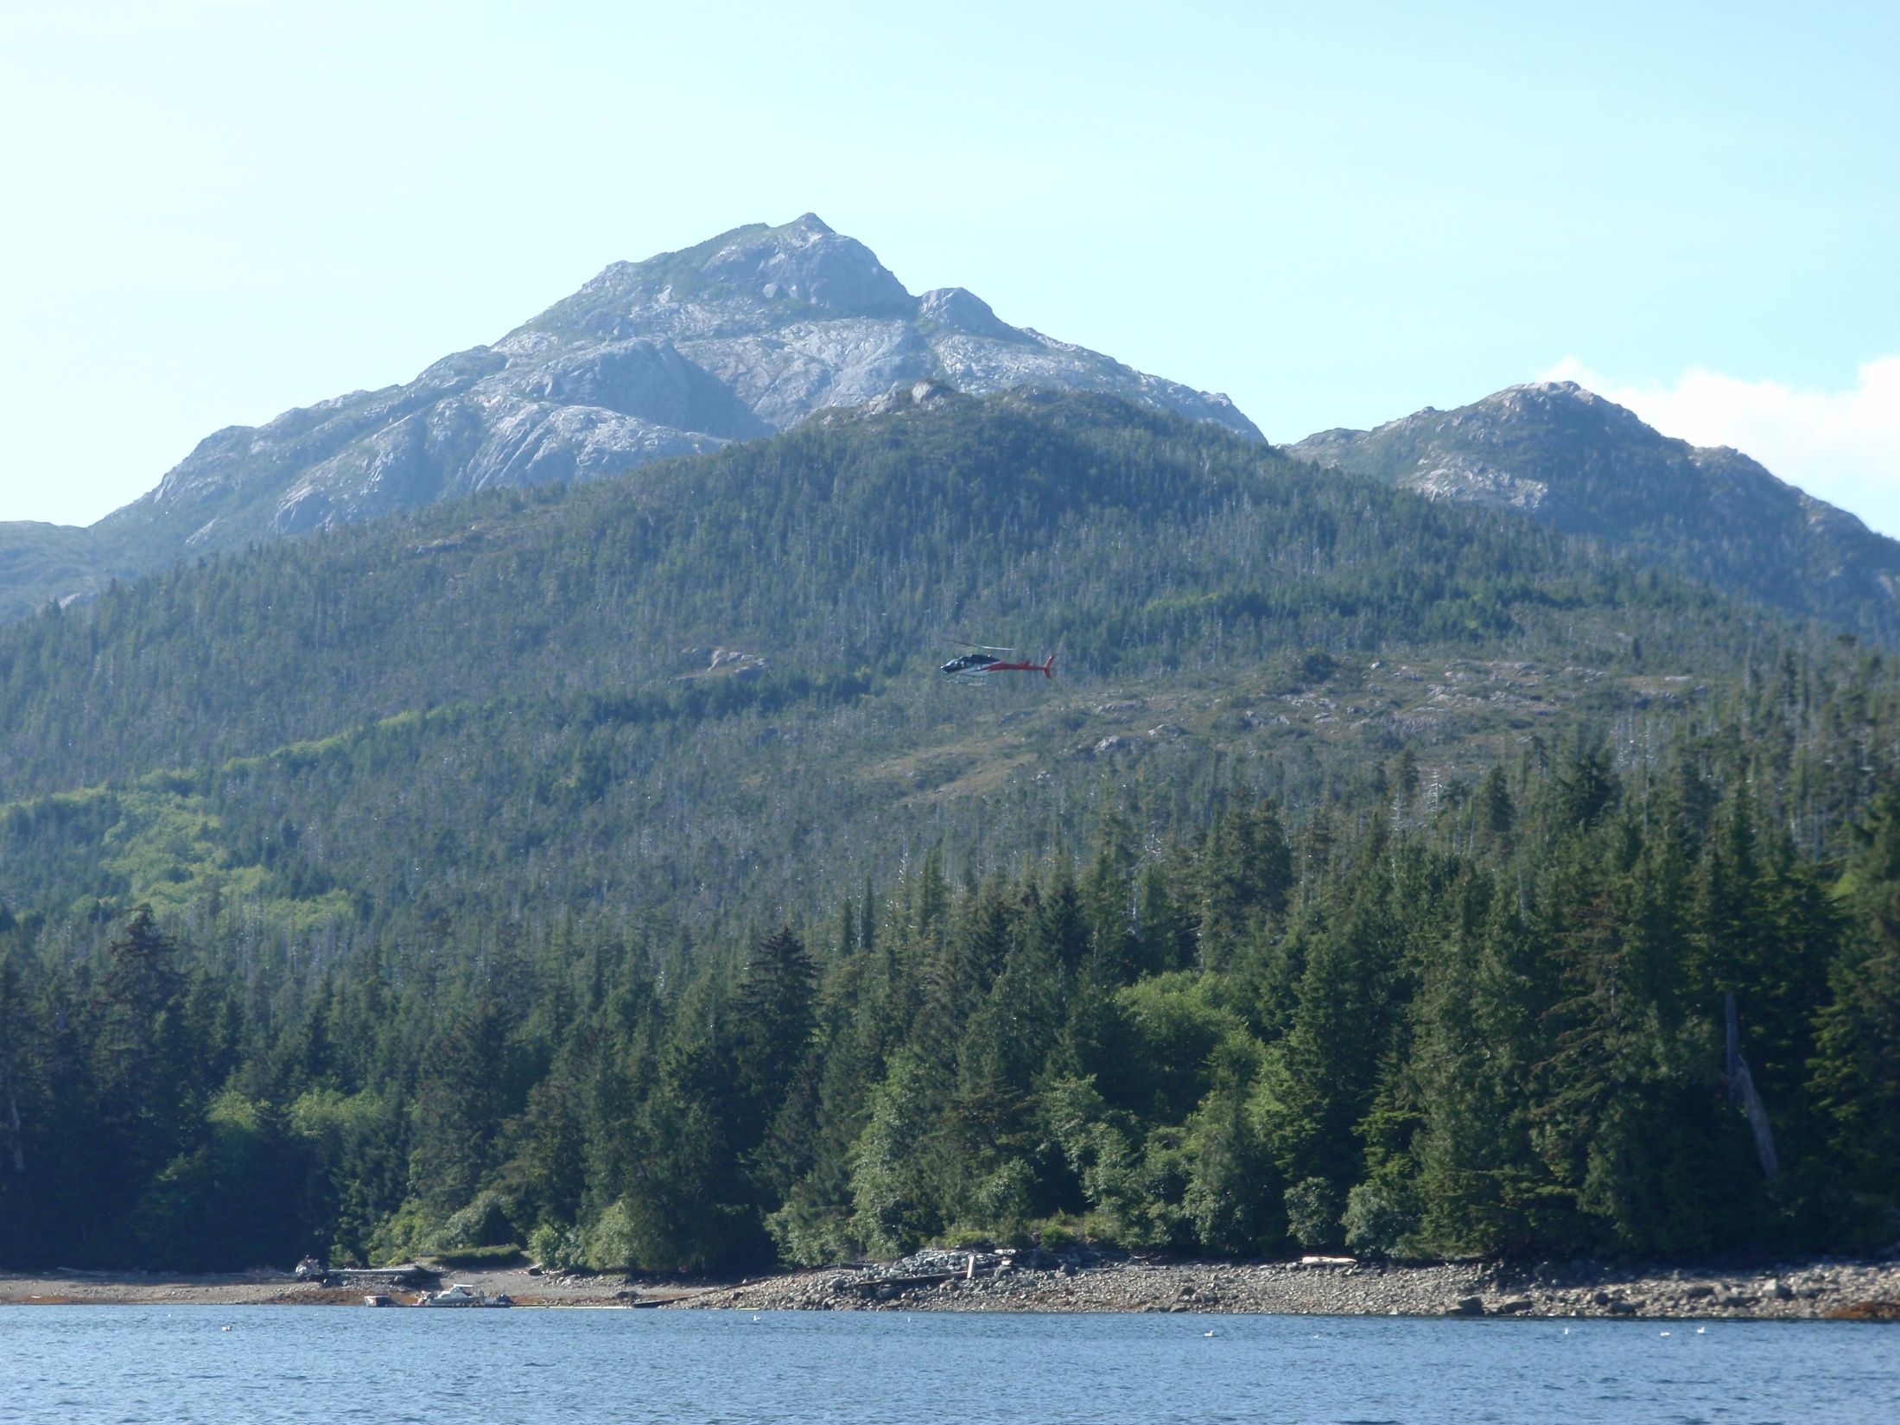
Alkaline Intrusion-Related Deposits
Associated with alkaline or peralkaline igneous complexes
Peralkaline: Na₂O + K₂O > Al₂O₃
Structural control on the veins, dikes & breccias
In zoned alkaline intrusive complexes, REE veins, dikes, and breccia bodies are late phases.
The REE are “incompatible elements”, such as Th, Nb, and Zr, that do not tend to participate in the earlier mineral-forming events.
Bokan Mountain, Alaska
Notes:
Veins, dikes, and breccias are another host for significant deposits of the rare earths.
They are…….

Slide 15
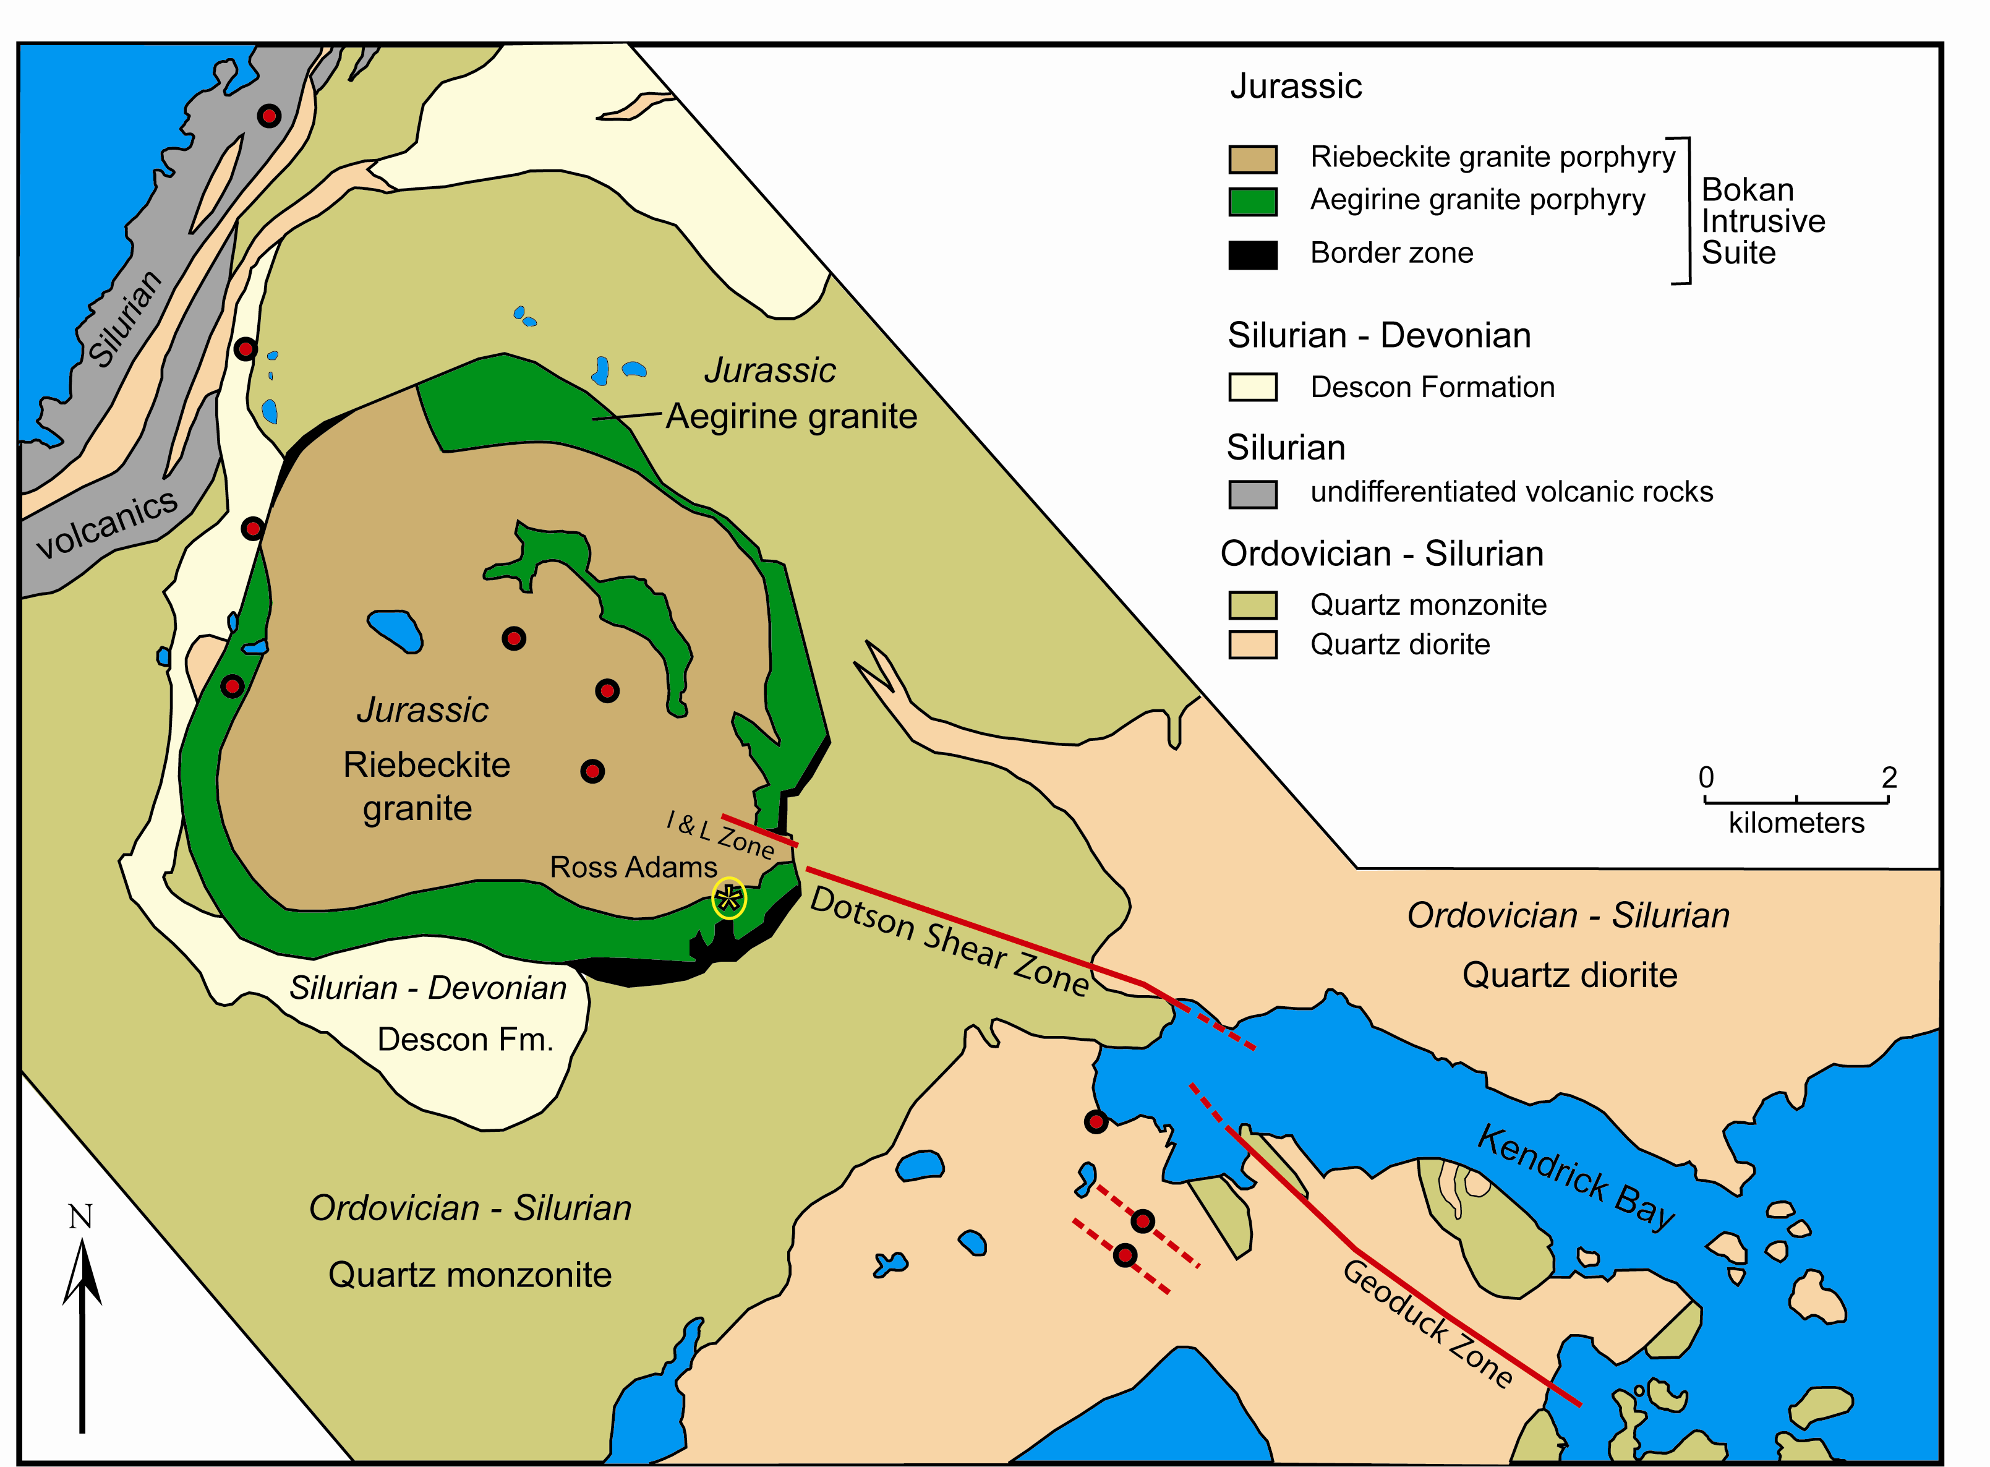
Bokan Mountain, Alaska
Ucore Rare
Metals
Notes:
This is a very generalized geologic map of the district.
During the Jurassic, the alkaline granites of the Bokan alkaline granites intruded into earlier formed Ordovician-Silurian quartz monzonite and diorite. The light yellow unit are Silurian-Devonian sedimentary rocks, which were metamorphosed by the intrusion. Silurian-age volcanic rocks also occur in the district.
The Bokan intrusive suite are peralkaline granites—a riebeckite-rich granite (riebeckite is a sodic amphibole) and an aegerine granite (which is a sodic pyroxene), thereby reflecting the sodium and potassium-rich nature of this granite.
Scattered rare earth deposits are shown by the red dots. All are structurally controlled. The most significant and the target for development are those along the Dotson shear zone. Alkaline dikes rich in rare earths occupy and follow this shear zone for more than 2 kilometers.
A company called Ucore Rare Metals have been core drilling along the dikes in the Dotson shear zone over the last few summers and this summer submitted large bulk samples for metallurgical testing.

Slide 16
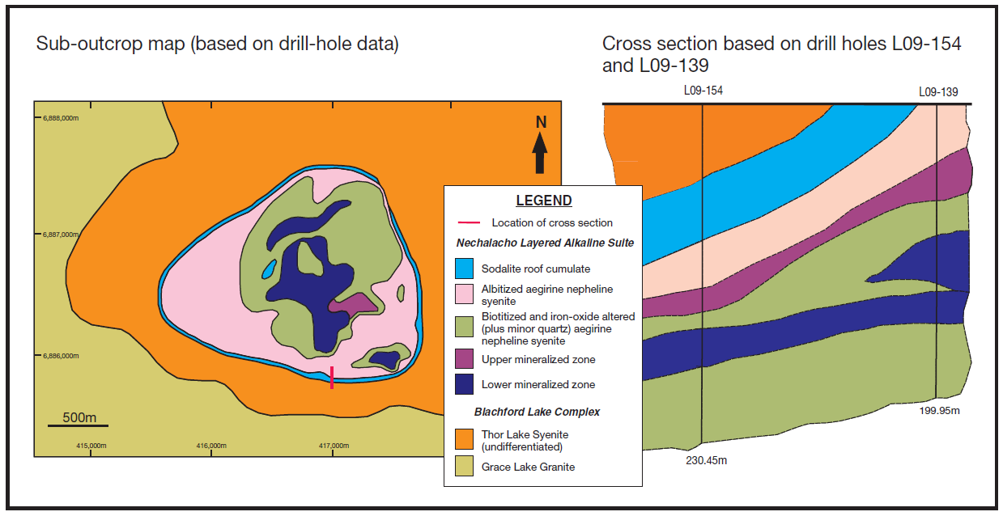
Thor Lake, NWT, Canada
From: Sheard, E.R., Williams-Jones, A.E., Heiligmann, M., Pederson, C., and Trueman, D.L., 2012, Economic Geology, v. 107, p. 81-104.
Notes:
This is a very generalized geologic map of the district.
During the Jurassic, the alkaline granites of the Bokan alkaline granites intruded into earlier formed Ordovician-Silurian quartz monzonite and diorite. The light yellow unit are Silurian-Devonian sedimentary rocks, which were metamorphosed by the intrusion. Silurian-age volcanic rocks also occur in the district.
The Bokan intrusive suite are peralkaline granites—a riebeckite-rich granite (riebeckite is a sodic amphibole) and an aegerine granite (which is a sodic pyroxene), thereby reflecting the sodium and potassium-rich nature of this granite.
Scattered rare earth deposits are shown by the red dots. All are structurally controlled. The most significant and the target for development are those along the Dotson shear zone. Alkaline dikes rich in rare earths occupy and follow this shear zone for more than 2 kilometers.
A company called Ucore Rare Metals have been core drilling along the dikes in the Dotson shear zone over the last few summers and this summer submitted large bulk samples for metallurgical testing.

Slide 17
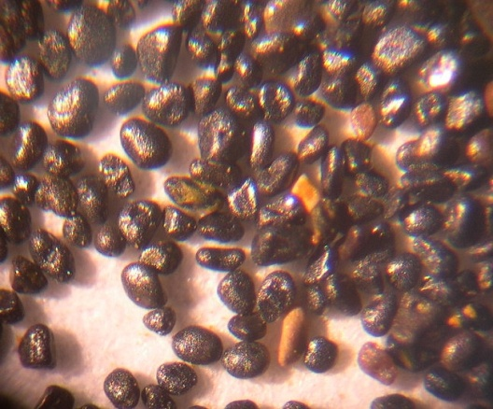
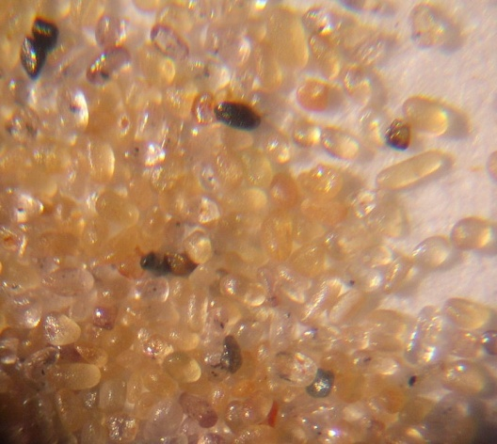
Heavy Minerals Sands (Placers)
Ilmenite
Heavy mineral sands are currently produced in Virginia and Florida.
Grades average ~2% heavy minerals
Ilmenite 20 – 70 %
Zircon trace – 20%
Rutile, leucoxene trace – 30 %
Garnet, staurolite, kyanite trace – 50 %
Monazite trace – 15 %
Monazite
Monazite ((Ln,Th)PO₄) concentrates are currently not produced because of concerns about thorium.
Monazite production risks: uranium & thorium

Slide 18
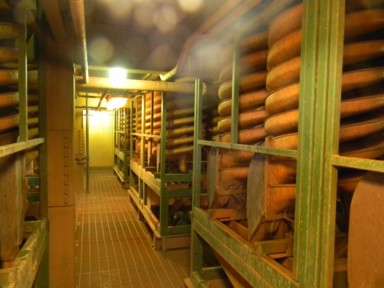
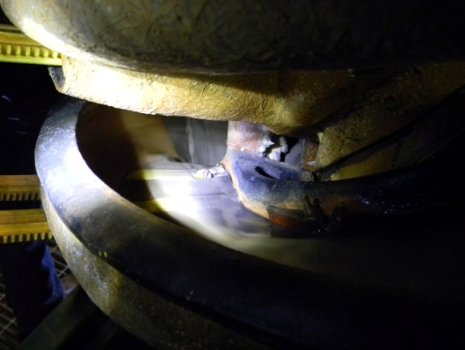
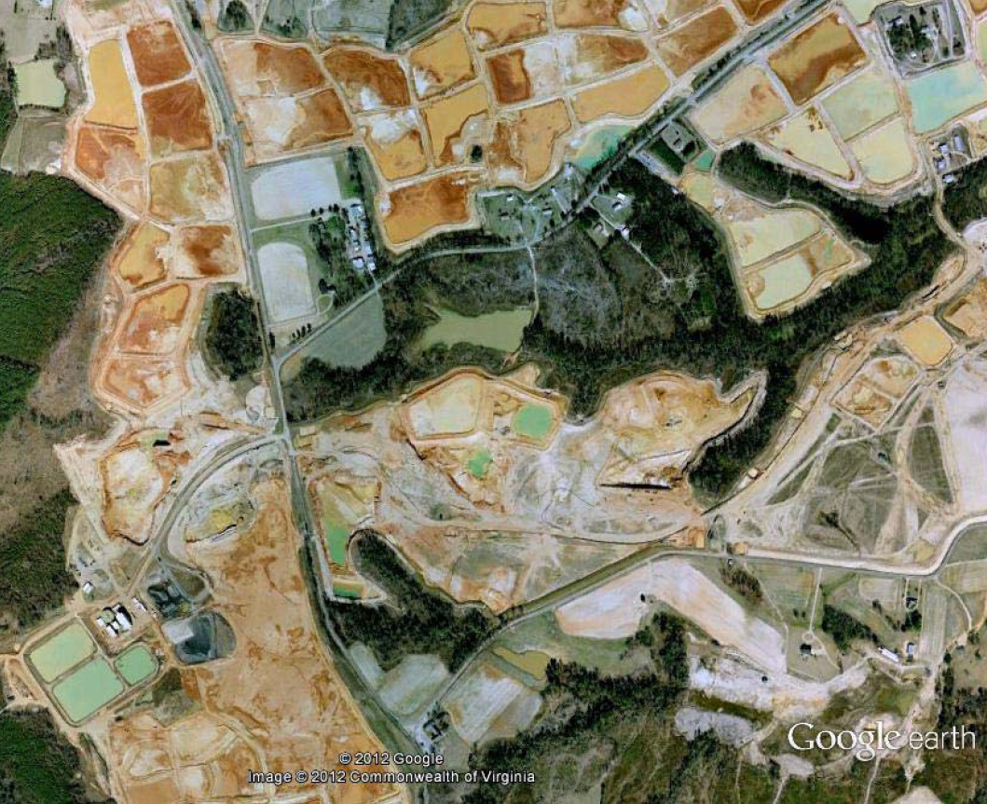
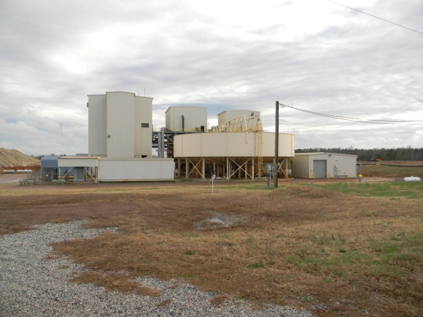
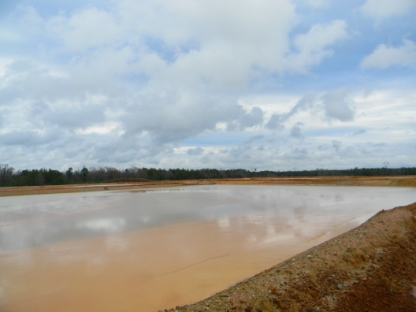
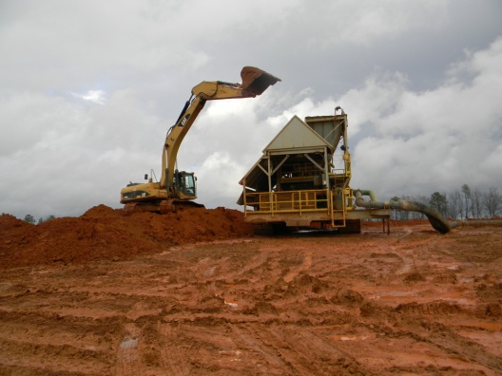
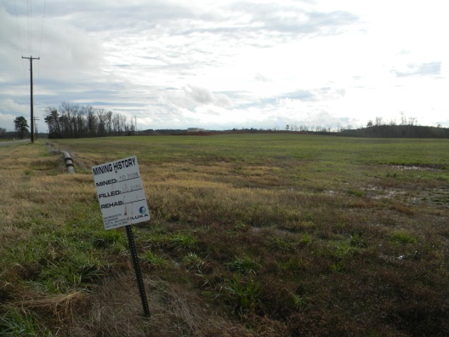
Iluka Concord Mine, Virginia

Slide 19
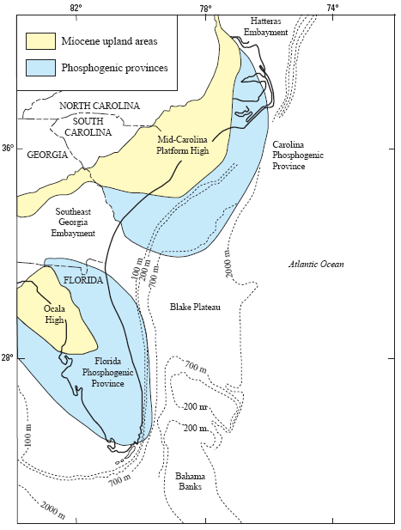
Phosphate Deposits
Phosphate is mined in Florida (~65 %), North Carolina, Idaho and Utah
Current potential and past production in Montana and Wyoming
REE concentrations approach 0.5 %.
REEs currently are not recovered.
REEs are part of the waste stream for phosphoric acid production.
Risks: uranium (radon), selenium

Slide 20
Environmental Characteristics of REE Deposits
Limited Data (Case Studies)
Few Active, Inactive, or Abandoned Mines
Bayan Obo
Mountain Pass
Thor Lake (advanced exploration)
Phosphate Fertilizer Industry
The Netherlands (water, sediment & soil guidelines)
China
Microbial bioassay studies confirm the Free-Ion Model for lutetium (Weltie et al., 2004)
REE toxicity to aquatic organisms may be a more complex function of water chemistry (e.g., Wood, 1990)
Geologic Characteristics
Notes:
There are four basic types of rare earth elements deposits in the U.S. At a broadest level these are……………
I won’t be discussing the magmatic iron deposits and the placer deposits today, because of limited time and because they seem unlikely to be significant contributors to our domestic rare earth supply in the near future.

Slide 21
Rare Earth Element Minerals & Chemistry
Group-Mineral | Formula | REO Wt% | ThO₂ Wt% | UO₂ Wt%
Oxides
Aeschynite | (Ln,Ca,Fe)(Ti,Nb)₂(O,OH)₆
Euxenite | (Y,Ln,Ca)(Nb,Ta,Ti)₂(O,OH)₆
Fergusonite | YNbO₄
Carbonates
Bastnäsite | (Ln,Y)CO₃F | 70 - 74 | 0 - 0.3 | 0.09
Parisite | Ca(Ln)₂(CO₃)₃F₂ | 59 | 0 – 0.5 | 0 – 0.3
Synchisite | Ca(Ln,Y)(CO₃)₂F | 49 – 52 | 1.6
Tengerite | Y₂(CO₃)₃•n(H₂O)
Phosphates
Apatite | (Ca,Ln)₅(PO₄)₃(OH,F,Cl) | 0 -20
Monazite | (Ln,Th)PO₄ | 35 - 71 | 0 - 20 | 0 - 16
Xenotime | YPO₄ | 52 – 67 | 0 - 3 | 0 -5
Silicates
Allanite | (Ln,Y,Ca)₂(Al,Fe³⁺)₂(SiO₄)₃(OH) | 3 – 51 | 0 -3
Eudialyte | Na₄(Ca,Ce)₂(Fe²⁺,Mn²⁺,Y)ZrSi₈O₂₂(OH,Cl)₂ | 1 - 10
Thalenite | Y₂Si₂O₇
Zircon | (Zr,Ln)SiO₄ | 0 – 0.7 | 0.1 – 0.8
Ln: Lanthanide (a.k.a. REE)

Slide 22
Acid-Generating Potential - Thor Lake, NWT, Canada
Carbonatites?
Despite lack of data, carbonatite-hosted REE deposits would be expected to be strongly net alkaline.
Thor Lake data: http://www.reviewboard.ca/registry/project.php?project_id=87

Slide 23
Rare Earth Elements: Surface Water Guidelines
 |  | Yellow River, Baotou, China Bayan Obo Industrial Complex |  |  | Valzinco, VA |  | Thor Lake, NWT, Canada
 | MPC* µg/L | Main Channel | Site F | Site G | VLZN-10 | VLZN-3 | Tailings HCT
pH |  | 7.6 - 8.2 |  | 3.7 - 6.9 | 1.1 | 3.3 | 7.5
Y µg/L | 6.4 |  |  |  | 370 | 2.0 | 0.183
La µg/L | 10.1 | 0.103 | 140 | 988 | 340 | 4.6
Ce µg/L | 22.1 | 0.22 | 152 | 1149 | 870 | 9.5
Pr µg/L | 9.1 | 0.0304 | 16.08 | 294 | 150 | 1.2
Nd µg/L | 1.8 | 0.095 | 52.01 | 1193 | 650 | 4.7
Sm µg/L | 8.2 | 0.023 | 6.91 | 62.35 | 180 | 0.9
Gd µg/L | 7.1 | 0.028 | 7.22 | 67.33 | 140 | 0.7
Dy µg/L | 9.3 | 0.082 | 3.8 | 9.08 | 93 | 0.4
*From: Maximum Permissible Concerntration; Sneller et al. (2000)
Thor Lake data: http://www.reviewboard.ca/registry/project.php?project_id=87

Slide 24
Thor Lake Tailings & Concentrate: Leachate (HCT)
 | Chronic Surface Water | Acute Surface Water | Drinking Water | Tailings
SO₄ mg/L |  |  | 250 | 2.9
Y µg/L | 0.28 | 6.4 |  | 0.18
Al µg/L | 750 | 87 | 200 | 20
As µg/L | 340 | 150 | 10 | 0.5
Cd µg/L | 0.3 | 2 | 5 | 0.2
Co µg/L | 3.1 | 195 |  | 0.1
Cr µg/L | 570 | 74 | 100 | 1.7
Cu µg/L | 13 | 11 | 1,300 | 1.4
Fe µg/L |  | 1,000 | 300 | 5.8
Mo µg/L | 239 | 10,100 |  | 12.1
Ni µg/L | 470 | 52 |  | 1.2
Pb µg/L | 65 | 2.5 | 15 | 0.15
Sb µg/L | 104 | 985 |  | 52
Se µg/L |  | 5 | 50 | <1
Sn µg/L | 73.7 | 2680 |  | 2.2
U µg/L | 1.87 | 33.5 | 30 | 3.9
V µg/L | 19.1 | 284 |  | 0.04
Zn µg/L | 120 | 120 | 5,000 | 3
Zr µg/L | 54.9 | 982 |  | 0.71
Thor Lake data: http://www.reviewboard.ca/registry/project.php?project_id=87

Slide 25
Thor Lake Tailings & Concentrate: Sediment & Soil
 | Unit | Sediment |  | Soil |  | Thor Lake
 |  | TEC/NC* | PEC/MPC* | Residential | Industrial | Tailings
Al | mg/kg |  |  | 77,000 | 990,000 | 62,000
As | mg/kg | 9.79 | 33 | 23 | 160 | 4.4
Cd | mg/kg | 0.99 | 4.98 | 70 | 810 | 6
Cr | mg/kg | 43.4 | 111 | 280 | 1,400 | 640
Cu | mg/kg | 31.6 | 149 | 3,100 | 41,000 | 18
Mo | mg/kg |  |  | 390 | 5,100 | 73
Ni | mg/kg | 22.7 | 48.6 | 1,600 | 20,000 | 330
Pb | mg/kg | 35.8 | 128 | 400 | 800 | 9.9
Se | mg/kg |  |  | 390 | 5,100 | 3.2
U | mg/kg |  |  | 230 | 3,100 | 9.9
Zn | mg/kg | 121 | 459 | 23,000 | 310,000 | 68
Ce | mg/kg | 256.2 | 18,800 |  |  | 1,900
Dy | mg/kg | 26.2 | 2,200 |  |  | 170
Gd | mg/kg | 23.2 | 1,800 |  |  | 210
La | mg/kg | 83.6 | 4,700 |  |  | 850
Nd | mg/kg | 43.2 | 7,500 |  |  | 970
Pr | mg/kg | 66.1 | 5,800 |  |  | 250
Sm | mg/kg | 30.9 | 2,500 |  |  | 210
*Neglible Concentration, Maximum Permissible Concentration; Sneller et al. (2000)
Thor Lake data: http://www.reviewboard.ca/registry/project.php?project_id=87

Slide 26
Geologic Summary
Primary and byproduct deposits
Carbonatites
(Per)alkaline intrusive complexes
Potential byproduct sources (?)
Phosphate deposits
Heavy minerals (placer) deposits
Economic Risks
Estimated 1 in 10,000 showings become mines
Estimated 1 in 2,000 or 3,000 prospects become mines
Ore processing is very deposit specific because of variety of REE minerals
In other words, the United States has potential, but do not expect a flood of new REE mines in the near future.
Notes:
There are four basic types of rare earth elements deposits in the U.S. At a broadest level these are……………
I won’t be discussing the magmatic iron deposits and the placer deposits today, because of limited time and because they seem unlikely to be significant contributors to our domestic rare earth supply in the near future.

Slide 27
Environmental Summary
Knowledge is extremely limited
Few mines (active, inactive, abandoned)
Environmental risks vary among deposit types, but some risks are common to most types
Acid-Generating Potential is Low
Scarce sulfide minerals
Carbonatites have abundant carbonate minerals
Notes:
There are four basic types of rare earth elements deposits in the U.S. At a broadest level these are……………
I won’t be discussing the magmatic iron deposits and the placer deposits today, because of limited time and because they seem unlikely to be significant contributors to our domestic rare earth supply in the near future.

Slide 28
Environmental Summary (continued)
Uranium
Radium: windblown dust; waterborne potential low because of low acid-generating potential
Radon
Potential for recovery
Thorium
Current liability; domestic market limited
Future development and construction of thorium-based nuclear reactors in China, India, or France may represent future market.
Other trace elements
REEs? Cd? Ni?
Notes:
There are four basic types of rare earth elements deposits in the U.S. At a broadest level these are……………
I won’t be discussing the magmatic iron deposits and the placer deposits today, because of limited time and because they seem unlikely to be significant contributors to our domestic rare earth supply in the near future.

Slide 29
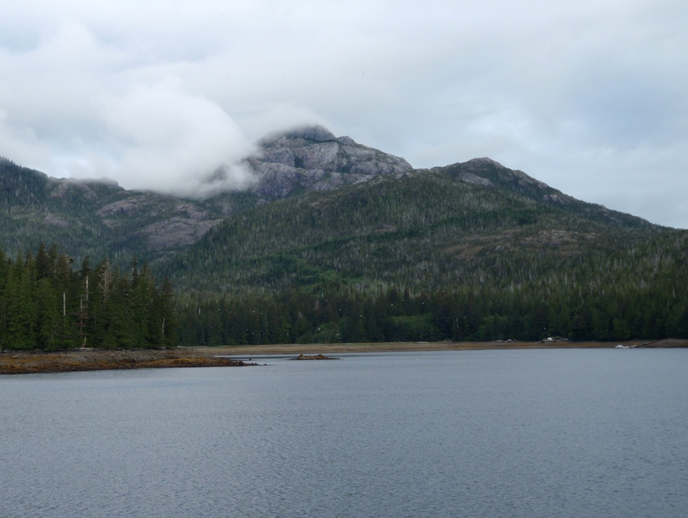
More work is needed! Questions?
Notes:
There are four basic types of rare earth elements deposits in the U.S. At a broadest level these are……………
I won’t be discussing the magmatic iron deposits and the placer deposits today, because of limited time and because they seem unlikely to be significant contributors to our domestic rare earth supply in the near future.

Slide 30
References
Haxel, G.B., 2005, Ultrapotassic mafic dikes and rare earth- and barium-rich carbonatite at Mountain Pass, Mojave Desert, Southern California: Summary and field trip localities: U.S. Geological Survey Open-File Report 2005–1219, 4 p. Available at http://pubs.usgs.gov/of/2005/1219/.
Haxel, G.B., Hedrick, J.B., and Orris, G.J., 2002, Rare Earth Elements—Critical Resources for High Technology: U.S. Geological Survey Fact Sheet 087-02, 96 p. Available at http://pubs.usgs.gov/fs/2002/fs087-02/.
Jiang He, Chang-Wei Lu, Hong-Xi Xue, Ying Liang, Saruli Bai, Ying Sun, Li-Li Shen, Na Mi, and Qing-Yun Fan, 2010, Species and distribution of rare earth elements in the Baotou section of the Yellow River in China: Environmental Geochemistry and Health, v. 32, p. 45-58.
Long, K.R., Van Gosen, B.S., Foley, N.K., and Cordier, D., 2010, The principal rare earth elements deposits of the United States—A summary of domestic deposits and a global perspective: U.S. Geological Survey Scientific Investigations Report 2010–5220, 96 p. Available at http://pubs.usgs.gov/sir/2010/5220/.
Sheard, E.R., Williams-Jones, A.E., Heiligmann, M., Pederson, C., and Trueman, D.L., 2012, Controls on the concentration of zirconium, niobium, and the rare earth elements in the Thor Lake rare metal deposit, Northwest Territories, Canada: Economic Geology, v. 107, p. 81-104.
Sneller, F.E.C., Kalf, D.F., Weltje, L., and van Wezel, A.P., 2000, Maximum permissible concentrations and negligible concentrations for rare earth elements (REEs): Rijksinstituut Voor Volksgezondheid En Milieu (National Institute of Public Health and the Environment), RIVM Report 601501-011, 66 p. Available at: http://rivm.openrepository.com/rivm/bitstream/10029/9551/1/601501011.pdf
Verplanck, P.L., and Van Gosen, B.S., 2011, Carbonatite and alkaline intrusion-related rare earth element deposits–A deposit model: U.S. Geological Survey Open-File Report 2011–1256, 6 p. Available at http://pubs.usgs.gov/of/2011/1256/.
Weltie, L., Verhoof, L.R.C.W., Verweij, W., and Hamers, T., 2004, Lutetium speciation and toxicity in a microbial bioassay: Testing the free-ion model for lanthanides: Environmental Science and Technology, v. 38, p. 6597-6604.
Wood, S.A., 1990, The aqueous geochemistry of the rare-earth elements and yttrium: 1. Review of available low-temperature data for inorganic complexes and the inorganic REE speciation of natural waters: Chemical Geology, v. 82, p. 159-186.

