Slide 1
Life Cycle Assessment Analysis of Various Active and Passive Acid Mine Drainage Treatment Options
Dr. James Stone
Tyler Hengen & Maria Squillace
South Dakota School of Mines & Technology
Department of Civil and Environmental Engineering
Notes:
Thank you all for being here today. My name is Maria Squillace and this is Tyler Hengen, and will be presenting our research involving the life cycle assessment analysis of various active and passive acid mine drainage treatment options.

Slide 2
Acknowledgements
University Supervisors
Funding Sources
Dr. James Stone
South Dakota School of Mines & Technology, Rapid City, SD
Dr. Aisling O’Sullivan
University of Canterbury, Christchurch, New Zealand
New Zealand Government
Technology New Zealand (Foundation for Research, Science & Technology)
Solid Energy New Zealand Ltd
Coal Association of New Zealand
University of Canterbury
Department of Civil & Natural Resources Engineering
Notes:
I want to first acknowledge our university supporters and funding sources. Dr. Stone from the Civil and Environmental Engineering Department at SDSM&T and Dr. O’Sullivan from the University of Canterbury in NZ have provided an enormous amount of support though this research. I would also like to thank several of our funding sources the New Zealand Government, the University of Canterbury, and various other funding sources.

Slide 3
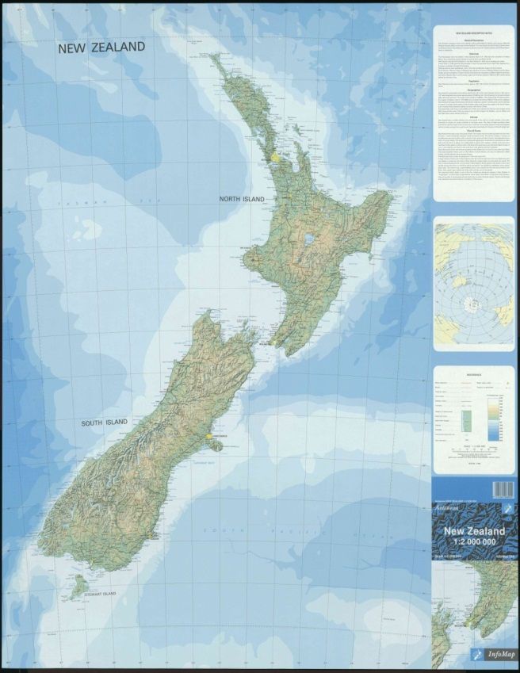
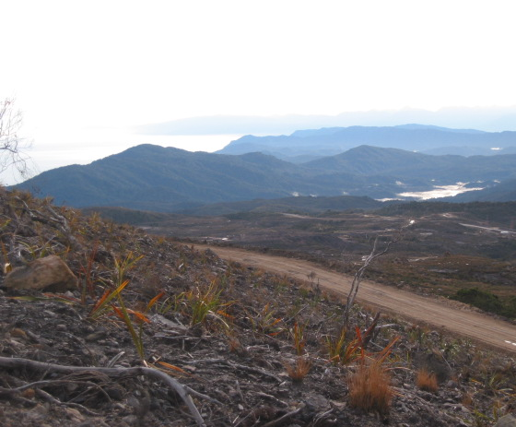
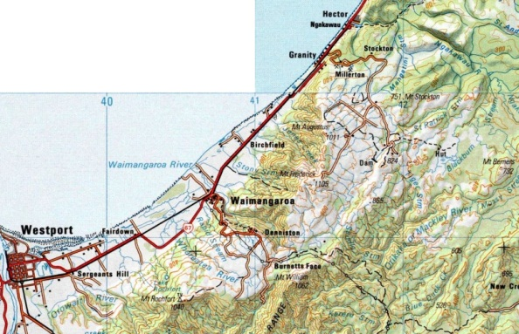
Project Location
Stockton Coal Mine, New Zealand
West Coast on the South Island
New Zealand’s largest open cast coal mine
Auckland
Westport
Wellington
Christchurch
Coal Mine Location
Stockton Coal Mine
McCauley et al (2010)
Notes:
For our site location I want to take you to the Stockton Coal Mine, located on the West Coast of New Zealand. Mining activities commenced at the Stockton Mine in the 1950s and it is currently New Zealand’s largest opencast mining operation. While the Stockton mine has created local jobs, the environmental impact has caused some resistance against extending the operation to include other proposed mining sites in the area. Research began to determine treatment methods of the AMD for the Stockton Mine.

Slide 4
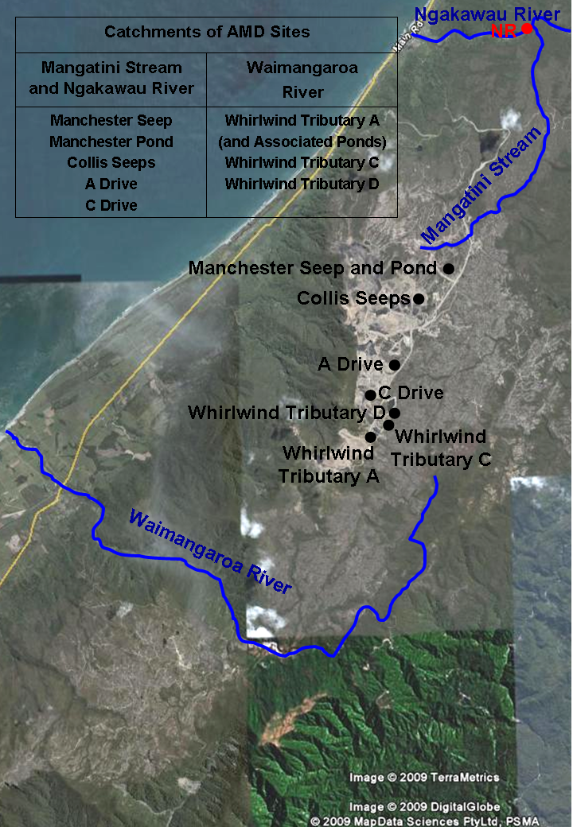
AMD Monitoring Sites
13 Sites
10 seep locations
Effluent from 3 sediment ponds
Primary water chemistry parameters
Dissolved metals
pH
Sulfate
Acidity
Community agreed on compliance levels of pH≥4.0 and 1 mg/L Al 99% of the time
NZ AMD Monitoring Sites
McCauley et al (2010)
Notes:
Thirteen AMD sites consisting of seeps emanating from waste rock dumps and associated sediment ponds, were developed and monitored at Stockton Coal Mine during the initial stages of environmental research. The objective of this monitoring was to quantify contaminants of concern and delineate their spatial and temporal variability across the mine site. The primary contaminants of concern included acidity, metals and sulfate. The current community agreed on a compliance level of pH>4.0 and an Al concentration <1 mg/L.

Slide 5
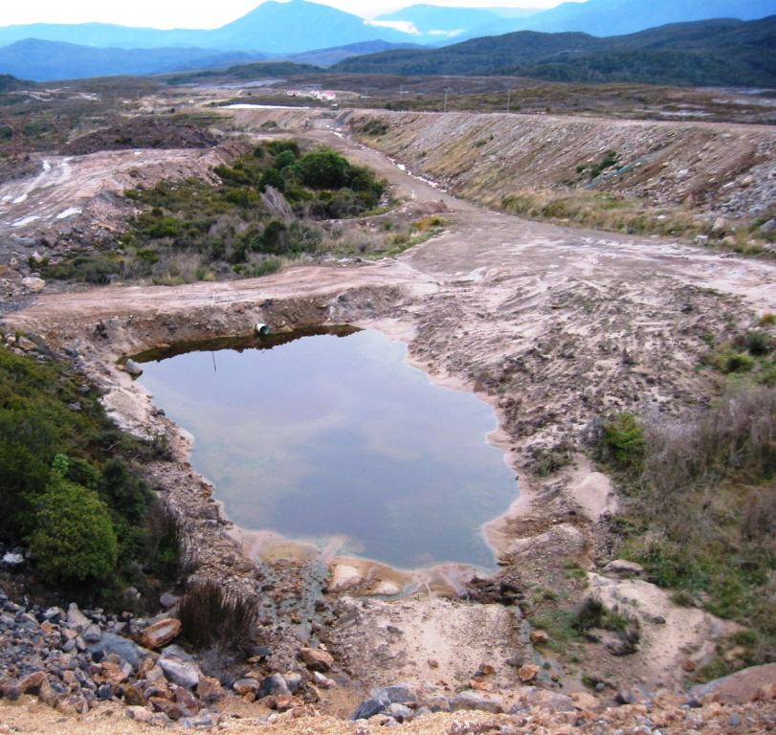
Manchester Seep Description
Candidate site for assessing AMD treatment methods
Reportedly not influenced by active or future mining
 | Median | Min | Max
Flow (L/s) | 1.84 | 0.35 | 10.5
pH | 2.8 | 2.5 | 3.3
DO (mg/L) | 9.6 | 8.1 | 10.9
DO (% Saturation) | 82 | 73 | 94
Eh (mV) | 709 | 691 | 744
Calculated Acidity (mg/L as CaCO₃) | 426 | 88 | 728
Diss Fe (mg/L) | 63 | 4.3 | 143
Diss Al (mg/L) | 33 | 7.4 | 57
Sulphate (mg/L) | 428 | 101 | 692
McCauley et al (2010)
Outlet Culvert
ManchesterPond
ManchesterSeep
Notes:
The loading characteristics of the Manchester Seep made it a primary candidate for AMD treatment. The seep water was also not expected to be influenced by present or future mining activities, and ample area was available to construct pilot or full-scale treatment systems. This table shows the breakdown of the composition of the Manchester Seep AMD. Fe and Al accounted for >98% of metal loading in Manchester Seep, and the Al and pH are well above the compliance levels.

Slide 6
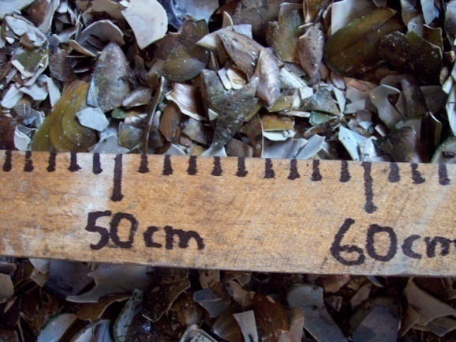
AMD Treatment Scenario Overview
Passive Treatment Methods
Mussel Shell Bioreactor
Waste product in NZ from large fishery industry
Adds alkalinity and reduces metal concentrations
Active Treatment Methods
Lime Dosing
Lime Slaking Plant
Environmental analysis of treatment methods using LCA… What is LCA?
Mussel shells used as
bioreactor substrate
McCauley et al (2010)
Notes:
The University of Canterbury began research implementing and analyzing several passive and active AMD treatment methods at the Manchester Seep. A more non traditional treatment method was the use of mussel shells as a substrate in a bioreactor. NZ considers mussel shells a waste product. Mussel shells are primarily made up of CaCO3 and can be utilized to treat AMD by adding alkalinity and reducing heavy metal concentrations. More traditional treatment methods examined included lime dosing and the design of a lime slaking plant. Our particular research here at SDSM&T was to analyze the environmental impacts associated with each of these treatment methods using life cycle assessment (or LCA), and many of you are probably wondering then, what exactly is LCA?

Slide 7
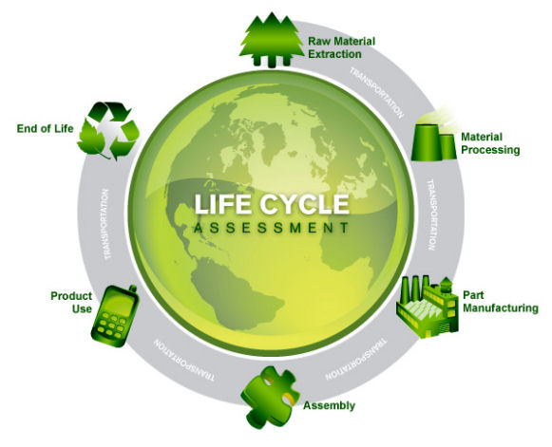
LCA History and Background
Life Cycle Assessment (LCA) - approach to quantifying the environmental impacts of a scenario
“Cradle to Grave”
Compile inventory
Evaluating potential impacts
Interpreting results to make informed decision
www.solidworks.com
Notes:
A life-cycle assessment is a technique to assess environmental impacts associated with all the stages of a product's life taking a “cradle-to-grave” approach. LCA’s can help avoid a narrow outlook on environmental concerns by compiling an inventory of relevant energy and material inputs and environmental releases, evaluating the potential impacts associated with identified inputs and releases, interpreting the results to help you make a more informed decision.

Slide 8
LCA Input Value Definitions
Construction
Energy
Material Transport
Transport energy from source to mine site (kgkm)
Earth excavation and substrate emplacement (m³ of material)
AMD Treatment
Method
Process Energy
Disposal of waste after project life
(m³ of material)
Raw Materials
Pumped drainage or chemical additions if applicable to scenario (kwhr)
(kg of material)
Functional Unit: kg acidity removed/day
Notes:
For the LCA analysis input categories included raw materials associated with the process in kg of material, transport of the materials from the source to the mine site (kgkm) and the construction energy including earth excavation and substrate emplacement. The process energy included pumping drainage or chemical additions for the treatment, and finally the disposal of the waste after the project lifetime is complete. All inputs for each scenario were adjusted to a functional unit of kg acidity removed/day to normalize environmental impacts.

Slide 9
Impact Category Selection and Functional Unit
SimaPro 7.3 (Netherlands)
Midpoint category selection:
Indicators chosen between inventory results and endpoints
Impact assessment translated into environmental themes
Less uncertainty
Endpoint category selection:
Environmental relevance linked into issues of concern
Higher uncertainty- easier to understand and interpret
Notes:
Our LCA analysis was completed using the world’s leading LCA software, SimaPro. In the LCA preformed the user has the option to select impact categories to analyze the environmental impacts. The impacts are divided into two categories, midpoint and endpoint. The midpoint categories are impacts chosen between the emission and the endpoint. Midpoint impacts are translated into environmental themes, and because they are closest to the emission there is less uncertainty associated with the results. The endpoint category selected take the environmental impacts presented in the midpoint categories and link them into issues of concern. There is a higher uncertainty with endpoint categories, but they are easier to understand and interpret and make a decision based off of.

Slide 10
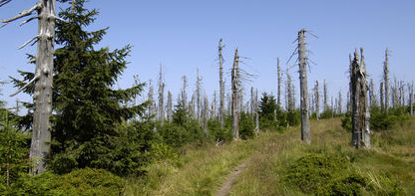
SimaPro Category Definitions
Midpoint Categories
Endpoint Categories
Damage to Human Health
Respiratory diseases
Cancer
Damage to Ecosystems
Dying forests
Extinction of species
Climate Change
Change in weather patterns
Terrestrial Acidification
Deposition of wet and dry acidic components
Typical effects of acid rain (scienceclarified.org)
Notes:
The LCA assessment has a breakdown of each of the categories into specific areas of concern. For our assessment we chose climate change and terrestrial acidification for our midpoint categories. Climate change is heavily influenced by process that impact the change in weather patterns and global temperature. Terrestrial acidification is the deposition of wet and dry acidic components particularly influenced by the release of sulfur and nitrogen components in factories, electricity generation, and vehicles. The endpoint categories included damage to human health which would particularly include increased rates in respiratory disease and cancer development. Damage to ecosystems focuses in on the extinction of species and damage to the surround environment. Finally, damage to resources is directly linked to the reduced resource base including minerals and fossil fuels.

Slide 11
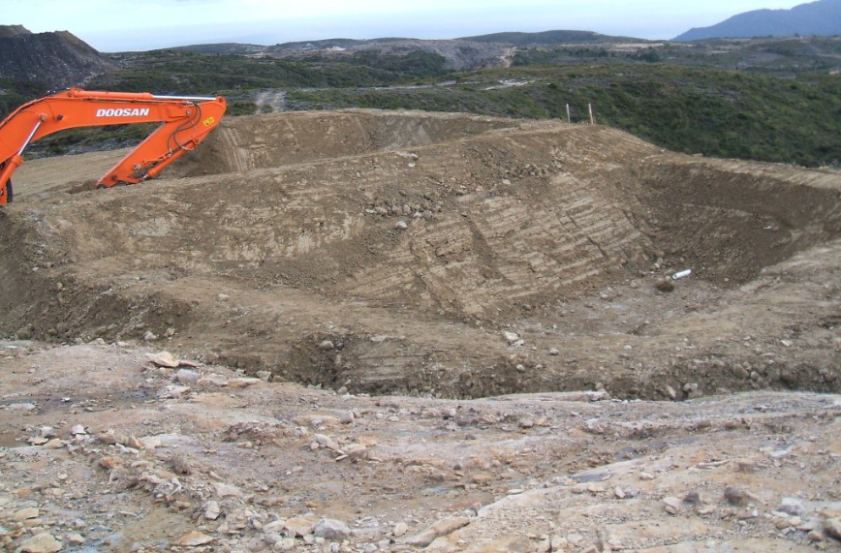
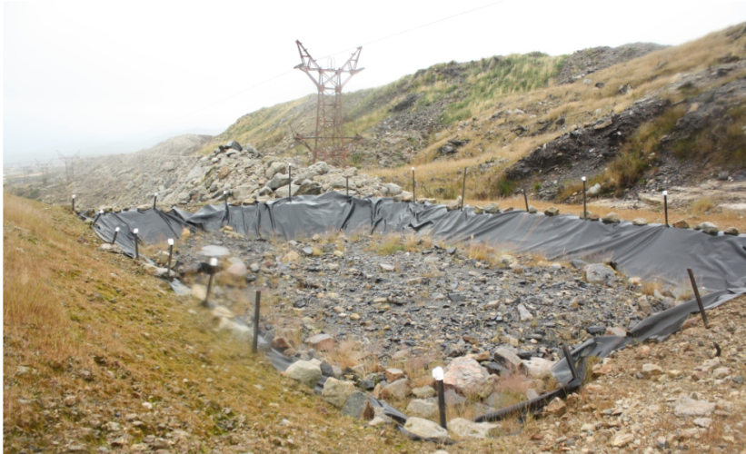
Bioreactor Scenario
Sulfate reducing environment in bioreactor lowers acidity and precipitates metal
Dimensions: 32 m (w) x 40 m (l) x 2 m (d)
Substrate: 30 vol. % mussel shells, 30 vol. % bark, 25 vol. % post peel, 15 vol. % compost
AMD gravity-fed from sedimentation pond receiving Manchester Seep AMD
Flow into bioreactor is 2.29 L/s
Designed to remove 85.2 kg acidity as CaCO₃/day
16.9 year lifetime
McCauley et al (2010)
Notes:
Now I will introduce all of the AMD treatment scenarios that were investigated in this research. As I mentioned earlier, the primary passive treatment was the mussel shell bioreactor. The sulfate reducing environment in the bioreactor lowers the acidity and precipitates out the heavy metals. The construction of the bioreactor at the Stockton Coal Mine can be seen in these figures. The dimensions of the completed bioreactor was 32 meters wide, 40 meters in length, and 2 meters in depth. The substrate included mussel shells, along with bark, post peal, and compost to increase the sulfate reducing environment. At the Manchester Seep, the AMD is completely gravity fed to the bioreactor, so no energy was implemented into this process. The flow into the bioreactor is 2.29 L/s and it is designed to remove 85.2 kg acidity/day. The bioreactor was designed with a 16.9 year lifespan based on the dissolution of the mussel shells ability to add alkalinity to neutralize acidity. Lab analysis was preformed at the University of Canterbury to develop these results.

Slide 12
Bioreactor Scenario Modifications
Mussel shell bioreactor with modified transport
½ transport distances for all materials
Mussel shell bioreactor with process energy
Pump added for non-gravity fed AMD
Modified substrate bioreactor
Volume of mussel shell substrate replaced by limestone
Mussel shell leaching bed
Mussel shells only substrate included in bioreactor design
Notes:
Theoretical modifications were made to the bioreactor scenario inputs to broaden the environmental analysis. The first was to look at the impacts of using more locally sourced materials, so all transport distances were cut in half. Many sites cannot use gravity fed AMD, so this scenario incorporated the use of a pump to transport the drainage to the treatment site. Next, mussel shells are not readily available in all parts of the world, and a more commonly used substrate is limestone. In this scenario the mussel shell substrate was replaced by limestone. Finally, and mussel shell leaching bed, which only included mussel shells for the substrate was sized based off of the incoming acidity and neutralizing capacity of mussel shells.

Slide 13
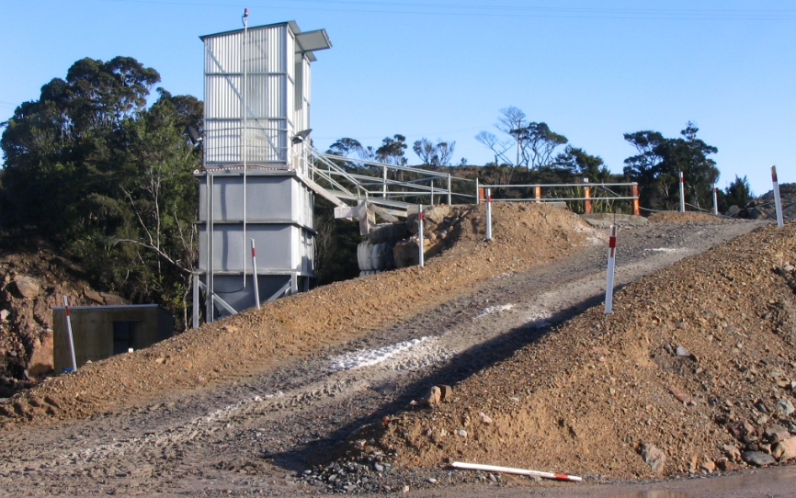
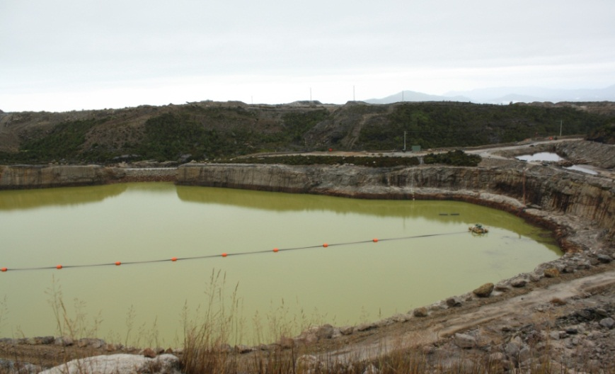
Lime-Dosing Scenario
Ultra-fine limestone (UFL) neutralizes acidity and precipitates metals from Mangatini stream
Finely ground limestone (CaCO₃)
Gravity fed slurry fed into stream
Natural flow of Mangatini stream is 0.4 m³/s
Treats 17,800 kg acidity as CaCO₃/day
Consumes 11,000 tonnes UFL per year
Only material inputs are ultrafine limestone and a prefabricated silo for storing the limestone
McCauley et al (2010)
Notes:
The first of two active treatment methods than an LCA was preformed on is the lime dosing scenario. In this scenario a gravity fed ultra-fine limestone slurry was directly injected into the Mangatini stream. In the figures you can see the lime silo and the slurry mixing pond. The natural flow of the Mangatini stream is 0.4 m3/s, and this process treats roughly 18,000 kg CaCO3/day, and based on the process efficiency, consumes 11,000 tonnes of UFL/year. The only material inputs for this process is the limestone and a prefabricated silo.

Slide 14
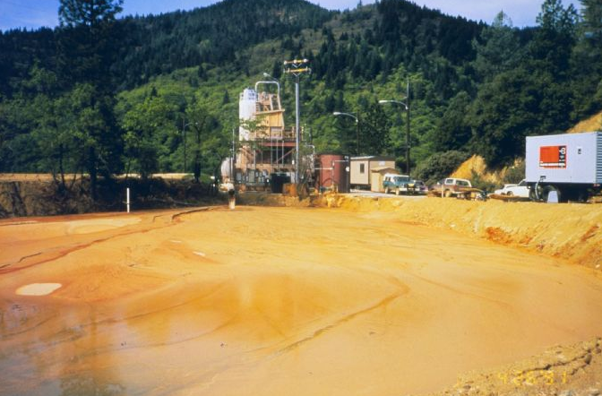
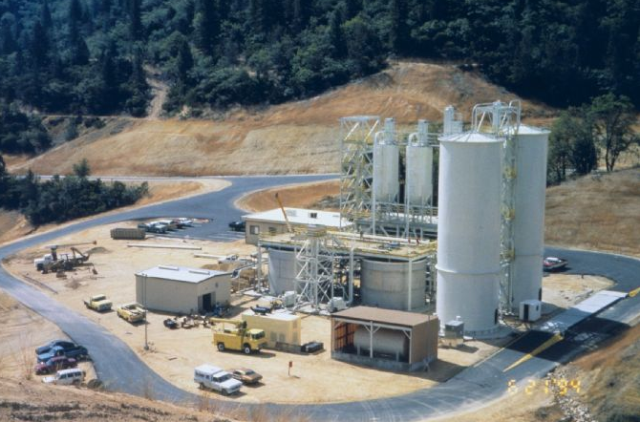
Lime Slaking Plant Scenario
Lime slaking utilizes hydrated lime for AMD treatment
Calcium oxide slaked with water
Hydrated Lime: Ca(OH)₂
EPA Design Manual: Neutralization of Acid Mine Drainage
Designed using parameters from lime dosing scenario
Consumes 6,200 tonnes hydrated lime/year
Includes: Equalization basin, lime storage and feed system, flash mix tank, aeration tank, settling basin with sludge removal
http://www.aditnow.co.uk
Notes:
A lime slaking plant was designed for this research due to its popularity around the world in treating AMD. I am sure all of you are familiar with this process. Our plant was designed to treat the same flow as the lime dosing using hydrated lime, which is calcium oxide slaked with water. This plant was designed from the EPA design manual. Hydrated lime is roughly 2 times more efficient limestone so it only consumes 6,200 tonnes of hydrated lime/year. This process was more extensive including an equalization basin, lime storage and feed system, flash mixing and aeration tanks, and a settling basin with a sludge removal system.

Slide 15
Preliminary Climate Change Results
Passive treatments show unusually high impacts.
Disposal for passive treatment buried in sanitary landfill
Lime-dosing proved to have the least environmental effect
Notes:
Tyler will now discuss the results of our LCA process.
This first slide looks at the climate change, measured in kg CO2 eq, results of our preliminary designs, where the passive treatment systems were assumed to be disposed of in a sanitary landfill. As the slide shows, the results showed surprisingly high impacts for all of the passive treatment scenarios, and the lime-dosing plant showed to have the lowest climate change impact results. This didn’t sit right with us, as it seemed that the passive treatment systems should generally have lower environmental impacts than the active treatment systems. So, we looked a little farther into this:

Slide 16
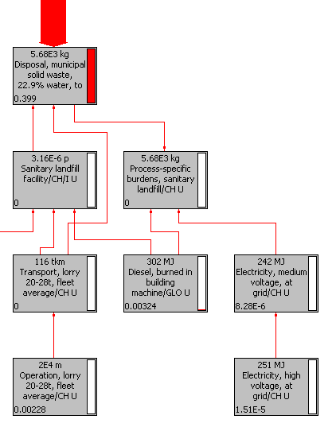
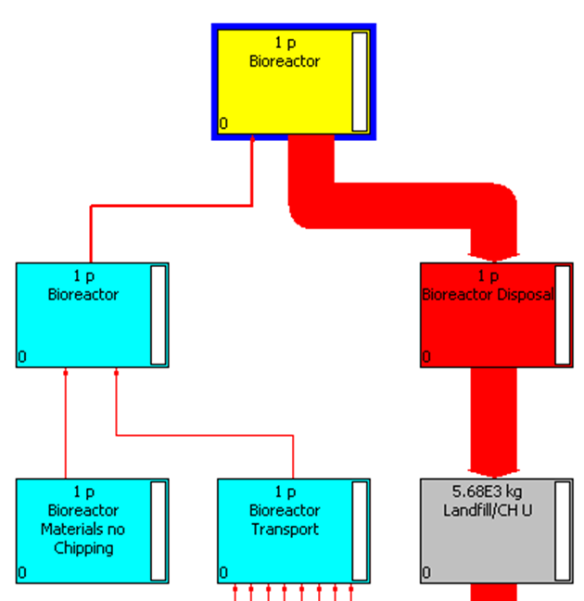
Preliminary Climate Change Bioreactor Network
Sanitary landfill disposal accounted for over 95% of impacts
Notes:
SimaPro allows you to look at the contributions to an impact category in the form of a network tree. So, looking at this network, the yellow box at the top is the bioreactor. The arrows entering and exiting the bioreactor represent contributions to the overall category. The thickness of the line indicates the amount contributed to the overall category. As you can see from the network, disposal in a sanitary landfill accounts for almost the entire climate change impact for the passive treatment system. The reason that the disposal had such a large impact, is that there is so much that goes into the operation of a municipal landfill. Machinery, buildings, and utilities all influence the environmental impact of disposal in a sanitary landfill. Upon further review, we learned that the more likely scenario for disposal was to just bury the material from the treatment system on site. So, we remodeled our process to see how that would change our results:

Slide 17
Climate Change Results - Onsite Disposal
Lime slaking demonstrates significant midpoint impacts
Redesigned scenario for on-site disposal – more realistic
Significantly reduced passive treatment impacts
Notes:
This slide shows the climate change results assuming onsite disposal. For the onsite disposal, we modeled a second pit large enough to hold the entire volume of substrate that was used over the 16.9 year life cycle of the treatment system. These results show trends that are more along the lines of what we expected, with active treatment scenarios generally showing larger impacts. The bioreactor utilizing purchased energy rather than being gravity fed also shows large impacts, demonstrating that a significant contributor to climate change is the use of pumped energy. Also shown, and I’ll address this shortly, but lime slaking demonstrates very high midpoint impacts compared to the other scenarios. This holds true for all of the different impact categories available for assessment.

Slide 18
Climate Change Lime Slaking Network
Quicklime air emissions: CO, CO2, heat, particulates, sulfur dioxide
Notes:
This is a look at the climate change impacts of lime slaking, which was again the scenario with the highest impact in the climate change category. What you can see from this network is that the materials are the primary contributor to the lime slaking impact, and dissecting this a little further, the quicklime is the main contributor to the materials. Associated with the production of quicklime are large amounts of carbon monoxide, carbon dioxide, heat, particulates, and sulfur dioxide being emitted to the air.

Slide 19
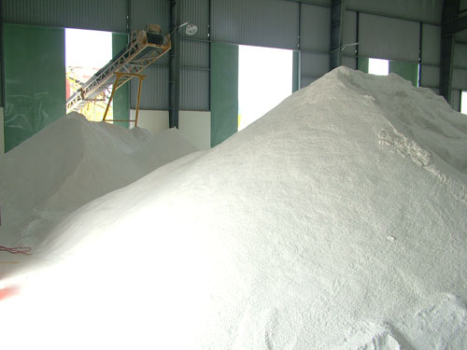
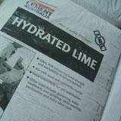
Limestone vs. Quicklime Material Preparation
http://leattach.com
http://leattach.com
Crushed Limestone
Process Energy
Crushing
Washing
Transportation by conveyor belt
Heavy Machinery
2 crushers
2 sieves
2 small silos
Quicklime
17x the process energy of crushed limestone
Crushing, milling, cyclone filtering, dedusting, storage,
10x the weight of heavy machinery
Crusher, roller mill, dedusting plant, cyclone, small silo
Notes:
Limestone: recultivation (transformation from mineral extraction site to forest and the diesel consumption- covering closed mine) of limestone, blasting, diesel, energy from fuel particulates- emissions
Next, I want to address some of the reasons that we see such large differences between lime-dosing and lime-slaking. They are both treating the same amount of water, but show drastically different results. Quicklime requires 17 times the process energy of limestone, 10 times the weight of heavy machinery, as well as additional truck and rail transport. The process energy for ultrafine limestone consists of crushing, washing, and transportation by conveyor belt, while the process energy for quicklime consists of crushing, milling, cyclone filtering, dedusting, and storage. The heavy weight embodied in the ultrafine limestone consists of 2 crushers, 2 sieves, and 2 small silos, while the heavy weight embodied in the quicklime consists of a crusher, a roller mill, a dedusting plant, a cyclone, and a storage silo,

Slide 20
Terrestrial Acidification Results
Purchased energy scenario and Lime Slaking – require large amounts of coal over project lifetime
Notes:
Next, we look at the midpoint results for terrestrial acidification. Terrestrial acidification is acid deposition in soil, generally by way of acid rain. These midpoints are measured in kg SO2 eq. What the results show are again, scenarios using pumped energy show higher results generally. The lime slaking scenario, and the bioreactor with purchased energy both require large amounts of coal over the project lifetime. The reason that lime-dosing doesn’t show such a large impact, even though it does require pumped energy, is that the only pumping is for the ultrafine limestone, while the water is still gravity fed. Another important factor when looking at acid rain forming potential is transportation distances.

Slide 21
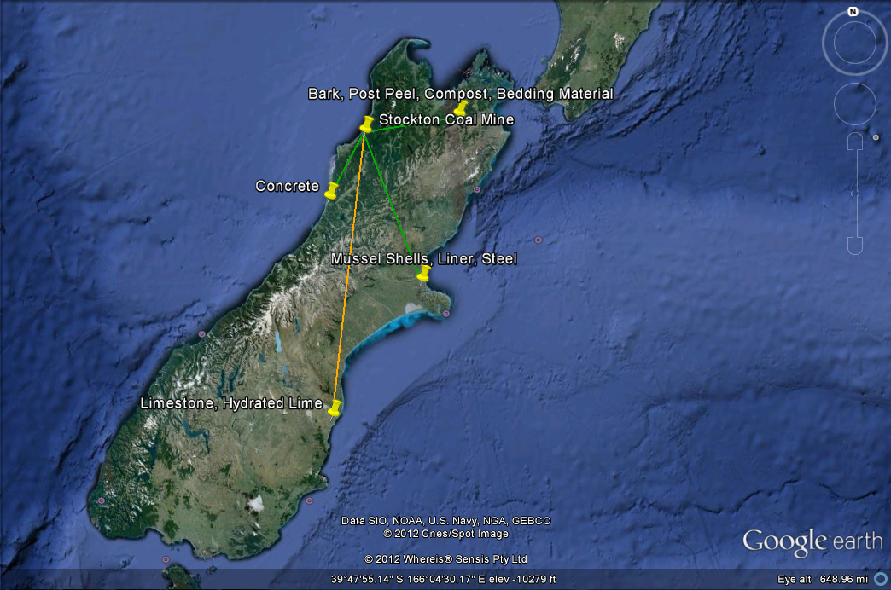
Transportation Distances
160 km: concrete
250 km: bark, post peel, compost, bedding material
400 km: Christchurch: mussel shells, liner, steel
550 km: limestone, hydrated lime
Notes:
This is a map of the south island of new zealand. (Show locations of Stockton Coal Mine and Christchurch). The orange line denotes materials going into the active treatment scenario, while the green lines denote materials going into the passive treatment scenarios. The concrete is sourced 160 km away in greymouth. The bark, post peel, compost, and bedding material is sourced approximately 250 km away in the Marlborough area, the mussel shells, liner, and steel are all sourced in Christchurch, 400 km away, and finally the limestone and hydrated lime have to be sourced 550 km away at the Parkside Limestone Quarry. So, not only do the active treatment scenarios have pumped energy contributing to coal combustion, they also have mined limestone, rather than waste material like the bioreactor uses, which has embodied SO2 emissions, as well as much farther transportation distances than the bioreactors, resulting in additional SO2 contributions.

Slide 22
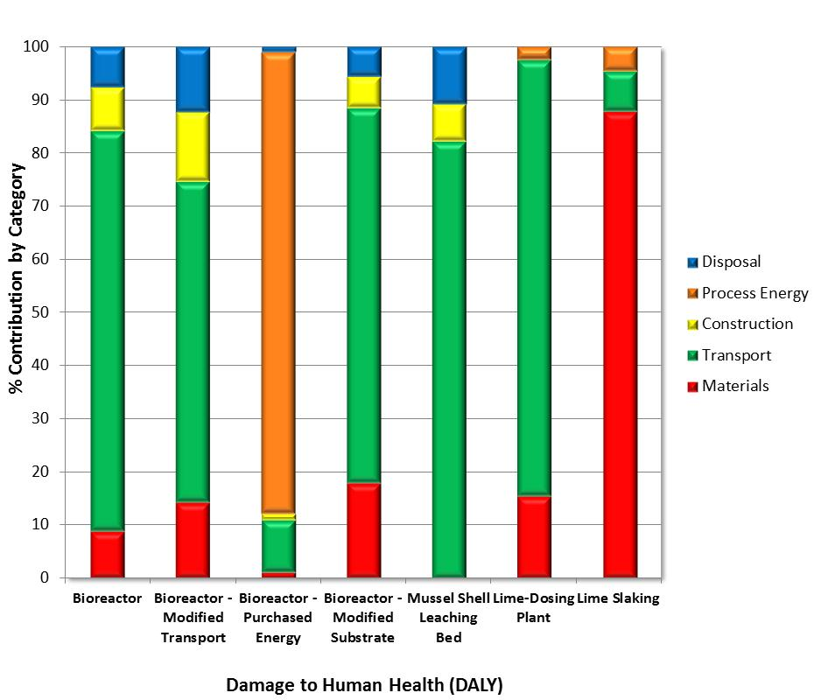
Endpoint Results - Damage to Human Health
Transport is the main contributor to damage to human health in most scenarios
Bioreactor uses waste materials – shows minimal impact
Notes:
Now, to look at the endpoint results. The first endpoint result that we looked at was the damage to human health. This is measured in disability adjusted life years, which is years of life lost due to illness per 100,000 people. Within the damage to human health, you have climate change, ozone depletion, human toxicity, photochemical oxidant formation, particulate matter formation, and ionising radiation, all measured in disability adjusted life years. One important thing to note with these graphs, is that the results are all relative to each other. Each category is the percent contribution to the overall result. For instance, looking at the bioreactor and the bioreactor with purchased energy, it looks like there is much less transportation going into the bioreactor with purchased energy. Realistically, though, it is the exact same amount of transportation between the two scenarios, the introduction of pumped energy just has higher damage to human health contributions than the transportation.

Slide 23
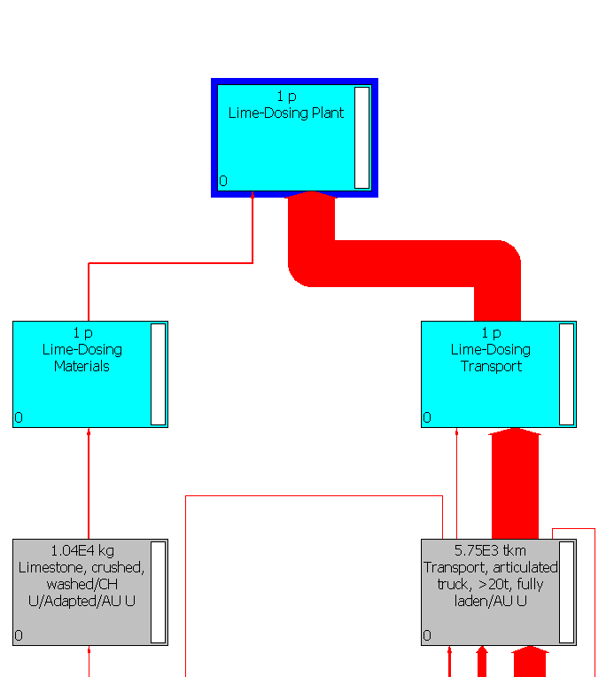
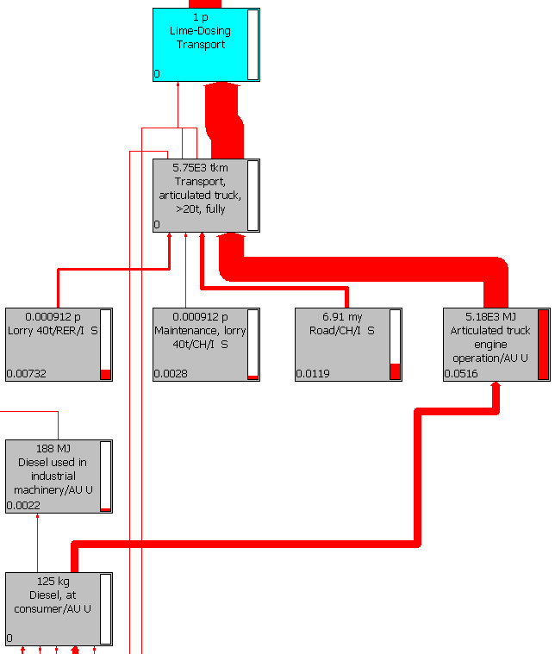
Lime Dosing Damage to Human Health Network
Air emissions associated with articulated engine: carbon dioxide, nitrogen oxides, carbon monoxide, methane; minimal soil and water emissions
Notes:
This is a look at the network for damage to human health for the scenario of lime dosing. The transport is the large contributor as the graph on the last slide showed, and the main contributor to the transport is the articulated truck engine operation. Within this articulated truck operation, there are air emissions in the form of carbon dioxide, nitrogen oxides, carbon monoxide, methane, with minimal emissions to soil and water.

Slide 24
Endpoint Results - Damage to Ecosystems
Process energy larger contributor to bioreactor versus lime dosing and lime slaking
Notes:
For the damage to ecosystems, the unit of measurement is in species per year. This is a measure of the number of species expected to go extinct per year because of a process. Within the damage to ecosystems category, you have climate change, terrestrial acidification, freshwater eutrophication, and terrestrial, freshwater, and marine ecotoxicity. Again these results are all measured as percent contributions to the overall category. These results show similar trends to the damage to human health results slide. Transport is the main contributor, purchased energy in the bioreactor is a large contributor, and the lime slaking material processing accounts for almost 90% of the total damage to ecosystems contribution.

Slide 25
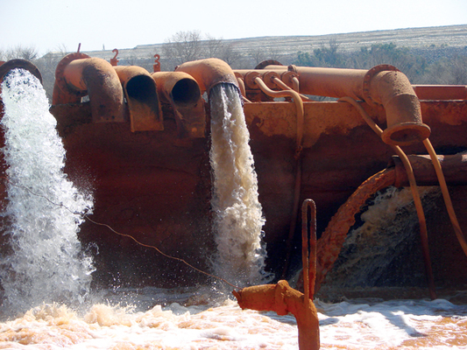
Process Energy Breakdown
Bioreactor with Purchased Energy
Pumps AMD constantly
3822 kWh/kg acidity removed per day
Lime Dosing
Pumps only chemical addition, AMD gravity fed
83 kWh/kg acidity removed per day
Lime Slaking
Pumps chemical addition and AMD
911 kWh/kg acidity removed per day
Bioreactor: $260/ kg acidity removed per day
Lime Dosing: $6/ kg acidity removed per day
Lime Slaking: $62/ kg acidity removed per day
Picture: earthmagazine.org Energy Costs: eia.gov
Notes:
One common trend that we’ve seen throughout our results is the influence that using pumped energy has on the LCA impacts of these scenarios. This slide looks to break down what is going into this pumped energy. For the scenario of the bioreactor with purchased energy, the AMD is pumped constantly, and it takes an estimated 3822 kWh of energy per kg acidity removed. For lime dosing, the only pumping is the chemical addition while the AMD is gravity fed. The lime dosing is estimated to use 83 kwh of energy per kg acidity removed. Finally, the lime slaking has pumped energy for both the hydrated lime and the AMD. This results in 911 kwh of energy per kg acidity removed. We looked at an estimated cost breakdown of this using the current industrial estimate cost for energy of 6.8 cents per kwh, and this showed that the bioreactor cost 260 dollars per kg acidity removed, the lime dosing cost 6 dollars per kg acidity removed, and the lime slaking cost 62 dollars per kg acidity removed.

Slide 26
Conclusions
Passive versus Active Treatments
Efficiency based on treatment abilities
Environmental impacts
Limestone vs. quicklime
Utilize locally sourced and waste materials
On-site disposal vs. sanitary landfill
Largest contributor- gravity fed AMD and chemical additions in placement of pumps
Factors to consider- economic, social, environmental
Scope of LCA
Notes:
To conclude, we looked at the life cycle impact results of a number of different passive and active treatment scenarios either currently being used at the Stockton Coal Mine, or hypothetical modifications to the current processes at the Stockton Coal Mine. The treatment efficiency of these scenarios are based on their treatment abilities, so active treatments were taken to treat much higher volumes of water and acidity compared to the passive treatment scenarios. Still, while active treatment is more efficient, it also results in much higher environmental impacts overall. Another result that was surprising was the influence of using ultrafine limestone versus quicklime. Utilizing locally sourced and waste materials looks to play a large role in the environmental impact of these scenarios. The largest contributor to all of the scenarios was the influence of pumping in the environmental impact. Situations where you could rely on gravity feeding or a minimal amount of pumping resulted in much lower environmental impacts. So, our recommendation, probably unsurprisingly, would be to implement passive treatment wherever possible. However, while this does show some very valuable information about the potential environmental impacts of a scenario, there are certain things that fall outside of the scope of the LCA that we really couldn’t consider in this study. LCA is a very valuable tool that needs to be used as an integral part of the larger puzzle rather than the entire puzzle itself. There are a number of things that additionally need to be considered when deciding on an AMD treatment option.

Slide 27
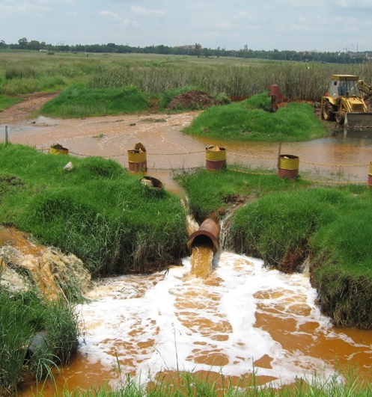
Recommendations
AMD Treatment approach dependent on a number of items:
Amount of AMD
Material costs
Available sources of alkalinity
Local waste materials
Site suitability for feeding AMD
Use LCA as a piece of the puzzle to determine the best treatment option for the site
http://www.earthlife.org
Notes:
Probably the most important issue to consider when deciding on a treatment method is establishing the amount of AMD needing to be treated. If you’re looking at a flow rate of a few L/S you could likely get away with a passive treatment bioreactor. If you have a large flow needing to be treated though, you almost certainly would need to implement some sort of active treatment just to keep up. Beyond that, economics are obviously going to be a driving factor. The materials available are going to influence the decision as well. Site suitability for gravity feeding or pumping will also play a role in deciding the proper AMD treatment approach for your site. These issues, among others, all need to be thoroughly examined alongside the life cycle assessment to determine the method of treatment for AMD.

Slide 28
Thank you for your time.
Questions?
Contact Information:
Dr. James Stone- james.stone@sdsmt.edu
Maria Squillace- maria.k.squillace@mines.sdsmt.edu
Tyler Hengen- tyler.hengen@mines.sdsmt.edu

